Slide 1

Forests as Economic Social and Environmental Assets for Communities:
Exiting Poverty in Latin America
Augusta Molnar
Director, Community and Markets Program
Forest Trends
Notes:
FT has looked strategically at a number of trends in the forest sector:
New Markets for Ecosystem Services, Corporate responsibility
Markets for Low-income producers, Forest Ownership by Communities,
Forest Conservation and Finance, and Specific Country Experiences in China, Pacific Rim, Mexico, Brazil, Central America.

Slide 2

Structure of Presentation
Structure of the Presentation
Communities are a major player in the global landscape
  tenure shift, governance shifts, and market shifts
Community forest enterprises contribute significantly to conservation and poverty reduction
There are different models of community forestry: examples from Latin America
Governments play a key role in enabling or limiting these opportunities
Notes:
Timber, Non-Timber, Tourism, Agroforestry, Partnerships

Slide 3
Changing Global Context
Key Trends in the Global Forest Landscape
Industry in Transition
  Changing Demand, Supply and Structure
Markets in Transition
  Growing value of forest ecosystem services
  Greater accountability
Conservation in Transition
  Changing objectives and approaches
Governance in Transition
  Civil Society: New Owners, New Constituencies
  Government: Redefining roles of public agencies

Slide 4
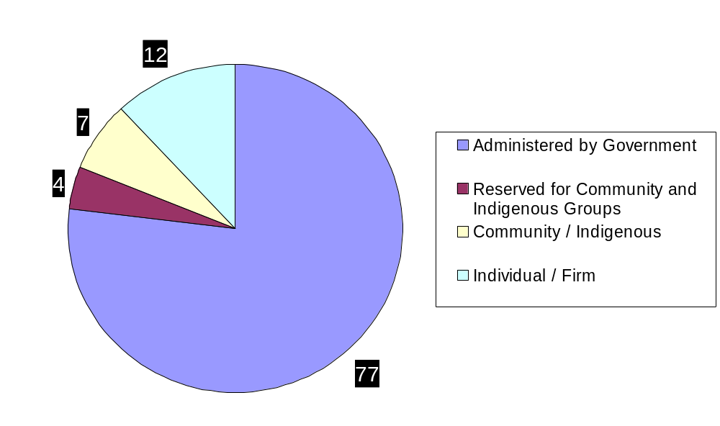
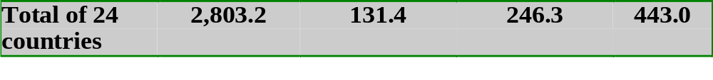
Forest Tenure Shifts in 24 Forest Rich Countries
Forest Tenure Shift in 24 Countries

Slide 5

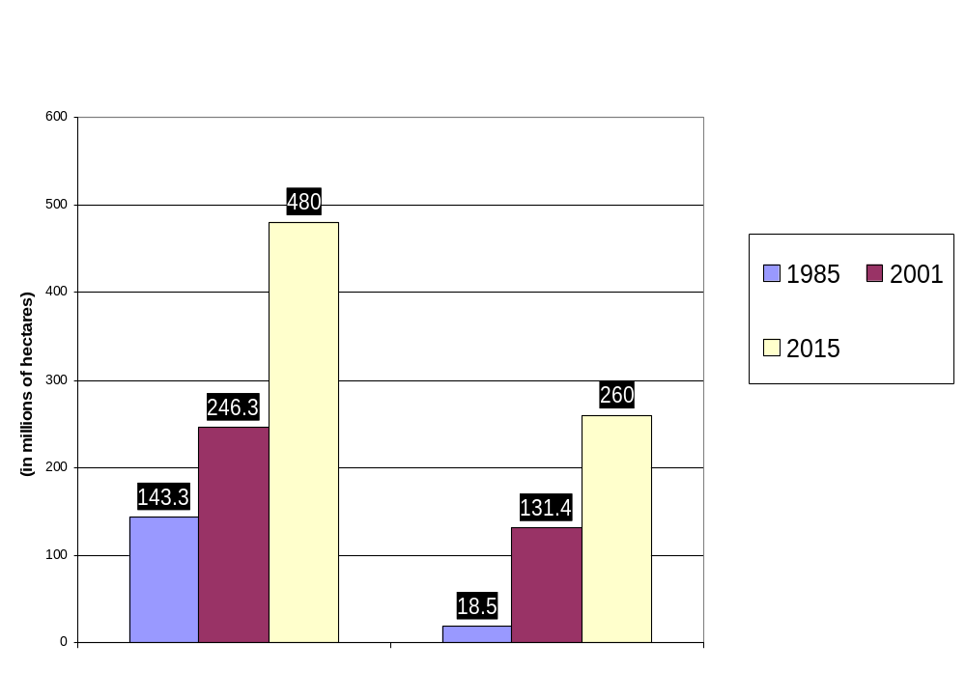
Dramatic Increase in Community Ownership and Access: Double in 15 Years and May Double Again
Three times what is owned by industry and individuals

Slide 6
Community Response in Mexico
and Central America

Slide 7
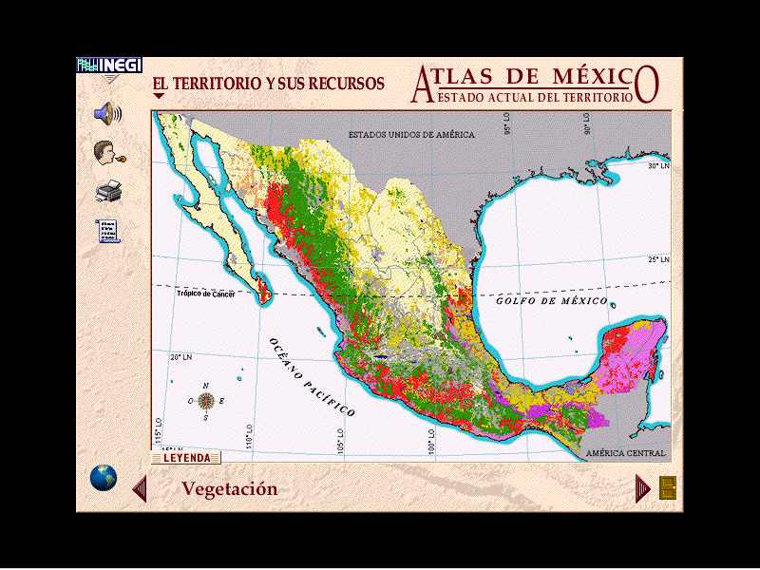
The Forest Sector in Mexico
(Source: CONAFOR 2002)
12 million people live in the forested areas.
43 ethnic groups (5 million indigenous people) live in forest areas.
80% of extreme poor are indigenous peoples
50 million hectares forest; 19 tropical; 27 temperate.
Mexico is megadiverse (6th in world; 3rd in Latin America).
Annually 600,000 million hectares of forests lost.
Forest resources can generate goods and environmental services (potential water capture is 48 billion m3).

Slide 8
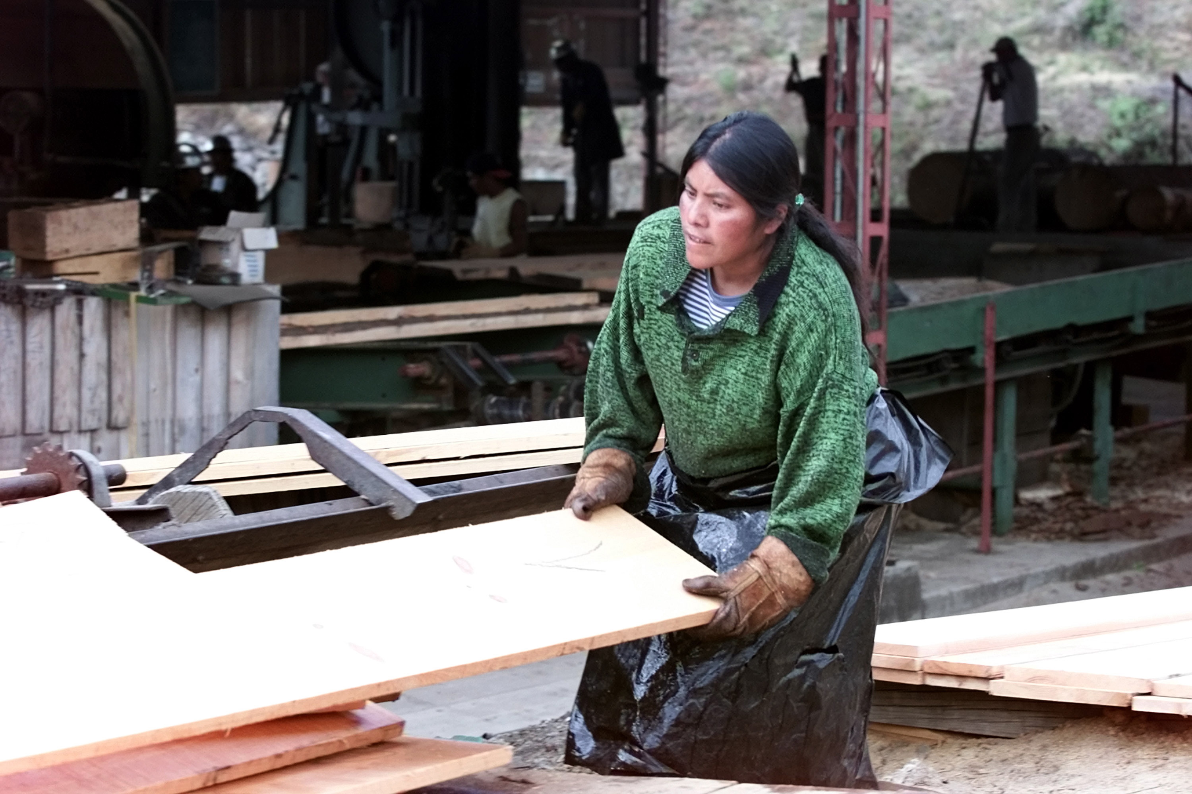
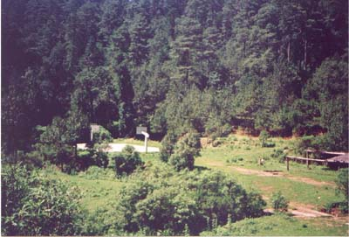
Social Conditions in Forest Regions
(Source: G. Segura, CONAFOR 2002)
Indigenous Communities and Ejidos:
8,420 in the Forested Regions
45% indigenous groups.
65% have commercial production potential.
25% (or 1800 social units) have management plans.
5% in which forestry is the primary source of income and employment.

Slide 9
Outcome in 3 years of support
Returns Over 3 Years in Mexico
Government project of US$ 10 million supporting community initiatives
  + 180, 000 hectares forest under improved management in Oaxaca
  + 75,000 hectares in new forest management
  + 35,000 hectares of comm.protected areas
  + 1300 permanent community jobs
Diversification of incomes on pilot basis through tourism and non-timber products
500 communities in three states form regional fora for social capital and directing support
Sustained Natural Resource Asset Base

Slide 10
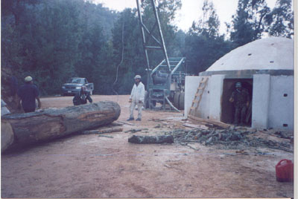
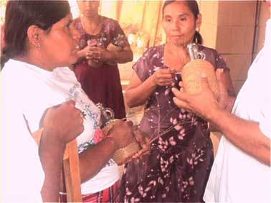
Economic Advantage of Community Timber Enterprises
Generate local employment with skills training and support
Absorb start-up costs socially enabling creating diversifying into non-timber and tourism
Investment of profits in social and human infrastructure
Reduce burden on state of forest protection and oversight
Economic activity creates new state revenue streams
Fire control and management
Notes:
Issue is about scaling up.

Slide 11
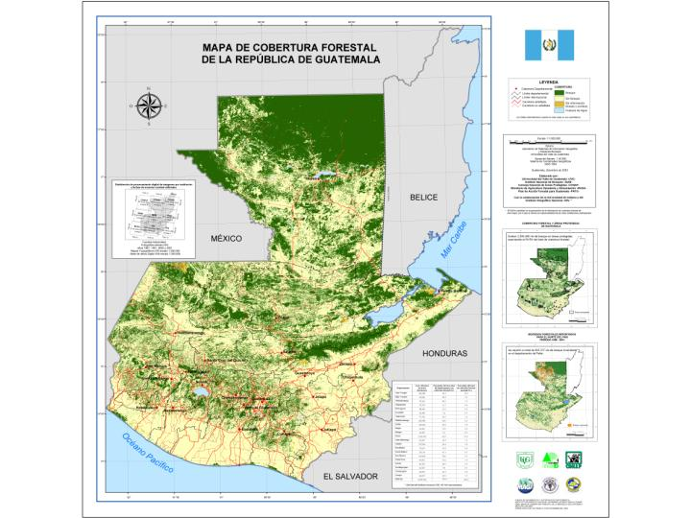
Community Conservation in Guatemala
Concesiones Comunitarias
Source: Marcedonio Cortave, ACOFOP, Hondurasworkshop 2004.

Slide 12
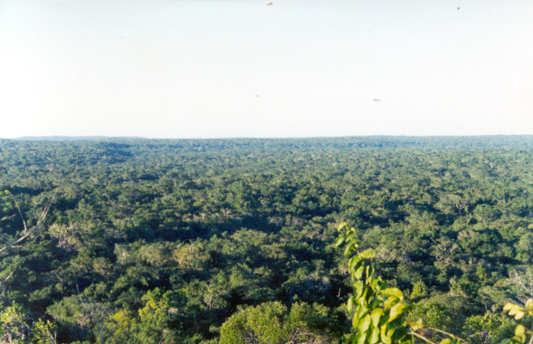
Guatemala Peten Experience 23 Community Concessions
450,000 has. of community forest in the Mayan Biosphere; 332,000 has. certified
More than 14,000 people directly benefited from the activities
More than 70,000 people benefited indirectly

Slide 13
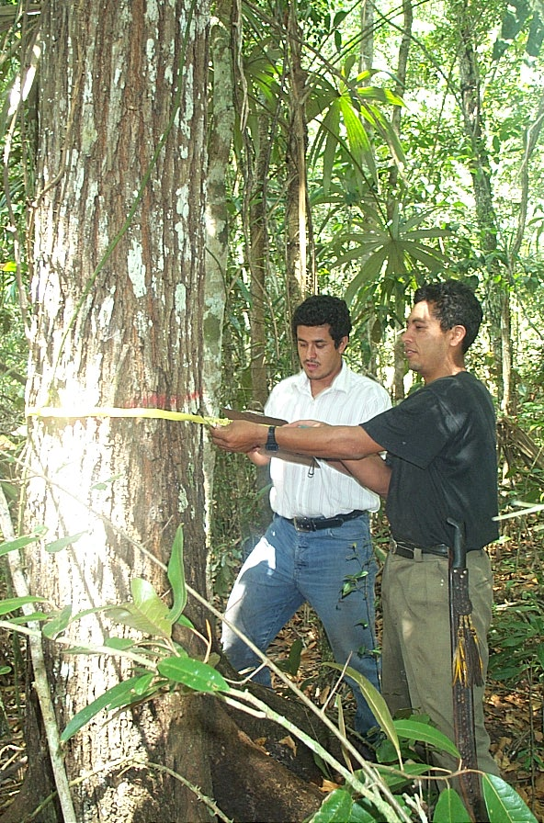
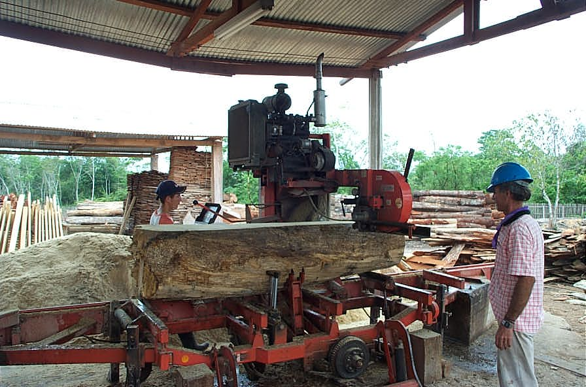
CFEs have developed community technical capacity.
In 2003, Peten generated US$ 387,000 in fiscal revenues to the State.
CFEs invested US$ 140,000 in fire control and management.
CFEs invested US$ 136,000 in vigilance
CFEs link biodiversity conservation to livelihoods.
Source: Marcedonio Cortave, ACOFOP

Slide 14
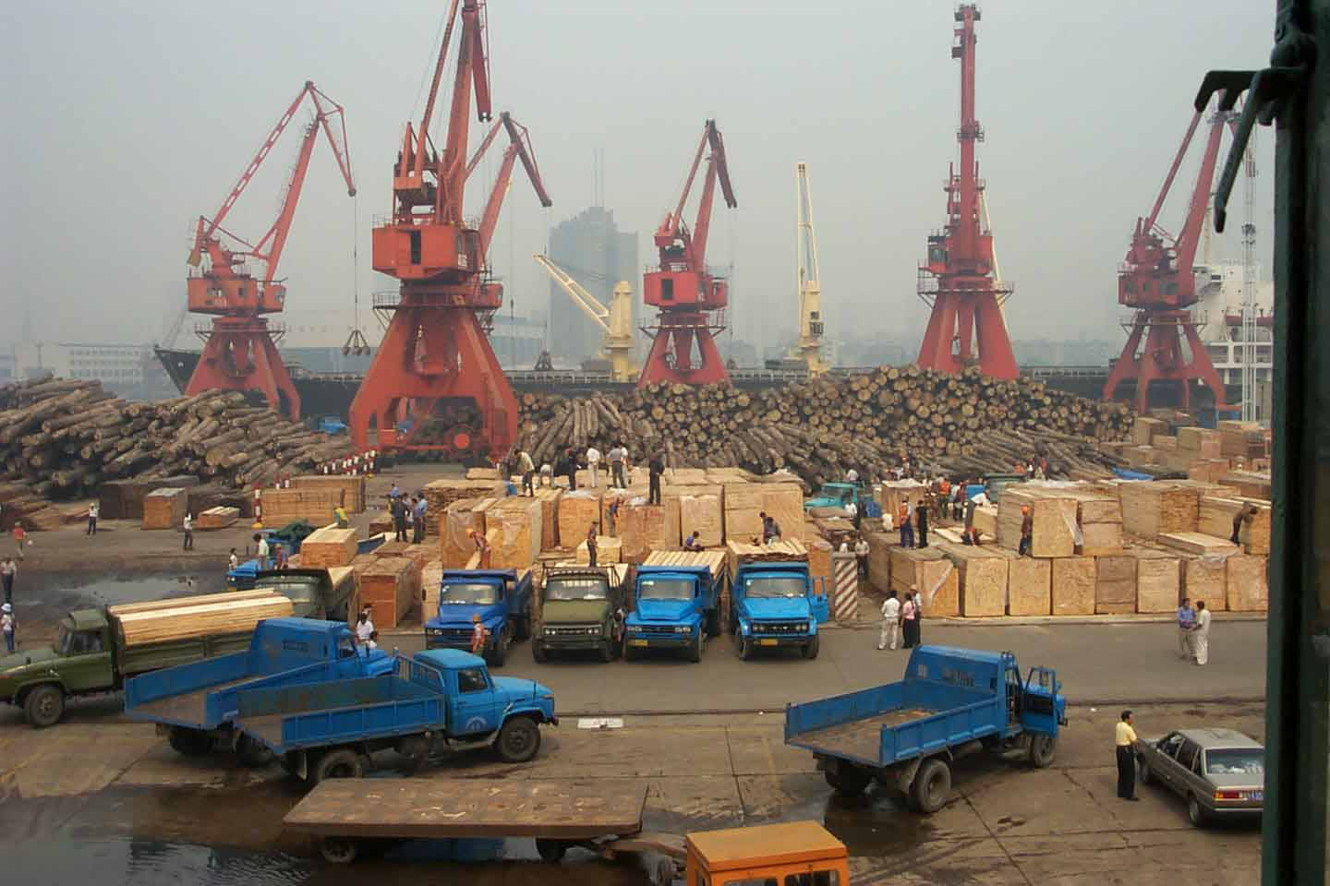
OWNERSHIP IN TRANSITION
Industry Transition in Supply and Demand

Slide 15
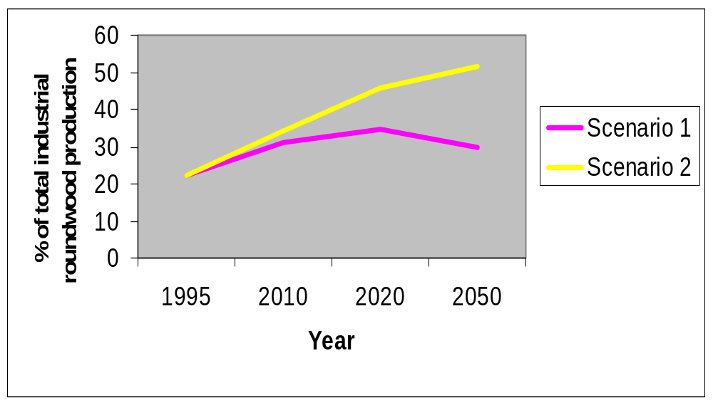
Changing Source of Supply: Plantations
Average annual returns: 8-12%
Notes:
Source: FAO 1999 (Brown Draft Report)
Table 15: Percentage share of plantation production in total industrial roundwood production – Scenarios compared with Extrapolations.

Slide 16
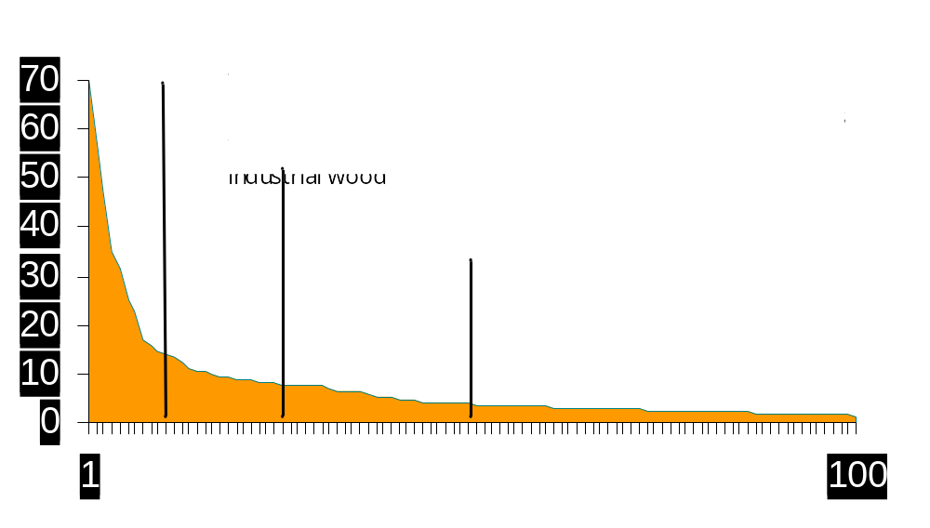
Industry in Transition: Industry Consolidation
Industry in Transition: Consolidation

Slide 17
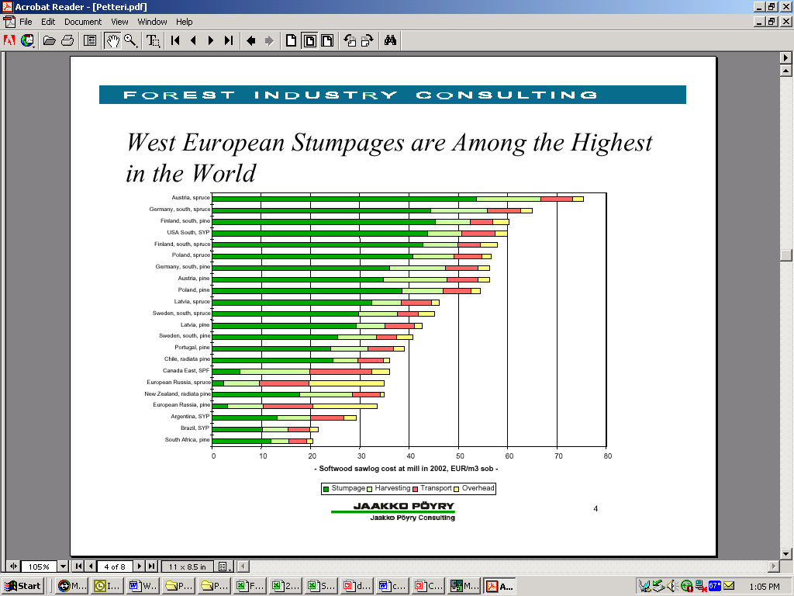
The U.S. South Has some of the Highest Log Cost in the World
U.S. has Some of the Highest Log Costs in the World
U.S. South
Eastern Europe
Chile
East Canada
European Russia
Brazil
Notes:
When you consider the delivered log cost to the mill, we in the south have some of the highest delivered log cost in the World. This isn’t where we want to be. It is those countries and regions in that are the most cost competitive that are attracting capital for growth and expansion.

Slide 18
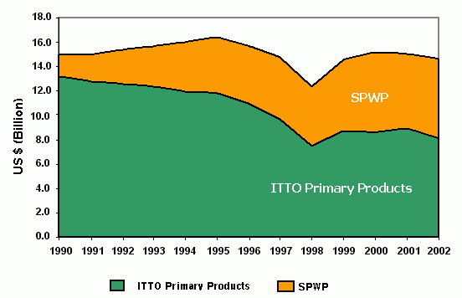
Trade of Primary and Secondary Tropical Timber Products
Primary products of ITTO= (plywood, sawnwood, veneer, logs,
furniture, moulding, woodwork, etc)
SPWP= (secondary processed wood products)

Slide 19
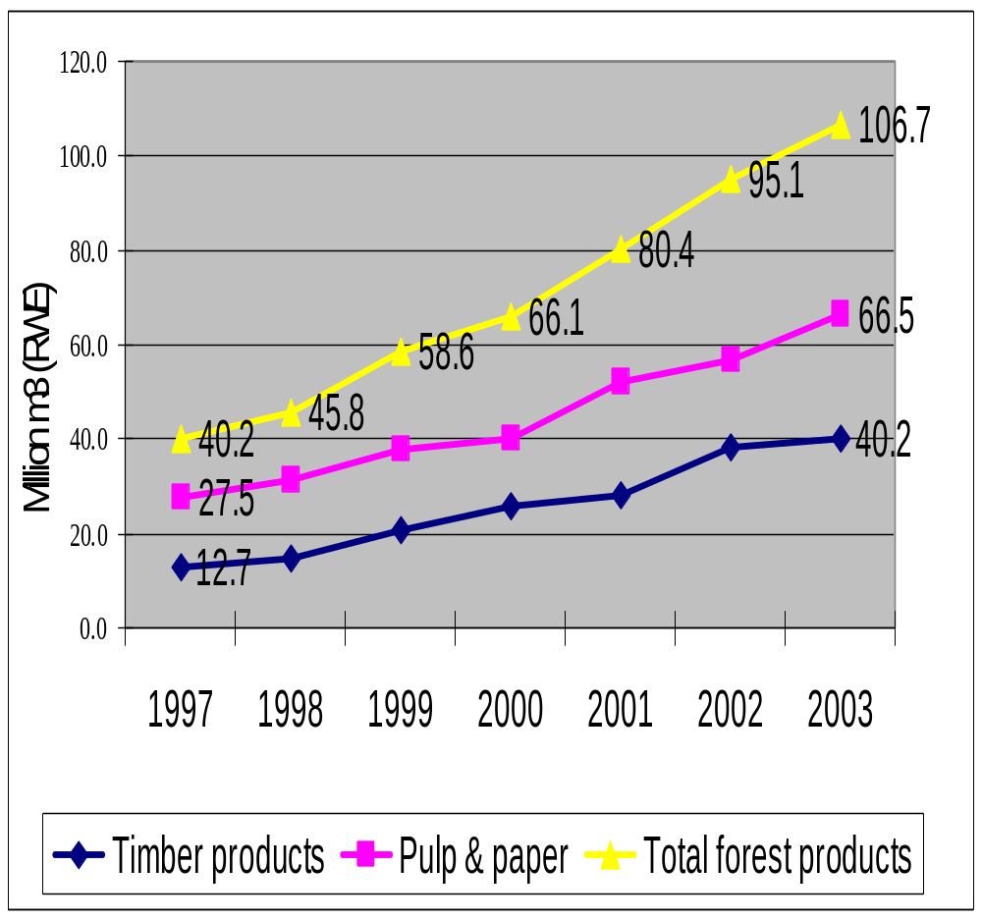
China: Rising Wood Imports
China: Rising wood imports
Timber imports increase 23% in one year alone (1998-1999)
Suddenly the world’s leader in wood imports-from 7th to 1st in last 7 years
Wood sourced from all over the world; leading tropical wood importer
1980’s
1990’s
Notes:
Increased use of recycled paper products, unclear what the potential supply can be from collective forests (> 95 M hectares) if ban is lifted and AAC changes. Pressures to change the rules regarding public protected areas.

Slide 20
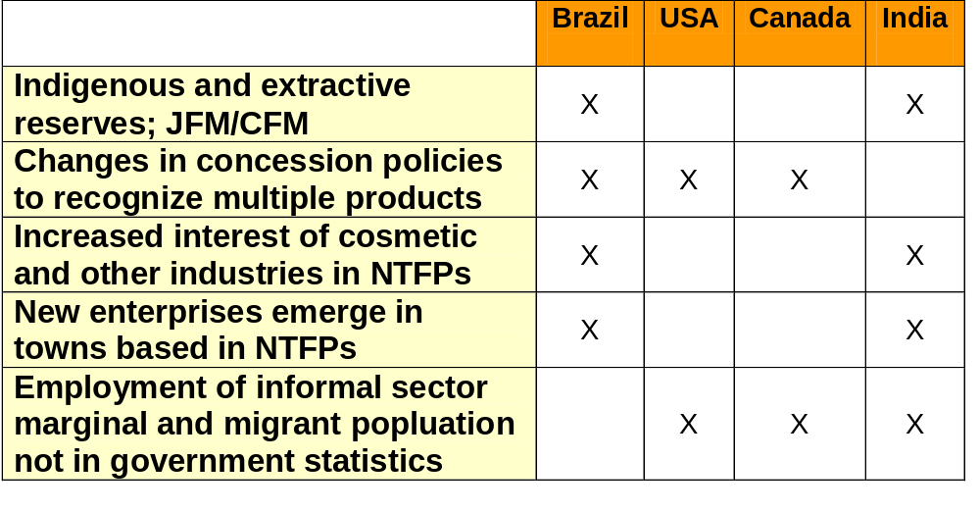
Non-Wood Forest Products in Community-Administered Forests: Examples
Non-Woods in public, community and municipal forests: Examples

Slide 21
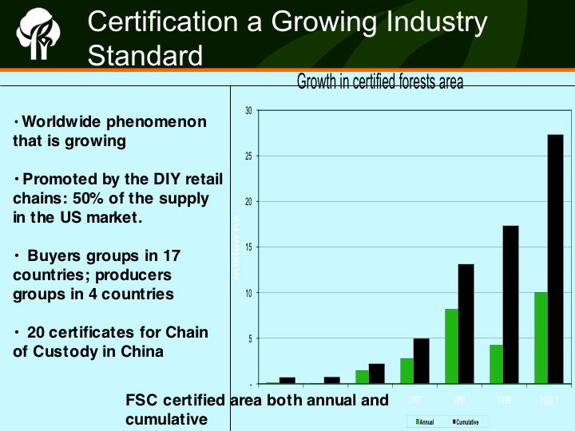

Slide 22
Pine Lumber Commodity Chain in Mexico
Primary Transformation
Lumber Commerce
Secondary Transformation
Management
Community enterprises for secondary transformation
Community sawmills
Independent Retailers
Carpentry
Small lumberyards
Construction: building
Community Forestry Operations
Construction: appearance
Eslabones posteriores
Producers of cajas
Large lumberyards
Other sawmills
Small furniture makers
Medium and large furniture makers
Illegal wood
Pallets
Imports
Export

Slide 23
Comparison of Market Segments
Opportunities for Mexican Pine:
Furniture (Rustic, upholstered, visible wood)
Carpentry/production of crates
Appearance grade construction materials
Tool handles
Cabinetry
Flooring and veneers
IF CAN IMPROVE QUALITY AND DELIVERY OF PRODUCT
Segments dominated by Chilean Pine or other replacement materials:
Pallets
Scaffolding
Railway ties
Export Furniture
Notes:
ISSUES FACING MEXICAN COMMUNITIES ARE TWO FOLD--What are the segments where they have a competitive advantage and what are the changes in how they sell their products which will increase their market access and share--both in what they produce, quality and delivery of product, and who they sell it to

Slide 24
Barriers Versus Enabling Conditions for Communities
BARRIERS
High cost of regulation
High transaction cost of permits
SME taxation rules
Lack sources of capital and credit
Cultural and social barriers for managing social business
ENABLING
Community standards
Simplify permits & FMPs
Maximize long-term revenue from SMEs
Develop skills and business capacity
Horizonal exchange of information and ideas
Promote company-community partnerships

Slide 25
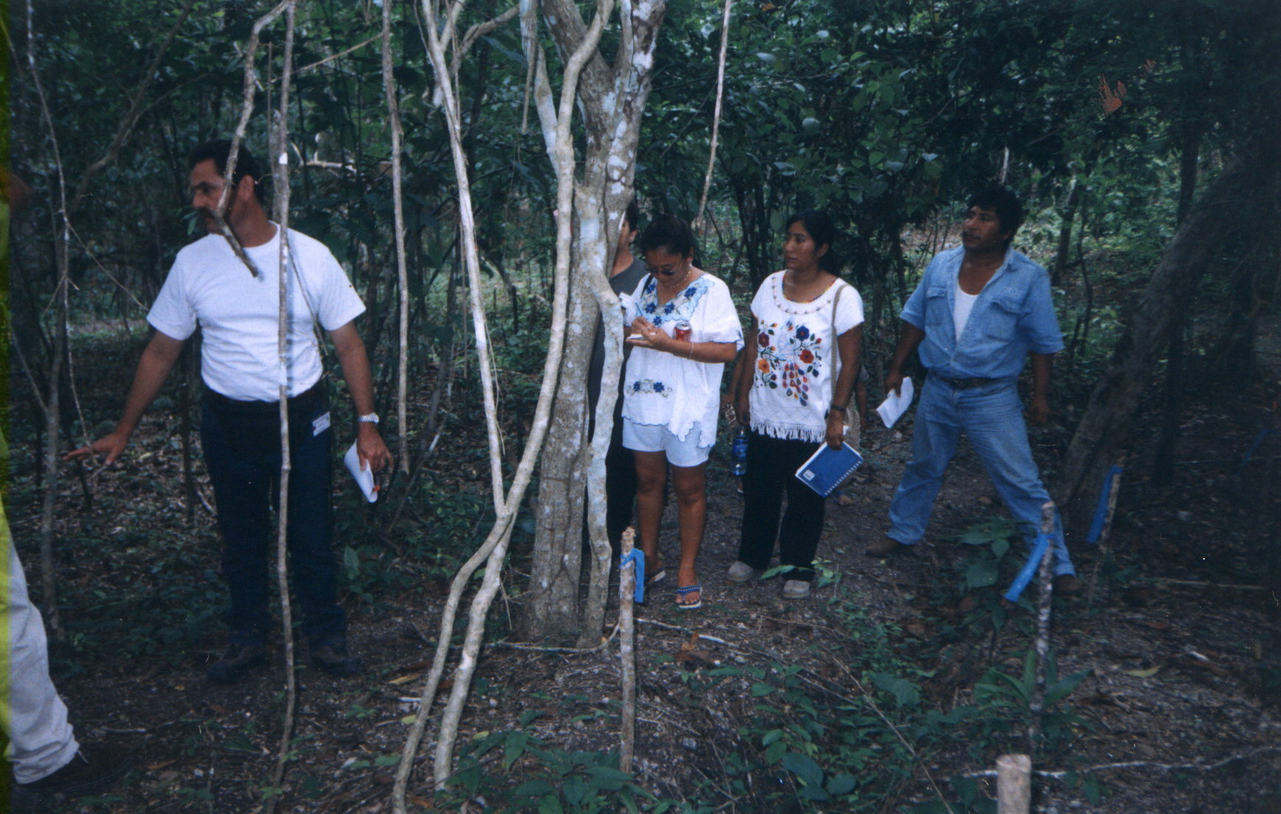
How Can Countries Best Support Community Responses?

Slide 26
Forest Regulations Have Failed to Address the Real Problems
The typical reaction to degradation and deforestation has been more laws and more regulation. Agencies make more ”command and control” efforts
But the problems go beyond simply applying the law as legal and policy frameworks are a problem in themselves
  Laws are not practical and cannot be followed
  Laws are unjust, inequitable, and discriminatory to poor
  Laws are inefficient
The State cannot possibly control the myriad number and types of actors with its limited powers and coverage

Slide 27
General Findings to Date
Role of the federal forest agency and government is changing in many countries
Tenure is an important element of long-term trust
Communities generate different economies and the old formulas miss poverty reduction potential
There are other pro-poor models of conservation than public protected areas or state owned forests Regulations that needlessly exclude the poor are counter to environmental goals.
Forest product markets knowledge for local people; generate and disseminate market information.

Slide 28
Questions for Discussion
What is the role of policy as an enabling condition for community enterprises?
What are the market opportunities for small-scale community enterprises?
Where does “ecolabelling fit in?
What is the role of tenure reform for pro-poor forestry?
What are effective means to build capacity for sustainable enterprises and equitable forestry?
Roles of NGOs, government, private sector, community organizations?

Slide 29
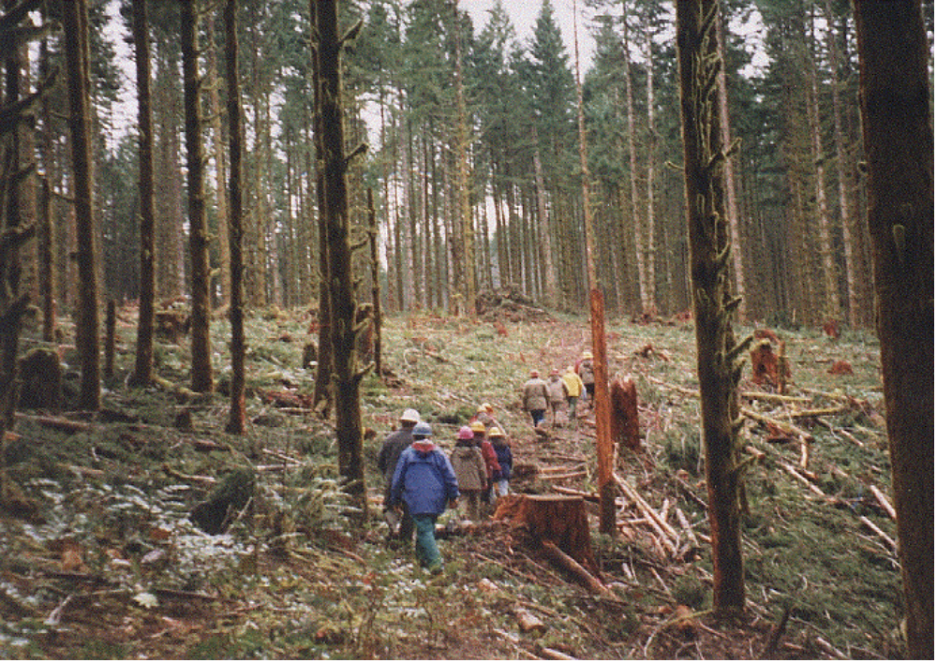
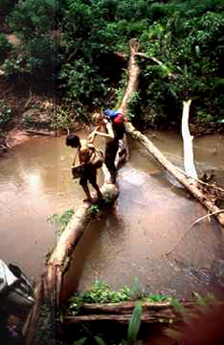
THANK
YOU
For More Information Visit:
www.forest-trends.org

