Slide 1
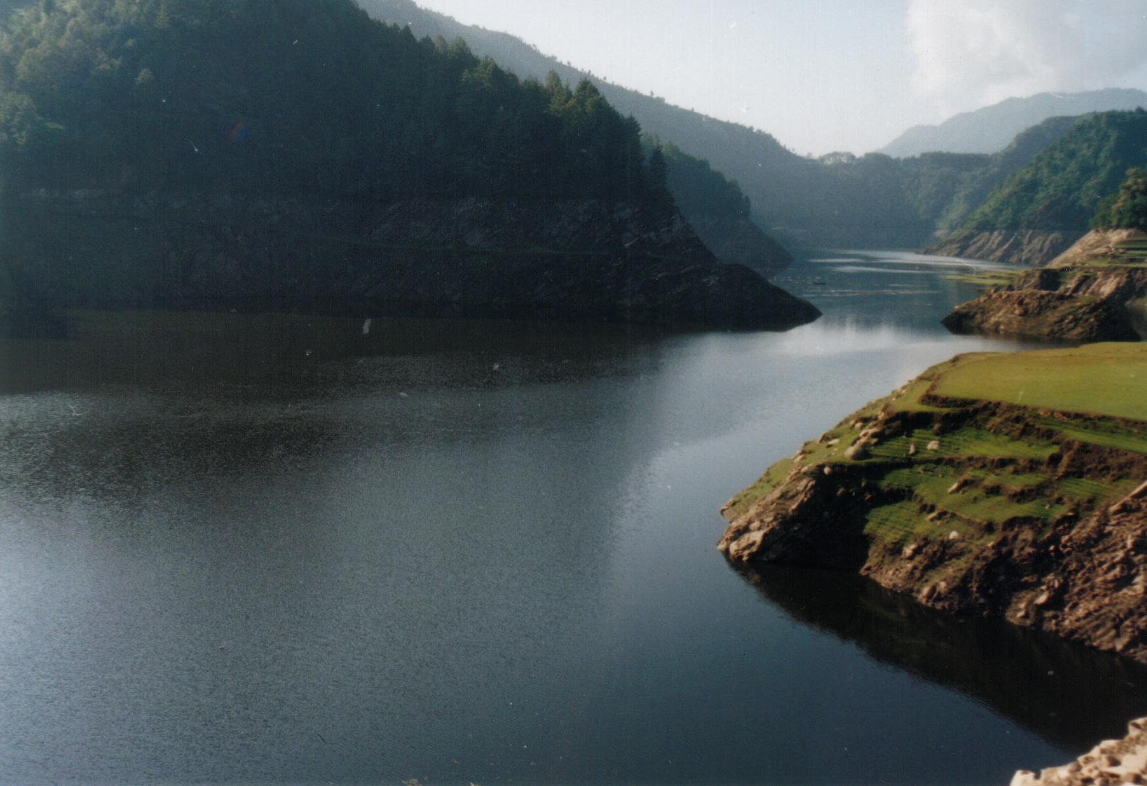
Payments for Environmental Services:
A Pathway Out of Poverty?
USAID-NRM/Poverty Seminar Series
February 17, 2005

Slide 2
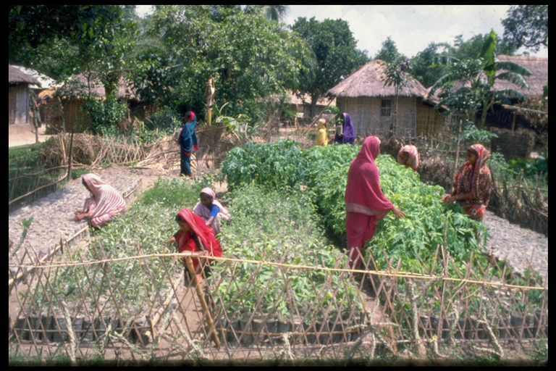
Payments for Environmental Services (PES)
Compensation for providing environmental services:
Biodiversity conservation [including landscape beauty]
Carbon sequestration
Watershed Protection

Slide 3
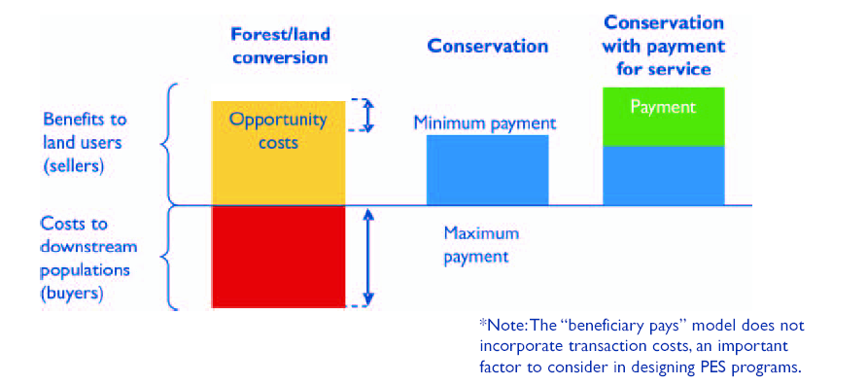
Conceptual Model
Based on Pagiola, 2004

Slide 4
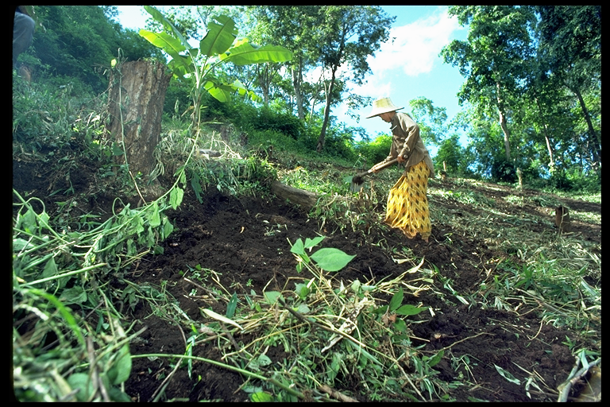
Status of PES
PES: what and how
Lessons learned, with special interest in:
  Successful mechanisms/approaches that actually result in payments to resource stewards for providing environmental services
  Constraints

Slide 5

Environment and Poverty
Initial concern was environmental but there has been increasing interest on the impact on poverty
Reflection of poverty reduction focus: commitment to MDGs; preparation of PRSPs

Slide 6

PES and Poverty
Early optimism that funds would be available for environmental service payments – could environmental stewards be the recipients?
Improved resource management and economic benefits to the stewards

Slide 7
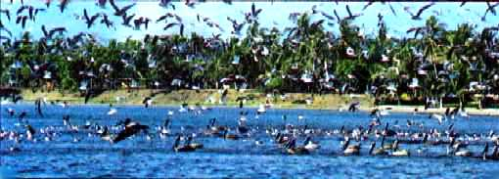
Biodiversity
International buyers with interest in biodiversity, species-rich habitats/hot spots
Funding levels are leveling/declining
Eco-labeling – growing markets; Bioprospecting – small, unrealized; Ecotourism/nature tourism - growing but very competitive
Findings: international actors - local environmental stewards not receiving significant payments

Slide 8

Carbon
Kyoto Protocol: country to country (concerns about capacity; establishing DNAs)
High transaction costs (intermediaries assuming the burden – sustainability concerns)
International buyers for carbon in developing countries slow to emerge
Findings: Not a likely pathway for poverty reduction

Slide 9
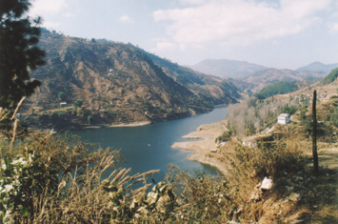
Watershed
Local, domestic or regional rather than international
In some cases, royalty or fee system in place
Smaller the watershed – better identification of benefits; buyers and sellers; and lower transaction costs
Findings: Potential….

Slide 10
Principles
Financially self-sustainable
Transaction costs minimized
Transparent flow of funds and information
Smallholders targeted as providers
Special efforts to include women and other disadvantaged groups
Best management practices locally defined and monitored

Slide 11
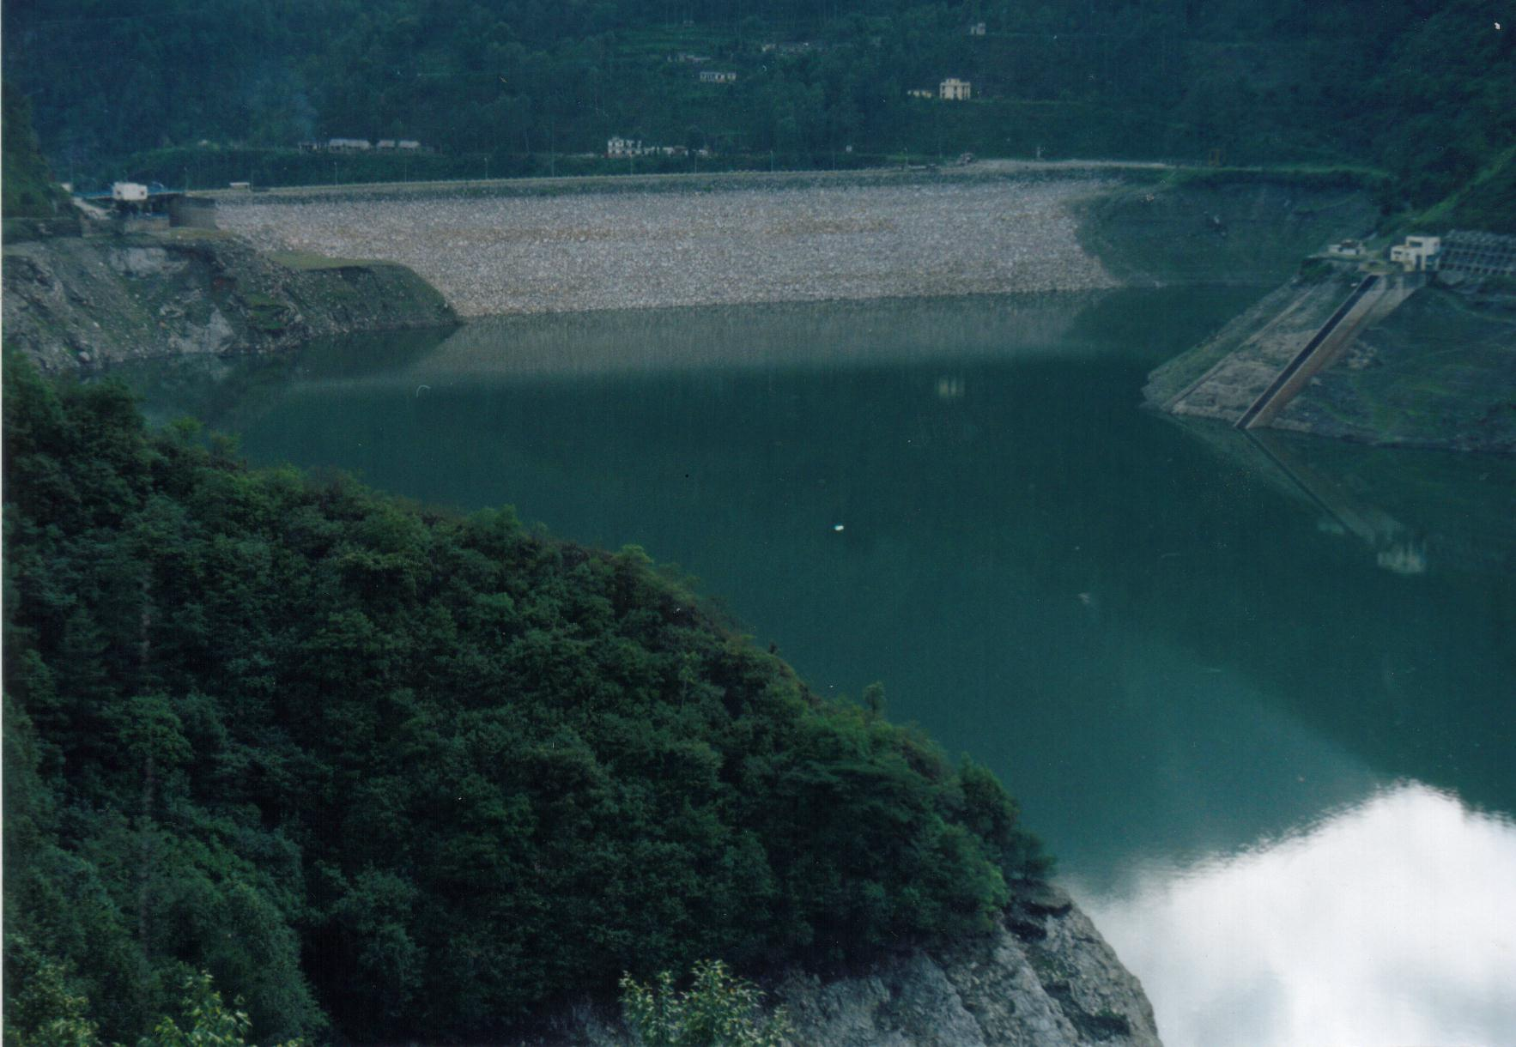
Hydroelectric
Key Lesson from other PES programs:
Need to bridge the gap between the environmental stewards (sellers) and the buyers
Link the payment to the services

Slide 12
Environmental Services for Hydroelectric Producers
Quantity and quality
Current payments: compensation for displacement
Not linked to watershed services (although funds may be earmarked for tree planting, restoration)

Slide 13
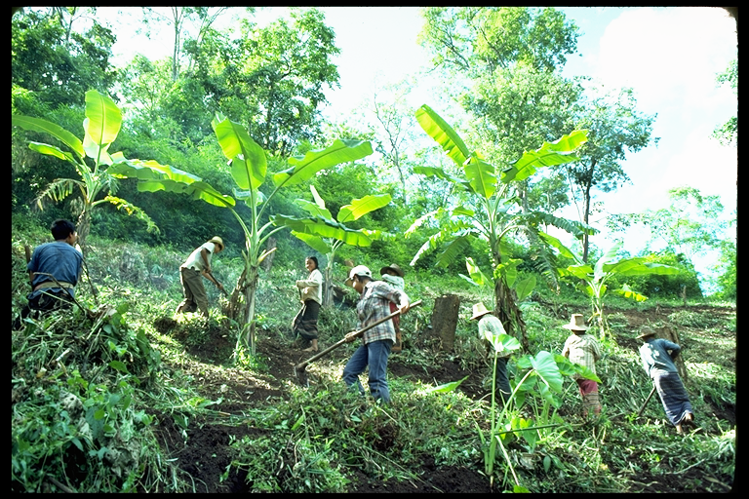
To Bridge the Gap
Environmental service payments linked to watershed management.
Environmental stewards: from laborers to managers with appropriate rts. and responsibilities (payments linked to performance).

Slide 14
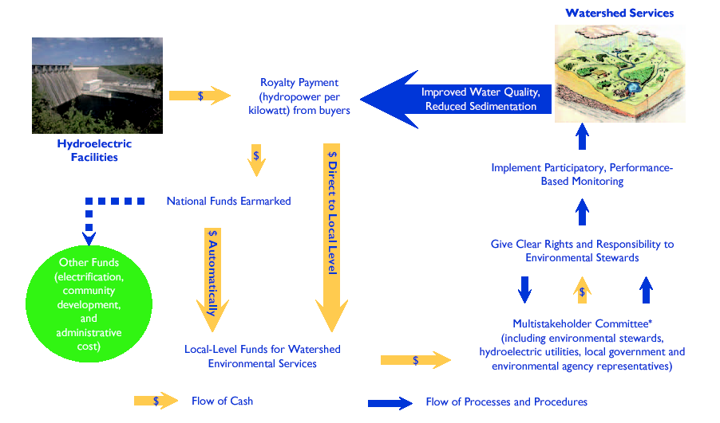
Payment Flow of Environmental Services

Slide 15
Key Elements
Clearly defined Royalty/Fee
Assessments
Earmarked funds with transparent
processes and procedures for disbursement
Multi-stakeholder committees
Locally Determined Payment Priorities & mechanisms
Participatory planning and performance monitoring

Slide 16
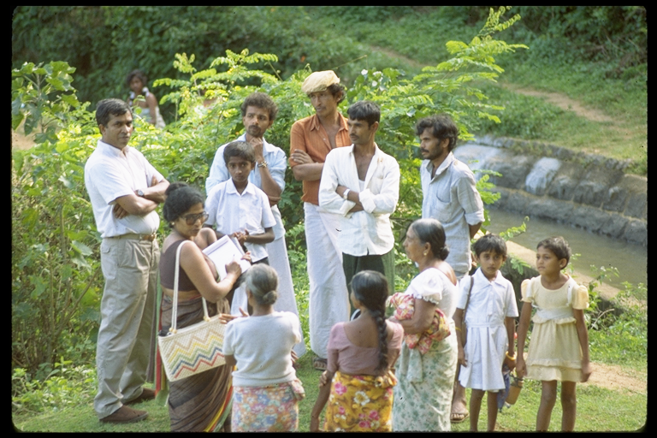
Pieces of the Model Already in Place
Common:
Royalty and fees
Earmarking of funds
But not:
Payment for performance
Strong voice of environmental stewards

Slide 17
Can PES be a Pathway Out of Poverty?
  Current programs already contain many of the critical elements
  What is needed for designated PES programs that reward environmental stewards for providing recognized services?

Slide 18
What is Needed for PES to Have a Positive Impact on Poverty?
Supportive policies and procedures
Poverty reduction explicitly addressed
Resource rights and tenure given
Rights and responsibilities of all parties, including the intermediaries, clearly defined
Fees transparently assessed, collected, and effectively disbursed;
Transaction costs minimized
Sustainability: designed to operate at national and local levels independent of long-term external financial resources

Slide 19

Thank you!
Questions?
Comments?

