Slide 1
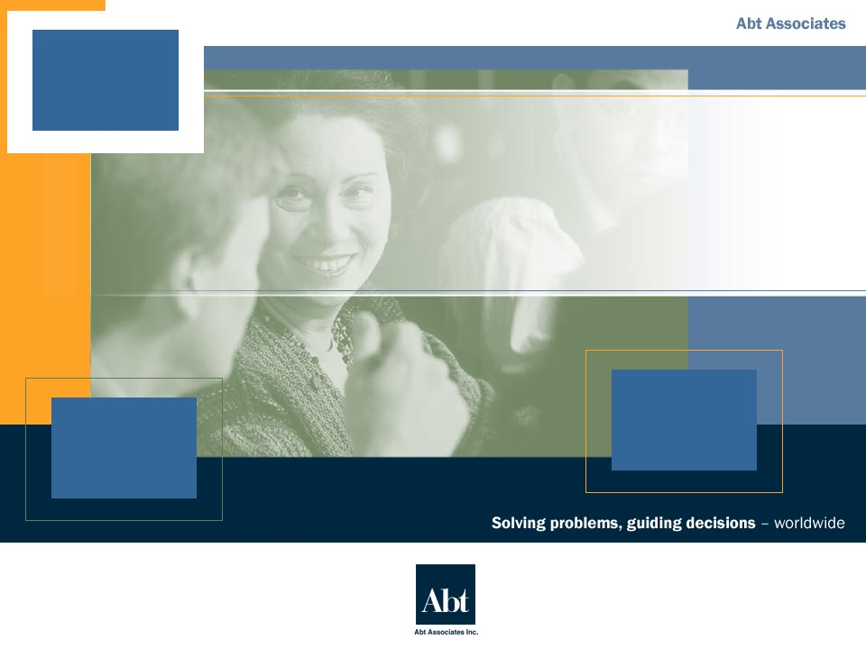
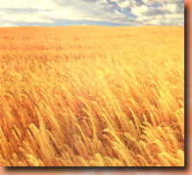
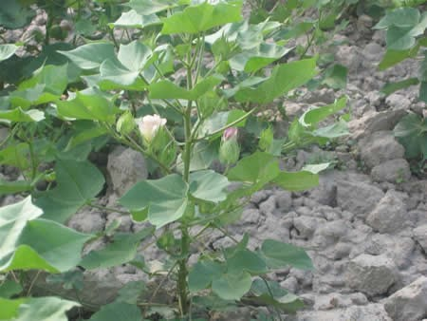

Dynamics of Agricultural Markets and Trade:
Poverty and Environmental Impacts
“Markets, Trade and Poverty Reduction” Seminar
January 6, 2005
Sponsored by Office of Natural Resources Management,
Office of Poverty Reduction, USAID EGAT
Copyrighted by Abt Associates, Inc.
December, 2004 All Rights Reserved

Slide 2
Why Talk About Agriculture in this Seminar?
In most LDCs, ag still contributes at least 15% of GDP, sometimes much more (e.g. Benin 36%, Nicaragua 29%, Vietnam 22%)
Both extensification of agriculture (e.g. cotton in West Africa), and intensification (e.g. high value crop or livestock) can have negative impacts on the environment
Despite growth in NTAE products, which tends to occur near ports and/or cities, agriculture remains a largely rural sector
While urban poverty is rising, on the whole poverty is still rural (75% in Sub-Saharan Africa and Asia, less in LAC)
So what happens in agriculture matters greatly to both poverty and natural resources management

Slide 3
Major Themes
Agriculture and the environment are intimately connected
Agriculture is the best engine for rapid, pro-poor growth
Agricultural exports fuel sectoral growth
The determinants of export-led agricultural growth are actionable
Emerging standards (including environmental) are increasingly important in agricultural trade
Key market forces are changing the structure, conduct and performance of agriculture and trade
This all has great implications for development policy, strategy, programming and implementation
Unfortunately the possible negative interactions between ag an the environment must be acknowledged…

Slide 4

Many Negative Interactions Can Occur Between
Agriculture and the Environment
Conversion of marginal or fragile lands
Degradation of soils
Nutrient pollution
Depletion of aquifers
Habitat fragmentation
De-vegetation
Contamination of natural resources (effluents, agrochemicals, waste)
Source: Adapted from Sara Scherr, The Relation Between Poverty and Resource Degradation, Poverty and NRM Seminar #1, October 2004

Slide 5
Yet There Can Also Be Positive Interactions…
Industries based on renewable natural resources
  Raw silk
  Brazil nuts
  Shea butter
  Marula oil
Natural inputs
  Beekeeping
  Biopesticides
  Sulfur, lime, humus, etc.
Restorative agriculture
  Nitrogen-fixing crops
  Re-stocking of fish
Leisure/aesthetic/cultural values, e.g.
  Coffee tours
  Recreational ponds
  Game farms/parks
  U-pick fields
Now let’s look at how agriculture and trade relate to poverty alleviation and its corollary, which is hunger

Slide 6


The “More Eco-friendly” Technologies Have Tried to Emphasize the Positive & Reduce the Negative
Main Approaches to Sustainable Agriculture
Shared Criteria for Success
Organic farming
Biodynamic
agriculture
Biological farming
Nature farming
(Regenerative agriculture)
Environmentally sound
Economically viable
Socially acceptable
Source: Steve Diver, Towards a Sustainable Agriculture, New Renaissance Magazine, Vol. 6. No. 2, 2003
Yet they represent a small share of overall agricultural output, are not always feasible or profitable, and ar e not enough

Slide 7
Expansion in Commercial Agriculture and Trade both Tend to Accelerate Economic Development
Growth is good for the poor (Dollar and Kray)
Openness to trade is correlated with faster growth (Hoekmann)
The structure (urban vs. rural, sectors) of growth matters (Mellor)
Agriculture is more pro-poor than (say) textiles and apparel because of where it occurs, labor intensity, and impact on food prices
Very few countries have had rapid economic growth without ag growth preceding or accompanying it (Pinstrup-Anderson)
In sum, agriculture is the most effective and pro-poor engine of growth in LDCs, except those that have significant mineral or fossil fuel resources, and those where access to/control over productive land is highly skewed (Delgado)

Slide 8
Agricultural Growth Generates Direct Impacts on Farm Households and Farm Workers
Intermediate Consumption Outlays
Producing agricultural goods to satisfy final demand
Decreased Poverty
&
Hunger
Payment of Labor and Land Rent
(poor workers gain)
(farm households gain)
Increased Net Farm Income

Slide 9
Growth in Commercial Agriculture Especially has Indirect Impacts, Via Goods and Services
Sale of Goods
and Services
Intermediate Consumption Outlays
Land, Labor, Materials, etc
Producing agricultural goods to satisfy final demand
Decreased Poverty
&
Hunger
Payment of Labor and Land Rent
Rural, Non-farm Income
Increased Net Farm Income
The cycle of production and purchases repeats but declines due to leakage, yet the result is a significant multiplier

Slide 10
The Multipliers From Agricultural Growth Can Be Substantial, Especially for the Rural Poor
Direct effects of growth: production changes associated with the initial change in final demand
Indirect effects of growth: production changes in backward-linked industries caused by the changing input needs of directly affected industries
Induced effects of growth: changes in regional household spending patterns caused by changes in household income generated from the direct and indirect effects.
Source: Lindall and Olson, The IMPLAN Input and Output System, MIG Inc ftp://plum.he.net/pub/implan1/documents/implan_io_system_description.pdf,

Slide 11
Induced Impacts Arise From Consumer Spending By Farmers, Workers, Micro-entrepreneurs…
Sale of Goods
and Services
Intermediate Consumption Outlays
Outlays: Land, Labor, Materials, Services
Producing agricultural goods to satisfy final demand
Decreased Poverty
&
Hunger
Payment of Labor and Land Rent
Income from Rural Non-farm Enterprises
Increased Net Farm Income
…because consumption for non-tradables (and some savings or investment) occurs locally

Slide 12
Agricultural Exports (And Also Imports) Fuel Sectoral Growth
Larger Markets with Different Needs
Transformation of Agricultural and Related Sectors via Higher Output and Productivity
Increased Agricultural Trade
Stimulation of Further Innovation
Increased Private & Public Investment

Slide 13
The Determinants of Rapid, Export-led Agricultural Growth are Fairly Well-Known
Capital Deepening & Widening
+
Sustainable Competitive Advantage(s)
Favorable Policy Environment
+
+
Technological Change
+
Standards
Management
Comparative Advantage(s) for Agriculture
+
Increased Productivity
+
Organization and Management
Index
Before discussing standards, let’s review the logic by reversing the order of the last three slides...

Slide 14
Standards are Changing the Rules of the Game as Larger Volumes are Procured at a Distance
Service Standards
EnvironmentalStandards
Social Standards
Sanitary and Phytosanitary Standards
Quality and Condition Standards
If time allows, this will be fleshed out further at the end…otherwise see presentation handout

Slide 15
Market Forces at the Consumer Level Affect the Structure, Conduct, Performance of Agriculture
Developed Markets
  Aging of the population
  Slowdown in population growth in general
  Rise in share of ethnic groups due to immigration and faster birth rates
  Declining share of disposable income for food
  More travel and exposure
  Desire for variety and convenience
  Desire for healthy food
LDC Markets
  Faster population growth
  Youth bubble
  Increases in disposable income for middle class
  More travel and exposure
  Dietary upgrading toward fish, meat, poultry, produce
  Urbanization of the population

Slide 16
Market Forces at the Industry Level Also Affect Ag Sector Structure, Conduct and Performance
On-going consolidation in chain stores, foodservice firms and food processors require buying offices to handle much larger volumes with fewer people
In UK at least, category management is being outsourced to leading suppliers, whose decisions control access to the major retail chains
Fewer major exporters and importers
Elimination of middlemen that don’t add value
Prices become less volatile, but possibly lower over time
The cycle of production and purchases repeats but declines due to leakage, yet the result is a significant multiplier

Slide 17
There Has Been Rapid Evolution in the Way Food Trade Is Structured and Conducted…
e.g season-long program between grower/shipper and chain, special packaging, stepped or fixed price, delivered basis
Going Direct
e.g. exclusive marketing deal between grower/shipper and importer/distributor, with 50/50 split of profits after costs
Multi-year Collaborative Relationship
Season-long Programs
e.g. one half of total production, from grower-shipper to importer/distributor, with minimum price guarantee
Volume-bound Deals
e.g. 250,000 boxes of mangos from exporter to receiver, price for each load set FOB port of exit
Spot Transactions
e.g. single load of mangos from exporter to commercial sales agent, shipped on consignment,

Slide 18
…As Cost Driven, Shipper-Controlled Supply Chains Transition to Buyer-Controlled Chains…
Production
Yr-Rd
Sourcing
Multi-regional,
-international
Service-
oriented
Suppliers
Differentiated
Products
Emerging
Branding
and
Private
Labels
Streamlined
Distribution,
Account-
oriented
marketing,
Category
Management
Shipper-controlled,
Cost-driven Supply Chain
Buyer-controlled,
Profit-driven Supply Chain
Adapted from Rabobank, Mexico
Notes:
5
7
6
6
5
5
The simplified business system will be used as a reference throughout the presentation
The business strategies derive from chosen end-consumer targets and choices, the analysis of alternative strategies will likewise be looked at going upstream, i.e......... from end product or consumer to raw materials or inputs
In broad terms, all upstream activities (and animal processing to a certain degree) are cost driven activities where the top players in the market are also those that have the highest cost control level.
Downstream activities, i.e......... processing and distribution, are mainly revenue driven. The choice of market strategy, product mix, branding, etc..... differs significantly from one player to another and all aim at maximizing achievable revenues and or profit margins.

Slide 19
…That Are Integrated and Coordinated
Increasing use of partnership and preferred supplier agreements
Shared strategic planning processes
Collaborative product development (new forms, presentations, line extensions)
Joint production and delivery scheduling (even across suppliers who used to be competitors)
More efficient logistics and distribution (chartered carriers, dedicated warehouses, Efficient Consumer Response, in-store replenishment)
Seamless information flow via electronic data interchange
Joint marketing, promotional and merchandising efforts (grow the category, promote the brand, shave peaks in supply)

Slide 20
How Is This New and Different?
Longer-term vision
More stable relationship between two companies, not based so much on personal relationship between salesman and buyer
Joint responsibility and accountability
Bottom line is profitability and growth of the category as a whole—year-end, not weekend results
Fewer players control more of the volume
Heavy emphasis on enterprise-wide use of Information Technology
Shared staff, dedicated facilities

Slide 21
What Exactly is an Agricultural Supply Chain?
Extended enterprise that comprises the entire set of processes and activities required to produce a food or agricultural product and then deliver it to a target market
The term “produce” encompasses growing, transforming, or manufacturing
The entire chain goes from “farm to fork,” but development projects are usually concerned with a subset of links within the chain
For the chain to work, numerous supporting activities are also required, such as input supply and transport
Good access to factors of production is critical to success

Slide 22
A “Supply Chain” is Not Synonymous with “Value Chain”, Because…
Value chains are concerned with what the market will pay for a good offered for sale
The main objectives of value chain management are to maximize gross revenue and sustain it over time
Supply chains are concerned with what it costs and how long it takes to present the good for sale
The main objectives of supply chain management are to reduce the number of links and to reduce friction (bottlenecks, costs incurred, time to market)

Slide 23
Weaknesses of Small Farmers in Global Supply Chains for Food and Agricultural Products
Shortage of capital and lack of collateral with which to borrow
Lack of access to technology
Difficult access to good land
Environmental degradation, especially soils and water
High pest/disease pressure in tropical and subtropical areas
Inputs often not available, or late
Power usually expensive
Time, distance and cost to market
Transport infrastructure and services often inadequate
Small scale of farm units, difficulty delivering volumes needed
Inability to speak English
Lack of know-how and know-who for export markets
Policy and enabling environment
HIV/AIDS scourge

Slide 24
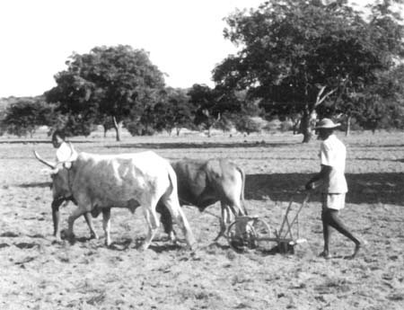
Strengths of Small Farmers in Global Supply Chains for Food and Agricultural Products
Vocation for agriculture
Low wage rates, and after training, low cost of labor
Good growing conditions for some crops
Extended growing season in tropical and subtropical areas
In some cases, low cost of production
Lack of options means often means strong motivation
In many places, a tradition of working together (e.g. “minga” in Ecuador and Peru)
Nearness to growth market of the future for food products, which is developing countries in general, and urban markets in particular

Slide 25
Small Farmers Can Still Aspire to Participate in Global Supply Chains But They Will Need to:
Better understand markets and marketing
Identify value chains worth developing
Eliminate friction in the corresponding supply chains
Select and deal with export catalysts and channel captains
Comply with official and commercial standards of all kinds
Generate the required volumes
Assimilate enabling technologies
Add value once they have penetrated a market

Slide 26
The Trends Noted Above Have Great Implications for Development. We All…
Need to recognize and understand what major markets want and expect
Need to grasp the complexity of interactions between agronomic, biological, physical, economic, social systems
Need to take whole range of emerging standards (not just environmental) into account when designing interventions
Need to take value chain and supply chain approaches to development of clusters and deals
Need to be creative to help small farmer-oriented agriculture and other natural-resource based economic activity be more productive, competitive, and sustainable

