Slide 1
POVERTY & NATURAL RESOURCES MANAGEMENT
USAID
October 28, 2004
Jan Bojö
Adviser, World Bank
Notes:
Bojo brings empirical information to the table to argue that most poverty is rural, and will remain so for 15 yrs or more.
This presentation provides a reality check on the concepts we use to define poverty, and insight into how we can better approach global poverty reduction.

Slide 2
Storyline
Most poverty rural & dependence high on NR
What sustainable pathways out of poverty?
  Economic growth?
  Public/donor policy & spending re-alignment?
  Payment for ecological services?
Notes:
Most of the world’s poverty is rural, and dependence by the poor on natural resources is high.
What are the sustainable pathways out of poverty? And what conclusions we can make about the policies needed to enable sustainable pathways out of poverty? Answers go in widely divergent directions. The World Bank maintains that urban environments are more productive than rural environments, thereby making it inherently difficult to reduce the prevalence of poverty among rural people. Others say we need more spending to address poverty. And yet others say we need to amend traditional markets with payment for ecological services.
All of these answers are correct.

Slide 3
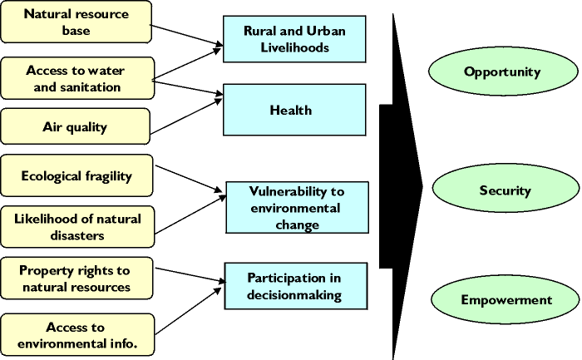
Poverty-Environment Nexus
Conditions Major links Dimensions of poverty
Notes:
This is a conceptual map illustrating the multitude of factors that shape the dimensions of poverty. Poverty is broader than income alone; voices of the poor give powerful testimony to the fact that poverty includes lifestyle aspects of health, education, economic opportunities, security, and empowerment. All are related.
This discussion focuses on the income concept. It also focuses on the rural livelihoods link and the livelihoods link to the natural resource base (NRM).

Slide 4
NR Dependence Among Poor
Vedeld et al (2004)
Objectives:
  Investigate extent of rural poor dependence on
  environmental income
  Recommend good practice methodology
  54 studies reviewed
Notes:
For a review of the dependence by the poor on natural resources, Bojo recommends reading the publication entitled “Counting on the Environment” (Vedeld et al. 2004) for a review of good practice methodology based on a meta-study of more than 50 gray literature studies. An entire chapter is devoted to environmental income.

Slide 5
“Environmental Income”?
Definitions: EI = Rent (value added) captured through consumption, barter or sale of natural capital within the first link in a market chain
Study focused on forest EI
Notes:
Environmental income (EI) is defined as the rent or value added that is captured through the consumption, barter or sale of natural capital.
Vedeld et al (2004) focus their review on Forest EI

Slide 6
Study
Results
Wild food & fuelwood most important
About 1/5 of income FEI
Cash about half of FEI
Notes:
The following are study results. Vedeld et al (2004) found that food and fuelwood are the most important resources, comprising 1/5 of all forest income (income FEI).

Slide 7
Study Results (2)
Within communities, relative dependence on FEI higher for the most poor
Across communities, FEI grows in proportion to total income
Poorer hh more diversified
Notes:
The poorest of poor are even more dependent on natural resources. The poorest households also tended to be more diversified in how income was generated. The poorest are forced to diversify, because they have no other alternatives.

Slide 8
Caveats
Not random sample
Studies “typical” of large populations
Methodological problems:
  Unclear use of “EI”
  Omissions of sources
  Dubious valuation
  Sustainability unclear
Notes:
The caveats to this study are important to consider in understanding the results.

Slide 9
FEI – A Poverty Trap?
Functions often as gap-filling, safety net
Poverty trap only if external restrictions
Pathway out of poverty – rarely
Regional differences
Notes:
Are we looking at a poverty trap? Only if people are prevented from utilizing natural resources to enhance income. FEI is rarely a pathway out of poverty. Regional differences exist.

Slide 10
Are We Missing FEI in Poverty Assessments?
Survey coverage varies
  Fuelwood: little detail
  Wild foods: often missing
  Fodder: often missing but captured as livestock output
  Cash FEI: in consumption measure if missed as income
  We will try to assess the omissions!
Notes:
Are we missing out on FEI when we assess poverty?
Wild foods are often missing. Fodder may be captured indirectly as livestock income. These will underestimate the role of environment in many assessments.

Slide 11
Drivers of Change?
Economic growth? (GDP/poverty)
Align public/donor policy & spending (PRSPs)
Markets for NR values (PES)
Align asset rights (not incl. here)
Build capacity (ditto)
Notes:
What will fix the problems? What are the drivers of change to consider?
Can traditional markets be amended to capture natural resource values? (Although asset rights and building capacity are important in addressing issues, they will not be addressed in this presentation.)

Slide 12
Growth & Poverty
Source: Cord et al (2003)
54 countries
Data availability varies; 1950s to current
Average per capita growth vs. growth of income p.c. among 20% poorest
Notes:
In a 54-country survey, Cord et al. (2003) compared overall (average) per capita growth vs. income growth. The answer is diverse. Pro-poor growth is the most common; overall economic growth provides more chances for the poor, but may not necessarily decrease overall poverty.

Slide 13
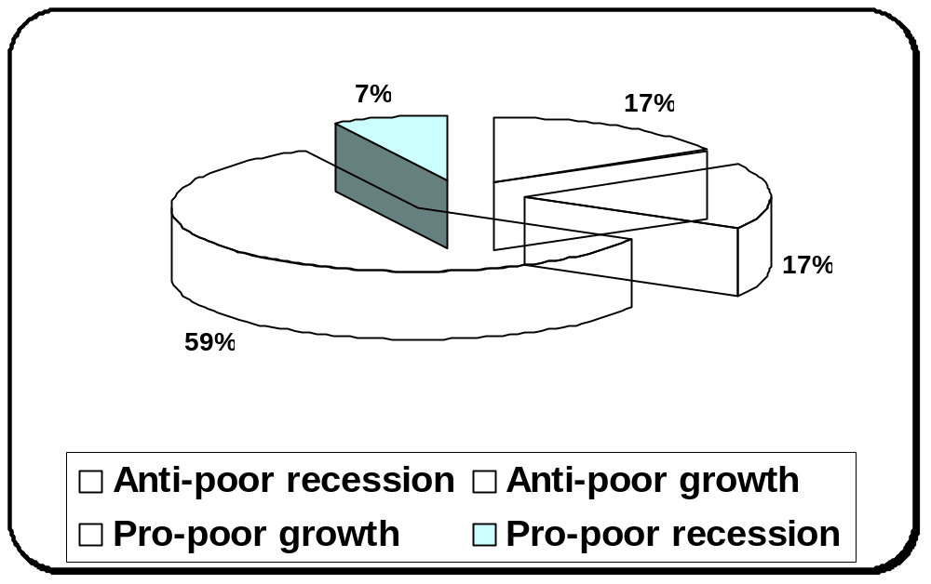
Pro-Poor Growth?

Slide 14
Poverty Reduction Strategy Papers & NRM
PRSPs are
  Country-owned
  Requested by WB/IMF for concessional lending
  Outcome focused
  Tools for donor coordination
Notes:
Poverty Reduction Strategy Papers (PRSPs) serve as rallying points for substantial flows from other donors. How is environment included in these papers? Poverty and environment links are highlighted, but more in the environment-health (and water) links rather than NRM links.

Slide 15
NRM in PRSPs
Environmental review shows great variance
More attention to poverty - environmental health links than NRM links
Interventions focus on growth promotion, public sector reform, social spending
Good NR mainstreaming: Mozambique

Slide 16
PRSP Implementation
Almost 60 PRSPs
21 Progress Reports
Rated both with nominal scores
Correlation coefficient 0.15
Weak link in mainstreaming environment
Notes:
Payment for ecological services
Review of case studies: Silver Bullet or Fools’ Gold?
Poor often have low opportunity cost for participation. Poor could gain or lose.

Slide 17
Payment for Environmental Services (PES)
Biodiversity
Carbon sequestration
Watershed protection
Landscape beauty
Notes:
Does payment for ecological services compensate the poor adequately?
Landell-Mills and Porras (2002) provide a review of case studies by in the publication “Silver Bullet or Fools’ Gold?”
These cases show that the poor can gain or lose.

Slide 18
Poverty Impacts?
Poor often low opportunity cost for participation
Labor impacts ambiguous
Title could be problem
Credit for investments
Transaction costs high
Tradeoff environmental efficiency vs. poverty targeting

Slide 19
Summary Points
EI among poor often significant and underestimated
Pathways out of poverty:
  Economic growth necessary, not sufficient
  PRSPs: important, but indirect instruments
  PES: limited but promising, some tradeoffs
  environment vs. poverty reduction
Notes:
EI among poor is often significant, yet is also often underestimated.
Various pathways out of poverty have been used, with varying success:
Economic growth is necessary and will enhance the probability that poverty reduction will occur, but is not sufficient on its own;
PRSPs are important, but they indirect measurements;
Experience with payment for ecological services is limited, but tradeoffs between environment and poverty reduction are promising.

Slide 20
References
Bojö, J, K. Green, S. Kishore, S. Pilapityia, and R. Reddy (forthcoming) Environment in PRSPs and PRSCs. World Bank Environment Department Paper. Washington, D.C.
Cord, L. H. Lopez, and J. Page (2003) “When I Use a Word…” Pro-poor Growth and Poverty Reduction. Processed. World Bank, Washington, D.C.
DFID, EC, UNDP and World Bank (2002) Linking Poverty Reduction and Environmental Management: Policy Challenges and Opportunities. Published by the World Bank, Washington, D.C.
Landell-Mills, N. and I. Porras (2002) Silver Bullet of Fool’s Gold? A global review of markets for forest environmental services and their impacts on the poor. IIED, London.
Pagiola, S., A. Arcenas and G. Platais (forthcoming in World Development) Can Payment for Environmental Services Help Reduce Poverty? An Exploration of the Issues and the Evidence to Date from Latin America.
Vedeld. P., A. Angelsen, E. Sjaastad and G. Kobugabe-Berg (2004) Counting on the Environment: Forest Incomes and the Rural Poor. Environment Department Paper No. 98. World Bank, Washington, D.C.
Notes:
These references were cited throughout the presentation, and are highly recommended as background reading on poverty reduction.

