Slide 1
The Apparent “Curse” of Natural Resources
Andrew Warner, Sr. Economist
Millennium Challenge Corporation (MCC)
Poverty Reduction and Natural Resource Management
Seminar, USAID/EGAT, Washington, D.C.
October 28, 2004

Slide 2
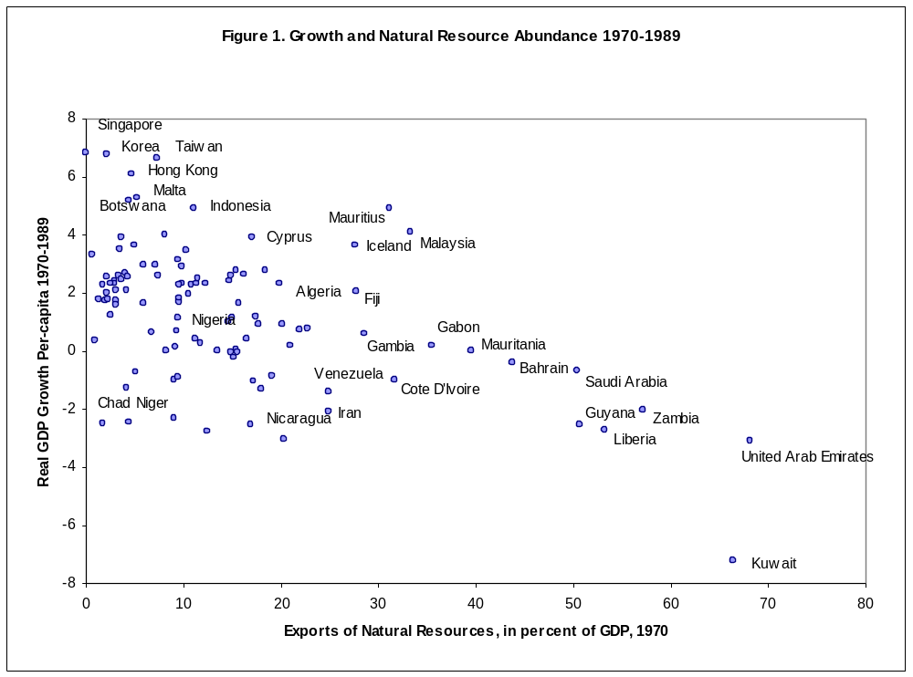
Canada 1900
Sweden 1910
Australia 1901
Notes:
This presentation by Andrew Warner, Sr. Economist at Millennium Challenge Corporation (MCC), discusses his paper entitled “The Natural Resources Curse”. Warner presents data for what some people argue as evidence for an apparent curse of natural resources (NR). The curse refers to the observed phenomenon that the exploitation of NR and the wealth derived from exports can grow very rapidly and negatively impact country development.
Important Note: this presentation is limited ONLY to the discussion of mineral and oil reserves as natural resources.
In the data, driving countries are those with oil reserves (defined by renewable and non-renewable resources). If you measure NR wealth as a share of a country’s economy, what emerges are only the countries that are well endowed with oil (Zambia, Chile, ME). Oil exporting countries mostly show up on the left side of the graph.
X axis – exports of NR
Y axis – GDP
It is very hard to find a country that is well endowed in NR and also grows rapidly.
What about US and Australia’s growth dependent on the rich endowment of NR in 19th century? Although this was important, the intensity of NR use in the colonial period is not nearly as intensive as today.
What are the causes of the apparent curse?
Dutch disease – refers to any case where the existence of wealth (such as oil) raises the prices of labor, electricity and things used by other industries. This hurts the competitiveness of any other business sector trying to export, and thus explains lack of growth in anything but the oil industry in, for example, Saudi Arabia. Oil wealth also lowers returns from education.
Corruption can be a mechanism for the curse, provided corruption is getting worse over time.
Oil rich countries have high startup costs.

