Slide 1
The Relation Between Poverty and Resource Degradation
Sara J. Scherr, Forest Trends
Poverty Reduction and Natural Resource Management
Seminar, USAID/EGAT, Washington, D.C.
October 28, 2004

Slide 2
Key Messages
Natural resources are critical to food security & livelihoods of the rural poor
The poor are not most responsible for degradation, but are most affected
For the poor to protect and restore degraded resources requires investment
Pro-poor NRM policies are needed to achieve MDG’s, esp. in rural areas
Notes:
There is increasing evidence that the natural resource (NR) base is critical to the poor. Evidence that poor are not the most responsible for degradation, but are certainly the most affected by it. Pro-poor NR policies are needed to achieve the Millennium Development Goals (MDGs), particularly in rural areas. This presentation discusses the nature of the relationship between poverty and NR degradation.

Slide 3
Natural Resources: Roles in Food Security & Livelihoods of the Poor
Food, micronutrients, medicines
Fuel, construction, raw materials
Farming inputs (fodder, compost, fencing, stakes)
Ecosystem services (soil, watershed services; pollinator, game habitat)
Asset convertible to other assets (savings, investments)
Notes:
There are many examples of the importance of NR to poor people. Poor people often have difficulty obtaining sufficient micronutrients in their diet, and wild foods are the primary source of such nutrients and medicines for rural people. Fuel and raw materials are derived from NR, as well as farming inputs (fodder, compost, fencing). People also depend on NR to provide many important ecosystem services, such as soil/watershed services, pollination, and game habitat.

Slide 4
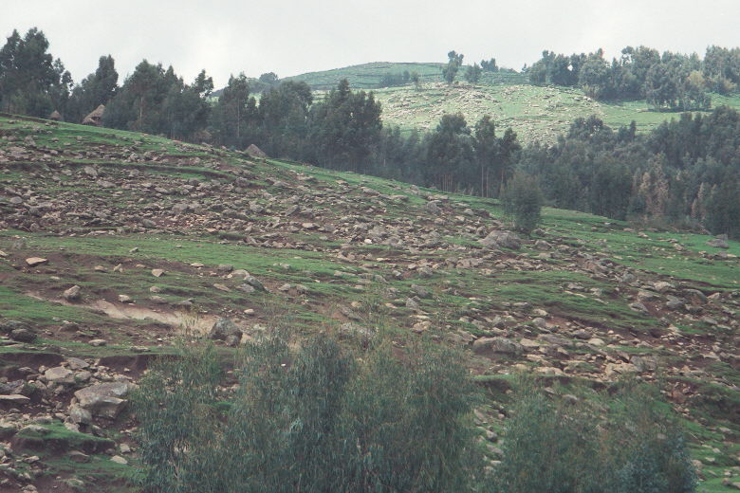
Agricultural Impacts on
Natural Resources
Wetlands conversion
Land degradation
Nutrient pollution
Contamination
Habitat fragmentation
Irrigation using over 70% of freshwater withdrawals (89% + in LDC’s)
Devegetation
Notes:
We are seeing a rise in data that documents NR degradation due to agriculture on a scale that wasn’t seen before. Half of all wetlands have been converted due to agriculture. Two thirds of all agricultural ecosystems are degraded. Contamination from agrochemicals is a major problem in many habitats. Agricultural activities often promote habitat fragmentation. Irrigation uses over 70% of all the freshwater withdrawals. The ecological footprint due to agriculture is large; approximately 80% of the total land area has been modified significantly, often leading to devegetation, and is most obvious in Africa and Asian, and mountainous areas of Latin America. These observations lead to concerns about the sustainability of the world’s major rice bowls and bread baskets.

Slide 5
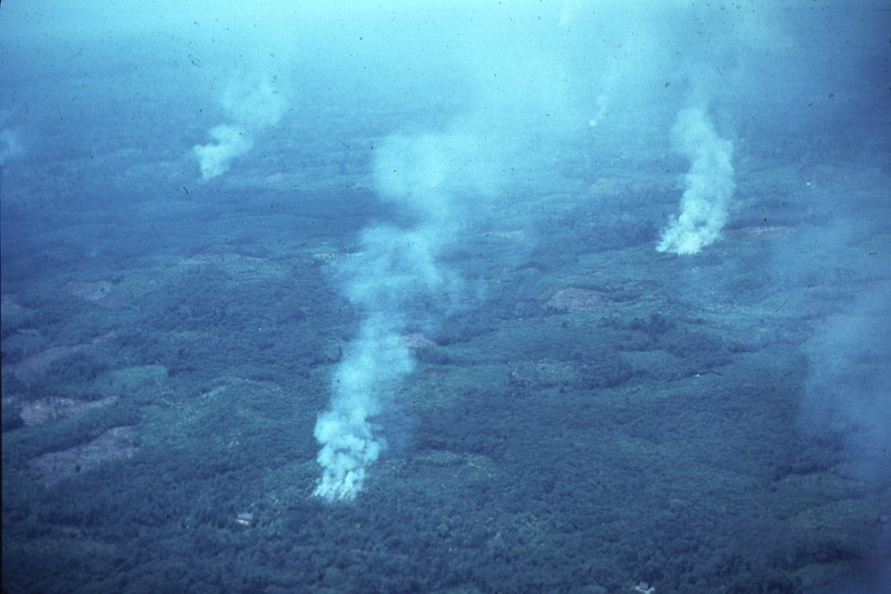
Who is Responsible for Resource Degradation? Mostly Not the Poor
Poor public stewardship
Large-scale agriculture
Urban, industrial demand
for wild products
Non-poor claim, collect more in commons
Notes:
Who is responsible for NR degradation? Evidence suggests it is largely NOT the poor; the ecological footprint of wealthy people in developed countries is much greater. Large-scale industrial agriculture, poor public stewardship, and urban/industrial demand for wild products are largely to blame.

Slide 6
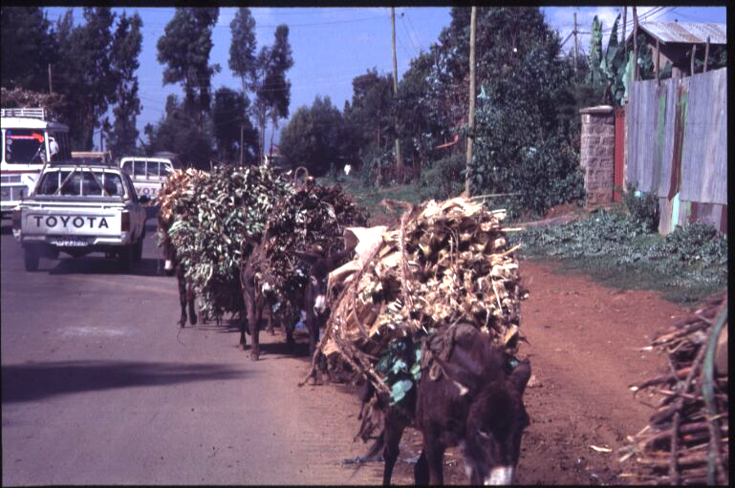
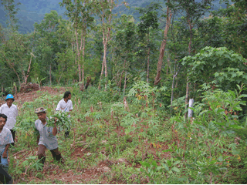
Who is Responsible?
Sometimes the Poor
Over-harvesting unmanaged commons
Over-exploitation of resources in emergencies
Rapid local population growth—expansion of agriculture, infrastructure
Notes:
However, in some instances we do find that the poor cause some degradation, as observed in the over-harvesting of unmanaged resources, over-exploitation in crisis years, or rapid local population growth that leads to expansion of agriculture.

Slide 7
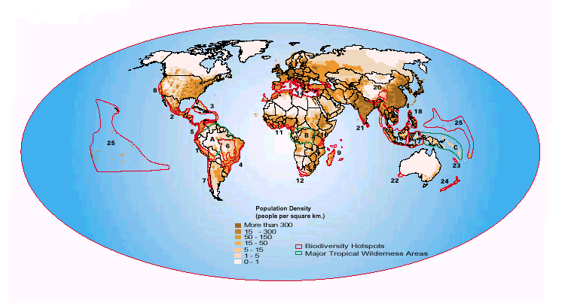
Population in Global Biodiversity Hotspots
Population in Global Biodiversity Hotspots
Notes:
In the biodiversity hotspots identified by Conservation International, we see an overlay of agricultural areas with protected areas; about 35% of the world’s protected land is in agricultural areas.

Slide 8
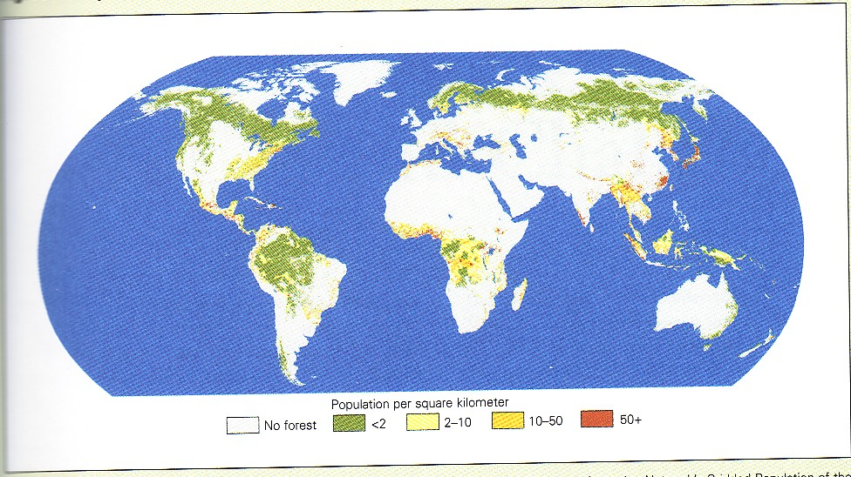
Population Density in Forests
Notes:
We also find many of the world’s highest densities of people in the biodiverse-rich forests of the world.

Slide 9
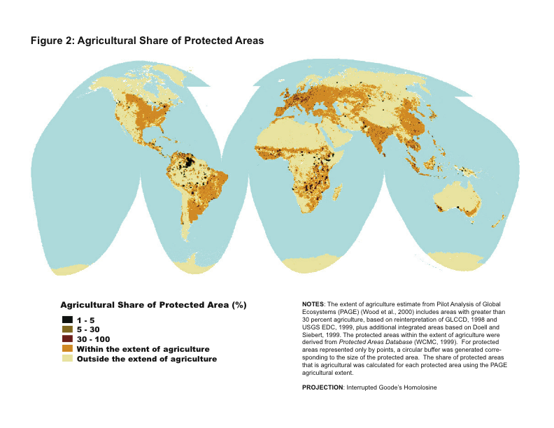
Notes:
About 35% of the world’s protected land is in agricultural areas. These maps underscore the interrelated nature between livelihoods and NR.

Slide 10
Impacts of Degradation on Livelihoods of the Poor
Impacts on poor not well documented
Decline in ag’l income
Loss of in-kind income, food
Impacts of over-regulation
Decline in household, community wealth
Notes:
The impacts of degradation on livelihoods are manifested in many ways: decline in agricultural income; loss in in-kind income and food; and impacts of over-regulation, all of which lead to a decline in household and community wealth.

Slide 11
Rural Poor are Critical to Conserve
Globally Important Resources
Wild biodiversity
Critical watersheds
Terrestrial carbon sequestration, storage
Coastal fisheries and reefs
Notes:
The rural poor are critical to conserve globally important resources such as:
Wild biodiversity
Critical watersheds
Terrestrial carbon sequestration, storage
Coastal fish and reefs
We need to think about these jointly. How can the poor be stewards of these valuable resources?

Slide 12
Capacity and Record of the Poor for Resource Protection/Restoration
Forest cover, soil conservation improve with increased pop’n density in hillsides (Templeton & Scherr)
Forest conservation by indigenous, local people (Molnar et al)
Ecoagriculture cases (Equator Initiative)
Watershed restoration (India)
Key: organization, governance, link to income
Notes:
What is the record of the Potential for the Poor and PR to Move Together?
There is evidence that people can improve and protect NR
With population increase, we often see NR degradation until it gets so high that institutions are developed to help protect them, and at that point the environment begins to improve (the impact is u-shaped).

Slide 13
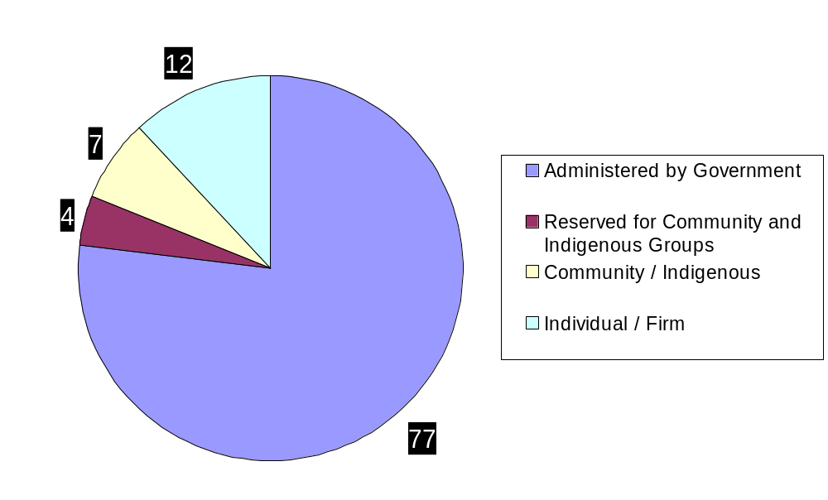
Who Owns the
Developing World’s Forests?
Notes:
Who Owns the World’s Forests?

Slide 14
Community Forest Conservation
370 mln has in community conservation (450 mln under govt. cons.):
  Indigenous reserves (100 mln)
  Community forest/agroforest mgmt (+120 mln)
  Settlers adopting compatible uses (+ 50 mln)
  Restoration in intensively managed lands (+ 100 mln)
$1.3 bln community investment in forest conservation ($1.4 bln by gov’ts and donors)
$3.0 bln govt’ support for PA systems (stable)
$1.3 bln ODA, $.2 bln Foundation support for PA’s (declining)
Notes:
There is evidence of positive conservation by communities. It is documented that 370 M ha are under the influence of community conservation.
The level of investment by communities is about the same level as that by donors and governments.
Community investment is increasing, and donor/government investment is going down.
We are not taking advantage of this trend. Communities can be effective stewards.

Slide 15
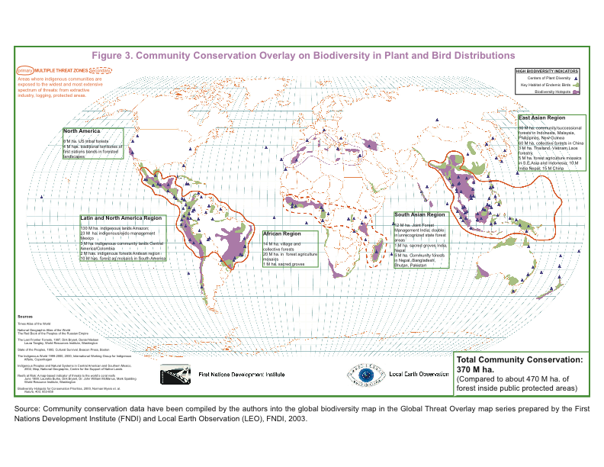

Slide 16
Ecoagriculture: Potential Synergies Between Agricultural Productivity & Natural Resource Quality
Efficiency of input use
Synergies between components
Substitute natural capital for financial capital
More efficient spatial organization
Improved input performance
Economies of scale thru farmer collaboration
Wild species managed to benefit farming
Notes:
Ecoagriculture is the array of practices that lead to agricultural productivity, biodiversity conservation, and livelihood productivity.
The reasons why you get these synergistic outcomes are:
Efficiency of input use
Synergies between…..(see slide)

Slide 17
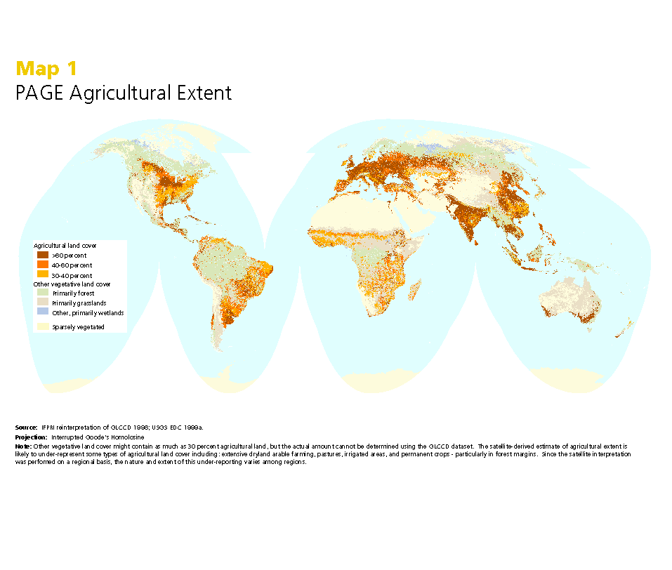

Slide 18
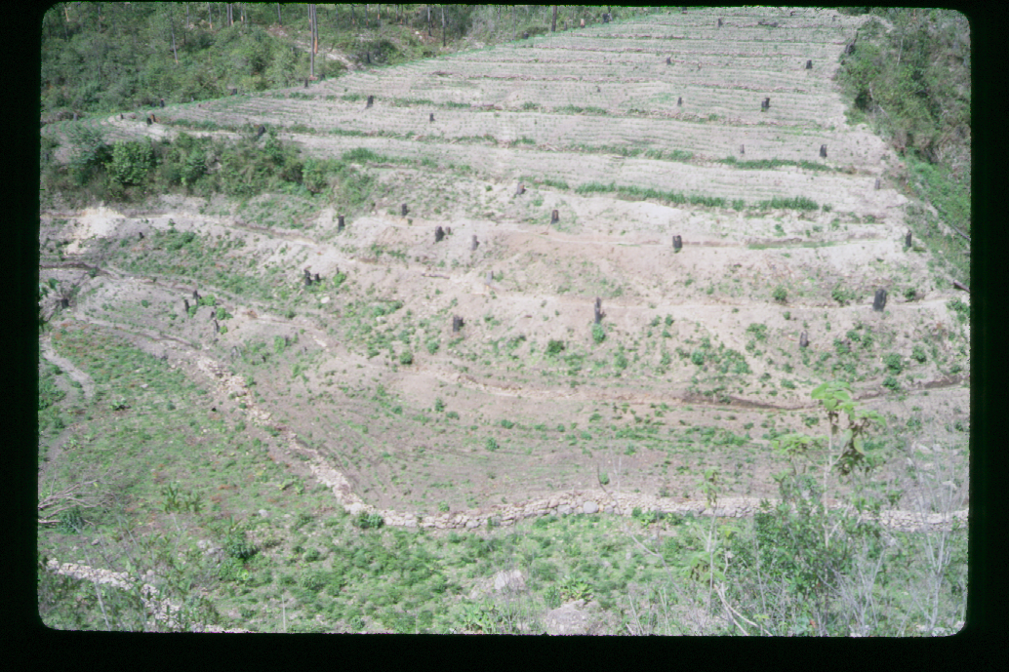
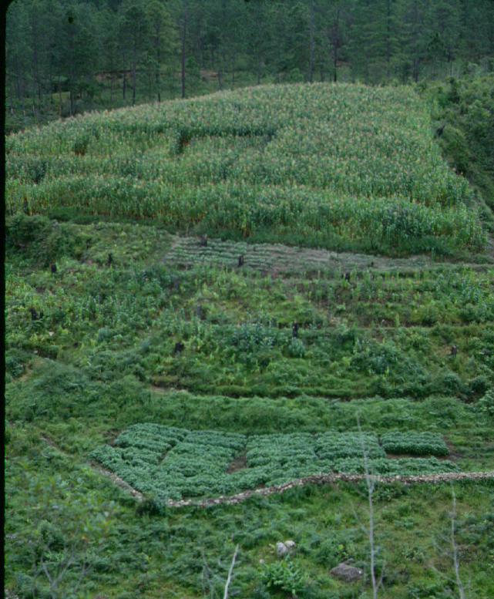
Restoration of Degraded Farmlands
Notes:
The following four slides show examples of how communities can help improve the state of natural resources.

Slide 19
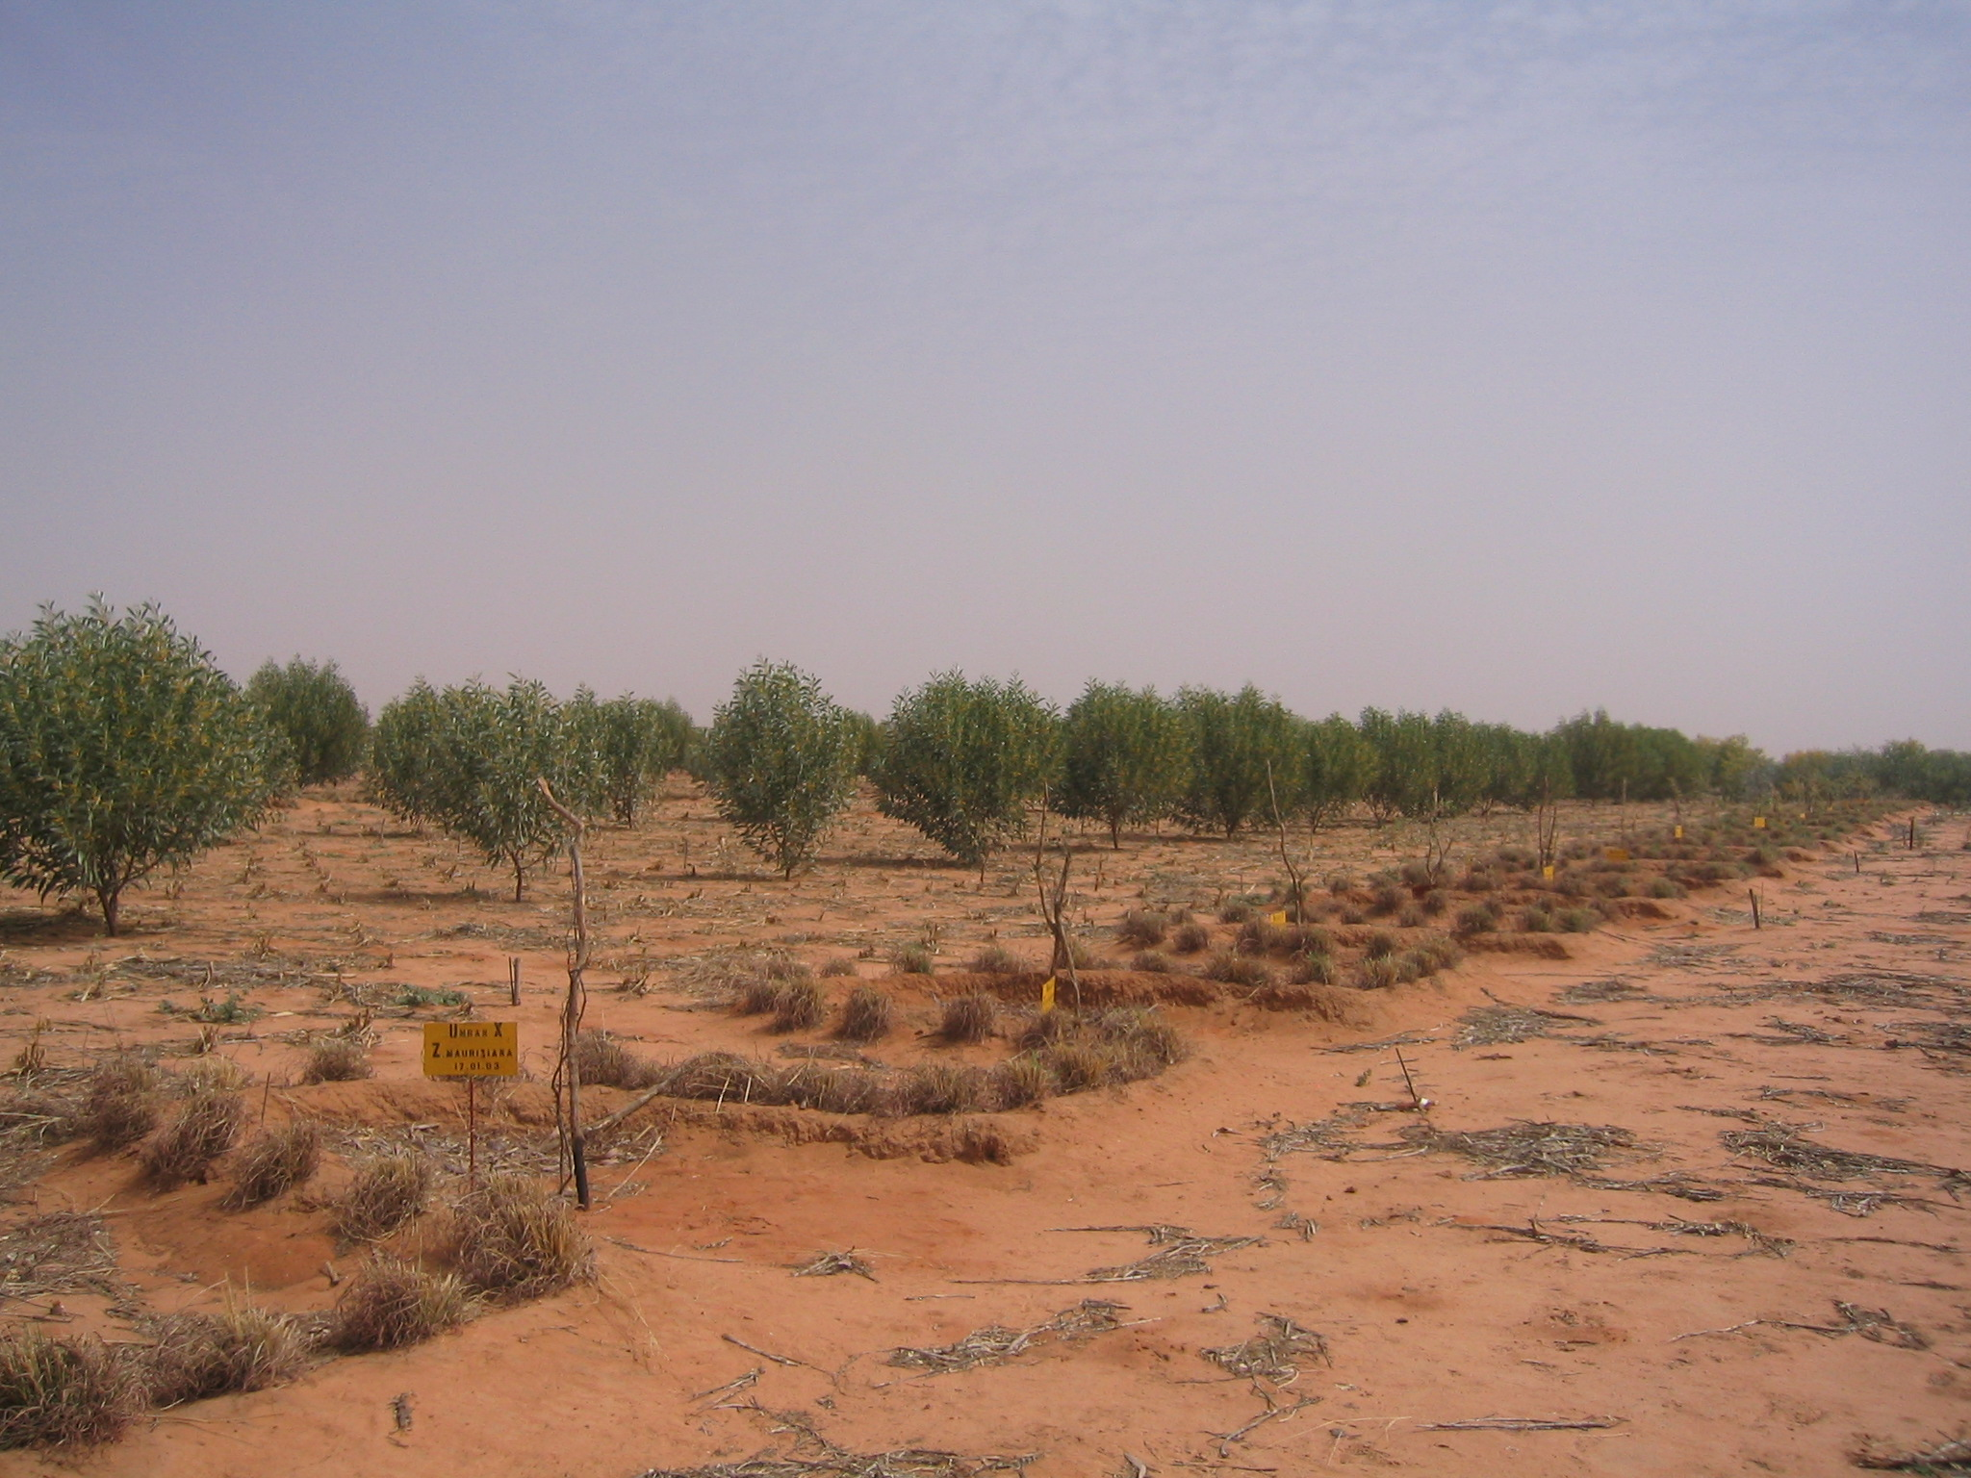
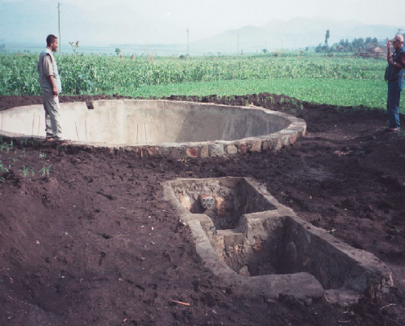
Water Harvesting to Restore Dryland Environments

Slide 20
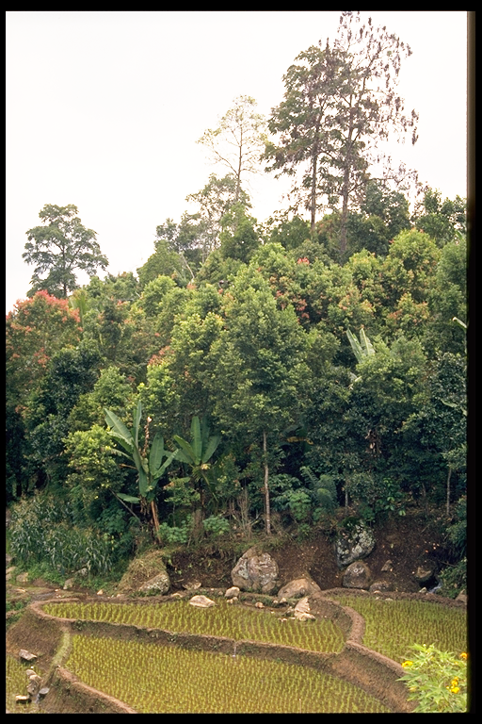
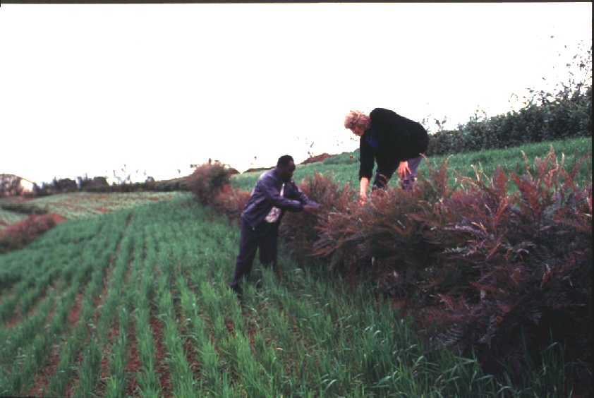
Revegetation with Useful Plants

Slide 21
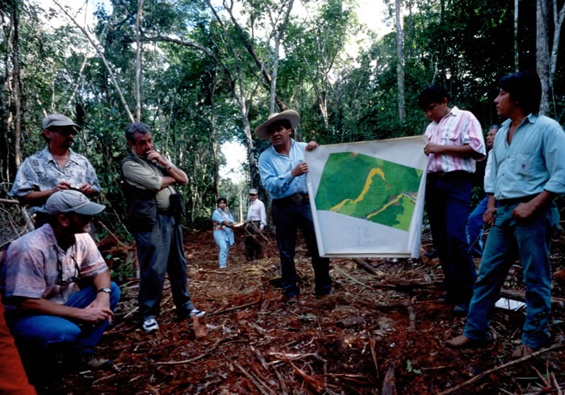
Strengthen Community Organization
Notes:
Key elements to make this happen:
Community organization
NRM at a landscape scale

Slide 22
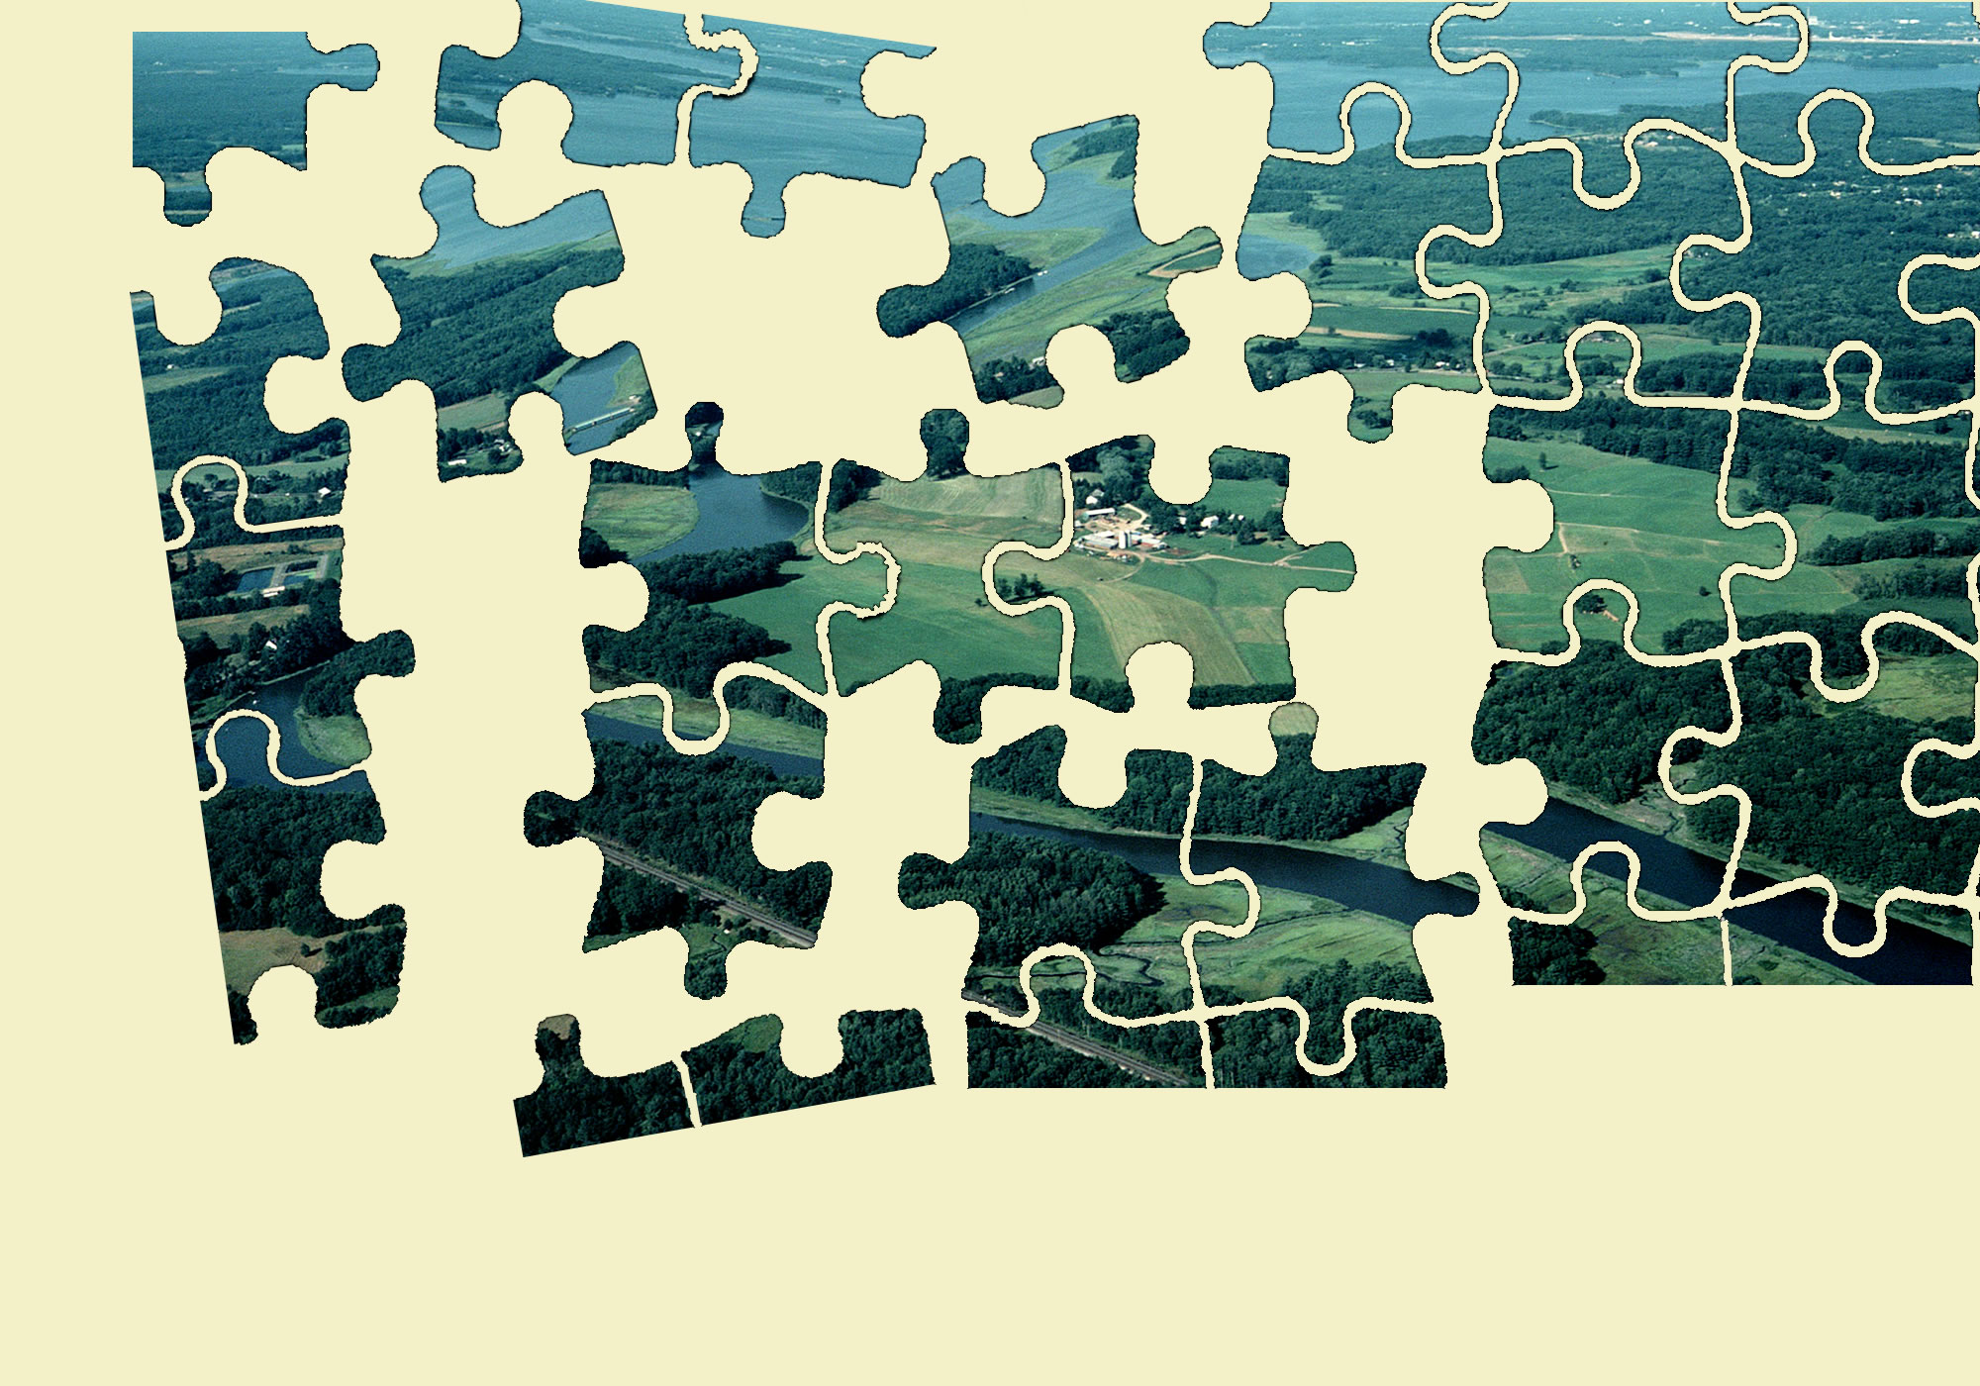
Natural Resource Management
at a Landscape Scale

Slide 23
Meeting the MDG’s:
Implications for Rural Policy
Secure tenure security & access
Local, landscape-scale governance
Link NRM with agricultural strategies
Co-invest to restore natural resources
Promote ‘green’ enterprises
Synergies among MDG’s
Notes:
What we need to meet the Millennium Development Goals (MDGs):
1) Secure tenure security an access
2) Local, landscape-scale governance
3) Link NRM with agricultural strategies
4) Co-invest to restore natural resources
5) Promote green enterprises and provide business support (payments for ecosystem services)
6) Integrate synergies among other MDGs (for example, a watershed restoration project can help meet every one of the MDGs)

Slide 24
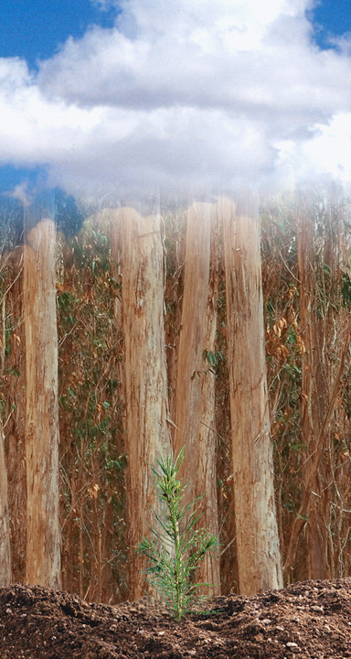
Thank you…
For more information, visit:
www.forest-trends.org
www.ecoagriculture partners.org

