Slide 1
Trade, Environment and Poverty
Linkages and Potential
Markets, Trade and Poverty Reduction
Washington DC, January 6, 2005
Aaron Cosbey
International Institute for Sustainable Development
A. Cosbey - IISD JPAC Ottawa June 17 - 18 2002

Slide 2
Trade, Poverty and Environment
Trade and investment can work to alleviate poverty, while respecting the environment.
But this will only happen if policy makers understand the linkages, make policy accordingly.

Slide 3
TRADE
POVERTY
ENVIRONMENT
Notes:
HUGE NUMBER OF LINKAGES
GO IN ALL DIRECTIONS
SOME POSITIVE, SOME NEGATIVE
WE ARE ONLY DEALING WITH SMALL SUBSET – THOSE LINKAGES INVOLVING ALL THREE.

Slide 4
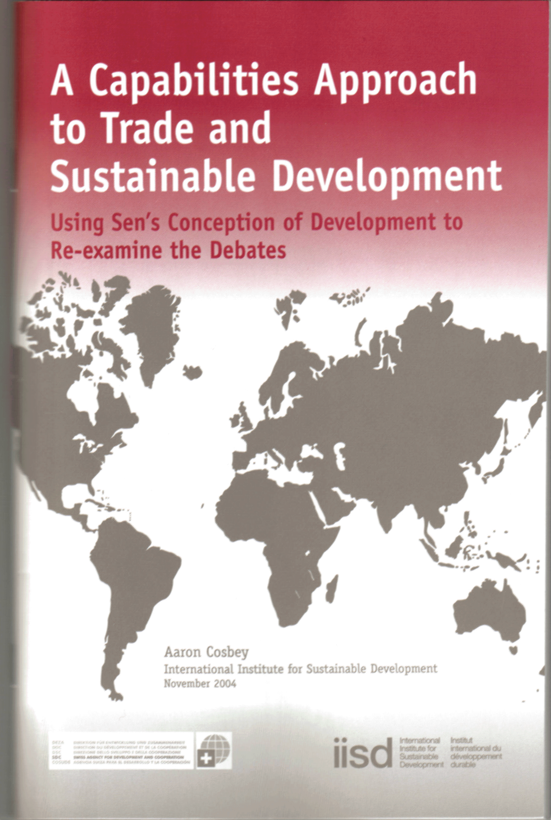
First Things First:
Defining Poverty:
Sen: Poverty is lack of freedom, resulting in lack of capability to fulfill potential.
Development as various freedoms
Environment as one type of freedom
Notes:
POVERTY AS MORE THAN LACK OF MONEY
THIS IS A BOTTOM UP DEFINITION OF DEVELOPMENT –
WE NEED TO CREATE THE CONDITIONS OF FREEDOM THAT WILL ALLOW POEOPLE TO MAKE DEVELOPMENT HAPPEN
ONE OF THOSE FREEDOMS IS ECOLOGICAL SECURITY
DEGRADED ENVIRONMENT IS AS LIMITING AS DISEASE OR LACK OF MONEY:
PROVISIONING (FOOD, FIBRE, FUEL)
REGULATING (PURIFICATION, DETOXIFICATION, MITIGATION OF DROUGHTS AND FLOODS)
ENRICHING (SPRITIUAL, AESTHETIC, SOCIAL)

Slide 5
Defining Trade
Trade flows, trade policy, trade law
“Trade” these days encompasses:
  Trade in goods, services
  Investment rules
  Intellectual property rights protection
  Rules on standard setting
  Competition policy, etc.

Slide 6
Trade, Poverty, Environment Linkages
Ecological capital
Public Capital
Market opportunities

Slide 7
Trade, Poverty, Environment Linkages
Ecological capital:
Do export flows undermine their own basis? (forests, fisheries)
Do export flows undermine ecological services to the poor?
Do trade rules undermine the ability to regulate in the public interest? (health, environment)
Notes:
WE ALREADY NOTED – ECOLOGICAL SECURITY IS AN ELEMENT OF POVERTY ALLEVIATION.

Slide 8
Trade, Poverty, Environment Linkages
Public capital:
Liberalization of investment, services, leads to water services concessions, privatization.
  Implications for access by poor, quality of water treatment (both potable and sewage treatment.
Notes:
INVESTMENT AND PRIVATIZATION DONE WELL CAN BRING INCREASED QUALITY OF SERVICES.
DONE POORLY IT CAN BRING HIGHER PRICES, EXCLUSION AND POOR SERVICES.

Slide 9
Trade, Poverty, Environment Linkages
Market Opportunities:
Green markets (barriers, opportunities)
Meeting foreign environmental standards
Notes:
MARKETING ENVIRONMENTALLY FRIENDLY PRODUCTS CLEARLY FOSTERS SUSTAINABLE DEVELOPMENT. REMOVING BARRIERS TO THOSE MARKETS DOES TOO.
ONE FORM OF BARRIER IS THE INABILITY TO MEET FOREIGN STANDARDS.

Slide 10
What Role for ODA?
Starting point: Take trade liberalization as a given.
Driven by …
  International negotiations
  Unilateral initiatives
  Structural adjustment mandates

Slide 11
What Role for ODA?
Invest in prerequisites to gains from liberalization: domestic policies and institutions.
Invest in ensuring that those gains are pro-poor, green.
Notes:
BECAUSE THE CURRENT SYSTEM DOESN’T WORK FOR THE POOR.
ECONOMIC RESTRUCTURING
NEW INVESTMENT, EXPORT OPPORTUNITIES, EFFICIENCIES
PAINFUL TRANSITION
OK IN THE END
THE PREREQUISITES TO GAINS FROM LIBERALIZATION ARE NOT IN PLACE:
EXPORTS: CREDIT, DOMESTIC STANDARDS REGIMES, EXPORT PROMOTION AGENCIES, COMPETITION POLICY, TRADE FACILITATION
INVESTMENT: RULE OF LAW, REGULATORY REGIMES, FINANCIAL SECTOR
TRANSITION POLICIES

Slide 12
What Role for ODA?
Prerequisites to gains from liberalization:
  Strong regulatory regimes
  Rule of law
  Social capital: education, health
  Market readiness
Notes:
ENABLING CONDITIONS!
REGULATORY REGIMES:
ENVIRONMENT: KEEP GROWTH CLEAN (SHRIMP EG.)
FINANCIAL: COMPETITIVE MARKETS
INFRASTRUCTURE: WATER, ENERGY, COMM
RULE OF LAW:
PROPERTY LAW, IPR LAW, CONTRACT LAW
SOCIAL CAPITAL:
EDUCATION, HEALTH, SAFETY NET
MARKET READINESS:
DOMESTIC STANDARDS REGIME, ACCREDITED CONFORMITY ASSESSMENT
EXPORT PROMOTION, INSURANCE, CREDIT

Slide 13
What Role for ODA?
Making growth pro-poor, green:
  Strong regulatory regimes
  Rule of law
  Social capital: education, health
  Market readiness
Notes:
KEY MESSAGE: IT’S THE SAME AGENDA!
SOME DIFFERENCES, OBVIOUSLY.
AND OBVIOUSLY IT’S INCOMPLETE – MANY ROLES FOR ODA THAT DON’T RELATE TO TRADE.
BUT THE TRADE-RELATED STUFF IS ALL ABOUT THE RIGHT POLICIES AND INSTITUTIONS TO ENABLE PRO-POOR, PRO-GREEN GROWTH.
IF YOU INVEST IN STRONG ENVIRONMENTAL REGULATORY CAPACITY, OR IN FACILITATING MEETING STANDARDS IN EXPORT MARKETS, YOU ARE DOING THE JOB.

Slide 14
What Role for ODA?
Invest in creating fertile grounds for sustainable development: in policies and institutions that support positive reinforcement of environment-economic linkages.
By-product is poverty reduction.

