Slide 1

Poverty, Inequity, and the Distribution of Natural Resource Revenues in Africa
Peter Veit
Institutions and Governance Program
World Resources Institute
February 2005

Slide 2
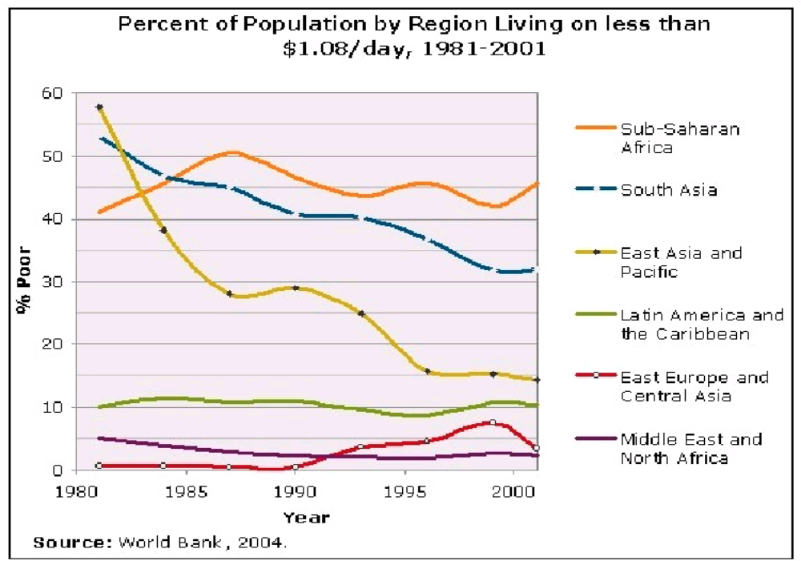
Poverty Rates

Slide 3
Why Worry About Inequity?
Inequity retards econ growth and can cause poverty and underdevelopment; equity promotes faster econ growth
Constitutions guarantee basic right to life and broad-based national development
Inequity (probably more than poverty) breeds resentment and can lead to violence and ultimately separatist movements

Slide 4
Civil Wars Linked to Resource Wealth: Africa, 1990-2002
STATE YEAR NATURAL RESOURCE
Angola 1975-2002 Oil, diamonds
Angola (Cabinda) 1975 Oil
Congo, Rep. of 1997 Oil
Congo, Dem. Rep. of 1996- Copper, gold, cobalt, diamonds, coltan
Liberia 1989-96 Timber, iron, rubber, gold, diamonds, rubber
Morocco 1975- Oil, phosphates
Sierra Leone 1991-2000 Diamonds
Sudan 1983-2005? Oil

Slide 5
Inequity by Region
Gini Index Range | Number of Countries
60-100 |  |  |  |  | 6
50-59.9 |  |  |  |  | 7 |  | 5 | 5 | 1
40-49.9 | 8 | 1 |  | 2 | 9 | 1 | 5 | 6
30-39.9 | 14 | 19 |  | 7 | 7 | 1 | 1 |  | 2
0-29.9 | 3 | 15 |  |  | 1
 | Asia | Europe |  | Mid East/N Africa | Sub-Saharan Africa | North America | CA & Caribbean | South America | Oceana
 | Regon of the World
Source: 2004 Human Development Report, UNDP

Slide 6
Inequity by Population Group
Gini Coefficient, South Africa
Ethnic Group | 1991 | 1996 | 2001
African | 62 | 66 | 72
White | 46 | 50 | 60
Coloured | 52 | 56 | 64
Asian | 49 | 52 | 60
Total | 68 | 69 | 77

Slide 7
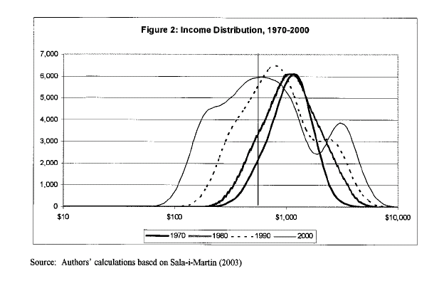
Trends in Inequity

Slide 8
Addressing Poverty with High Inequity: The Case for Distribution
Econ policy reforms are conducive to reductions in poverty, econ growth is a necessary, but insufficient condition
Location (infrastructure, education) and access (finances, land) matter. In their absence, the poor cannot benefit from new economic opportunities, increasing inequity
Distribution, especially of assets, to the poor, coupled with intensified growth in the sectors in which they engage can speed up their participation in the growth process

Slide 9
Addressing Poverty with High Inequity cont’d
Distribution is more effective than econ growth in reducing poverty in high inequality countries and in the least developed countries. Small changes in distribution can have a large effect on poverty reduction.
Multiple targeting methods for poverty reduction. Using more methods produces provides better targeting; implementation matters to outcomes.

Slide 10
Goal and Objectives
Goal. Increase efficiency of econ growth and maximize the reduction in poverty by use of distribution strategy of natural resource assets, especially in countries with high inequity.
Objectives
Increase the assets of the poor and their opportunities for high returns to these assets so that they can participate in the econ opportunities
Poverty is a primary criteria in establishing distributions; poor people are targeted in the distribution of public resources
In resource-dependent economies, poor people capture a disproportionately large share of natural resource revenues

Slide 11
Why Focus on Natural Resource Assets?
Large, underutilized environmental endowments
National and household economies driven by natural resources; rural poor most dependent on nature
Natural resources not evenly distributed in space and not equally accessible to all
Easier to distribute natural resource assets than other forms of capital
If not managed well, can lead to poverty, inequity, environmental degradation, unsustainable development

Slide 12
Resource Dependency, 1995
Mineral Dependency Oil Dependency
Rank State % GDP Rank State % GDP
1. Botswana 35.1 1. Angola 68.5
2. Sierra Leone 28.9 6. Congo, Rep. of 40.9
3. Zambia 26.1 7. Nigeria 39.9
5. Mauritania 18.4 9. Gabon 36.1
8. Liberia 12.5 12. Algeria 23.5
9. Niger 12.2 14. Libya 19.8
11. Guinea 11.8
12. Congo, Dem. Rep. of 7.0 Chad, Equatorial Guinea,
15. Togo 5.1 Congo Dem Rep of,
16. Central African Rep. 4.8 Uganda, Tanzania?
18. Ghana 4.6
20. Angola 3.6

Slide 13
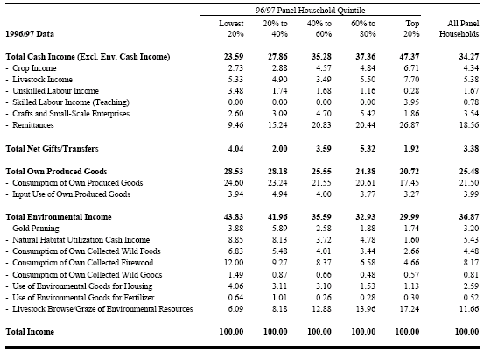
Households’ Total Income Shares by Quintile and by Major Income Source
Rural Households and their dependence on Environmental Resources (A Case Study of Zimbabwe)
Environmental Income makes a substantial contribution to total incomes, comprising 36.87 percent
The share of aggregate environmental income decreases as income rises, therefore, the poor are more resource-dependent than the rich
Source: Cavendish 1999

Slide 14
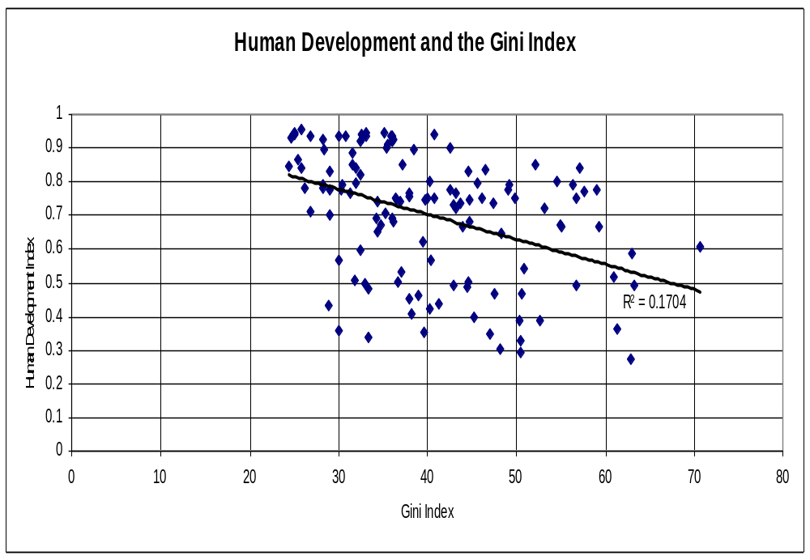
Source: 2004 Human Development Report, UNDP

Slide 15
Two Components of Distributional Equity
Vertical Distribution. The distribution of revenue among institutions along the market chain from the source to the market
Problem: Policies and practices ensure that benefits are concentrated and captured by the elite
Goal: Raise the return of the poor’s natural resource assets and enable them to capture a larger share of profits as direct income
Horizontal Distribution. The distribution of public revenues, including public goods/services, across regions and peoples
Problem: Poverty not a main distribution criterion
Goal: Target poor people and regions; rural poor receive a larger share of public assets

Slide 16
Vertical Dist - Charcoal Profits, Senegal
Urban population
1994 2002/3
12%
22%
-
-
53%
10%
3%
?
?
-
-
+
=
?
Retailers
Urban wholesalers
Transporters
Coxeur de Brousse
Co-operatives
Merchants/
Patrons
Migrant
Wood-cutters
Forest Villages

Slide 17
Mechanisms of Benefit Concentration
VILLAGERS
→ Forest access control
    Threats of violence
    Village access (wells & housing)
MERCHANTS
→ Control of labor opportunities
    Permits
    Credit
    Control of market access
→ Control of access to markets
    Quotas, licenses
    Cooperative membership
    Social ties with government
→ Leverage over prices
    Collusive price fixing
    Inter-locking credit-labor arrangements
    Misinformation
WOODCUTTERS
→ Access to merchants
  Social ties → Social identity
  Technical skills
WHOLESALERS
→ Control of distribution
  Credit Arrangements/Capital
  Knowledge of demand
  Social ties with vendors & merchants
RETAILERS
→ Maintenance of access to wholesalers
  Manipulation of Weight
  Management plans
  RC right to say no
  RC labor allocation
  Access to RC

Slide 18
Horizontal Distribution
Inter-Jurisdictional Equity. Distributional equity across districts and other sub-divisions within a nation
A central government responsibility and a function of the willingness of the state to engage in distributive justice among regions
3 common disbursement mechanisms
  Central government public/social services
  Central government transfers to local levels
  Central government direct disbursements to citizens

Slide 19
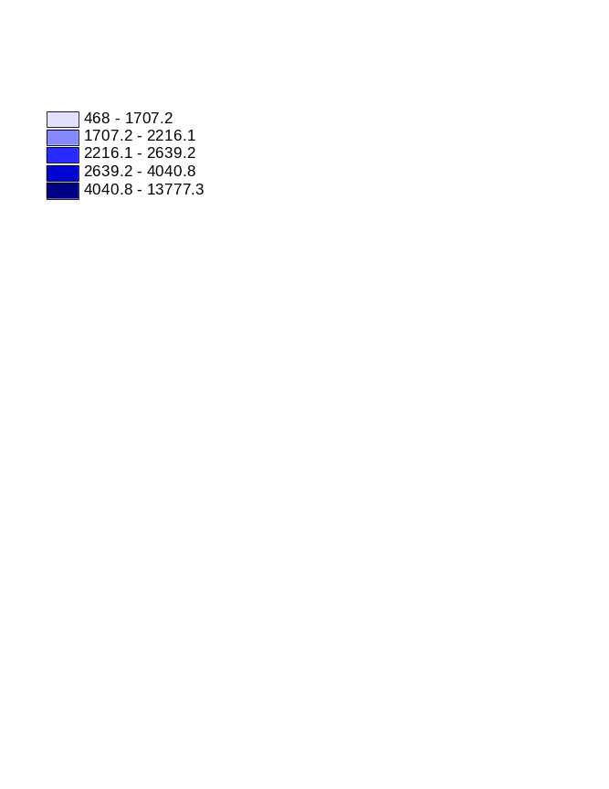
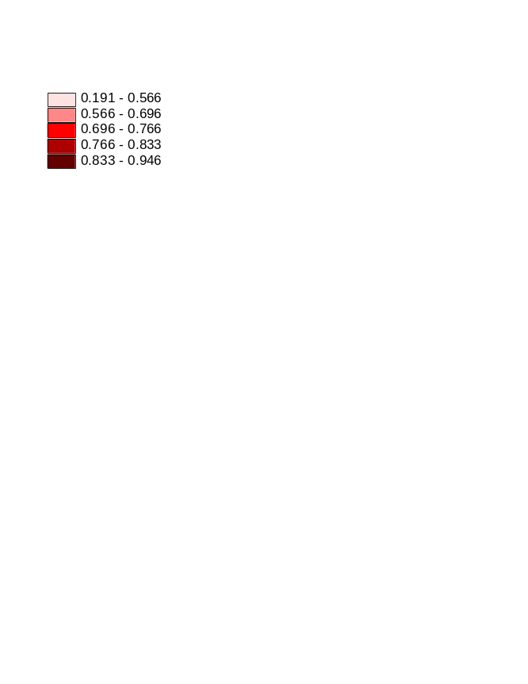
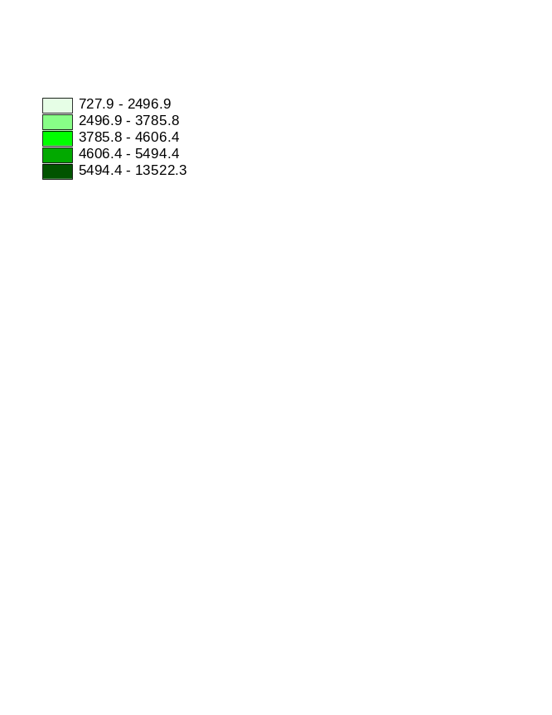
Central Government Public Services and the Poor: Madagascar
District Poverty Incidence
p.c. health to districts
p.c. edu to districts
Source: E Galasso, The World Bank, 2002

Slide 20
Central Gov’t Transfers to Local Level: Kenya
171 Local Authorities (County Councils)
Local Authority Transfer Fund. 0.5-5M Ksh; development needs
LA Service Delivery Action Plan. 0.5-5M Ksh; recurring costs
210 Constituencies
Constituency Development Fund. 0.5% of national budget. 20M Ksh to each constituency (85% of fund); remaining 15% by poverty
Constituency Bursary Fund. Small amounts, disbursement now based on student enrollment and level of poverty
Constituency HIV/AIDS Fund. Small amounts, competitive

Slide 21
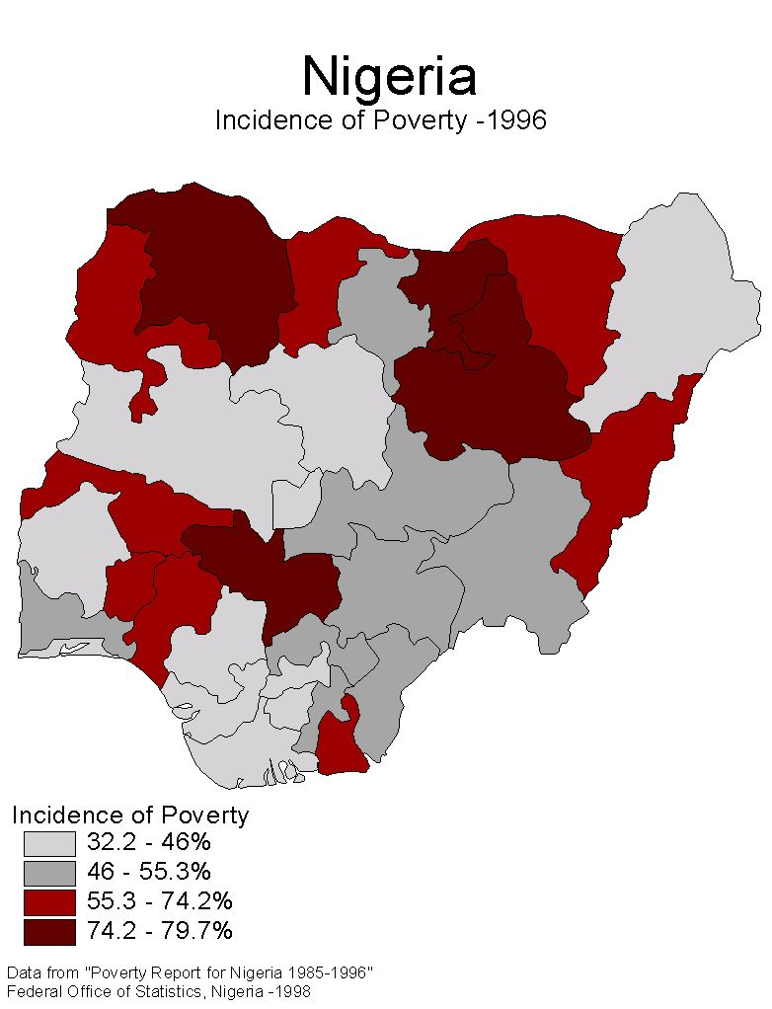
Oil Producing States

Slide 22
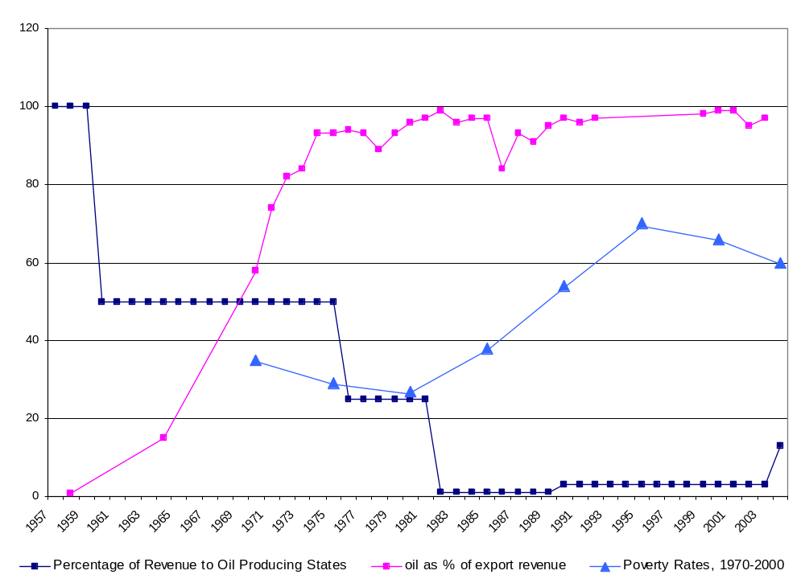
Oil Export Revenue, Returned Revenue,
Poverty Rates: by Percent, 1958-2004

Slide 23
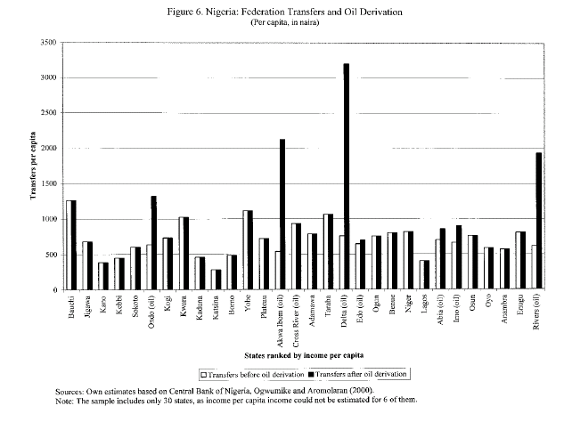

Slide 24
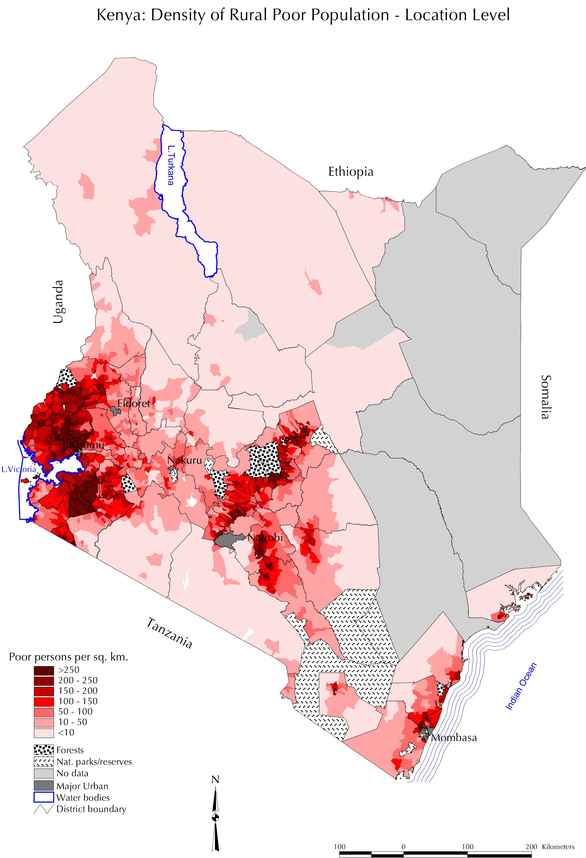
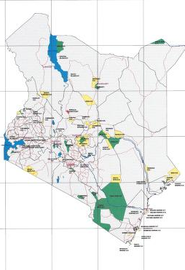
Poverty and Protected Areas, Kenya
Density of Rural Poor Populations
Location of Protected Areas

Slide 25
Horizontal Distribution
Intra-Jurisdictional Equity. Distributional equity across peoples and communities within levels of public administration below central government
Assumed to be function of decentralization – local authorities are thought to be more effective at identifying and reaching the poor than the central state
Evidence that responsiveness to the poor is a rare outcome of decentralization; pro-poor practices at the local level are mainly associated with strong central govt commitments

Slide 26
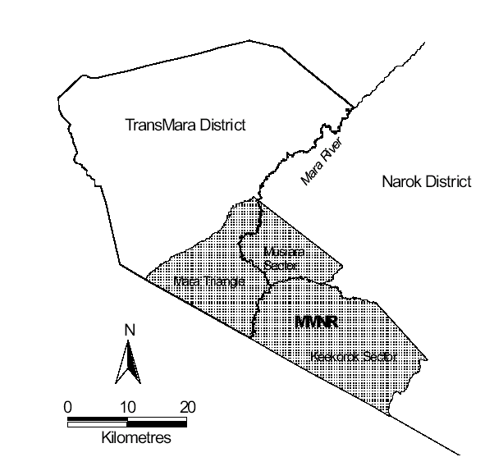
Intra-Jurisdictional Equity:
Maasai Mara Game Reserve, Kenya

Slide 27
Key Issues
Different distribution criteria (derivation, poverty, population, recurring costs) generate unique incentives with specific outcomes (environmental mgmnt, poverty reduction). Mix of criteria to meet multiple objectives (principles of fairness)?
Which distribution mechanisms (CG public services, CG transfer, disbursements to citizens) is most effective in poverty reduction and sound environmental management?
Measures for promoting distribution equity in undemocratic countries (FPIC, Publish What You Pay)
Transboundary distributional equity. Are there principles of fairness across nations? Should they be driven by poverty levels?

Slide 28
In this new century, millions of people in the world’s poorest countries remain imprisoned, enslaved and in chains. They are trapped in the prison of poverty. It is time to set them free.
-Nelson Mandela, 3 February 2005, preceding
G7 finance ministers meeting

Slide 29
Thank you!

