Slide 1
BASIS Project on Rural Markets, Natural Capital and Dynamic Poverty Traps in East Africa
Rural Poverty Dynamics:
Development Policy Implications
Christopher B. Barrett
And
Festus Murithi
August 2003
USAID BASIS CRSP TC Meeting
Pumula Beach Hotel, Umzumbe, South Africa

Slide 2
Rural poverty dynamics: What we know
Claim: Poverty dynamics a more fundamental policy concern than static concerns about the location of a poverty line or instantaneous poverty measures.
Why? Because some of the poor need assistance and some do not. And the sort of assistance needed varies by initial conditions. Picking the right policy to help a given subpopulation depends on accurate understanding of rural poverty dynamics.

Slide 3
Rural poverty dynamics: What we know
The simple mathematics of income dynamics:
Y = A`R + ε^{T} + ε^{M} (1)
R = r + ε^{R} (2)
dY = dA`R + A`dr + A`dε^{R} + dε^{T} + dε^{M} (5)
E[dY] = dA`r + A`dr (6)
Equation (6) embodies the past half century’s core poverty reduction strategies.

Slide 4
Rural poverty dynamics: What we know
Key distinction #1: Transitory and Chronic Poverty
Transitory poverty undesirable, but is there a role for policy?
The share of poverty that is transitory can easily be overstated

Slide 5
Rural poverty dynamics: What we know
Key distinction #2: Safety Nets and Cargo Nets
Safety nets prevent the non-poor and transitorily poor from falling into chronic poverty
- truncate lower tails of ε^{R} and ε^{T}
- Ex: crop/unemployment insurance, disaster aid
Cargo nets lift or help the chronically poor climb out of poverty
- shift A and r
- Ex: land reform, school feeding, subsidized microfinance or agricultural input programs
Safety nets block pathways into chronic poverty. Cargo nets help set people onto pathways out of chronic poverty.

Slide 6
Rural poverty dynamics: What we know
Identifying and Explaining Chronic Poverty
Different people need different types of policies. So we must be able to sort between the chronically and transitorily poor.
Easy to do ex post but tough to do ex ante: structural correlates of chronic poverty help provide indicator/geographic monitoring/targeting variables
- born into poverty and cannot accumulate assets
- cannot effectively employ assets they own
- physical, cultural, political geography
- adverse shock(s)

Slide 7
Rural poverty dynamics:
Basics from BASIS sites
Ultra-Poverty Transition Matrices
$0.50/day ($0.25/day) per capita income thresholds
 | Poor in Subsequent Period |  | Non-Poor in Subsequent Period
Poor in Initial Period | 2000-2001 Dirib Gumbo 100.0% (62.5%) | 1989-2002 Madzu 60.7% (3.4%) 1997-2002 Fianarantsoa 82.8% (46.6%) | 2000-2001 Dirib Gumbo 0.0% (0.0%) | 1989-2002 Madzu 20.2% (16.9%) 1997-2002 Fianarantsoa 10.3% (10.3%)
 | 2000-2001 Ngambo 86.5% (63.6%) | 1997-2002 Vakinankaratra 58.5% (23.4%) | 2000-2001 Ngambo 9.0% (4.5%) | 1997-2002 Vakinankaratra 7.4% (16.0%)
Non-Poor in Initial Period | 2000-2001 Dirib Gumbo 0.0% (25.0%) | 1989-2002 Madzu 10.1% (7.9%) 1997-2002 Fianarantsoa 6.9% (31.0%) | 2000-2001 Dirib Gumbo 0.0% (12.5%) | 1989-2002 Madzu 9.0% (71.9%) 1997-2002 Fianarantsoa 0.0% (12.1%)
 | 2000-2001 Ngambo 0.0% (13.6%) | 1997-2002 Vakinankaratra 22.3% (29.8%) | 2000-2001 Ngambo 4.5% (18.2%) | 1997-2002 Vakinankaratra 11.7% (30.9%)

Slide 8
Rural poverty dynamics: What we still need to learn
Chronic poverty likely not just about
(i) weak hh/comm-level endowments,
(ii) exogenous changes in returns to assets, or
(iii) shocks, but last category offers an important clue.
Shocks can have persistent effects only in the presence of hysteresis that generates irreversibility or differential rates of recovery.
Suggests nonlinearities associated with poverty traps.

Slide 9
Rural poverty dynamics: What we still need to learn
Uncovering poverty traps and threshold effects
The pivotal feature of poverty traps: wealth thresholds that people have a difficult time crossing from below.
Threshold effects generate multiple dynamic equilibria with birfurcated path dynamics around the threshold.
Suggests potential endogenously increasing r due to:
Risk avoidance behavior
Credit market imperfections and imperfect matching
Locally IRS due to discrete occupations/technologies

Slide 10
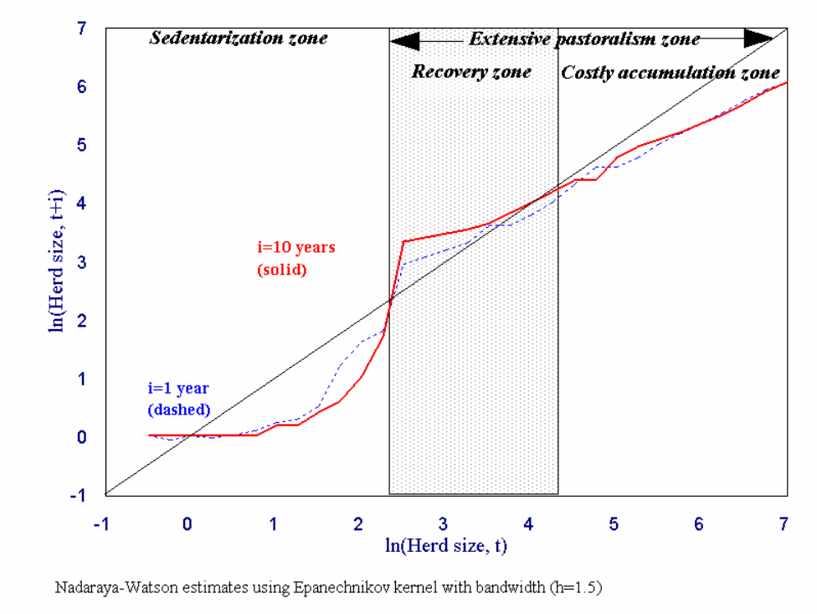
Rural poverty dynamics: What we still need to learn
Practical problem: the existence of endogenously increasing returns is less interesting, useful (and difficult) than identifying the relevant thresholds at which welfare dynamics bifurcate.
Methodological challenge: tough to find using parametric methods and in small samples because looking for an unstable equilibrium, and cannot uncover using quantile-based growth differences.
Figure 1: Nonparametric
estimates of expected herd size
transitions in southern Ethiopia
(Lybbert et al. 2002)

Slide 11
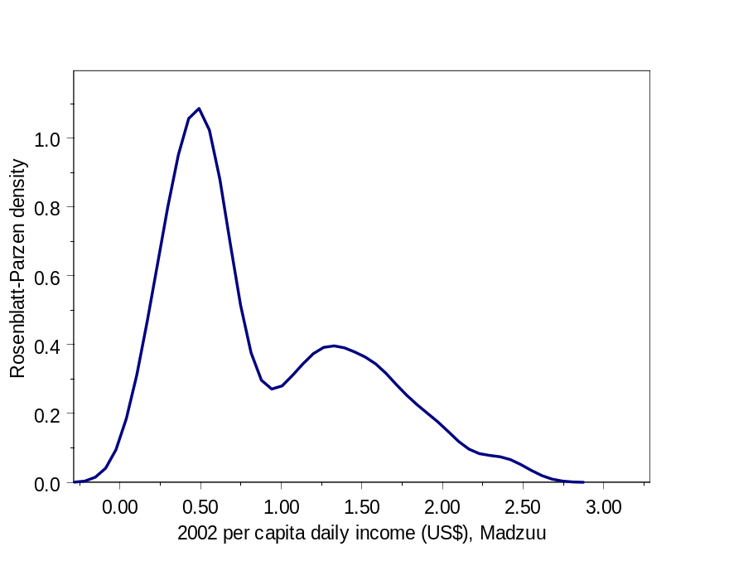
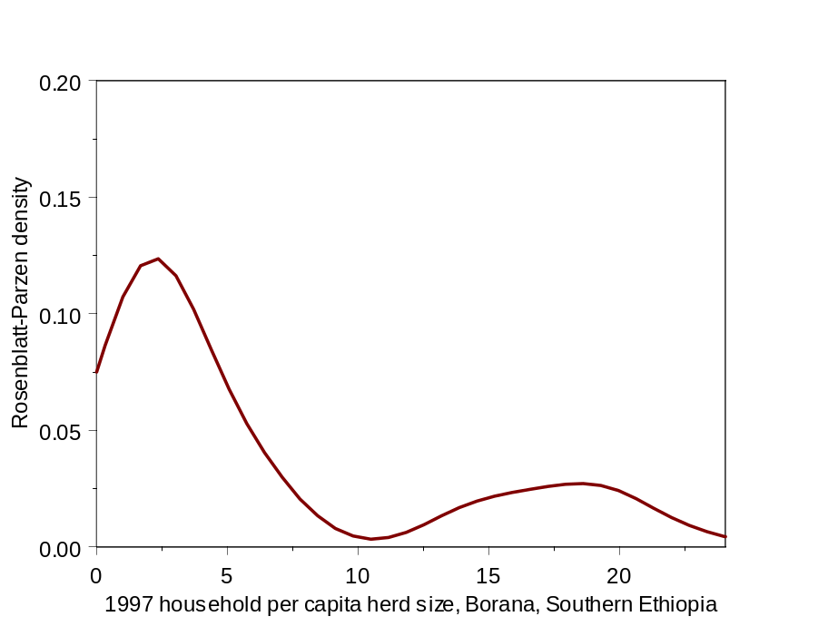
Rural poverty dynamics: What we still need to learn
Value of qualitative methods for uncovering thresholds
Looking for thresholds in distributional data: find multiple equilibria manifest in “twin-peakedness” (Quah 1996)
Figure 2: Bimodal income in western Kenya Figure 3: Bimodal cattle wealth in southern Ethiopia

Slide 12
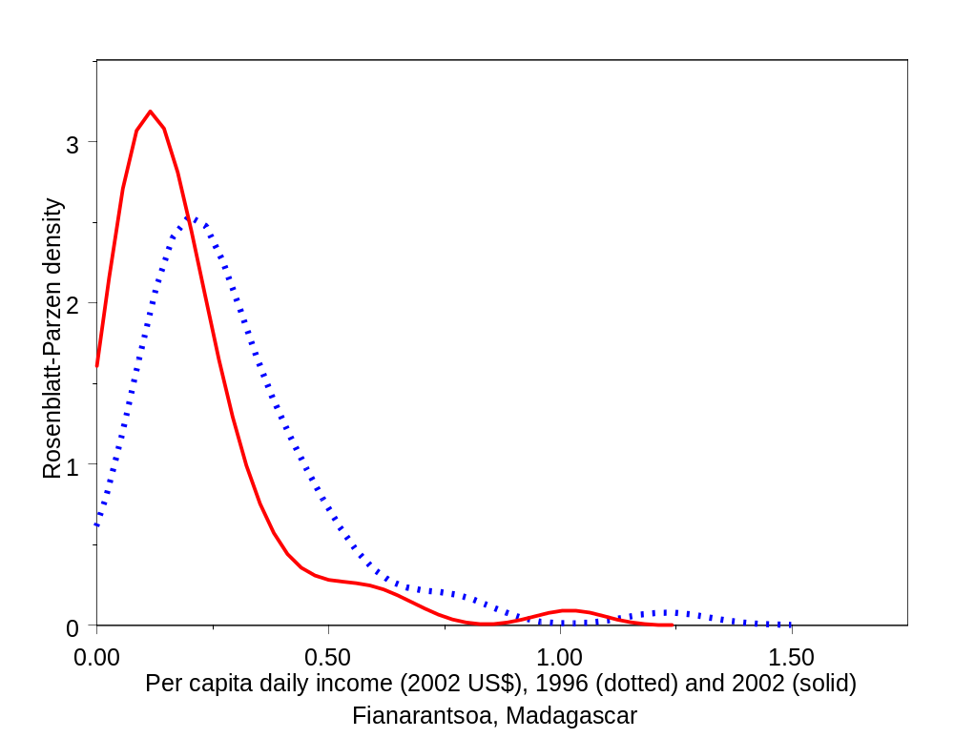
Rural poverty dynamics: What we still need to learn
Unimodal distributions may appear in geographic poverty traps, where there are few pathways out of poverty and few non-poor households (“less-favored lands”).
Figure 4: Intertemporal shifts in unimodal income distributions

Slide 13
Rural poverty dynamics: What we still need to learn
Explaining poverty traps
There are multiple pathways out of poverty: worry less about a particular path than about the existence of some path out.
Poverty traps exist when a household’s optimal strategy does not lead to accumulation of assets to grow out of poverty.
Why might this be?
Locally increasing returns based on discreteness
    - Importance of transition technologies/occupations
Financial market failures
  - displacement of finance into other markets

Slide 14
Development Policy Implications
Need to distinguish chronic from transitory poverty
Important distinction between cargo nets and safety nets
Targeting issues (who/what/where/when/how) become central:
- geographic targeting for less-favored lands and in wake of natural/manmade disasters
- indicator targeting related to variables defining critical thresholds
- self-targeting: useful for safety nets when used as standing policies. Less good for chronic.
- importance of triage in transfer programs.

Slide 15
Development Policy Implications
In order to enable the chronically poor to being accumulating productive assets, one must know what factors currently most limit their choices.
Here, the familiar range of micro-to-macro issues emerge. Simple, blanket prescriptions rarely work. Effective development policy depends on careful, empirical research customized to local conditions.
The roots of effective development policy lie in uncovering the mechanisms underlying rural poverty dynamics.

Slide 16
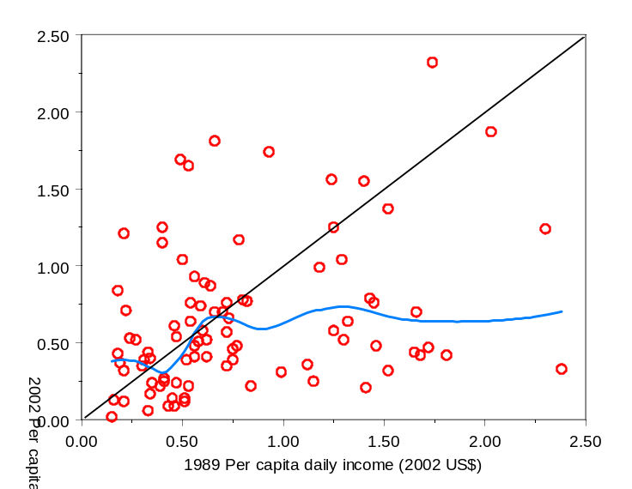
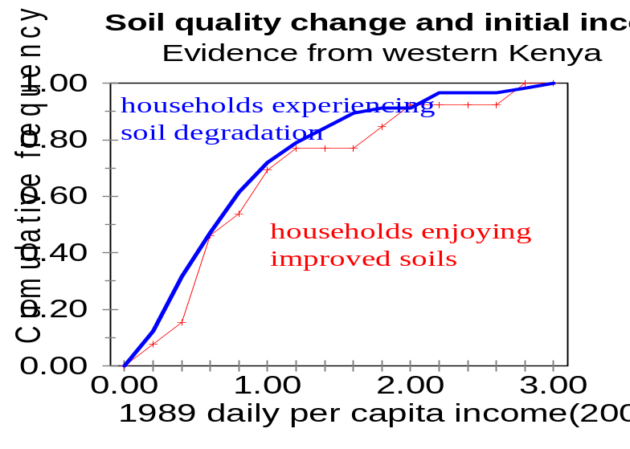
Implications for BASIS Research
Look for nonlinear asset or income dynamics across sites and differences in threshold points
(Examples from Madzuu,
Vihiga District, Western Kenya)
Examine dynamic relationship between assets or income and soil quality

Slide 17
Implications for BASIS Research
Looking for explanations at multiple scales:
HH-level: finance and fixed/sunk costs; crucial role of education and the off-farm labor market
Community-level: Coordination problems (Striga control, terracing, SRI water management, marketing)
Crucial role for qualitative research (sequential mixing model) to complement quantitative work

Slide 18
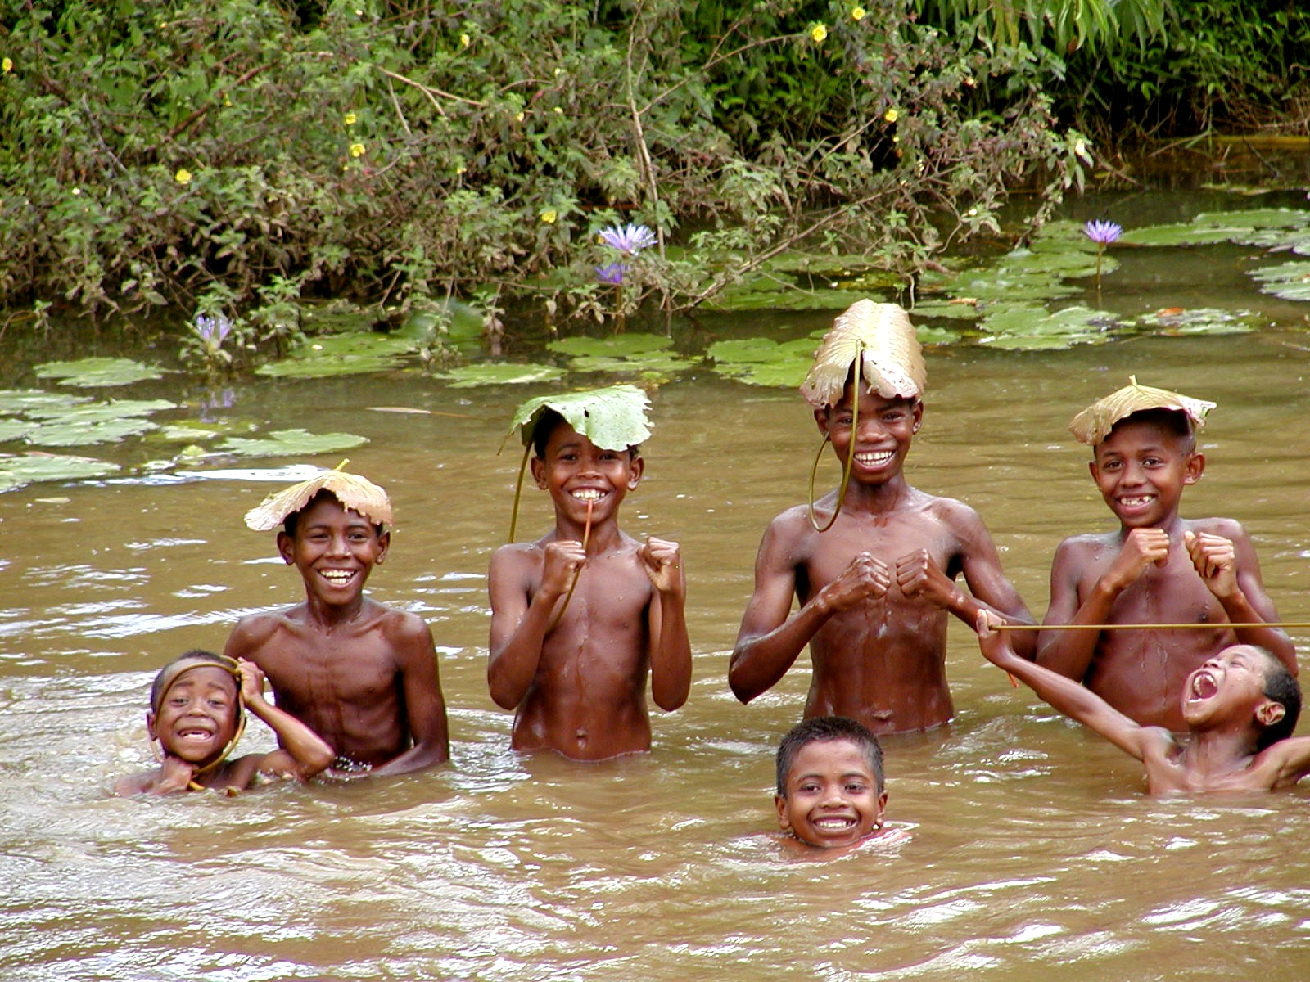
Thank you for your timeand attention!
We appreciate your comments on this project.

