Slide 1
Implementing Sustainable Tourism in the USAID Context
Arusha, Tanzania
February 2006

Slide 2
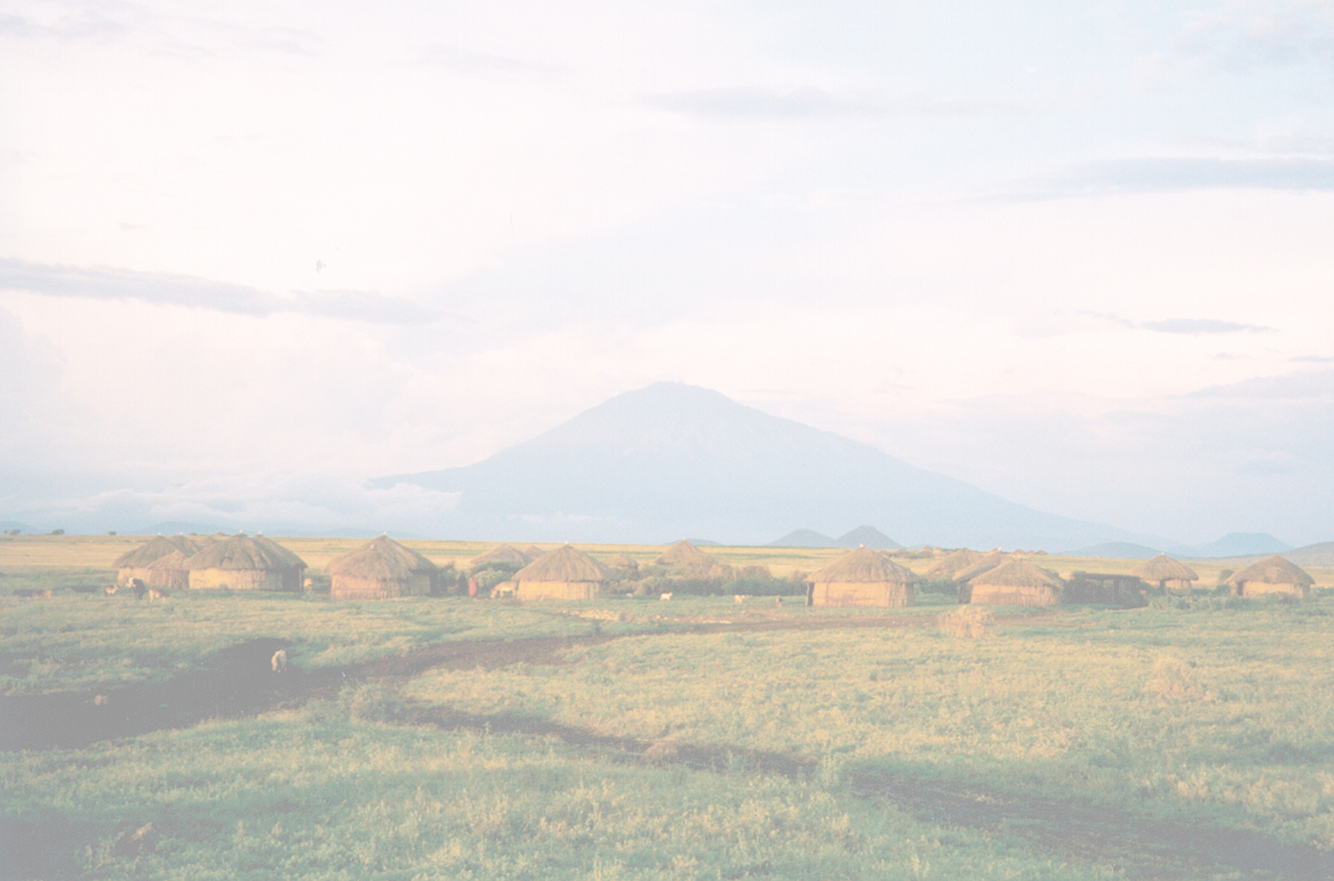
MODULE 2:
USAID & TOURISM

Slide 3
Objectives
By the end of the session, participants will be able to:
Explore approaches where USAID has used tourism to address programmatic themes
Examine how tourism fits into USAID strategic framework
Identify the Role of Tourism within USAID
Address Development Objectives
Identify a framework for USAID interventions
Explore examples where tourism fits into a Mission’s strategic objectives

Slide 4
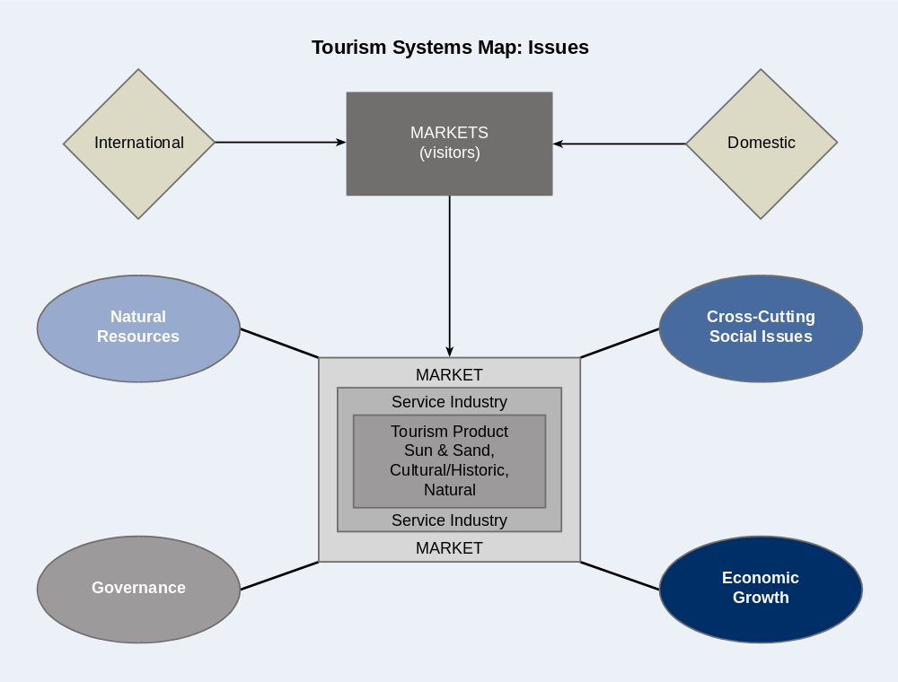
Tourism for Development: Exercise 2-1
How does USAID utilize tourism for achieving its
broader objectives?

Slide 5
Exercise 2-1
What tourism-related issues are included in the four categories?
Ex: NRM - visitor damage to resources
GOV – open skies policy
EG – access to credit
SOCIAL – visitor health
Divide into four groups (by category), choose a recorder and reporter
Brainstorm list of issues (10 minutes)
Identify what stakeholders might affect or be affected by these issues (5 minutes)
Share your list (2 minutes)

Slide 6
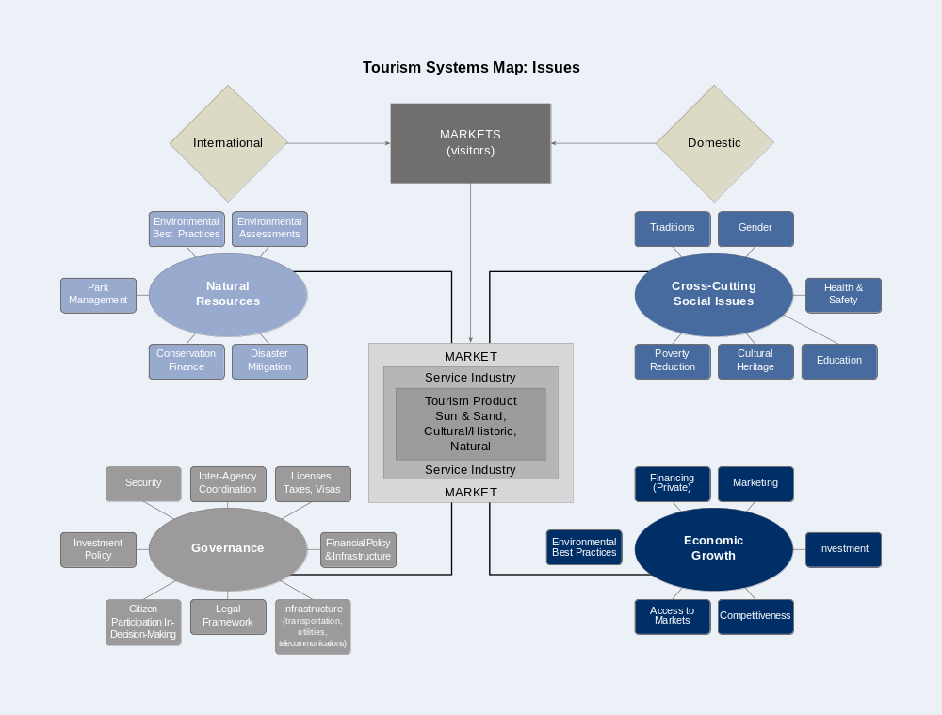
Thematic Issues and Tourism

Slide 7
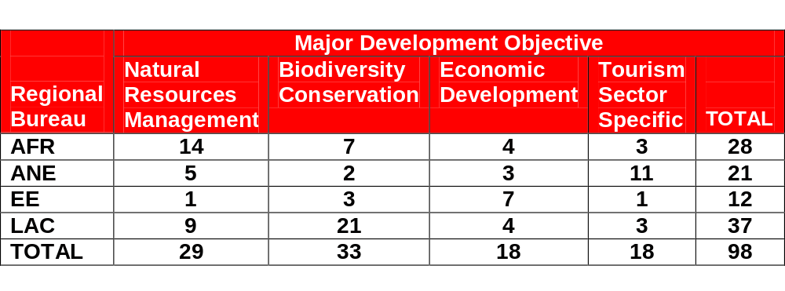
Number of USAID Projects with a Tourism Component by Major Development Objective, 2000-2004
Source: Natural Resources Information Clearinghouse

Slide 8
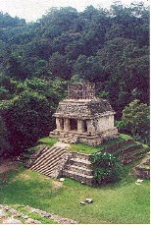
Illustrative Types of USAID Projects
Utilizing Tourism
Selva Lacandona, Mexico:
Interventions: biodiversity
conservation, cultural heritage, governance, gender equity
Tourism activity: ecotourism
projects including a pilot hotel,
training.

Slide 9
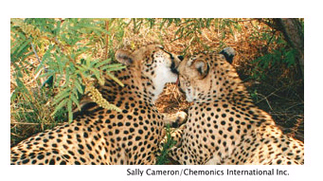
Illustrative Types of USAID Projects
Utilizing Tourism
Living in a Finite Environment (LIFE), Namibia:
Interventions: natural resources management, rural development, governance
Tourism activity: establishing community-based wildlife conservancies

Slide 10
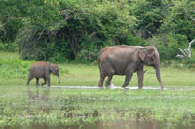
Illustrative Types of USAID Projects
Utilizing Tourism
Competitive Initiative, Sri Lanka:
Interventions: economic development, biodiversity conservation
Tourism activity: tourism cluster, ecolodge, institutional reform

Slide 11
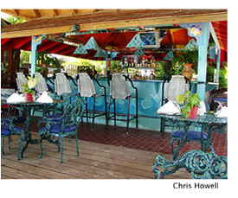
Illustrative Types of USAID Projects
Utilizing Tourism
Environmental Audits for Sustainable Tourism (EAST), Jamaica
Interventions: natural resources management, governance
Tourism activity: hotel environmental audits, integrated destination management

Slide 12
Thematic Issues and Tourism

Slide 13
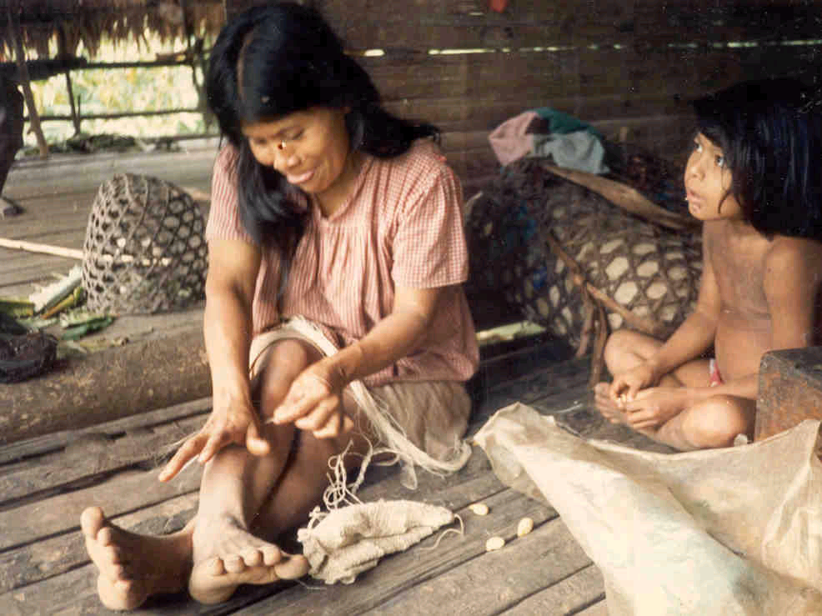
Environment – Ecuador
SO: Biodiversity Conserved in Selected Protected Areas and Their Buffer Zones
Program: Biodiversity Conserved in Indigenous Areas (CAIMAN)

Slide 14
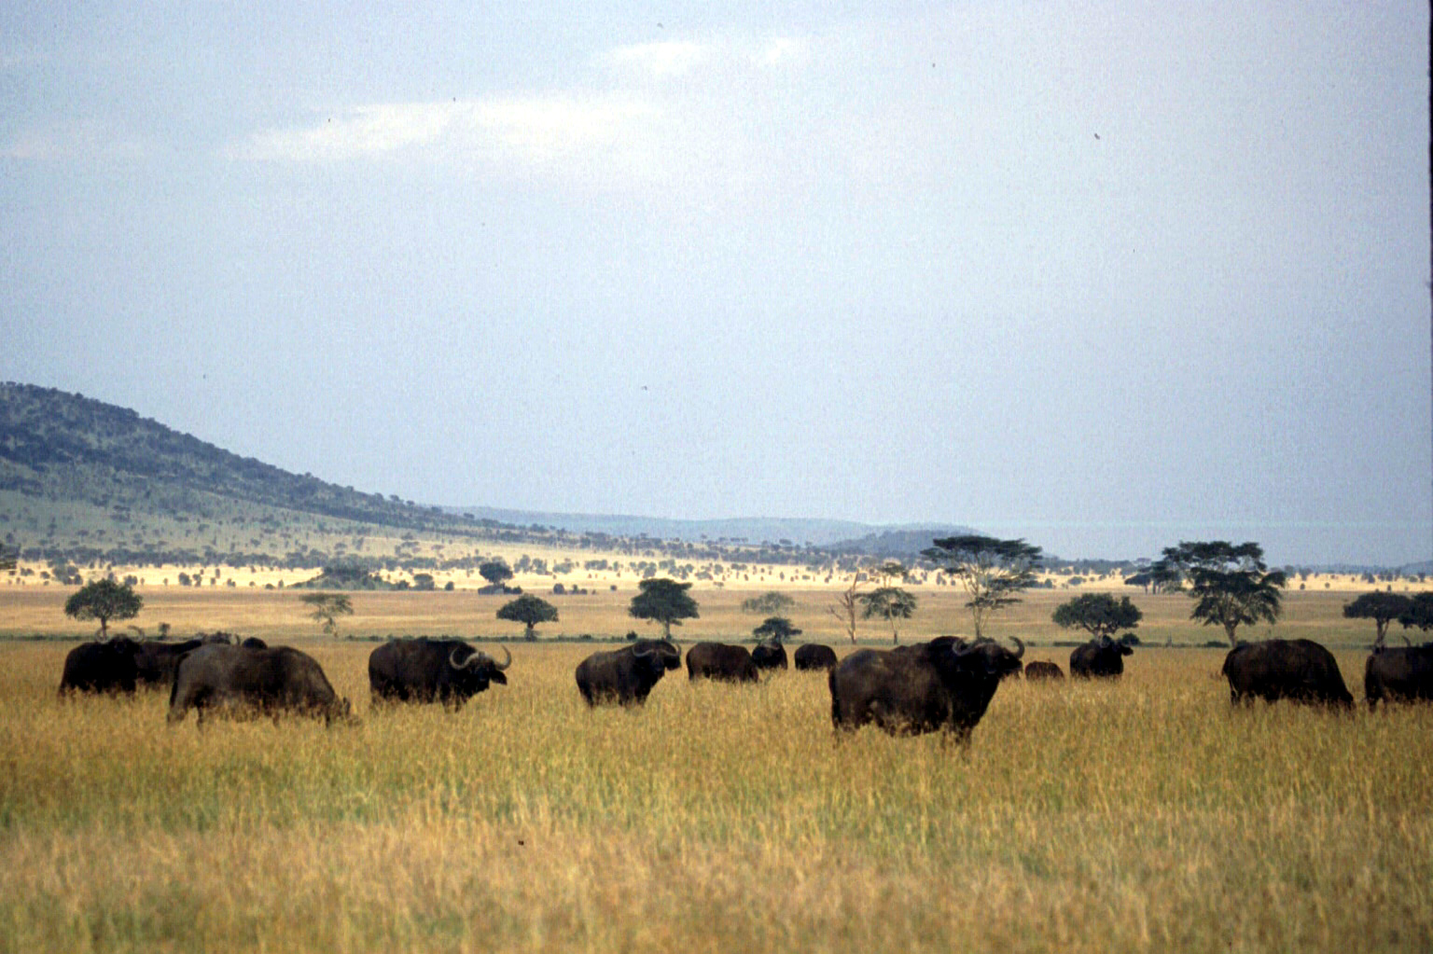
Environment – Kenya
SO: Improved Natural Resources Management in Targeted Bio diverse Areas by and for the Stakeholders.
Program: Conservation of Resources through Enterprise (CORE)

Slide 15
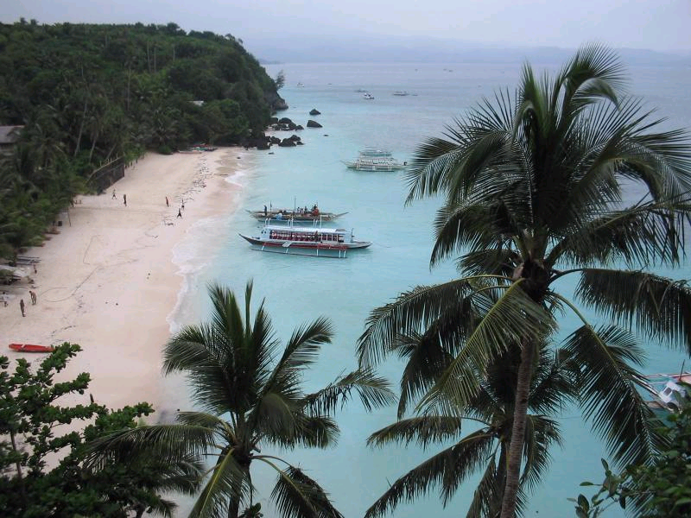
Environment – Philippines
SO: Enhanced Management of Renewable Natural Resources
Program: Coastal Resource Management Project (CRMP)

Slide 16
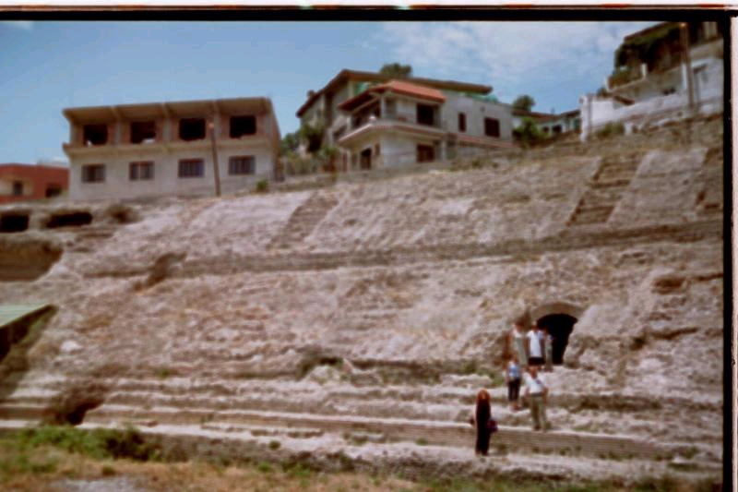
Economic Growth – Albania
SO: Economic Restructuring and Agricultural Development
Program: Enterprise Development and Export Market Services (EDEM)

Slide 17
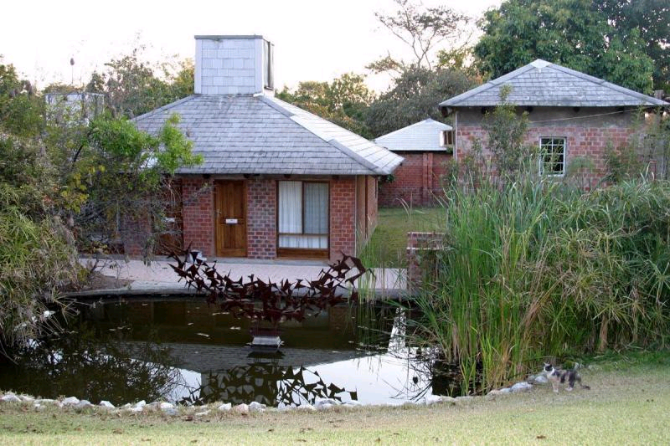
Economic Growth – Zambia
SO: Rural Income Growth
Program: Community-Based Natural Resource Management and Sustainable Agriculture (CONASA)

Slide 18
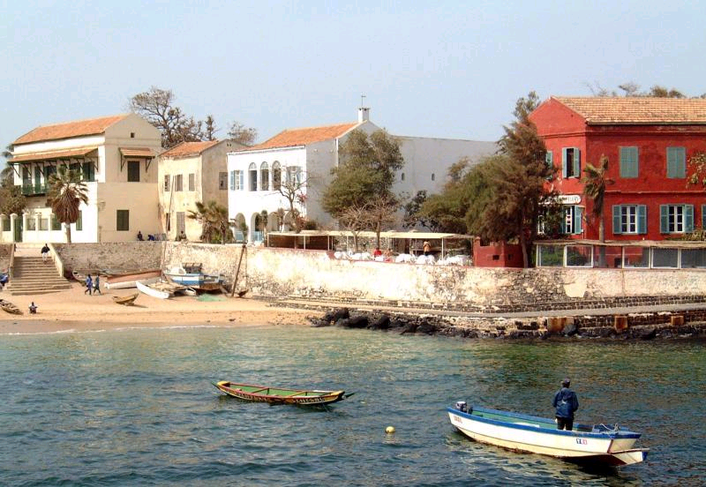
Governance – Senegal
SO: Improved Local Delivery of Services and Sustainable Use of Resources in Targeted Areas
Program: Wula Nafaa – Agricultural and Natural Resources Management

Slide 19
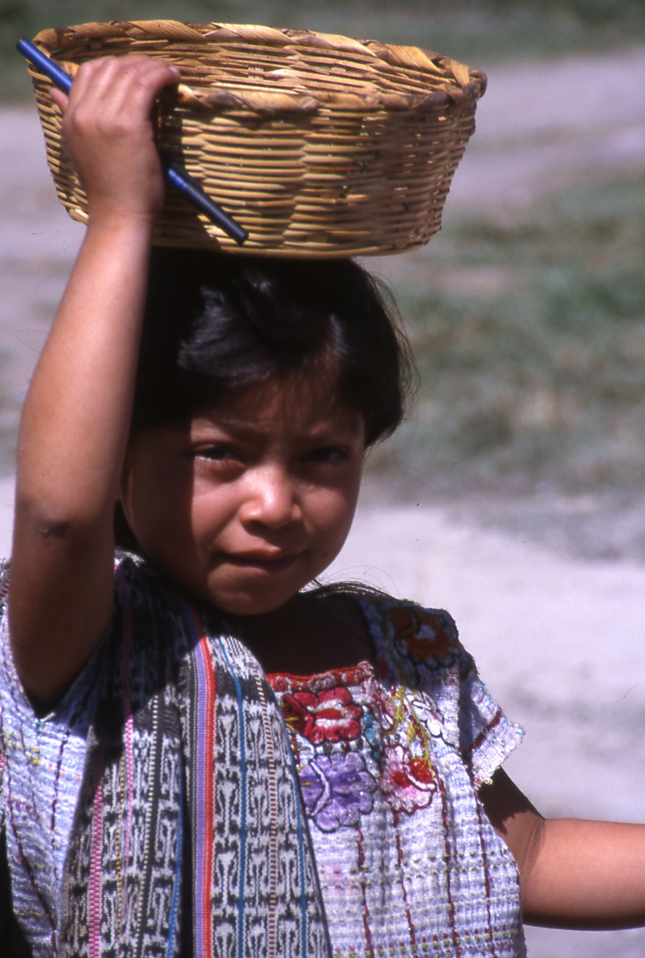
Cross-Cutting Social Themes
Gender
Health and Safety
Poverty Reduction
Cultural and Archaeological Heritage
Education
Conflict Mitigation

Slide 20

Tourism within the USAID Results Framework
USAID Strategy for Jamaica
2005-2009

Slide 21
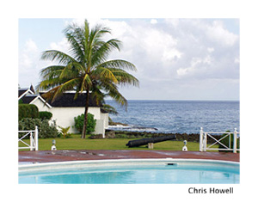
Goal: Transformational change to accelerate sustainable and equitable growth in a more competitive world.

Slide 22
Related Strategic Objectives
Increased trade competitiveness in target industries
Natural assets managed for rural development and sustainable economic growth
Improved health status among youth and most vulnerable groups
Improved education of targeted Jamaican youth
Improved accountability and citizen security and participation

Slide 23
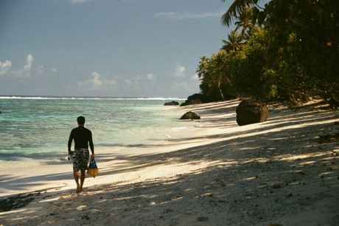
SO: Natural Assets Managed for Rural Development and Sustainable Growth

Slide 24
Intermediate Results:
IR-1: Improved management of targeted ecosystems
IR-2: Institutional capacity to manage natural assets increased
IR-3: More environmentally sustainable rural enterprises

Slide 25
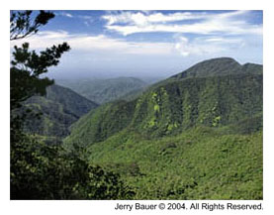
IR-1: Improved management of targeted ecosystems
Intervention Areas:
Improved Watershed management, coastal water quality, and conservation of biodiversity-rich habitats

Slide 26
IR-2: Institutional capacity to manage natural assets increased
Intervention Areas:
Strengthening NGO, civil society and government skills and inclusion in community environmental management and decision-making.

Slide 27
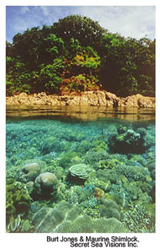
IR-3: More environmentally sustainable rural enterprises
Interventional areas:
Enhance rural prosperity through new and improved environmentally and economically sustainable rural enterprises, such as ecotourism, community tourism and heritage tourism

Slide 28
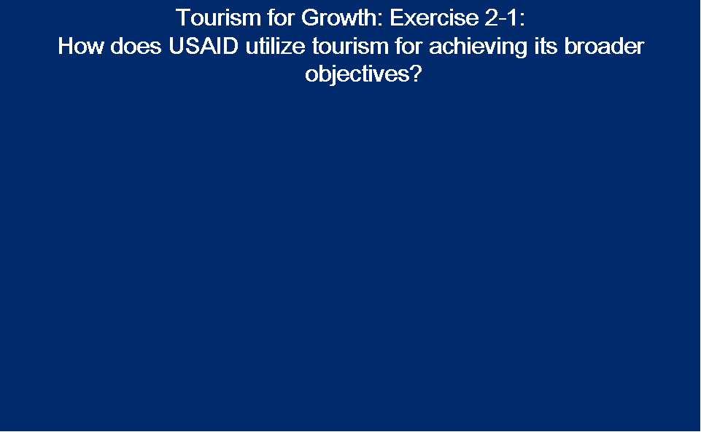
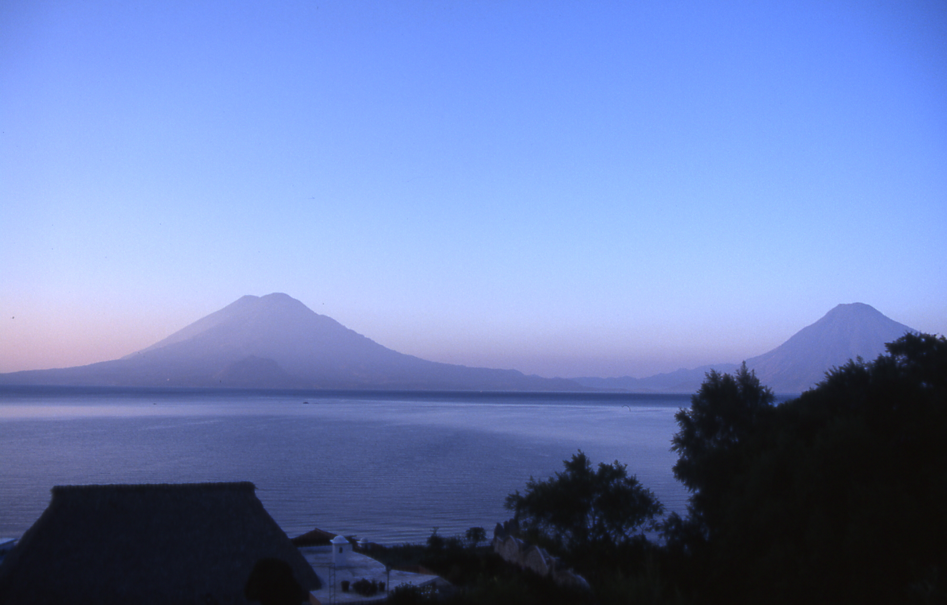
Tourism for Development Brainstorm: Exercise 2-2
Brainstorm: In which ways is tourism important to meeting these development priorities?
Natural resources
management
Poverty reduction
Biodiversity conservation
Local governance
Gender equity
Health and Safety

Slide 29
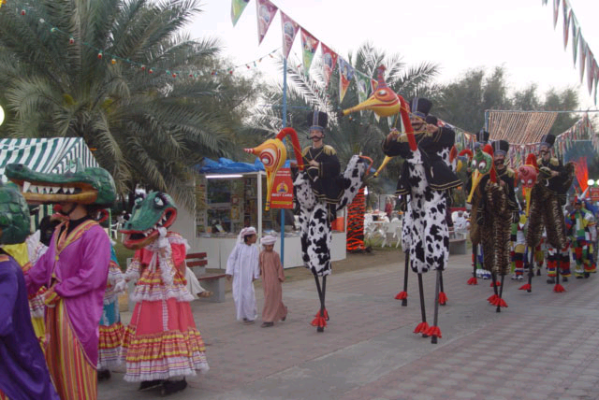
Group Discussion: Exercise 2-3
Has your Mission used – or is it planning to use – tourism to help implement any SOs?
Summarize in 2 minutes:
What are the related SOs?
What are the related IRs?
What are intervention areas?
What types of tourism activities?
Any results so far?

Slide 30
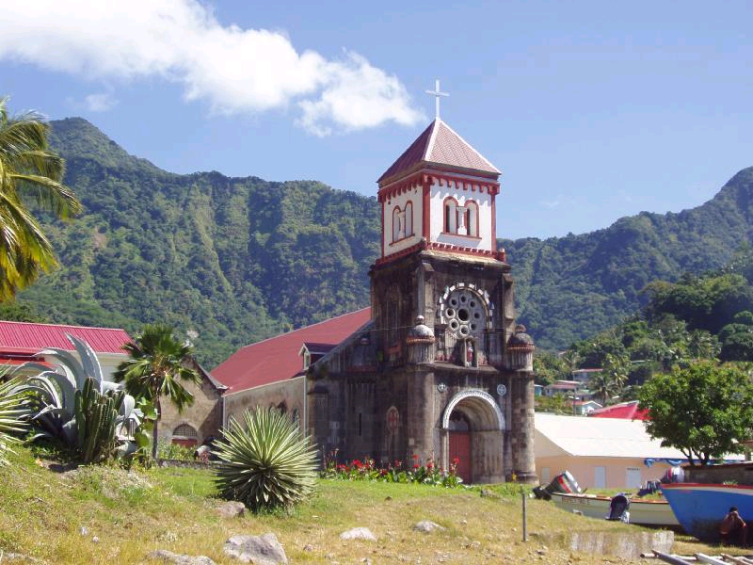
Tourism Intervention Areas: Exercise 2-4
Caribbean Open Trade Support (COTS)
Identify potential intervention areas where tourism could be used

Slide 31
Some Basic Tenets
1) Tourism is not a panacea.
2) Many Strategic Objectives are mutually supporting or, increasingly, merge previously distinct Objectives.
3) To be sustainable, tourism-related intervention areas need to be more demand-driven than supply-driven.

Slide 32
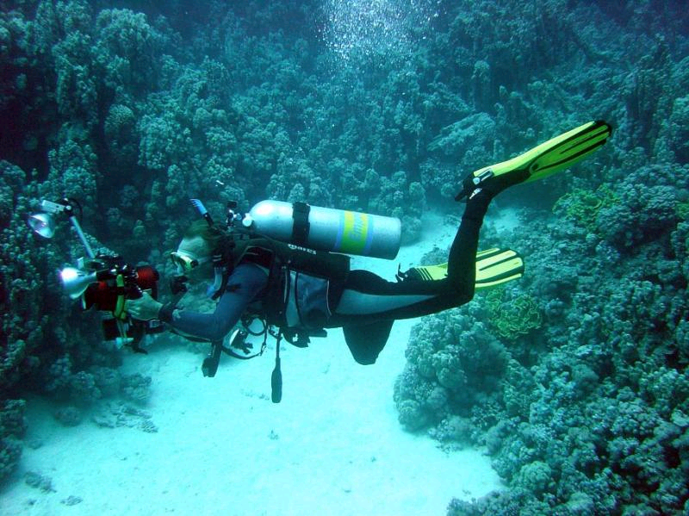
Tourism is Not a Silver Bullet: Red Sea Example
The history of tourism development on the Red Sea illustrates that tourism can sometimes be neither economic nor environmental panacea – in fact quite the reverse!

Slide 33


RECAP
Tourism fits into many USAID program areas
Tourism can be used as a project component to achieve multiple objectives
There are many case studies you can turn to for ideas and lessons learned

