Slide 1
Implementing Sustainable Tourism in the USAID Context
Arusha, Tanzania
February 2006

Slide 2
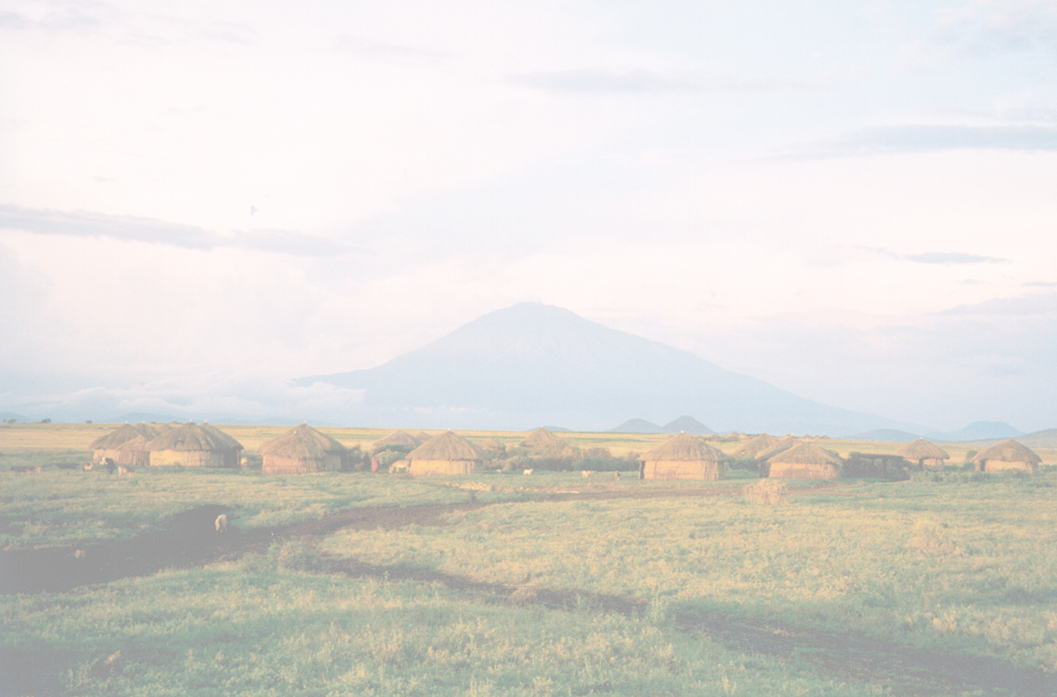
MODULE 5:
PROJECT DESIGN –
NRM, BIODIVERSITY CONSERVATION & CULTURAL HERITAGE INTERVENTIONS, TOOLS & APPROACHES

Slide 3
Objectives
By the end of the session, participants will be able to:
Understand current USAID approaches to natural resource management and biodiversity conservation
Collaborate on designing an effective tourism intervention that addresses NRM and biodiversity needs
Establish a set of NRM-related indicators for sustainable tourism

Slide 4
Integrated Natural Resources Management
Nature
Nature
Nature
Biodiversity
Biodiversity
Biodiversity
Social Systems
Social Systems
Social Systems
Ecosystems
Ecosystems
Ecosystems
Water
Water
Water
Forests
Forests
Forests
Power
Power
Wealth
Power
Wealth
Wealth
Land
Land
Land
Economies
Economies
Economies

Slide 5
What are the major USAID program areas relating to environment and natural resource management?
Biodiversity
Forestry
Land Management
Water and Coastal Resources
Pollution Prevention
Environmental Policy Development
Environmental Research
Biotechnology
Climate Change
Energy

Slide 6
USAID Biodiversity Earmark (priority of US Congress)
Criteria for counting project costs toward the Biodiversity earmark:
Program must have an explicit biodiversity objective
Activities must be identified based on an analysis of threats to biodiversity
Program must monitor associated indicators for biodiversity conservation
Site-based programs must positively impact biologically significant areas

Slide 7
Interaction between Tourism and the Environment/Culture
Environment can attract tourists
Tourists can put pressure on natural resources
Tourists can damage ecosystems
Tourism can provide incentives to restore/sustain environment

Slide 8
Interaction between Tourism and the Environment/Culture
Environment/
Culture attracts
tourists
Benefits of tourism to
Benefits of tourism to
Benefits of tourism to
Benefits of tourism to
community creates
community creates
community creates
community creates
incentive
incentives to sustain/
incentives to sustain/
s to sustain/
Tourists use/pressure
incentives to sustain/
restore attracting
restore attracting
restore attracting
natural resources/ culture
restore attracting
environment
environment
environment
environment/culture
Pressures damage
ecosystem functions/
services/ culture

Slide 9
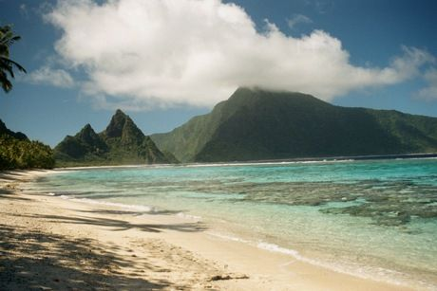
What basic levels of intervention does USAID utilize to address issues?
National policy & governance level
Site level

Slide 10
Policy and Governance – Issues
Summary of national policy and governance Issues affecting tourism
Revenue for operations and maintenance
Access to resources
Appropriate and compatible use of land and marine resources
Impacts on indigenous cultures and local communities
Impacts on biologically diverse areas
Facility sitting, design and construction
Availability of utility services (water and electricity supply, and wastewater and solid waste management)

Slide 11
Policy and Governance – Interventions
Major intervention areas related to national policy and governance
Conservation financing and revenue generation
Authority and support for CBNRM
Land management
Coastal zone management
Cultural heritage preservation
Protected area management
Environmental regulation of tourism operations
Infrastructure for tourism operations and/or environmental sustainability

Slide 12
Policy and Governance Interventions
1) Conservation Finance/Revenue Generation & Use
Legal authorization to collect
Mechanism design (cost-effectiveness & social functionality)
Mechanism implementation
Allocation of revenues for sustainable management

Slide 13
Policy and Governance Interventions
2) Community-Based Natural Resources Management
Legal authorization of group and/or individual resource tenure/access
Institutional support to formalize/register tenure/access
Co-management plans (communities, government, private sector)
Community capacity building for implementation

Slide 14
Policy and Governance Interventions
3) Land Management
Land use planning and zoning
Resource rights (individual and community access/tenure)
Guidelines for sitting and design
Public access
Management of public lands in tourism destinations
Licensing for recreational use of public lands

Slide 15
Policy and Governance Interventions, cont.
4) Coastal Zone Management & Tourism
Determination of the management area (site and ecosystem approaches)
Inter-agency coordination
Mitigation of conflicting uses
Ecological profiling and mapping
Access rights
Integrated Coastal Zone Management

Slide 16
Policy and Governance Interventions
5) Cultural Heritage Preservation
Education on links between research, conservation, and tourism
Development of standards and regulations
Site restoration, monitoring; “voluntourism”

Slide 17
Policy and Governance Interventions
6) Tourism in Protected Areas
Institutional strengthening of responsible authority(ies)
Official designation and delineation of boundaries
Concession agreements for tourism operators
Partnerships with gateway communities

Slide 18
Policy and Governance Interventions
7) Environmental Regulation of Tourism Operations
Environmental impact assessment system
Standards development and enforcement
Permit system for on-site waste management, etc.
Monitoring requirements for environmental quality

Slide 19
Policy and Governance Interventions
8) Environmental Infrastructure for Tourism Operations
Water supply and treatment infrastructure
Wastewater treatment, reuse and disposal
Solid waste recycling and disposal

Slide 20
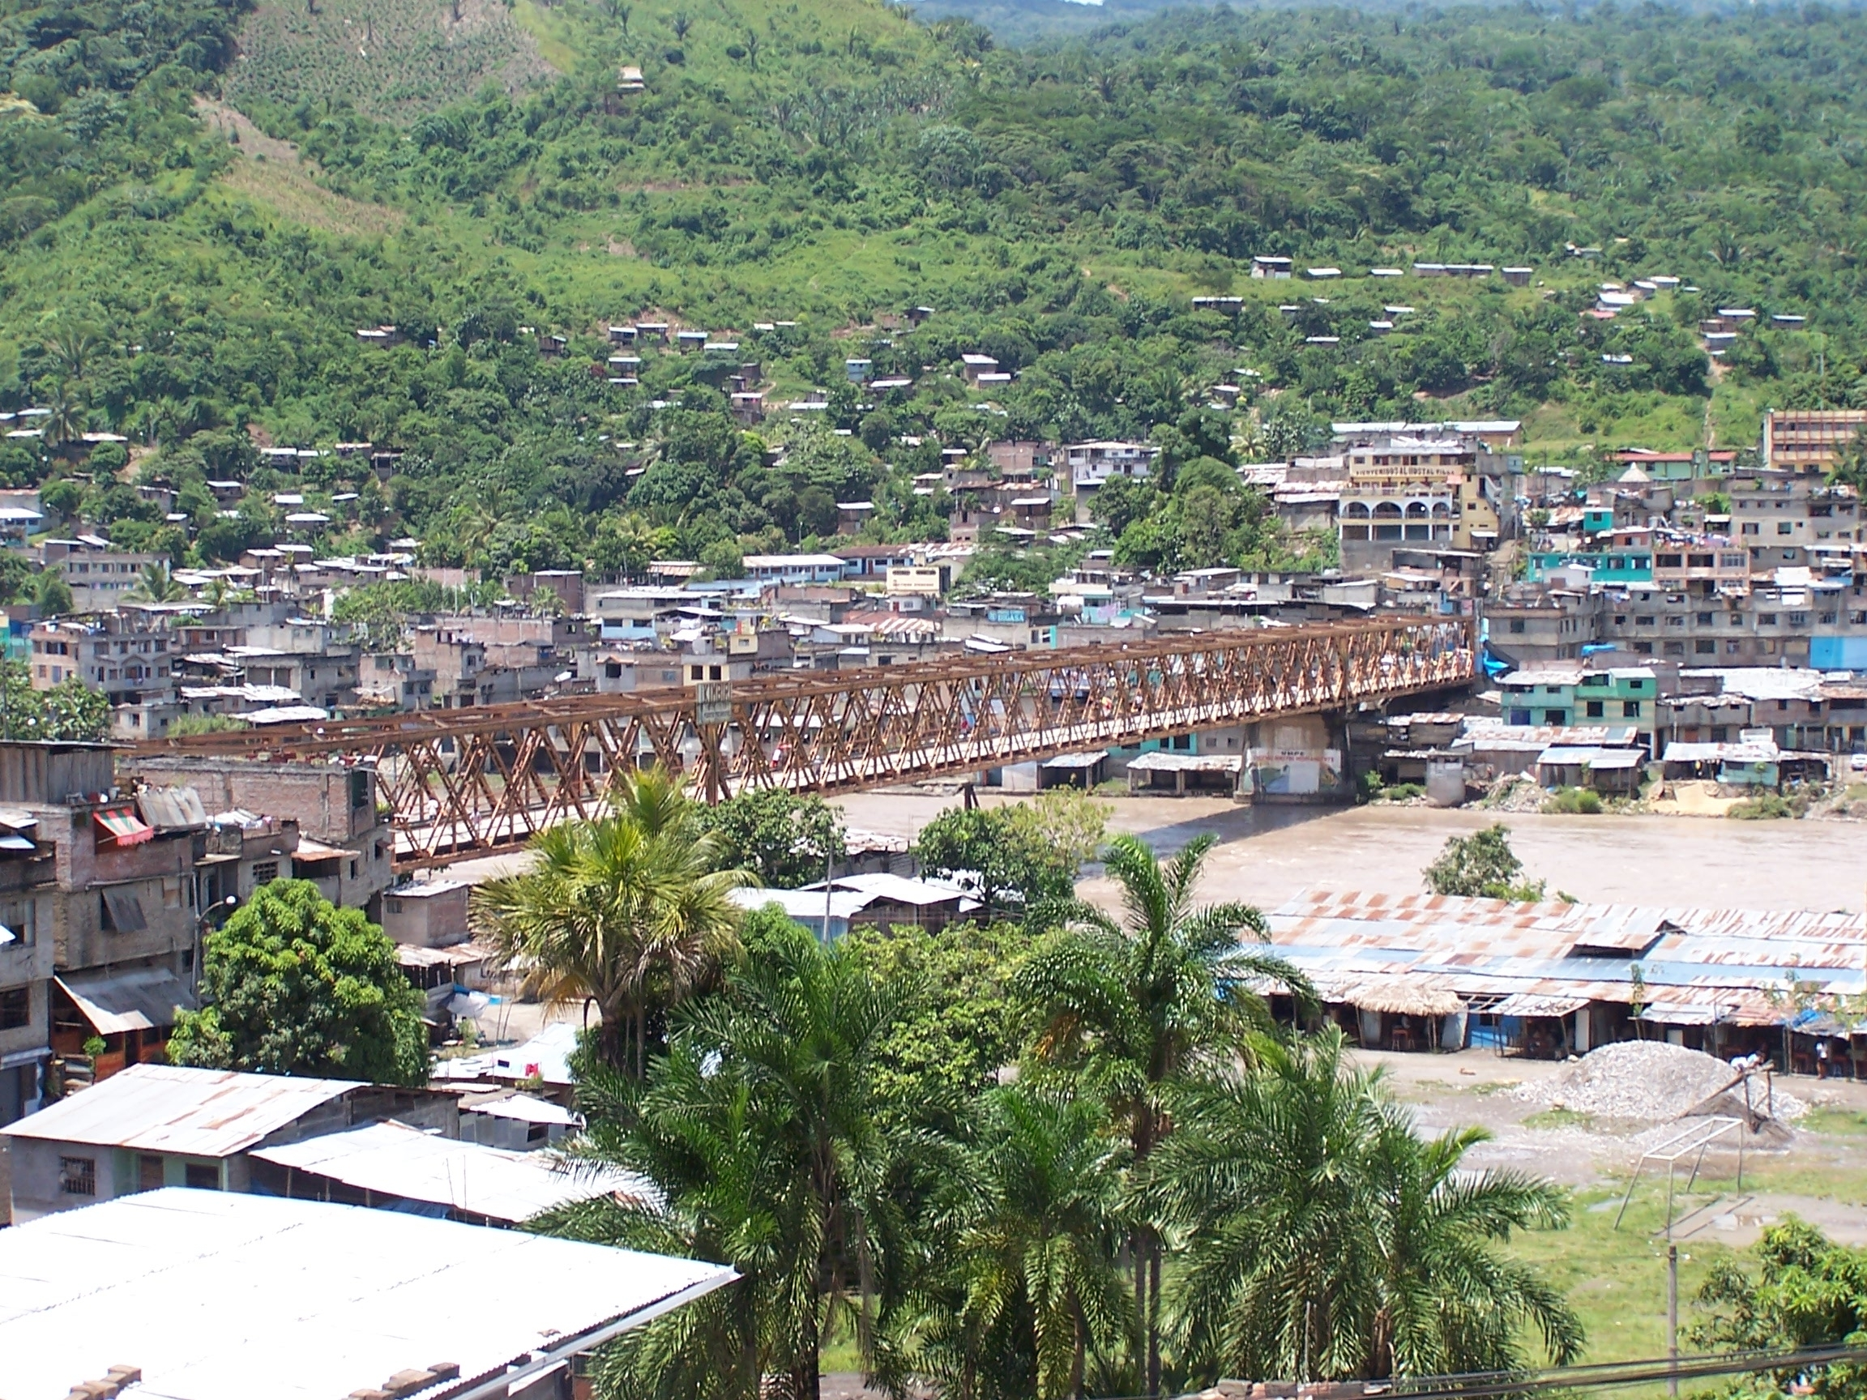
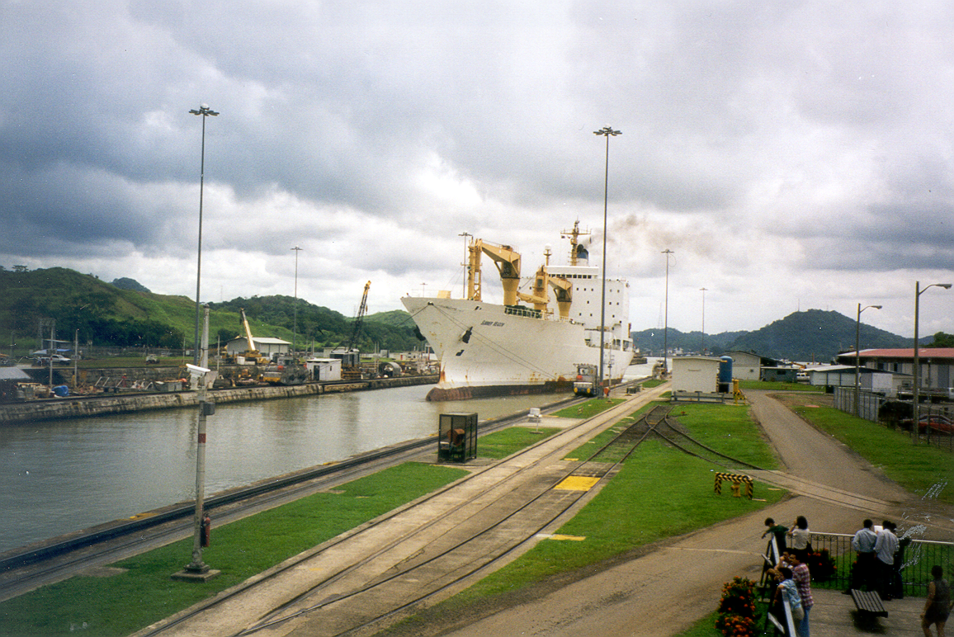
National Level: Exercise 5-1
What are some of the NATIONAL POLICY and
GOVERNANCE─ related environment and natural
resource issues and interventions that could affect (positively or negatively) the success of tourism?

Slide 21
Site Level
Summary of Site-Specific Issues Related to Tourism:
Scale of tourism operation
Ownership and control
Current and future use of resource
Resource management responsibilities
Quality and availability of tourism product
Infrastructure requirements
Social and cultural impacts
Marketing and access to markets

Slide 22
Site Level Intervention areas
Corporate environment and social responsibilities
Community-based tourism
Destination planning and management
Tourism activities in natural areas

Slide 23
Site Level Interventions
1) Corporate environment & social responsibilities:
Industry association capacity-building
Development of alliances and partnerships
Education and awareness programs
Training

Slide 24
Site Level Interventions
2) Community-based tourism:
Community capacity-building
Managing economic and social impacts on the community
Product development and cultural attractions
Business planning
Ensuring benefits to the community

Slide 25
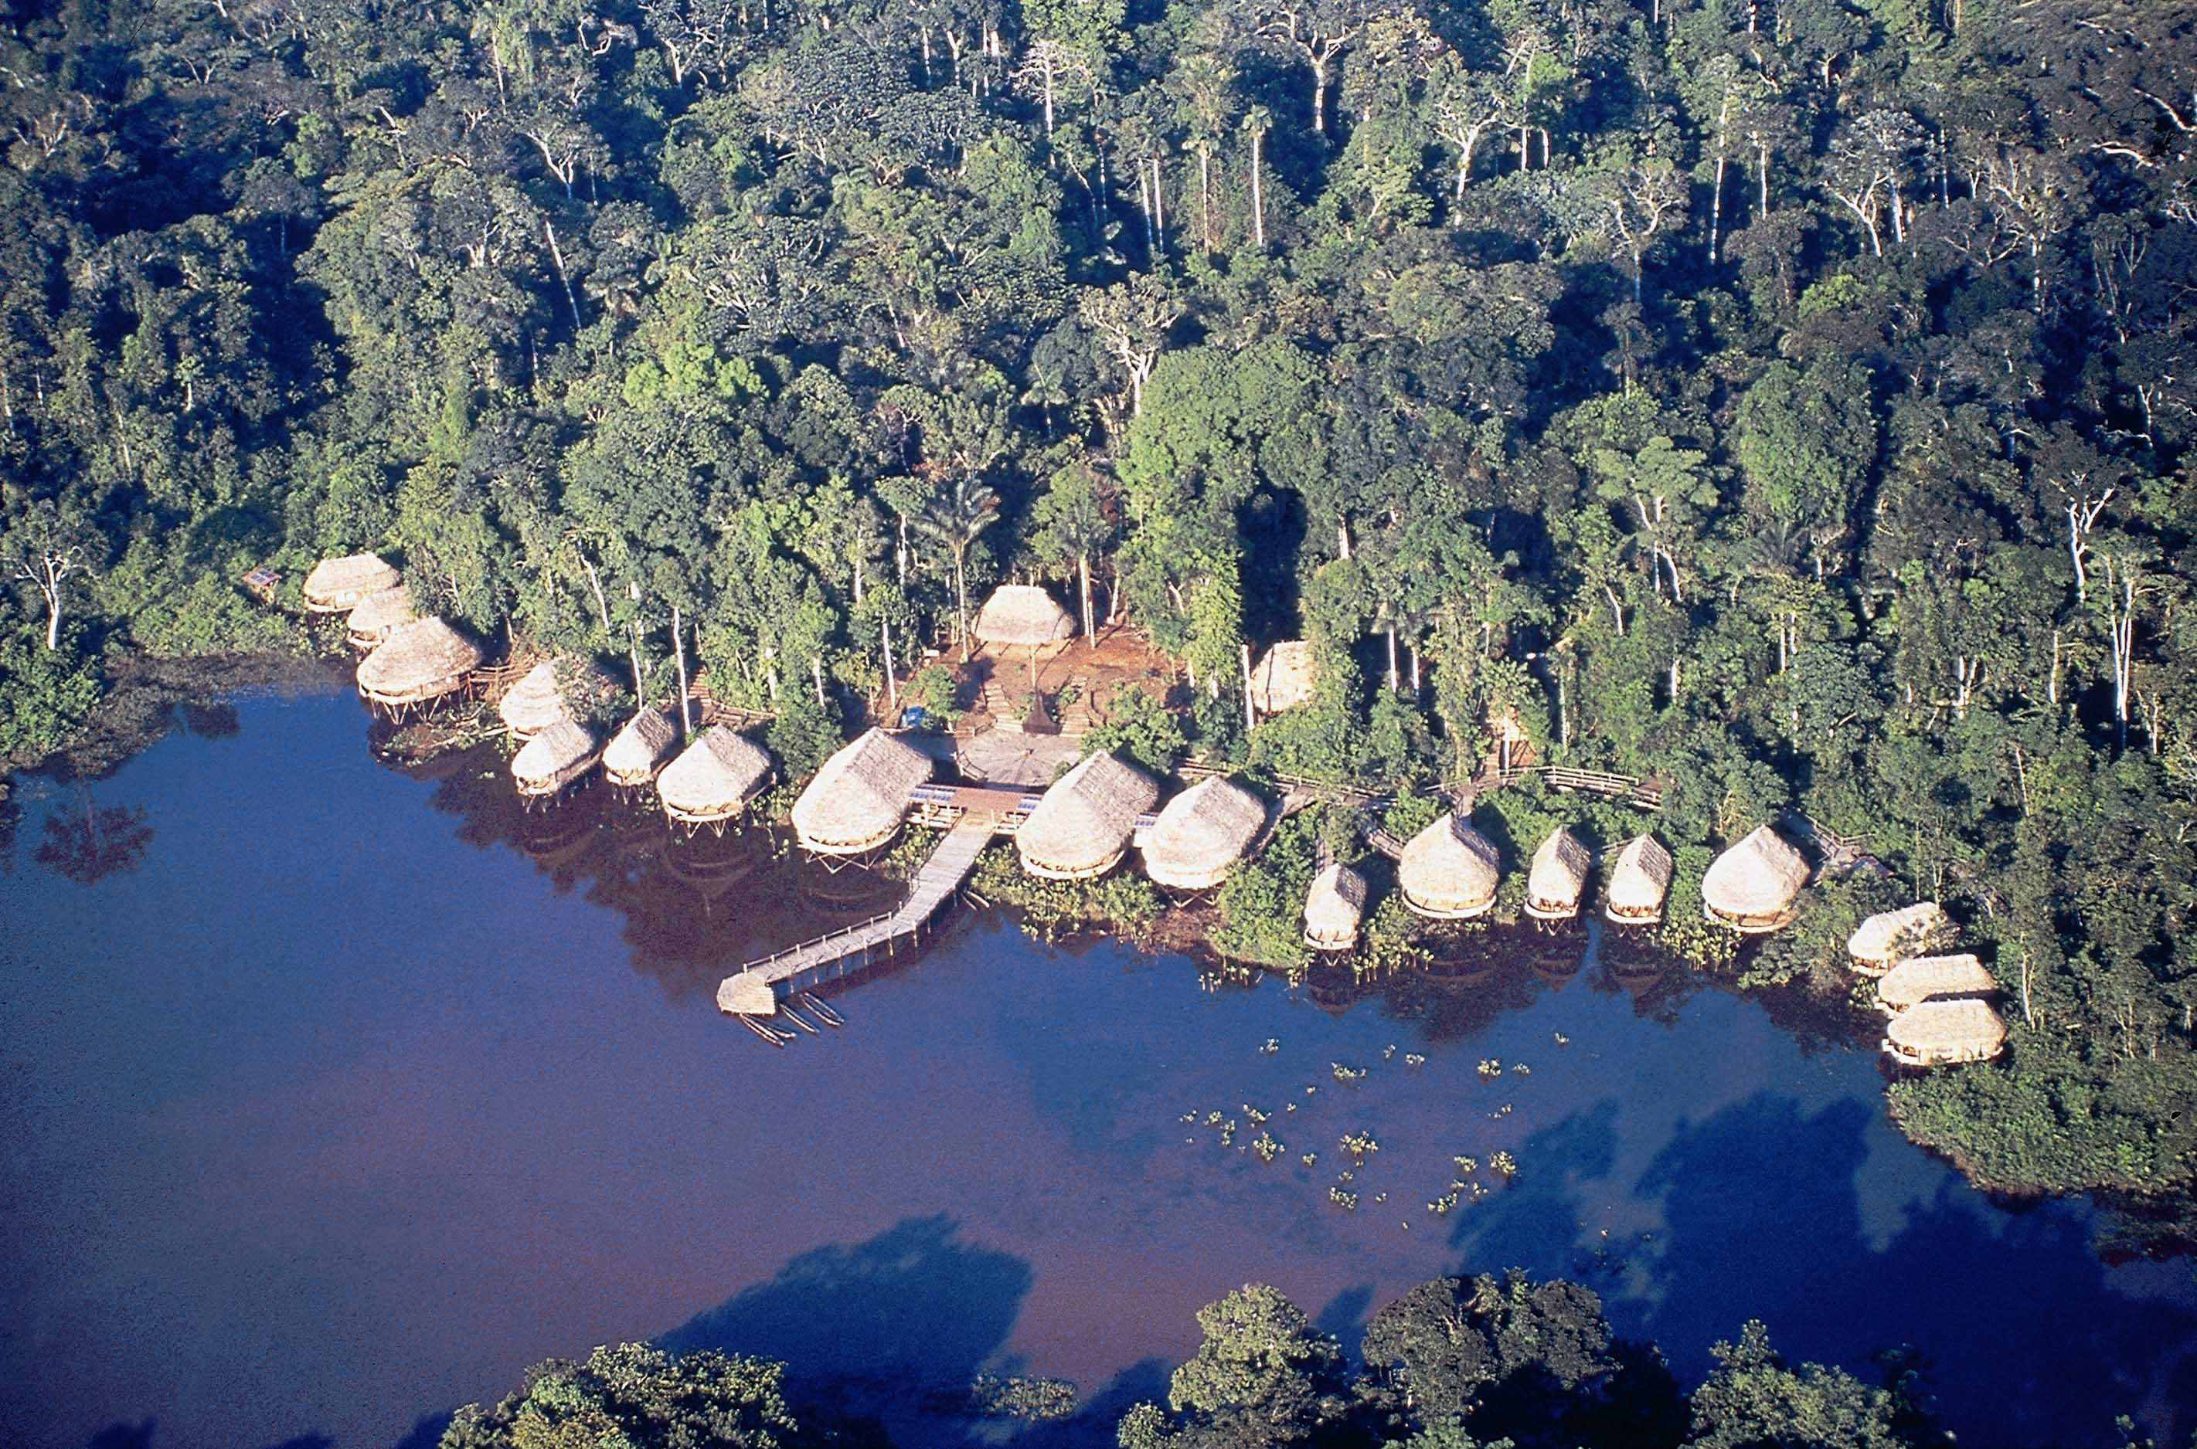
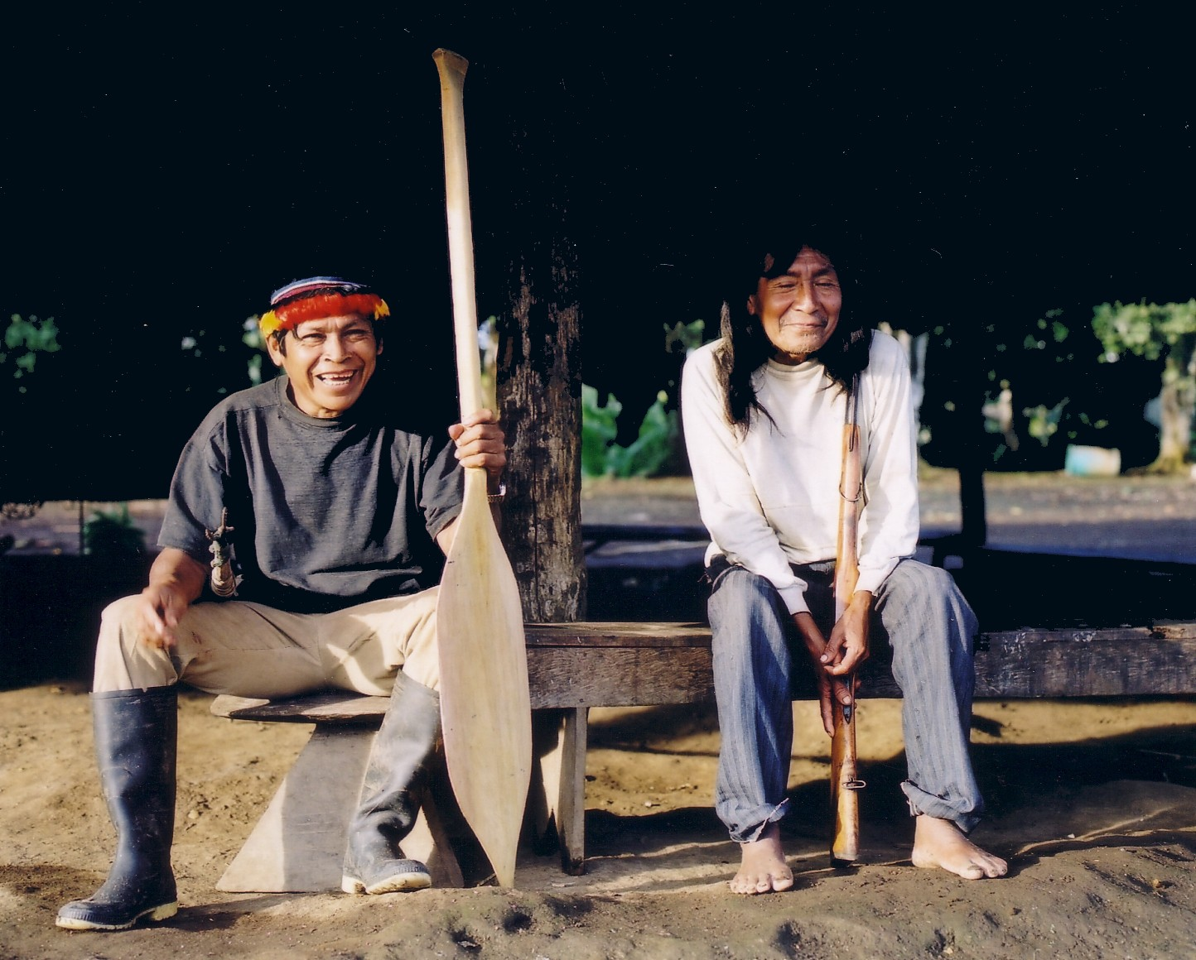
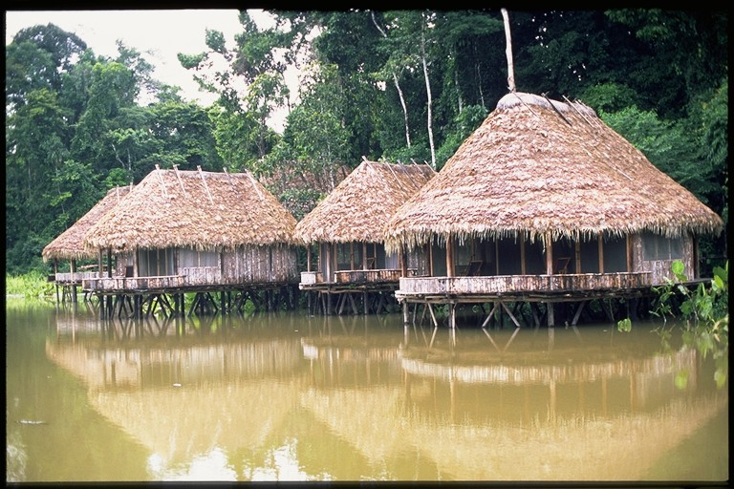

Slide 26
Site Level Interventions
3) Destination Planning & Management:
Infrastructure
Linking sites and attractions
Commons/public resource management
Cumulative impacts assessment and management
Market diversification

Slide 27
Site Level Interventions
4) Tourism Activities in Natural Areas:
Zoning for visitor use
Visitor site planning and design
Sustainable infrastructure design
Revenue-generating mechanisms
Visitor impact monitoring and management
Guiding and visitor interpretation
Source: Ecotourism Development: A Manual for Conservation Planners and Managers (The Nature Conservancy).

Slide 28
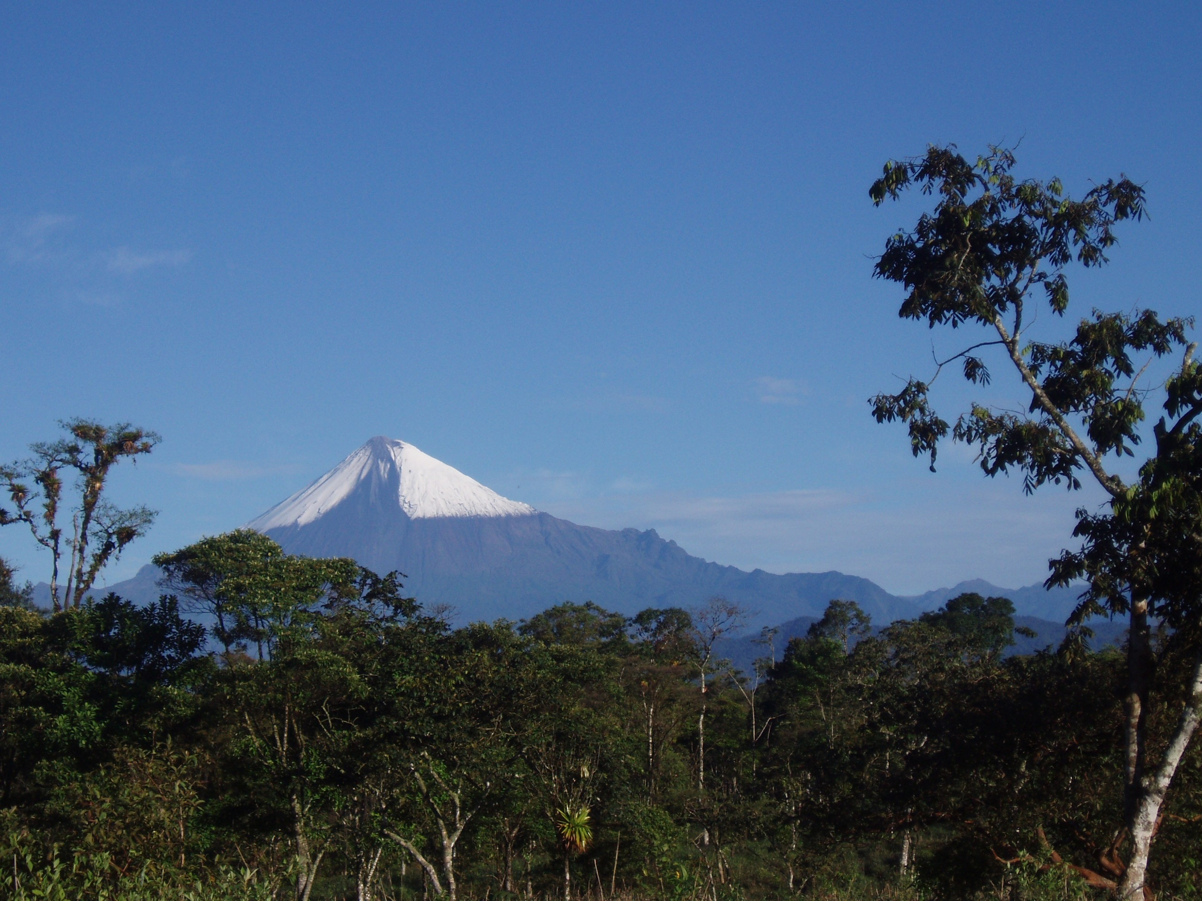
National Level: Exercise 5-2
What are some of the SITE-SPECIFIC related
environment and natural resource issues and
interventions associated with tourism development?

Slide 29
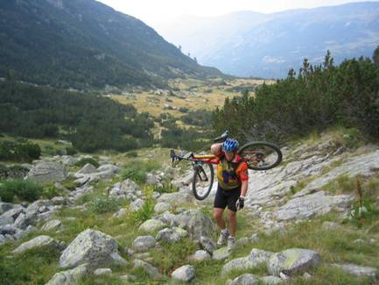
Project Example: Biodiversity Conservation and Economic Growth - Bulgaria
SO: Special initiatives: poverty reduction and economic growth
Program: Biodiversity Conservation & Economic Growth (Phases I & II)
Intervention Area: Protect and conserve cultural and natural resources, deregulation of industry, private/public, coordinate governmental policies, foster public awareness, develop effective marketing.

Slide 30
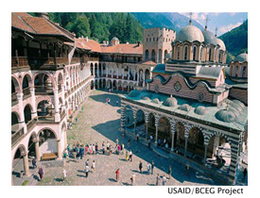
Project Example: Biodiversity Conservation and Economic Growth - Bulgaria
Tools/Mechanisms Used:
Triple bottom line approach, framework development, active policy dialogues, linkages, best practices, evaluation.
Partners/Collaborators: Ministries of Environment and Water, Economy, Agriculture and Forests, Rila and Central Balkan National Parks, Strandja Nature Park, UNDP, World Bank, Bulgarian Society for the Conservation of Birds, Pirin Tourism Forum

Slide 31
Categories of USAID NRM Performance Indicators for Tourism
Conserving built and living cultural heritage
Protection of valuable natural assets
Managing scarce natural resources, energy, water and solid waste

Slide 32
Sample ENV/Cultural Performance Indicators
1) Conserving built and living cultural heritage:
Number and type of new legislation or amendments to preserve structures
Percentage of eligible sites or structures
Amount of funds allocated to the restoration, preservation and maintenance of cultural assets on a yearly basis
Voluntary contributions
Tourism contribution to conservation
Number of sites restored

Slide 33
Sample ENV/Cultural Performance Indicators
2) Protection of valuable natural assets:
Health of population of key species (counts/sightings) in tourist areas
Level of contamination of bodies of water in marine destinations
Funds allocated for management and monitoring
Tourism contribution to protection and maintenance
Percentage of budgets self-generated from sustainable sources
Number of rangers trained in visitor management
#/Area of conservation management plans integrating tourism use
Development of visitor management infrastructure (numbers of trails created, visitor centers built, mooring buoys installed and maintained, etc.)
Reductions in damages* (careful to avoid counting error)

Slide 34
Sample ENV/Cultural Performance Indicators
3) Managing scarce natural resources, energy, water & solid waste:
Per capita consumption of energy from all sources (overall and by tourism sector)
% of businesses participating in energy conservation programs or applying techniques
% of energy consumption from renewable resources
Water use - total volume, volume per tourist, volume recycled
% of water use reduction
% waste water or grey water recycled
Utility/infrastructure benefits to community
# of EMS/Audits
Water quality monitoring results

Slide 35
NRM and Cultural Conservation Intervention: Exercise 5-3
Small groups; choose and develop a sustainable tourism development activity from one of your countries:
· Break into 3 groups to focus on country level issues and interventions (Rwanda group, Montenegro group and Tanzania Group)
What are the issues?
What tourism related intervention could be used for each issue?
How would you incorporate cross-cutting (social) issues?
What performance indicators could be measured?

Slide 36


RECAP
Tourism’s contribution to natural and cultural heritage conservation can be improved through interventions at the national policy level and directly at the site level.
Sample projects show that tourism can be effective in addressing a variety of NRM issues including biodiversity conservation in protected areas, community support, and land use planning.
Tourism’s impact on natural resources, biodiversity, and culture can be measured with a set of performance indicators specific to sustainable tourism.

Slide 37
Some additional country examples…
Red Sea
Mexico
Tanzania

Slide 38
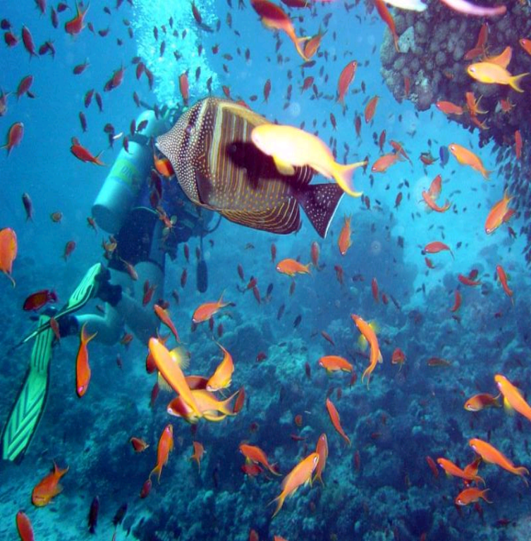
Project Example: Red Sea Sustainable Tourism Initiative
SO: Approaches to sustainable tourism development
Program: Red Sea Sustainable Tourism Initiative (RSSTI) Project
Intervention Area: Strengthen tourism environmental policy, monitoring and planning capacity, develop and adopt a land use zoning policy and management system in the Southern Red Sea Zone

Slide 39
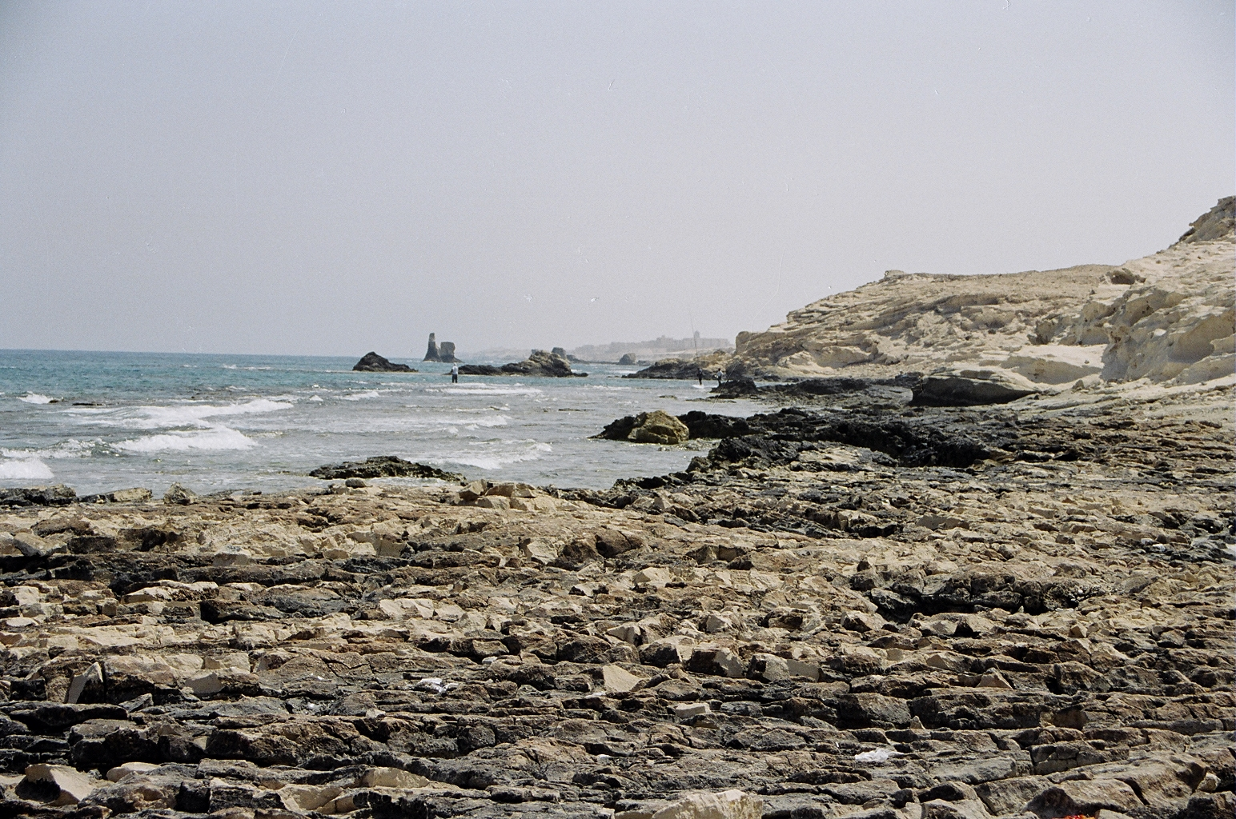
Project Example: Red Sea Sustainable Tourism Initiative, cont.
Tools/Mechanisms Used: Best practices, conducting environmental impact assessment and monitoring, the design of environmental management systems, and the promotion of sustainable tourism awareness.
Partners/Collaborators: Egyptian Tourism Development Authority (TDA)

Slide 40
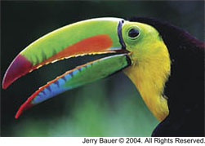
Project Example: Conservation and Sustainable Development in Mexico
SO: Critical Ecosystems and Biological Resources Conserved
Program: Strategic Planning & Monitoring for Conservation & Sustainable Development
Intervention Area: Develop regional conservation strategy, monitor critical areas of the Lacandon forest, train indigenous communities.

Slide 41
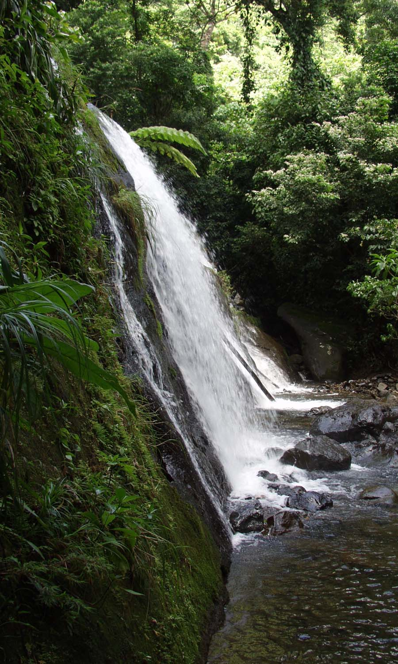
Project Example: Conservation and Sustainable Development in Mexico, cont.
Tools/Mechanisms Used:
Training programs, geographic database, business diversification, facilities management, environmental monitoring system.
Partners/Collaborators:
Local governments and government agencies, local NGOs

Slide 42
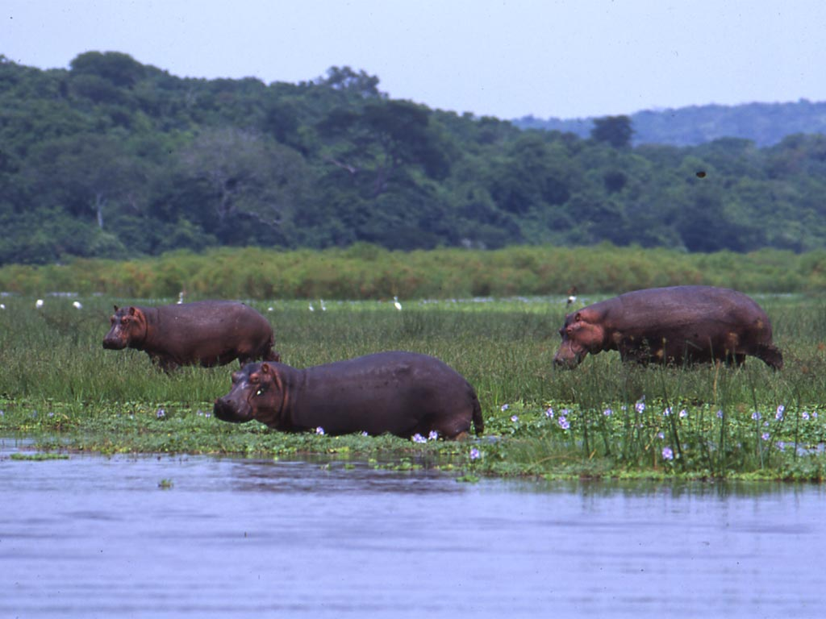
Project Example: Tanzania Coastal Management Partnership
SO: Coastal and wildlife resources conservation
Program: Coastal Resource Management II: Tanzania Coastal Management Partnership
Intervention Area: Promote local investment in coastal areas, conduct community outreach and training, ensure stakeholder involvement, identify priority culturally and biologically diverse areas for tourism development, promote community-based goods.

Slide 43
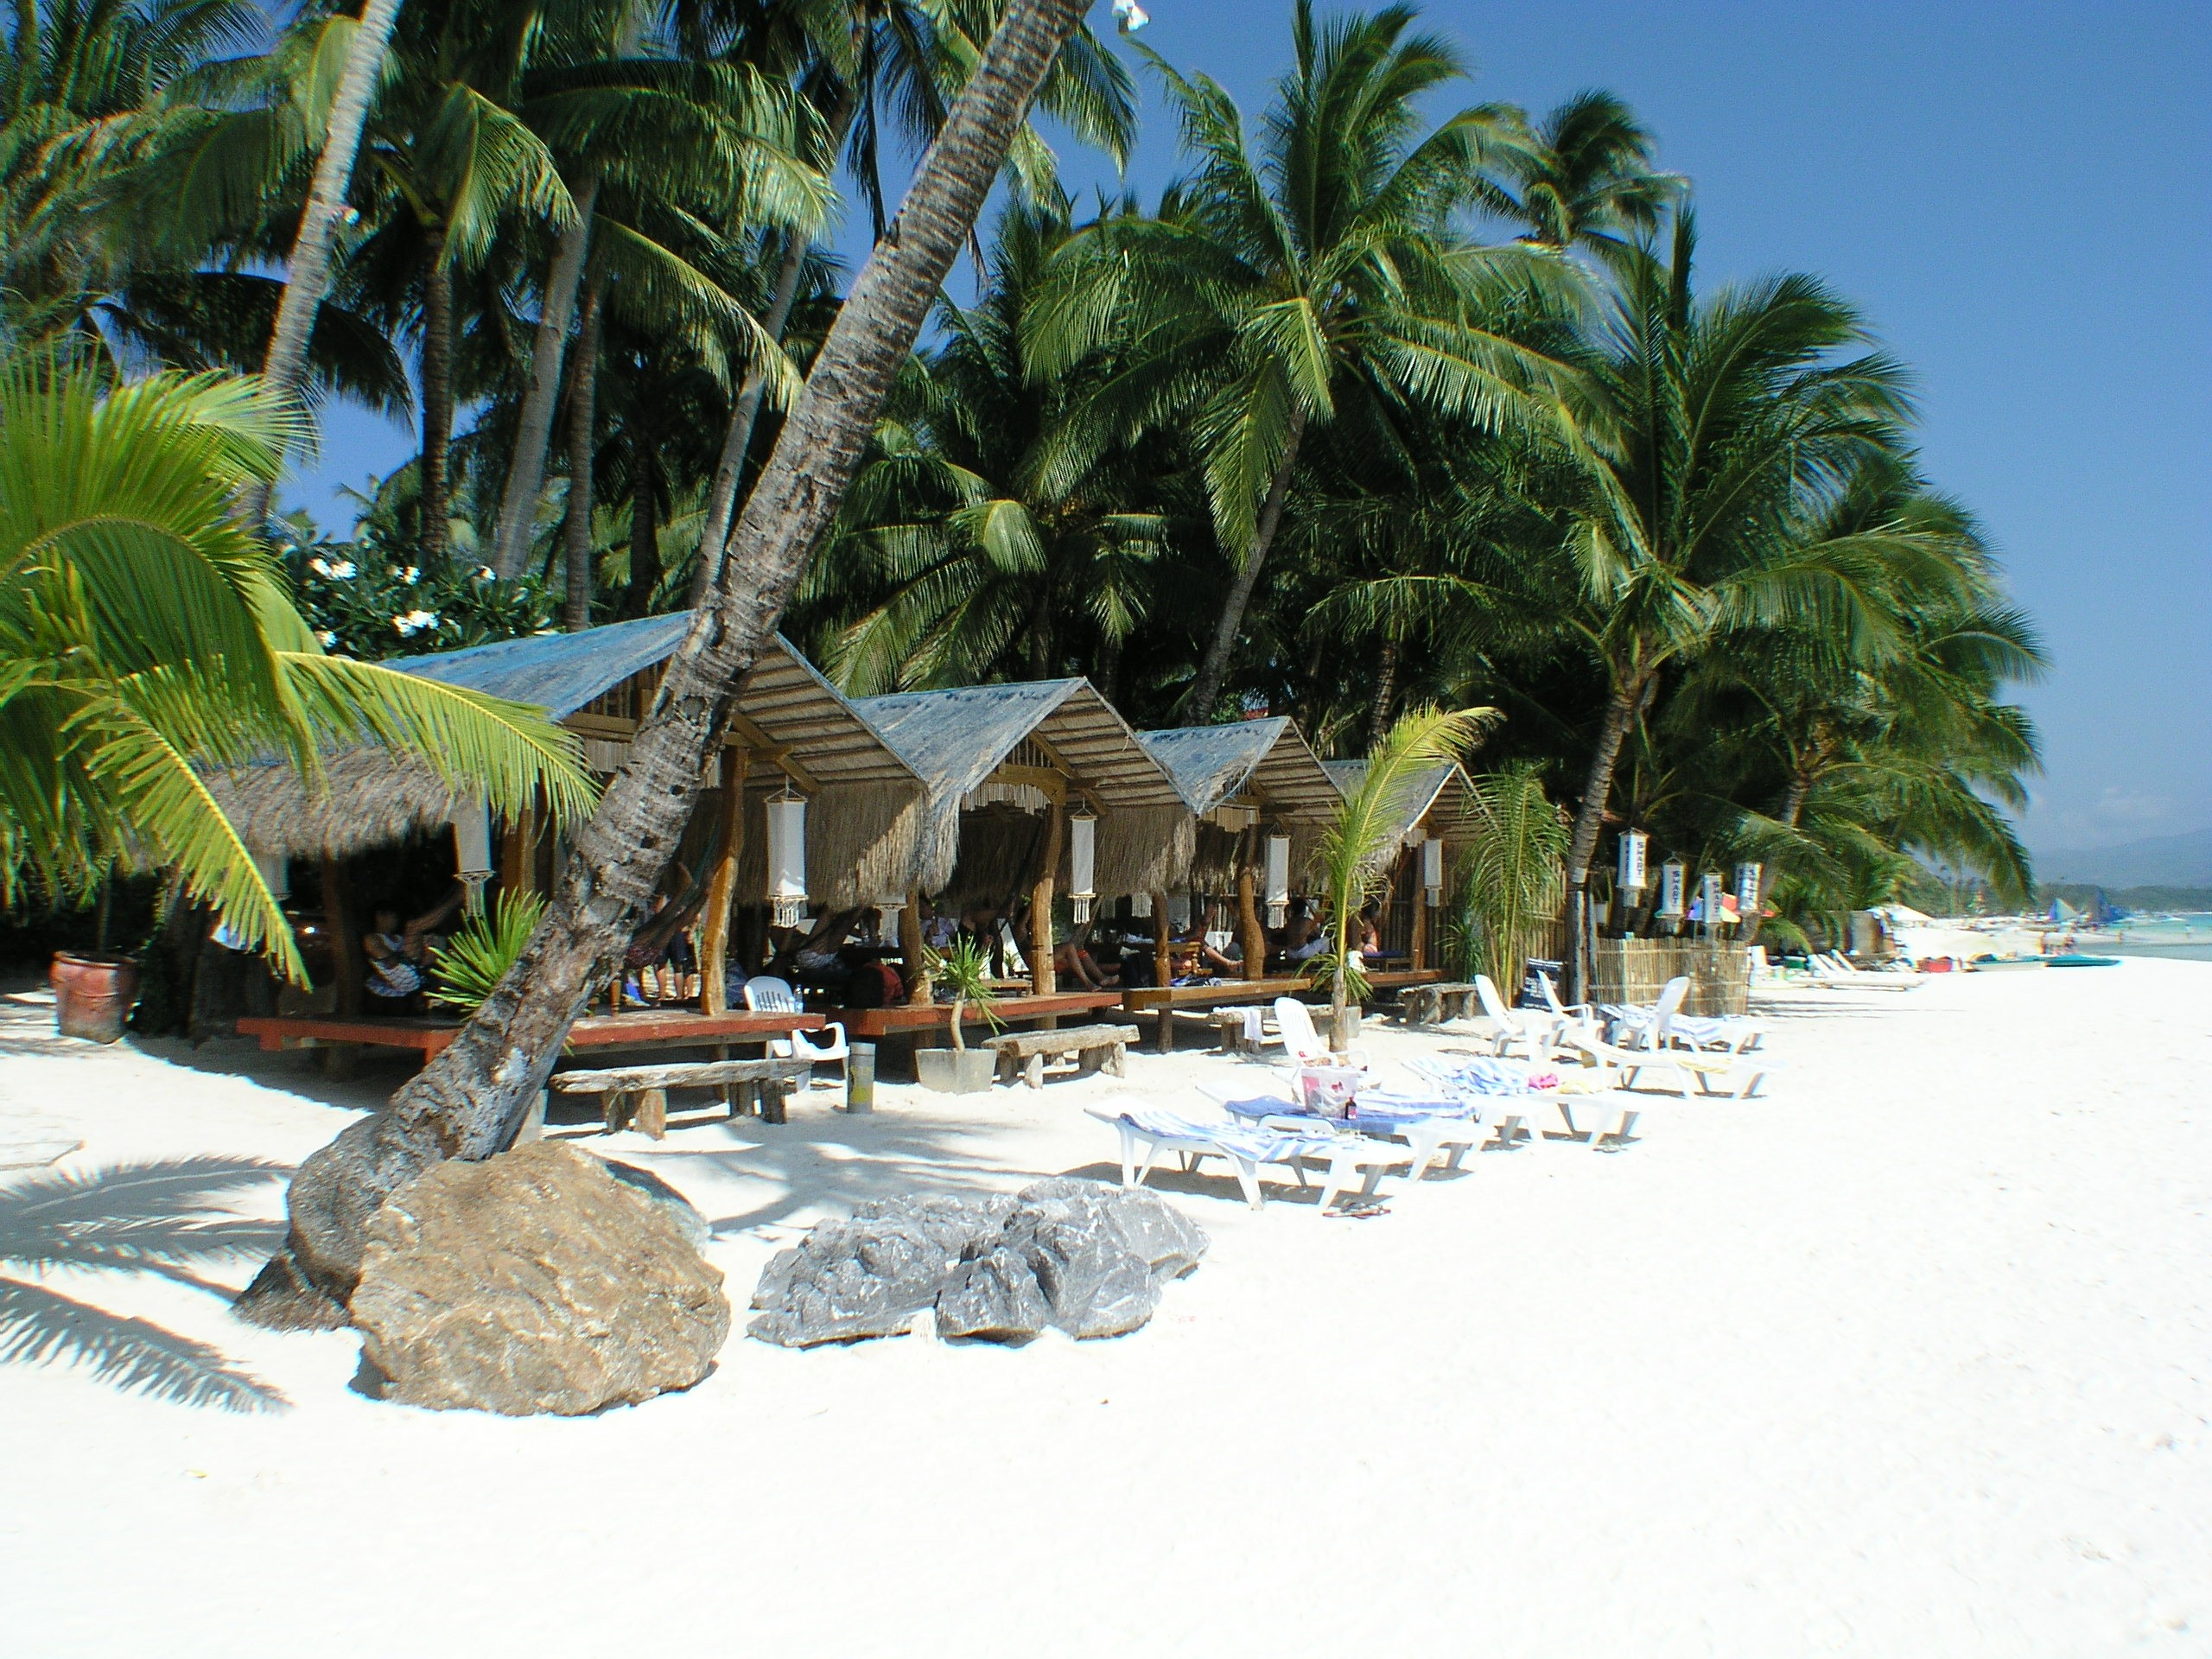
Project Example:Tanzania Coastal Management Partnership, cont.
Tools/Mechanisms Used: Public/private, industry-driven promotion network, development of collaborative agreements, streamlined investment guidelines, training programs.
Partners/Collaborators: GreenCOM: Tanzania, National Environmental Management Council of the Vice President: Tanzania, University of Rhode Island Coastal Resources Center (URI/CRC)

