Slide 1

Phil. Tropical Forest Conservation Foundation, Inc.
www.ptfcf.org
Linking Natural Resources, Economic Growth and Good Governance
A presentation to the TransLinks Workshop
June 21, 2007
ERIC D. BUDUAN
Project Officer

Slide 2
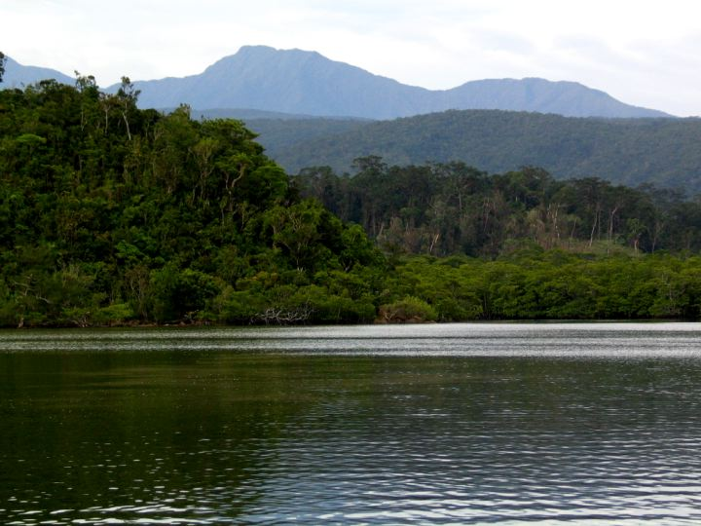
Our Vision…..
We envision lush and biologically diverse Philippine forest that are sustainably managed and equitably accessible to responsible stakeholders, as a collective responsibility for the greater good.

Slide 3
Creation of PTFCF…
Established under two bilateral agreements signed on Sept. 19, 2002, between the governments of the United States and the Republic of the Philippines under the US Tropical Forest Conservation Act.
Leveraged a $5.5 million USG appropriation to treat $41.5 million in RP-US debt and divert $8.25 million in peso-denominated interest payments over 14 years, to the Tropical Forest Conservation Fund.
9 Trustees (5 NGO representatives, 2 each for Philippine and US governments)

Slide 4
Eligible activities…
1. Protection activities
2. Natural Resource Management
3. Capacity Building
4. Restoration or Sustainable Use
5. Research on Medicinal Uses
6. Livelihood of Forest Dwellers
7. Coastal Forest Management
and Protection

Slide 5
PTFCF Supported Projects (2005 – 2006)
QSEED-Quirino
FRENDS – Quezon, NV
CGN – Kibungan, Benguet
JV Ongpin – La Trinidad, Benguet
MUFA – Kasibu, NV
KAISAKA-Bolinao, Pangasinan
IRDF – Dingalan, Aurora and Gabaldon, NE
LUZON
TK – Aurora and Quezon
SIKAT-Zambales
ISO - Quezon
BCISTI-Morong, Bataan
CERD – Biri, Northern Samar
Ulan – Quezon City
Tanggol Kalikasan – Luzon wide
Binhi – Negros Occidental
PhilDHRRA – Cebu, Bohol, Antique & Aklan
PCC - Palawan
PACIFARM – St. Bernard, So. Leyte
Haribon Palawan - Palawan
VISAYAS
SWCF – RSPL, Bohol
BCMPC-Palawan
CART – CDO
BIDEF – Corella & Sikatuna, Bohol
Dr. Hansel – Iligan City
SAC Tandag – Surigao del Sur
XAES – Zamboanga Sibugay
LEAF – Sn Francisco,Agusan Del Sur
CoSEED- Zamboanga del Sur
MINDANAO
Mainit NPCS-Nabunturan, ComVal
Landcare – Claveria, Misamis Oriental
ISFI – Montevista, ComVal
Kinaiyahan – Davao City
IPHC – Talaingod, Davao Del Norte

Slide 6
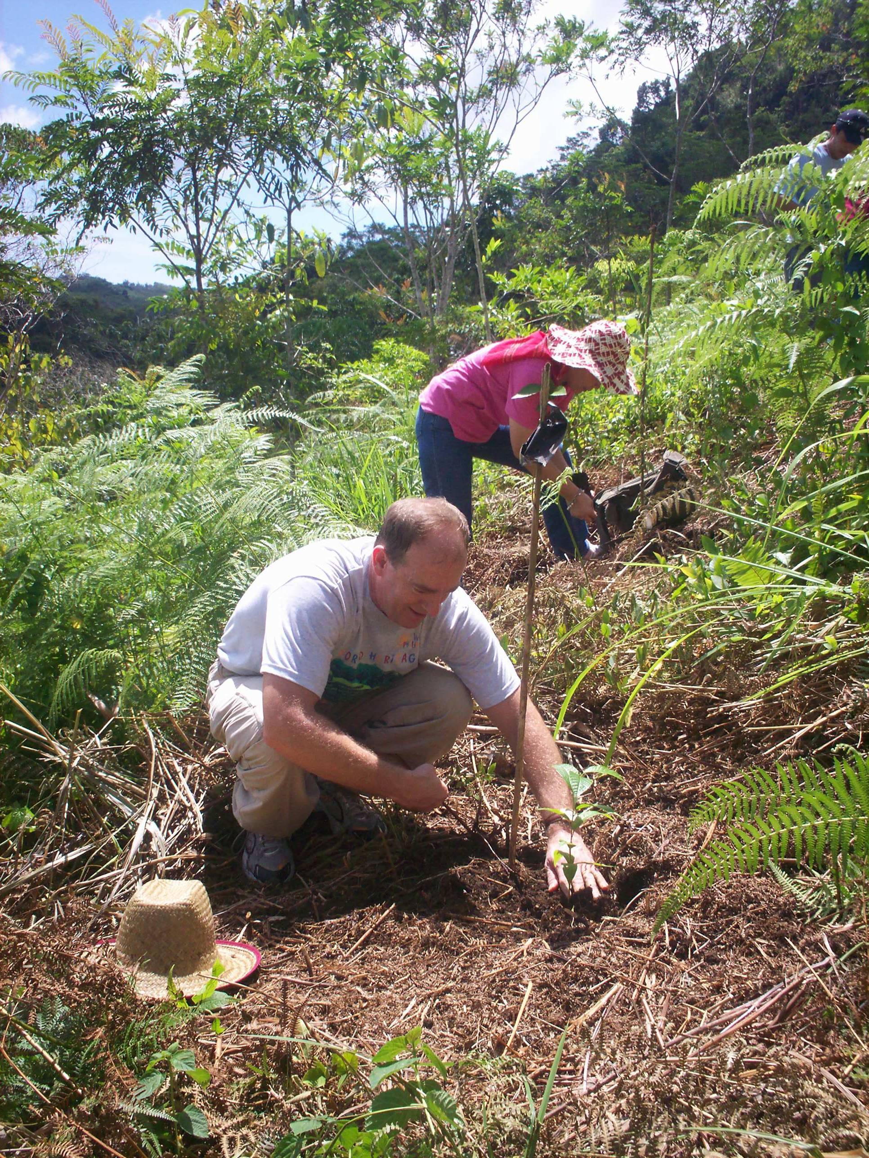
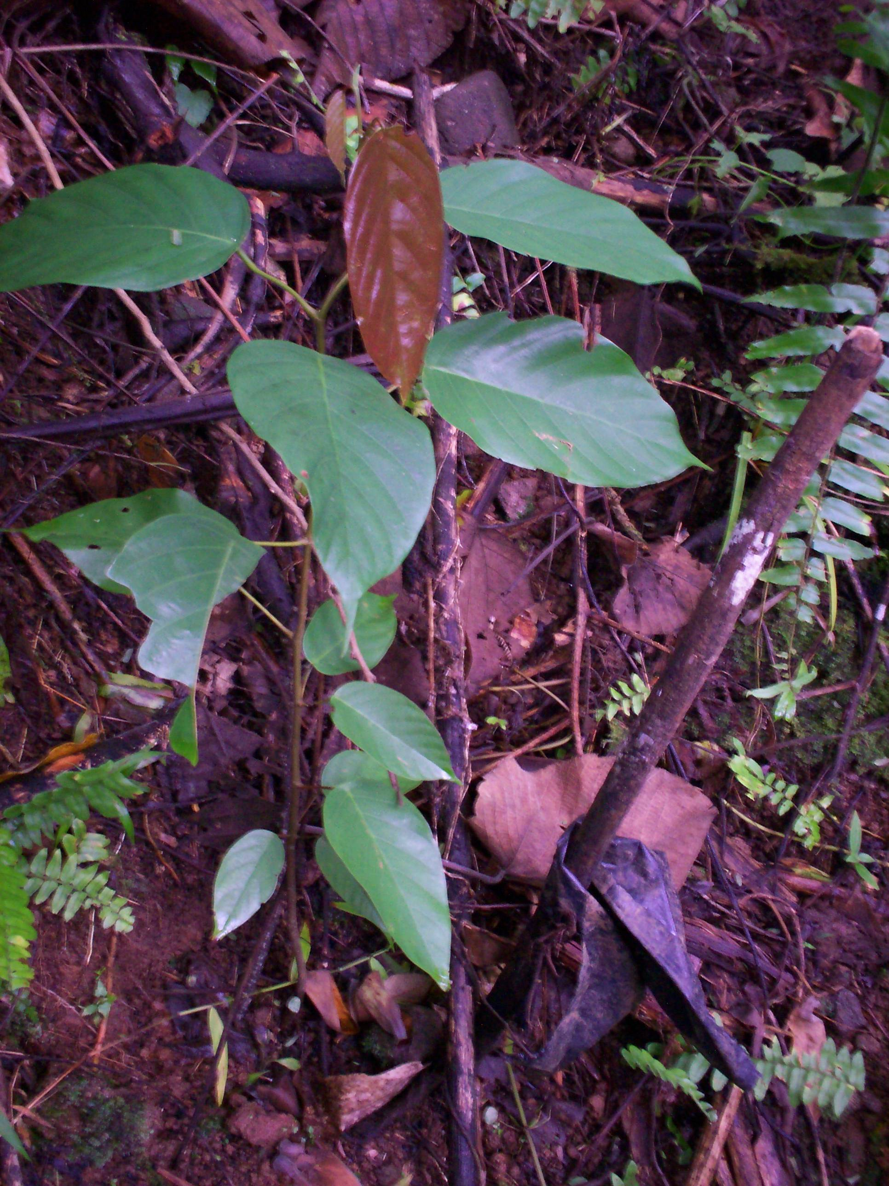
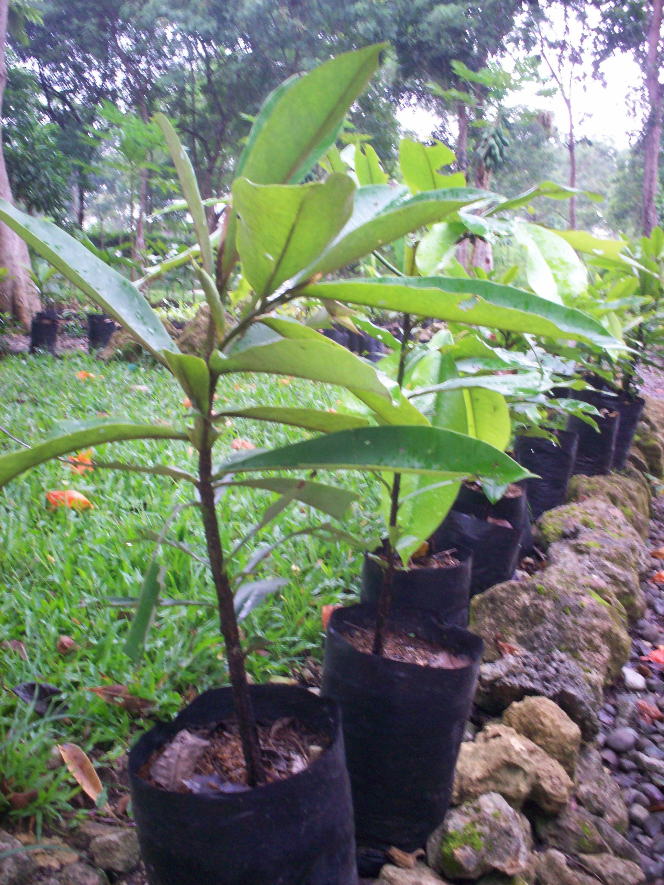
Nature initiatives
Forest inventories
Indigenous tree planting
Survey, Mapping, Profiling and delineation of communal forest, ancestral domain claims, watershed areas and protected areas/sanctuaries.

Slide 7
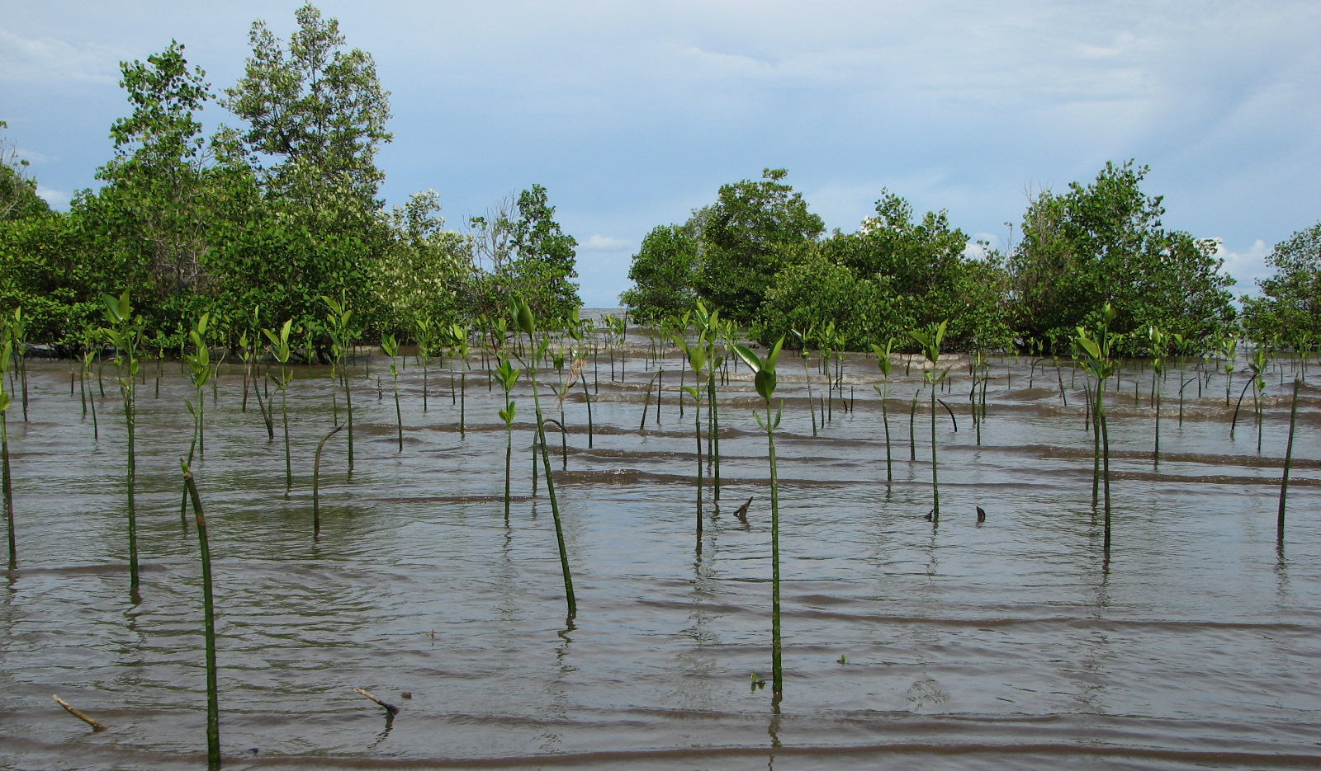
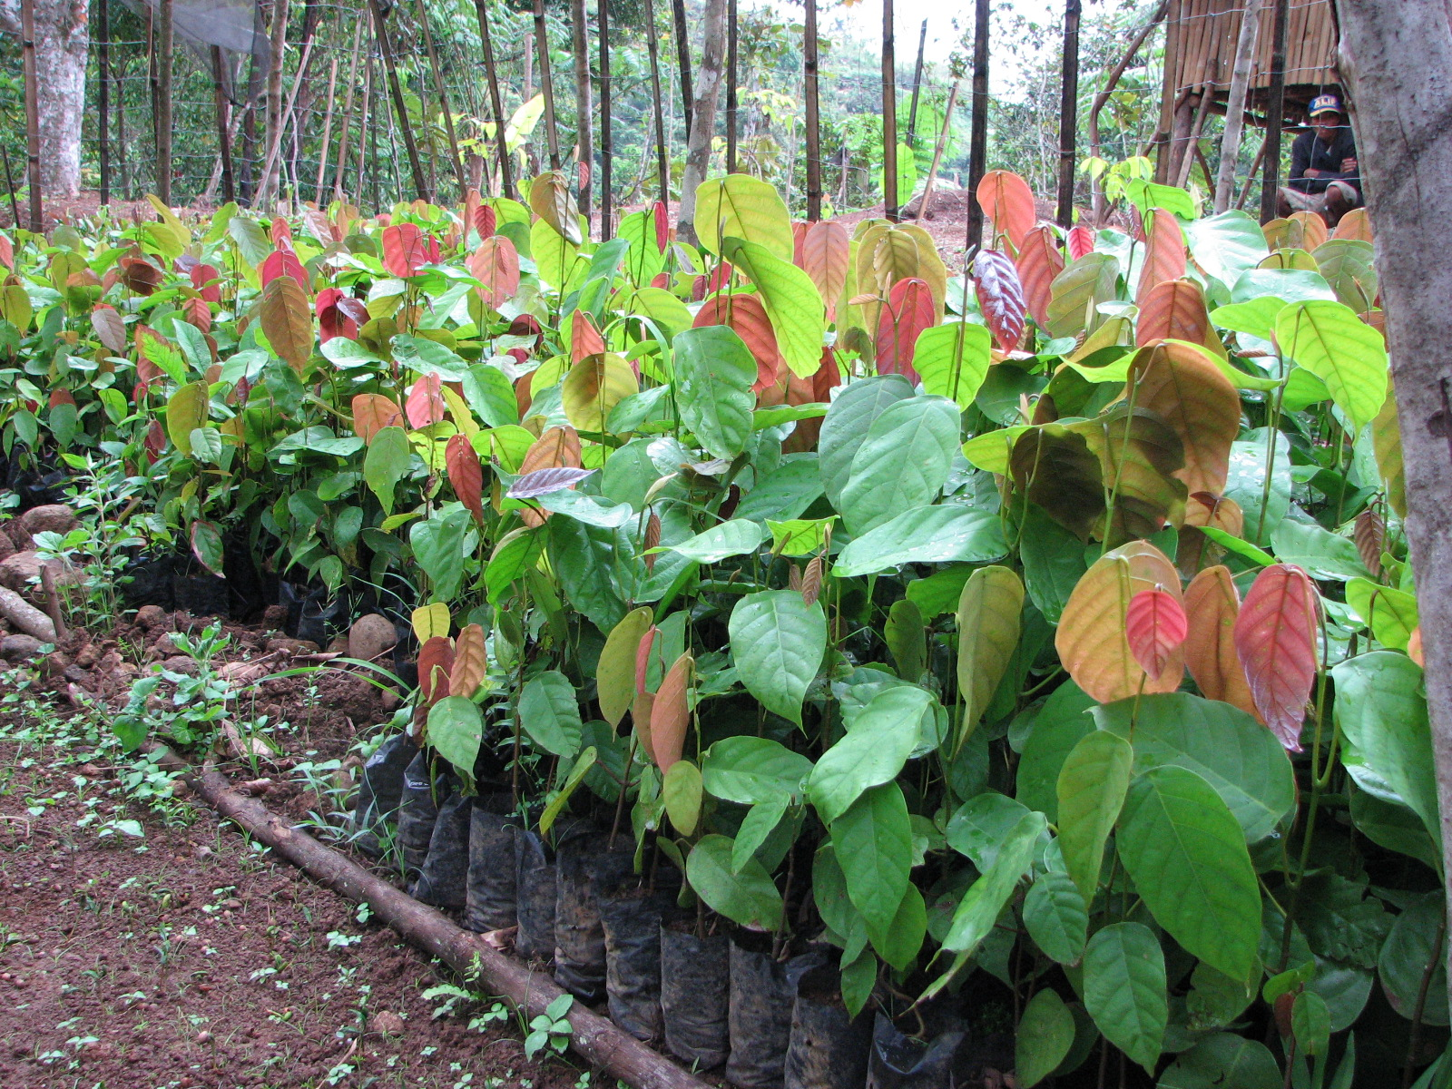
Nature initiatives
ANR/enrichment planting
Firebreak and greenbreak establishment
Nursery establishment
Riverbank stabilization
Developing alternatives to usual energy, food and livelihood sources

Slide 8
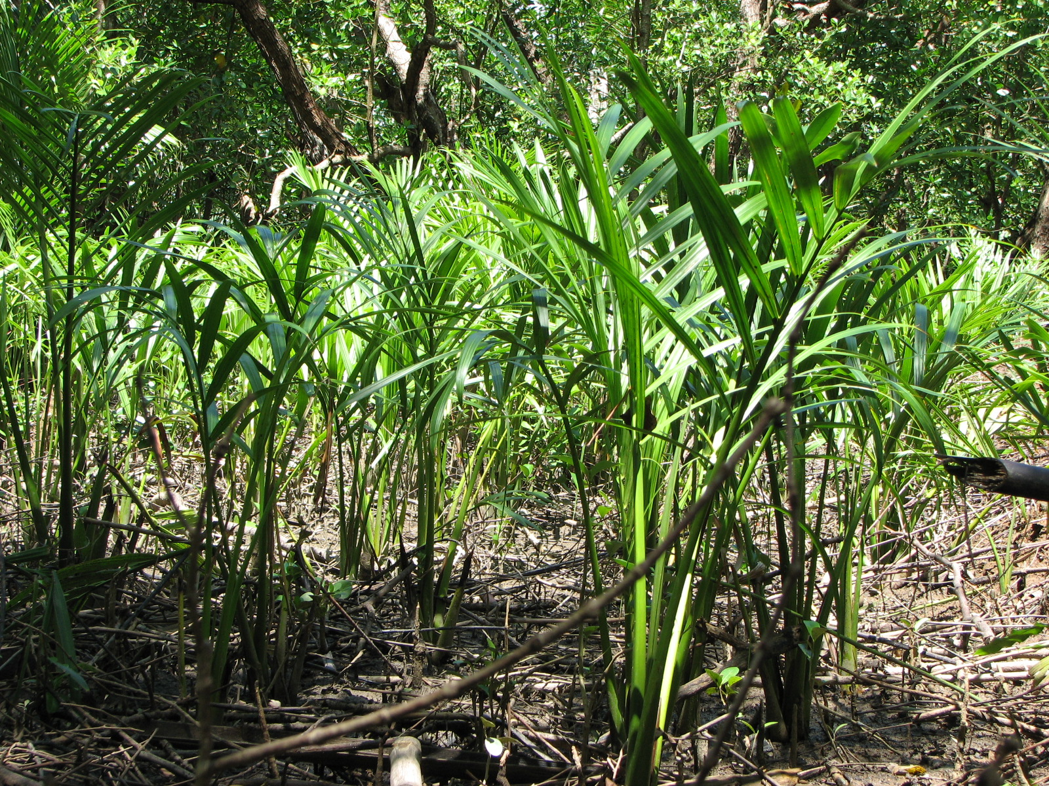
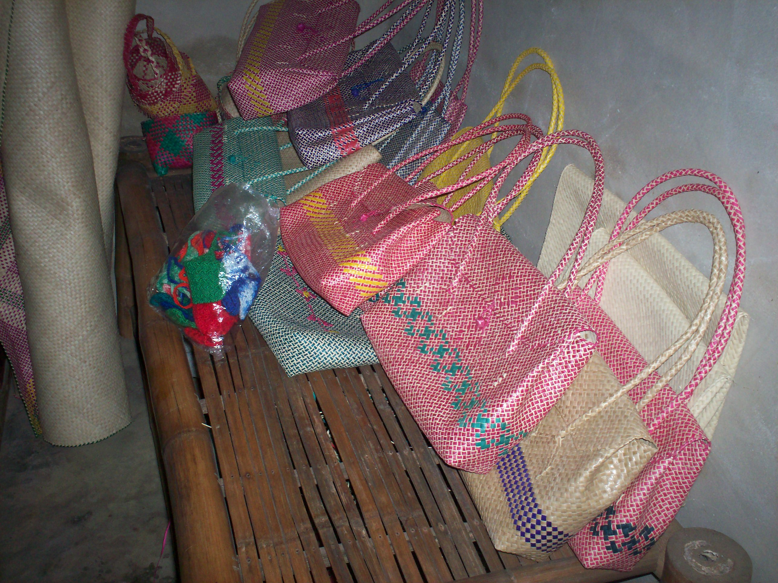
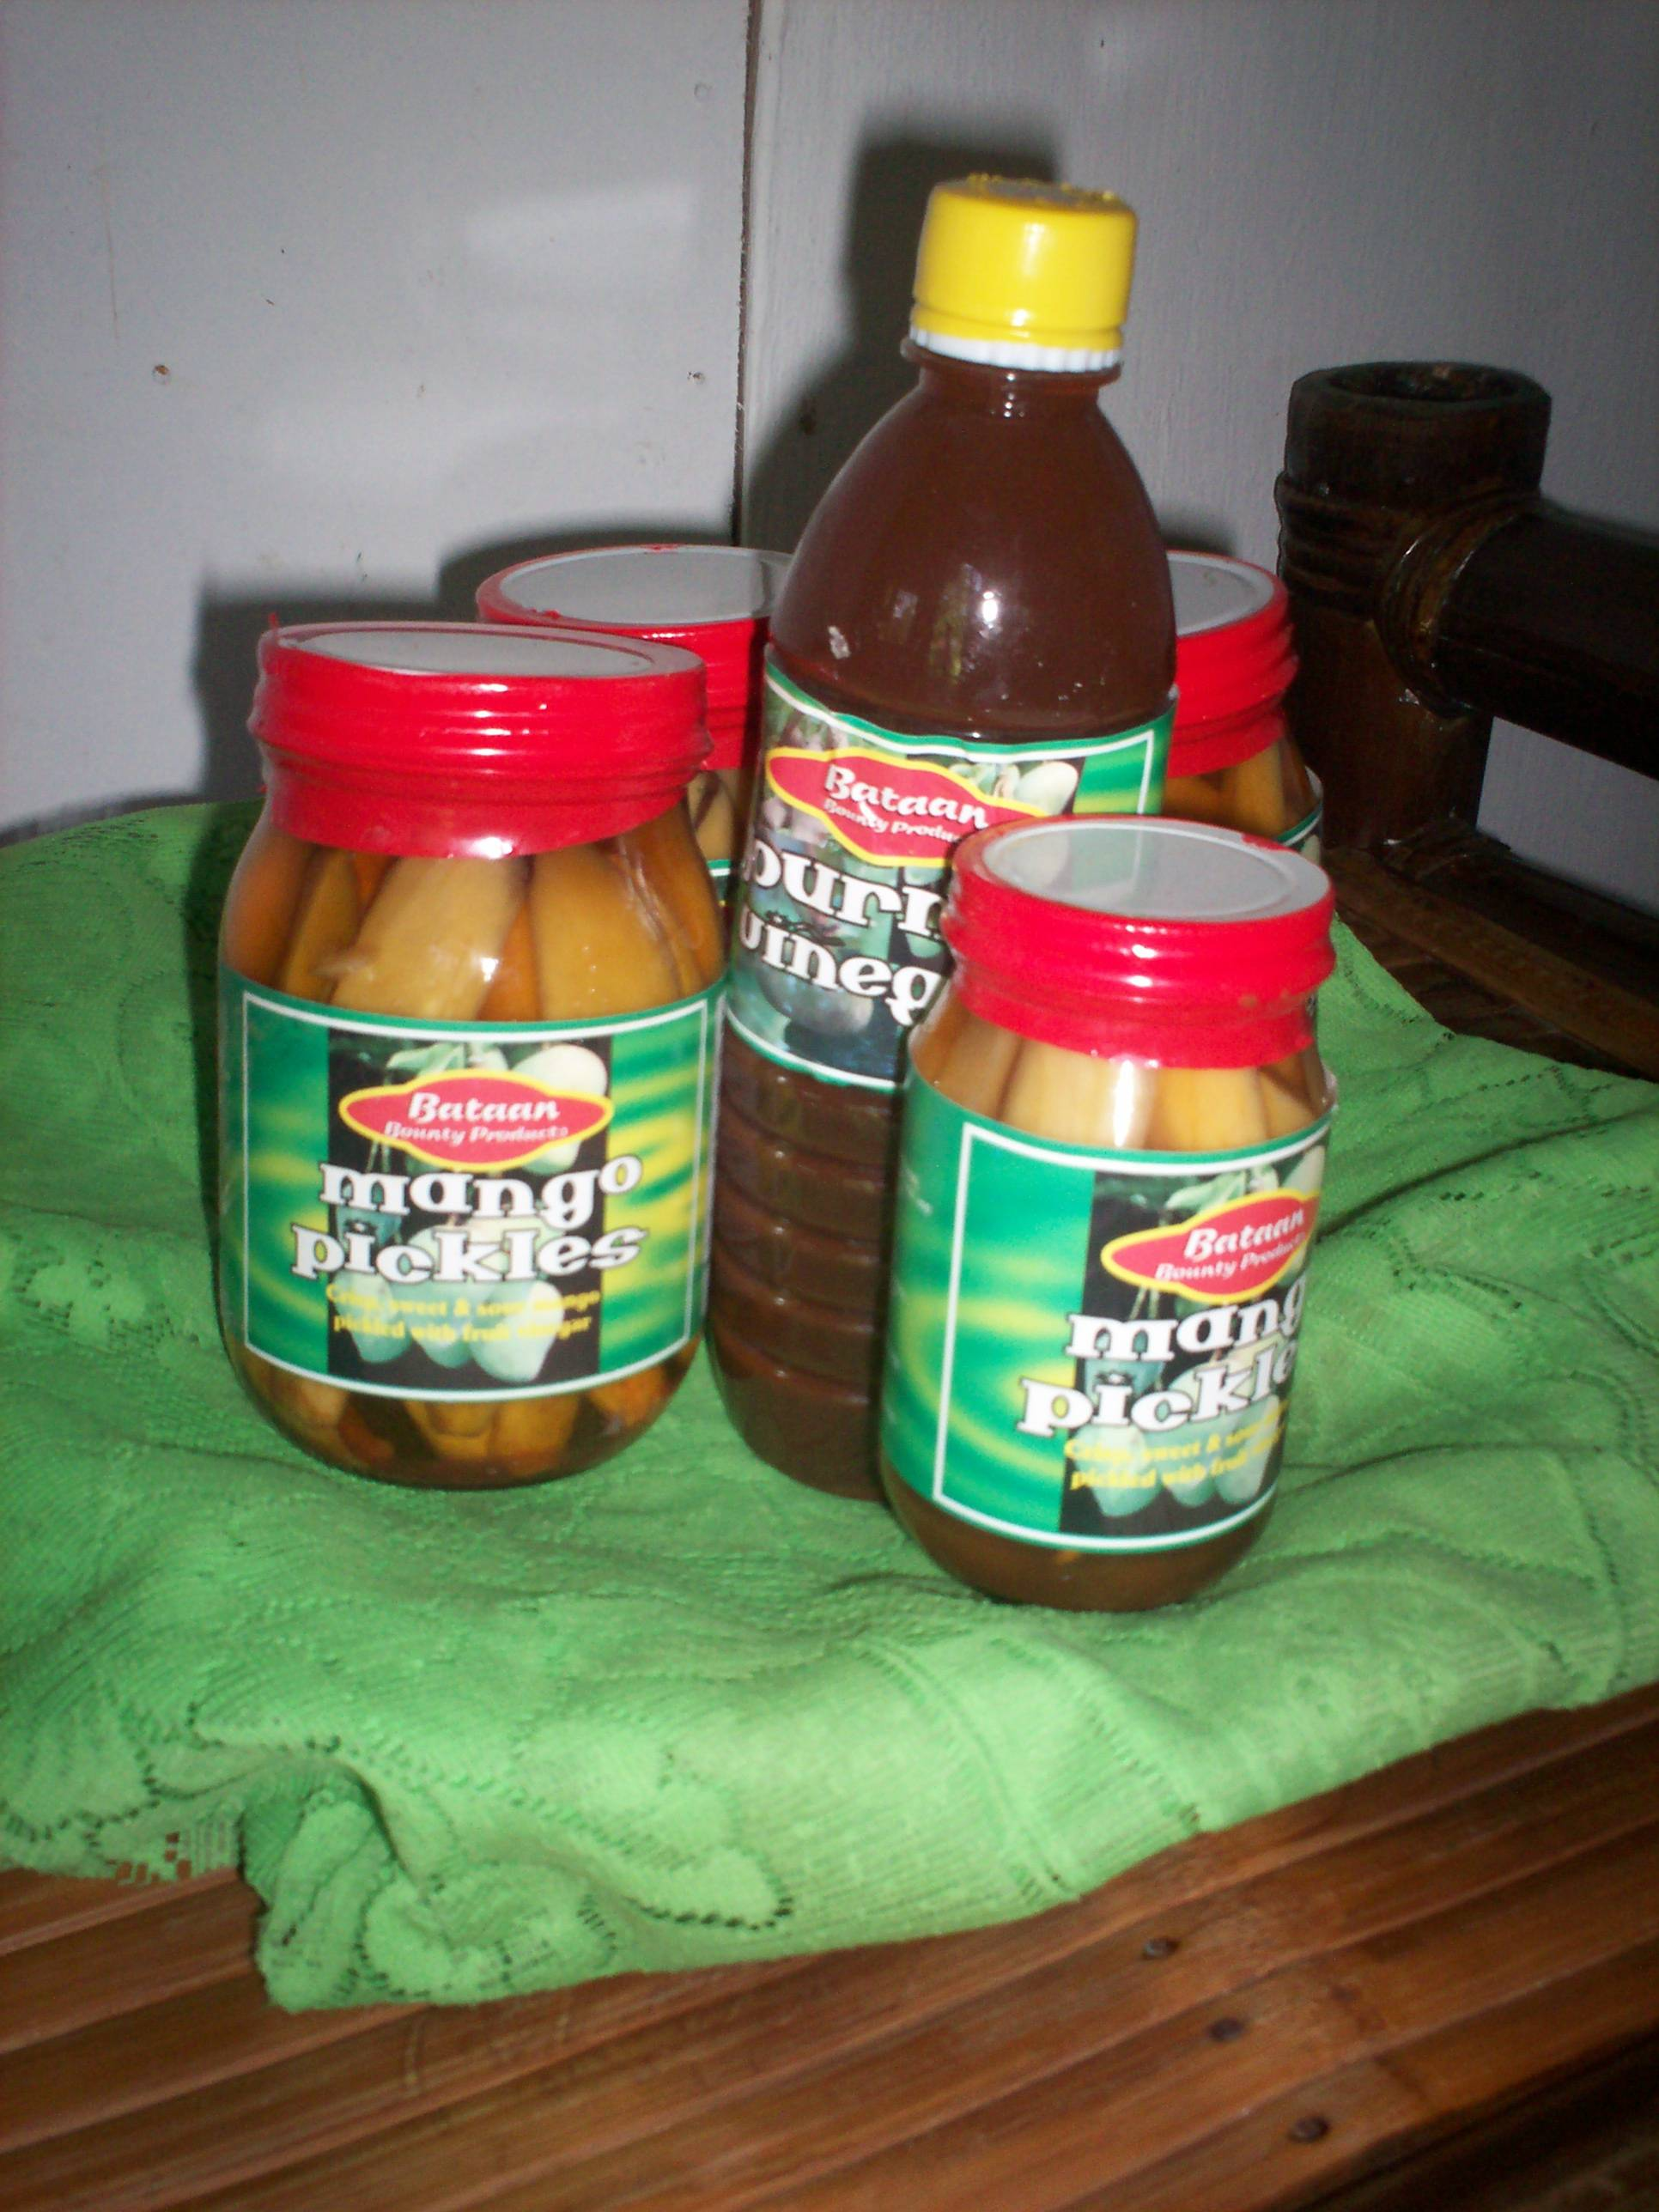
Wealth initiatives
Vegetable gardening
Processing of herbal tea, honey and forest fruits
Agroforestry, tree farming, nipa production
Eco-tourism (eco-guides, shed and huts along trail, brochure and video)
Rice trading
Buri product development and marketing

Slide 9
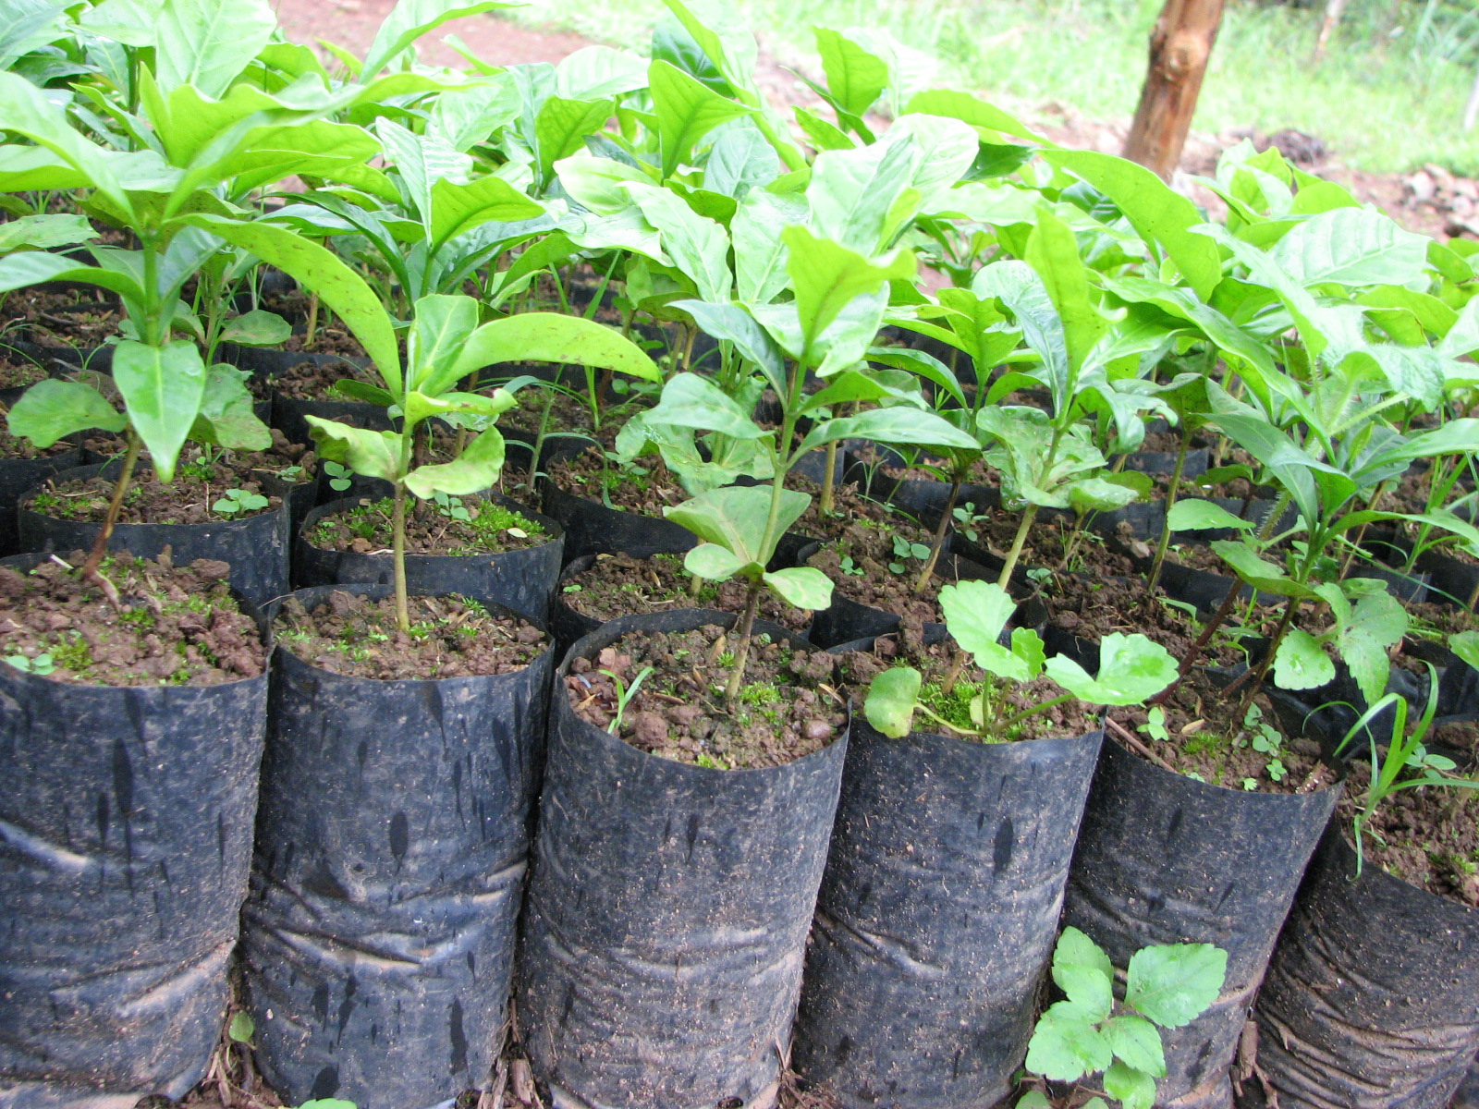
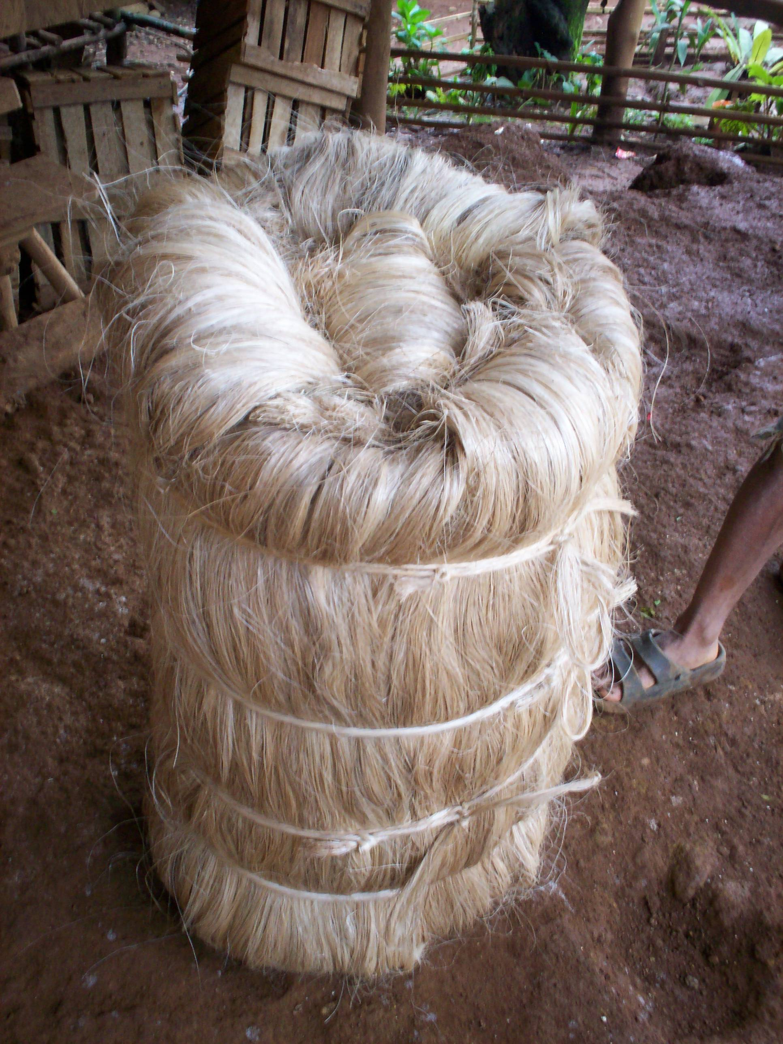
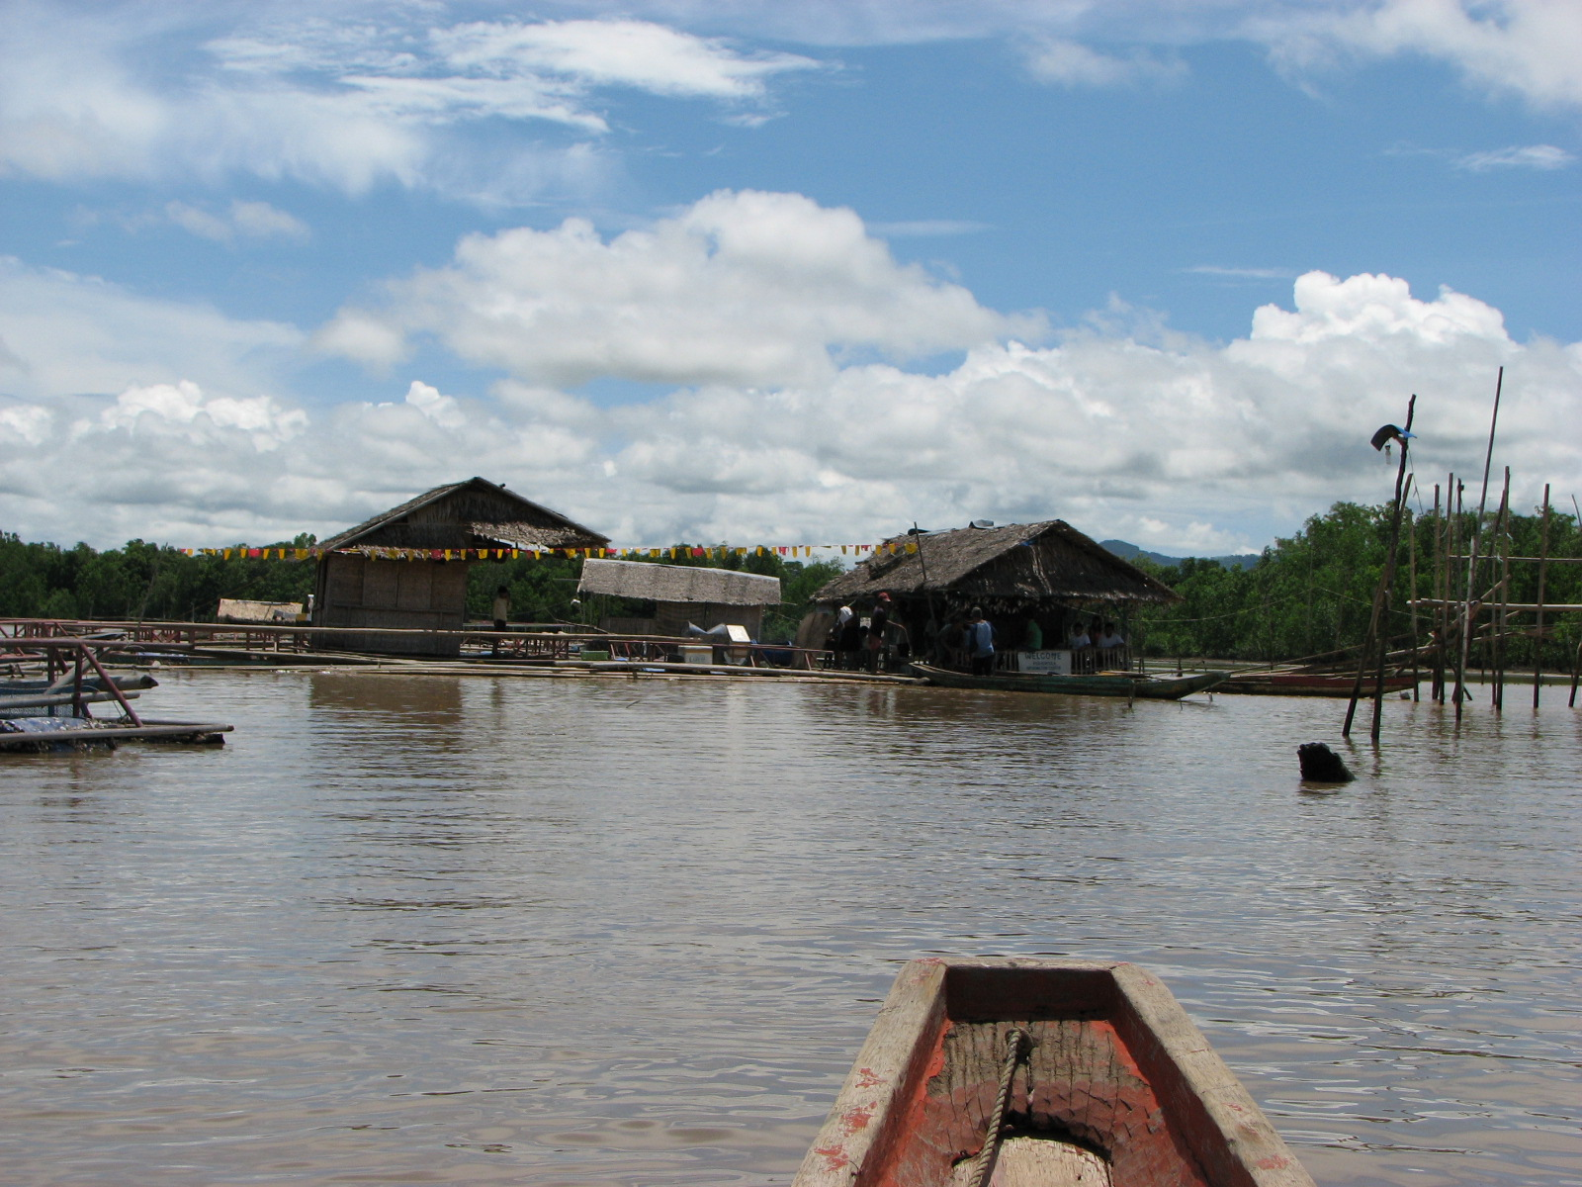
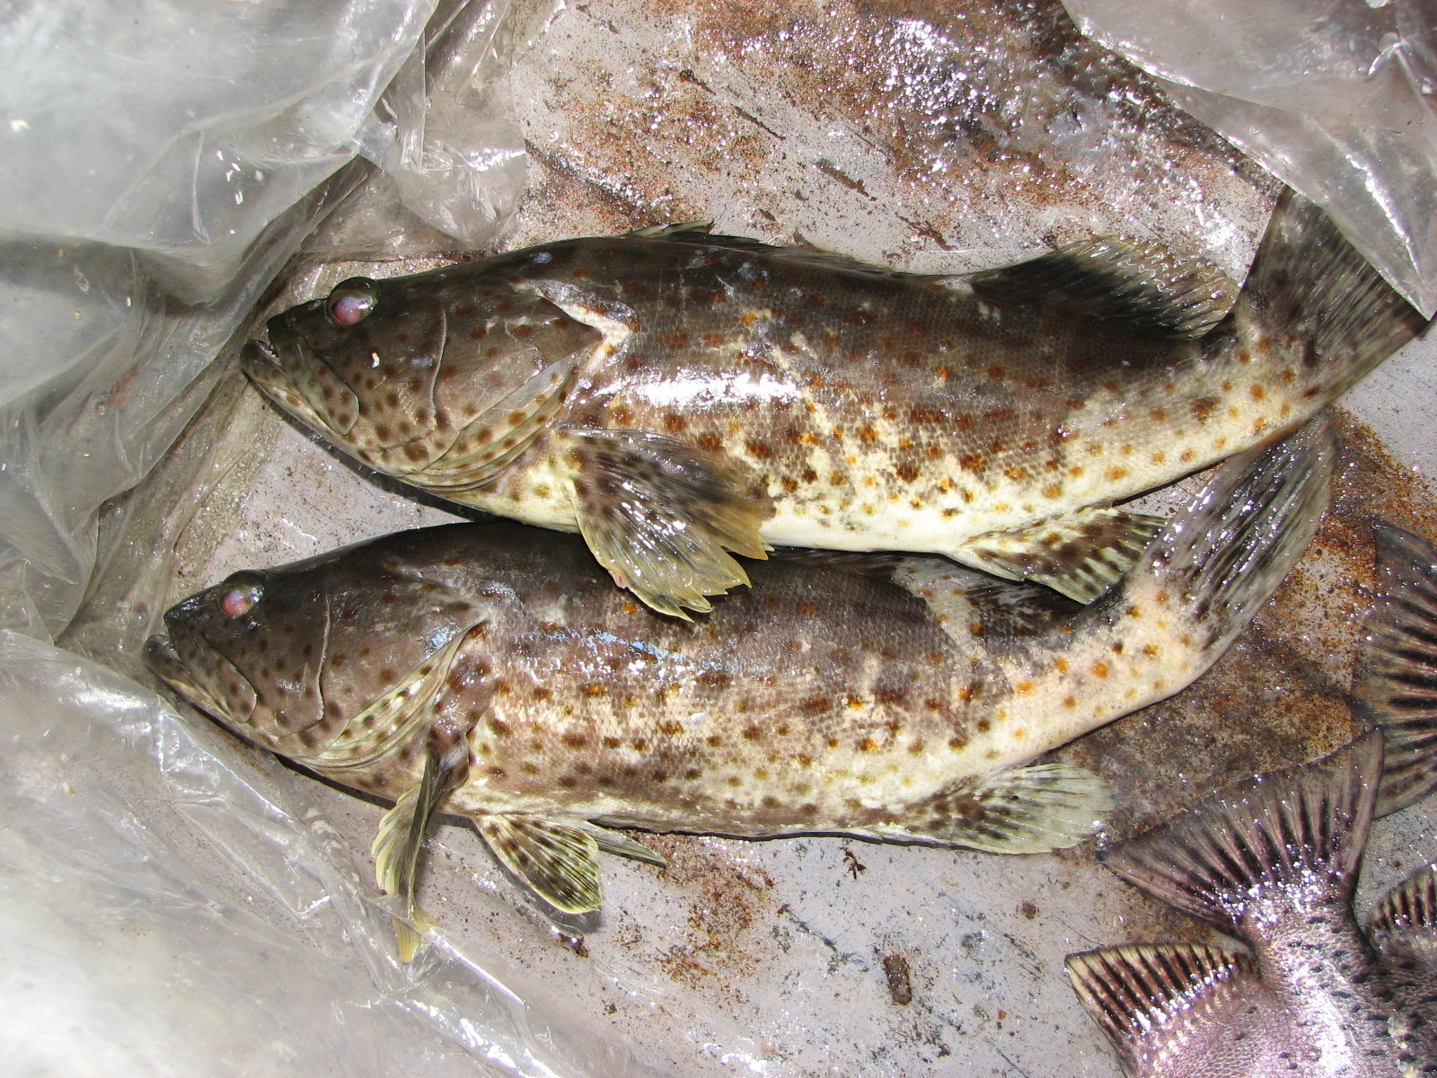
Wealth initiatives
Abaca and coffee production
“Tinagak (single strand knotted abaca fiber) processing and marketing
Aqua-culture based livelihood (fish cage, sea weed, mud crab, talaba, dried fish/squid)

Slide 10
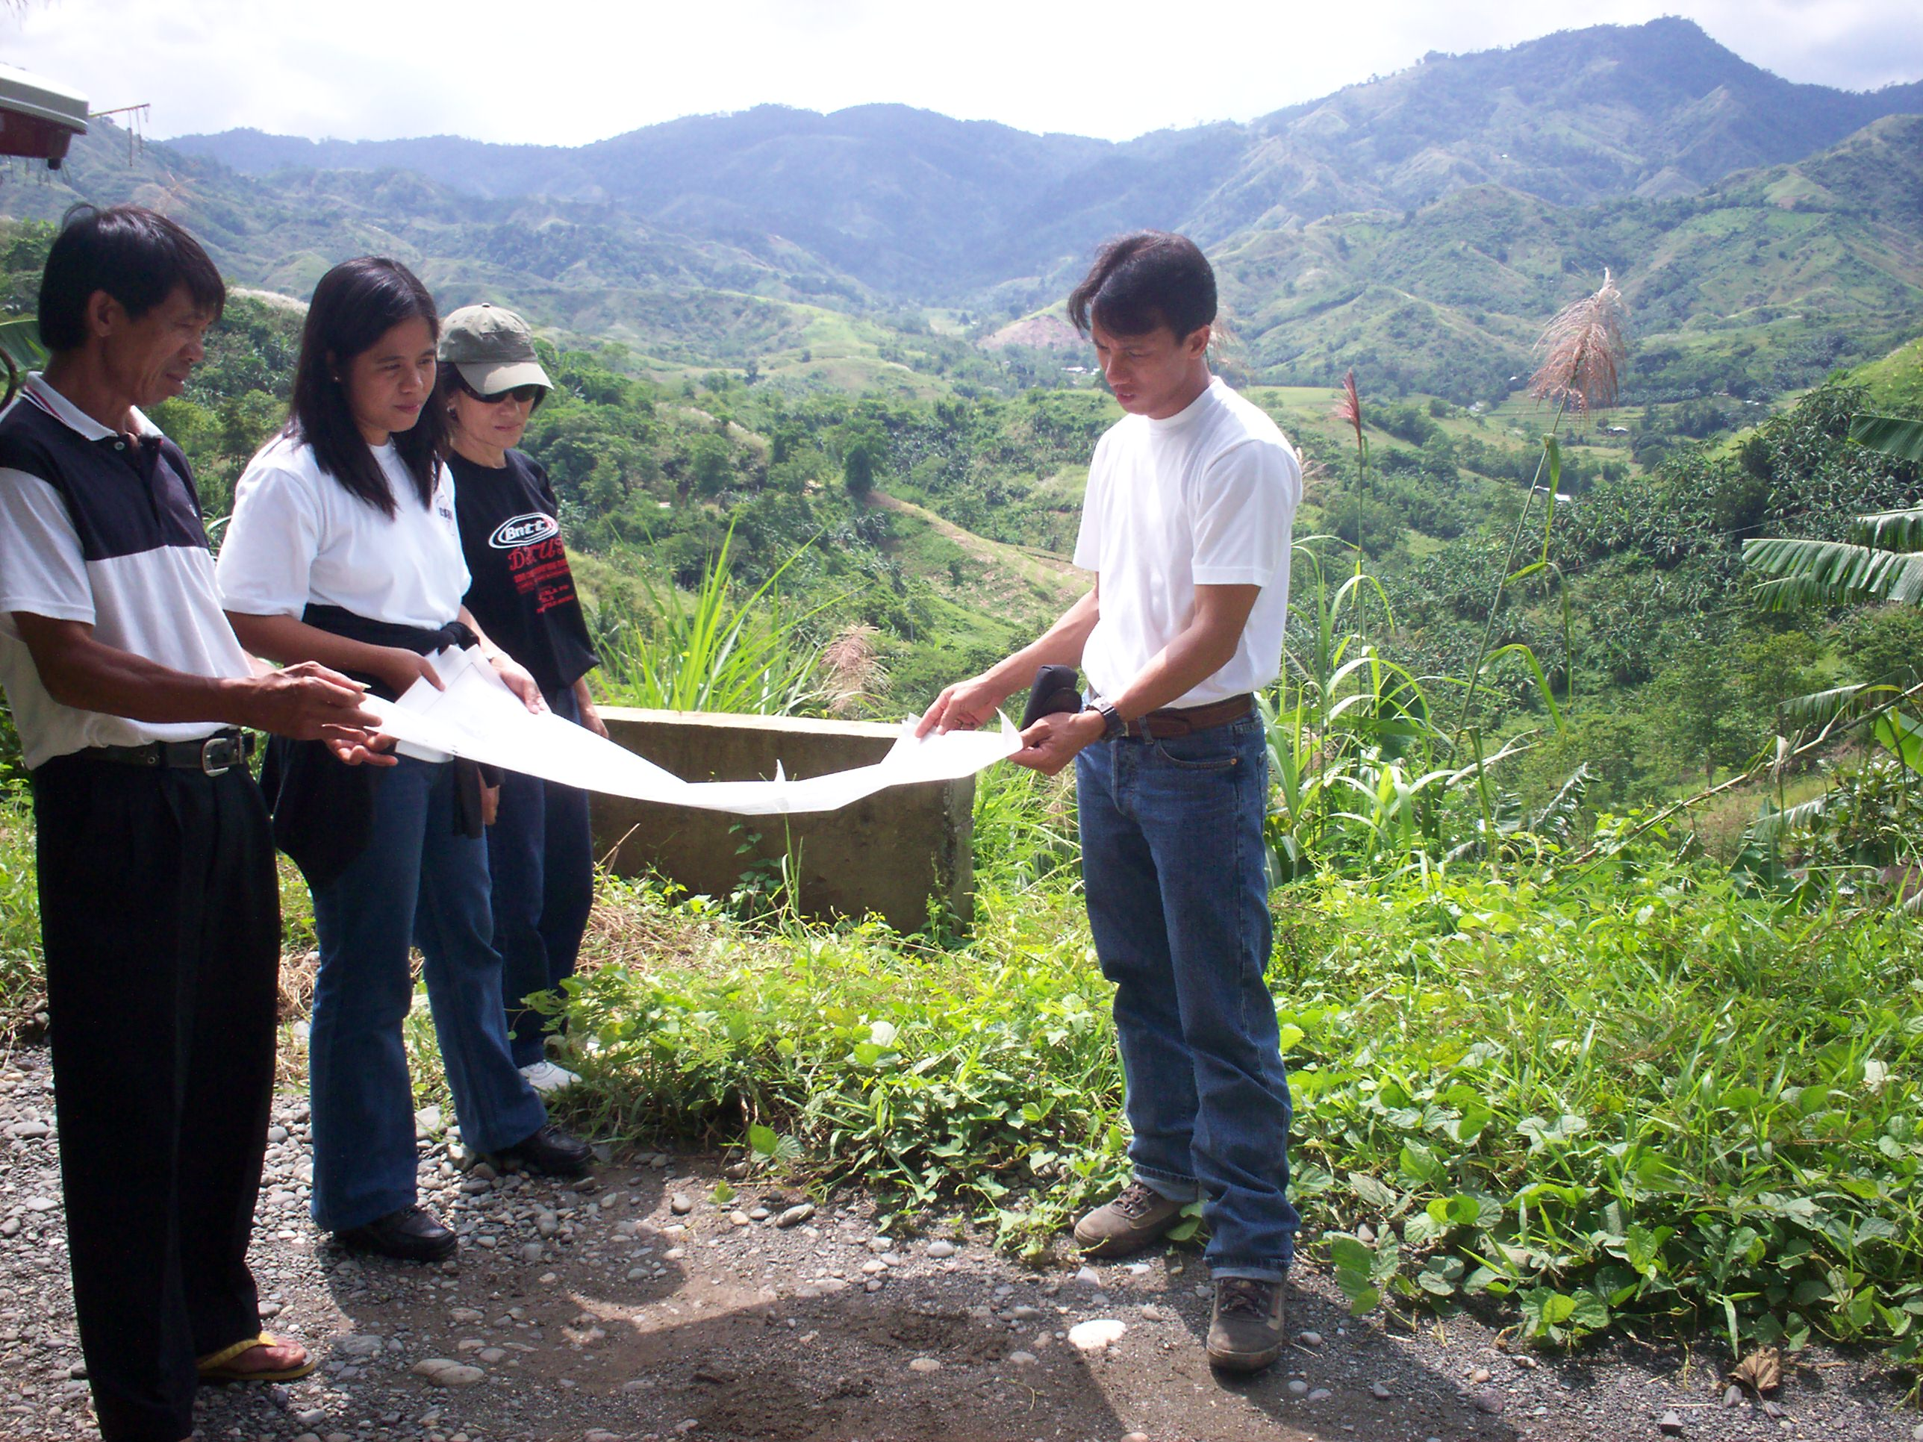
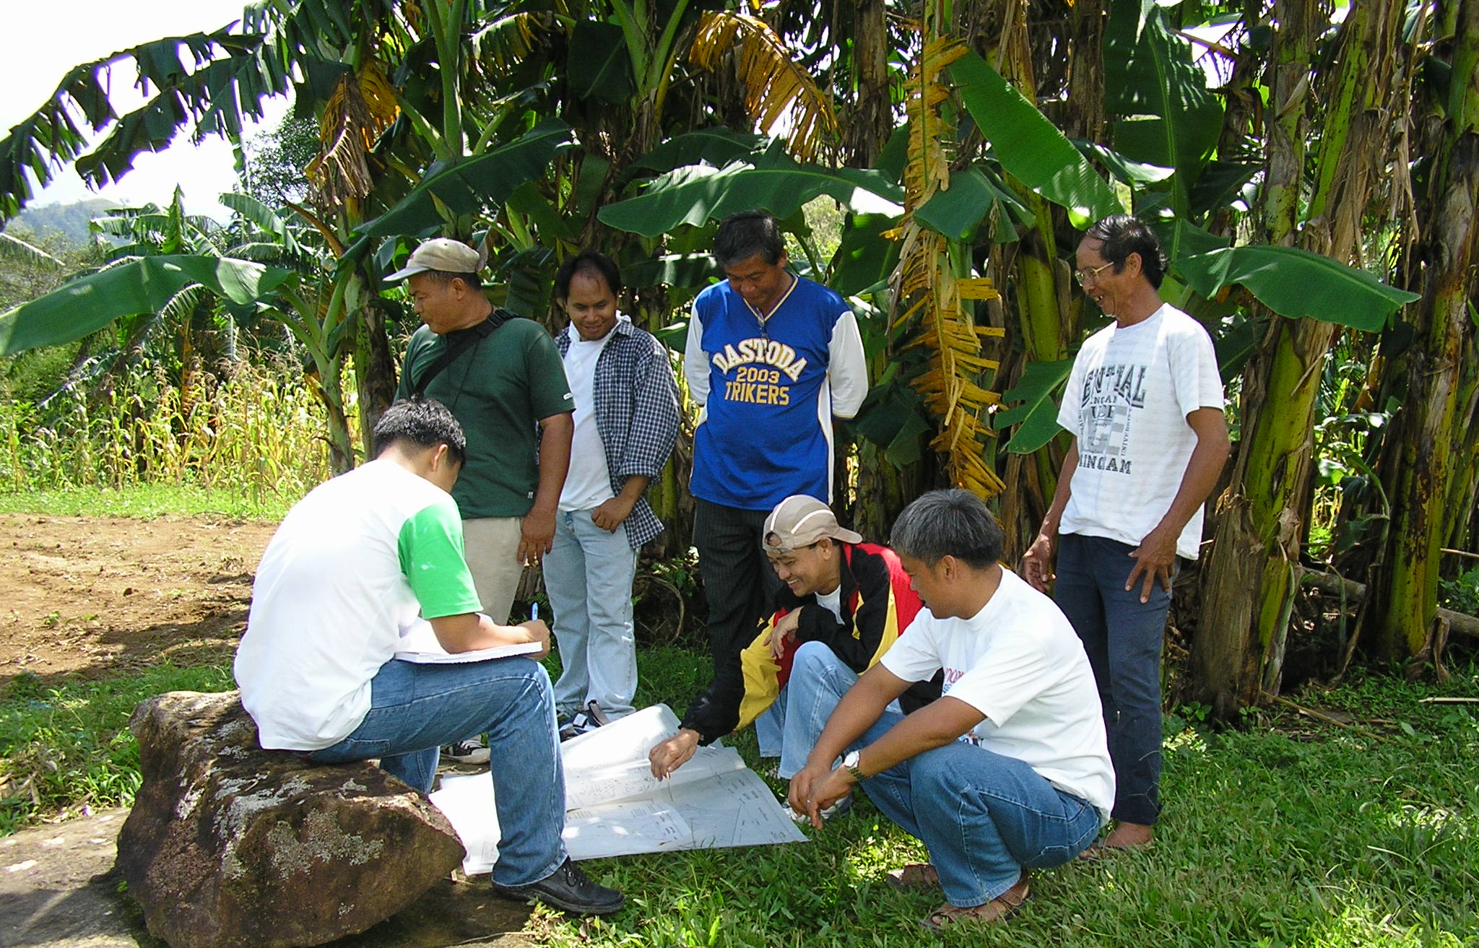
Power initiatives
ADSDPP/watershed mgt/land-use plan preparation
Delineation of ancestral domain claim/PA/watershed areas
CADT processing
Advocacy, awareness-building, information campaigns, mobilization and organizing.
Awarding of IPR within CBFMA
Technical, financial and organizational training/capacity building

Slide 11
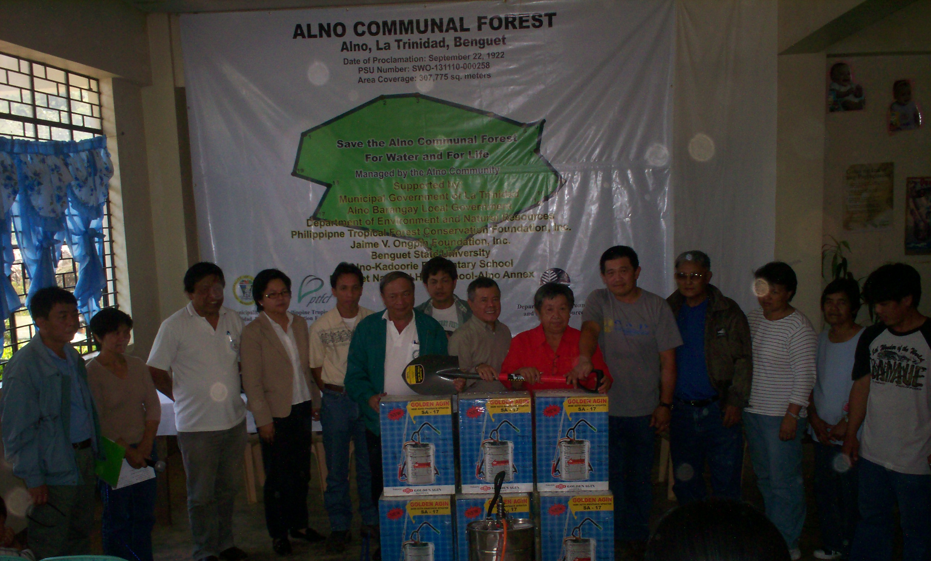
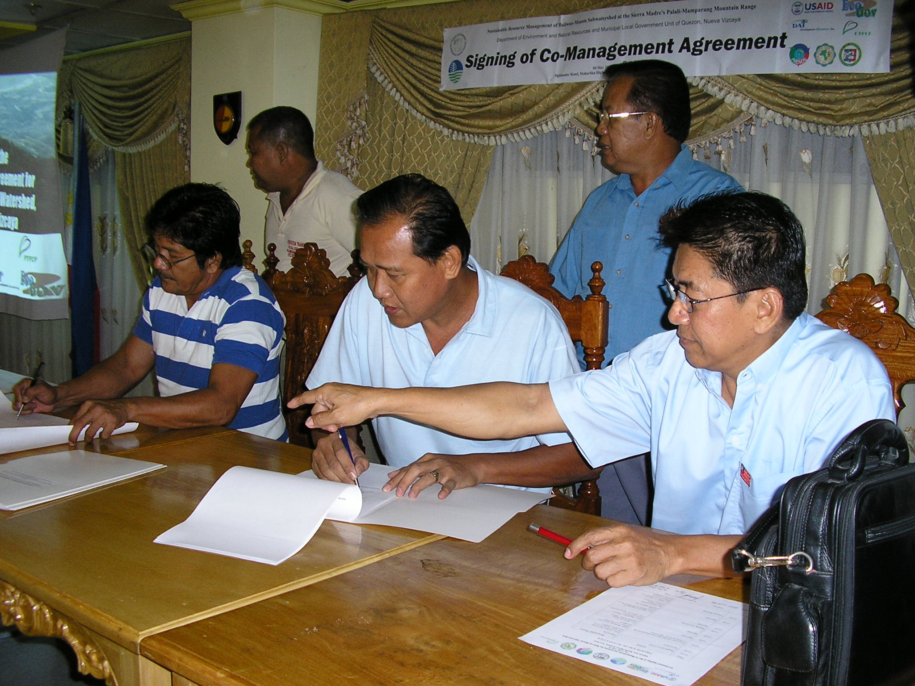
Power initiatives
Recruitment, training and operation of Bantay Lasang/Katunggan
Multi-stakeholder partnership for forest conservation

Slide 12
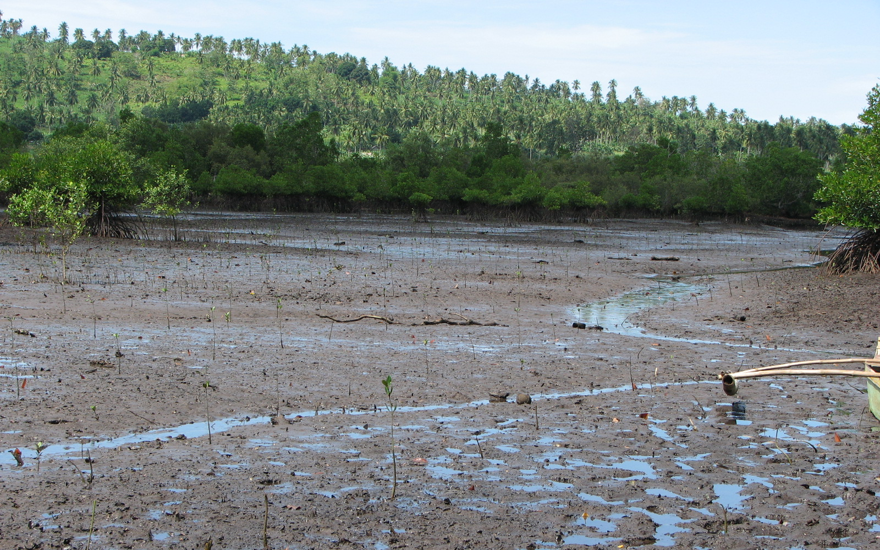
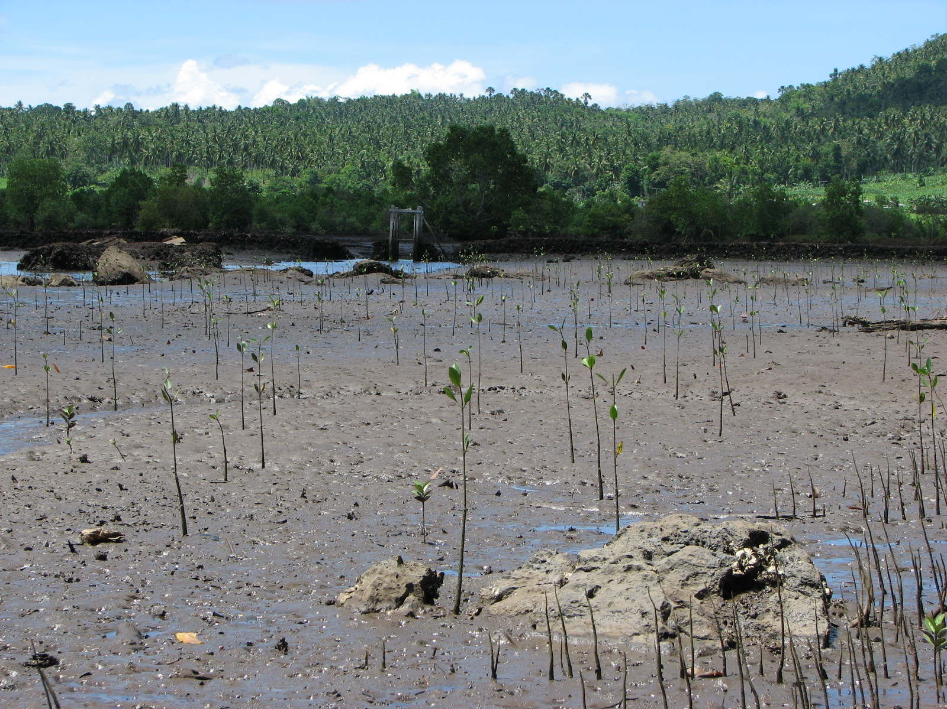
Power initiatives
Inventory of mangrove and FLAs
Cancellation of tax declaration of abandoned fishponds and subject to mangrove planting.
Co-mgt application
CRMF formulation

Slide 13
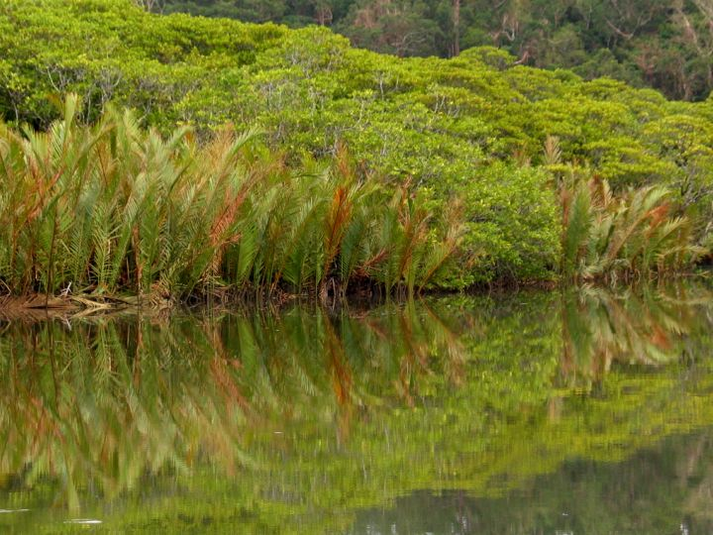
PTFCF initiatives
Natural Resources
3
1
13
12
6
Economic Growth
Governance
THANK YOU VERY MUCH…

