Slide 1



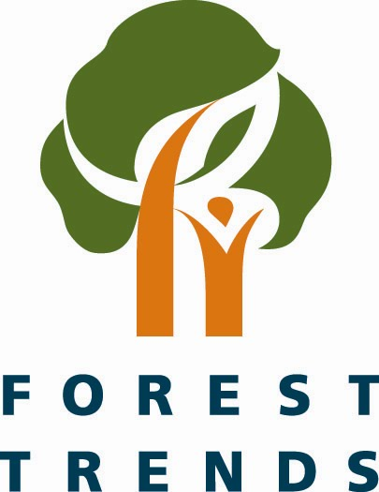


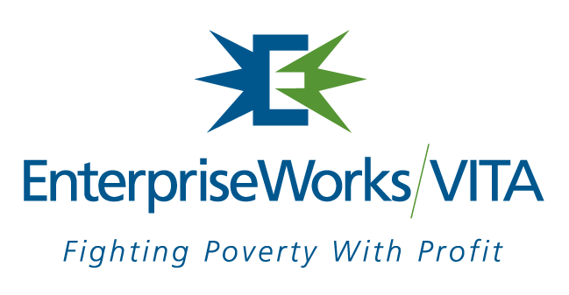

Welcome to the
Philippines Translinks Workshop
Proceedings CD
Prepared by EnterpriseWorks/VITA

Slide 2

This publication is made possible by the generous support of the American people through the United States Agency for International Development (USAID), under the terms of the TransLinks Leader with Associates Cooperative Agreement No.EPP-A-00-06-00014-00 to The Wildlife Conservation Society. TransLinks is a partnership of The Wildlife Conservation Society, The Earth Institute, EnterpriseWorks/VITA, Forest Trends and The Land Tenure Center. The contents are the responsibility of EnterpriseWorks/VITA and do not necessarily reflect the views of USAID or the United States government.

Slide 3
Philippines Translink Workshop
EnterpriseWorks/VITA hosted “Translinks: Linking Natural Resources, Economic Growth and Good Governance Workshop” on June 20-21, 2007 at Innotech in Quezon City, Philippines.
Translinks is a USAID-funded program under a Leader with Associates Cooperative Agreement and runs from 2007 through 2011. It is implemented by the Wildlife Conservation Society (WCS) in partnership with the Earth Institute’s Center for Environmental Research and Conservation at Columbia University, EnterpriseWorks/VITA, Forest Trends, and the Land Tenure Center at the University of Wisconsin.
The Philippines Translinks Workshop hosted 40 people.

Slide 4
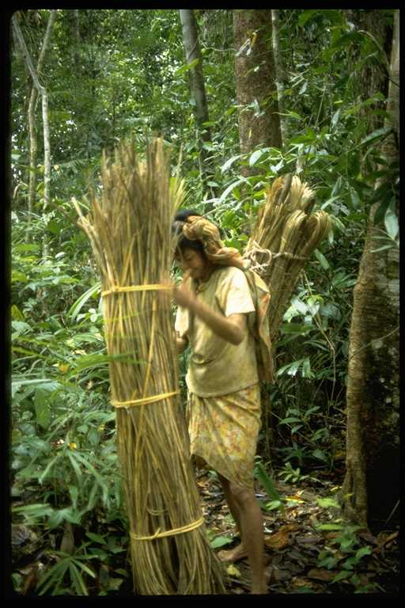

What this CD contains
The Philippines Workshop Proceedings are found in file folder “Proceedings”. This folder includes the executive summary for the workshop.
All the presentations made at the workshop are found in file folder “Presentations”.
Resource documents provided by the workshop participants are found in file folder “Resource Documents”.

Slide 5
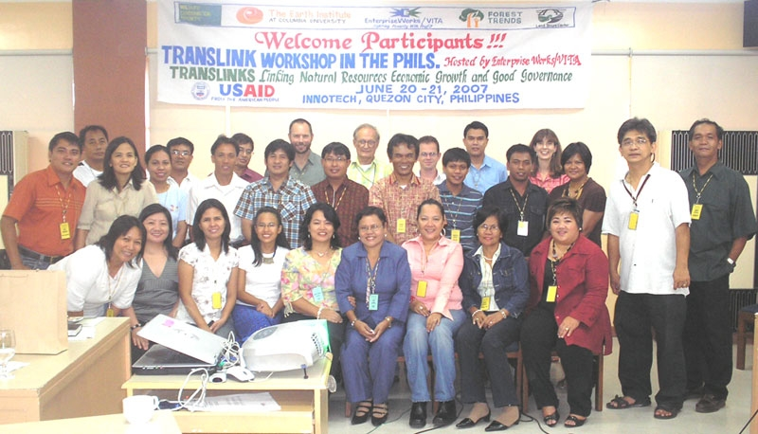
Our Thanks to …
All the presenters who traveled near and far and prepared excellent presentations.
The participants who gave their time, attention, input, and expertise.
USAID for providing the support to hold this valuable event and invest in the Translinks program.
The Translinks partnership, especially Wildlife Conservation Society, who are providing the guidance and mechanisms for learning to be captured beyond this workshop.
EnterpriseWorks/VITA Philippines staff who handled all the workshop logistics – well done.
Notes:
Will give example of natural products value chain
Will give examples for Philippines and Nepal.

Slide 6
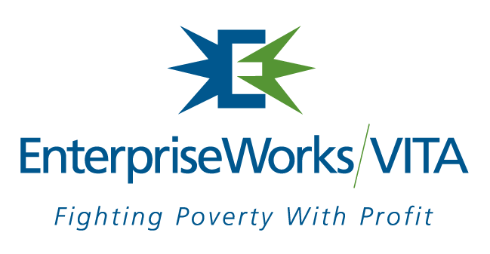
For more information contact…
EnterpriseWorks/VITA
1825 Connecticut Avenue NW, Suite 630
Washington, DC 20009, USA
Contact: Ann Koontz
Koontzann@enterpriseworks.org
www.enterpriseworks.org

