Slide 1
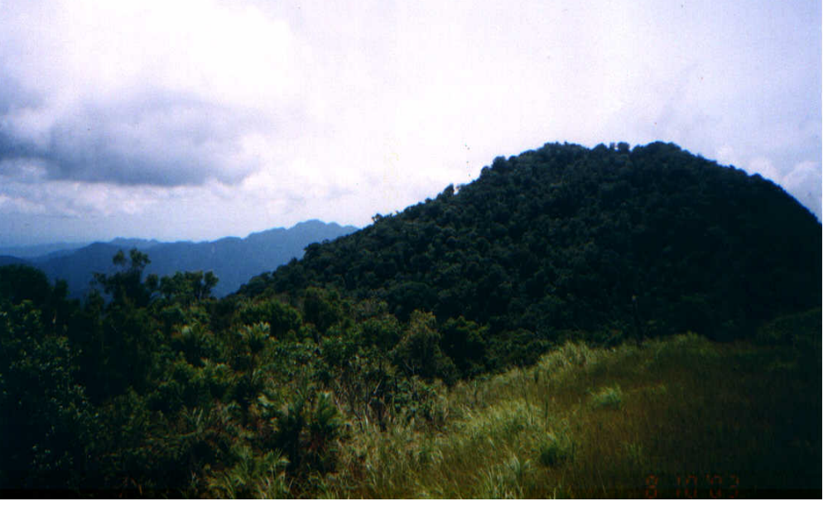
Tools for Measuring Nature Wealth and Power
EWV’s Biological Monitoring System and PO Assessment Methods in Region 2 and Palawan

Slide 2
Overview of the Presentation
How these tools were formulated
Monitoring framework
Introduction to the tools
What the tools provide us in terms of NWP analysis

Slide 3
BMS defined
A tool for measuring conservation impacts using ecological, social and economic criteria as indicators. This combines simple community-based techniques to complex measurements to gather the needed data in assessing the overall condition of natural resources.

Slide 4
Why Monitor Biodiversity?
To measure project impacts
A guide for planning
Determine optimum harvest levels for forest based enterprises
Shows the link between enterprise and forest use

Slide 5
BMS and the Project Planning Cycle
Biological Condition/Conservation Impacts
Project Intervention
Management Plans (CRMF, AWP, action plans)
Implementation (Reforestation, forest protection, IEC)
Technology (agroforestry, harvesting systems)
Project Monitoring and Evaluyation (POs, DENR, LGU, NGOs and other stakeholders
Threats to Biodiversity (Kaingin, fires, timber poaching, overharvesting of forest products)
Community/Social Response
(Socio-economic, cultural practices, technology)

Slide 6
Levels of Monitoring
DENR Monitoring –assessments, resource use permits, EIS, work plans, Management Plans
Overlap between DENR and Project Monitoring Systems
Project Monitoring System-
CBFM Baseline Assessments, Maps
PO Monitoring
Overlap between LGU-DA, enterprise and project monitoring systems
Overlap between DENR, DA-LGU and project monitoring systems
LGU, DA Monitoring and other monitoring that impacts biological resources- Barangay Profiles, organizational capacity
Enterprise Monitoring –Financial records, inventories, CDA monitoring
Overlap between PO, DENR, LGU-DA, enterprise and project monitoring systems
Notes:
BMS takes note of various monitoring systems at various levels, these monitoring systems in one way or the other has overlaps that may include the parameters the BMS wants to look at. For example, enterprise monitoring systems for rattan harvesting can give us a rough figure on the volume of rattan poles needed for a local shop to operate. The LGU has a database of the socio-economic components including land uses (for those with FLUPs. The CBFM has its own monitoring system that includes for instance: area reforested, area applied with ANR, area being protected or declared as “no touch zones”

Slide 7

3 Things the BMS is looking at
Ecological Health and Vitality – ecosystem indicators
Threats to natural resources – human activities in the locality that contributes to degradation of biodiversity in the area
Social response – technology adaptation, reacting to changes in the environment

Slide 8
Ecological Health and Vitality
Measurable Verifiers
1. Area of habitat –in hectares
2. Number - population
3. Density - number per area
4. Volume – for species being harvested
5. Increment – for regeneration rates
6. Species diversity – number per hectare
7. Stratification –horizontal and vertical
Notes:
In measuring biodiversity and forest resources we also borrow concepts from mathematical variables, we also borrow statistical and mathematical models to measure trends in relation to the ecosystem

Slide 9
Steps
Delineate area to be monitored (CBFM Boundary)
Identify concerned groups and introduce BMS
Identify sampling points or plots
Determination of project goals and objectives
Identify the things to monitor – i.e. forest cover increase, reduction of kaingin,
Notes:
Before we start with the monitoring we should first determine where to monitor-for the CBFM context, this often refers to the CBFM boundary, for FLUPs, this is limited by territorial boundaries
Since this involves concerns from different groups and the interaction between the economy, forest resources and institutions it is often effective to involve all concerned groups
Sampling units refers to who or who to interview among the institutions concerned and identifying sampling plots in a particular area.
Monitoring should be simple and be consistent with the goal of the community

Slide 10
Suggested Methods
Transect walk –simply making observations along a predefined path

Slide 11
Methods Used
2. Key Informant Interviews – using a set of questionnaires, respondents should have an in-depth knowledge of the subject being discussed

Slide 12
Methods Used
3. Focused Group Discussion

Slide 13
Methods Used
4. Community Mapping

Slide 14
Methods Used
5. Inventory of Forest Resources

Slide 15
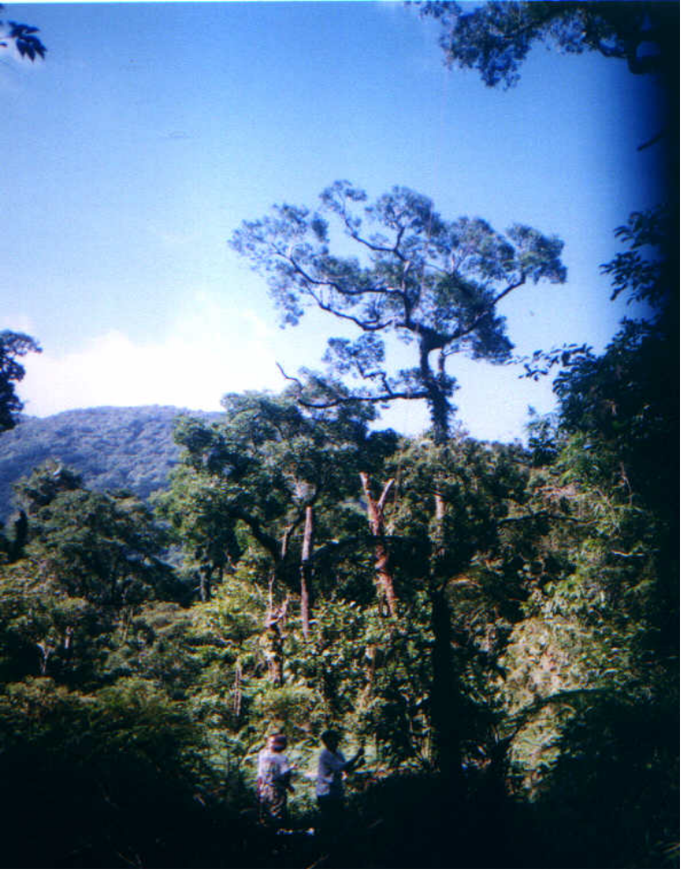
Methods Used
6. Photo documentation

Slide 16
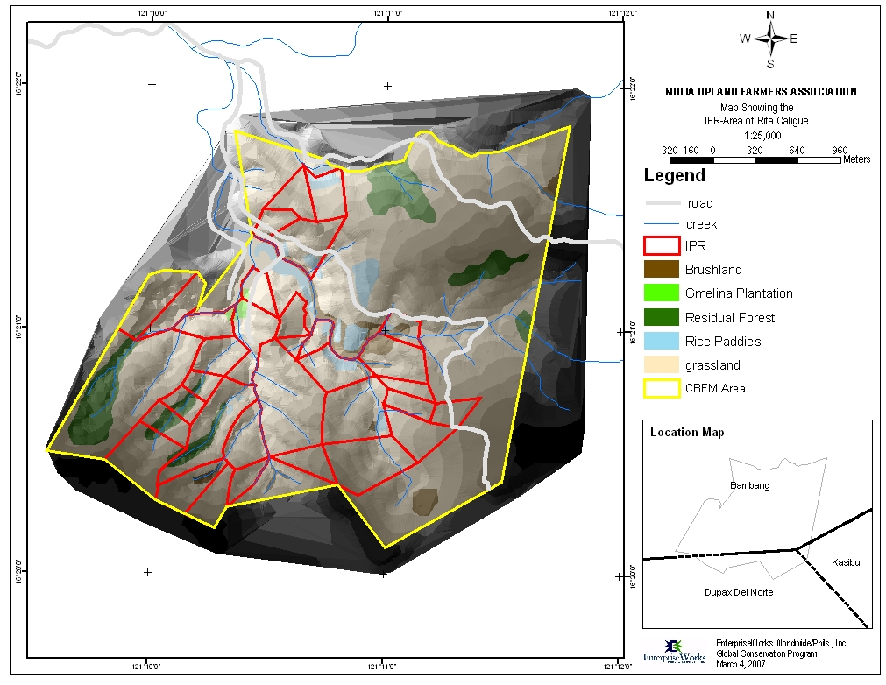
Methods Used
7. GIS Integration – allows us to store, analyze and integrate spatial information

