Slide 1
Hibernate

Slide 2
Enterprise Application Architectures

Slide 3
N-Tier Architecture
Application is made up of layers or tiers.
Common tiers
Presentation
Service
Persistence

Slide 4
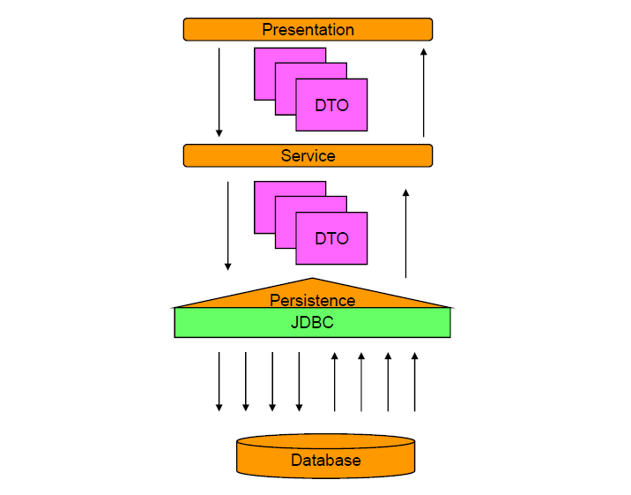
N-Tier Architecture

Slide 5
DAO Design Pattern
Data Access Object
Abstracts CRUD (Create, Retrieve, Update, Delete)operations
Benefits
– Decouples persistence layer
– Encourages and supports code reuse

Slide 6
Traditional Persistence
Persistence With JDBC

Slide 7
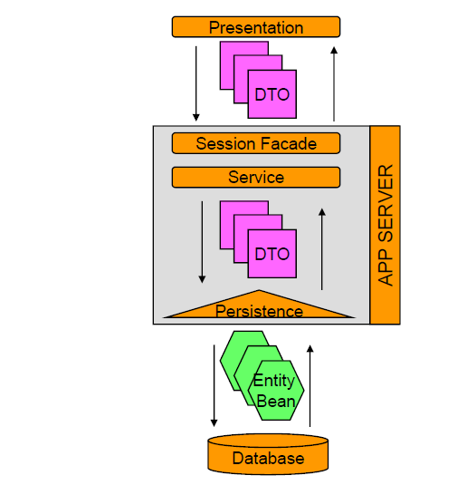
Traditional Persistence
Persistence with EJB 2.x

Slide 8
JDBC Overview
JDBC API provides ability to
– Establish connection to a database
– Execute SQL statements
– Create parameterized queries
– Iterate through results
– Manage database transactions

Slide 9
JDBC Overview
Basic Steps to JDBC Operations
1. Load driver or obtain datasource
2. Establish connection using a JDBC URL
3. Create statement
4. Execute statement
5. Optionally, process results in result set
6. Close database resources
7. Optionally, commit/rollback transaction

Slide 10
Common Problems with JDBC API
You must manually handle database connections.
You have to write a lot of bulky code.
You have to manually handle associations.
The code isn’t portable to other databases

Slide 11
EJB 2.x Overview
EJB API provides ability to
– Map object model to database tables
– Hand off management of database connections
– Take care of relationship management
– Manage transactions
– Use callback methods.
– Search for desired objects
– Access Control

Slide 12
EJB 2.x Overview
Basic Steps to EJB Operations
1. Create your EJB
• Home Interface
• Remote Interface
• Bean Class (implementation class)
2. Setup deployment descriptors
• ejb-jar.xml
• Container specific EJB descriptor (<container>-ejb-jar.xml)
3. In code, look up the EJB Home Interface
4. Create an instance of the EJB off the Home Interface, using attributes passed in through the method call

Slide 13
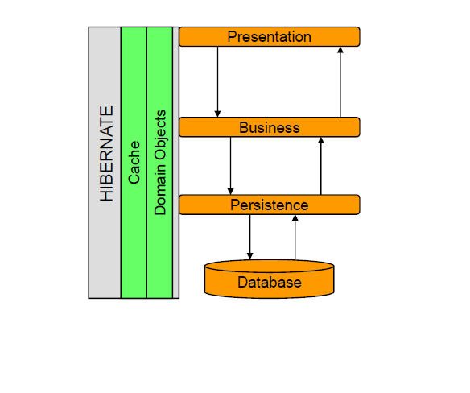
Traditional Persistence vs. Hibernate

Slide 14
Hibernate
ORM ( Object Relational Mapping) Tool.
Used in the DATA LAYER of Application
Implements JPA.

Slide 15
Need for Hibernate
3 Reasons
Performance
Effective Cross-Database Portability
Developers' Productivity

Slide 16
Why Hibernate?
Impedance mismatch
– Object-oriented vs. relational
Failure of EJB 2.x
– Entity Beans were extremely slow, complex
Java developers are not database developers
Increase performance by deferring to experts

Slide 17
ORM
Software Product/Application
Application → Object Model
Database → Relational Model

Slide 18
ORM
USER CLASS
Id
Name
Dob
address
Id | Name | Dob | Address

Slide 19
ORM-Challenges

Slide 20
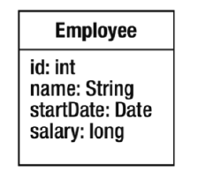
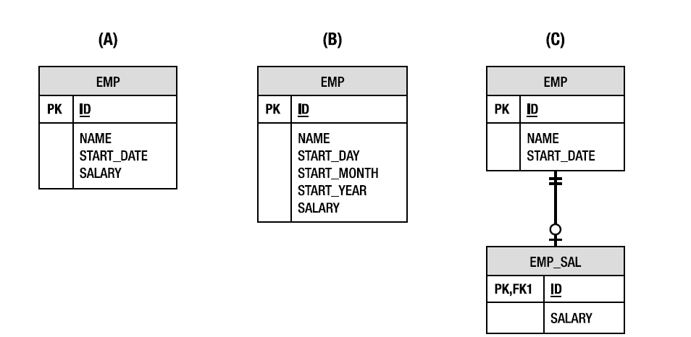
ORM- Impedance Mismatch
Object Model
Relational Model

Slide 21
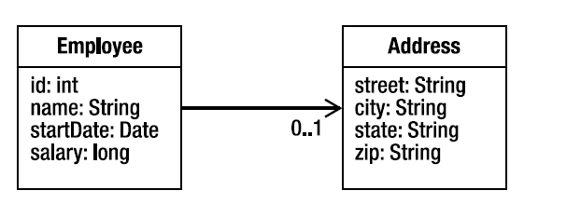
ORM-Relationships
Object Model with relationship

Slide 22
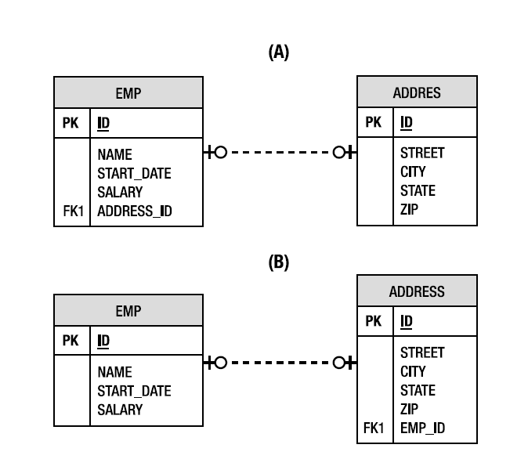
ORM-Relationships
Relational Model

Slide 23
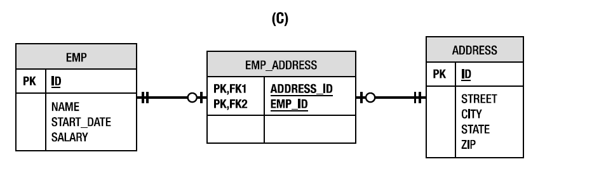
ORM-Relationships
Relational Model

Slide 24
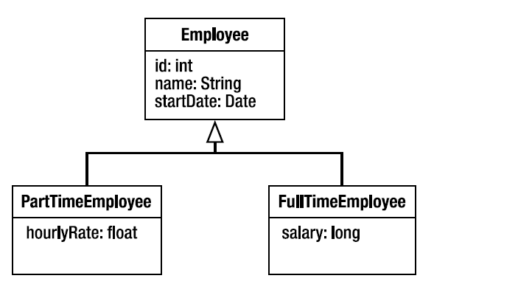
ORM-Inheritance
Object Model with Inheritance

Slide 25
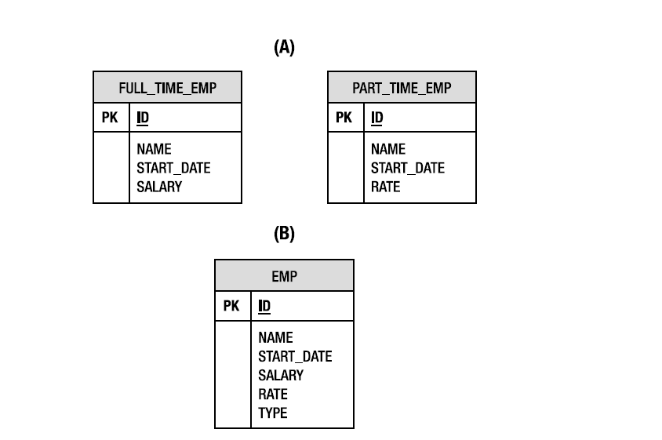
ORM-Inheritance

Slide 26
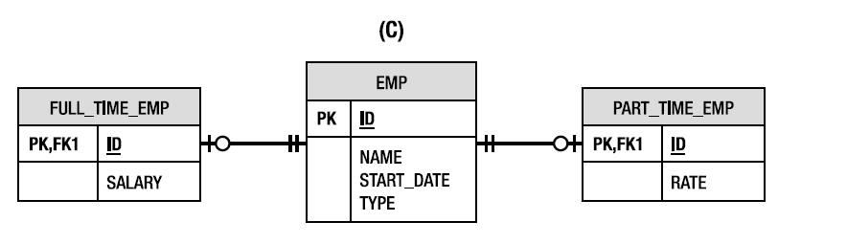
ORM-Inheritance

Slide 27
Setting Up Hibernate

Slide 28
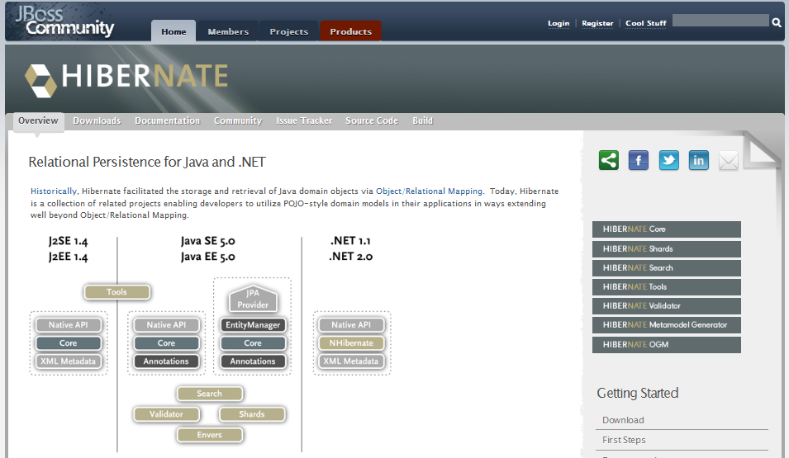
download
www.hibernate.org

Slide 29
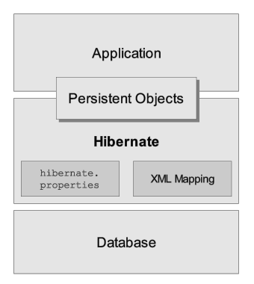
Hibernate architecture

Slide 30
Configuration
3 ways
Programmatic
Properties File
XML Based

Slide 31
XML Based Configuration
For Hibernate's configuration, we can use a hibernate.cfg.xml file.
Most users prefer the XML configuration file.
XML Need to present in project's CLASSPATH

Slide 32
Persistent Classes
Classes in an application that implement the entities of the business problem
(e.g. Customer and Order in an E-commerce application).

Slide 33
Persistent Classes-Rules
Simple POJO
Implement a no-argument constructor
Provide an identifier property
Prefer non-final classes
Declare setters/getters for persistent fields (optional)

Slide 34
O/R Mapping
Object/relational mappings can be defined in three approaches:
using Java 5 annotations (via the Java Persistence 2 annotations)
using JPA 2 XML deployment descriptors
using the Hibernate legacy XML files approach known as hbm.xml

