Slide 1
PROJECT DEFENCE ON
WEB-BASED HELP DESK SYSTEM
A CASE STUDY OF GOMBE STATE UNIVERSITY
BY BASHIR ISMAIL UG17/SCCS/1022
SUPERVISED BY
MR. ABDULKADIR A. LAMIDO

Slide 2
INTRODUCTION
A Help desk or service desk is a one-stop point of contact that provides centralized information and support management service to handle a company’s internal or external queries. A help desk system can generally collect complaints, and store them and these records are collected by the appropriate authority and then decide on the next step to be taken in solving the issues.
1

Slide 3
STATEMENT OF THE PROBLEM
Manual complain record keeping has resulted in many setbacks to the expected standard. The setback encountered include:
People are facing many difficulties while transferring data/information from one place to the other
Time wastage in manual processing of information and at times there is delay in response from the university staff.
Partial or total loss of file or documents.
2

Slide 4
AIMS AND OBJECTIVES
The aim of the project is to design and implement a web application titled “Help desk System”. The main objectives of this system are:
To develop, promote, and provide adequate and efficient way for storing, managing and maintaining students complains.
To save the time wasted when using the manual method of gathering students complains and providing feedback.
To provide quick responds to students complains within the campus.
3

Slide 5
METHODOLOGY USED
The SDLC or system development life cycle that was used is a Waterfall model. Waterfall model is chosen to develop this system because almost all the requirements are known. The waterfall model is sequential software development model in which the development process is seen as flowing steadily downward (waterfall) through several phases.
4

Slide 6
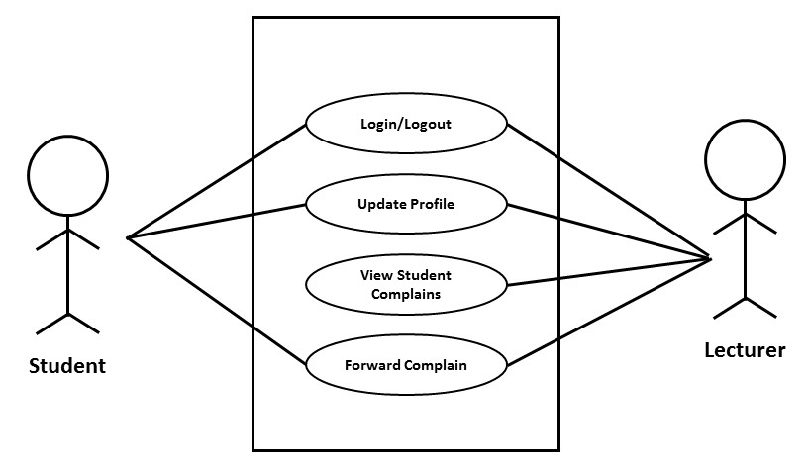
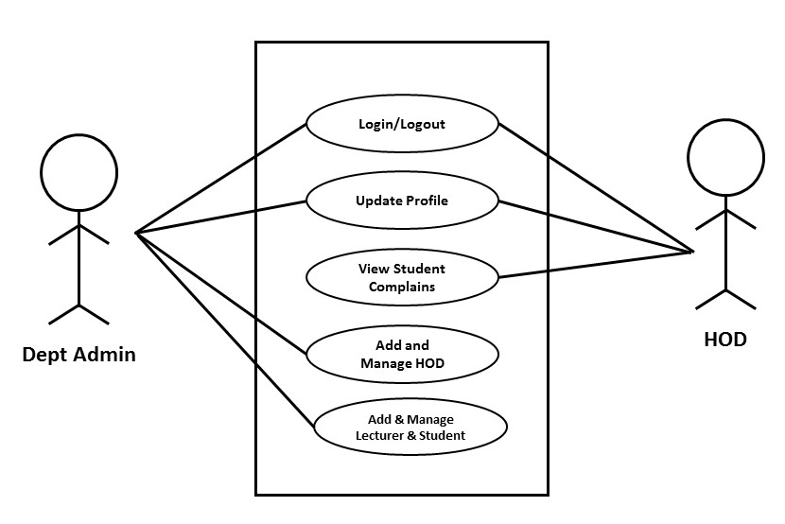
TOOLS USED FOR DESIGN AND ANALYSIS
USE CASE DIAGRAM
5

Slide 7
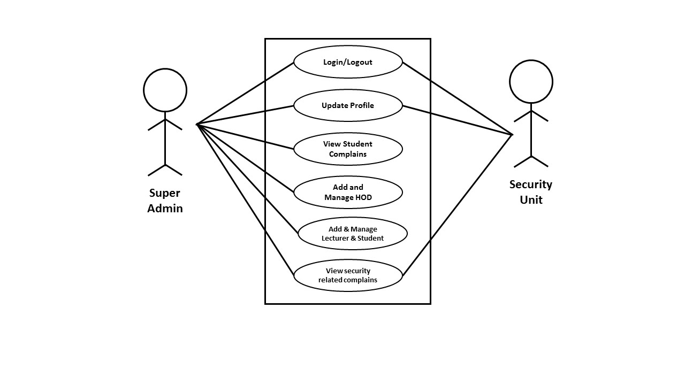
TOOLS USED FOR DESIGN AND ANALYSIS
USE CASE DIAGRAM
6

Slide 8
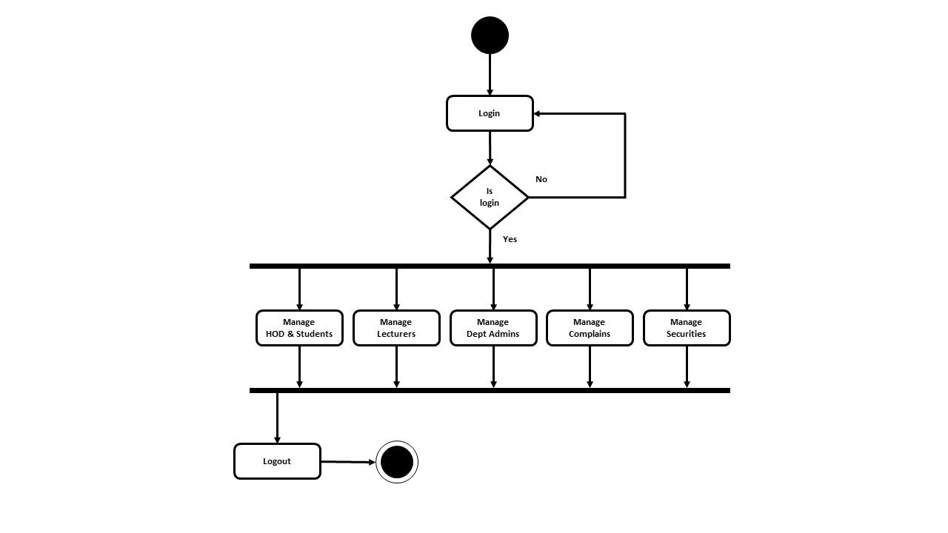
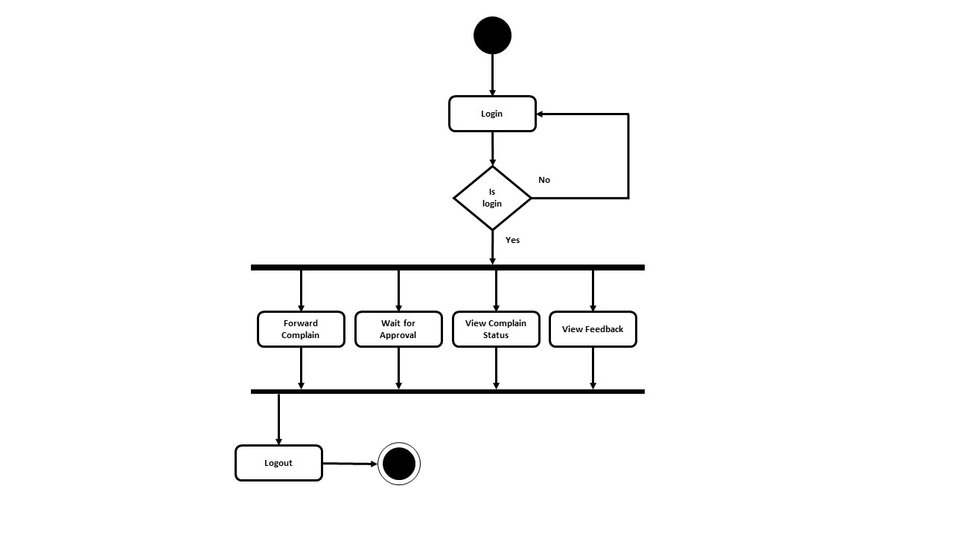
TOOLS USED FOR DESIGN AND ANALYSIS
ACTIVITY DIAGRAM
7

Slide 9
FUNCTIONAL REQUIREMENTS
These requirements describe what the system should do and how it should behave in different scenarios.
• Allow all the users to login and out of the system
• Students can forward their complains to lecturers, HODs, securities
• Head of departments can view complains from lecturers and students.
• Student can also report on bad activities like stealing in the school to the security unit.
8

Slide 10
NON-FUNCTIONAL REQUIREMENTS
Requirements that describe how the system should perform and behave in terms of quality attributes such as performance, reliability, security,
• The system should always be available when needed.
• The system should be able to process and store complaint data securely, protecting sensitive student information.
• The system should have a user-friendly interface that is easy to navigate • The system should provide fast response times for user actions.
9

Slide 11
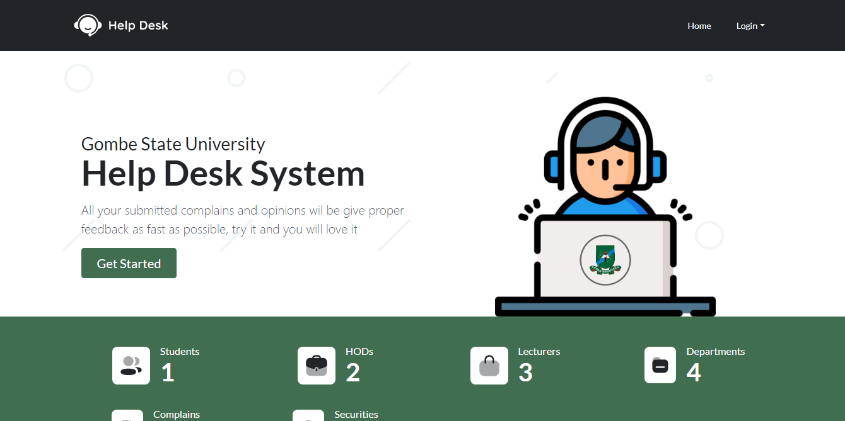
USER INTERFACE
HOMEPAGE
10

Slide 12
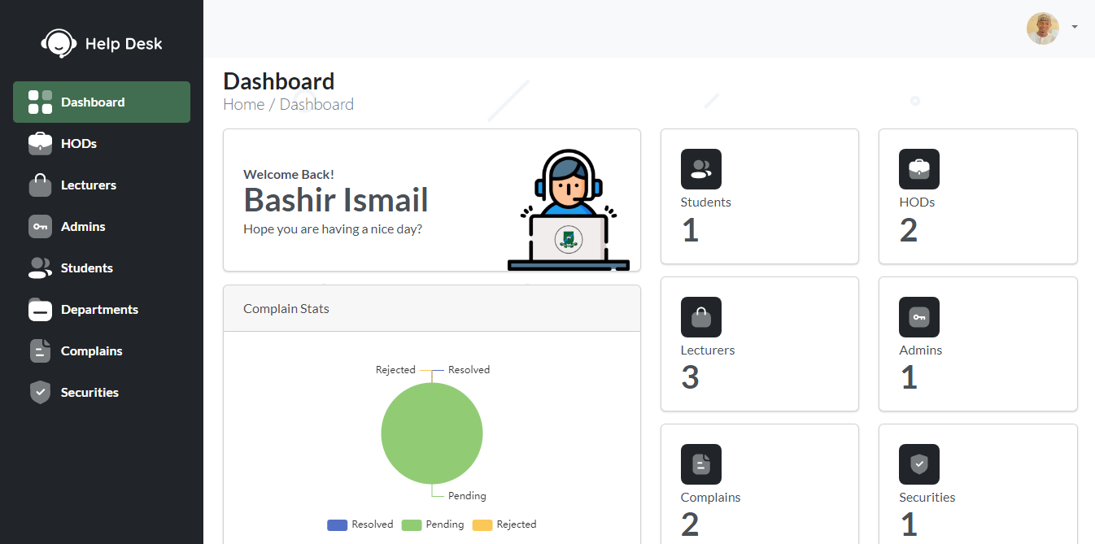
USER INTERFACE
DASHBOARD
11

Slide 13
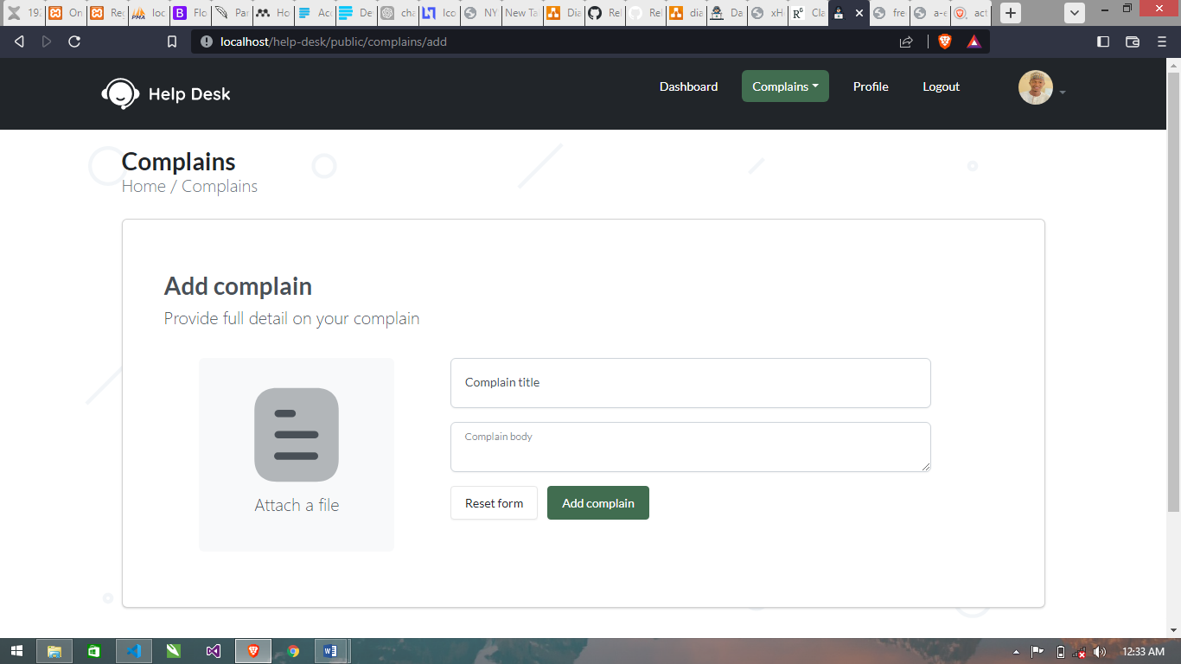
USER INTERFACE
ADD COMPLAIN
12

Slide 14
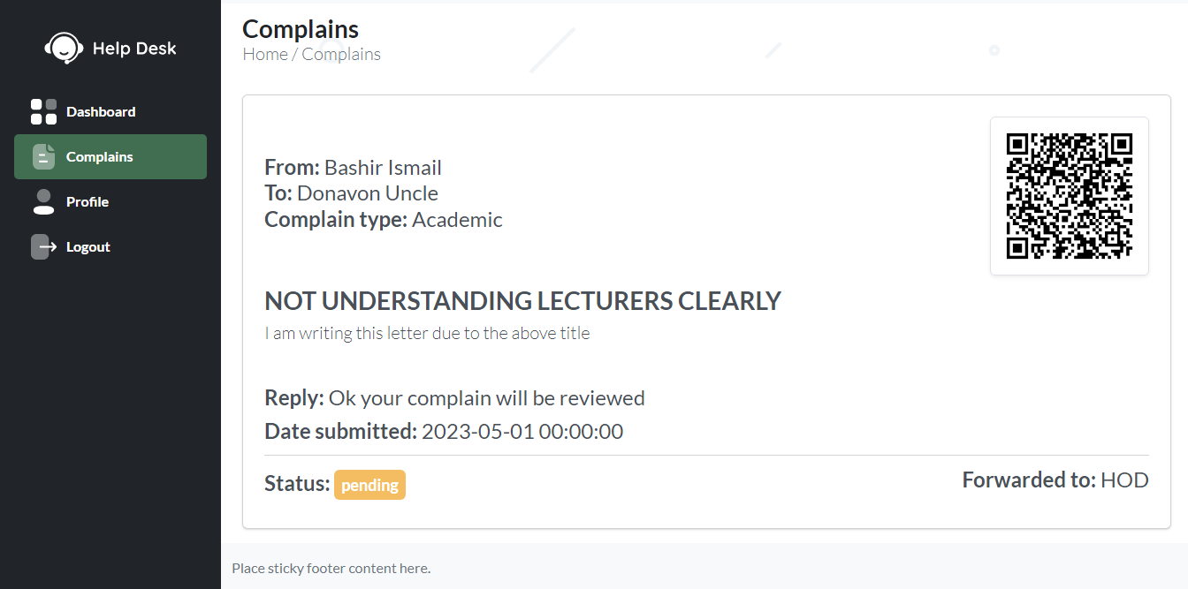
USER INTERFACE
VIEW COMPLAIN
13

Slide 15
CONCLUSION
At any point in time, a help desk software such as the one proposed in this project, can help in always knowing what students think of the school system. The help desk system can instantly allow students to lodge their complaint and still receive feedback from the right body. Details stored in a database make it easier to retrieve respective complaints at any point in time.
14

Slide 16
RECOMMENDATION
Additionally, I advise including additional features like automated email alerts to inform students of the progress of their complaints and more sophisticated reporting tools to help administrators better monitor and evaluate complaint data.
15

Slide 17
THANKS
FOR LISTENING

