Slide 1
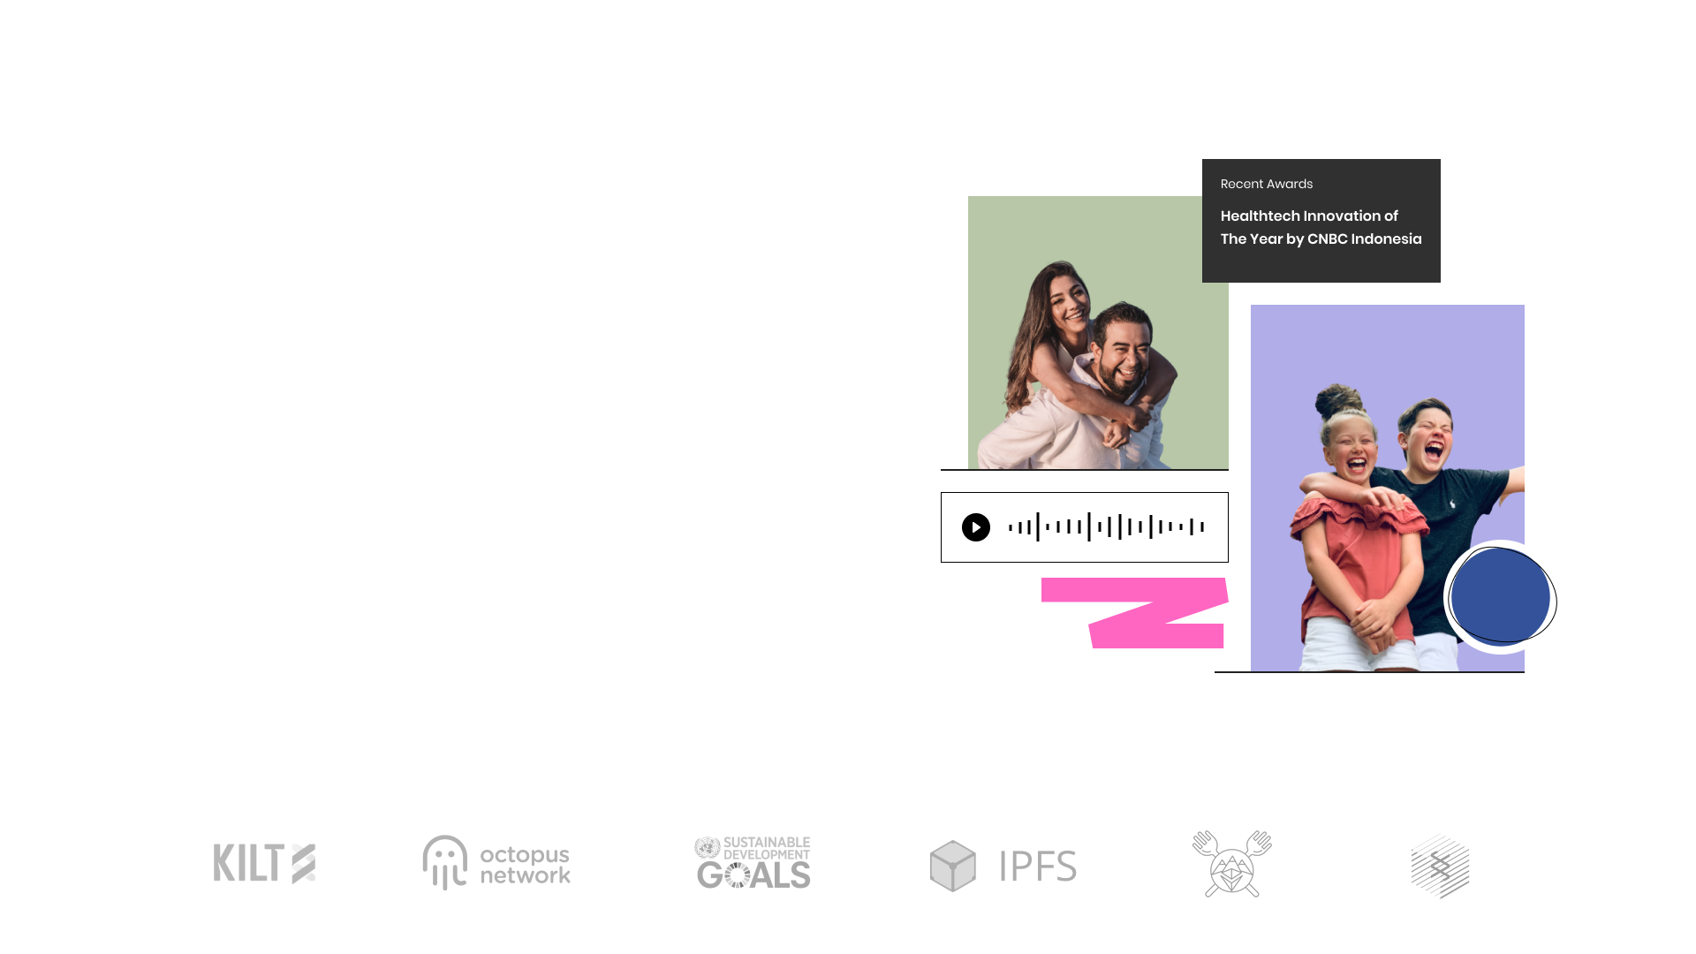
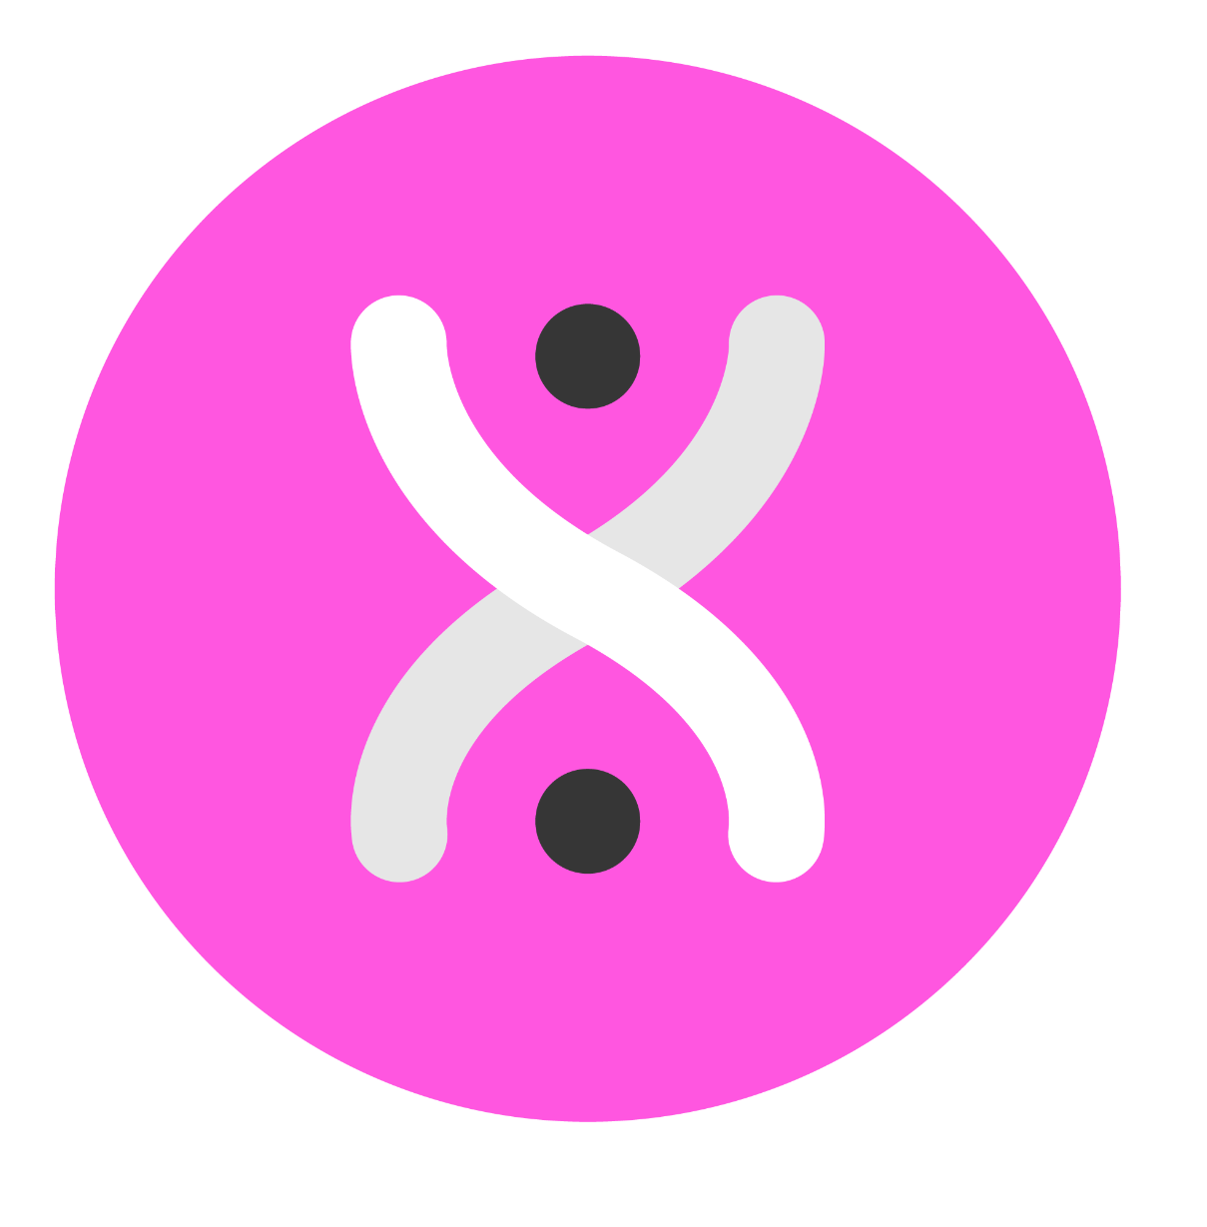
DeBio Network
The Anonymous-First Blockchain for Medical and Bioinformatics Data

Slide 2



DeBio Network
Our Vision
We aim to democratize direct-to-consumer genomics with a privacy-preserving, anonymous-first platform running on a fully decentralized, autonomous infrastructure.

Slide 3
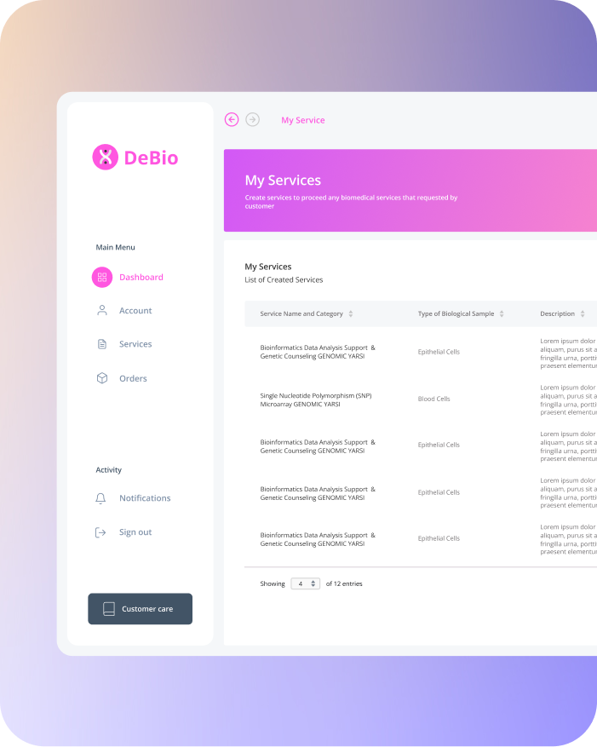

DeBio Network
Product Overview
Decentralized Genetics
Allow users to sample and sequence their genome and get genetic reports anonymously, without leaving home.
Genetic Analysis
Allow users to request genetic/DNA analysis to a verified Genetic Analyst on the DeBio dApp based on their uploaded genomic data.
Request Service
Allow users to request a service to the nearby Lab by staking some amount in $DBIO.
Electronic Medical Records
Allow users to upload their Medical records (e.g. MRI data, radiology images, etc.) which later can be accessed by service providers on the DeBio dApp, with their express consent.

Slide 4
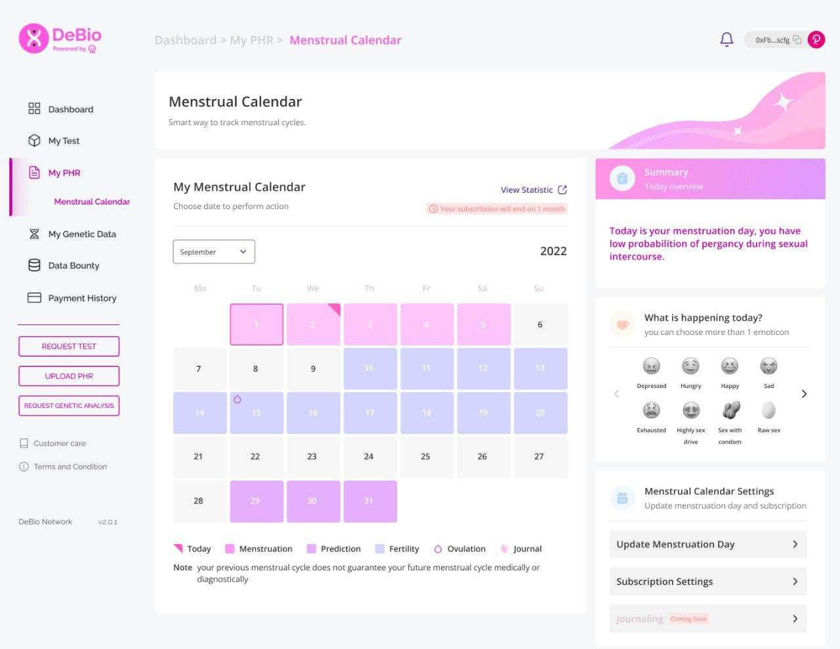
DeBio Network
Our Upcoming Feature

Slide 5
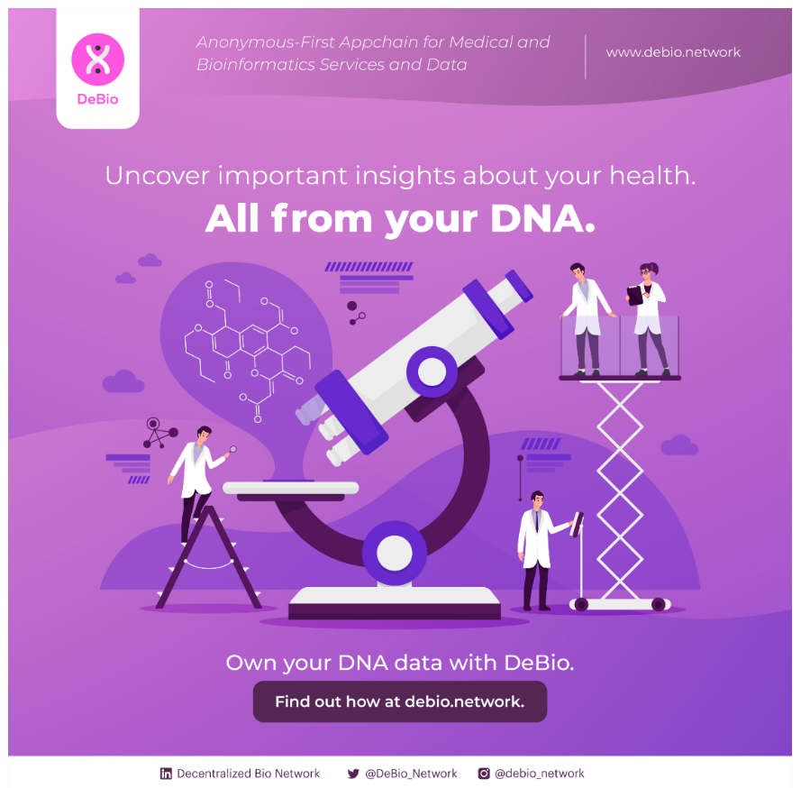
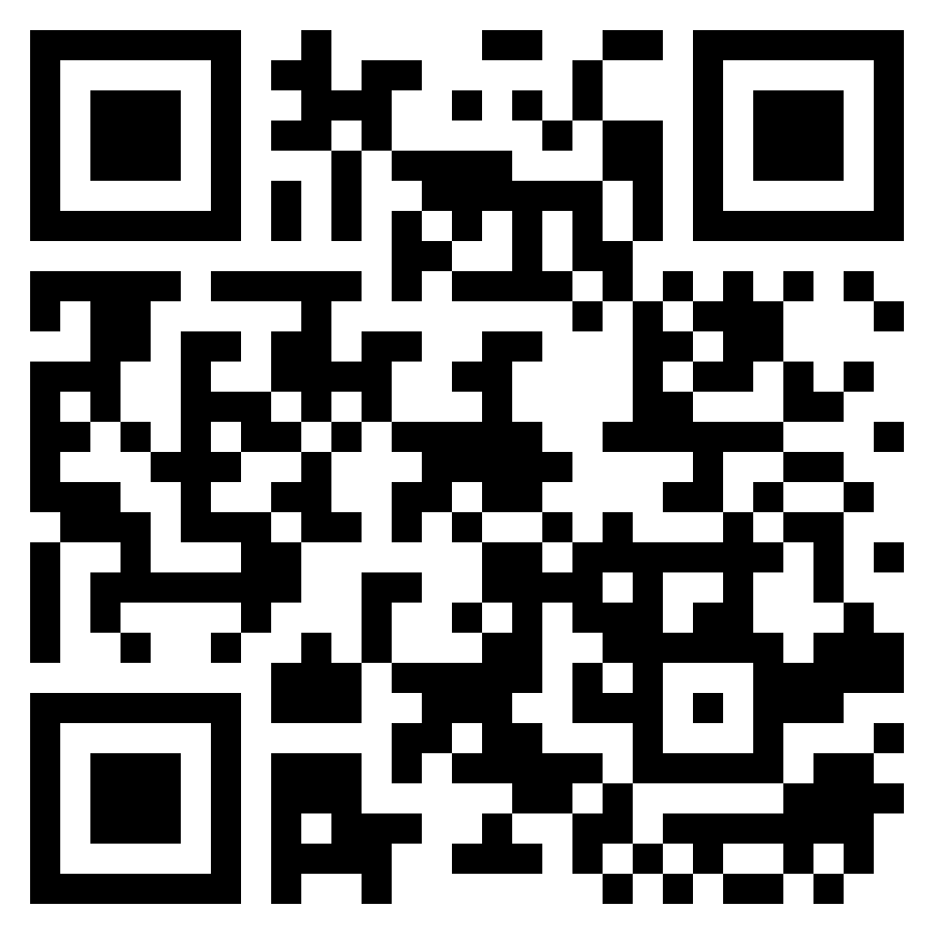
DeBio Network
Get Your Free Genetic Analysis
If you have taken a genetic test from 23andMe, Ancestry, MyHeritage, LivingDNA, FamliyDNA or equivalent. Upload your genetic data and get an analysis.
Users who use DEBIO and share their experience will stand the chance to have their entire transaction reimbursed.
SIGN UP HERE
https://forms.gle/huKxpreWbA8LtWMA7

Slide 6
Misc Content

Slide 7
DeBio Network
Some Helpful Data on NEAR
Current price = $4.26
Reported Marketcap = $3.71B
Reported Volume (24H) = $77.58M
ATH (USD) = $20.39 (17/01/2022)
Circulating Supply = 779,634,747.65 NEAR
Max supply = 1,000,000,000 NEAR
Total live accounts = 18857789
Total Number of Transactions = 200,834,902 (9/9/2022)

Slide 8
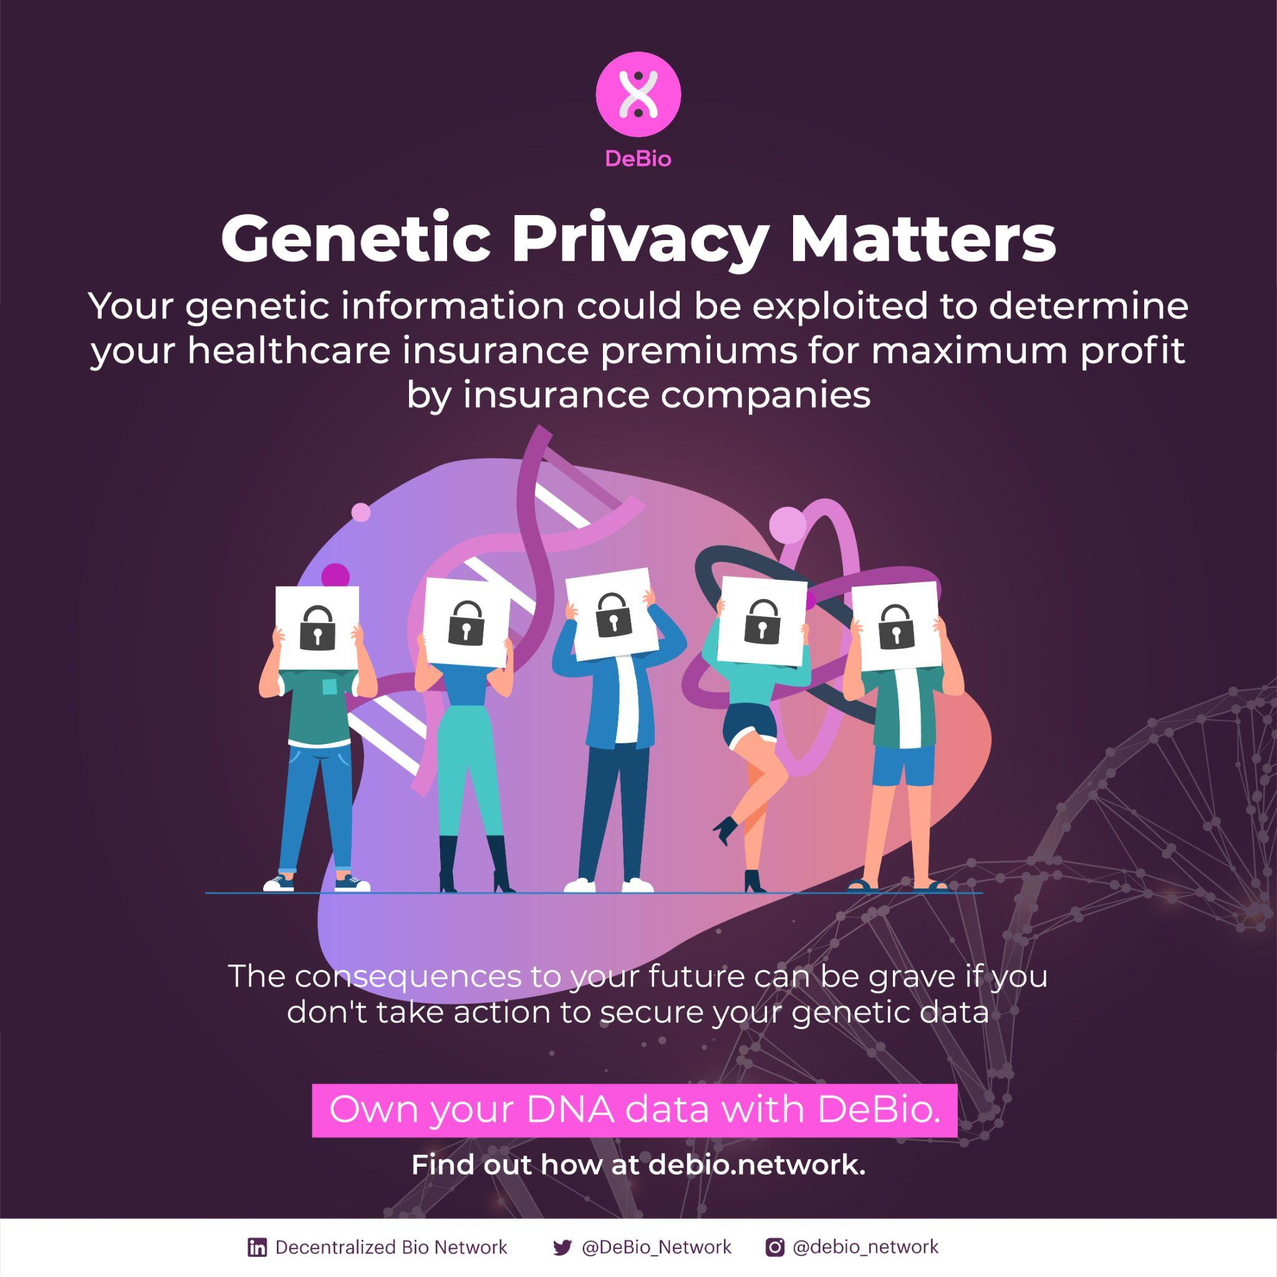


Slide 9
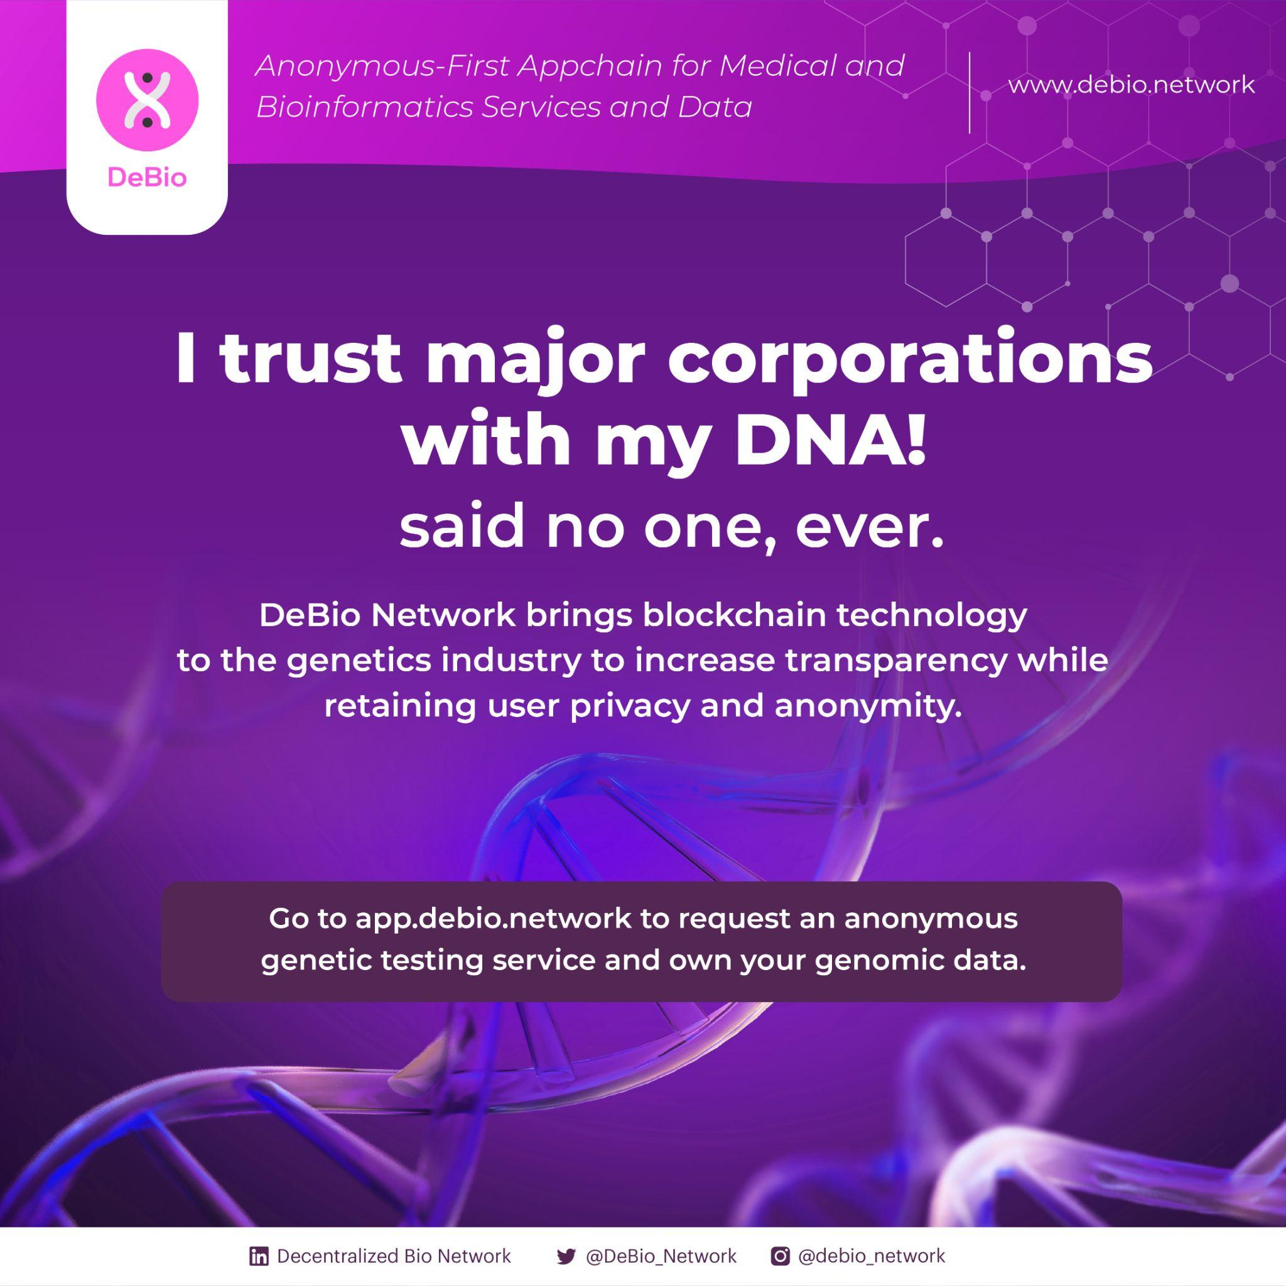
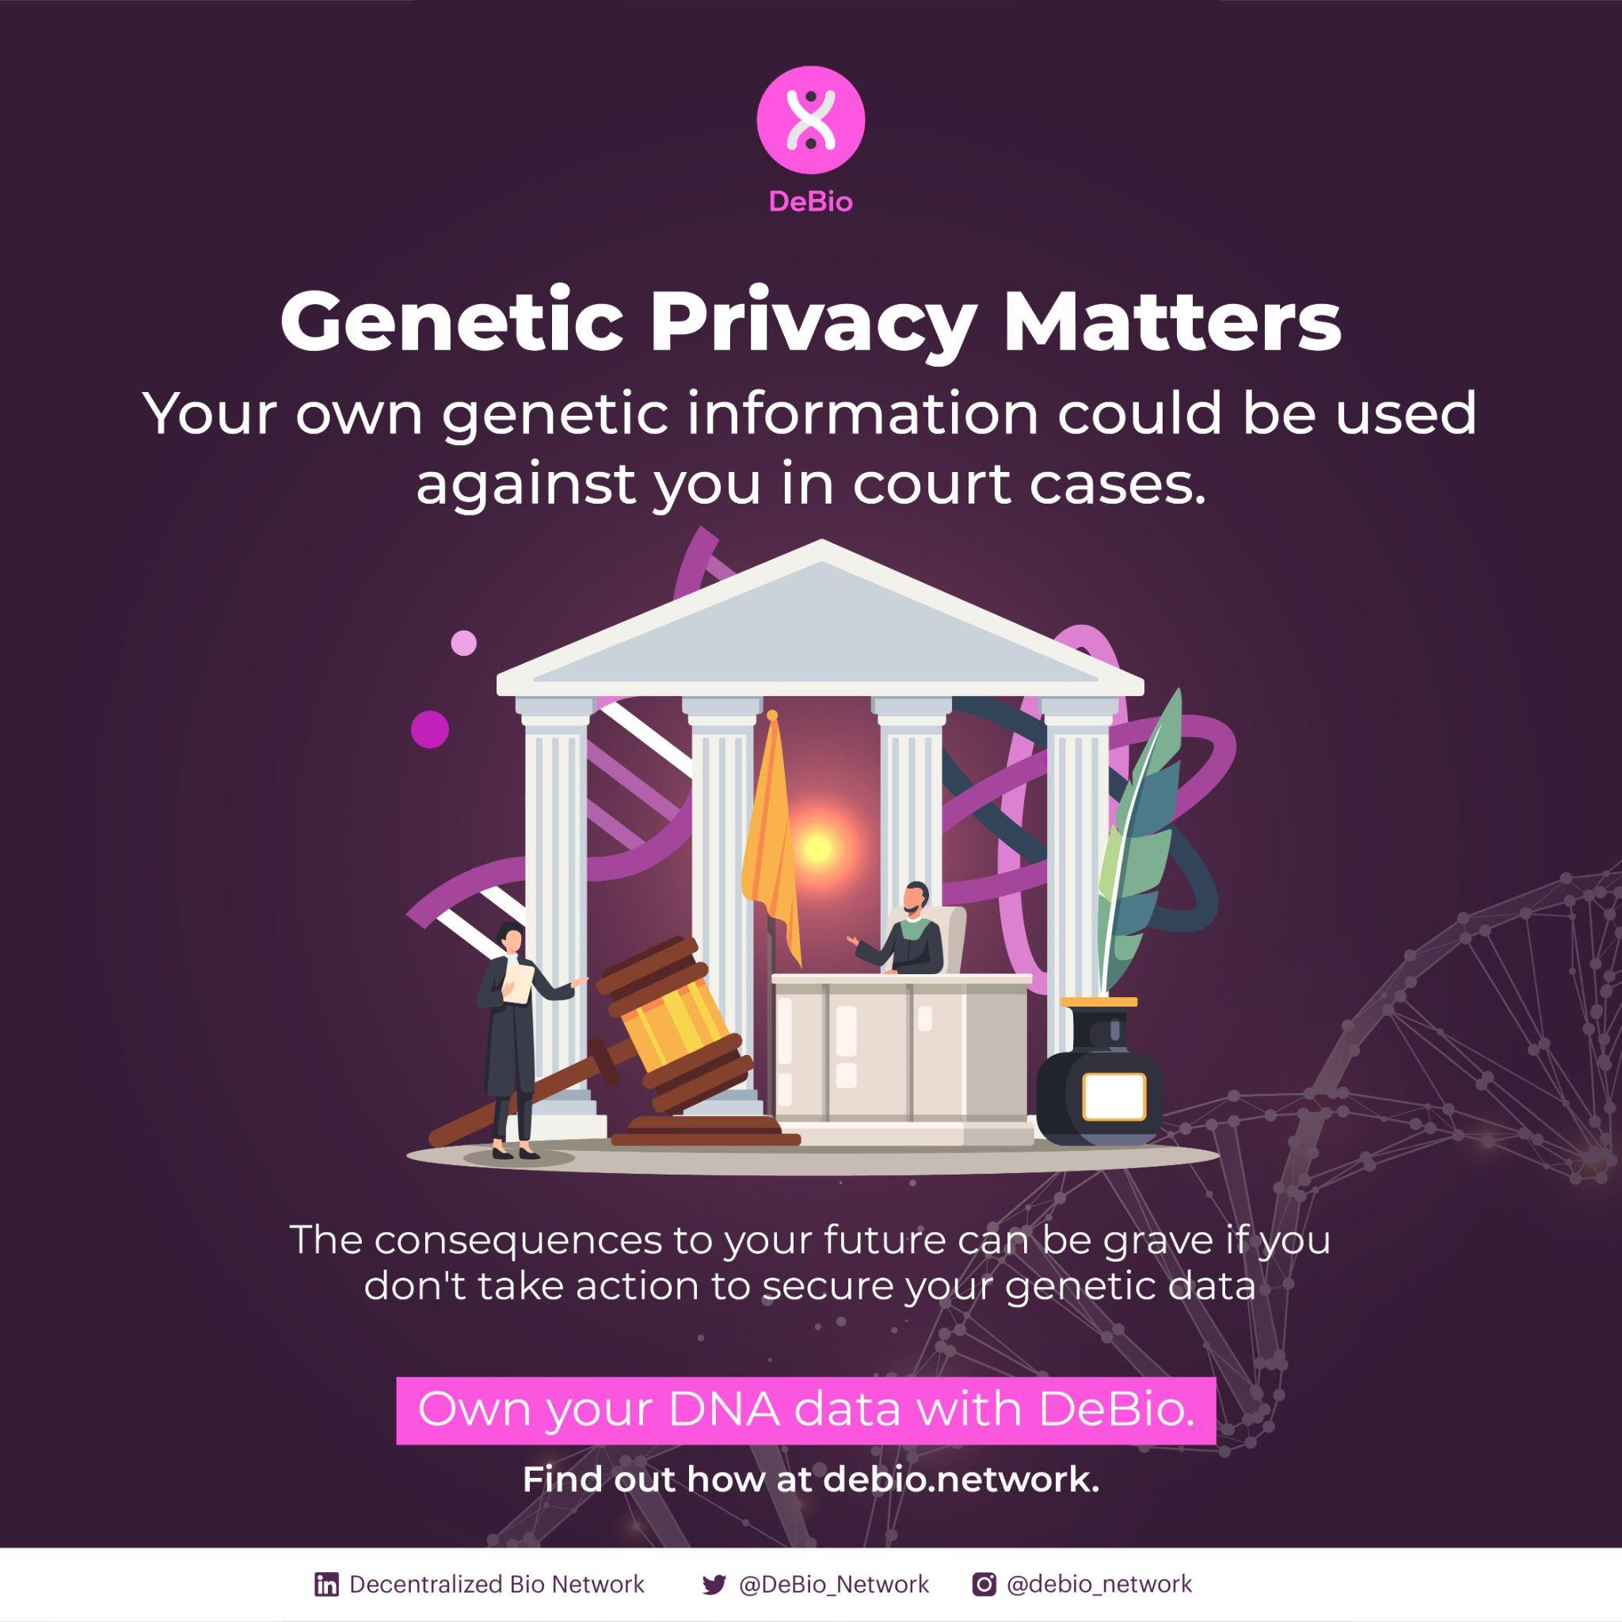

Slide 10
