Slide 1


It’s your turn to own the web

Slide 2
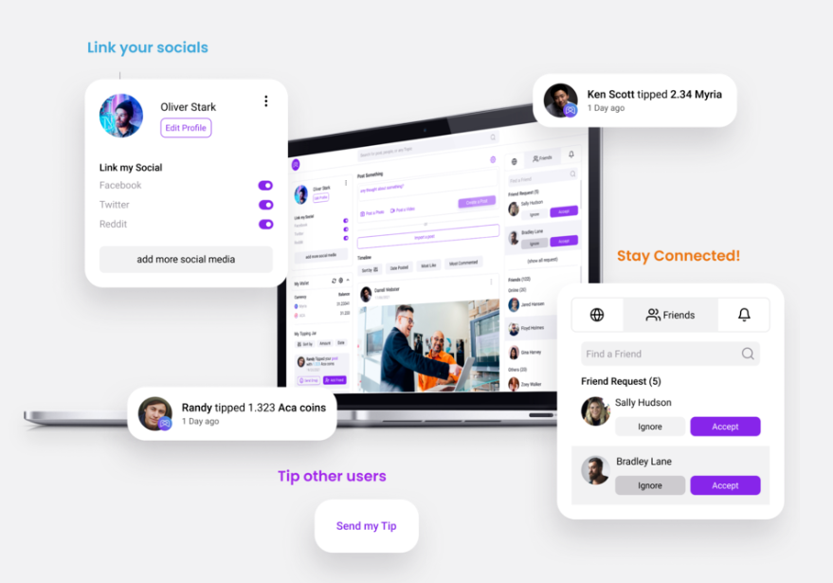
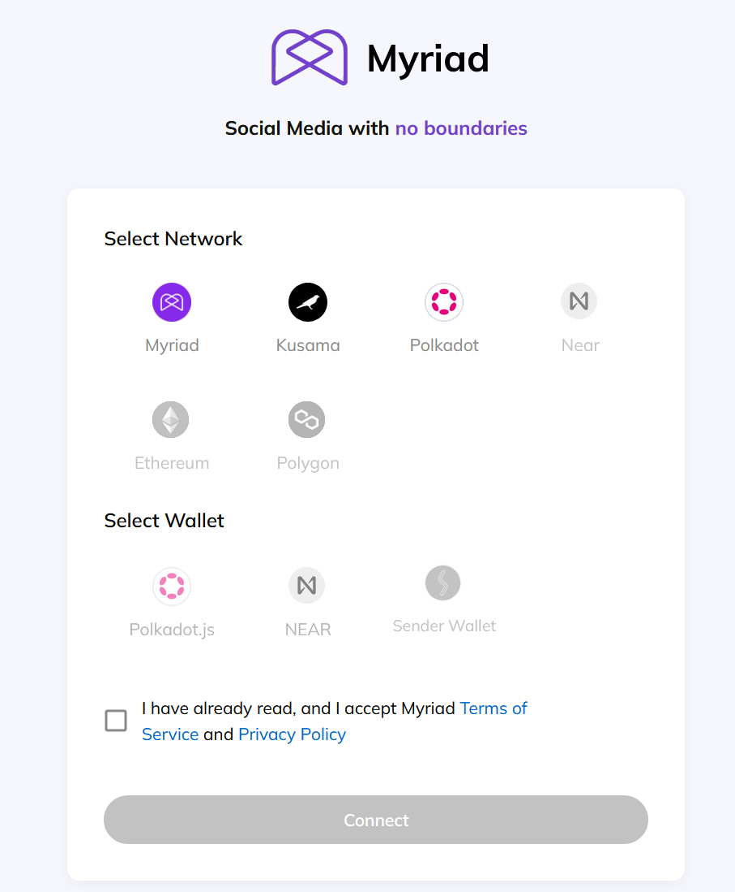
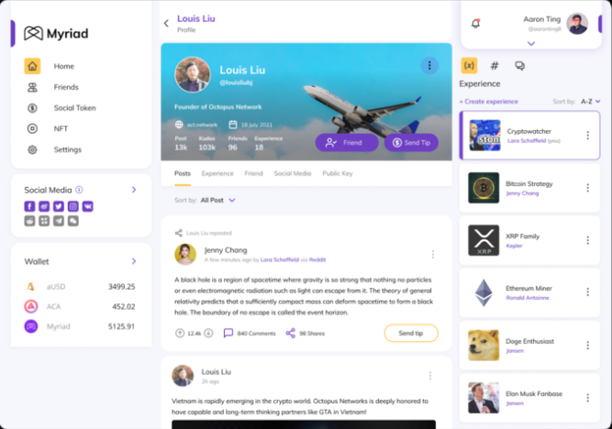
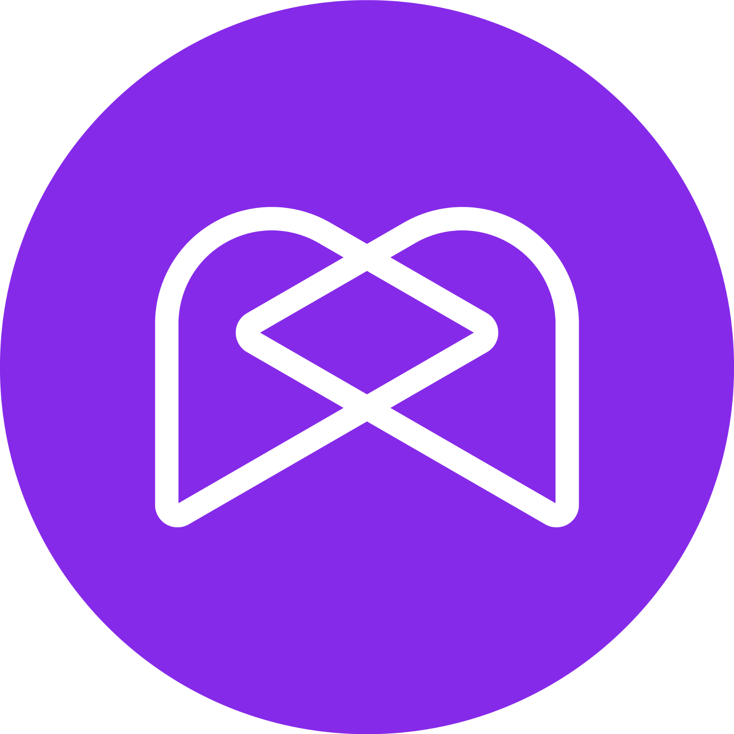
What is Myriad?
A web3 social media solution that is built on top of the existing web2 providers. We aim to provide a fully decentralised, community owned platform.
Key Points
Users can import posts directly from Twitter and Reddit.
Users can own their content.
Users can tip and receive multiple cryptocurrencies directly in their accounts.
Users can use popular wallets like NEAR, Polkadot or Kusama to login

Slide 3
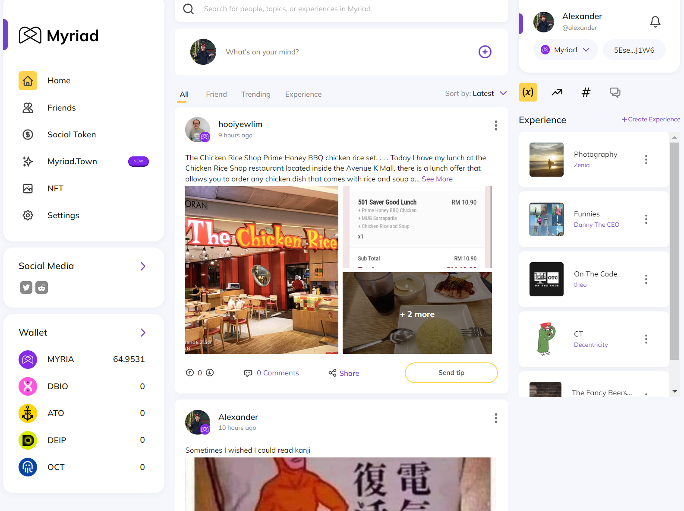
Why Myriad? - Our USPs
Myriad’s Unique Selling Points
Users can import posts directly from Twitter and Reddit.
Users can own their content.
Users can tip and receive multiple cryptocurrencies directly in their accounts.
Users can use popular wallets like NEAR, Polkadot or Kusama to login

Slide 4
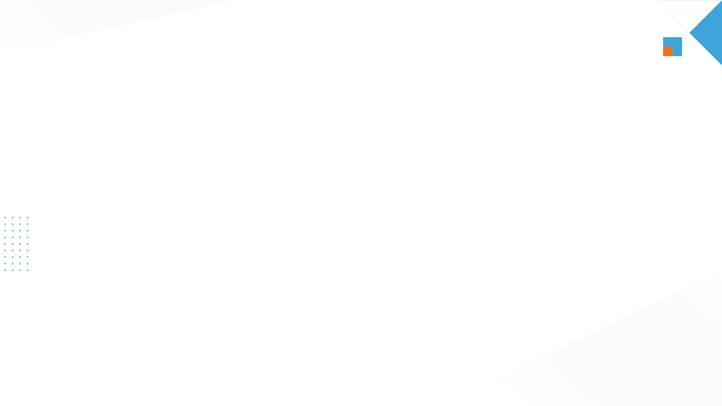
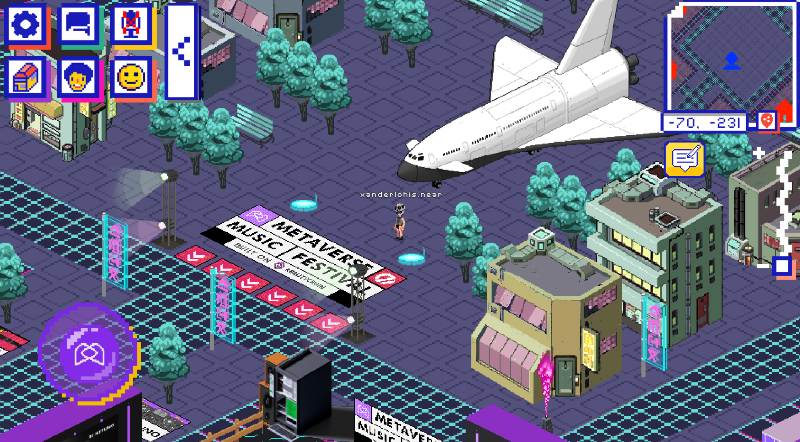
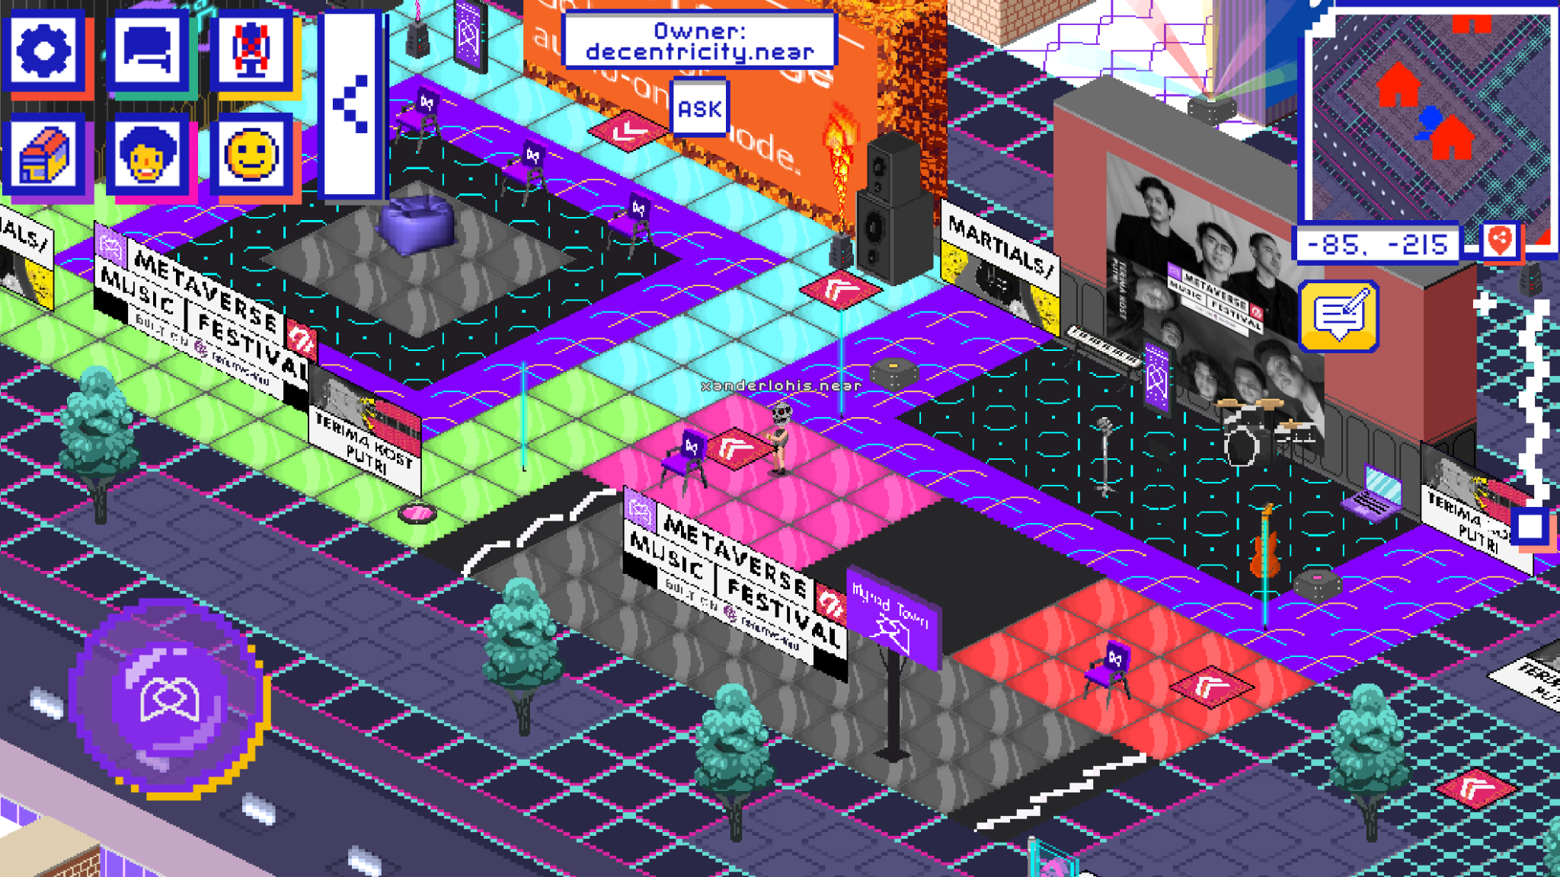
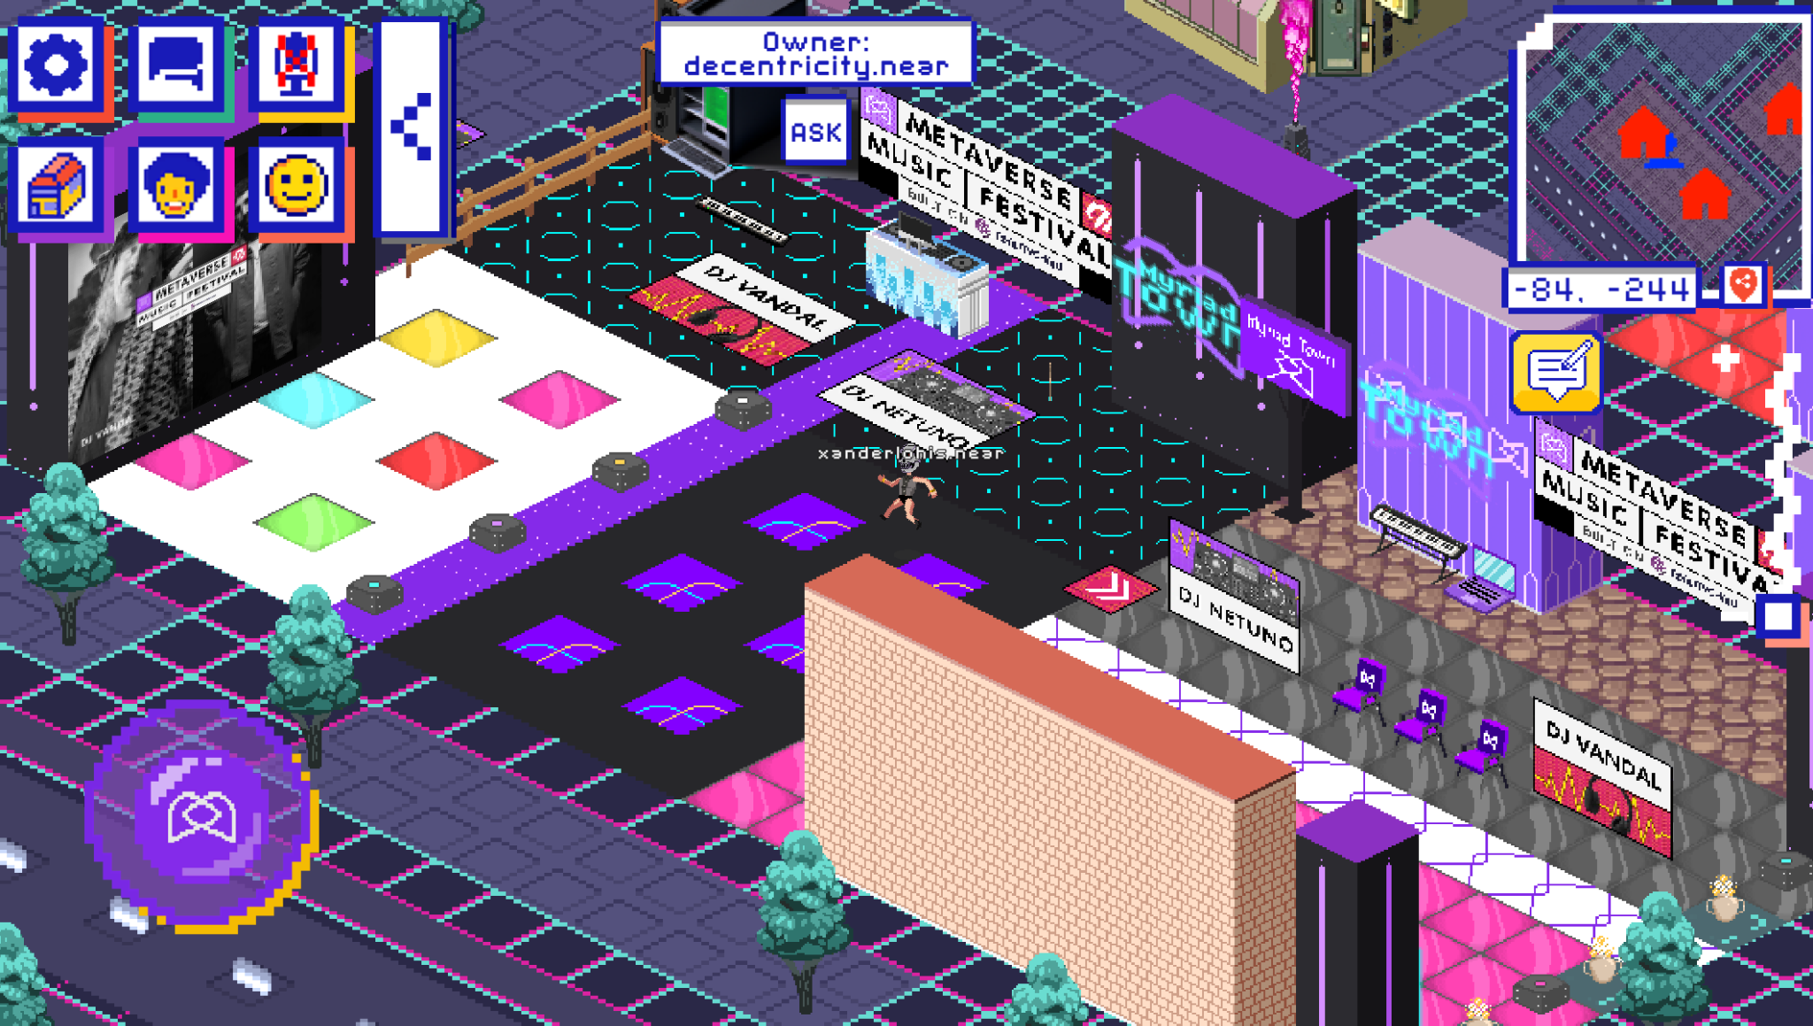
Myriad.Town - Music Festival Encore
Myriad.Town celebrated its launch on the 5th September 2022.
It attracted up to 306 party-goers and the metaverse had high user logins during the first 3 hours.

Slide 5
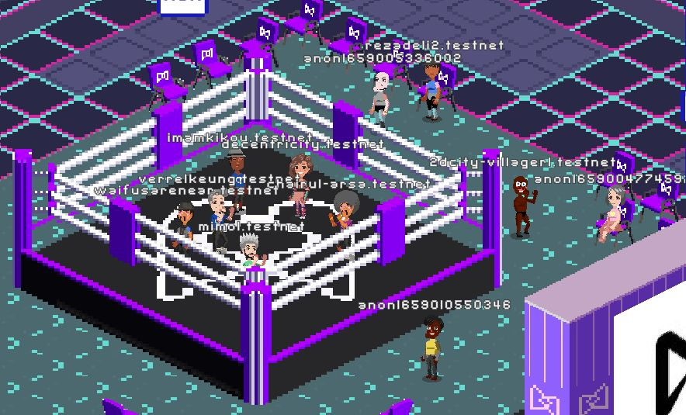
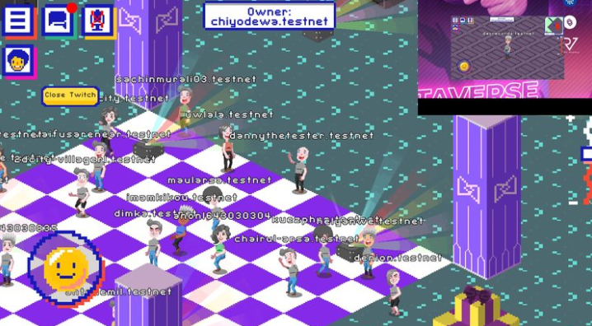
Myriad.Town - Music Festival Encore
Myriad.Town will have an encore on the 13th September 2022, 5pm UTC
Visit us at https://myriad.town to:
Experience the most awesome metaverse music festival again.
Rewards and airdrops.
Pick up land voucher NFTs to pick up land parcels on Myriad.Town
Another treasure hunt!
Learn More: https://town.myriad.social/

Slide 6
Misc Content

Slide 7
Some Helpful Data on NEAR
Current price = $4.26
Reported Marketcap = $3.71B
Reported Volume (24H) = $77.58M
ATH (USD) = $20.39 (17/01/2022)
Circulating Supply = 779,634,747.65 NEAR
Max supply = 1,000,000,000 NEAR
Total live accounts = 18857789
Total Number of Transactions = 200,834,902 (9/9/2022)

