Slide 1
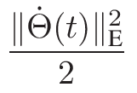
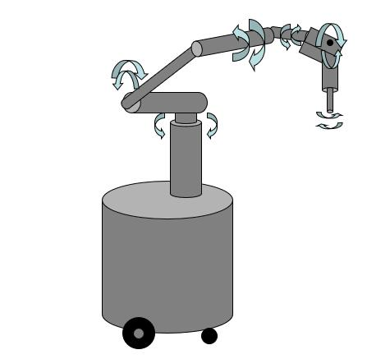
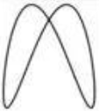






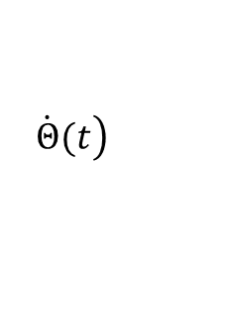


Criteria Optimization
RNN Model
Plant
Mobile Robot
Vector Valued
$$s_{1}$$
Control
Signal
Path Tracking
$$\left.\dot{Θ}(t\right)$$
Error Function
$$s_{2}$$
$$...$$
$$...$$
$$ε(t)=\left[\begin{matrix}\left.ε_{1}(t\right) \\ \left.ε_{2}(t\right) \\ ⋮ \\ \left.ε_{p}(t\right)\end{matrix}\right]$$
$$s_{i}$$
Physical Constraint
$$s_{p}$$

