Slide 1

Rock Paper scissors
Rock Paper scissors
Rock Paper scissors
By Deci1337 github.com/Deci1337

Slide 2
Info about My first mini project
I have posted my first project in the form of a game. I tried to write the code as much as possible according to the C# rules.
In the project, I also tried to use Object-Oriented Programming carefully.
It`s the first version, I would like to improve it and add local battles…
By the way, I didn't use AI, so, it was a experience for me.

Slide 3
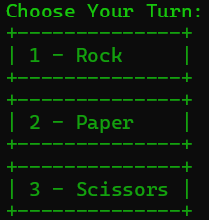
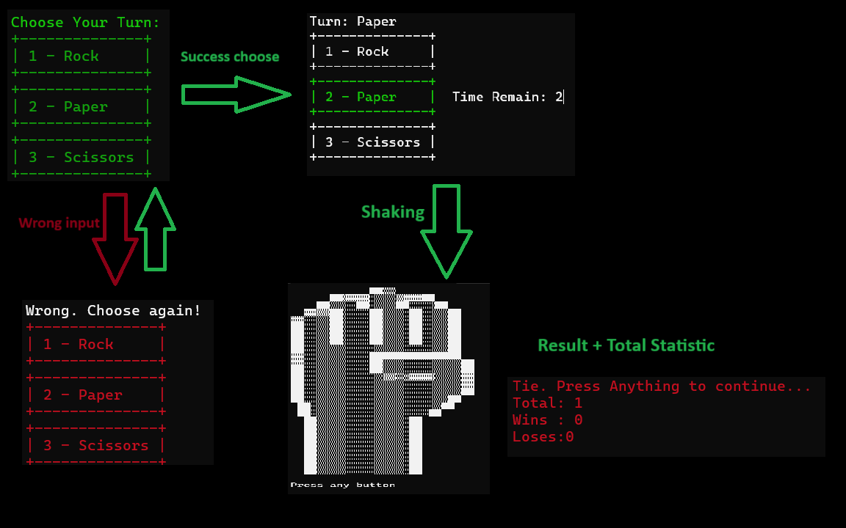
How does it look like?

Slide 4


Thanks!
Deci1337
github.com/Deci1337

