Slide 1














Decidish
Weekly Meal Plan
Breakfast, Lunch, Dinner
Project Requirements Overview
Personalized Recipes
Smart Shopping
Personalization
Shopping List
Ingredients & Products
Comprehensive Project Documentation

Slide 2
















Current User Challenges
Decision Fatigue
Lack of Personalization
Deciding what to cook or finding the right recipes is too time and energy consuming.
Internet is overflowing with non-personalized recipes that ignore individual needs.
Results in money being spent on food delivery or eating out, which is both more expensive and less healthy.
Recipes rarely consider budget, taste preferences, dietary restrictions, or regional ingredient availability.
Dietary Monotony
Resource Waste
Users often return to the same simple meals they already know due to lack of time or motivation.
Users waste food, time, and money due to poor meal planning and shopping management.
Creates nutritional imbalances and misses opportunities to discover new foods.
Food spoils when users don't know what they have at home, leading to double buying or forgetting essential items.
2/10

Slide 3














Project Goals & Solution
Overall Goal
Key Solution Aspects
Complete Personalization
Time Efficiency
Considers user preferences, budget, allergies, and dietary needs
Streamlined recipe selection and shopping list creation
Minimize Waste
Diet Diversity
Smart inventory management and meal planning
Expands food choices based on user preferences
Build a personalized, time-saving, and budget-friendly meal planner that transforms how users approach food.
Expected Outcomes:
Reduced food costs
Less time spent cooking
Healthier eating habits
More meal variety
3/10

Slide 4










User Experience Flow
1
2
3
Landing Page & Onboarding
Recipe Selection
Shopping List Management
Welcome page explaining the service
Set timeframe for planning (day, 2 days, week)
Create combined shopping list from chosen recipes
Optional localization with postal code for market selection
Swipe-style interface to browse recipes
Modify list (remove items already at home, add other items)
Personalization quiz including:
- Allergies
- Vegan or not
- Preferences
- Budget
Like/dislike recipes to indicate preferences
Share list with notes app or other formats
Recipe suggestions personalized to user profile
Online purchase option (future scope)
4/10

Slide 5
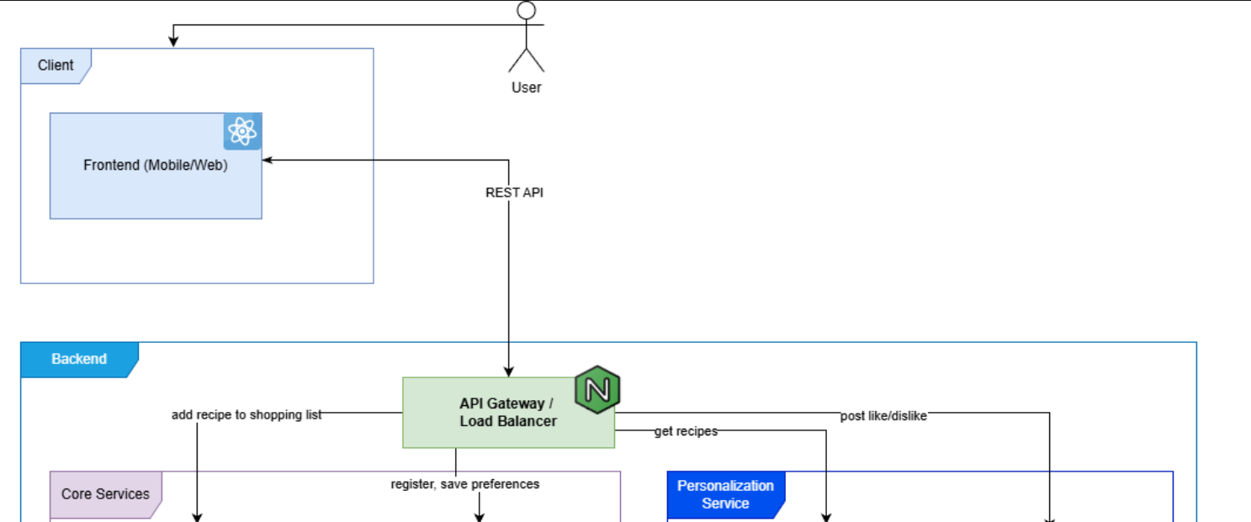
System Architecture Overview: Client Layer

Slide 6
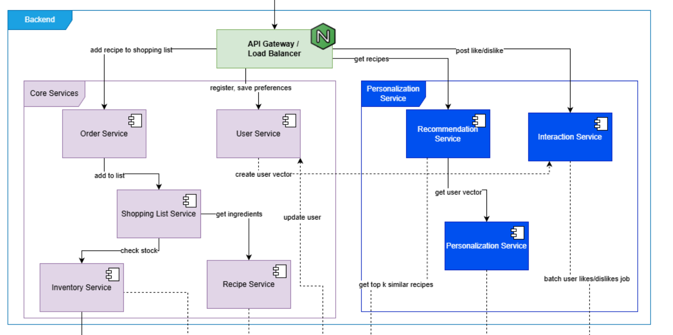
System Architecture Overview: Service Layer

Slide 7
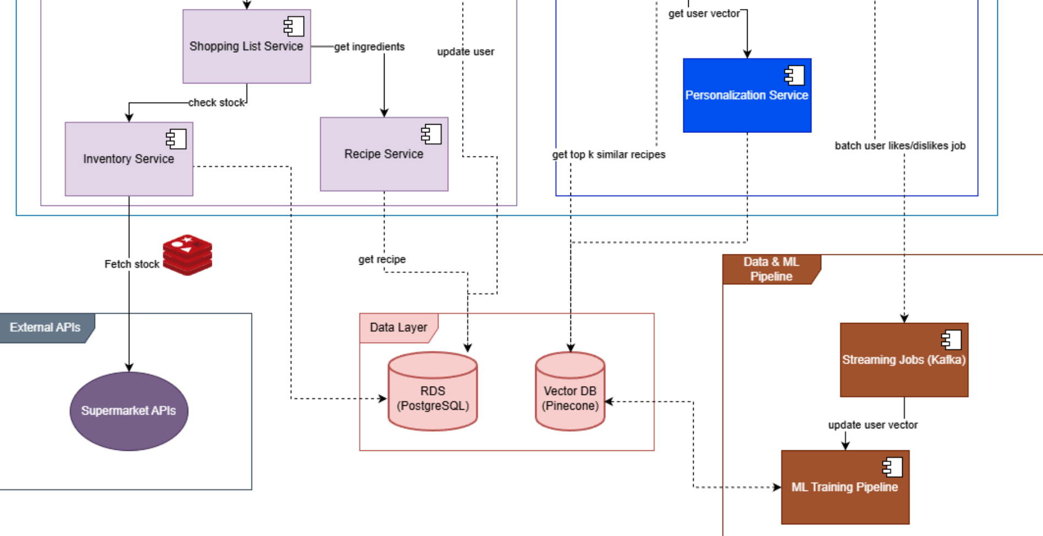
System Architecture Overview: Database, ML and APIs Layers

Slide 8



















Core Services Components
Core Services
Essential components powering the meal planning experience
Order Service
User Service
Shopping List Service
Inventory Service
Recipe Service
Adds a recipe to the shopping list
Stores user profile and dietary preferences
Checks ingredient availability in nearby supermarkets
Retrieves ingredients needed for a recipe
Generates shopping list from chosen recipes
Key Benefits
Decouples service logic for independent development
Enables scalability of individual components
Facilitates technology diversity across services
6/10

Slide 9










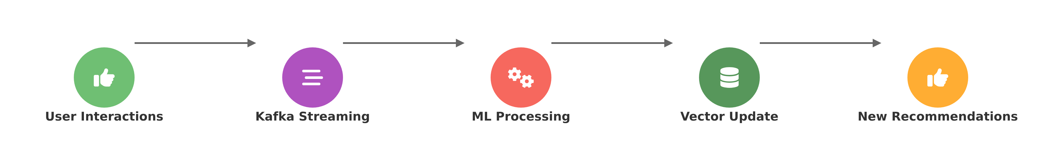









Personalization Services & ML Pipeline
Recommendation Service
Interaction Service
Personalization Service
Gets the K top recipes that the user is most likely to enjoy based on their preference vector.
Stores whether the user likes or dislikes recommendations to improve future suggestions.
Retrieves the user's current preference vector from the database for personalized recommendations.
Streaming Jobs (Kafka)
Machine Learning Pipeline
Vector Data Base
Stores user interactions (like/dislike) and triggers retraining of the ML model periodically.
Updates the user's preference vector based on interaction data using a ML algorithm.
Stores user preference vectors and recipe vectors for efficient recommendation calculations.
7/10

Slide 10





























Technology Stack
Frontend
API Gateway
Backend Services
Framework: React Native
Tool: Nginx
Personalisation: C#, dotnet
Language: TypeScript
Role: Load Balancing
Recipe Service: Java
API: REST API
Function: API Gateway
Order Service: Java
Database Layer
ML Pipeline
Performance Specs
Primary: AWS RDS (PostgreSQL)
Purpose: Update vector database
Response: P95 < 300 ms
Vector DB: Prisma
Stack: Python (PyTorch, Scikit-learn)
Transaction: < 150 ms
Storage: 50 MB/user
Messaging: Kafka
Uptime: 95%
8/10

Slide 11























Functional Requirements
Seven core system capabilities that define the meal planner application
1
Recipe Suggestions
2
Local Market Products
The system shall suggest suitable recipes based on the user's available ingredients.
The system shall retrieve available products from local markets.
3
Personalized Recommendations
4
Nearest Markets
The system shall generate personalized recipe recommendations.
The system shall find nearest markets (based on user location).
5
Shopping List Generation
6
User Profile Storage
The system shall generate a shopping list based on chosen recipes.
The system shall store user features, preferences, and profile information.
7
Recipe History Tracking
The system shall track and store the user's recipe history (e.g., liked/disliked meals).
9/10

Slide 12


























Performance & Quality Standards
Usability
Robustness
Performance
User Experience Requirements
System Stability Requirements
System Speed Requirements
Users must generate shopping lists within 10 clicks from dashboard
Continue operating despite component failures
Support horizontal scaling
Handle 50 MB data per user
Microservices must degrade gracefully
Transactions under 150 ms
Maintain data consistency under concurrent access
P95 response time under 300 ms
Availability
Portability
Quality Standards
System Uptime
Deployment Requirements
The system must balance these quality requirements while maintaining a seamless user experience across all platforms.
System must be available 95% of the time
Deployable on:
Android
iOS
Web Browsers
10/10

