Slide 1






Learning by Demonstration for the Masses
Dr. Karen L. Myers
Program Director
AI Center
SRI International

Slide 2
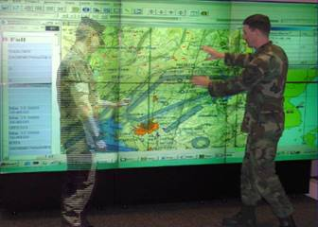
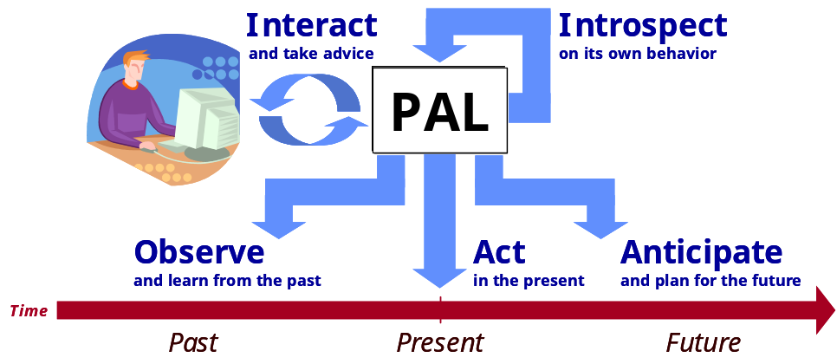
PAL: Personalized Assistant that Learns
Virtual assistant that learns
  Learns on the job
    by observing the user’s actions
    by responding to the user’s advice
  Learns the user’s activities, roles, topics, and preferences
  Learns to perform new tasks
  Learns to anticipate the user’s information needs
Software systems that adapt
  Adapt to different users
  Adapt to different missions
  Adapt to changing situations
  Adapt without reprogramming
Approved for Public Release, Distribution Unlimited
Notes:
PAL, the flagship cognitive program of DARPA’s Information Processing Techniques Office, aims to significantly improve the way that computers support humans by developing systems that can, learn from experience, be told what to do, reason with learned knowledge, explain their actions, and respond to surprise.
PAL’s prototype cognitive technology can be integrated into current and future systems to provide “virtual assistants” for commanders and their staff that adapt to different users, different missions, and changing situations, without reprogramming.
PAL capabilities include managing information and resources; scheduling meetings and complex events; preparing briefing materials, and dealing with uncertainty in the real world.
Today we’ll describe the PAL Challenge in progress at the Battle Lab and show you demonstrations of some of the PAL capabilities.
Let me draw your attention the center screen that addresses a number of PAL military transitions.

Slide 3
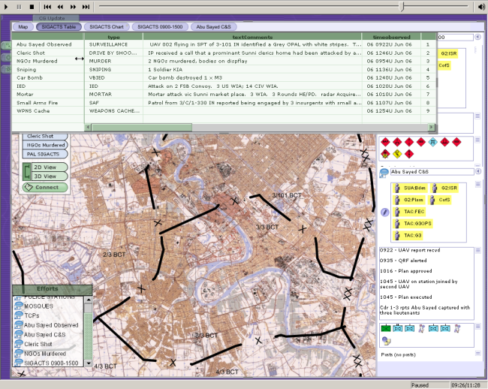
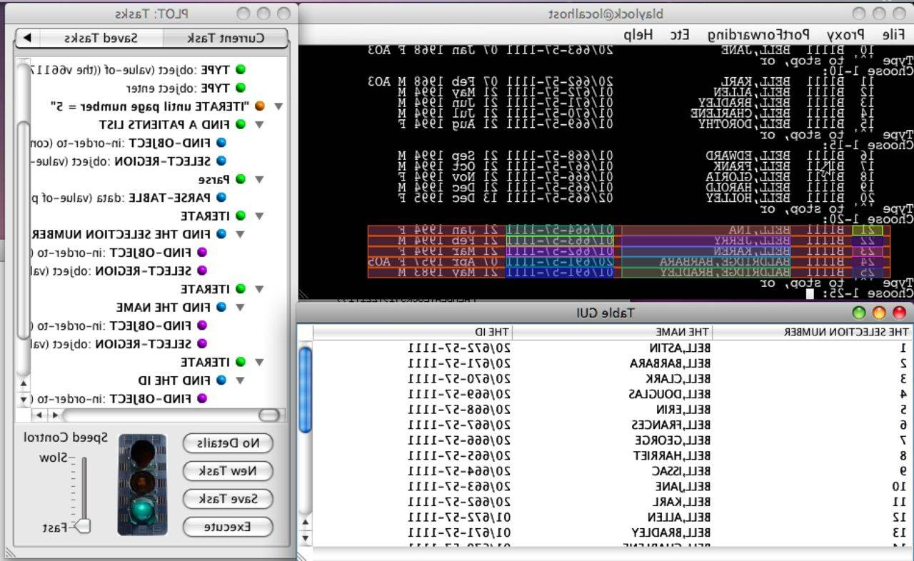
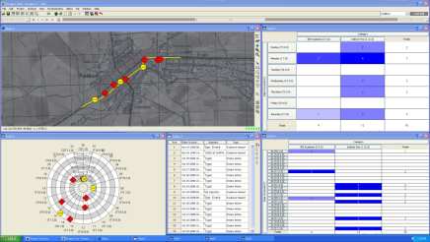
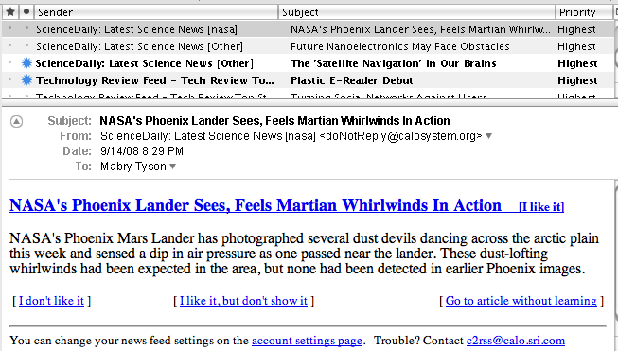
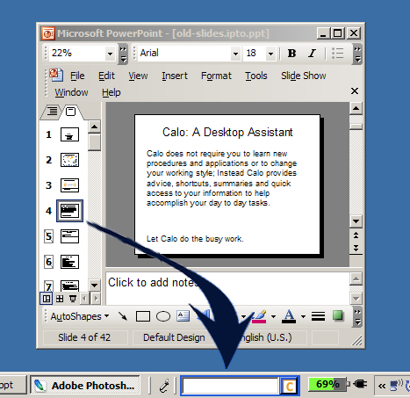
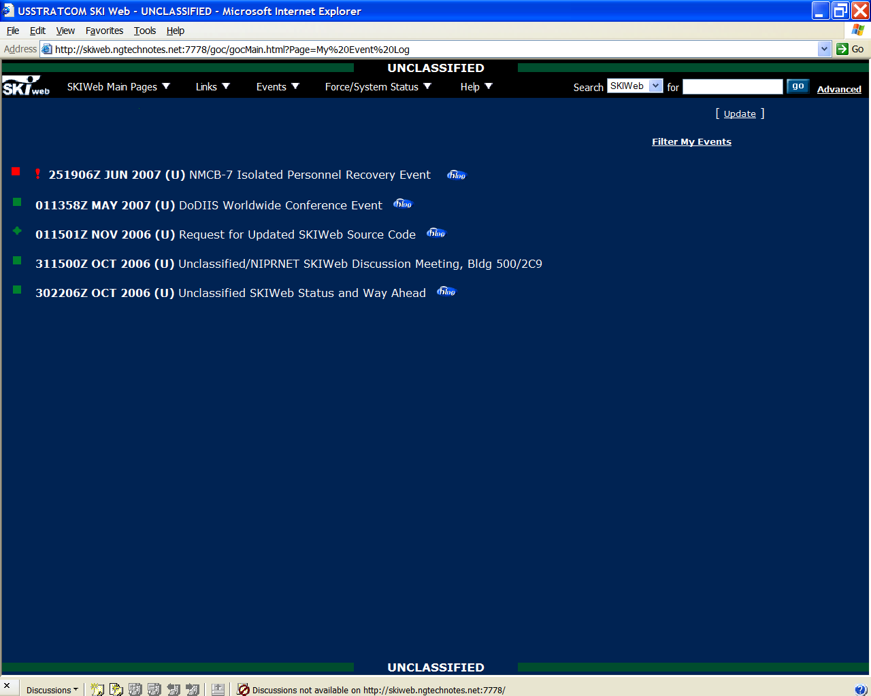
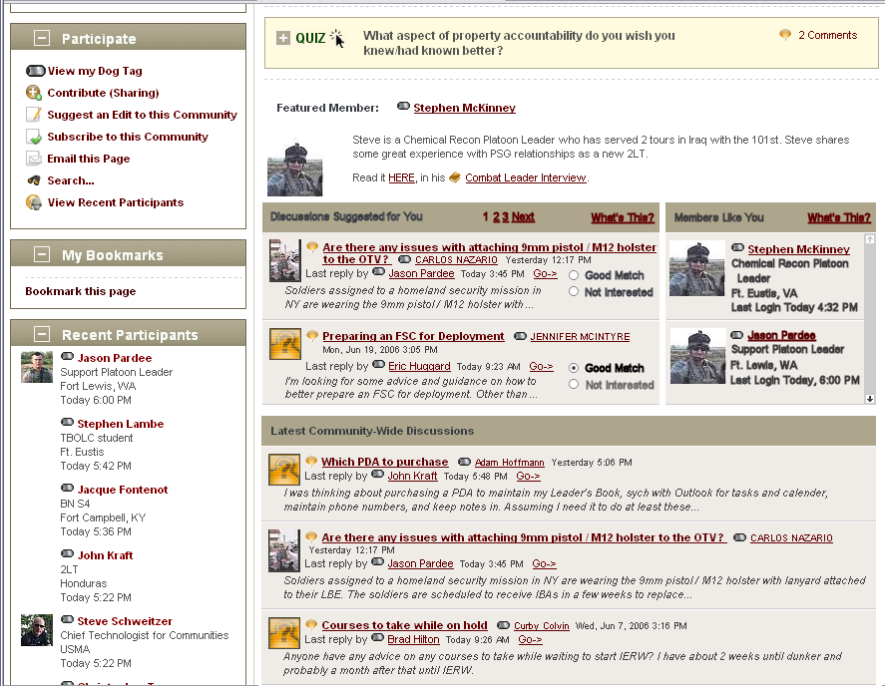
PAL Transitions
Military Applications
Technology
CPOF
Pensacola
Naval Hospital
Topic Learning
Preference Learning
WebTAS
NMCI
Task Learning
SKIWeb
PlatoonLeader
CompanyCommander
Activity Learning
SKIPAL Recommends These Events:
Remove
Remove
Remove
Remove
Remove
Ontology Learning
Commercial &
Government
Rule Learning
AFFECT
Smart Desktop
Active
SIRI
Social Kinetics
Tula Health
Fact/Relation Learning
Approved for Public Release, Distribution Unlimited
Notes:
The CALO Framework describes how CALO’s learning technology can be applied to some target system.such as…
(click) In CALO is the Learning Framework with its learning components. In a specific implementation of the framework, only some of the components would be included. But the framework definition includes all the components available.
(click) We’ll need A place to store the data.
(click) The components that control the actions of other components.
(click) Typically we’ll need some UI capabilities
Now, we need to describe how the systems are connected and any customizations that are needed. (click)
We may need plugins in the target system for instrumentation & automation. The target system may need some CALO-specific UI.
We have to pass data back and forth.
The description of the objects in the target system will potentially different for each target system. Depending upon the needs of the application, the ontology can be light-weight, as in CALO Express, or more extensive as in the CALO Research system.
Any procedural data is of course custom to the target system.
-----
The green boxes are the CALO system as we’ve known it.
The red text indicates parts that must be customized for a particular deployment.

Slide 4
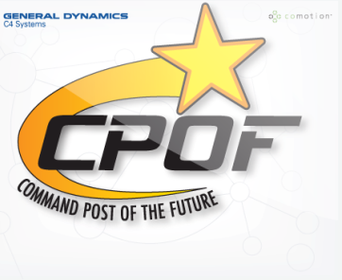
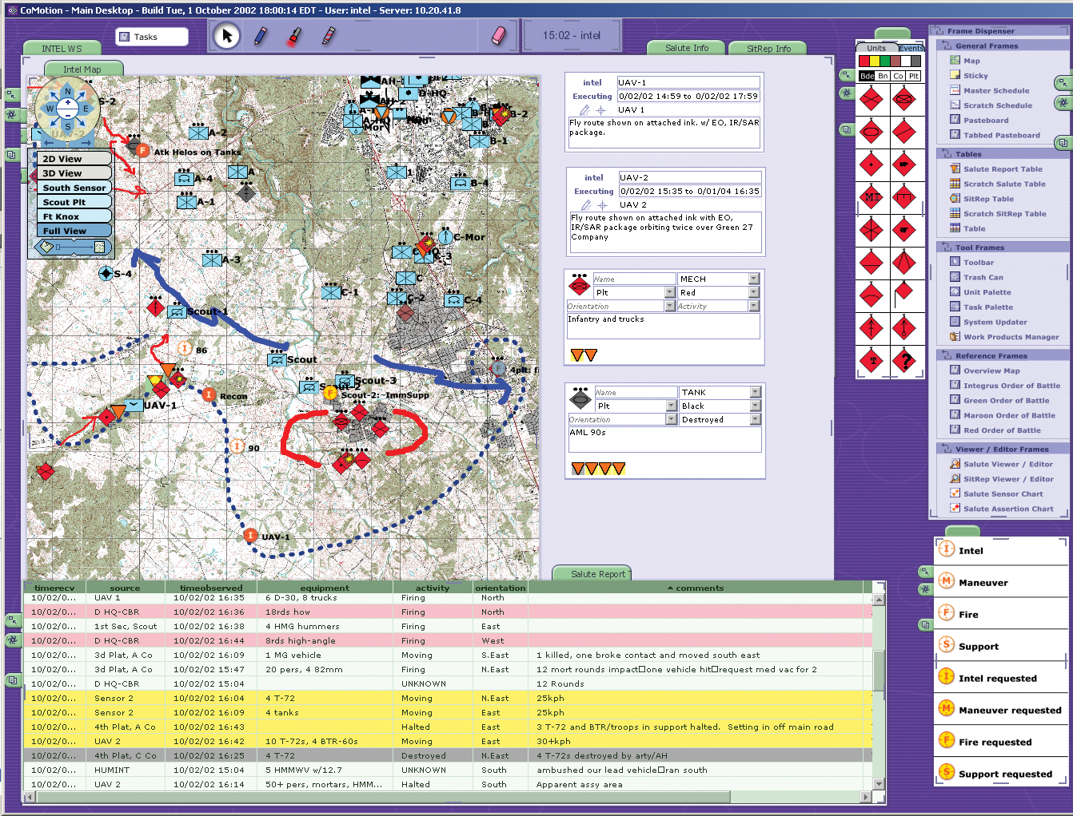
Command Post of the Future (CPOF)
A collaborative system for sharing and visualizing data
Over 1500 systems online in Iraq; doubling every six months
Built on CoMotion, derived from SAGE and VISAGE UI research platforms
DARPA Research Program active 1998-2003
Key notions:
  infocentricity
  direct manipulation
  deep collaboration
⇒ Powerful, flexible C2 tool but ‘click-intensive’
⇒ CPOF users engage in many repetitive, time-consuming processes
Approved for Public Release, Distribution Unlimited

Slide 5

PAL-CPOF Vision:
End-user creation of procedures
Idea: users apply Learning by Demonstration to extend and enhance system functionality in the field
  To customize operation
  To automate repetitive tasks
Rationale:
Simplicity, intuitiveness of Learning by Demonstration
User teaching → increased trust, user control over learning
Learning by Demonstration
Task Learning – Observe user
activity to create generalized procedures
Triggers – User-specified state
monitoring for automatically initiating procedure execution
+
Approved for Public Release, Distribution Unlimited

Slide 6
Overview
Path to Technology Transition
Task Learning and Execution in PAL-CPOF
Evaluation
Future Directions
Approved for Public Release, Distribution Unlimited

Slide 7
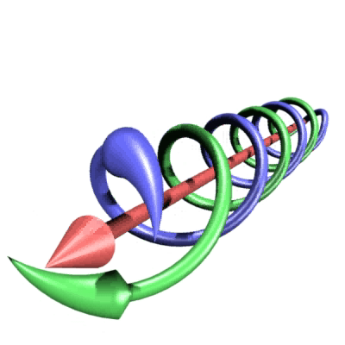
User-centric Technology Development
User-focused Double Helix technology development process
  Originated with CPOF development
Numerous interaction sessions with SMEs and users over 2-year period
  Both informal and formal
  Significantly shaped technology development:
    Issue identification
    Conceptual mismatches
    Determine essential features
Significantly increased user acceptance of the technology
Technology
ConOps
Experimentation
Double Helix development process: match technical capabilities with user needs
Approved for Public Release, Distribution Unlimited
Distribution authorized to U.S. Government Agencies only

Slide 8

LAPDOG: Learning Assistant Procedures from Demonstration, Observation, and Generalization
‘One-shot’ procedure learning
  application-independent learning algorithms
  heuristics and user feedback enable learning from one example
  can improve learning via multiple examples
Dataflow completion
  dynamic programming to generate information-producing plan
  efficient search for finding relations between KB objects
Parameter generalization
  generalization over scalar values, list expressions, tuples
Structural generalization: loop learning
  looping over a list or a set
  simultaneous looping/generation over multiple lists
Approved for Public Release, Distribution Unlimited

Slide 9

Event Trace
dataflow completion
parameter generalization
A₁
A₂
A₁
A₂
A(-a)
B(-m)
C(+a +m –[b c d])
D(+b -j)
E(+d -k)
F(–l)
G(+[j k l])
A(-$X)
B(-$Y)
C(+$X +$Y –$Z)
D(+first($Z) -$U)
E(+last($Z) -$V)
F(-$W)
G(+list($U $V $W))
A_{k}
unsupported input
A_{j}
inserted actions
perform dynamic programming search in space of information-producing actions; search over KB relations
find all unifications/variablizations across values and functional expressions over values
alternative completion paths
structure generalization
ABCDBCDBCDBCDE
A(BCD)*E
heuristic filtering
induce all possible loops:
over sets or lists
over multiple lists in parallel
over functional expns over lists
generating lists
Hypothesis
Space
prefer fewer targets, common paths; remove redundant paths, longcuts, repeated subpaths
heuristic selection
prefer shorter procedures, direct supports, existing supports, closest support
Learned Procedure

Slide 10
Action Model
Building blocks for procedure learning:
  A semantic specification of application actions + instrumentation and automation
Initial Approach
Level: primitive data changes
  e.g., create data entity, change entity attribute
Pros:
capitalized on existing CPOF architecture
compact (28 actions for full coverage)
Cons:
Lack of user comprehensibility – didn’t align with the way users thought about their actions
Extremely large procedures with many parameters (hundreds of actions, many 10s of parameters)
Final Approach
Level: effects on user-facing objects
  e.g., create object, add object to a collection, center object on map
Pros:
vastly improved user understandability
compact, intuitive learned procedures
Cons:
Significant reengineering of CPOF to provide instrumentation and automation
76 actions to cover core (but not all) CPOF functionality
Approved for Public Release, Distribution Unlimited

Slide 11
Triggers
Enable automated response to significant events
  e.g., automated configuration of workspace in response to SigAct
Trigger Types
  Time triggers
  Data triggers
  Area triggers
Led to significant ‘workflows’ involving combinations of triggers and procedures
Approved for Public Release, Distribution Unlimited

Slide 12
SPARK Executor
BDI Agent framework in the Procedural Reasoning style
  Reactive plan execution mechanism
  Goal directed & data driven
  Metalevel reasoning; introspection capabilities
Outside World
Agent
Advice
Intentions
Procedures
Executor
Beliefs
Actions
Sensors
Effectors
Approved for Public Release, Distribution Unlimited

Slide 13
PAL-Enhanced CPOF Capabilities
Learns straight-line procedures, procedures with iteration by demonstration
  Defined in a semantically meaningful Action Model
Key Features:
  supports task composition by demonstration
  supports triggered procedures
  supports continuous and stepped execution
Basic editing capabilities
  Delete steps, copy from other procedures, change parameters, add conditions/iteration
Approved for Public Release, Distribution Unlimited
Notes:
Need to verify that we can still do task composition

Slide 14
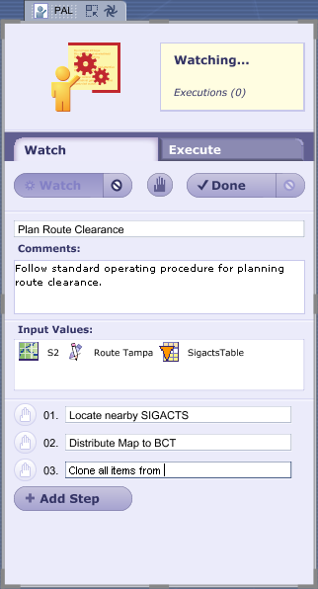
PAL-CPOF UI
Importance of UI consistency with core CPOF to ensure coherent user experience
A. Learning Appliance:
  Start/Pause/End demonstration
  Stepping
  Visual cue to notify ‘watching’
B. Trigger Palette
  Specialized templates for each trigger type
C. Activity Manager
  tracks triggered procedures
Approved for Public Release, Distribution Unlimited

Slide 15
Use Cases
Technology Use:
  automate routine tasks
  customization of workspace
  share best practices
Use Cases (from Army personnel, SMEs):
  Workspace Configuration and Monitoring
  Emergency Response Procedures
  Continuous IPB and Survivability
  Augmented Planning, Execution Monitoring
  Tracking Route Clearance Progress
  “While You were Away”
Approved for Public Release, Distribution Unlimited

Slide 16
Early Evaluation
Informal feedback on utility and usability of the technology
General enthusiasm for the technology
“[PAL-CPOF would] eliminate 90% of my job.”
-- Staff officer
“PAL … has the potential to save countless man-hours by conducting routine, repetitive tasks with little or no input from the user. Those man-hours could then be reallocated to other tasks (analysis, rest, etc) or even free up soldiers to conduct combat operations.”
-- Battle Captain, 3ID
“[PAL-CPOF will] provide time to think.”
-- Staff officer
Approved for Public Release, Distribution Unlimited
Notes:
Tool suites: MS vs intel vs Ops planning
Programming is expensive – especially for ‘one offs’
Recurrent tasks – take a lot of time: intel analyst example

Slide 17
Army Evaluation:
Battle Command Battle Laboratory
More rigorous evaluation held in December, 2008
  Part of a larger effort to assess usability and effectiveness of a range of PAL technologies
Focused on skeletal Brigade Combat Team (BCT) planning staff
Hypotheses
A PAL-enabled BCT, compared to a BCT without PAL, will be able to:
  H1. Achieve better situational awareness
  H2. Achieve better situational understanding
  H3. Complete more required actions in the same amount of time
  H4. Produce better quality products in the same amount of time
Approved for Public Release, Distribution Unlimited

Slide 18
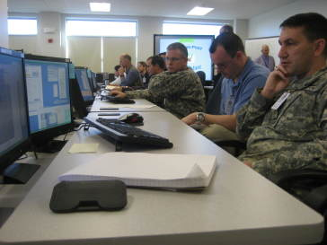


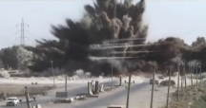

BCBL Event
Replicated core BCT staff with PAL-enhanced CPOF and WebTAS competes with staff without PAL
Each team receives events in response to actions they take
Blue BCT
has CPOF & WebTAS with PAL
Results
PAL
CPOF-WebTAS
*
Evaluation
PAL
CPOF-WebTAS
CPOF
Training
In-Garrison Training
Team
Swap
Green BCT
has only CPOF and WebTAS
CPOF-WebTAS
Evaluation
CPOF-WebTAS
A stressful escalating set of ad hoc, time-sensitive tasks
Scenario Events & Data
(Gryphon Strike)
A stressful escalating set of ad hoc, time-sensitive tasks
in Phase 4 of Gryphon Strike
BCBL Controllers
A stressful escalating set of ad hoc, time-sensitive tasks (HVTs, ambushes, major insurrection)
Approved for Public Release, Distribution Unlimited
Notes:
PAL Claims
PAL can learn to perform tasks for overburdened staff and can help staff stay on top of tasks
PAL can learn to direct the right information to the right person and present it so that it can be best assimilated and understood
PAL can adapt to users by extending and personalizing current military software system capabilities without requiring redesign

Slide 19
BCBL Analysis
 | Task Load Survey | Self assessment Survey | Post Hoc Survey | SA/ SU Quiz | S2 & Intel Survey | Trigger History Screen | Storyboard Time Hacks | Analyst Observations | Planning board Comparison | Storyboard Comparison | S2 Screen Shot Comparison
Situational Awareness
Situational Understanding
Quantity/ Speed
Quality
Hypothesis supported with initial analysis.
Initial data supports hypothesis.
Data requires additional analysis to draw a conclusion.
Initial data does not support hypothesis.
Data collection tool not designed for answering this hypothesis.
Approved for Public Release, Distribution Unlimited

Slide 20
Excerpts from BCBL Final Report
PAL Improves Situational Awareness
“When enabled with PAL-CPOF, the BCTs were able to handle routine actions, and had the time to focus their attention on the issues that met the criteria for the commander and staff’s attention. They had more time to think, plan and make sound decisions.”
PAL Enables Higher-Quality Staff Products
"The military decision making process products … were deemed to have a higher quality while produced in less time. Furthermore, directions given to subordinate units were more complete and contained more detail than the orders produced without PAL.”
Approved for Public Release, Distribution Unlimited

Slide 21
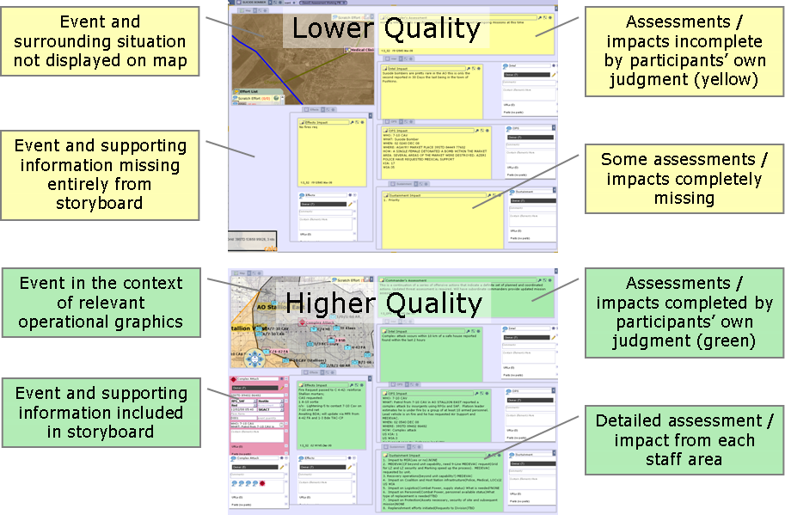
Storyboard Quality
Approved for Public Release, Distribution Unlimited

Slide 22
PAL-CPOF Transition: Next Steps
Field PAL-CPOF to an operational unit in the
  Aim for broader deployment if successful
Engineering Focus:
  Hardening, linkage to CPOF release 5.0
Technical Focus: Usability
  Procedure visualization and editing
  Procedure sharing
  Monitoring and analysis support
Approved for Public Release, Distribution Unlimited

Slide 23
Summary
Learning by demonstration technology is ready for prime time
Application to CPOF shows both utility and user acceptability of the technology
C2 operational benefits:
  A field-adaptable CPOF
  Significant time savings through user-created and refined automation of mundane tasks
  Improved accuracy and quality of products
  Capture and automation of unit SOPs and TTPs
“PAL saves time and time equals lives”
Approved for Public Release, Distribution Unlimited

