Slide 1
ODM Standard in Kubernetes
Http
user
endpoint
Decision Center
DevOps
Decision Server Console
Docker
Decision Server Runtime
Decision Runner
Container
Instance
Database

Slide 2
ODM Cluster in Kubernetes
Http
user
endpoint
Decision Center
DevOps
Decision Server Console
HA Proxy
Docker
Decision Server Runtime
Decision Runner
Container
Instance
Database

Slide 3
ODM Cluster in Kubernetes
Decision Server Console
End Users
DevOps
https
Decision Center
HA Proxy
Docker
Decision Server Runtime
Database
Decision Runner
Container
Instance

Slide 4
ODM Standalone in Kubernetes
End Users
https
Docker
Decision Runner
Decision Center
Decision Server
Database
DevOps
Container
Instance

Slide 5
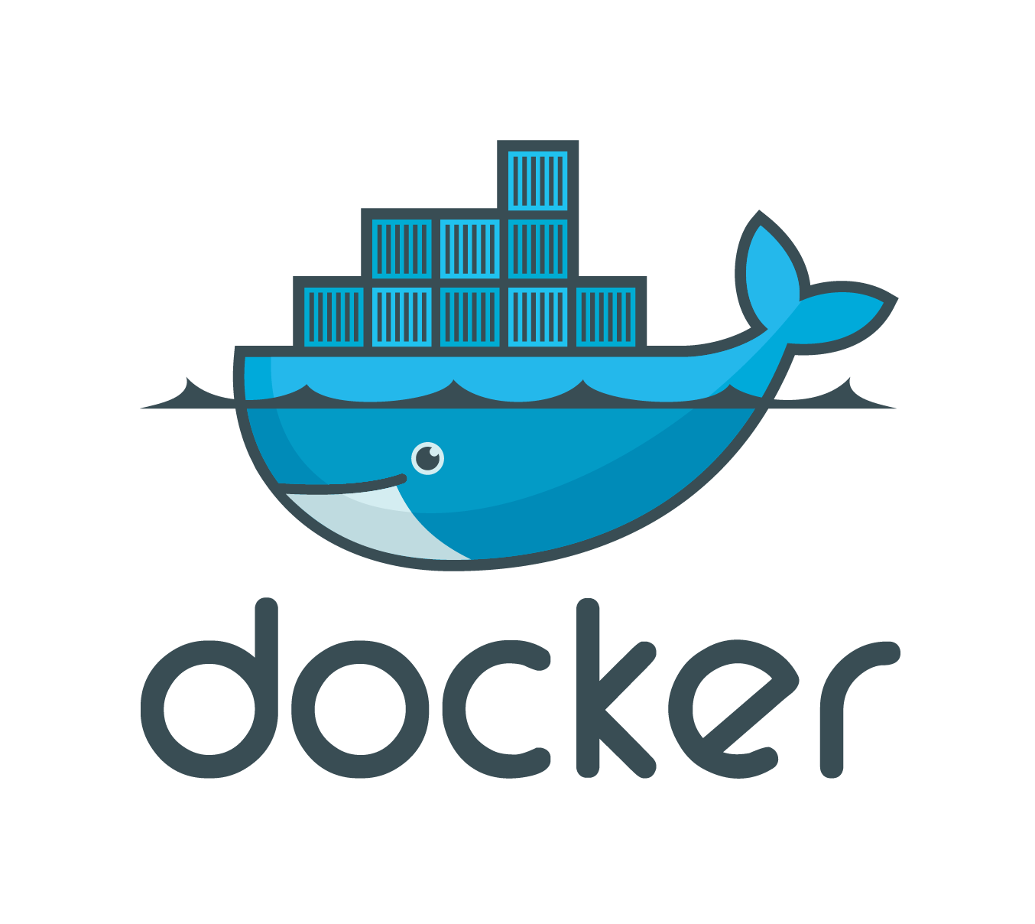
ODM Deployment Flow in Kubernetes
DEMO
Bluemix
Docker
Registry
Local machine
1
Push Docker images
2
Create the cluster
3
Provision ODM in Kubernetes
4
Use ODM containers

