Slide 1
ODM Standard in Kubernetes
Decision Center
DevOps
End Users
Decision Server Console
https
Docker
Decision Server Runtime
Database
Decision Runner
Container
Instance

Slide 2
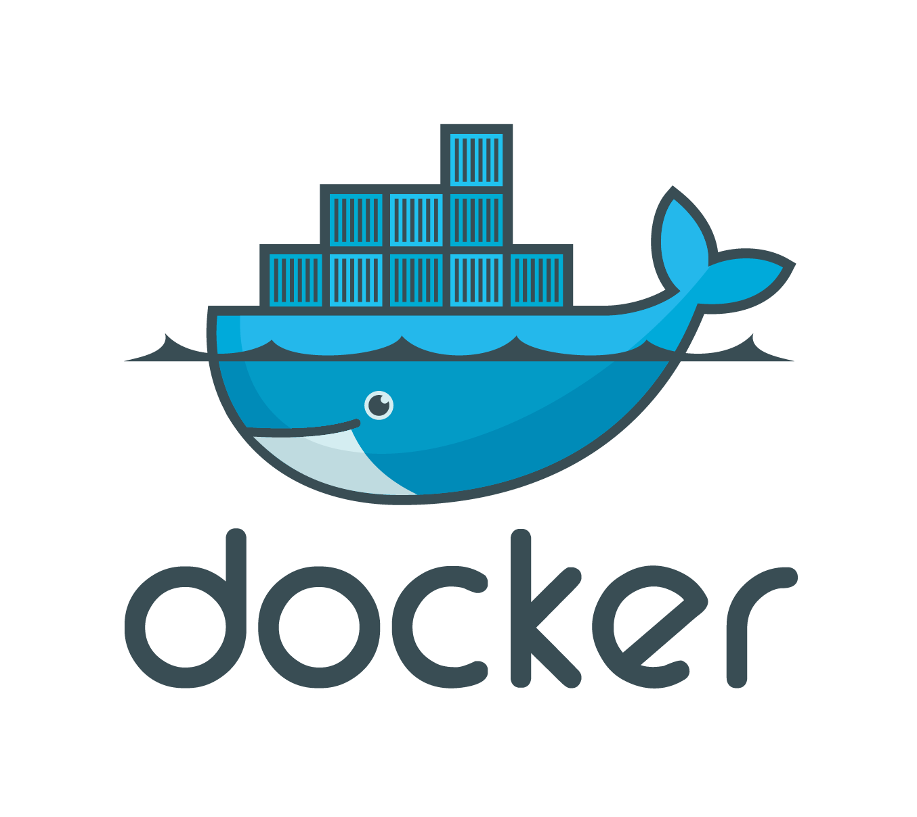
ODM Deployment Flow in Kubernetes
DEMO
Bluemix
Docker
Registry
Local machine
1
Push Docker images
2
Create the cluster
3
Provision ODM in Kubernetes
4
Use ODM containers

