Slide 1

One South West
Shared Care Record
NHS know-how, supported by international experience

Slide 2

Individual Health Record (IHR) - History
IHR originally conceived by CentriHealth in the UK and then developed in the US
Conceived by physicians and other healthcare clinicians
CentriHealth acquired by UnitedHealth Group (Optum’s parent company)
UHG is developing 67 million IHR’s for healthcare insurance customers in the US
Includes access by potentially >1m clinicians
Optum is using IHR in the US as the core of its Population Health Platform for Accountable Care Organisations
Optum UK has recently started IHR market engagement in the UK working with NHS Arden GEM CSU on specific opportunities
The branding and market collateral is in development consequently the video is in CentriHealth branding

Slide 3



What is the Individual Health Record – IHR?
The Individual Health Record (IHR) platform cognitively transforms multi-sourced heterogeneous data to improve the care of individuals.
Primary Care
Specialist
Surgery
Imaging
Integrated Health Record – providing clinicians, physicians and patients with a single common record to use
Clinician Dashboards – supports physician’s care management of their patients
Personal Health Record (PHR) – for patient access to their record
Time-of-Care Management System – Proactive 24x7 health monitoring, disease management and on-demand analytics
Pathology
Social
care
Multi-Disciplinary Team
Home
Care
IHR
Chemo/
Radiation
Hospice
Pharmacy
Accident &
Emergency

Slide 4
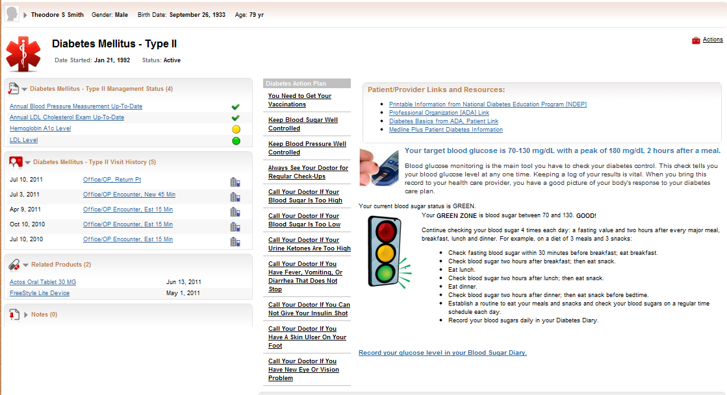
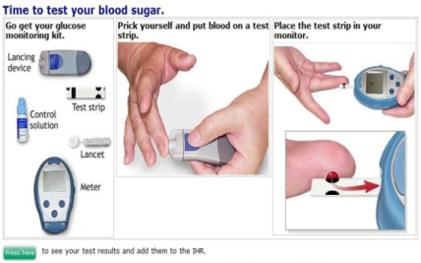
Patient is Empowered in their Health
Key Benefits for Individuals
Empowerment – taking charge of one’s own health care and treatment plan compliance
Knowledge – a center repository for all medical items
Action – enables things to follow up on (alerts, reminders) and be proactive with their health
Cost savings – reduces multiple tests, procedures, etc.

Slide 5
Video
Please follow the link below for the video
https://youtu.be/6A30cJ_uYg0
and the credentials for viewing the video are
Login: ananda.kanneganti@optum.com
Password: optum2019
Instructions for accessing the video
When you click the link it will show up as "This Video is Unavailable". This is because the video is listed as private. Please use the "Signin" at the top of the video and use the credentials (login and password) provided by us to view the video.

