Slide 1
pMFM speedup
Tian Fang

Slide 2
Outline
Introduction
Dataset Creation
Models and Performance

Slide 3
Outline
Introduction
Dataset Creation
Models and Performance

Slide 4
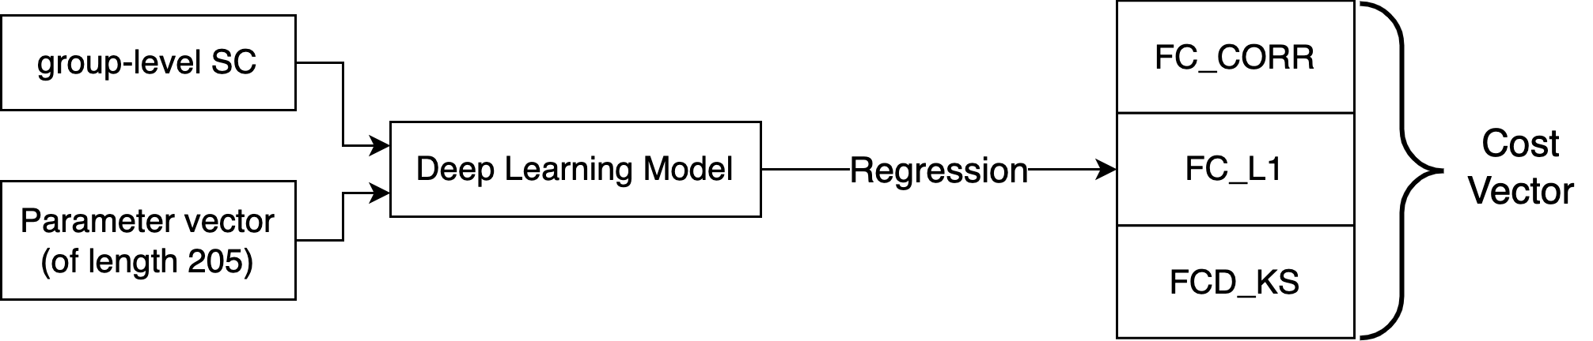
Introduction: Motivation for pMFM_speedup
Current pMFM’s major downside: slow simulation.
pMFM_speedup models
Takes the same inputs as the pMFM
perform a regression task and output predicted cost vector (of length 3: FC_CORR cost, FC_L1, and FCD_KS)

Slide 5
Outline
Introduction
Dataset Creation
Models and Performance

Slide 6
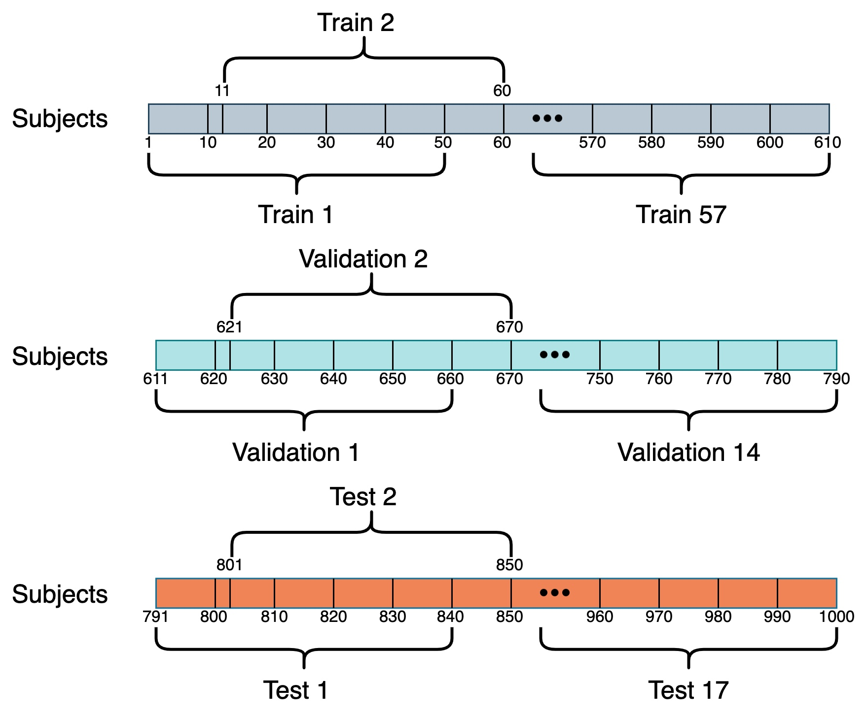
Dataset Creation: Dataset Generation Process
1000 subjects are split into 88 samples (50 subjects per sample)
57 training samples
14 validation samples
17 test samples
Generate 1 group-level empirical SC, FC and FCD for each sample

Slide 7
Dataset Creation: Parameter Selection for Data Generation
Initialize CMA-ES with G, wEE, wEI, and 𝜎 in their respective ranges
Ranges
Range for each wEE: [1, 10]
Range for each wEI: [1, 5]
Range for each 𝜎: [0.0005, 0.01]
Range for G: [0, 3]
Use CMA-ES (100 iterations with each iteration yielding 100 children) to generate 10000 different parameter vectors for each subject group
We will have 88 SCs, each with 10000 parameter vectors, resulting in 880,000 inputs

Slide 8
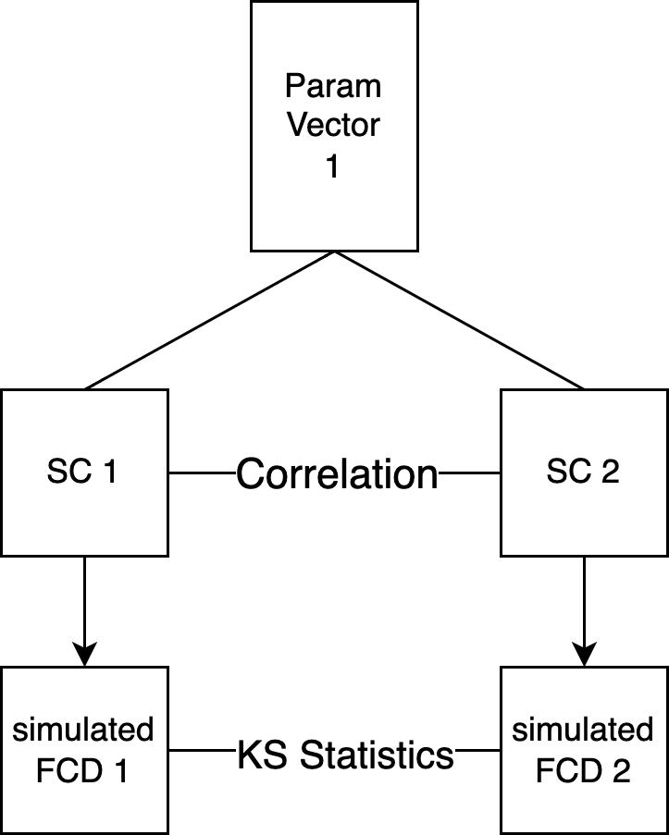
Simulated FCD are not sensitive to changes in SC
Randomly choose a parameter vector from the train set
Fix the parameter vector and use different SCs with that parameter vector to generate corresponding simulated FCD
For each pair of SC, compute the pair-wise KS statistic and correlation between SCs

Slide 9
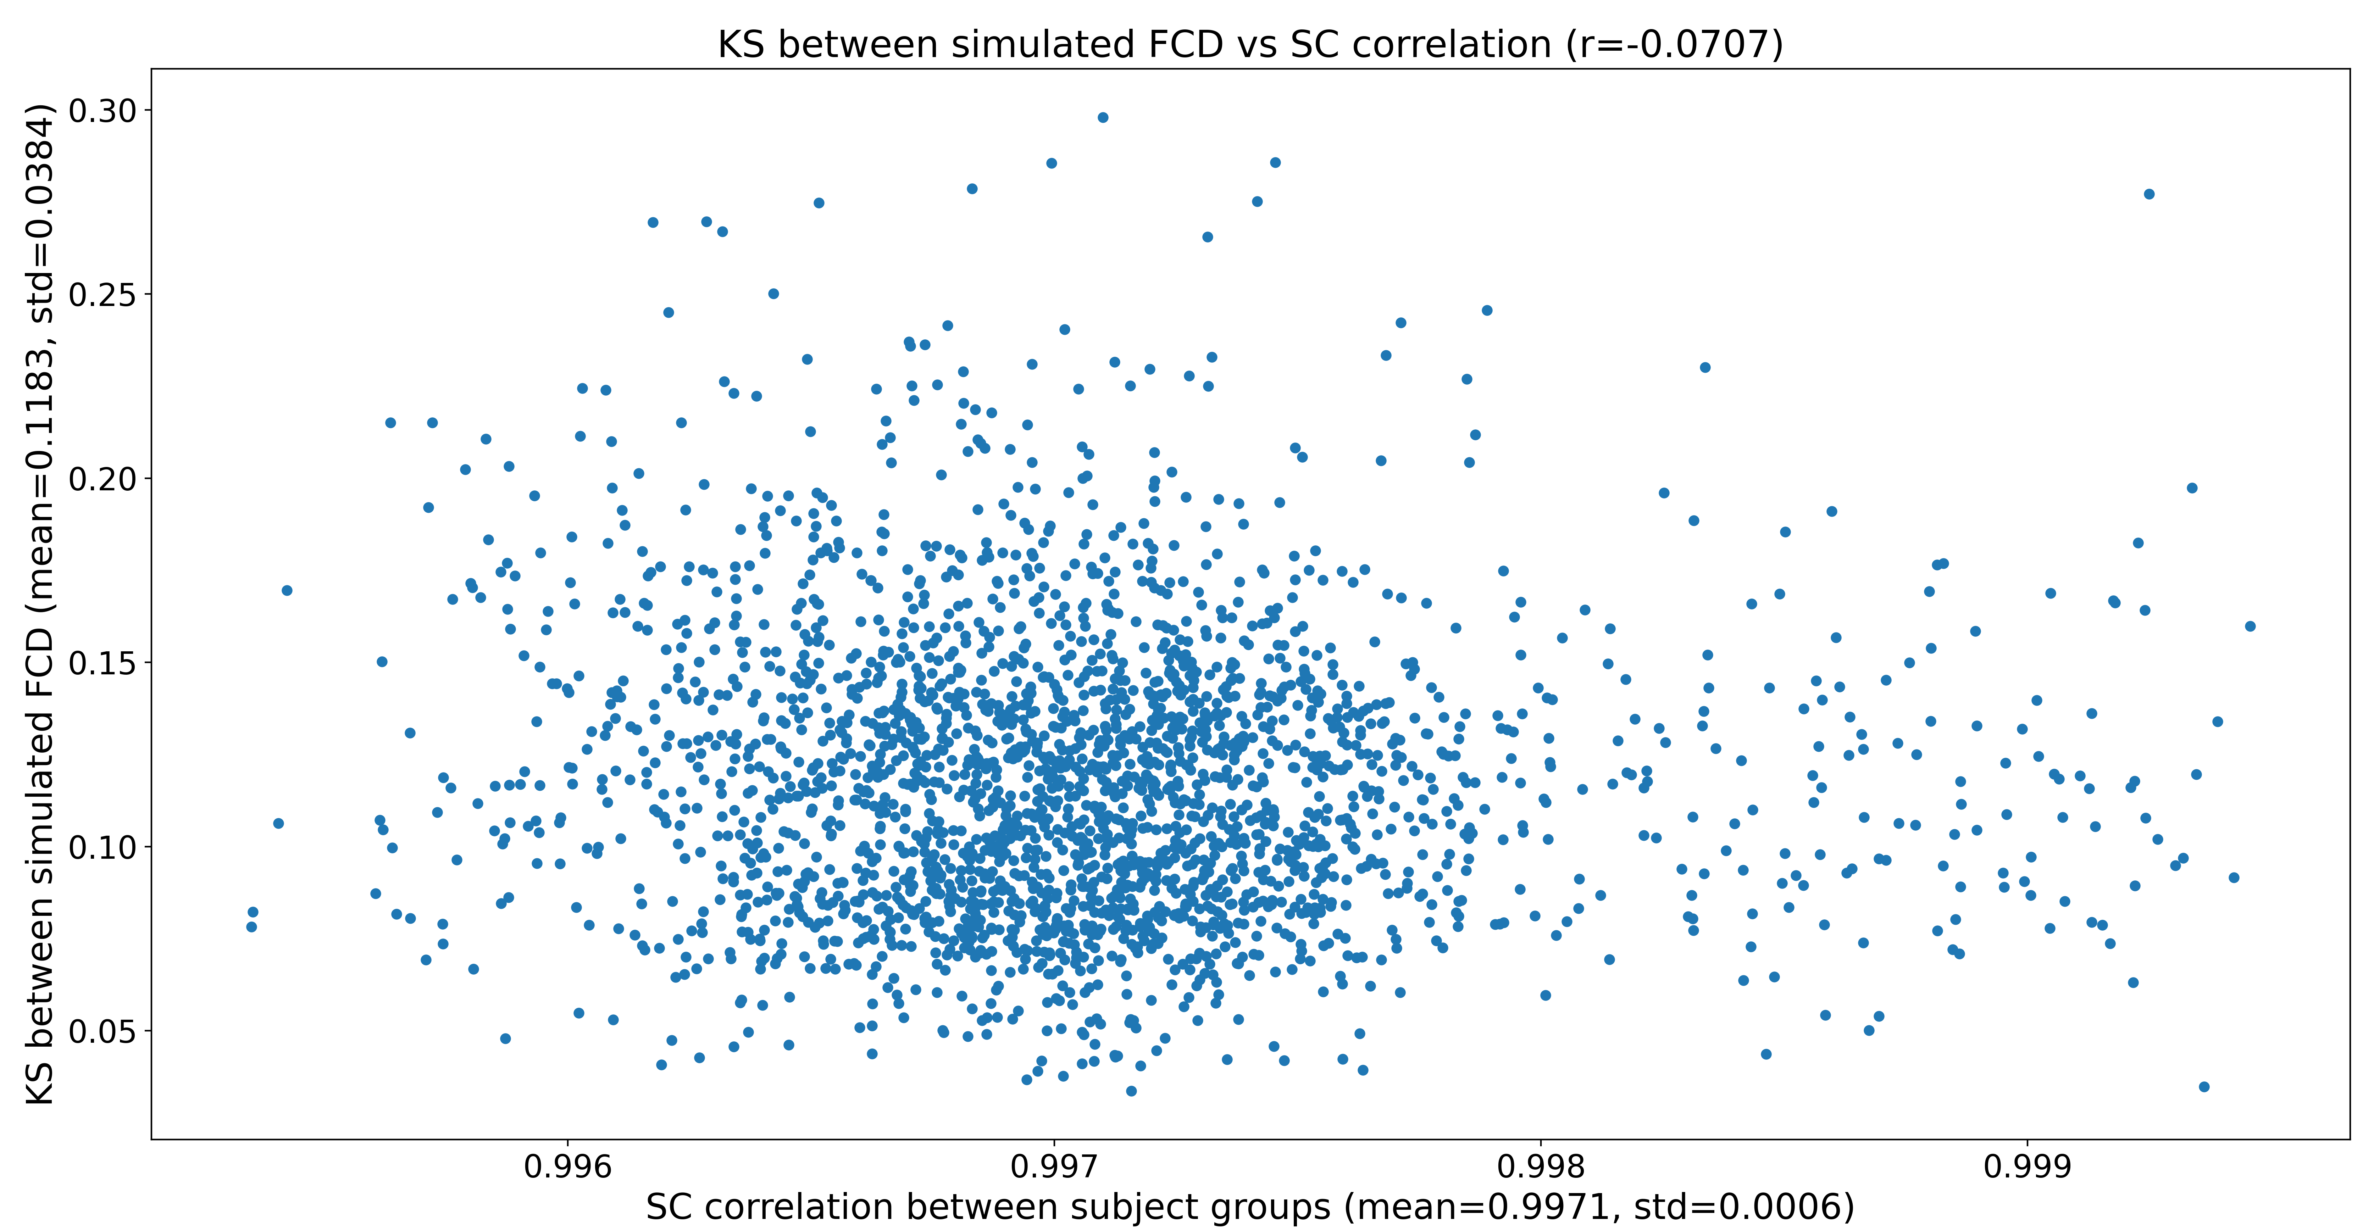
Simulated FCD are not sensitive to changes in SC

Slide 10
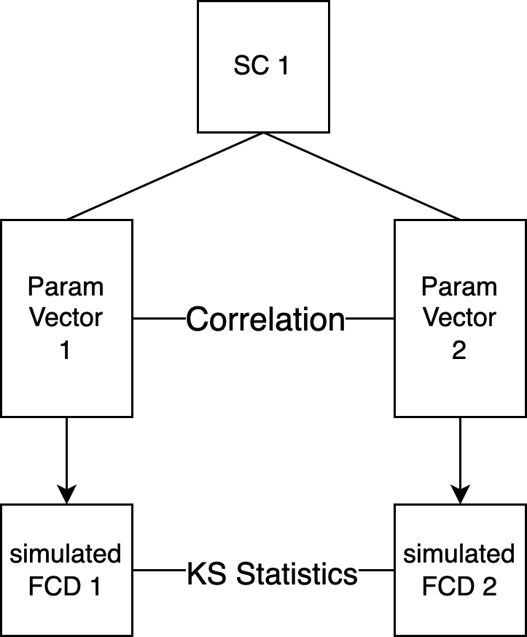
Simulated FCD are not sensitive to changes in param vector
Randomly choose an SC from the validation set
Fix the SC and use different parameter vectors with that SC to generate corresponding simulated FCD
For each pair of parameter vectors, compute the pair-wise KS statistic and correlation between parameter vectors

Slide 11
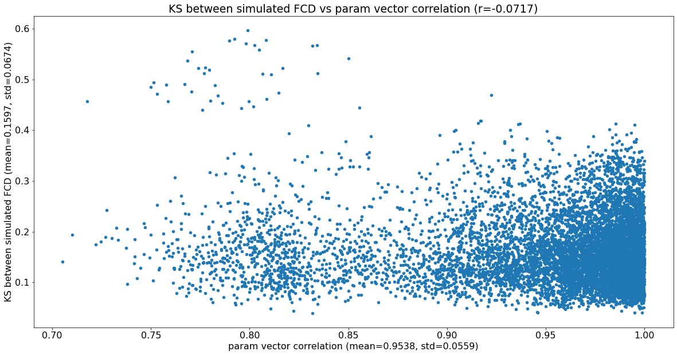
Simulated FCD are not sensitive to changes in param vector

Slide 12
Outline
Introduction
Dataset Creation
Models and Performance

Slide 13
Model:
Loss function: Mean Square Error (MSE) Loss
Optimizer: Adam optimizer (initial lr = 5e-4) with exponential decay learning rate scheduler (multiply lr by 0.98 every epoch)
Regularization: batch normalization is used to reduce overfitting
Batch Size: 256
Metrics logged:
During training: mse loss across 3 different cost terms
During validation: mse loss across 3 different cost terms, and mse loss for each individual cost
Hyperparameter tuning: Optuna

Slide 14
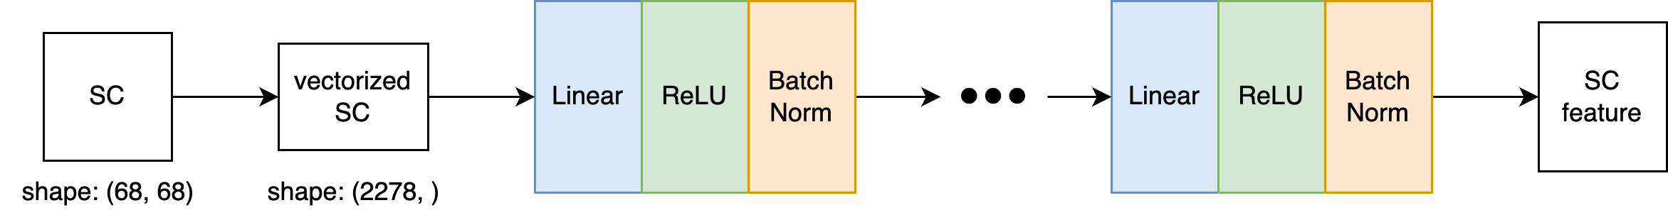
Model: SC Feature Extractor
Notes:
Since the SC matrix has many parameters (68x68) and SC matrices from different groups are highly similar. We can use neural nets to extract features ("embedding") from the SC matrix and proceed further with the SC feature with a much lower dimension. In this way, we have much fewer input parameters, which can address overfitting to some extent.
The current SC feature extractor used is CNN, using which we treat an SC matrix as a 68x68 image and use convolution to extract latent features of the SC matrix.

Slide 15
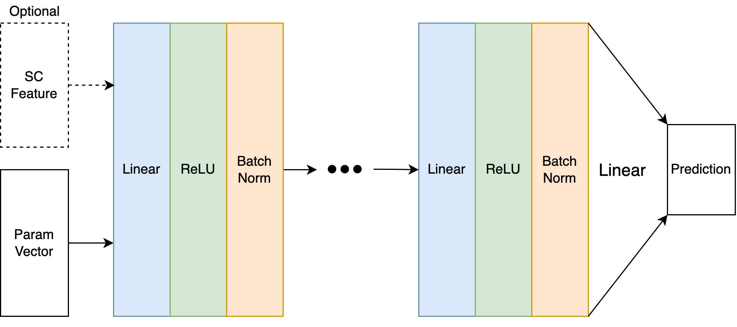
Model: Naive Net
If SC feature is used, it will concatenate
with the param vector of length 205
Notes:
Naive net is a straightforward simple network with several ReLU activated linear layers.

Slide 16
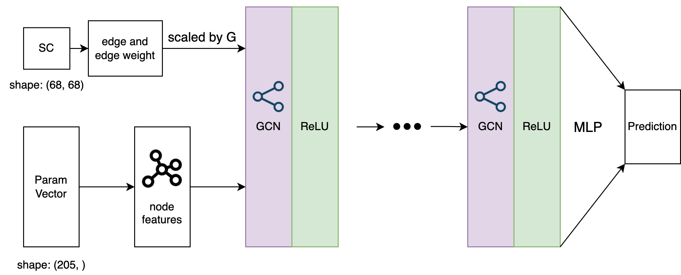
Model: Plain GCN
Node features for each ROI are concatenated before MLP
Notes:
And we have plain GCN, where we can treat each brain region as a node, and the parameters associated with a brain region as the corresponding node features. The edge and edge weight come from non-zero entries of a group's SC. The global scaling factor G is used to scale the edge weight, similar to its role in the pMFM (scaling connections between brain regions uniformly).

Slide 17
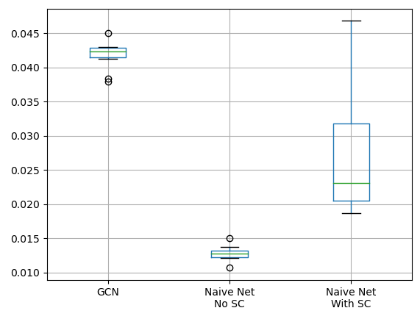
Top 10 sets of hyperparameters for each model
Top 10 set of hyperparameters are picked based on validation cost
MSE loss across 3 different cost terms
Naïve Net without SC performs the best (has the lowest validation loss and the lowest variation)

Slide 18
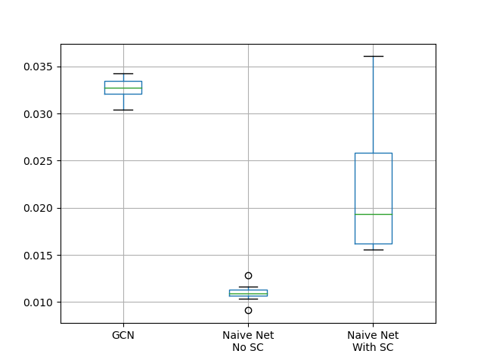
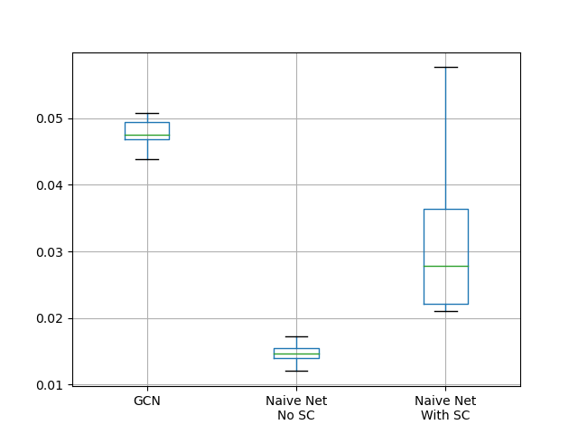
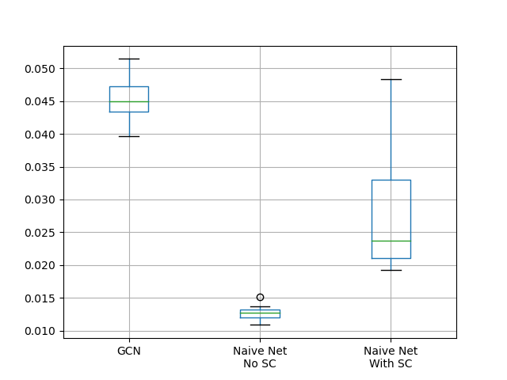
Top 10 sets of hyperparameters for each model
FC_CORR’s MSE
FC_L1’s MSE
FCD_KS’s MSE
Naïve Net without SC performs the best (has the lowest validation loss and the lowest variation)

Slide 19
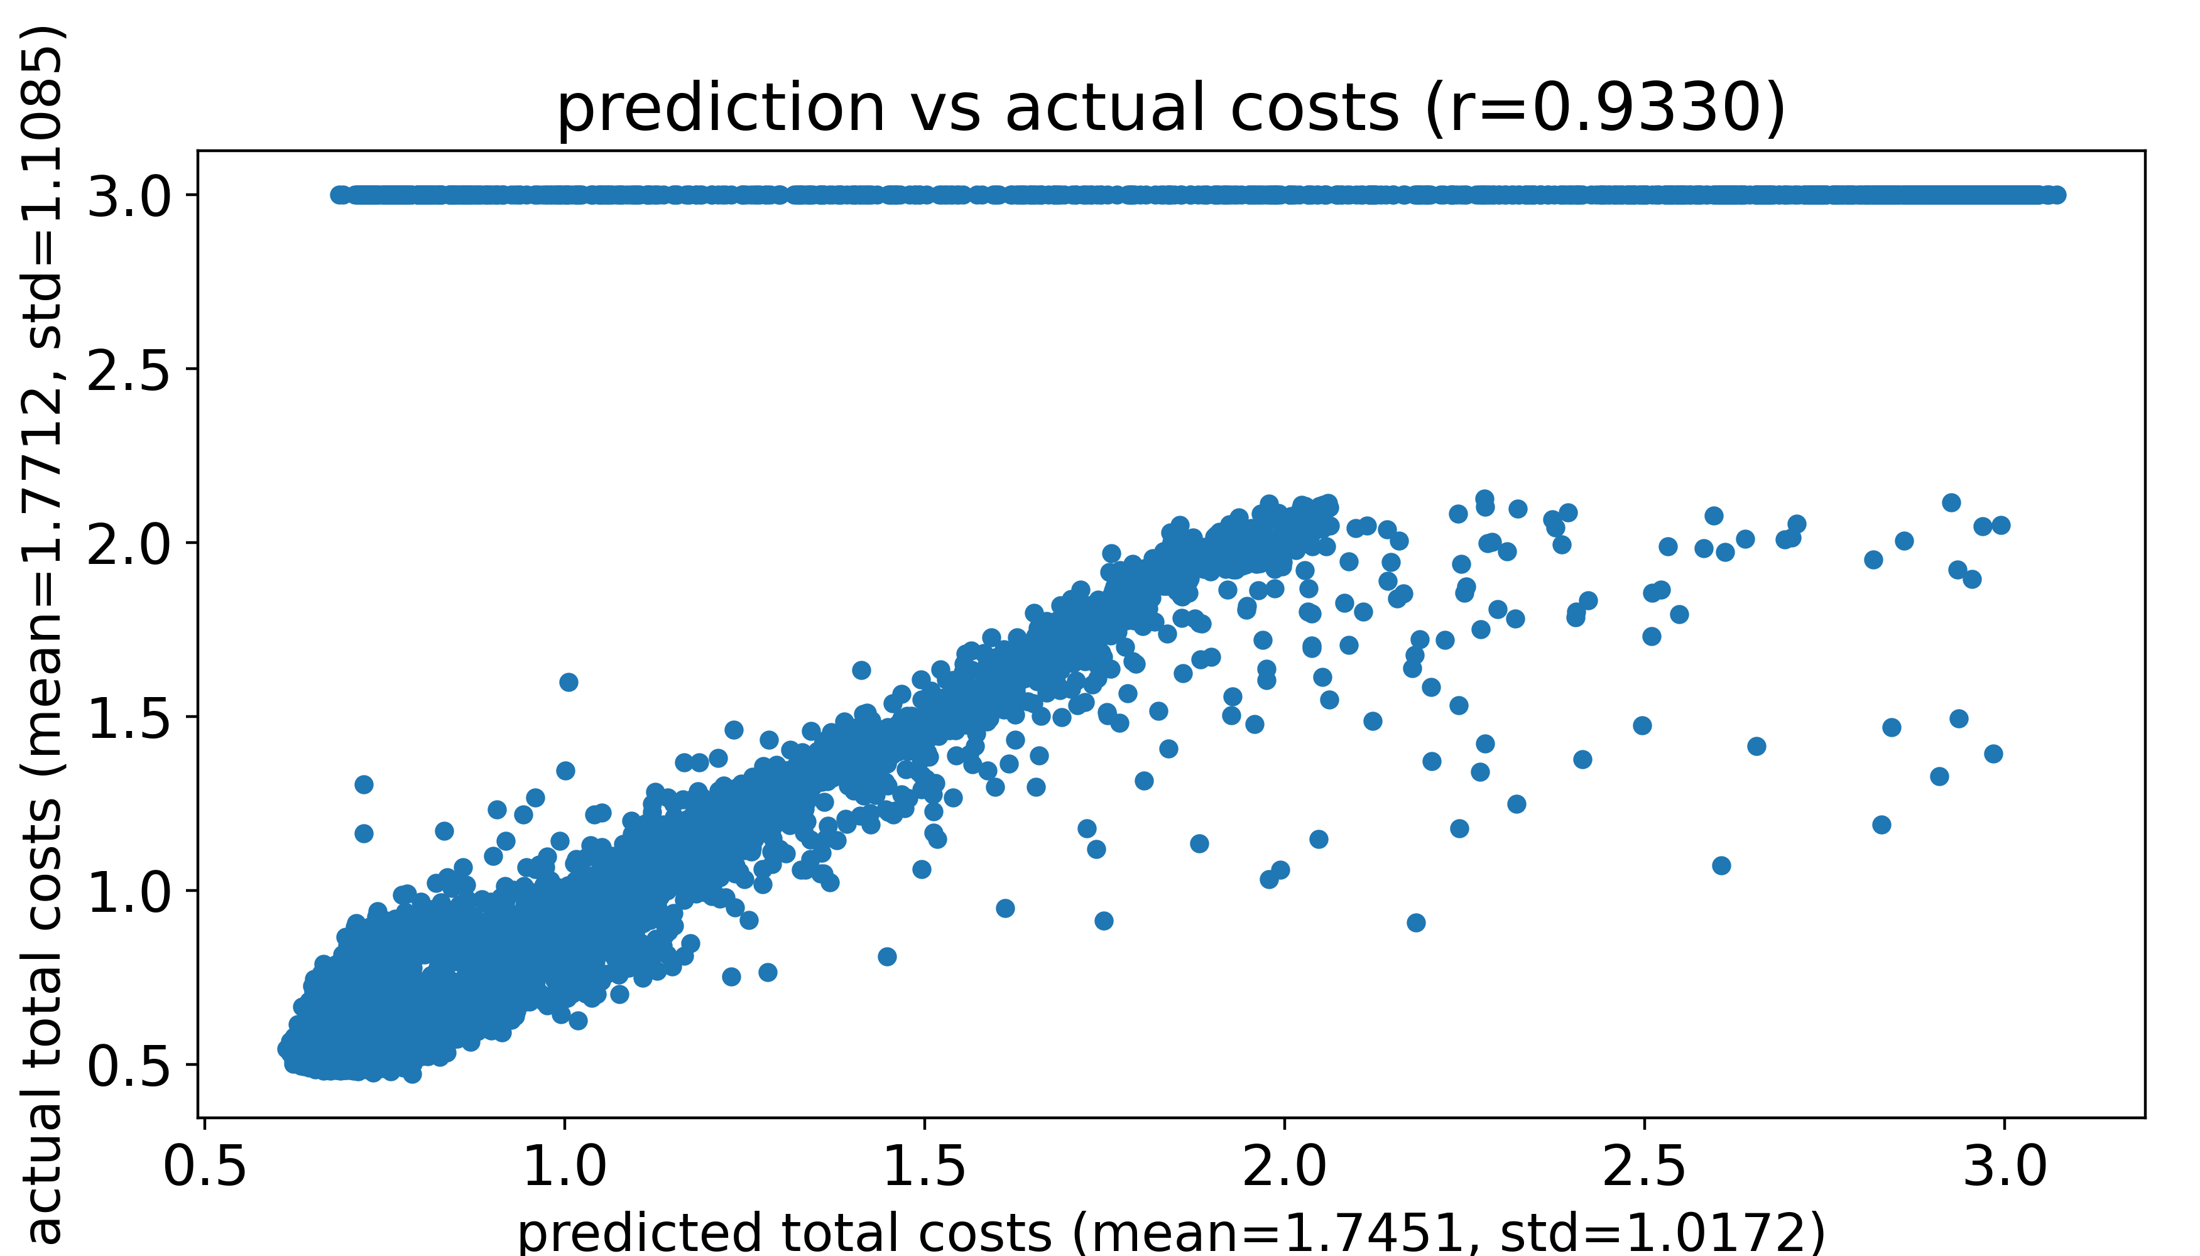
Compare prediction and actual costs
Only consider naïve net without SC
Evaluate the model’s performance on each validation sample by comparing the prediction and the actual costs
Dots with an actual cost of 3 represent parameters that generate NaN using Euler forward simulation
Predicted costs and actual costs for one validation sample

Slide 20
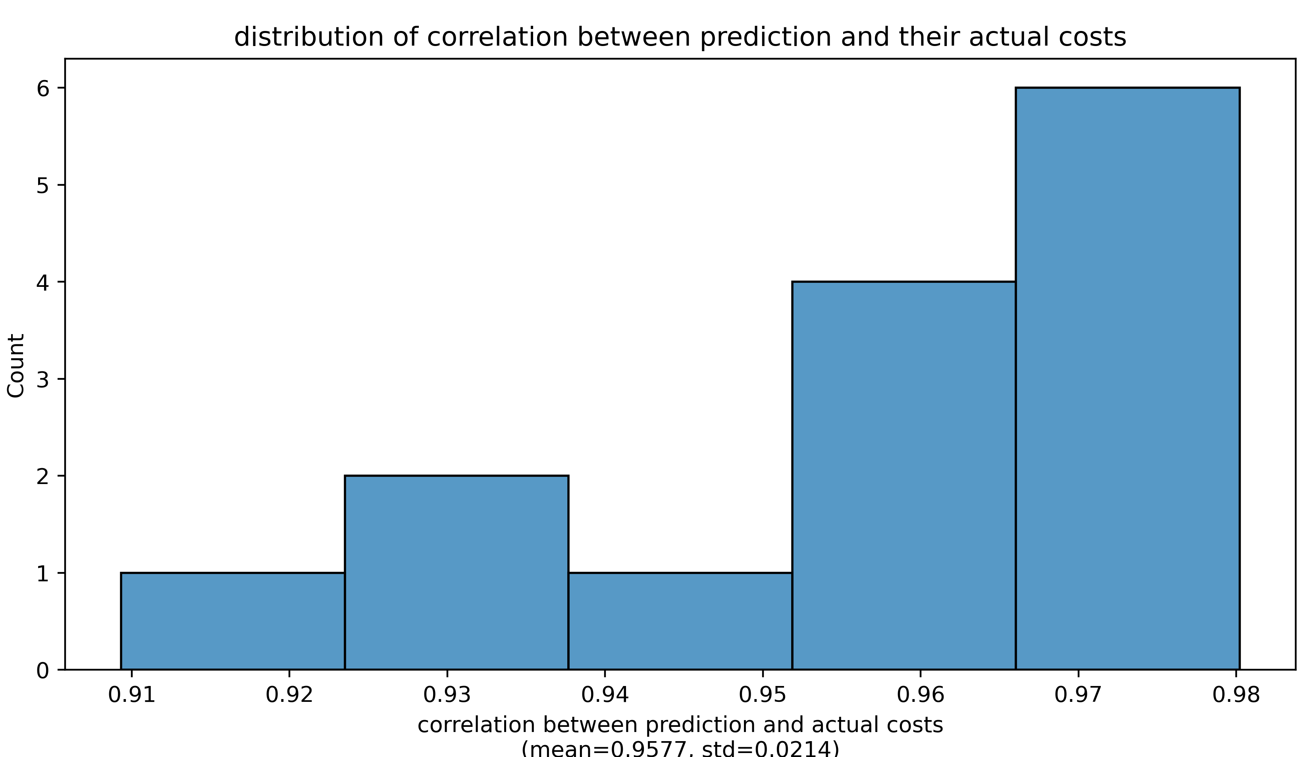
Compare prediction and actual costs
Only consider naïve net without SC
Evaluate the model’s performance on each validation sample by comparing the prediction and the actual costs
Dots with an actual cost of 3 represent parameters that generate NaN using Euler forward simulation
Strong correlation between prediction and actual costs in the validation set

Slide 21
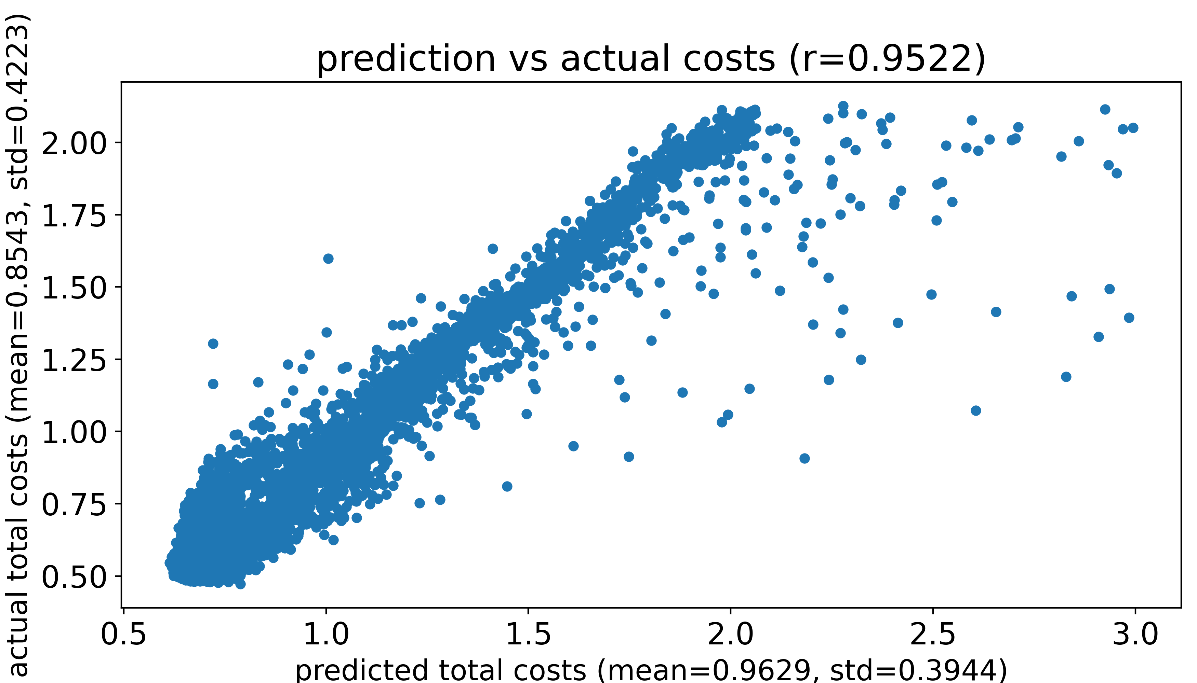
Compare prediction and actual costs
Only consider naïve net without SC
Evaluate the model’s performance on each validation sample by comparing the prediction and the actual costs
Predicted costs and actual costs for one validation sample

Slide 22
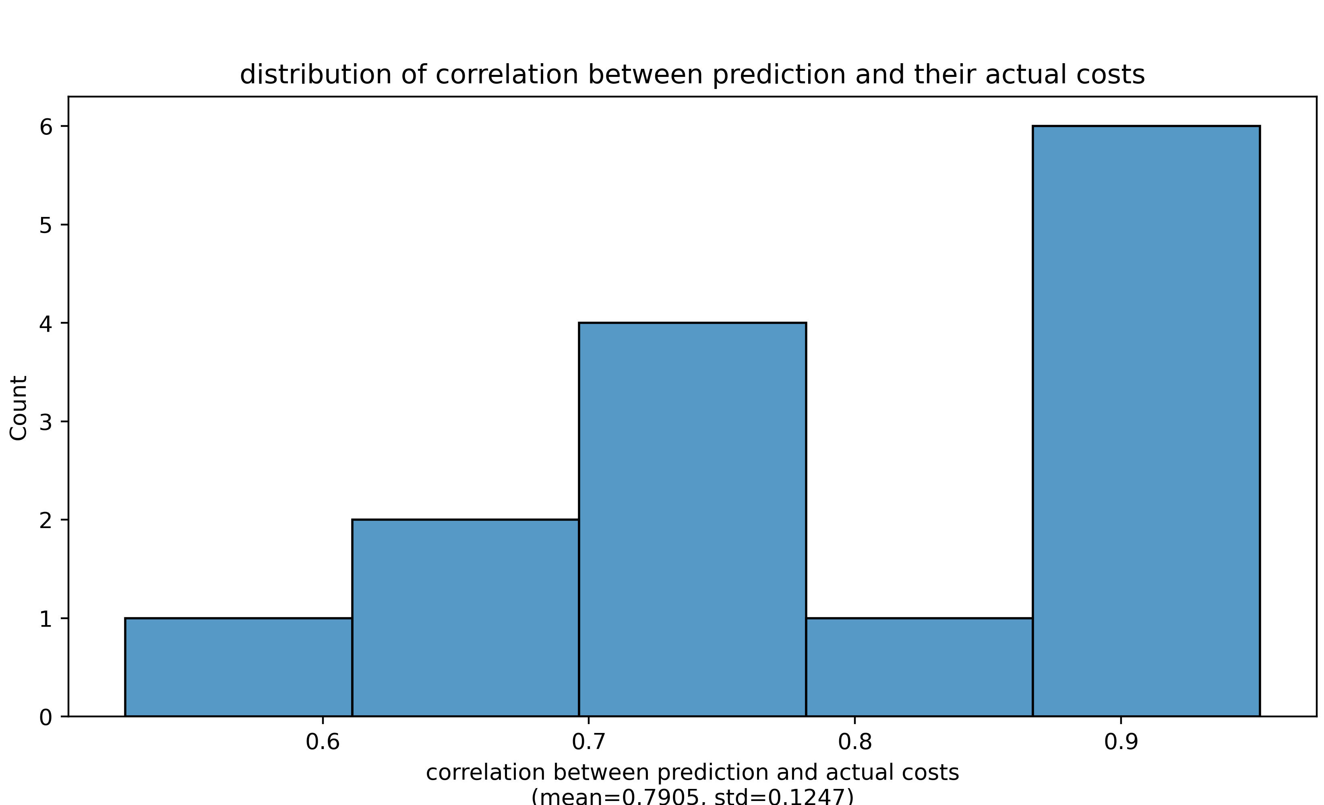
Compare prediction and actual costs
Only consider naïve net without SC
Evaluate the model’s performance on each validation sample by comparing the prediction and the actual costs
Strong correlation between prediction and actual costs in the validation set

Slide 23
Thank you

