Slide 1
pMFM speedup
Tian Fang

Slide 2
Overview
Parameter optimization using CMA-ES with DL Model with Parameterization

Slide 3
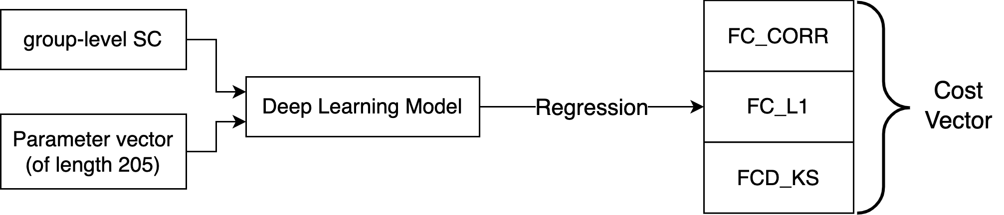
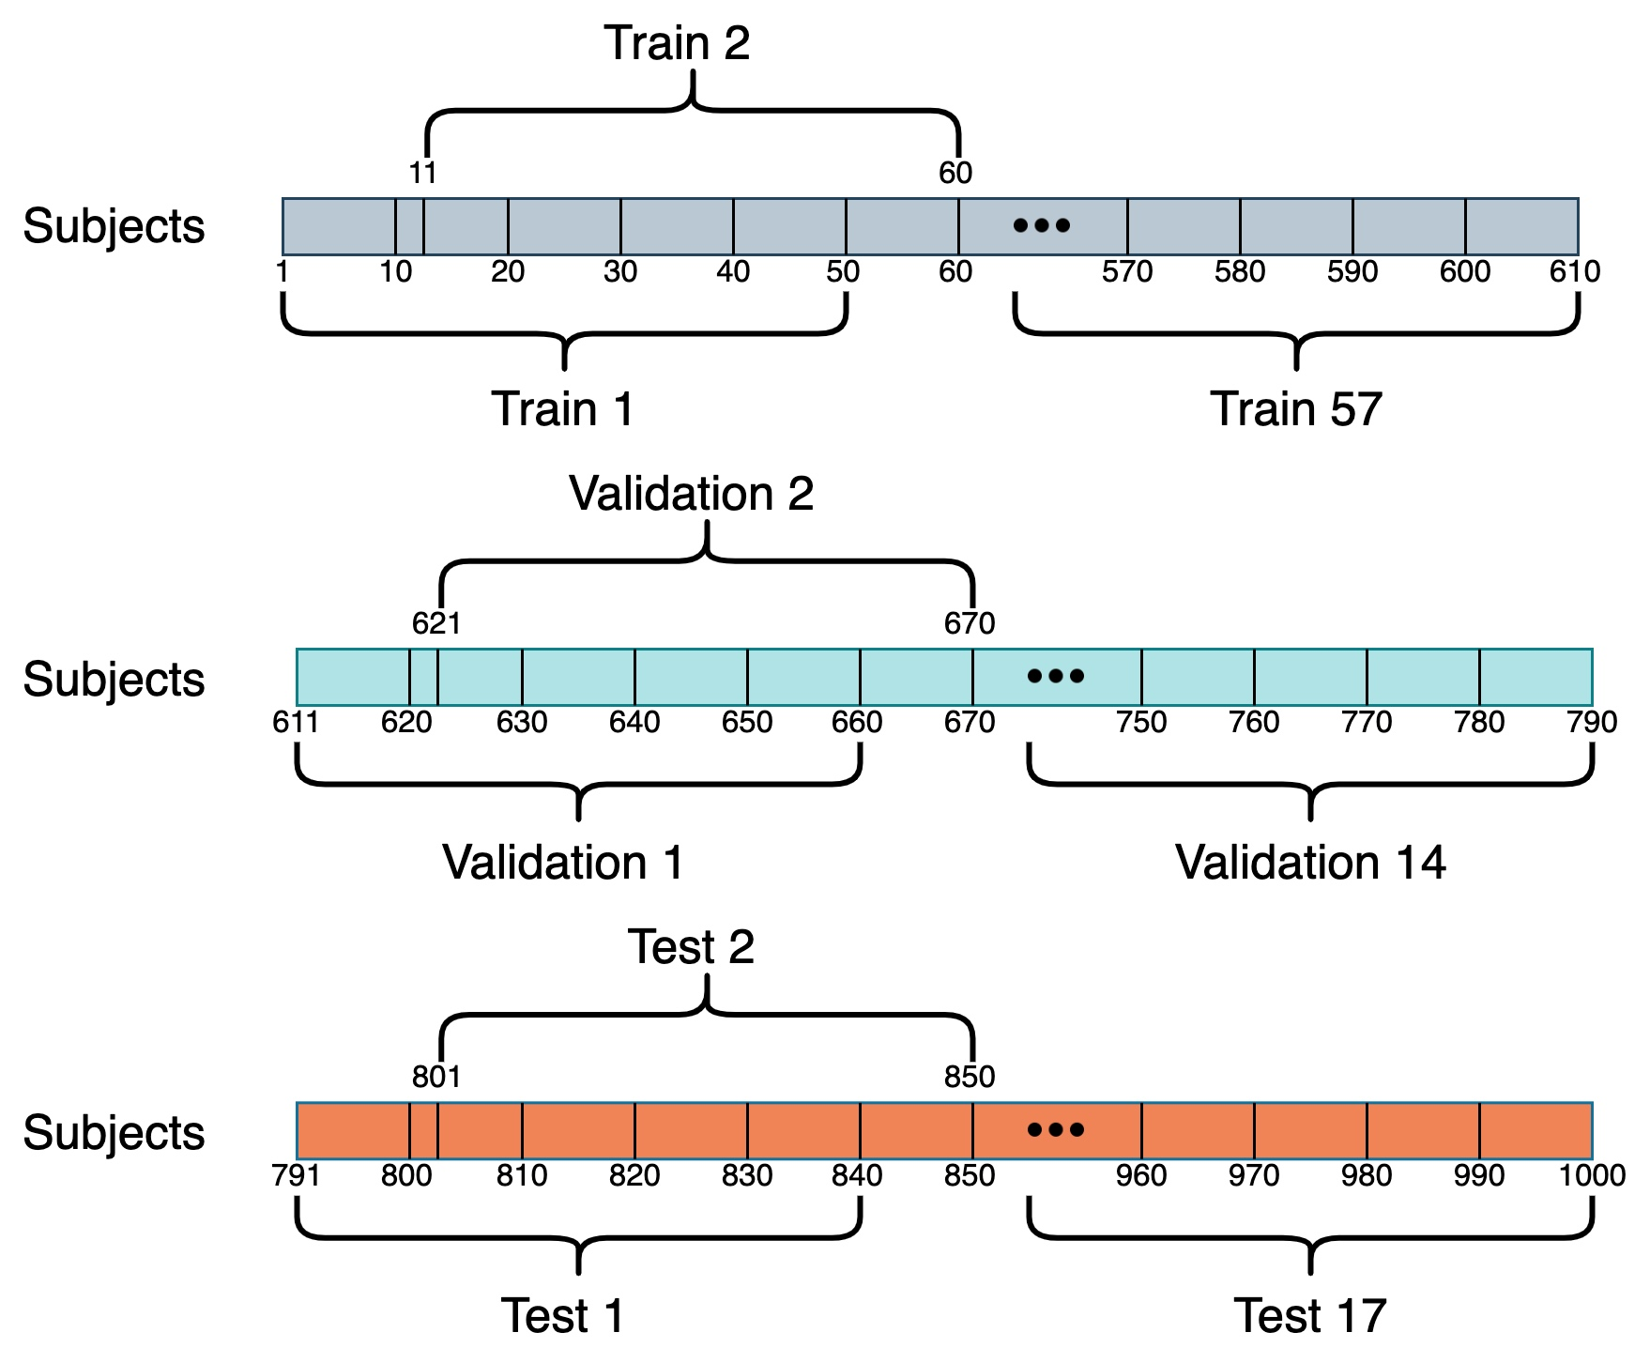
Recap: Prediction Task and Dataset
1000 subjects are split into 88 samples (50 subjects per sample)
57 training samples
14 validation samples
17 test samples
Generate 1 group-level empirical SC, FC and FCD for each sample

Slide 4
Parameter optimization using CMA-ES with DL Model with Parameterization

Slide 5
Deep Learning (DL) version CMA-ES
Same initialization as Euler Integration version CMA-ES
G, wEE, wEI, and 𝜎 Ranges
Range for each wEE: [1, 10]
Range for each wEI: [1, 5]
Range for each 𝜎: [0.0005, 0.01]
Range for G: [0, 3]
Use trained DL model (instead of Euler Integration) to predict costs of param vectors
Run up to 500 CMA-ES iterations, each yielding 1000 children
Choose 1 param vector with the best predicted costs

Slide 6
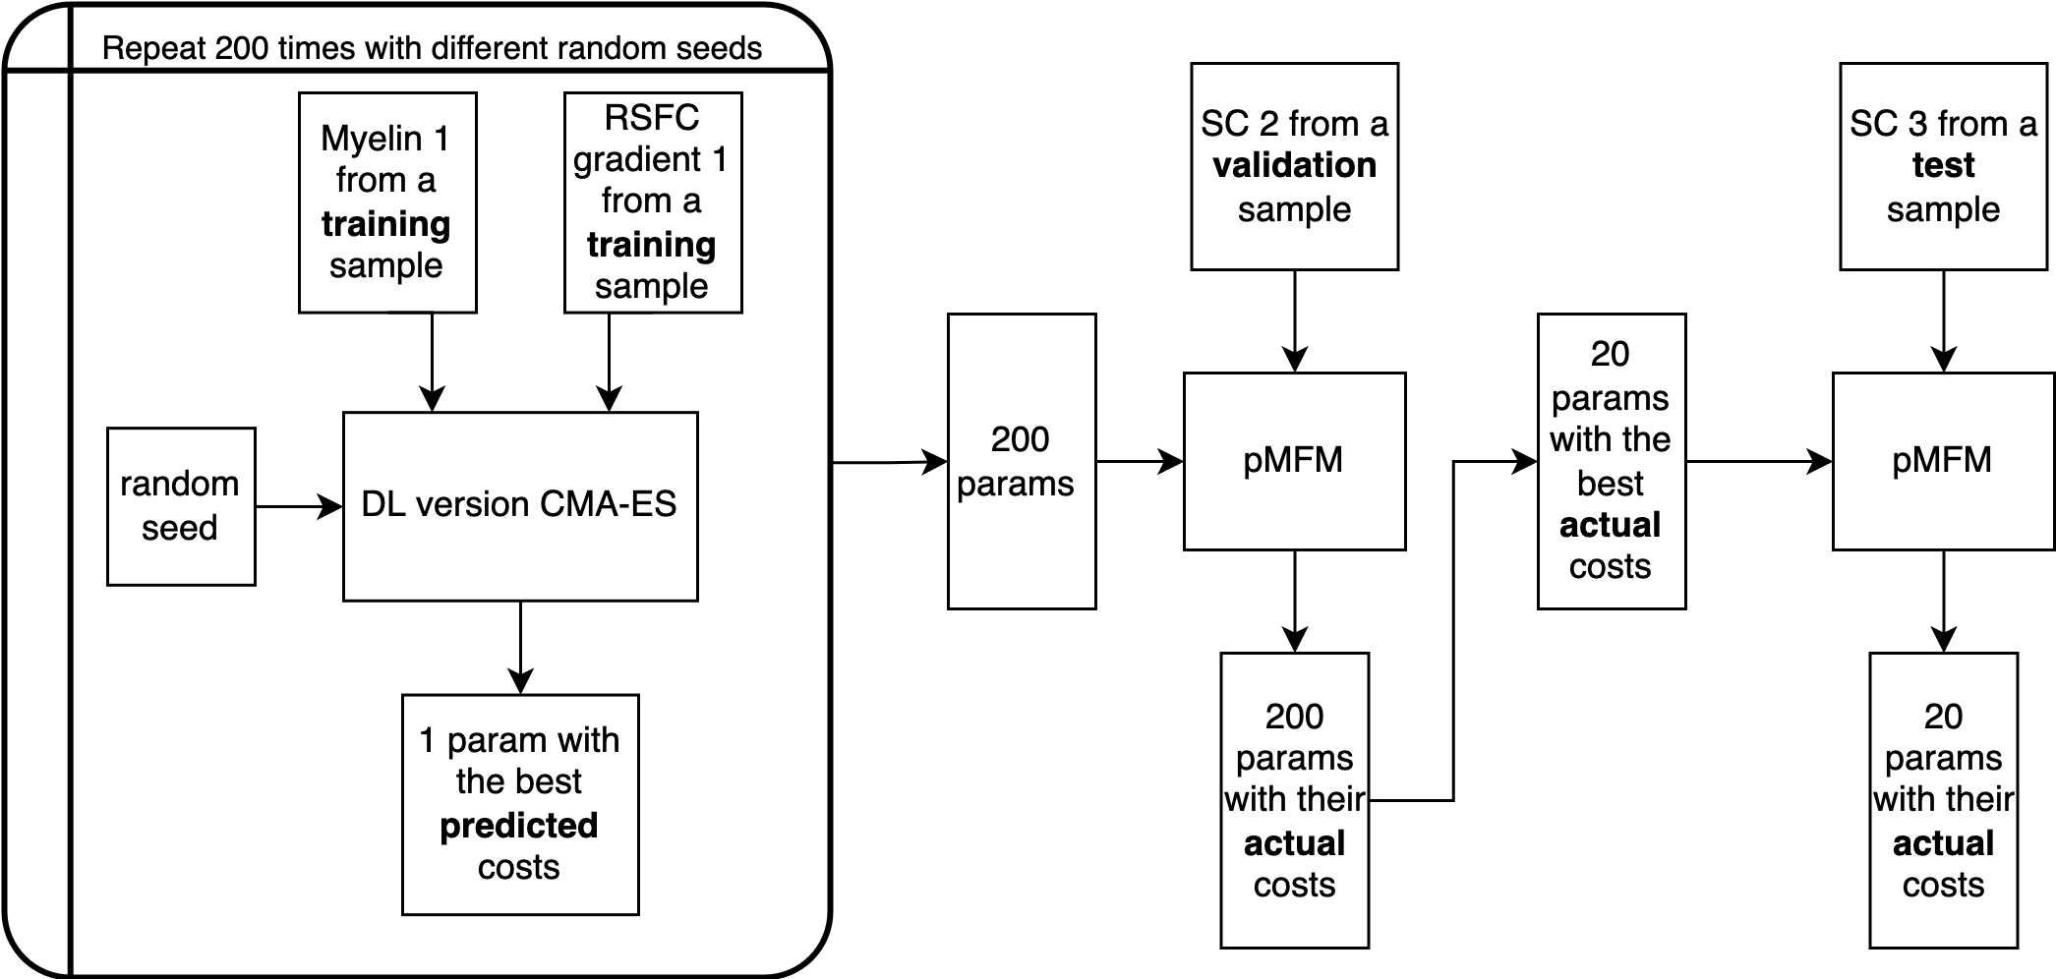

Deep Learning (DL) version CMA-ES

Slide 7
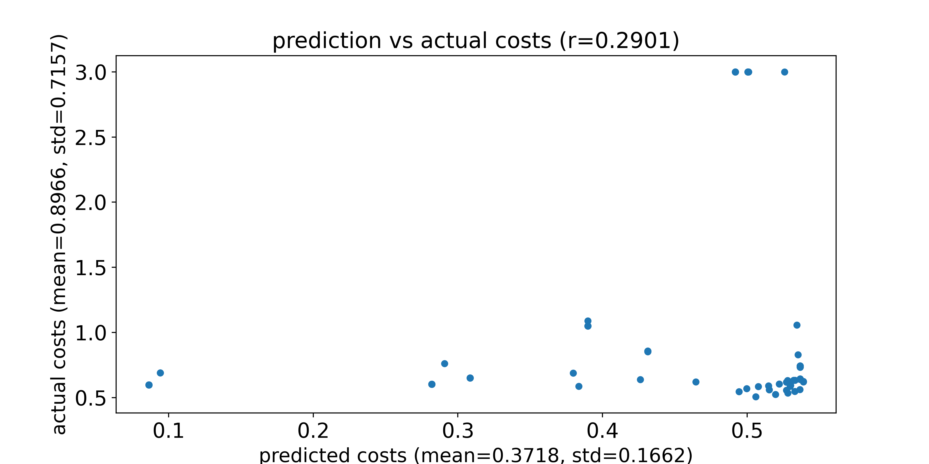
Compare prediction and actual total costs
DL model used is trained naïve net without SC
Feed the selected 200 params and an SC from a validation sample into pMFM, and compare the prediction and the actual costs
Dots with an actual cost of 3 represent parameters that generate NaN using Euler forward simulation
Predicted costs and actual costs for an SC from a validation sample

Slide 8
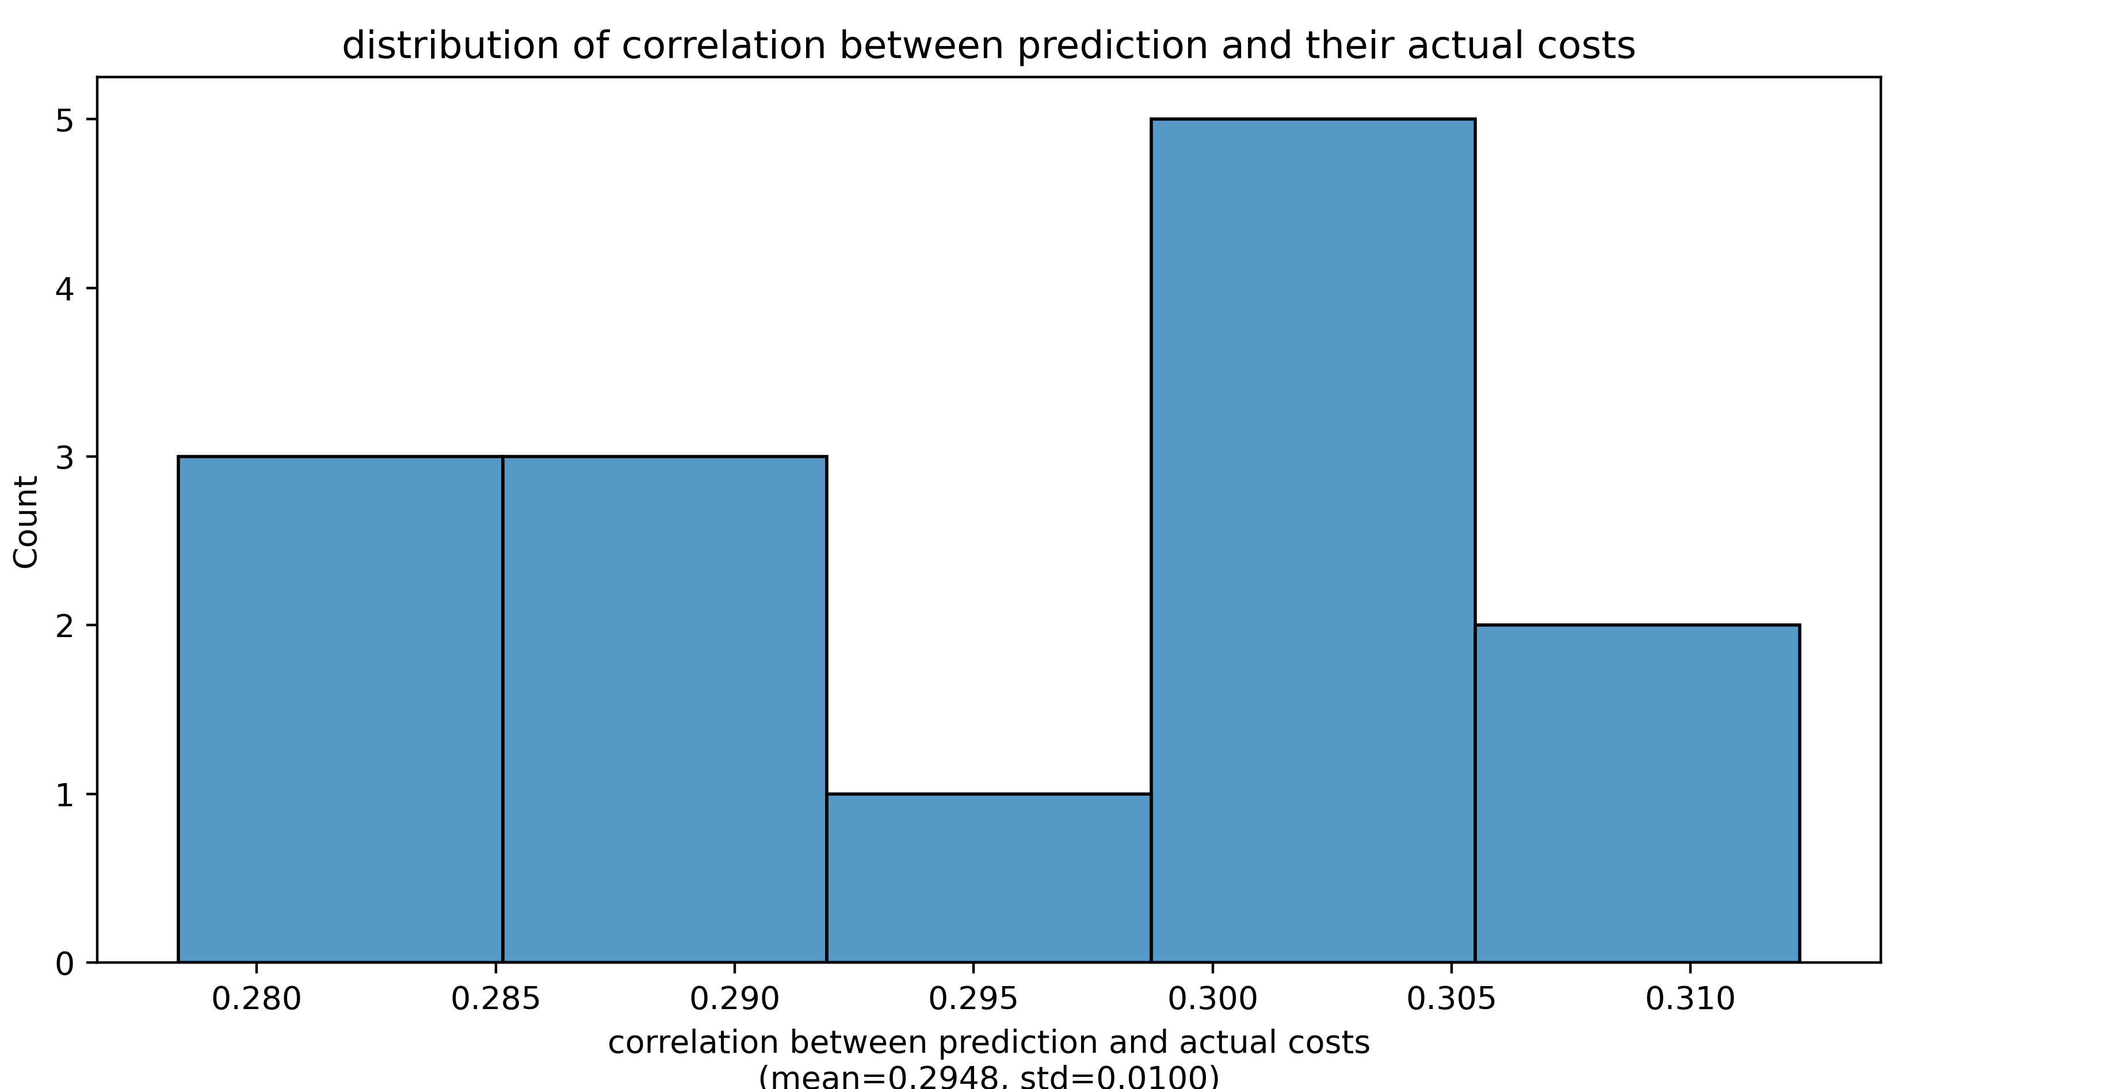
Compare prediction and actual total costs
DL model used is trained naïve net without SC
Feed the selected 200 params and an SC from a validation sample into pMFM, and compare the prediction and the actual costs
Dots with an actual cost of 3 represent parameters that generate NaN using Euler forward simulation
Distribution of correlation when we use different validation SC

Slide 9
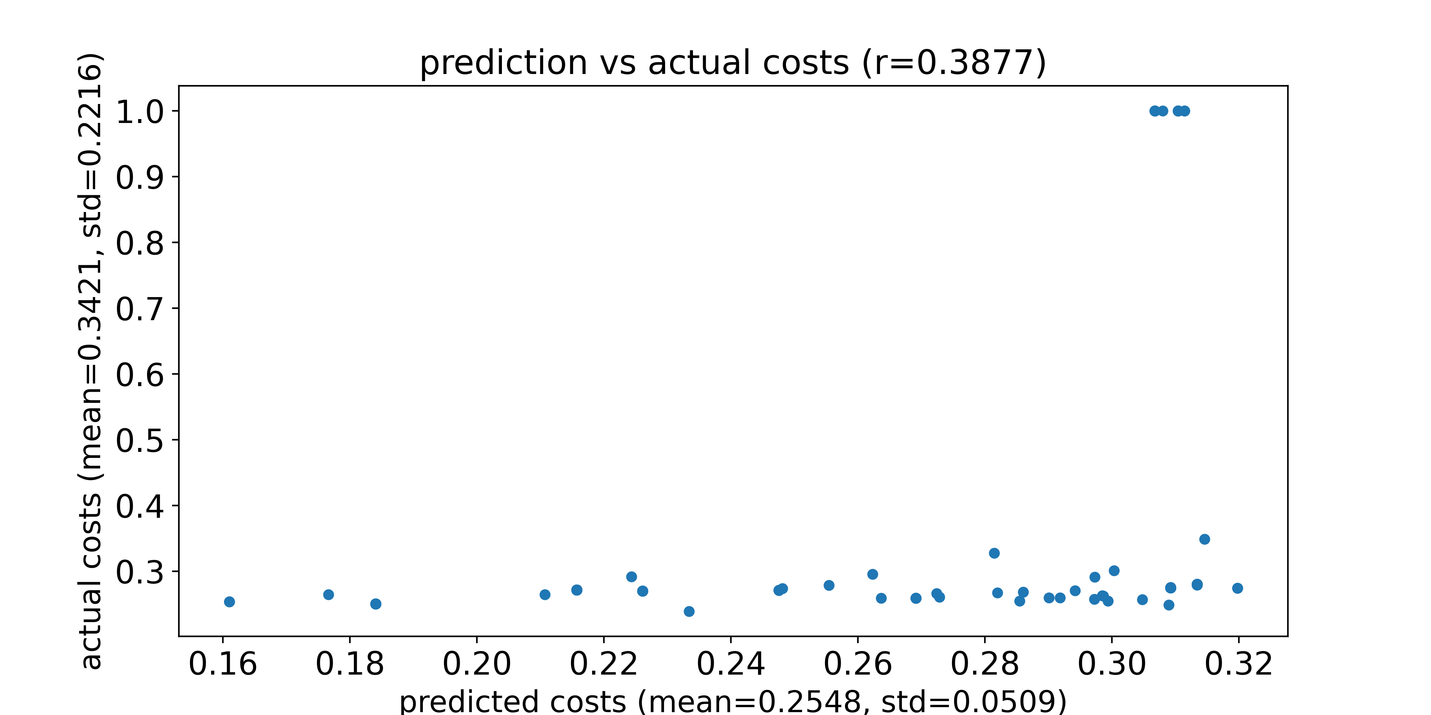
Compare prediction and actual FC_CORR costs
DL model used is trained naïve net without SC
Feed the selected 200 params and an SC from a validation sample into pMFM, and compare the prediction and the actual costs
Dots with an actual cost of 1 represent parameters that generate NaN using Euler forward simulation
Predicted costs and actual costs for an SC from a validation sample

Slide 10
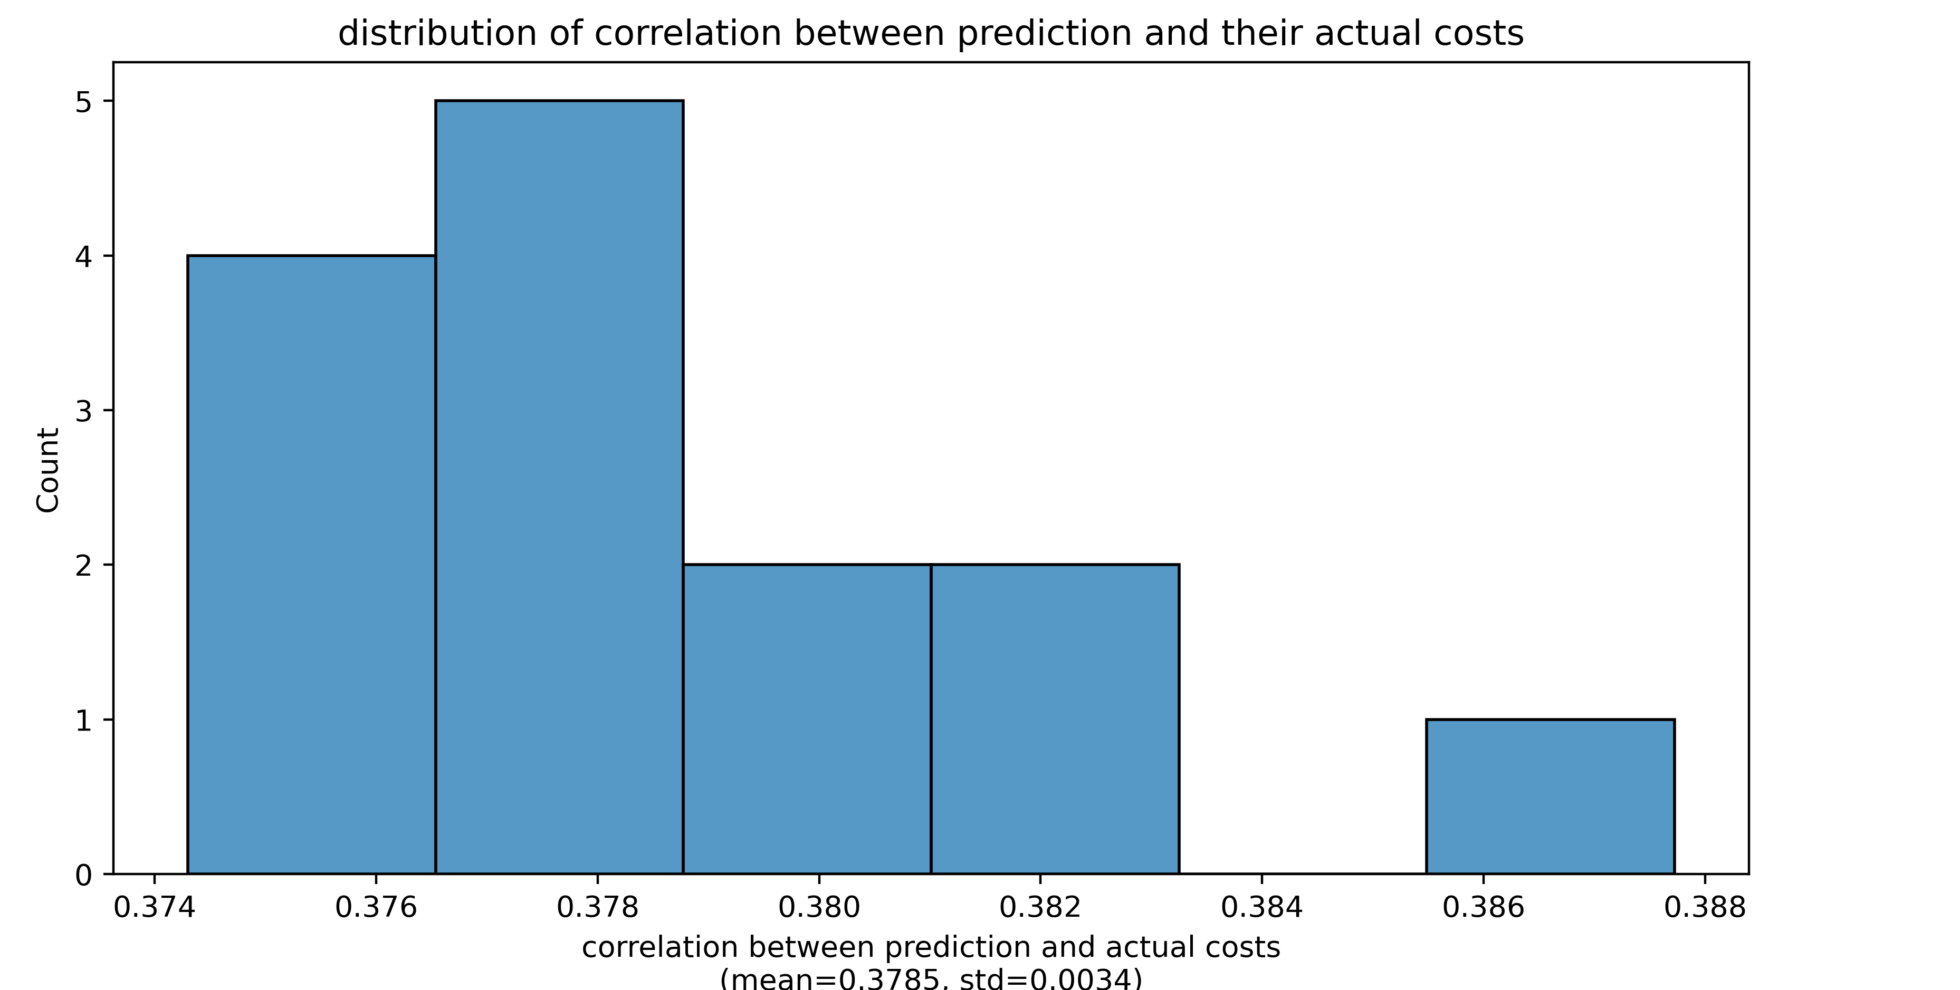
Compare prediction and actual FC_CORR costs
DL model used is trained naïve net without SC
Feed the selected 200 params and an SC from a validation sample into pMFM, and compare the prediction and the actual costs
Dots with an actual cost of 1 represent parameters that generate NaN using Euler forward simulation
Distribution of correlation when we use different validation SC

Slide 11
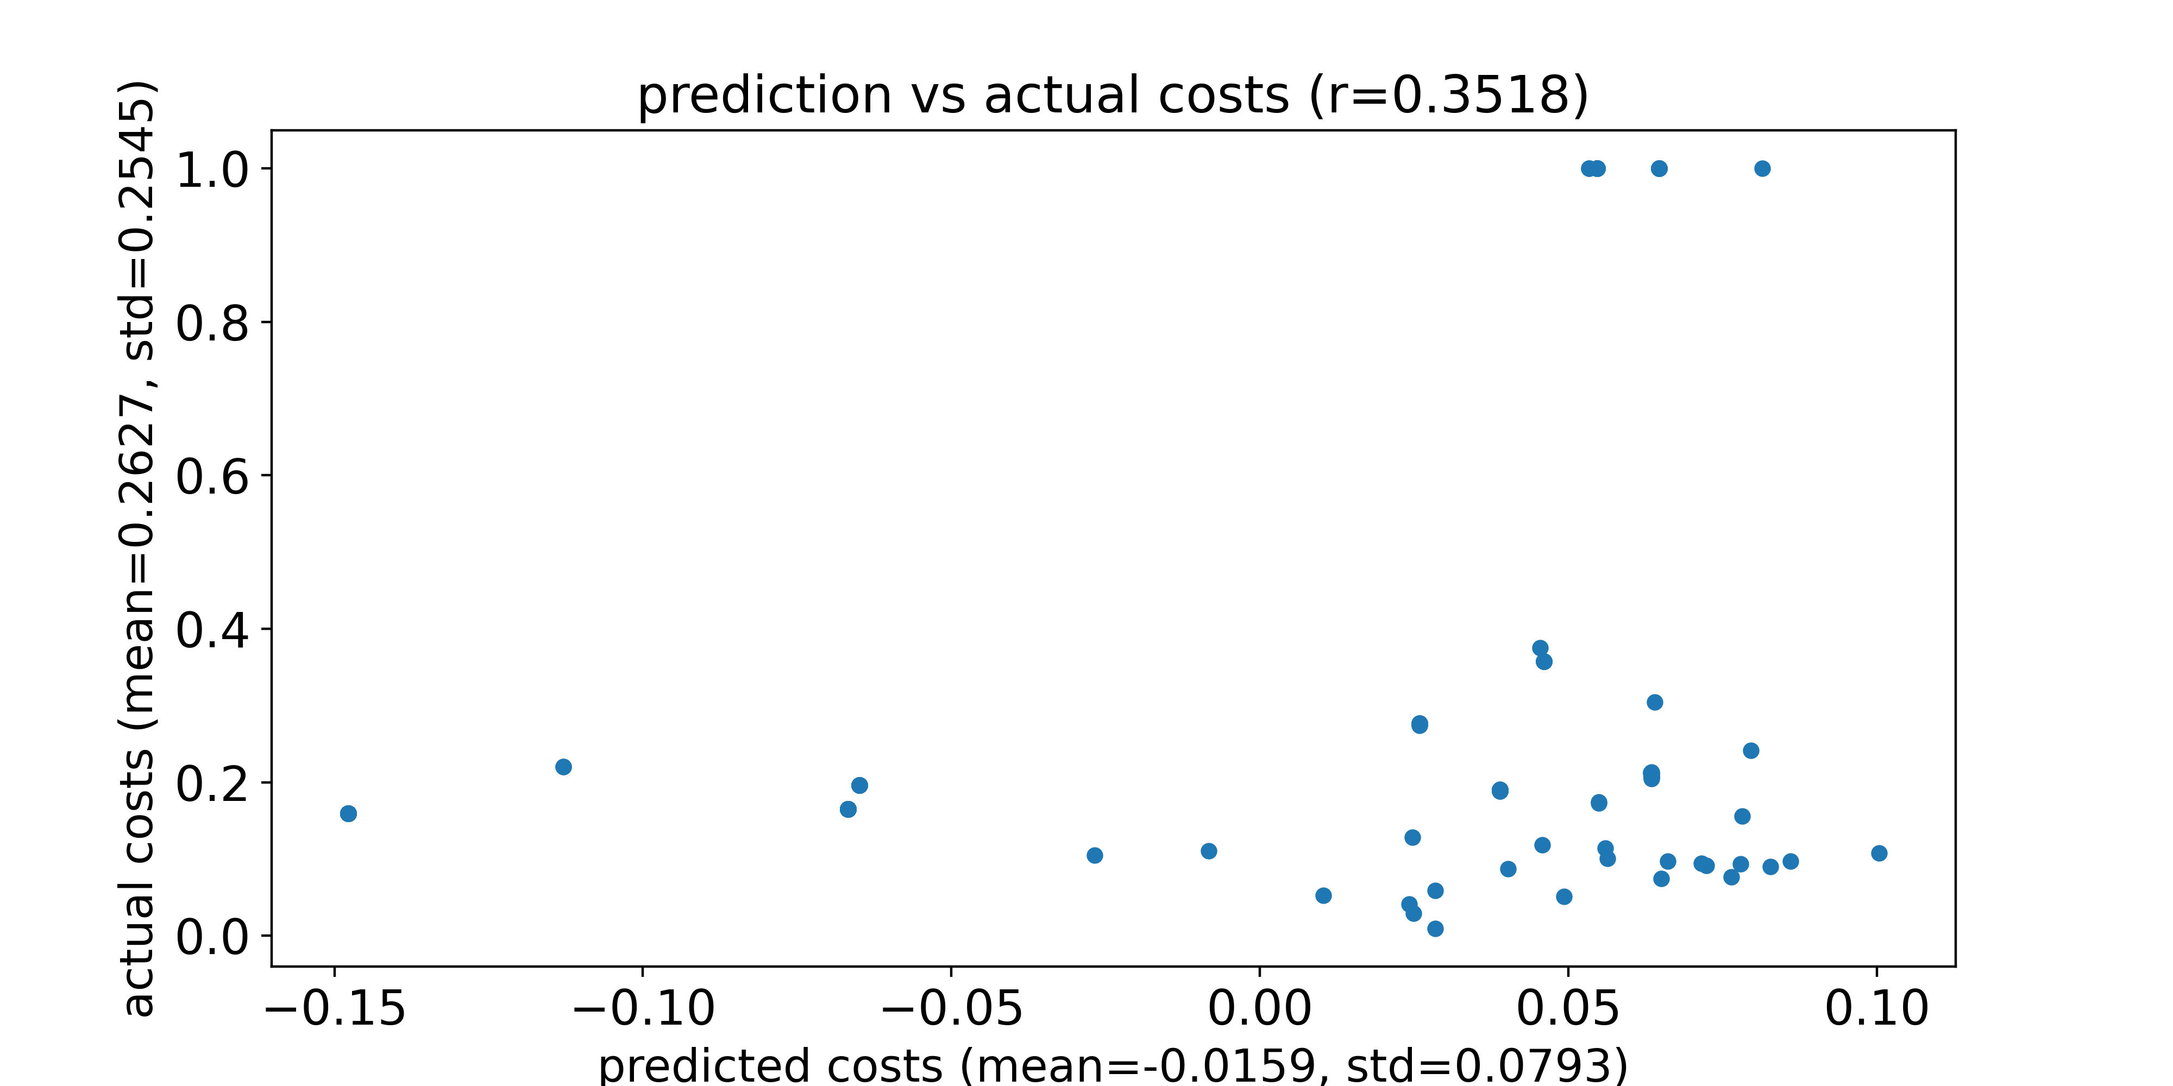
Compare prediction and actual FC_L1 costs
DL model used is trained naïve net without SC
Feed the selected 200 params and an SC from a validation sample into pMFM, and compare the prediction and the actual costs
Dots with an actual cost of 1 represent parameters that generate NaN using Euler forward simulation
Predicted costs and actual costs for an SC from a validation sample

Slide 12
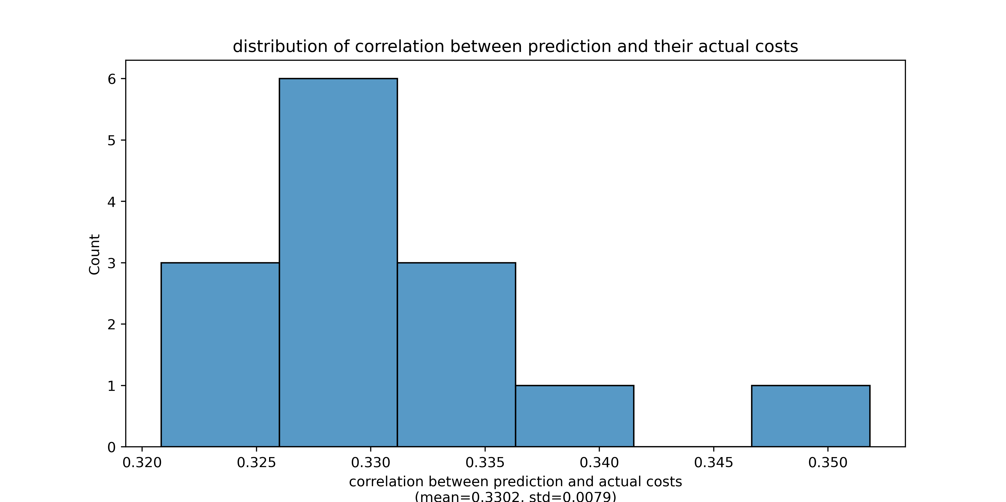
Compare prediction and actual FC_L1 costs
DL model used is trained naïve net without SC
Feed the selected 200 params and an SC from a validation sample into pMFM, and compare the prediction and the actual costs
Dots with an actual cost of 1 represent parameters that generate NaN using Euler forward simulation
Distribution of correlation when we use different validation SC

Slide 13
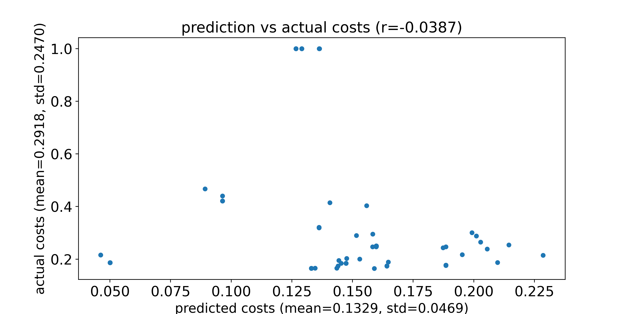
Compare prediction and actual FCD_KS costs
DL model used is trained naïve net without SC
Feed the selected 200 params and an SC from a validation sample into pMFM, and compare the prediction and the actual costs
Dots with an actual cost of 1 represent parameters that generate NaN using Euler forward simulation
Predicted costs and actual costs for an SC from a validation sample

Slide 14
Compare prediction and actual FCD_KS costs
DL model used is trained naïve net without SC
Feed the selected 200 params and an SC from a validation sample into pMFM, and compare the prediction and the actual costs
Dots with an actual cost of 1 represent parameters that generate NaN using Euler forward simulation
Distribution of correlation when we use different validation SC

Slide 15
Deep Learning (DL) version CMA-ES

Slide 16
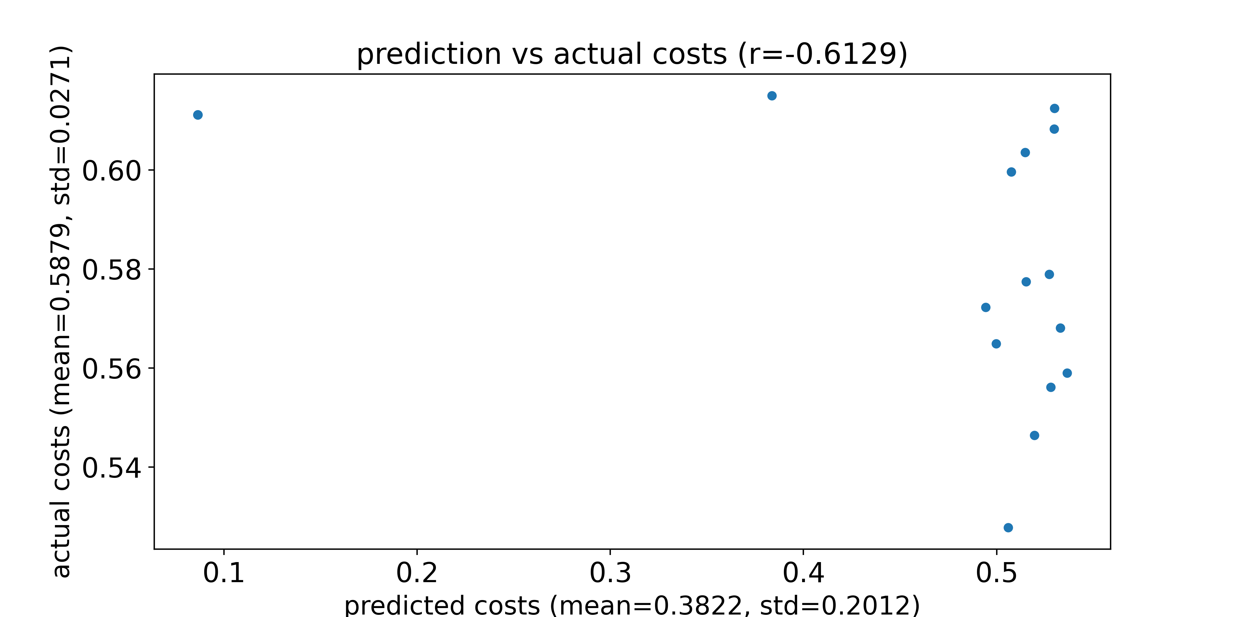
Compare prediction and actual total costs
DL model used is trained naïve net without SC
Feed the 20 params with best actual costs and an SC from a test sample into pMFM, and compare the prediction and the actual costs
Dots with an actual cost of 3 represent parameters that generate NaN using Euler forward simulation
Predicted costs and actual costs for an SC from a test sample

Slide 17
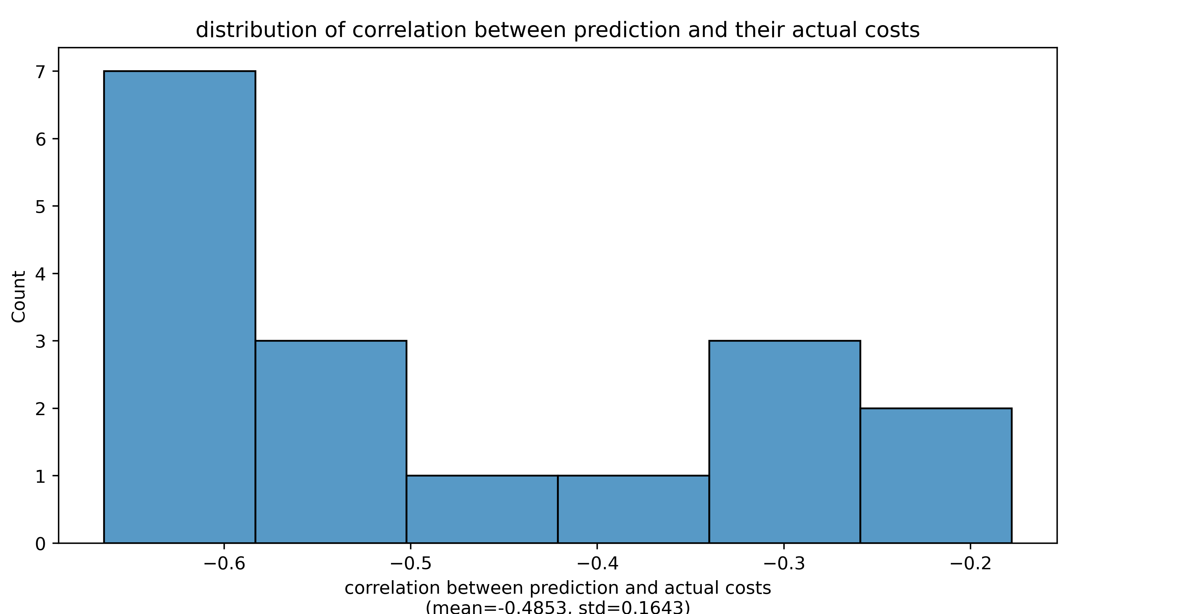
Compare prediction and actual total costs
DL model used is trained naïve net without SC
Feed the 20 params with best actual costs and an SC from a test sample into pMFM, and compare the prediction and the actual costs
Dots with an actual cost of 3 represent parameters that generate NaN using Euler forward simulation
Distribution of correlation when we use different test SC

Slide 18
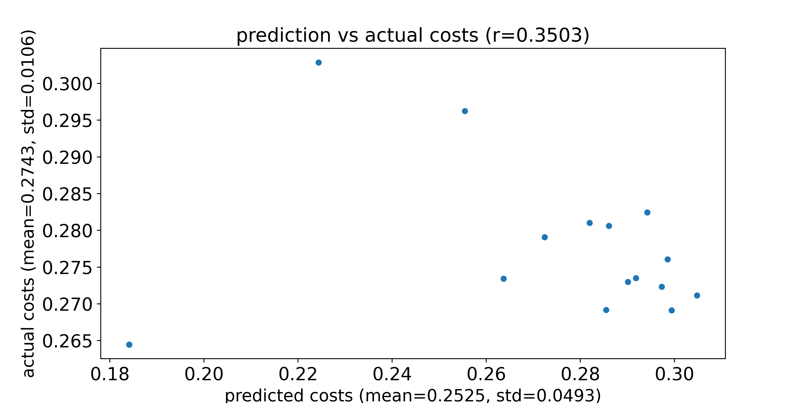
Compare prediction and actual FC_CORR costs
DL model used is trained naïve net without SC
Feed the 20 params with best actual costs and an SC from a test sample into pMFM, and compare the prediction and the actual costs
Dots with an actual cost of 1 represent parameters that generate NaN using Euler forward simulation
Predicted costs and actual costs for an SC from a test sample

Slide 19
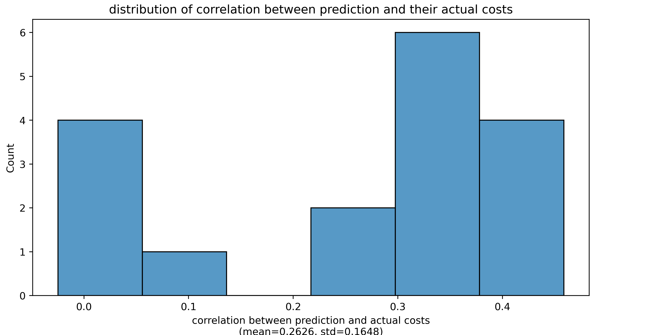
Compare prediction and actual FC_CORR costs
DL model used is trained naïve net without SC
Feed the 20 params with best actual costs and an SC from a test sample into pMFM, and compare the prediction and the actual costs
Dots with an actual cost of 1 represent parameters that generate NaN using Euler forward simulation
Distribution of correlation when we use different test SC

Slide 20
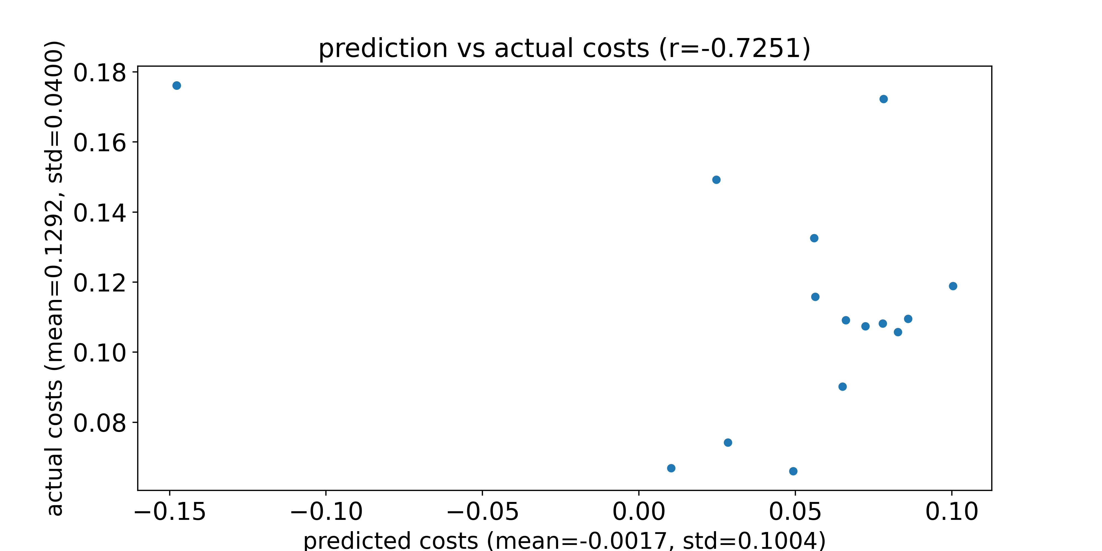
Compare prediction and actual FC_L1 costs
DL model used is trained naïve net without SC
Feed the 20 params with best actual costs and an SC from a test sample into pMFM, and compare the prediction and the actual costs
Dots with an actual cost of 1 represent parameters that generate NaN using Euler forward simulation
Predicted costs and actual costs for an SC from a test sample

Slide 21
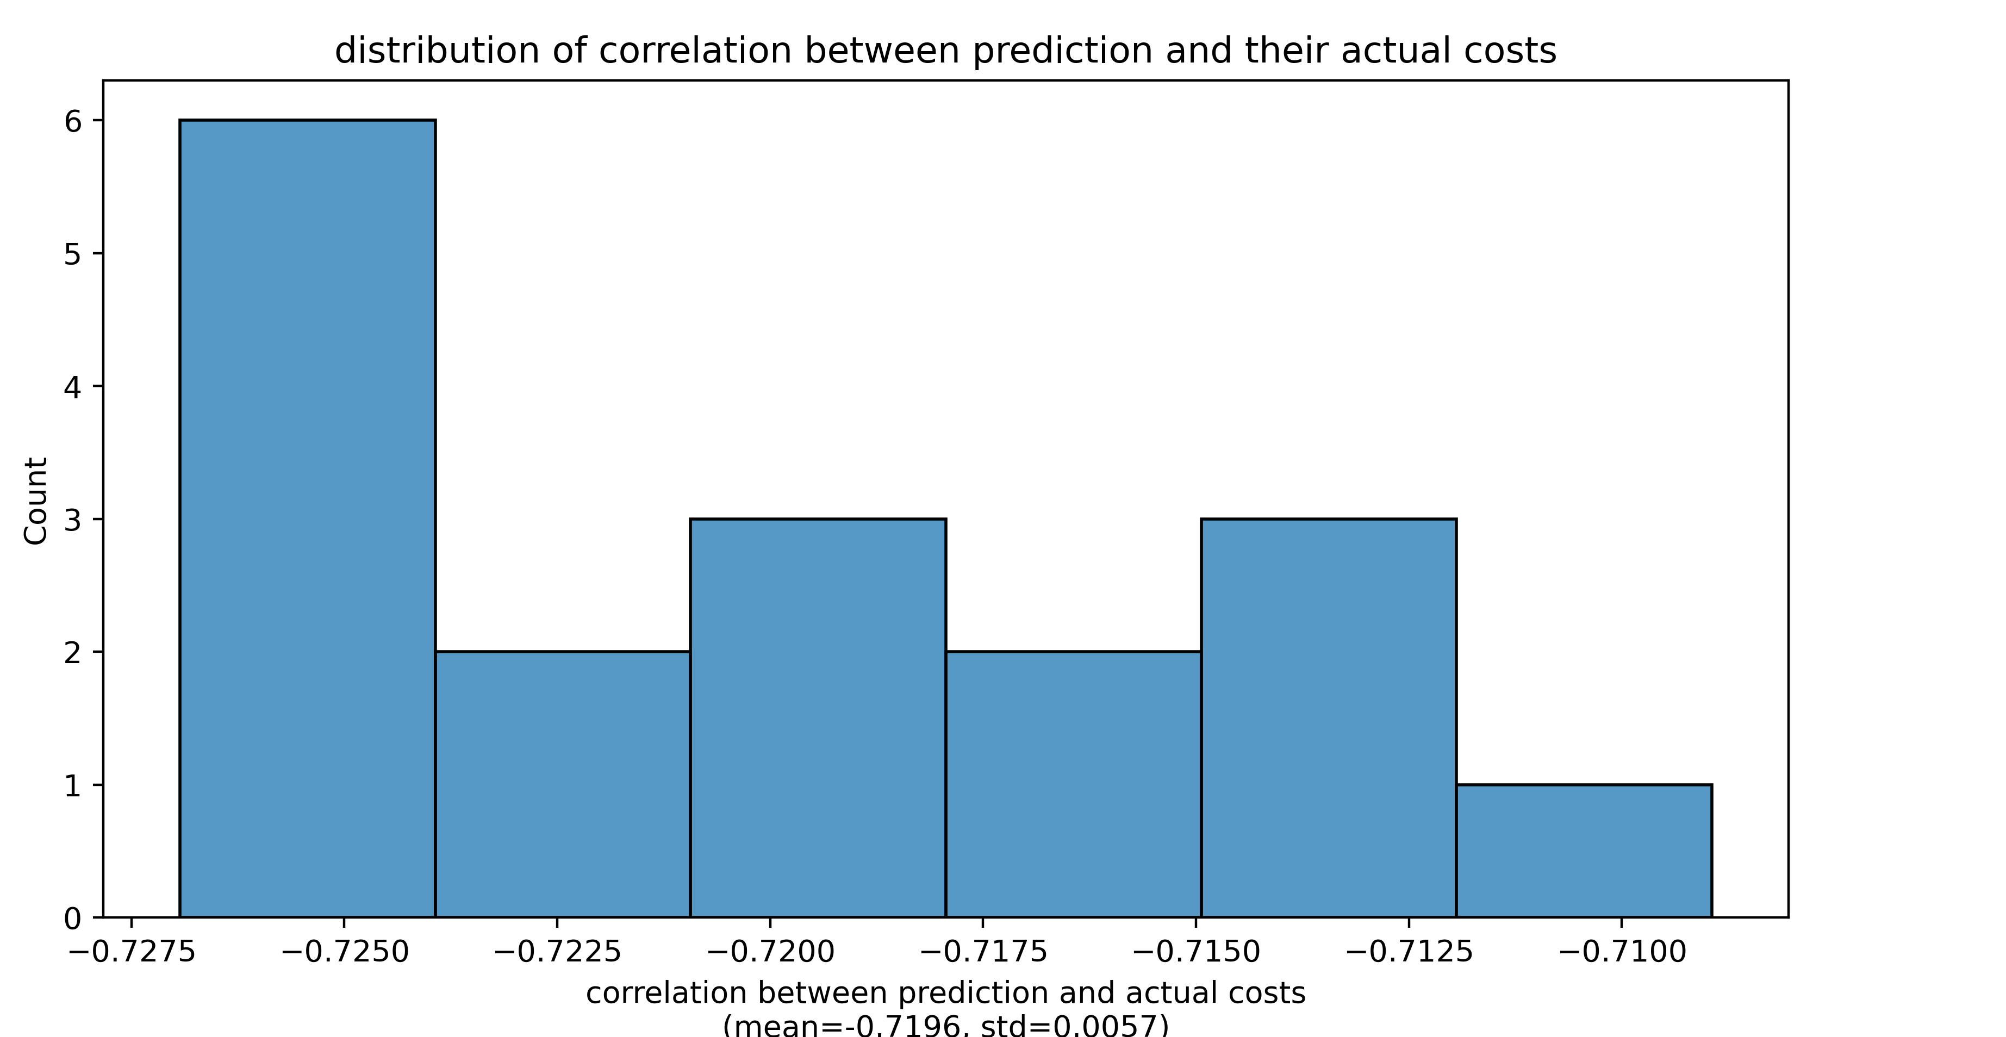
Compare prediction and actual FC_L1 costs
DL model used is trained naïve net without SC
Feed the 20 params with best actual costs and an SC from a test sample into pMFM, and compare the prediction and the actual costs
Dots with an actual cost of 1 represent parameters that generate NaN using Euler forward simulation
Distribution of correlation when we use different test SC

Slide 22
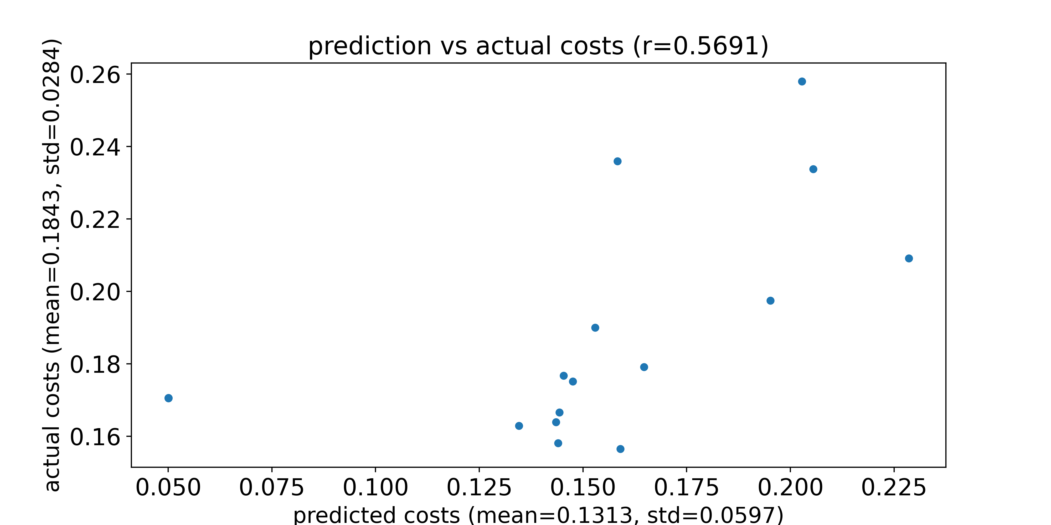
Compare prediction and actual FCD_KS costs
DL model used is trained naïve net without SC
Feed the 20 params with best actual costs and an SC from a test sample into pMFM, and compare the prediction and the actual costs
Dots with an actual cost of 1 represent parameters that generate NaN using Euler forward simulation
Predicted costs and actual costs for an SC from a test sample

Slide 23
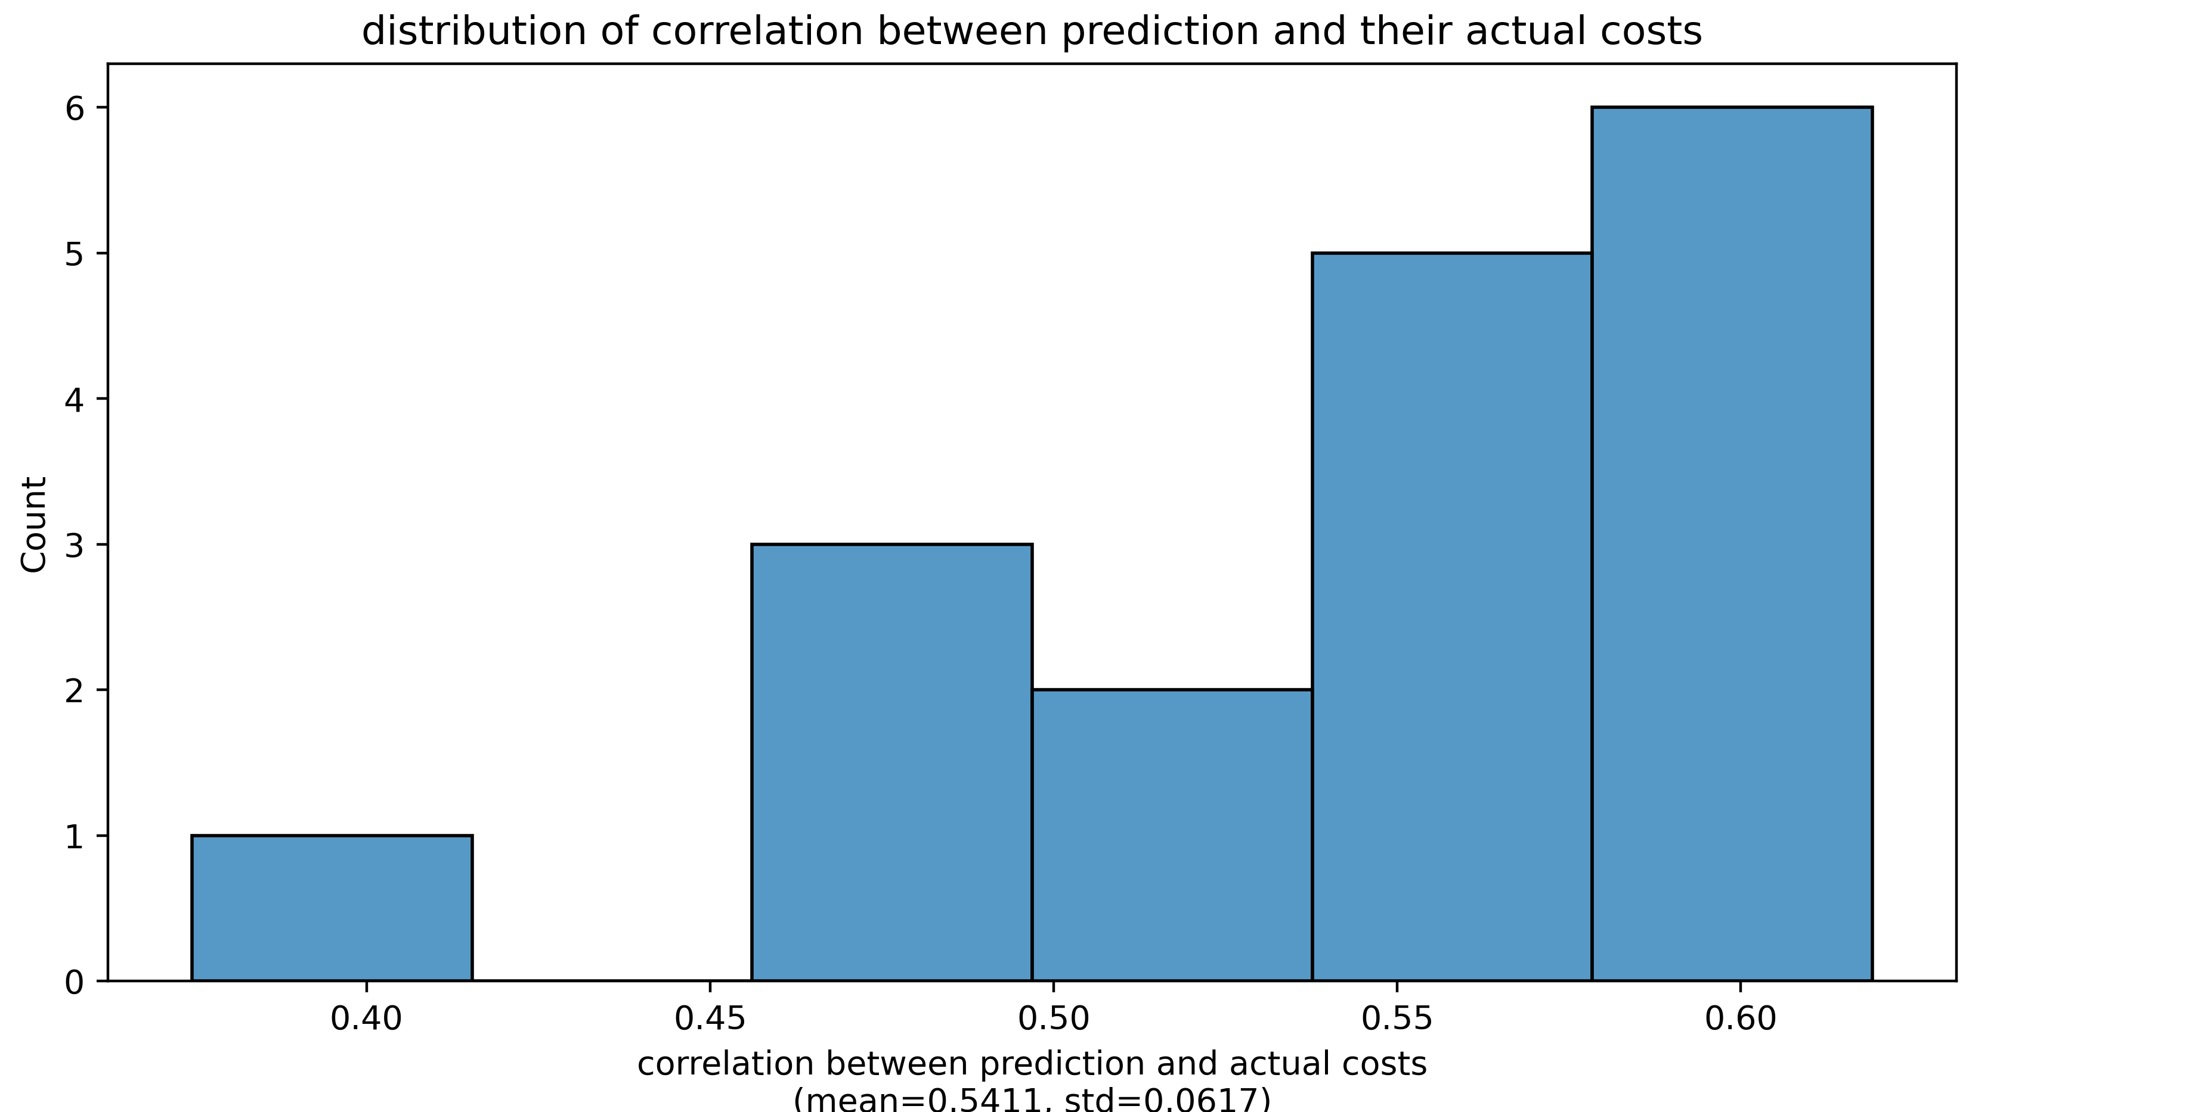
Compare prediction and actual FCD_KS costs
DL model used is trained naïve net without SC
Feed the 20 params with best actual costs and an SC from a test sample into pMFM, and compare the prediction and the actual costs
Dots with an actual cost of 1 represent parameters that generate NaN using Euler forward simulation
Distribution of correlation when we use different test SC

Slide 24
Thank you

