Slide 1
A Colourful Approach to Machine Learning
Declan Garvey

Slide 2
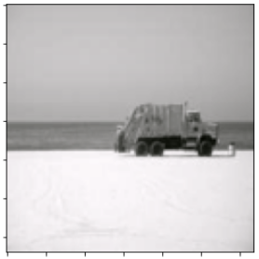
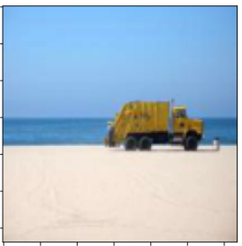
Project Goal
To produce a machine learning model to colourise grey scale images from image context
?
?
?

Slide 3
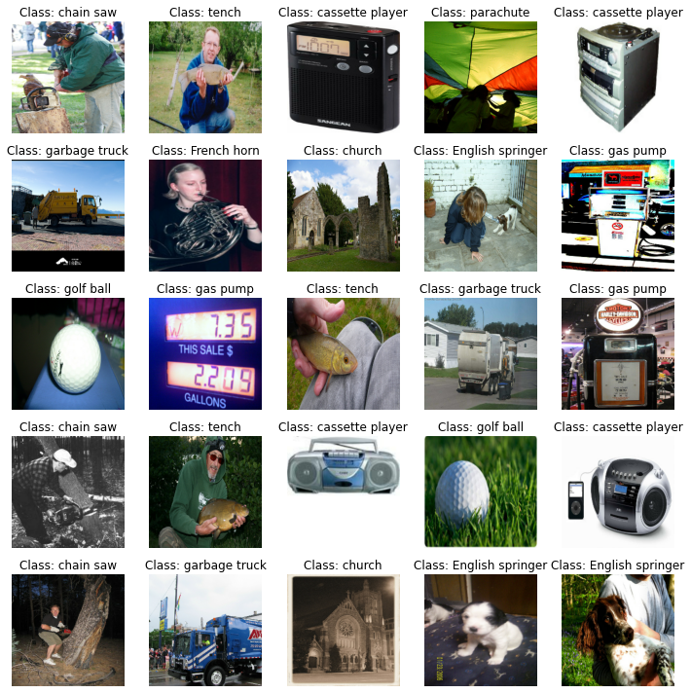
Data Source
The advantage of this project is that, in theory, any image dataset can be used
For convenience and size the imagenette[1] and all images are set to grey scale

Slide 4
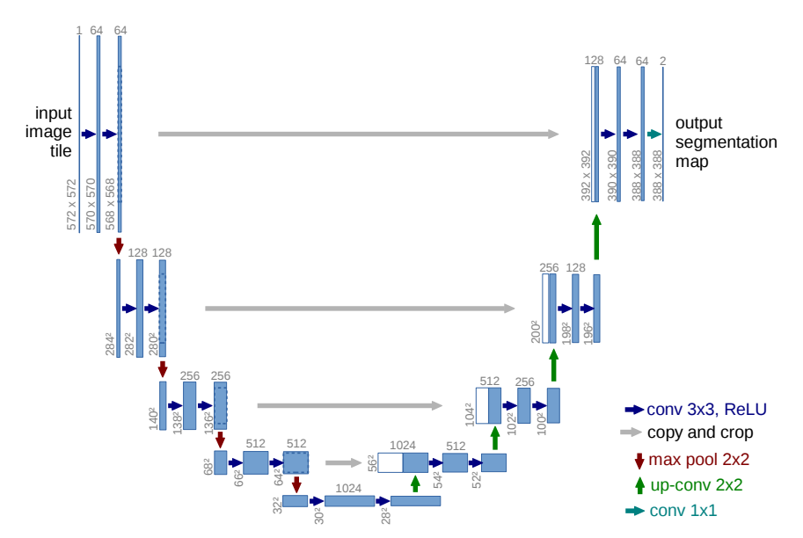
U-NET
A particular type of Neural Network architecture developed for image segmentation.[2]

Slide 5
U-NET Main Features
An Initial pretrained Resnet to pre-process the images.
Max Pooling layers replaced with down scaling.
Simple Trainable convolution neural network with upscaling layers
Skip connections between down scaling and upscaling layers.

Slide 6
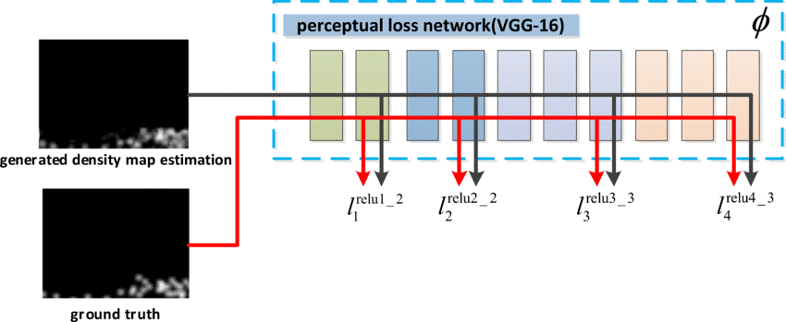
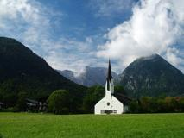







Perceptual Loss Function
[3]
Pretrained AlexNet
Image X
$$loss=$$
$$MSE\left(x_{1},y_{1}\right)$$
$$+$$
$$MSE\left(x_{2},y_{2}\right)$$
$$+$$
$$MSE\left(x_{3},y_{3}\right)$$
Image Y

Slide 7
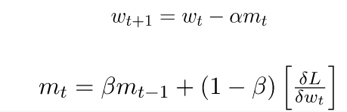
Adam [4]

Slide 8
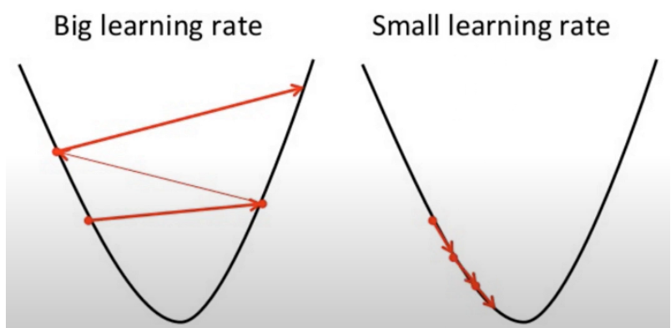
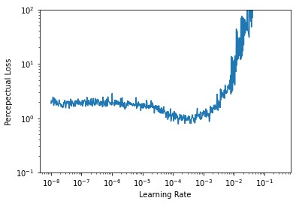
Learning Rate Optimisation[5]

Slide 9
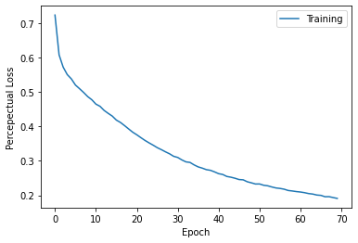
Training
Epochs = 70
Initial Loss = 0.73
Final Loss = 0.19

Slide 10
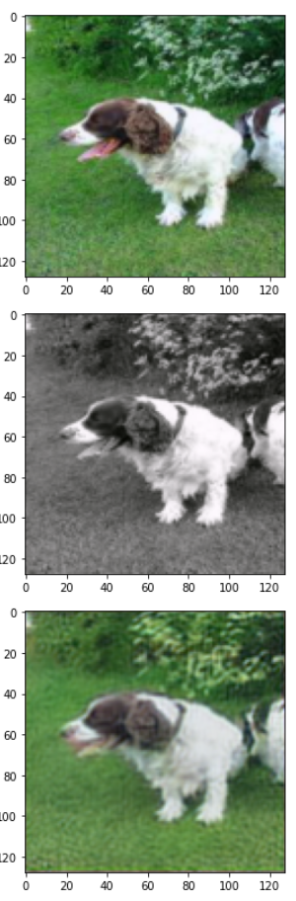
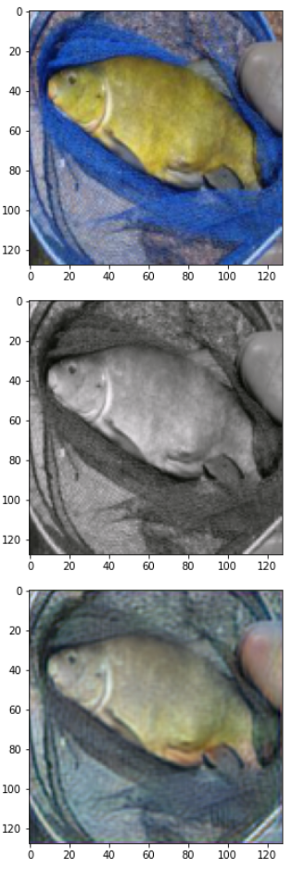
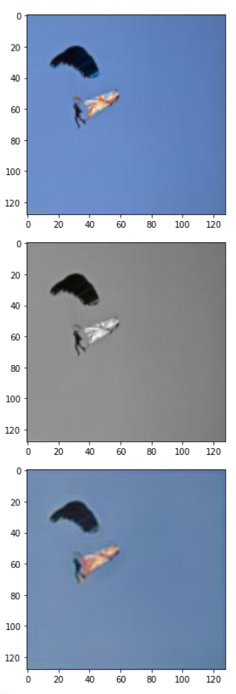
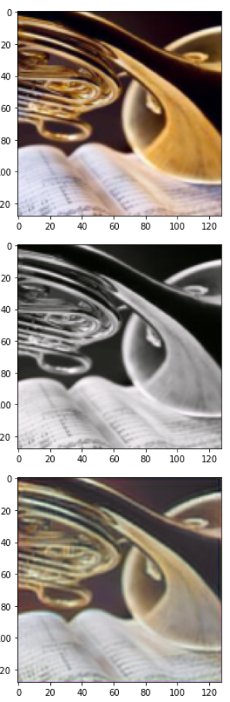
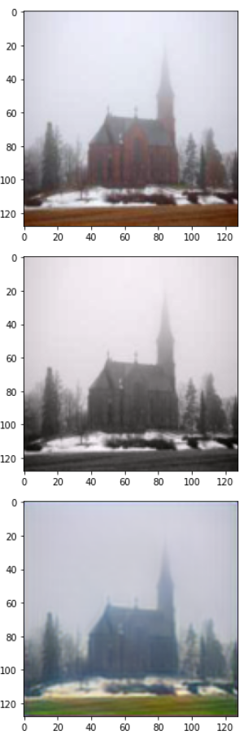
Testing
Original Image:
Grayscale Input:
Unet output:

Slide 11
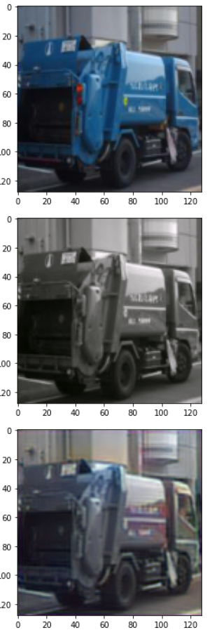
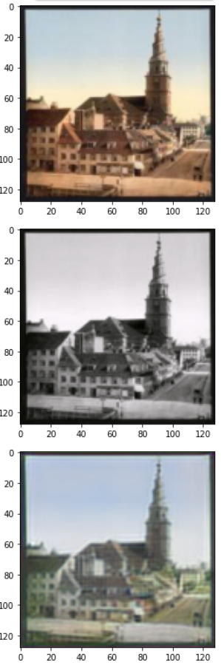
Some Errors
Some trucks are blue
Image Blurring

Slide 12
Conclusion
It worked, but not perfectly.
Given a more diverse dataset and more complex CNN better results may have been achieved.

Slide 13
References
“Imagenette Database”, https://github.com/fastai/imagenette
Ronneberger O, Fischer P, Brox T (2015). "U-Net: Convolutional Networks for Biomedical Image Segmentation". arXiv.org/1505.04597.
Justin Johnson, Alexandre Alahi, and Li Fei-Fei. Perceptual Losses for Real-Time Style Transfer and Super-Resolution. 2016. doi: 10.48550/ARXIV.1603.08155. url: https://arxiv.org/abs/1603.08155.1
Diederik P. Kingma and Jimmy Ba. Adam: A Method for Stochastic Optimization. 2014. doi: 10.48550/ARXIV.1412.6980. url: https://arxiv.org/abs/1412.6980.1
Jeremy Jordan. Setting the learning rate of your neural network. https://www.jeremyjordan.me/nn-learning-rate/. Accessed: 2022-12-30.1

