Slide 1




Cloud Native Fundamental project

Slide 2
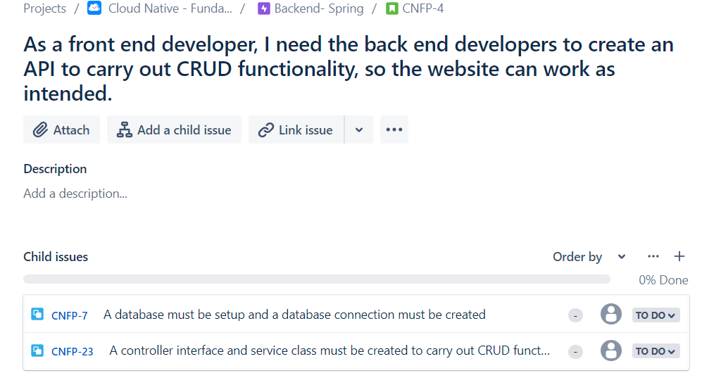
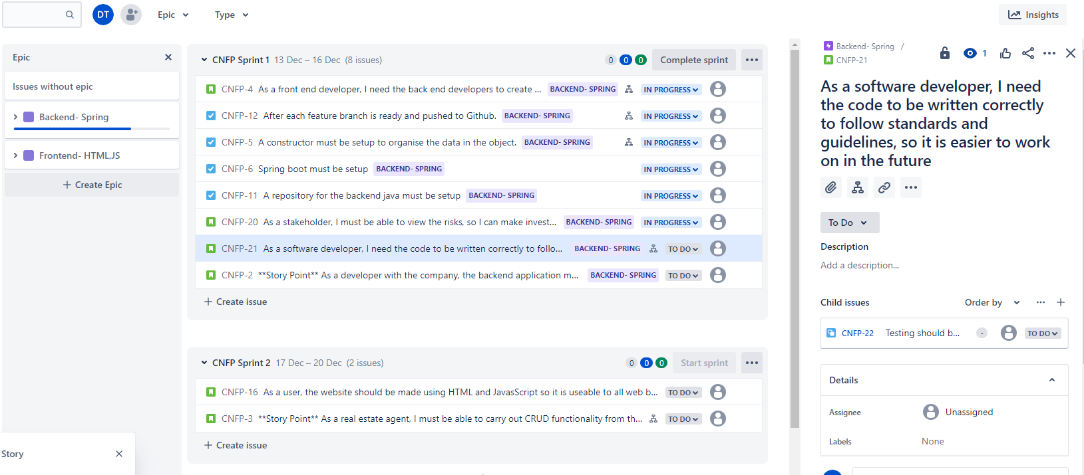
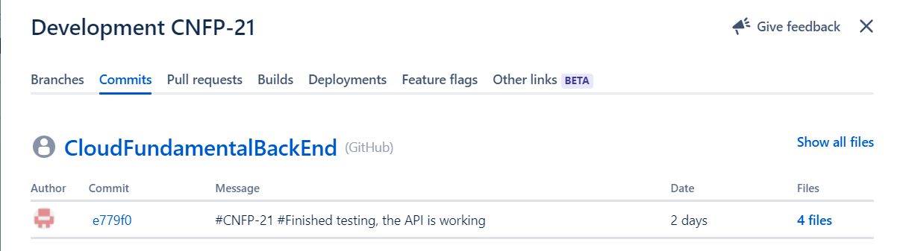
Project Management:
At the start of the project I setup up a Jira board with epics, user stories, child issues and integrated it with GitHub
Jira board
User Story and child issues
GitHub commits

Slide 3
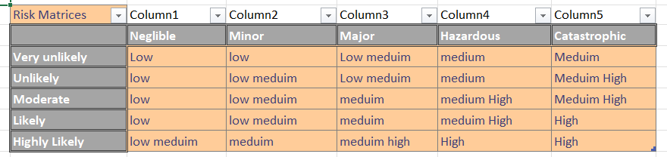
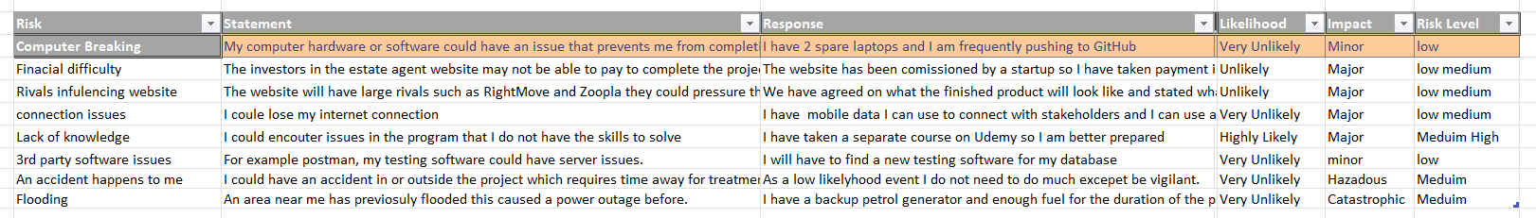
Project Management:
During the development of the project I have documented risks and ways to avoid them with a risk assessment table

Slide 4
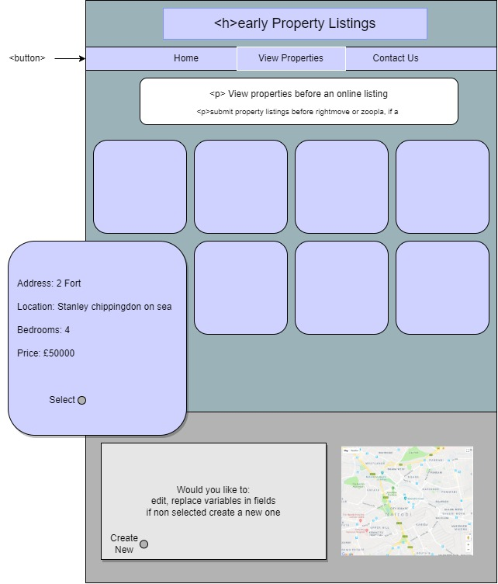
Designing the website
At the start of the website I created a mock design to help guide me on what to place when creating the HTML, CSS and JavaScript.
MoSCoW
The webpage MUST have a CRUD functionality
The website SHOULD have a user friendly design
It COULD have a Google map window with an API, this will need a gps location to be a field in the Spring application.
It WOULD have a navigation bar that leads to a contact and home page and a search bar to filter properties by name.

Slide 5
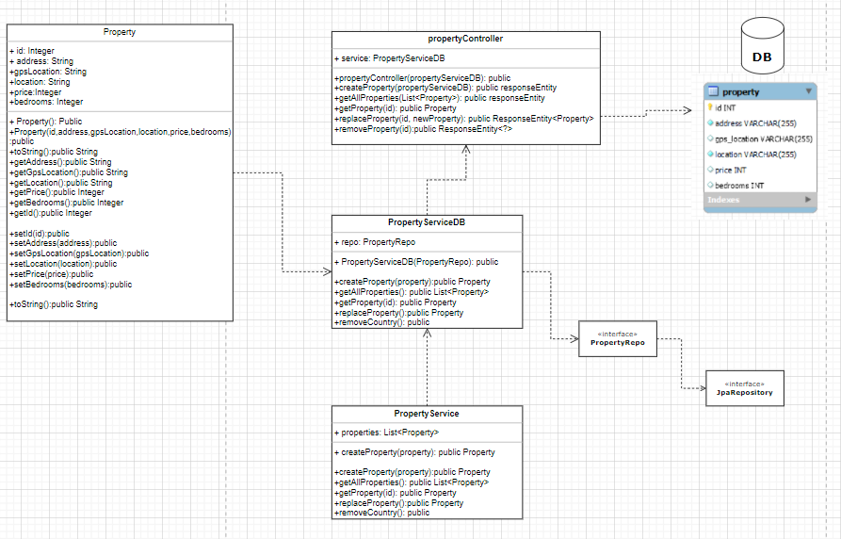
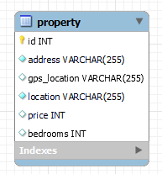
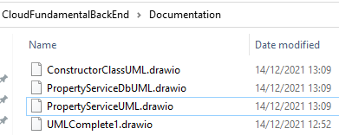
Diagrams
Throughout the project I have made multiple UMLs and integrated them into a main diagram after completing a class.
Database ERD
Previous UML diagrams
Completed UML

Slide 6
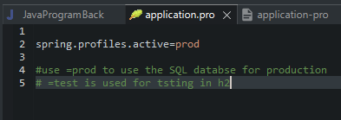
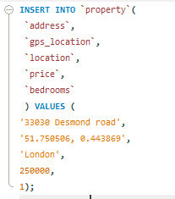
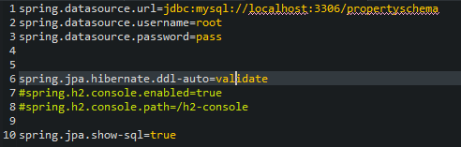
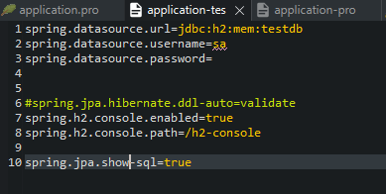
Database
During the creation of the project I have been using a h2 database to test and make changes. Once I finished I switched to a production database using SQL.
I have used an SQL database so CRUD functionality can be carried out then the results saved.
During testing I used the testing database

Slide 7
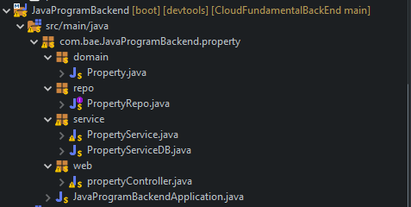
Java program
I created the backend using java and I used object orientated programming paradigm throughout the code.

Slide 8
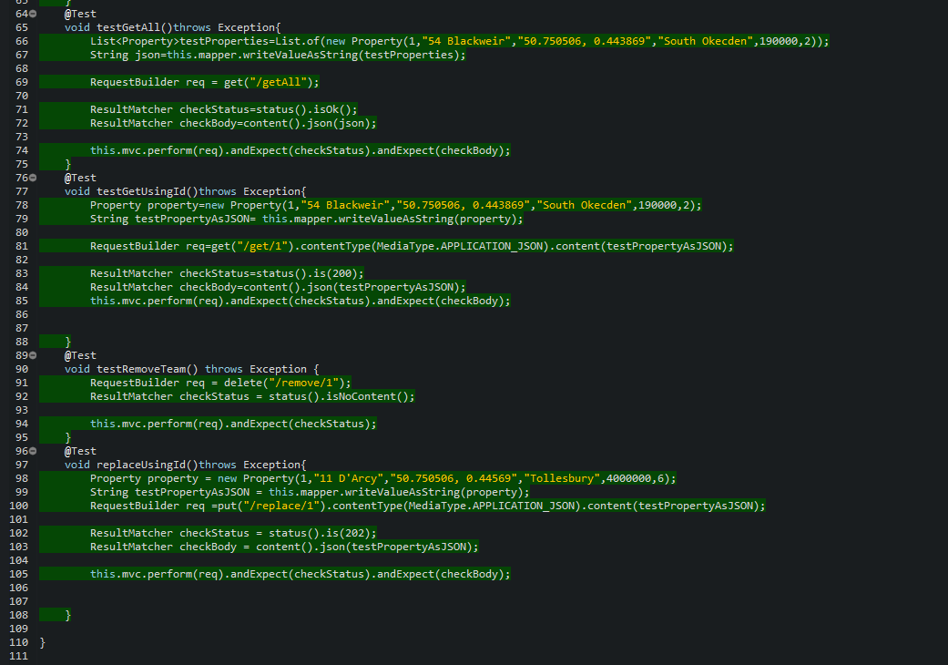
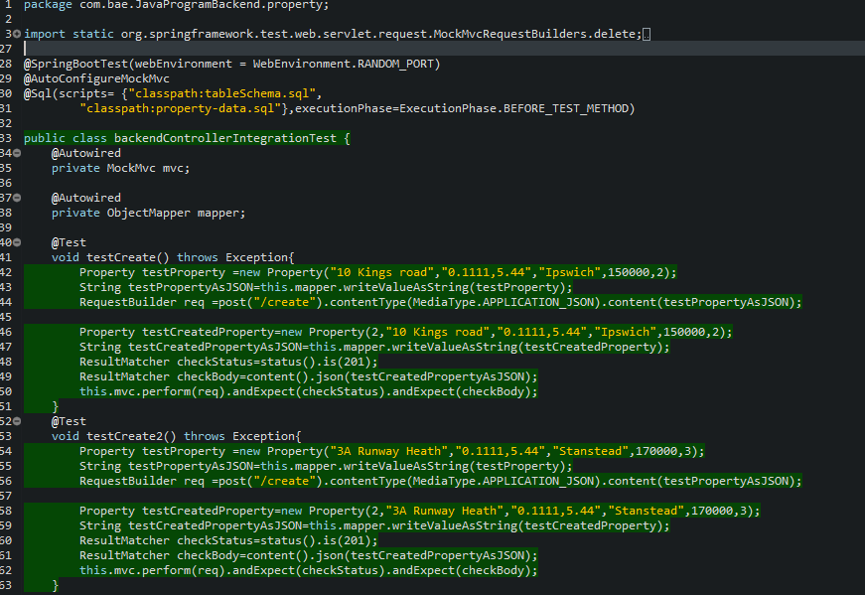
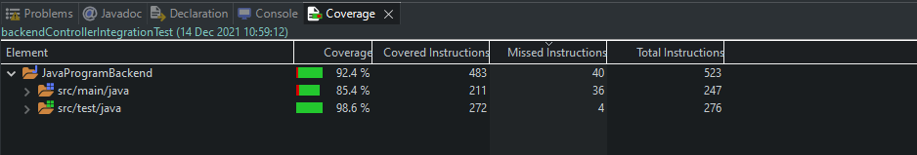
Testing:
Once the back-end Java program had been completed I carried out testing. I achieved 85.4% coverage in the main folder.

Slide 9
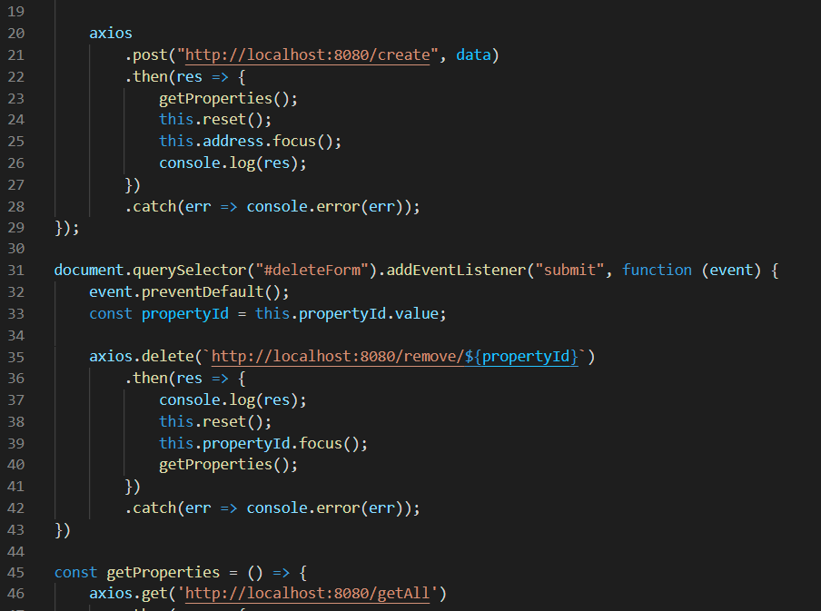
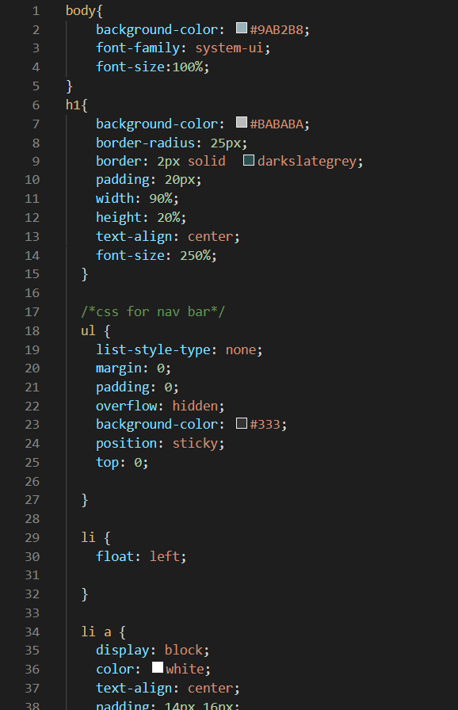
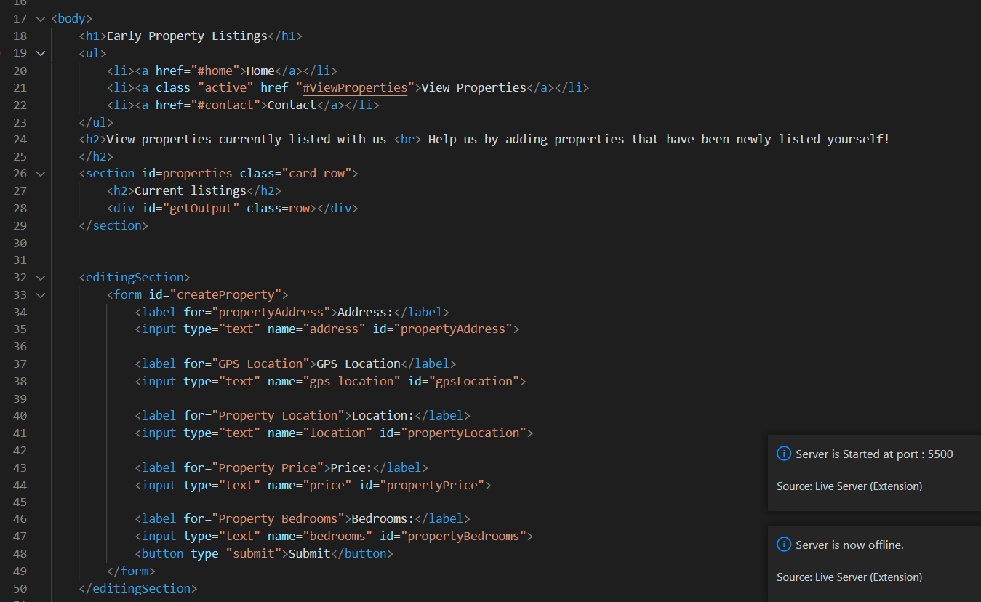
Front-end development
The website was created to match the design of the mock up using HTML, CSS and JavaScript.
It has full CRUD functionality

Slide 10
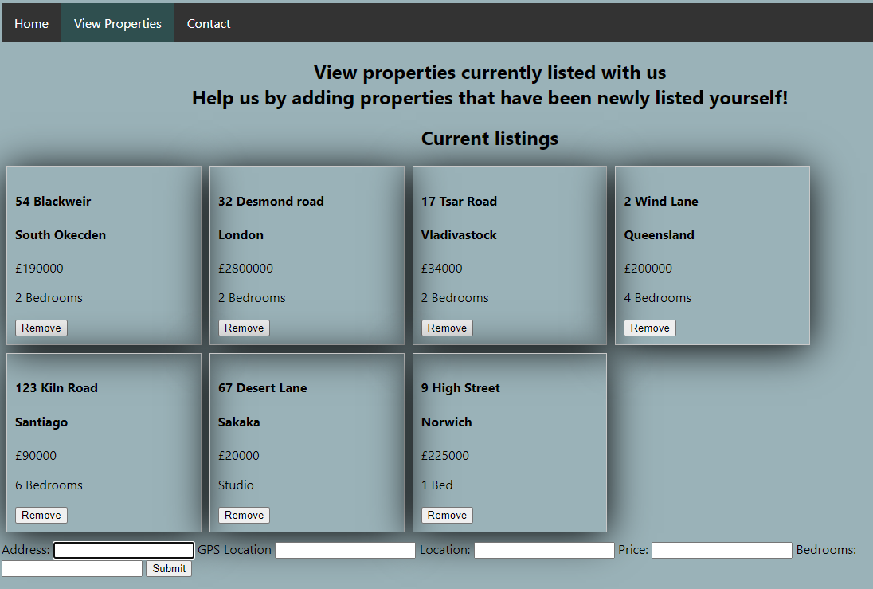
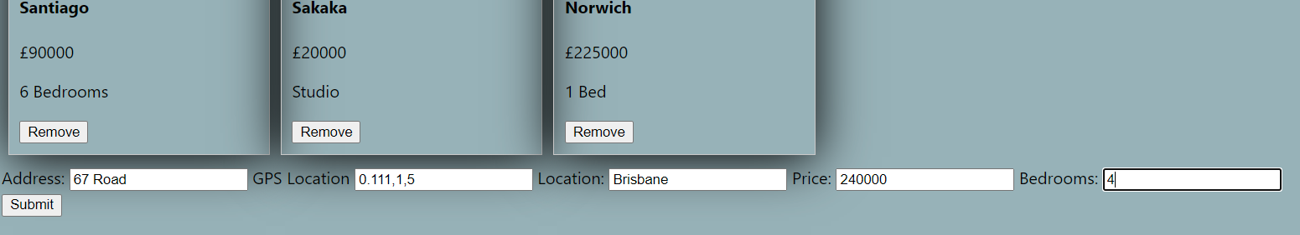
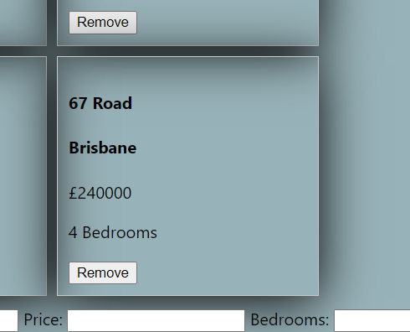
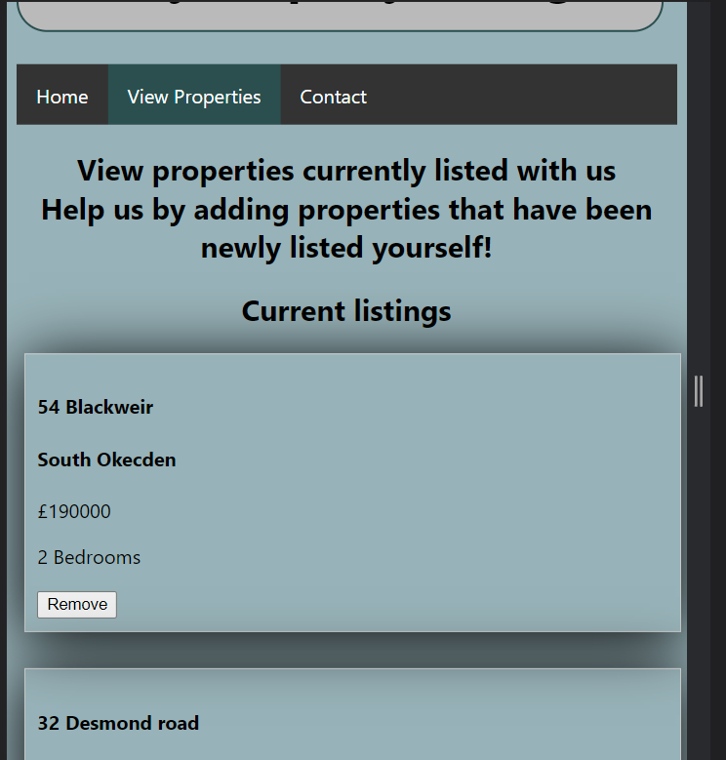
Demonstrating the website

Slide 11
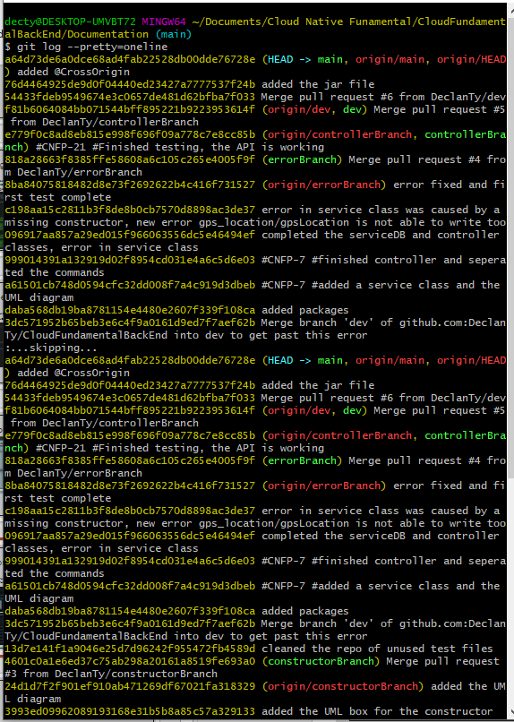
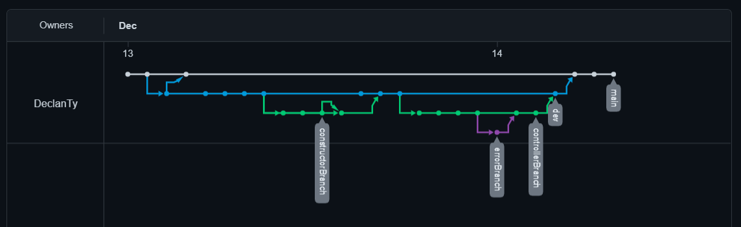
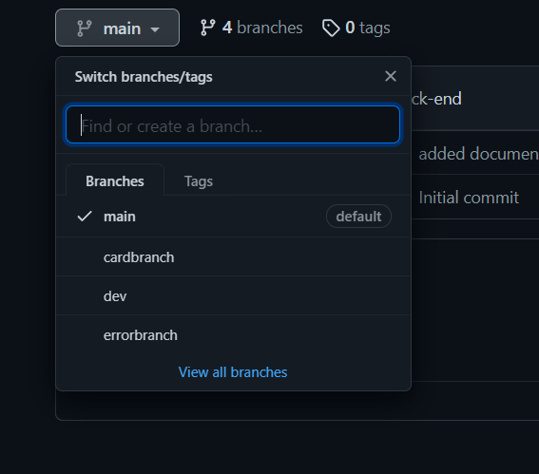
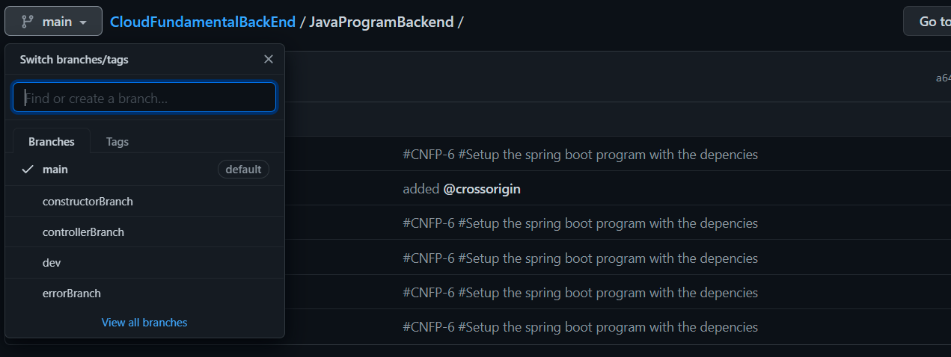
Version Control System
I have used two repositories for this project. I have made regular commits using Git and made frequent pushes to GitHub

Slide 12
Read me
The read me is included on the back-end repository.

