Slide 1
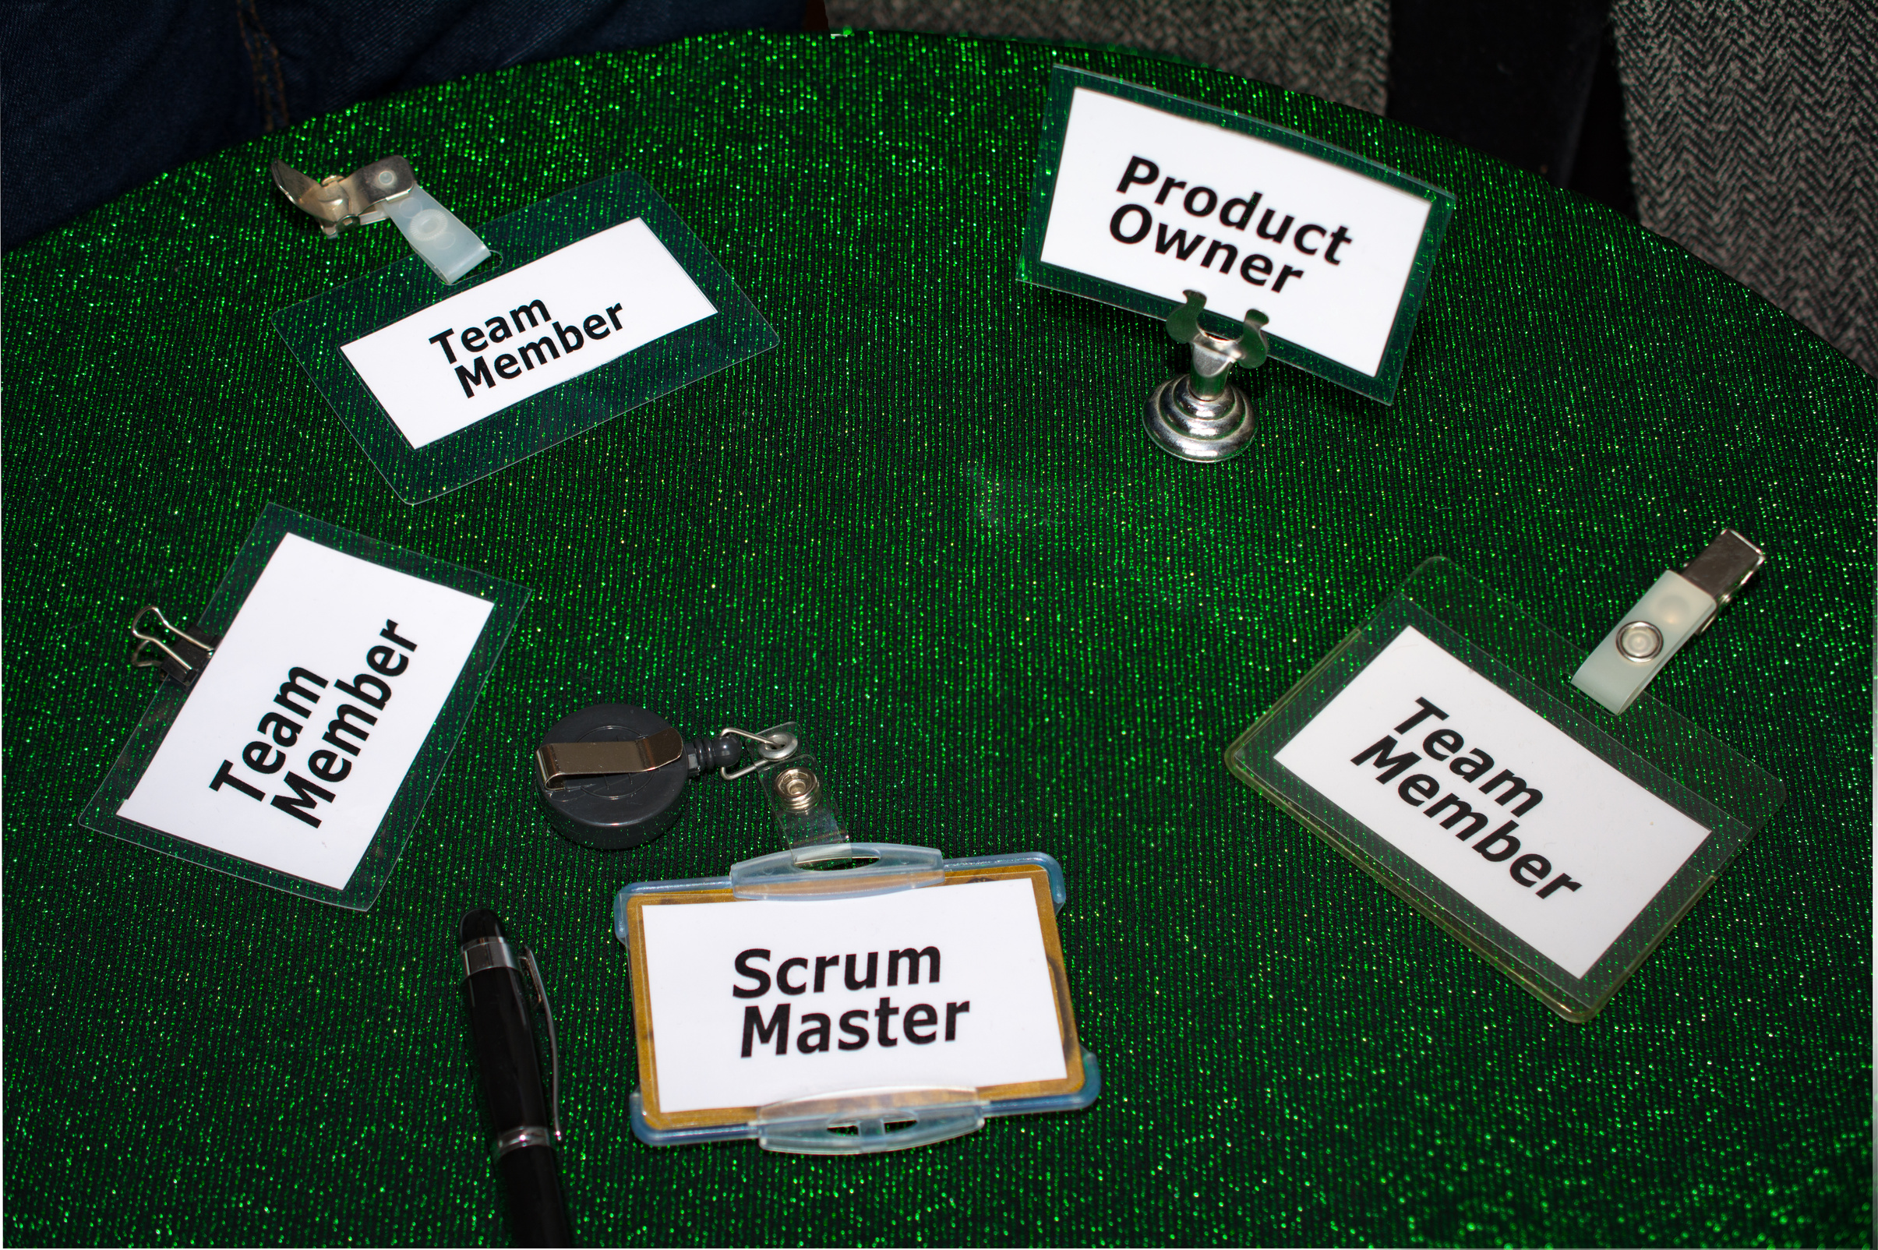

SCRUM MASTER
Develop your skills and get ready for the professional Scrum Master 1 Certification
1

Slide 2

TRAINING OBJECTIVES?
  Grasp the challenges within the context of an agile project
  Identify potential pitfalls when implementing Scrum
  Be able to clearly explain Scrum to the team and various stakeholders
  Gain all the essential knowledge and skills to successfully pass the certification
2

Slide 3

AGENDA
  Agile Methodology
  Deep dive into Scrum:
    History
    Introduction
    Theory
    Values
    Team
    Events
    Artifacts
    Key Rules
3

Slide 4

This symbol indicates that this page presents key concepts for the certification exam
4

Slide 5

01.
Agile is a project management methodology focused on flexibility, collaboration and continuous improvement
02.
It breaks projects into smaller tasks called iterations or Sprints allowing for quick adjustments and continuous delivery
WHAT IS AGILE METHODOLOGY?
03.
Encourages frequent feedback from stakeholders to ensure alignment and value delivery
5

Slide 6
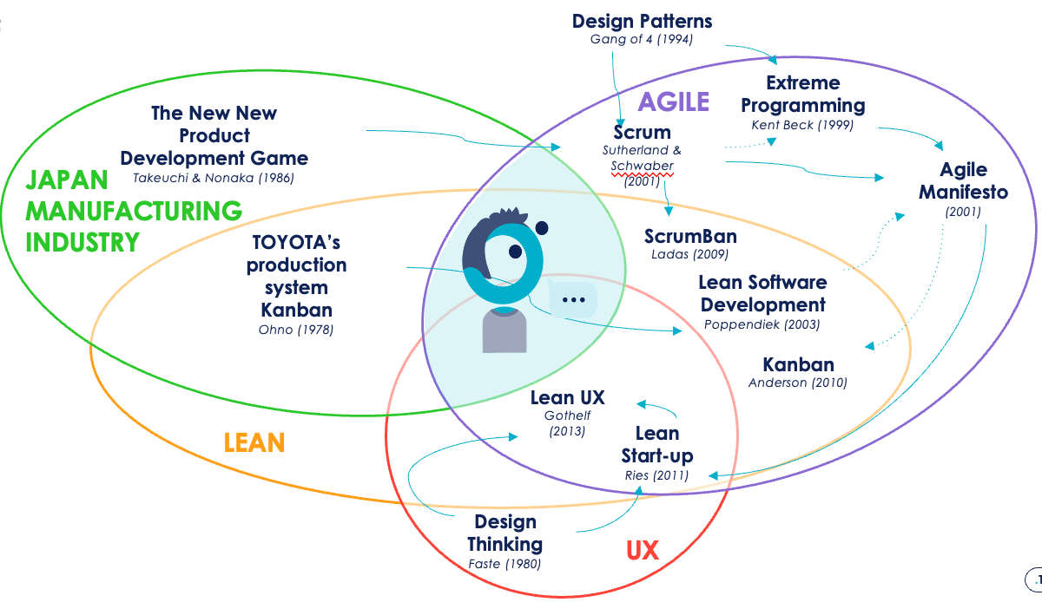
Scrum is part of the Agile Heritage; inspired by Lean, Kanban and Design Thinking. Created in 1995, it places people at the center to deliver value.
6

Slide 7

BENEFITS OF AGILE PLANNING
Fail Fast
01.
Learn Fast
02.
Deliver Quickly
03.
7

Slide 8
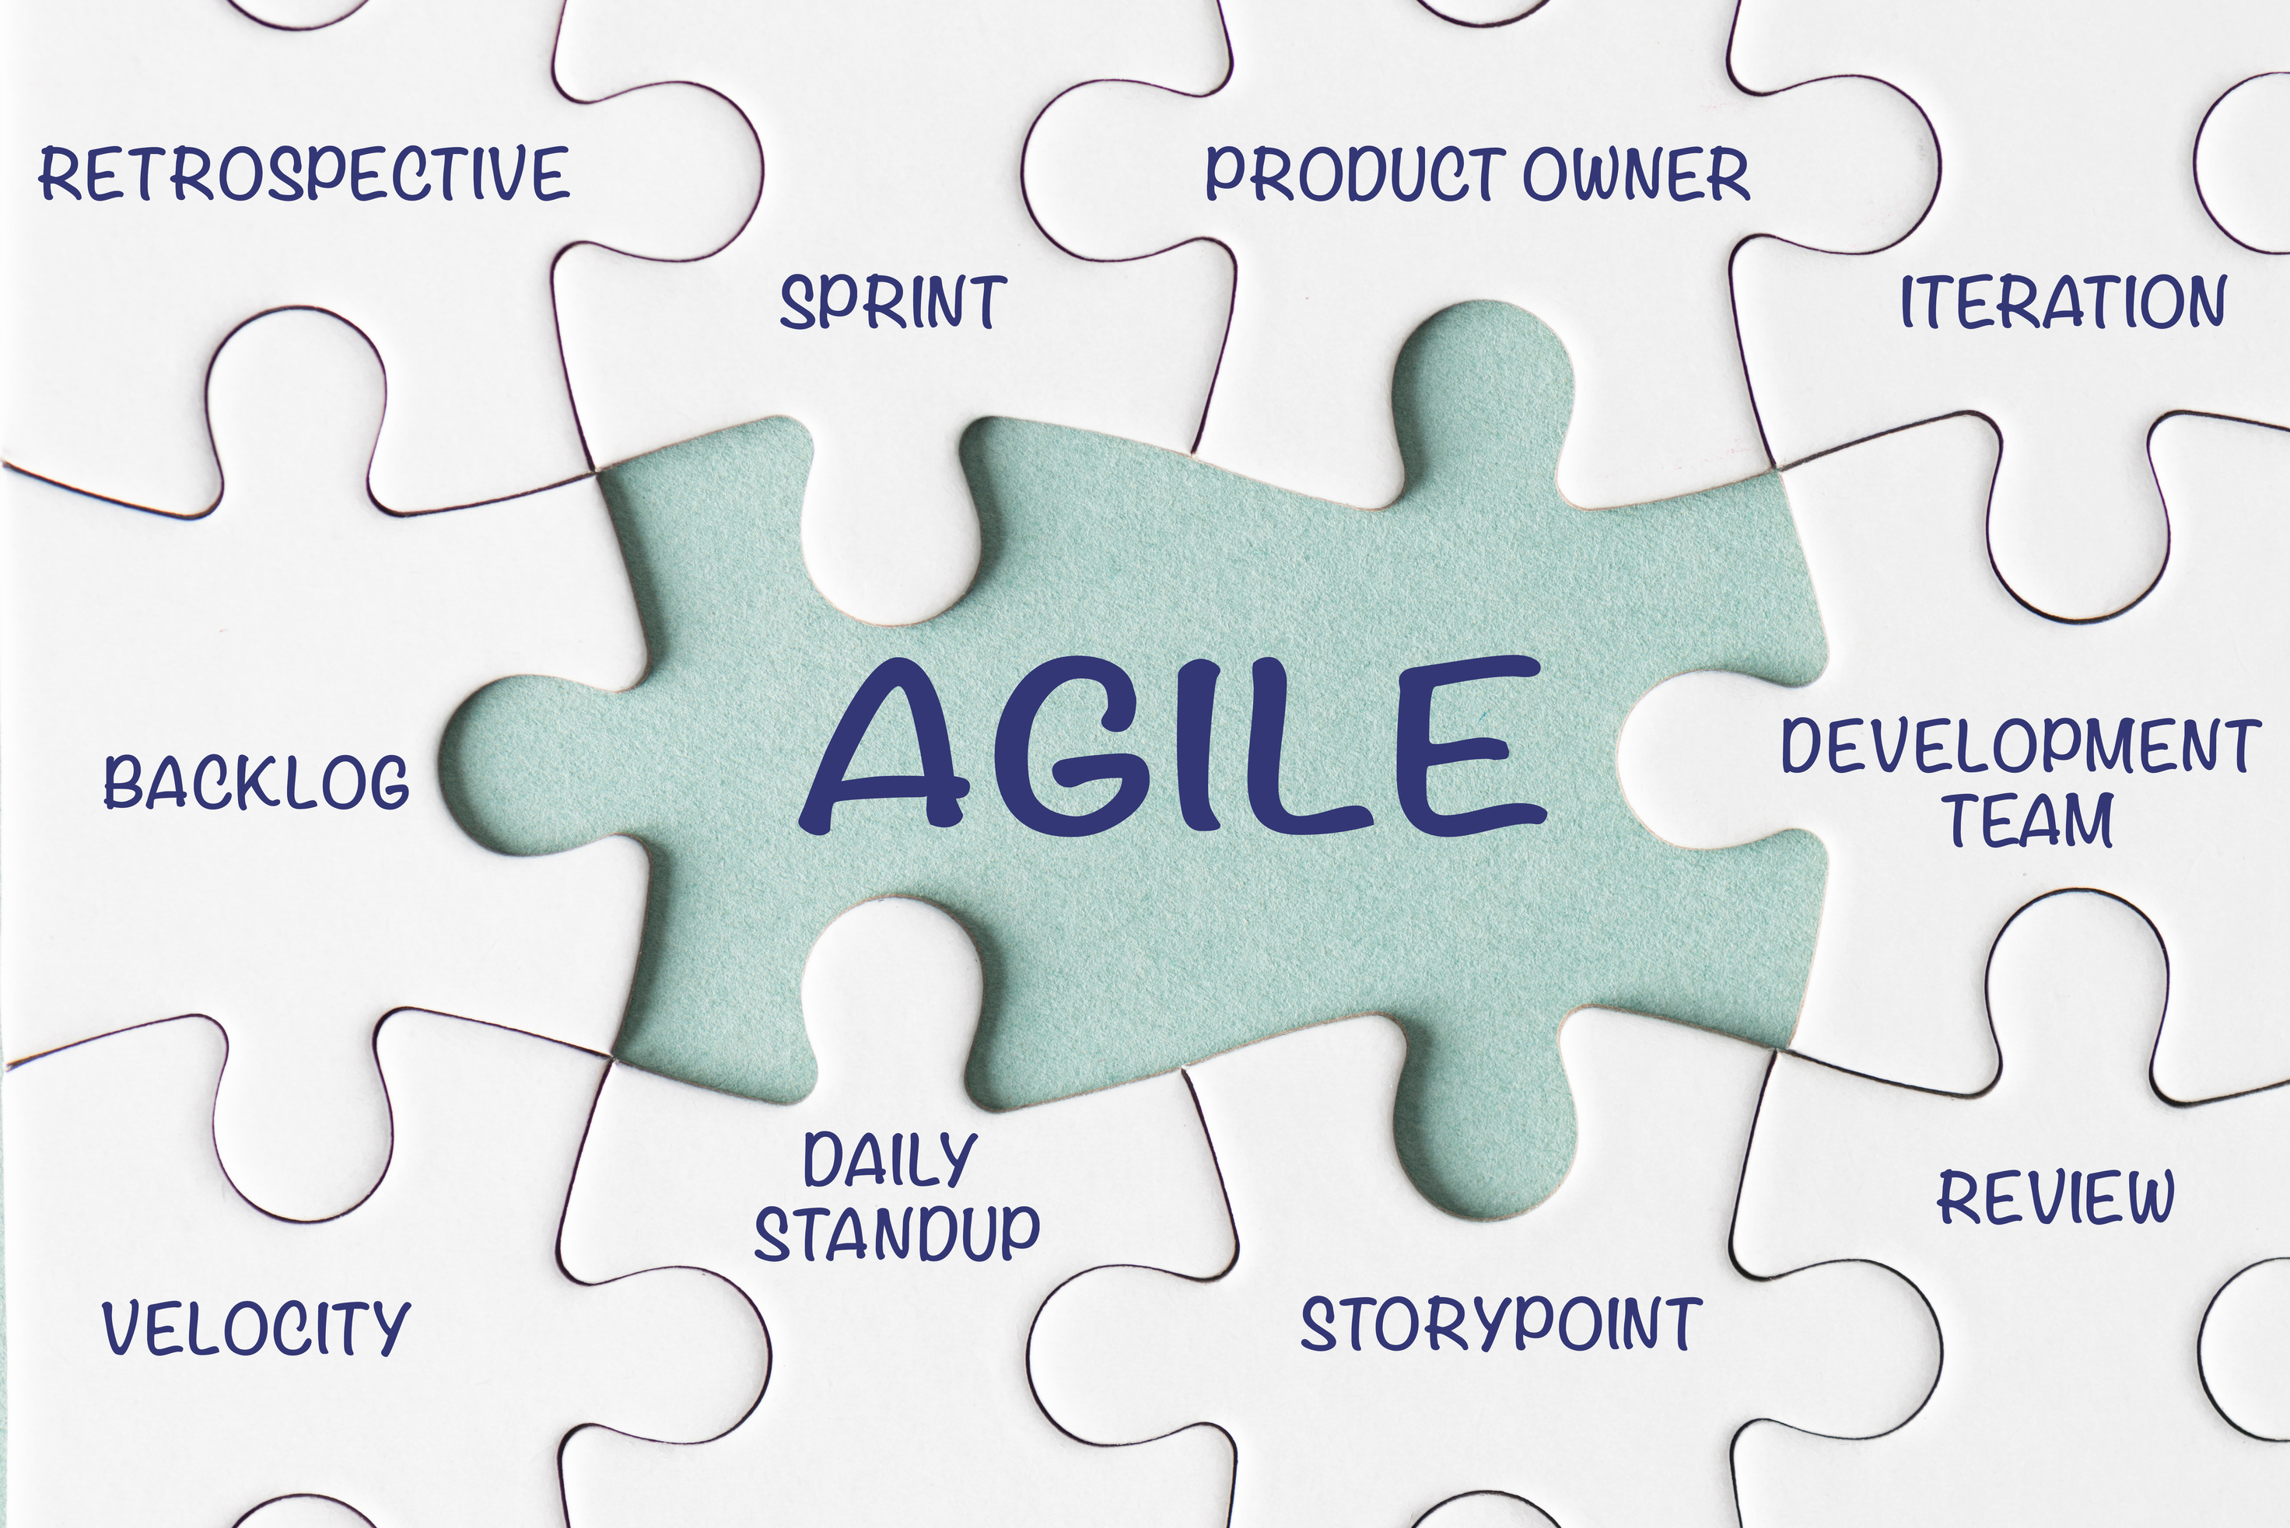
CORE PRINCIPLES OF AGILE
Customer Collaboration
Engage with customers throughout the project.
  Adaptability
Ability to change course based on feedback.
Iterative Process
Regular updates and iterations ensure progress.
Self-Organizing Teams
Teams manage their own work with autonomy.
8

Slide 9

9

Slide 10
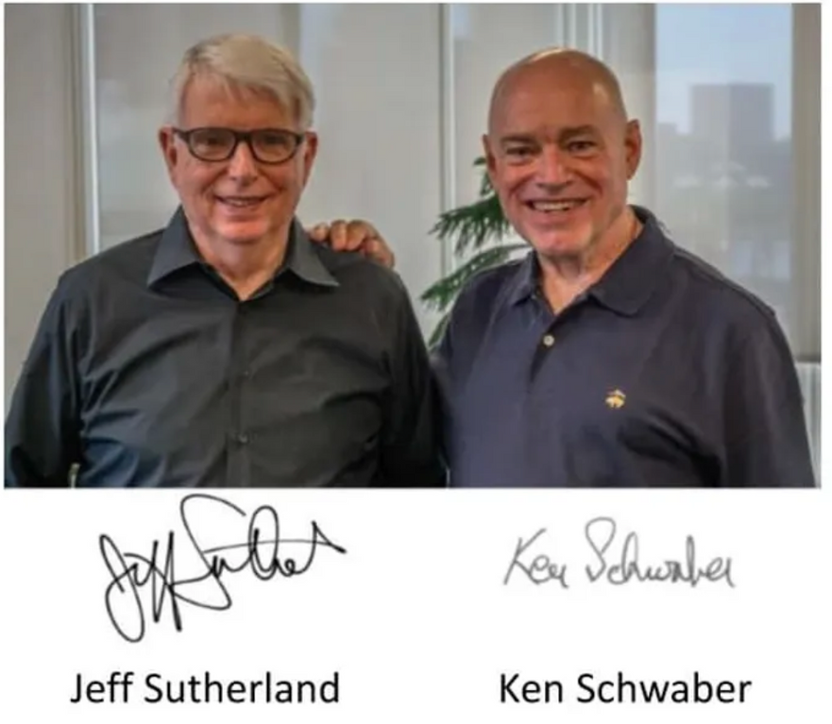

HISTORY
Formalization of Scrum
Scrum was formalized in 1995 by Jeff Sutherland and Ken Schwaber during the Oopsla (Object-oriented programming, systems, languages & applications) conference.
The framework was designed to address complex software development projects by improving teamwork, adaptability and efficiency.
The Scrum Guide
Sutherland and Schwaber published the first version of the Scrum Guide in 2010.
The latest version was updated in November 2020, simplifying and clarifying the framework.
10

Slide 11

INTRODUCTION
Definition
Scrum is a lightweight framework that helps people, teams and organizations generate value through adaptive solutions to complex problems.
Core requirements
  A product owner manages the product backlog
  The Scrum team delivers a value increment during each Sprint
  Continuous inspection and adaptation
  Repeat
11

Slide 12






THEORY
FOUNDATION:
  Empiricism: Knowledge comes from experience and decisions are based on observations
  Lean Thinking: Focuses on reducing waste and maximizing value
PILLARS OF SCRUM MANAGEMENT:
TRANSPARENCY
INSPECTION
ADAPTATION
ALL TEAM MEMBERS MUST CLEARLY UNDERSTAND THE PROGRESS, CHALLENGES AND GOALS OF THE PROJECT.
REGULAR REVIEWS OF PROGRESS ENSURE ALIGNMENT WITH OBJECTIVES AND ALLOW FOR NECESSARY ADJUSTMENTS.
TEAMS ADJUST THEIR PLANS AND STRATEGIES BASED ON THE RESULTS OF INSPECTIONS AND FEEDBACK.
12

Slide 13
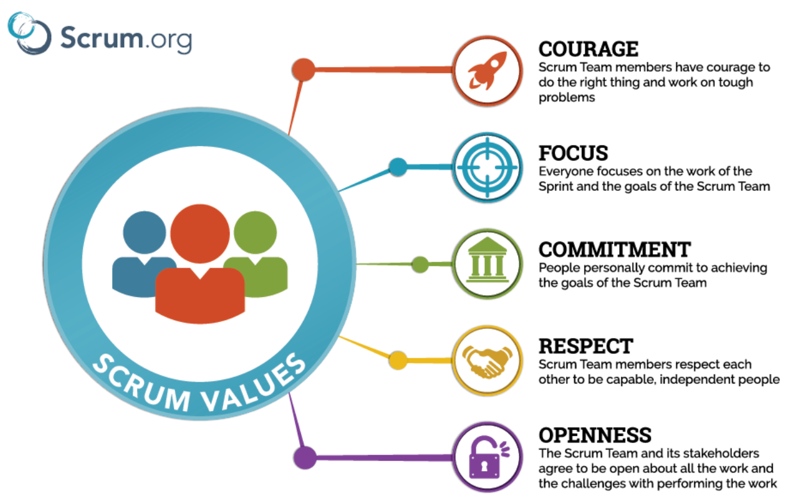
5 VALUES OF SCRUM
13

Slide 14
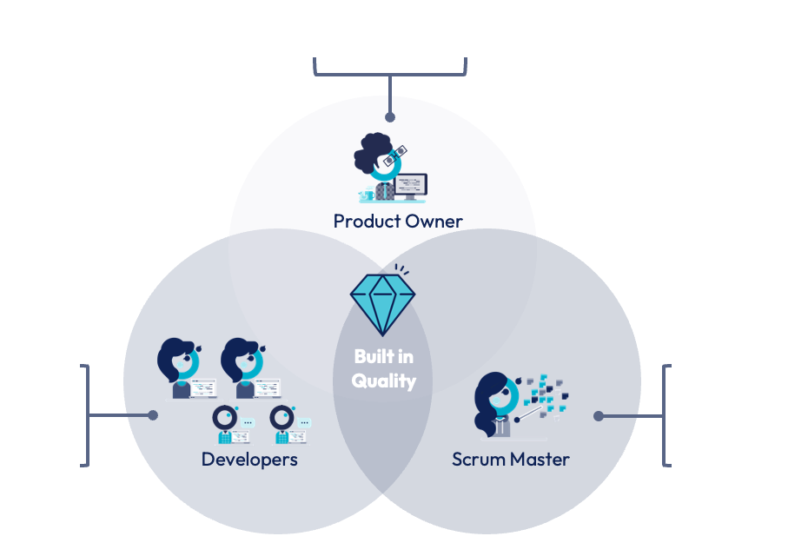
SCRUM TEAM
MAXIMIZES PRODUCT VALUE
  CREATE THE INCREMENT
  DEVELOPERS, BUSINESS ANALYST, TESTERS
MAXIMIZES PRODUCT VALUE
14

Slide 15
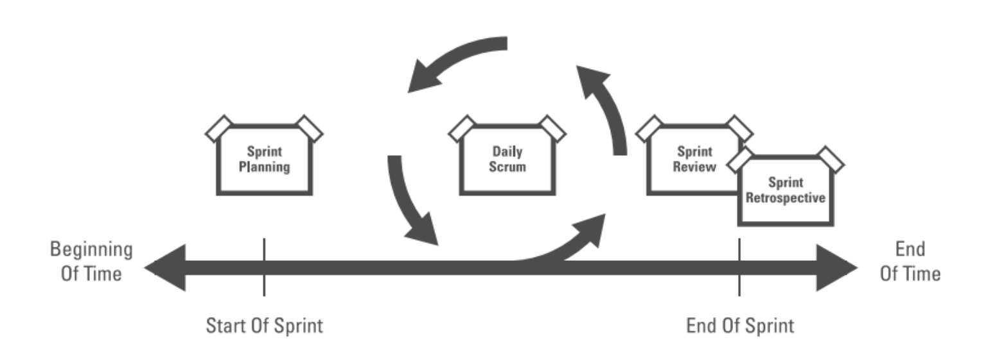
SCRUM EVENTS
SPRINT: 1 MONTH OR LESS
Sprint Planning - max 8h for a 1-month Sprint:
  By the entire Scrum Team
  Why is the Sprint valuable? → Define the Sprint Goal
  What can be done this Sprint? → Select Product Backlog items
  How will the work be done? → Create a plan
Daily Scrum - 15 min:
  For the developers
  Event to inspect progress and adapt plans
Sprint Review - max 4h for a 1-month Sprint:
  By the entire Scrum Team and Stakeholders
  Inspect the outcome and adapt the Product Backlog
Sprint Retrospective - max 3h for a 1-month Sprint:
  By Scrum Team
  Plan improvements for the next Sprint
  Concluded the Sprint
15

Slide 16
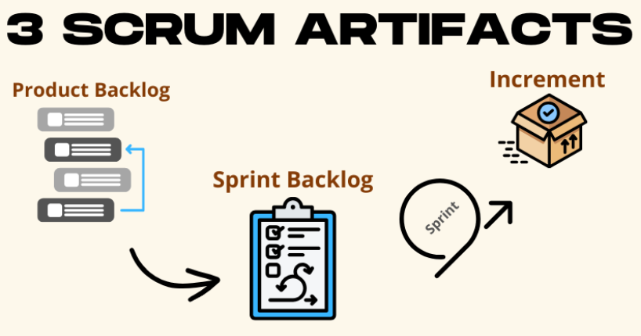
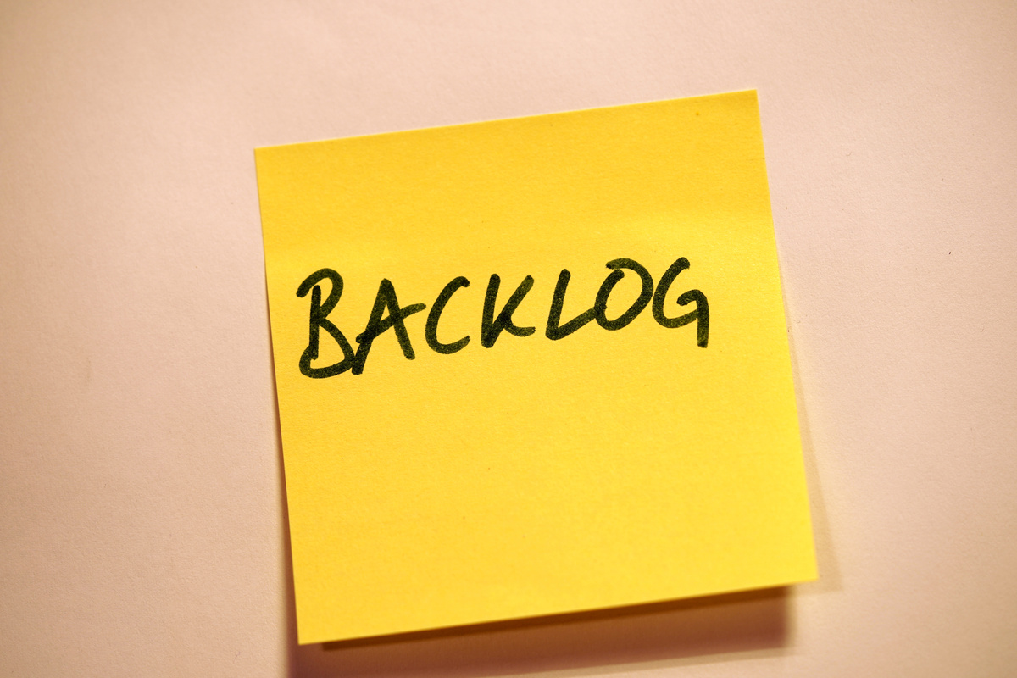
Product Backlog: Ordered list of everything needed for the product.
Commitment: Product Goal (future state of the product).
Increment: A usable, potentially shippable piece of the product.
Commitment: Definition of Done (quality standard).
Sprint Backlog: Selected Product Backlog items and the Sprint plan.
Commitment: Sprint Goal (objective for the Sprint).
16

Slide 17
KEY RULES OF SCRUM
• Scrum is immutable: All roles, events, and artifacts must be followed as defined.
• Scrum is a framework, not a methodology: It provides structure but allows for flexibility in processes and techniques.
• Accountability:
• Product Owner for maximizing value.
• Scrum Master for Scrum adherence.
• Developers for Increment creation.
17

Slide 18
PREPARING FOR CERTIFICATION
• STUDY THE SCRUM GUIDE (2020 VERSION).
• FOCUS ON:
• ROLES AND RESPONSIBILITIES.
• EVENTS AND THEIR TIMEBOXING.
• ARTIFACTS AND THEIR COMMITMENTS.
• PRACTICE SAMPLE QUESTIONS FROM SCRUM.ORG.
• UNDERSTAND REAL-WORLD APPLICATIONS OF SCRUM PRINCIPLES.
18

Slide 19
19

