Slide 1


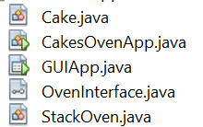
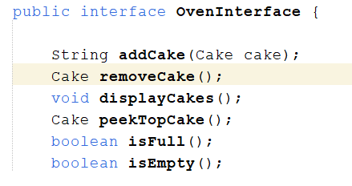
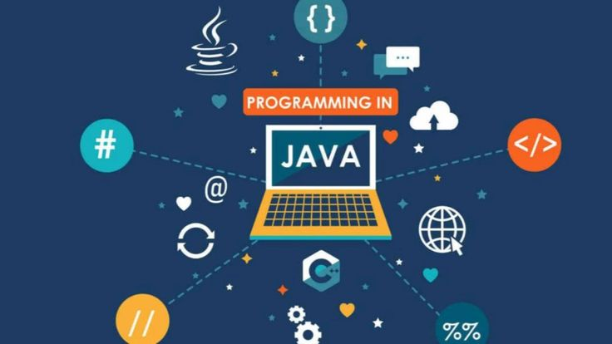
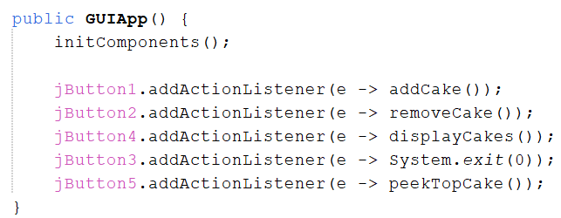
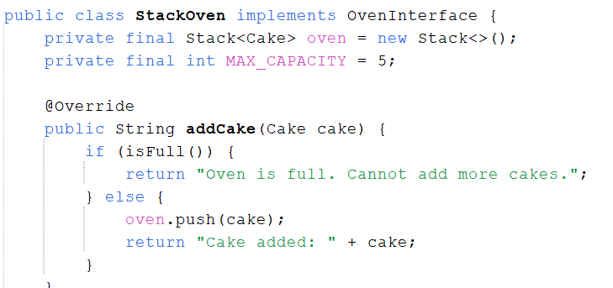
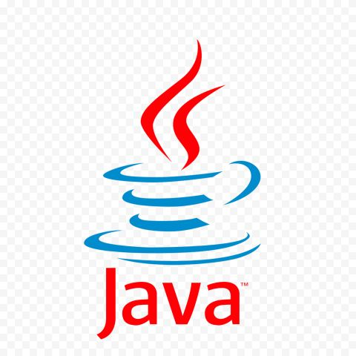
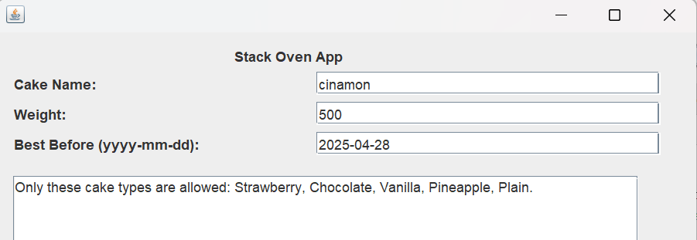
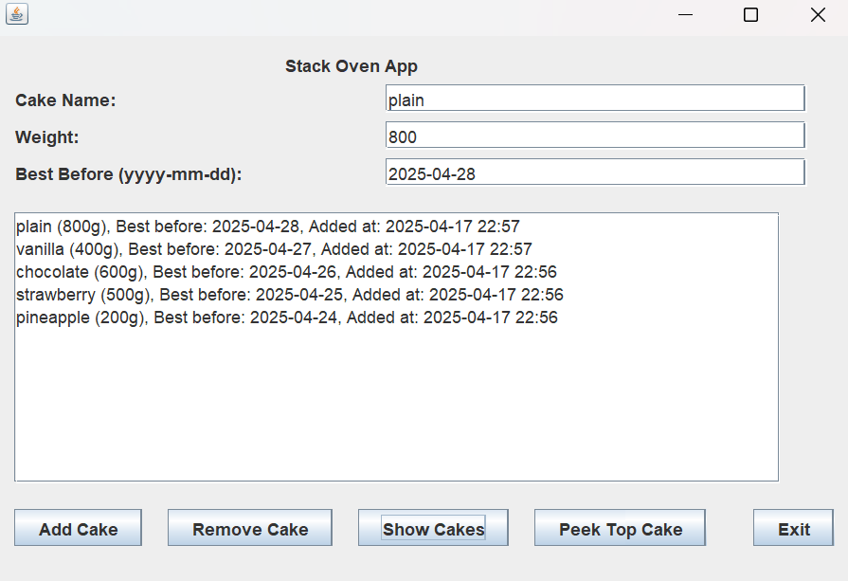
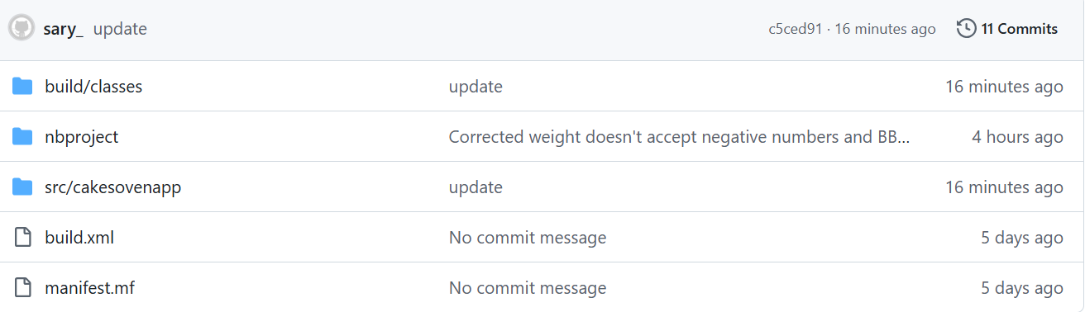
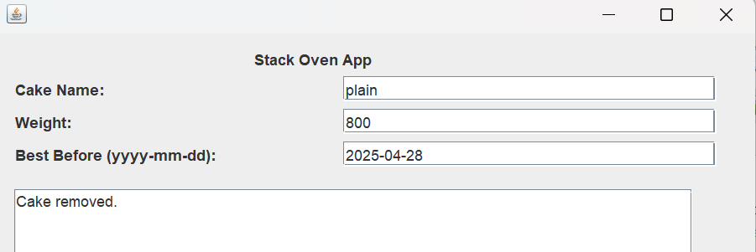
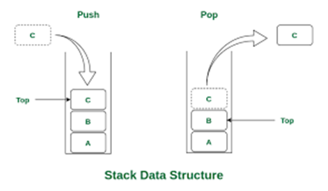
Java Stack Oven App
Object Oriented Programming
Why Stack?
I chose Stack method because from my point of view is the most used system to work with a conventional oven with just one door in the front where the backer introduce the cakes and the firsts in are the last to take out.
Advantages:
Easy to understand LIFO
Simple to implement
Similar to real world scenario
Disadvantages:
Just works in one way (LIFO)
Can not be resized
Doesn’t allow to access to history cakes
The concept is very simple: turn everything you need to work with into an object. OOP allows objects to interact with each other using four basic principles. (Anon., 2025)
Results
OOP Principles
Java code
Entities can have more than one form.
Entities can inherit attributes from other entities.
When an object only exposes the selected information.
Hides complex details to reduce complexity.
App files
Encapsulation
Abstraction
Inheritance
Polymorphism
Oven Interface methods
Elements of my Project
Objects:
addCake(…) each time I’m creating a new object
Classes:
Cake
StackOven
GUIApp
OvenInterface
Instances:
The means to create an object. Oven is an object of StackOven
Methods:
addCake
removeCake
displayCakes
peekTopCake
isFull
isEmpty
getCakeListAsString
toString
GUIApp buttons
Encapsulation:
Cake class -> encapsulates cake properties: Name, weight, best before date and Add time.
StackOven -> encapsulates Stack method and provide access with methods like addCake, removeCake, peekTopCake and Show cakes.
Abstraction
OvenInterface -> declares behaviors: addCake, removeCake, peekTopCake, displayCakes (making use of Override).
Inheritance
StackOven implements element from OvenInterface.
Polymorphism
I declared: OvenInterface oven = new StackOven(); and later could do: oven = new QueueOven();
Elements of OOP
Objects
Classes
Instances
Methods
Functions to use Stack
Data Structure used:
Stack LIFO(Last in, First Out)
Is a linear collection whose elements are added in a last in,
first out (LIFO) manner.
Stack operations:
push(object): inserts a cake.
object remove(): removes Last Inserted cake.
peek(): returns the last inserted cake, without removing it.
boolean isEmpty(): indicates when the oven is empty.
boolean isFull(): indicates when the oven is full.
App Interface
Here are some examples of using the GUIApp where the cakes where added, removed and system detected error.
References
Anon., 2025. softserve. [Online]
Available at: https://career.softserveinc.com/en-us/stories/what-is-object-oriented-programming-oop-explaining-four-major-principles#:~:text=OOP%20allows%20objects%20to%20interact,collaborate%20to%20create%20powerful%20applications
[Accessed 10 04 2025].

Slide 2
GitHub link: https://github.com/CCT-College-Dublin/ca1-40-sarita-ctrl

