Slide 1
(ITB/10: Federated Learning for Smart Healthcare using Blockchain)
Department of Information Technology
BE Major Project
Semester: VIII
Group Members:
(Anish kamble- 21101b0017)
(irfan ansari- 21101b0038)
(devank shinde- 21101b0047)
Under the guidance of
(Prof. neha kudu)
AY 2024-25

Slide 2
Outline
Introduction
Motivation
Objectives
Problem Statement
Literature Survey (Papers and/or existing applications- prepare In tabular form)
Technology Stack (Hardware/Software)
Implementation
Result
References

Slide 3
Abstract
Federated Learning (FL) enables secure, decentralized model training across institutions without sharing patient data.
This framework combines FL with blockchain to enhance privacy and data integrity.
Used for breast cancer detection using histopathology, mammography, and ultrasound datasets.
Blockchain ensures immutable model logging and regulatory compliance.

Slide 4
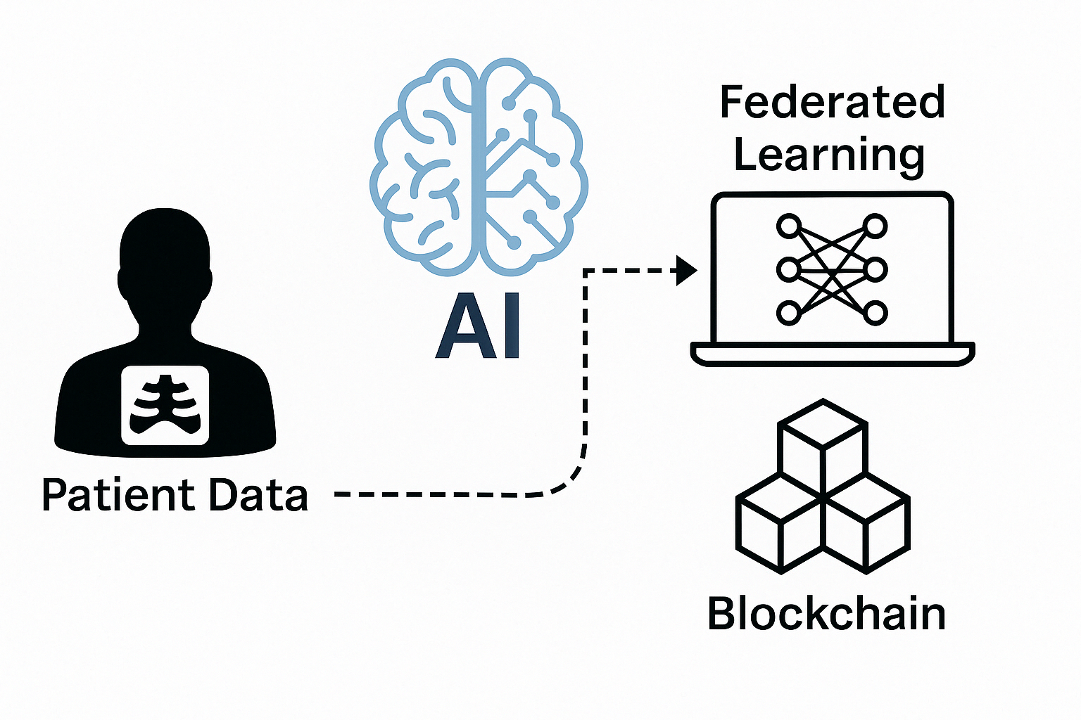
Introduction
Artificial Intelligence (AI) has transformed healthcare by enabling faster and more accurate disease detection. However, training effective AI models typically requires large-scale patient data, raising concerns about privacy, data security, and regulatory compliance.
Federated Learning (FL) addresses this by allowing multiple institutions to train a shared model without sharing raw data. Each client trains locally and sends only model updates to a central server, preserving data confidentiality.
While FL protects privacy, it lacks mechanisms for verifying and tracing model updates. To enhance trust and security, we integrate blockchain technology to log cryptographic hashes of updates on an immutable ledger.
Our approach combines FL and blockchain to enable secure, transparent, and privacy-preserving AI for sensitive healthcare tasks like breast cancer detection.

Slide 5
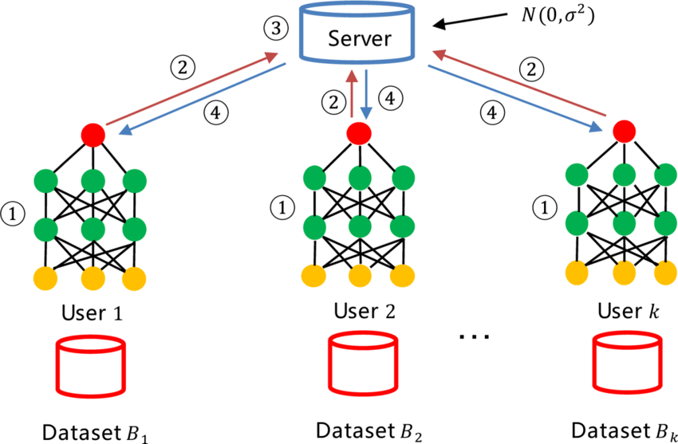
Each hospital (client) trains a local model on its own medical images (e.g., histopathology, mammography, ultrasound).
Only model updates (not data) are sent to a central server.
The server aggregates updates to create a global model.
The improved model is shared back with all hospitals.
Blockchain logs each update for transparency and trust.

Slide 6
Motivation
Privacy Concerns: Centralized AI training exposes sensitive patient data, risking breaches and non-compliance with HIPAA/GDPR.
Federated Learning (FL): Enables model training across institutions without sharing raw data, preserving privacy.
Trust Gap in FL: Lacks mechanisms for verifying and auditing model updates, making the system vulnerable to tampering.
Blockchain Integration: Adds transparency, traceability, and security by immutably logging model updates on a decentralized ledger.
Healthcare Need: Ensures privacy-preserving, secure, and collaborative AI development across hospitals and research centers.

Slide 7
Objectives
Enable Privacy-Preserving AI Train models without sharing raw patient data.
Integrate Blockchain for Trust Log model updates securely to ensure transparency and auditability.
Improve Diagnostic Accuracy Use federated learning across diverse medical imaging datasets.
Ensure Regulatory Compliance Align with HIPAA, GDPR, and healthcare data privacy standards.
Promote Secure Collaboration Facilitate multi-institutional AI training with verifiable contributions.
Maintain System Scalability Design a framework that works across various data sources and clients.

Slide 8
Problem Statement
Privacy Risks in Centralized Learning Transferring medical data to central servers compromises patient confidentiality.
Lack of Trust in FL Alone FL doesn’t provide mechanisms to verify or audit model updates.
Regulatory Challenges Centralized data handling often violates HIPAA and GDPR standards.
Limited Collaboration Institutions hesitate to participate due to security and ownership concerns.
No Built-in Audit Trail Difficulty in tracing model contributions and ensuring update integrity.

Slide 9
Future Scope
Integrate Differential Privacy Add formal privacy guarantees to further protect sensitive data.
Adaptive Model Weighting Balance contributions from clients with varying data sizes and quality.
Scalability to More Institutions Extend the framework to support larger, real-world healthcare networks.
Optimize Blockchain Efficiency Use lightweight consensus mechanisms to reduce latency.
Cloud & Mobile Deployment Enable secure access and real-time updates across devices and platforms.
Explainable AI (XAI) Improve transparency in predictions for better clinical trust and usability.

Slide 10
Literature Survey & Existing Papers
Paper | Technology Used | Application | Key Findings
Kaissis et al., Nature Mach. Intell., 2020 | Federated Learning | Medical Imaging | FL preserves privacy without sacrificing performance
Sheller et al., Brainlesion, 2019 | FL (Multi-institutional setup) | Brain Tumor Segmentation | Feasible collaborative training without data sharing
Kuo et al., JAMA, 2017 | Blockchain | Biomedical Data Management | Ensures trust, integrity, and access control
Nguyen et al., IEEE Trans. Intell. Transp. Syst., 2021 | FL + Blockchain | Autonomous Systems | Blockchain adds verifiability and prevents update tampering
Dayan et al., Nature Medicine, 2021 | Federated Learning | COVID-19 Outcome Prediction | FL is effective across hospitals for real-time model sharing
Rieke et al., npj Digital Medicine, 2020 | Federated Learning | Digital Health | FL enhances generalizability in multi-center studies

Slide 11
Technology Stack
Component | Technology | Purpose
Model Training | TensorFlow, Keras | Build and train CNN models on medical image data
Federated Learning | Flower Framework | Coordinate local training and global aggregation
Blockchain | Hyperledger Fabric | Securely log model updates, ensure auditability
Programming Language | Python | Core development for ML, FL, and blockchain layers
Data Communication | REST APIs | Enable client-server interaction and update flow
Image Processing | OpenCV, NumPy | Preprocess histopathology, mammography, ultrasound
Evaluation & Logging | Matplotlib, TensorBoard | Visualize accuracy, loss, and training metrics

Slide 12
Implementation
1: Dataset Preparation Assign and preprocess imaging data for each client (histopathology, mammography, ultrasound).
2 : Local Model Training Clients train CNN models on local data using TensorFlow without sharing raw data.
3: Federated Learning Setup Use the Flower framework to coordinate communication between server and clients.
4 : Apply Blockchain Layer Hash and log model updates to Hyperledger Fabric for integrity and traceability.
5: Model Aggregation The server validates hashes and aggregates weights using Federated Averaging (FedAvg).
6: Model Evaluation Track performance metrics (Accuracy, AUC, Loss) over communication rounds.
7: Compliance Check Ensure the system meets HIPAA and GDPR requirements by keeping data local.

Slide 13
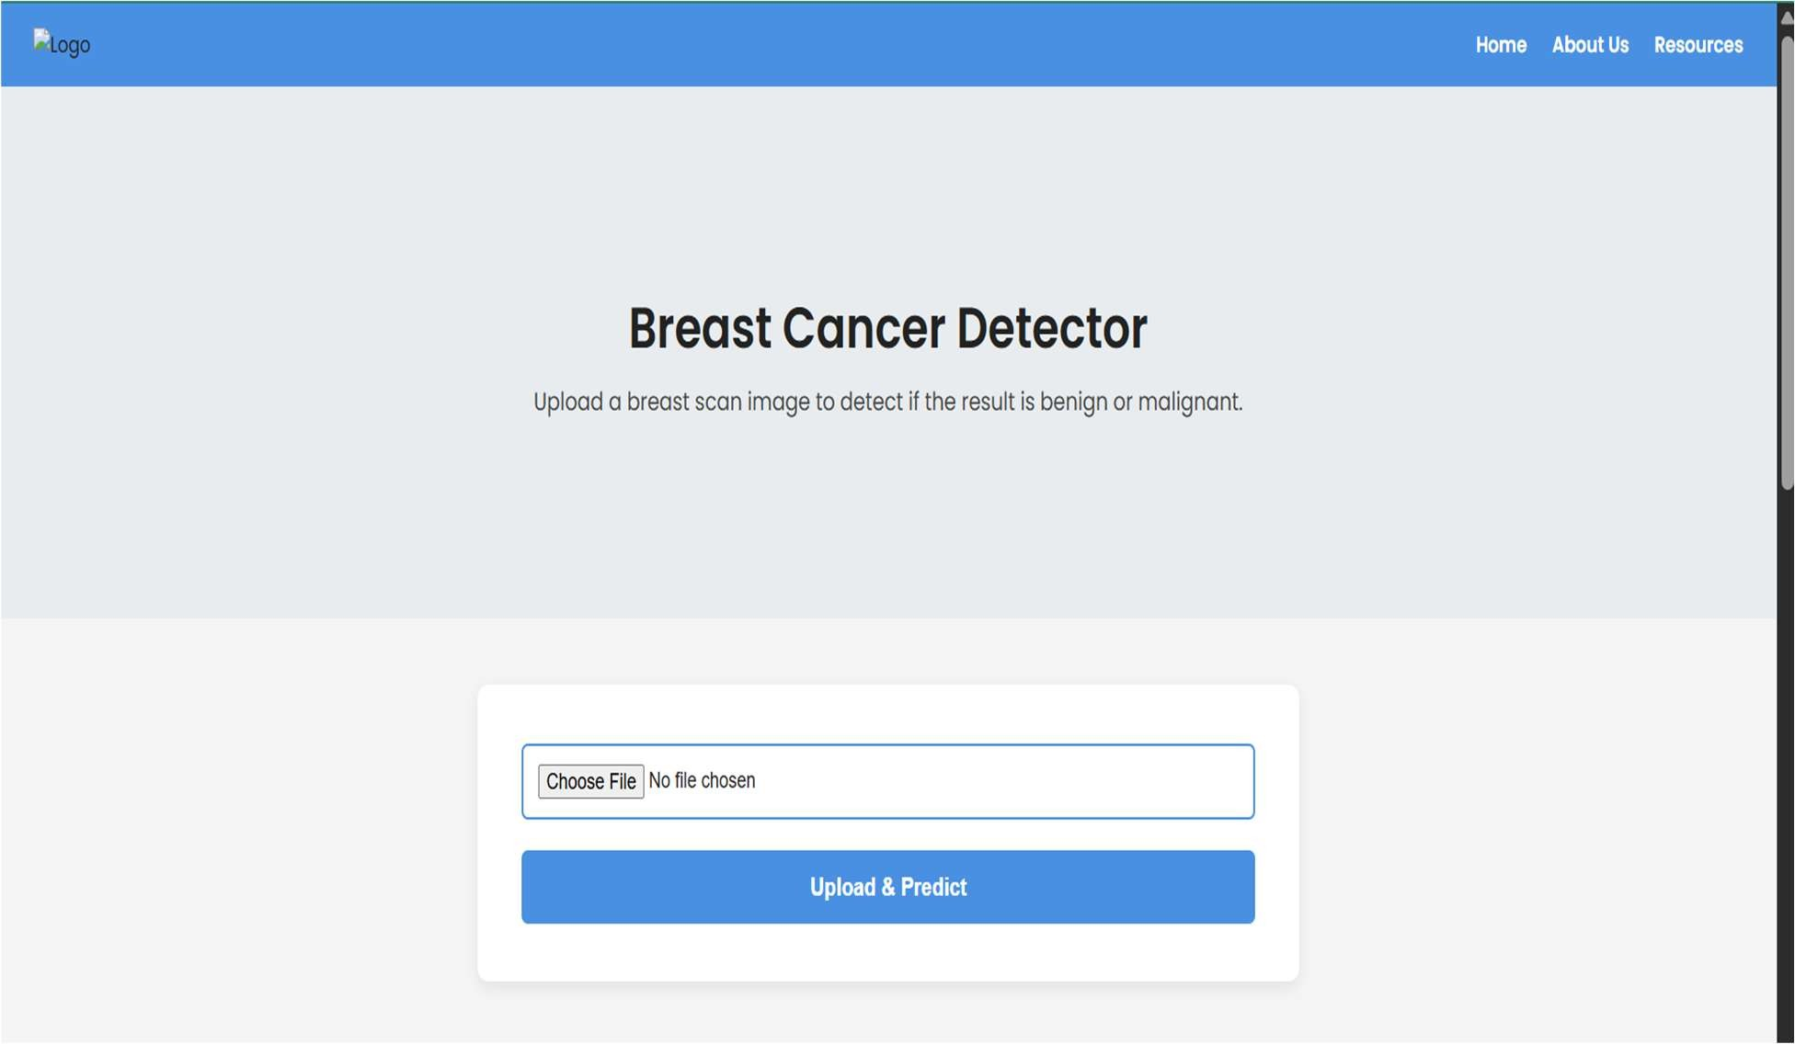
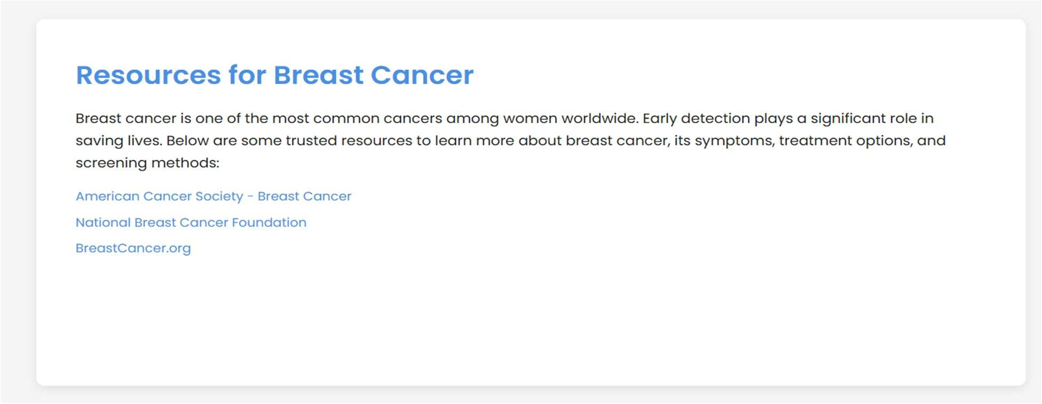
Result
LANDING PAGE

Slide 14
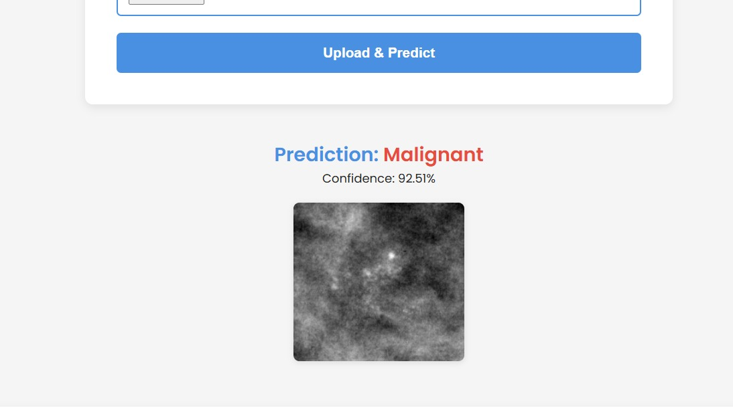
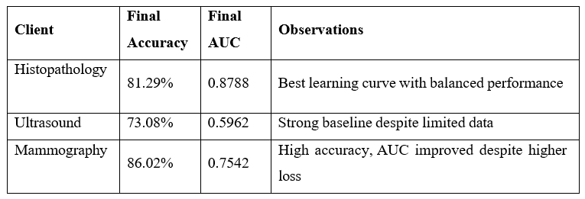
Result

Slide 15
References
No. | Title & Author(s) | Link
1 | Secure, privacy-preserving and federated machine learning in medical imaging Kaissis et al., 2020 | Link
2 | Multi-institutional deep learning modeling without sharing patient data Sheller et al., 2019 | Link
3 | Blockchain distributed ledger technologies for biomedical and health care applications Kuo et al., 2017 | Link
4 | Federated learning with blockchain for autonomous vehicles Nguyen et al., 2021 | Link
5 | The future of digital health with federated learning Rieke et al., 2020 | Link
6 | Federated learning for predicting clinical outcomes in COVID-19 patients Dayan et al., 2021 | Link

