Slide 1

Olymic Data Analytics Capstone Project:
Who Competes, Who Wins, and Why It Matters
Paris 2024 + Historical Comparison (Rio 2016)
By:
By Ra’Dicea Davis-Matthews
Capstone Project – Data Analytics
Notes:
Hello, my name is Ra’Dicea Davis-Matthewsand today I’ll be presenting my Olympic Data Analytics Capstone Project. This project combines Python, Tableau, and statistical analysis to uncover meaningful patterns about athlete demographics, participation, and performance.

Slide 2

INTRODUCTION

Slide 3

Problem Statement
The Olympic Committee needs clear insights into how athlete demographics, gender representation, and national resources influence participation and medal success at the Paris 2024 Olympics.
This project analyzes:
Athlete profiles (age, height, weight)
Participation by country & sport
Gender distribution
Economic impact
Changes compared to Rio 2016
Notes:
The goal of this project is to answer a simple but important question: what factors shape Olympic participation and performance? To do this, I analyzed athlete demographics, country participation, gender representation, and economic data from Paris 2024, and compared these trends to Rio 2016. This gives a full picture of how opportunity, resources, and physical demands influence performance.

Slide 4
Key Business Questions
1. Who are the athletes?
What are the demographic patterns across sports?
2. How do countries participate?
Which countries send more athletes and in which sports?
3. Is gender equity being achieved?
Which sports are male- or female-dominated?
4. How much does economics matter?
How does GDP relate to delegation size and medal success?
5. Are these patterns statistically valid?
Do age, height, gender, and GDP significantly influence outcomes?
Notes:
These business questions guided the project. First, I needed to understand who the athletes are. Second, I looked at how countries participate and whether gender equity is truly being achieved. Third, I explored the economic patterns behind participation and medals. Finally, I validated these insights with statistical tests to ensure the patterns are real and meaningful.

Slide 5

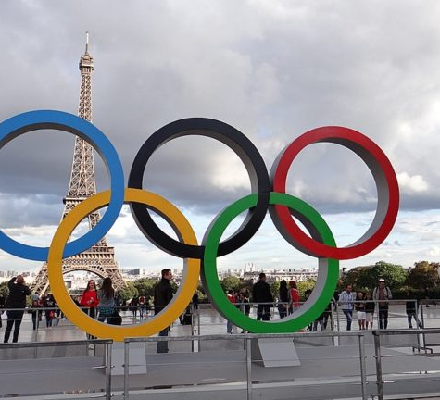
Business Context
10,500+ athletes, 206 countries
Rich data on demographics, gender, sports, and medals
Used for national training, policy, and equity decisions
This Photo by Unknown Author is licensed under CC BY-SA
Notes:
The Olympics bring together over 10,500 athletes from 206 countries, creating one of the richest sports datasets in the world. National committees rely on analytics to understand athlete performance, identify equity gaps, and decide where to invest. This project simulates the role of an Olympic Data Analyst.

Slide 6
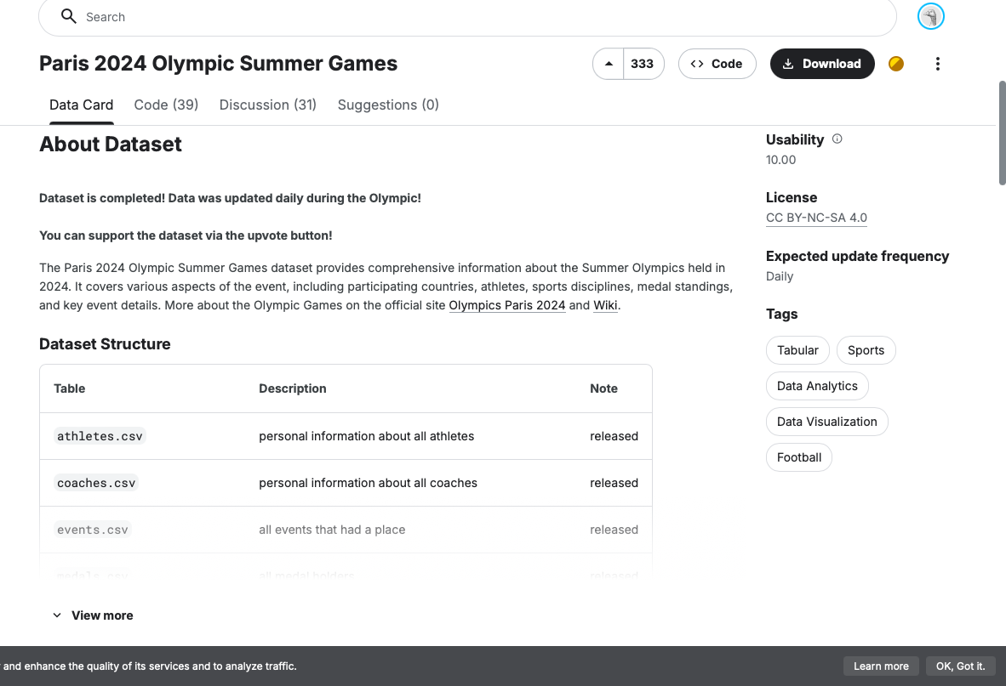
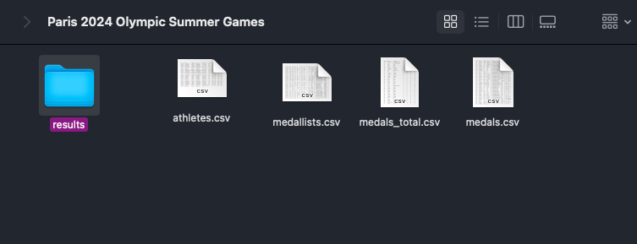
Data sources
Paris 2024 Athletes Dataset (Kaggle)
Athlete demographics, events, medals
World Bank GDP Dataset
GDP for 200+ countries
Rio 2016 Athletes Dataset
Used for historical comparison
Merged using country codes
Final dataset: merged_data_clean.csv
Notes:
To answer these questions I used the Paris 2024 and Rio 2016 dataset from Kaggle and the World Bank GDP dataset.

Slide 7
Project GoalS
Analyze
Analyze athlete demographics
Examine
Examine gender & participation trends
Study
Study economic factors (GDP) & performance outcomes
Validate
Validate trends using statistical testing
Compare
Compare Paris 2024 to Rio 2016
Notes:
My analysis focused on demographics, representation, economic impacts, and statistical validation while also comparing 2024 to Rio 2016.

Slide 8


Python Data Preparation
Loaded athlete, coach, medal, country & GDP files
Cleaned missing values
Calculated athlete age
Created age groups
Formatted GDP values
Merged datasets by country code
200+ countries, 10,000+ athletes
Notes:
I started with Python to clean and organize the data, I loaded all the datasets, cleaned missing values, standardized dates, calculated athlete ages, created age groups, cleaned GDP columns, and added delegation size. I then merged everything together by country code. This step ensured that I had a reliable analysis ready data set for Tableau.

Slide 9
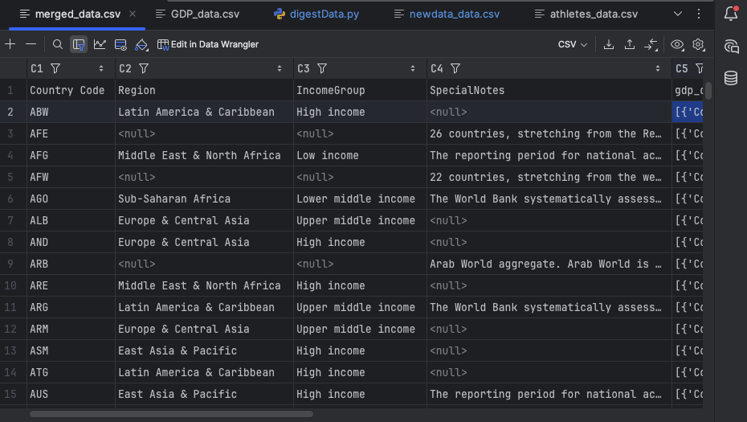
Python Data Merge
Joined athletes + medals + GDP
Nested per-country data
Final export to Tableau
Notes:
After cleaning I joined athletes, medals, and GDP data using the country code. After engineering new features and nesting athletes per country, I exported the finished dataset into a clean file used in Tableau. This file called “merged_data_clean” is what I used to help build my dashboard, additionally once I start building in tableau I find that my athletes column has its data all inside one coloumn so I end up creating a separate file in python, cleaning it and organizing it and this file is called “athletes_data.csv” both of this datasets help build my dashboard.

Slide 10
OUTCOMES: athlete's demographic

Slide 11
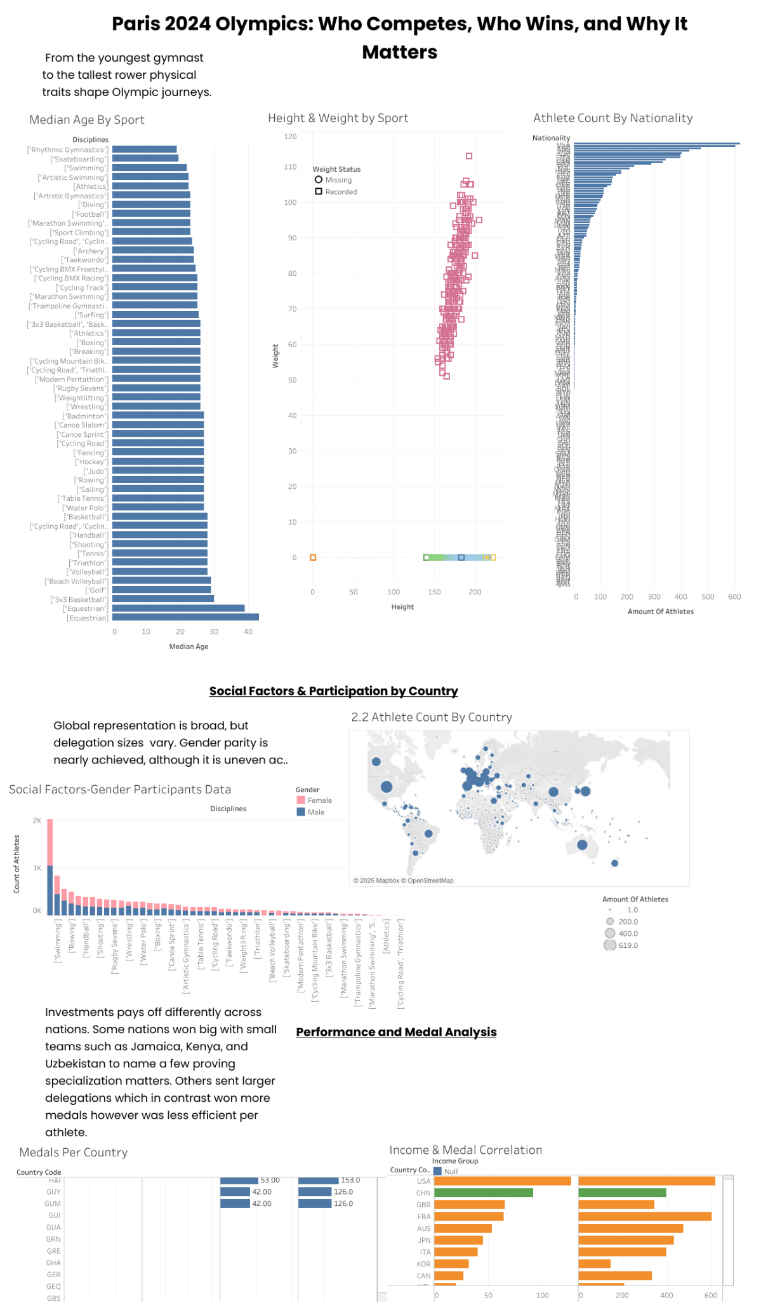
Tableau Work
Import merged data
Build visuals answering key research questions
Combine visuals into dashboards
Add interactivity & design
Notes:
In Tableau, I built visuals for demographics, gender, participation, economics, and country comparison, and combined them into interactive dashboards.

Slide 12
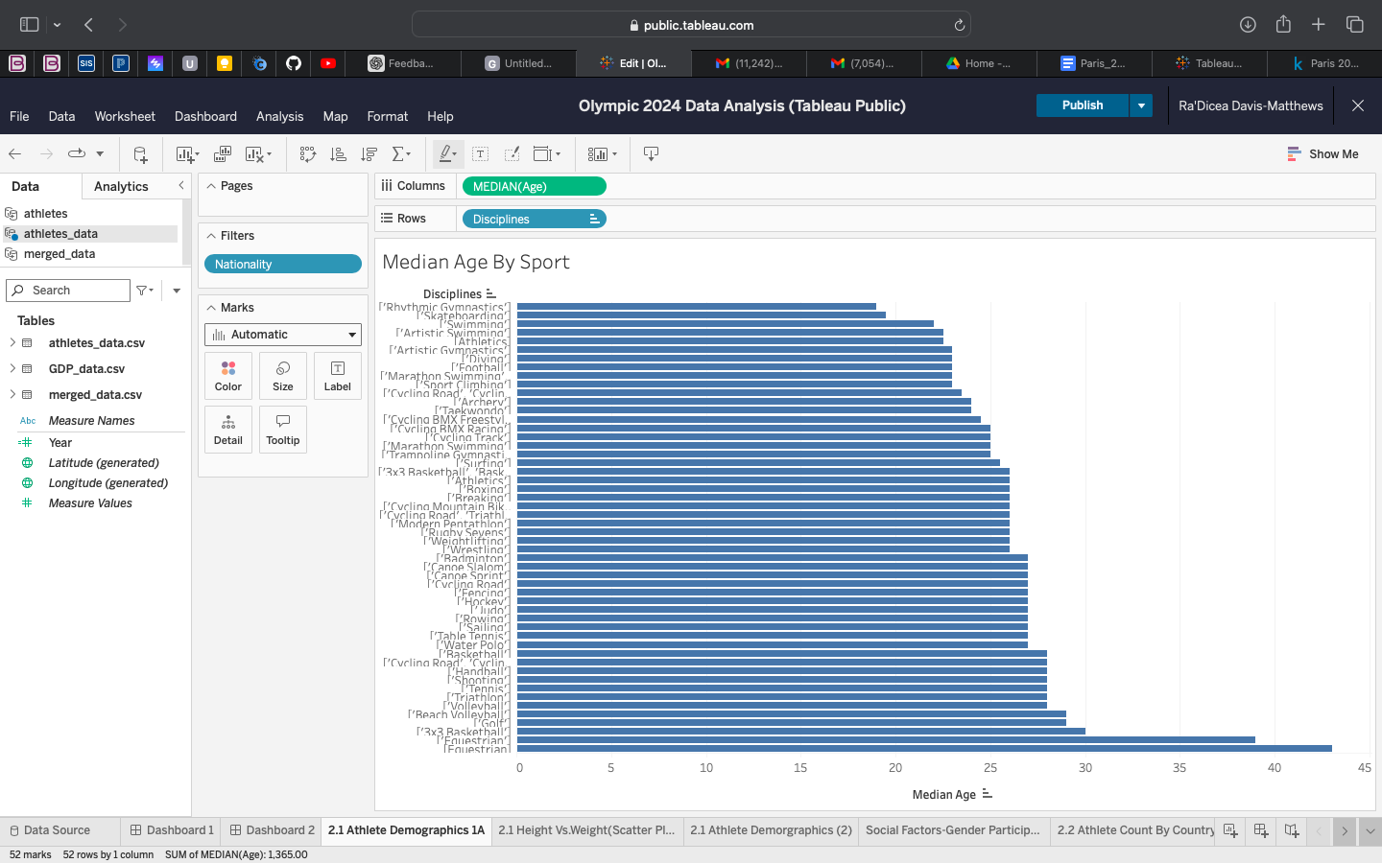
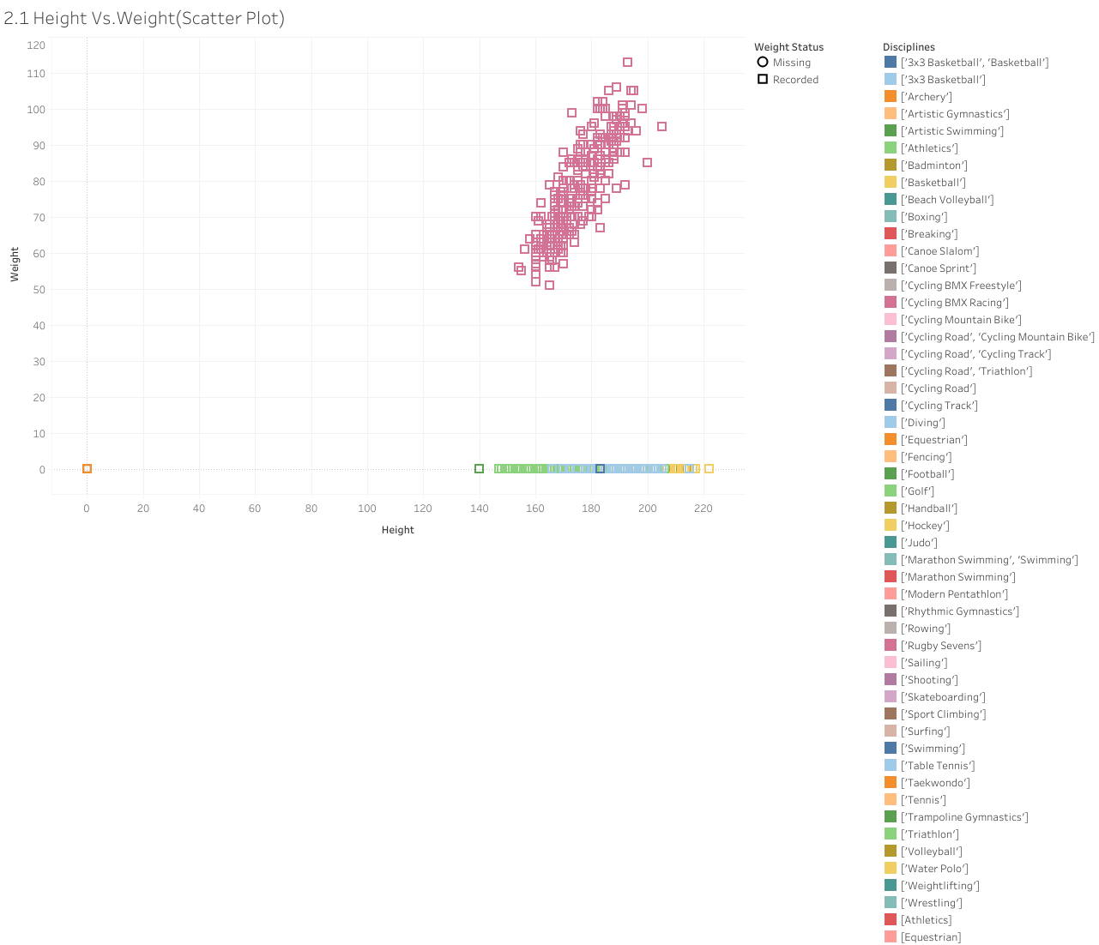
Findings: Athlete Demographics
Athletes peak in mid-20s
Height & weight vary strongly by sport
Some sports don’t report weight (due to no required weigh-ins)
Cleaned missing data to keep charts accurate
Notes:
Looking at Paris 2024 the age distribution shows a clear peak in the mid 20s, which aligns with the prime performance years in many sports, but certain sports trend younger or older. Height and weight vary dramatically depending on the sport. Gymnast, swimmers, and track athletes have very different profiles. One challenge was that several sports didn’t include weight data this is likely because weigh-ins are not mandatory. I left those values missing to keep the data accurate, filtering them out when necessary.

Slide 13
Findings: Gender, Participation & Social Trends
Female-only: Rhythmic & Artistic Gymnastics
Male-heavy: Wrestling, Football
Nearly 50/50 overall
Large delegation countries: USA, FRA, AUS, GBR
Many nations send fewer than 20 athletes
Notes:
Paris 2024 Participation showed strong gender balance overall. Many sports had balanced representation, although some still leaned heavily male or female. Countries participation varied widely in delegation size ranging from over 500 athletes to fewer than five..

Slide 14
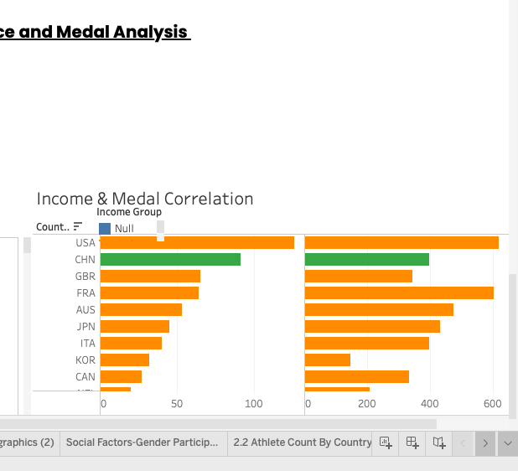
Findings: Economics & Medal Outcomes
High-income nations send more athletes
Strong positive relationship between GDP & medals
Medal efficiency: smaller nations sometimes outperform
Investing more does NOT always mean higher medal efficiency
Notes:
Next I connected GDP to Olympic participation. Higher-income countries generally sent more athletes and won more medals. But when you analyse medal efficiency, medals per athlete told a different story. Smaller nations can sometimes outperform, often due to speclization. Countries like Jamaica and Kenya performed extremely well per athlete proving that Olympic success isn’t only about size or wealth. This shows that specialization and strategy matter just as much as resources.

Slide 15
USA ATHLETES vs GLOBAL ATHLETES SUMMARY STATISTICS
USA ATHLETES | OTHER COUNTRIES ATHLETES (world)
AGE: 26 | AGE:26
HEIGHT: TALLER ON AVERAGE (180 cm) | HEIGHT: 177 cm
WEIGHT: insufficient data | WEIGHT: insufficient data
Notes:
For this part of my analysis , I calculated summary statistics for athlete age, gender, height, and weight and compared American athletes to the rest of the world.

Slide 16
Hypothesis Testing

Slide 17
Hypothesis Testing Overview
Tests performed:
Medalist Age (T-Test)
Height Across Sports (ANOVA)
Gender & Medal Likelihood (T-Test)
GDP & Medals (Chi-Square concept test)
Notes:
These tests mathematically confirm whether trends we saw visually are statistically meaningful.

Slide 18
Test #1: Medalist Age
Medalists: 27.1
Non-medalists: 26.4
Slight difference
Notes:
Medalists were slightly older, suggesting experience matters

Slide 19
Test #2: Height Differences Across Sports
p-value < 0.001
Significant height variation
Youngest → Gymnastics
Tallest → Basketball
Notes:
Height differences across sports are statistically significant and reflect the demands of each sport

Slide 20
Test #3: Gender & Medal Rates
Female medal rate: 13.3%
Male medal rate: 13.7%
No real difference
Notes:
Men and women medaled at nearly identical rates in 2024.

Slide 21
Test #4: GDP & Medal Success
Strong association
Medals cluster in high-GDP countries
Reject H₀
Notes:
Using GDP quantiles, we see medals heavily concentrated among high-GDP nations. This confirms a statistically significant relationship.

Slide 22
KEY INSIGHTS
Athlete traits vary by sport
Gender parity improving
Economic resources impact participation
Medals often correlate with GDP but efficiency varies
Smaller teams can still succeed through specialization
Notes:
To summarize the 2024 findings athlete traits very by sport, Gender equity continues to improve. GDP greatly influences participation but smaller teams can still succeed through specialization. This sets the stage for comparing modern trends to past Olympics.

Slide 23
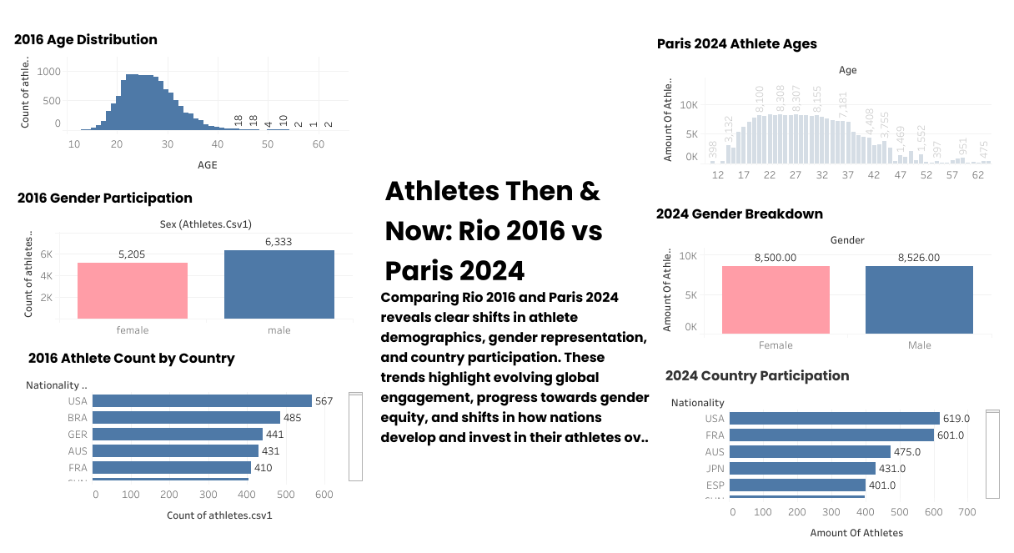
Athletes Then & Now: Rio 2016 vs Paris 2024
Age distributions similar: peak mid-20s
Gender parity improved in 2024
Country participation shifts
Reflects evolving investment & global engagement
Notes:
Comparing Rio to Paris shows improved gender equity and growing global participation.

Slide 24
Business Impact
Data supports talent pipelines
Helps allocate funding smarter
Guides gender equity goals
Notes:
These insights help Olympic Committees make smarter decisions about where to invest in athlete development, which sports to prioritize, and how to allocate resources effectively.Understanding demographic patterns supports long-term planning and scouting strategies.

Slide 25
Business Impact
Understand
Understand physical profiles by sport
Benchmark
Benchmark against global competitors
Improve
Improve resource planning
Notes:
For sports federations, this data can highlight gender gaps, reveal performance strengths, and guide partnerships or training programs.
It can also help identify emerging talent and support countries with fewer resources.

Slide 26
Data Limitations
Missing weight data in several sports
Inconsistent reporting across countries
GDP not adjusted for population
Some athletes missing demographic fields
“Unknown” values used to avoid bias
Notes:
Of course, the analysis has limitations. Not all sports reported weight data. Some countries had incomplete demographic fields. GDP wasn’t adjusted for population size. I filled missing values with ‘Unknown’ to avoid distortion, but this still limits certain analyses.

Slide 27
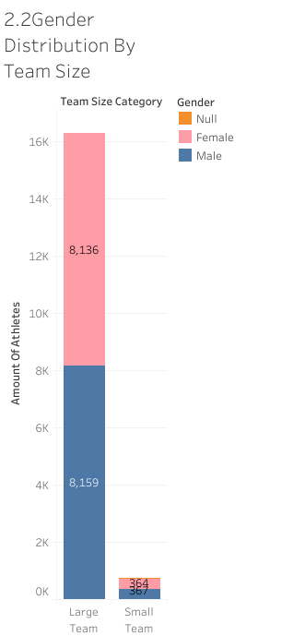
Conclusion
Paris 2024 marks strong progress toward global inclusion
Athlete demographics remain stable with structured variation
GDP strongly shapes participation and performance
Smaller nations can still excel through specialization
Long-term comparison (2016/ 2024) shows positive trends
Notes:
In conclusion, Paris 2024 reflects growing gender equity, stable athlete demographics, and strong relationships between GDP and participation.
Smaller nations continue to stand out through specialization, and long-term trends from 2016 to 2024 show positive shifts in global inclusion and engagement

Slide 28
Future Work
Add more historical Olympics
Include injury or performance metrics
Conduct predictive modeling for medal outcomes
Analyze impact of new or removed sports
Notes:
In the future, this project could expand by adding more Olympics like Tokyo 2020 or London 2012 or by building predictive models to forecast medal outcomes.
We could also incorporate injury data or performance variability by sport.

Slide 29
Thank You / Questions
Thank you!
Notes:
Thank you for listening. I’m happy to answer any questions.

