Slide 1

VIT BHOPAL UNIVERSITY
Review on Robotics Project : Skill Up
On
“Isolator”
Presented by:
Sarwagya Agarwal (21BAI10018)
Raghav Soni (21BAI10140)

Slide 2
CONTENT
Introduction
Literature Review
Objective
Problem Formulation
Methodology
Outcomes
Conclusion
References

Slide 3
INTRODUCTION
It has now been 2 years since the covid started and still no one can say for sure, whether or not there will be rise in covid cases. In such times of uncertainty we cannot do anything but to take precautions and these precautions can easily be kept in check with the help of Robotics.
We developed a small but useful Robot(software) to automate the process of maintaining social distancing.

Slide 4
OUR PROJECT - ISOLATOR
So, ISOLATOR, as the name suggests isolates you or we can say, maintains social distancing in this covid time.
The Robot will alert the people to maintain appropriate physical distance.

Slide 5
LITERATURE REVIEW
Computer Vision: Algorithms and Applications, By Richard Szeliski, 2011 edition, 2011 edition, Published by Springer-Verlag London Limited
Social Distancing using OpenCV written by Sanjeev Kumar and Saksham Bharwal - https://sanju-mehla3599.medium.com/social-distancing-detector-using-opencv-and-deep-learning-ab712c1882fc
Notes:
these are the overview of the previously published work of our project

Slide 6

OBJECTIVE
The main objective of this project is to alert people to maintain social distancing among themselves.

Slide 7
PROBLEM FORMULATION
How to automate the problem of people not maintaining social distancing?

Slide 8


Slide 9
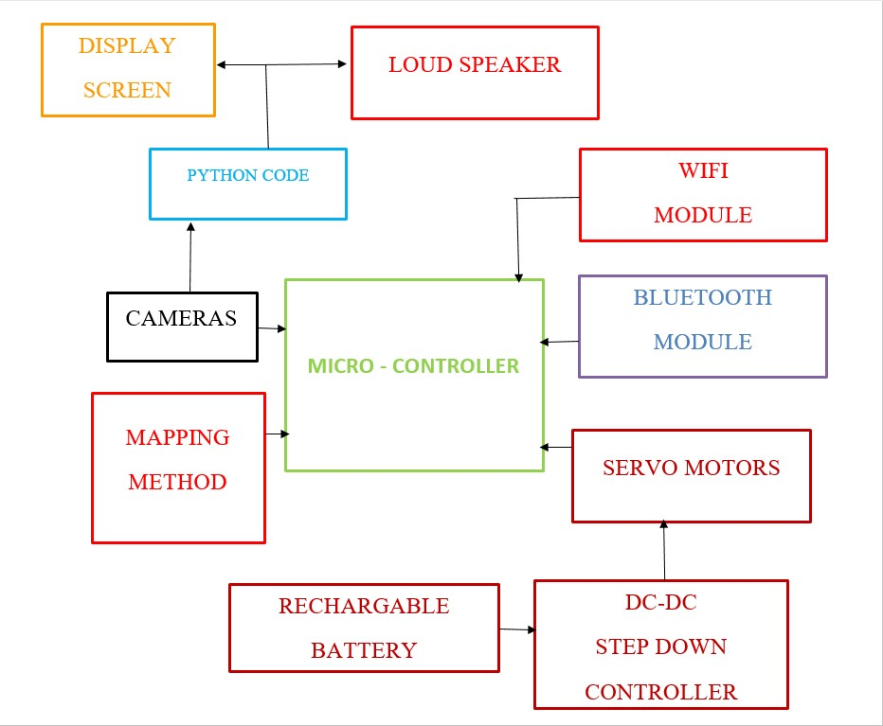
BLOCK DIAGRAM

Slide 10
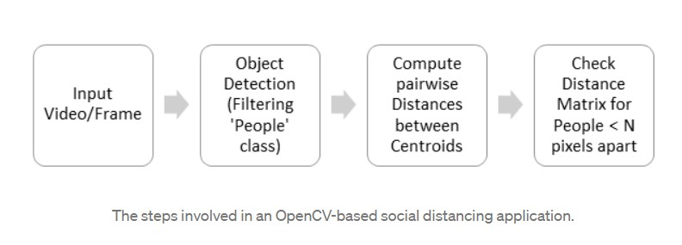
FLOW CHART

Slide 11
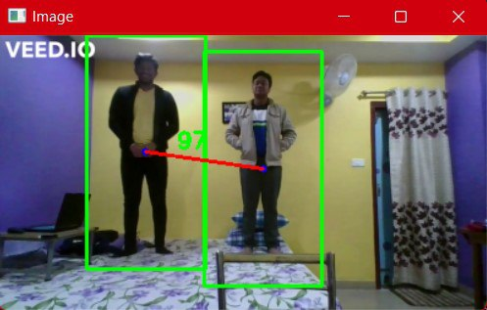
OUTCOMES

Slide 12
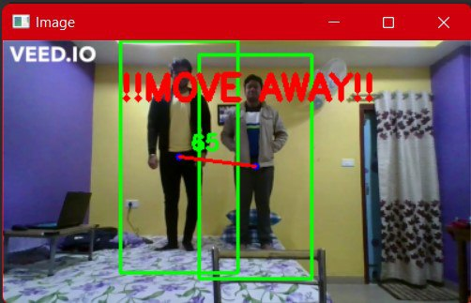

Slide 13
CONCLUSION
Living in a post covid world, no one knows for sure when another such type of disease will come. We can do nothing but take precautions and Robots are the way to do it.
Automation can be something on which we can rely on, as Robots would break the transmission chain of such type of diseases.

Slide 14
REFERENCES
GitHub Link -
https://www.geeksforgeeks.org/pedestrian-detection-using-opencv-python/
Youtube Link -
https://youtu.be/dDT6ZPNBl3c

Slide 15


