Slide 1

Grand Challenge Deconvolution entry using Open Source Components Integrated into the ImageJ2/ImgLib2 Framework
Brian Northan – True North Intelligent Algorithms

Slide 2
Introduction and motivation
Grand Challenge – Open source category
Software framework
  to easily take advantage of already existing open source deconvolution research.
  to enable comparisons of algorithm from different groups under the same conditions.

Slide 3
Outline
Algorithm Derivation
Open Source Tools
Results

Slide 4
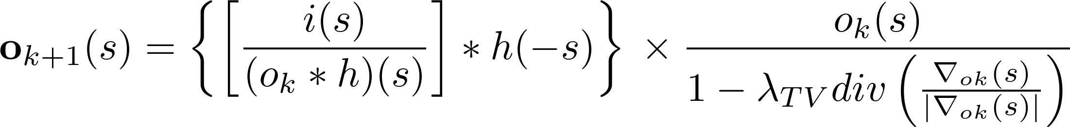
Non-circulant Total Variation Richardson Lucy
RLTV (Dey 2006)

Slide 5


Non circulant Total Variation Richardson Lucy
Assume a PSF of finite support
Treat the acquired image as a “windowed” measurement of a larger object.
Measurement Size
PSF Size
Potential object region

Slide 6
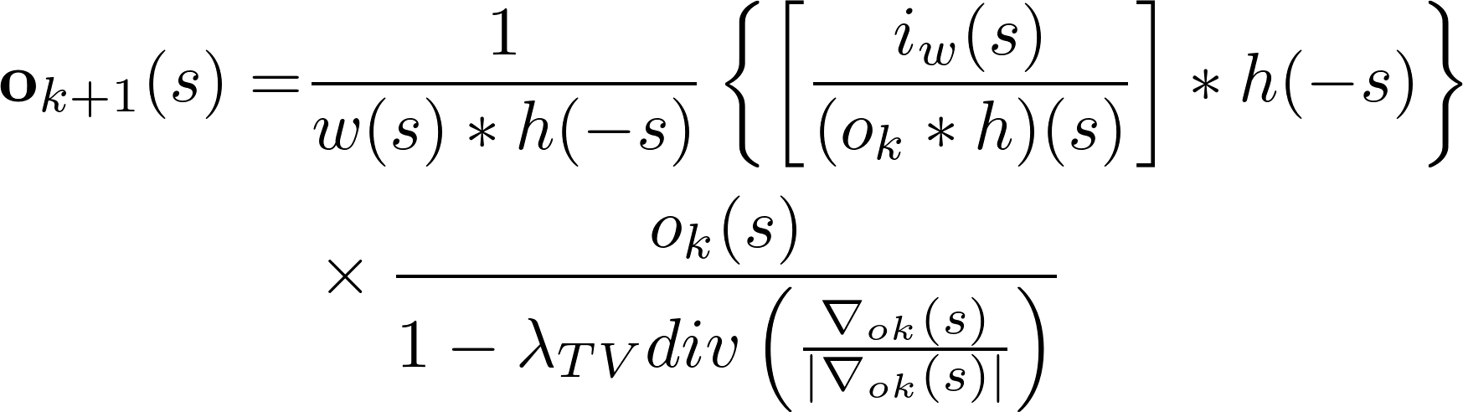
Non-circulant Total Variation Richardson Lucy

Slide 7
Why Open Source?
From opensource.com/open-source-way
  Learn more from each other when information is open
  We can solve problems that no one person may be able to solve on their own.
  Rapid prototyping
  Communities are formed around a common purpose.

Slide 8
Deconvolution Framework
A framework is needed to support deconvolution algorithms and related processing
  File IO
  Preprocessing
  Image Extension
  PSF Generation and Measurement
  Visualization
  Speed
    Algorithm acceleration
    Hardware acceleration (GPU)
  GUI

Slide 9
Tools used for implementation
7 code bases needed to complete challenge
  ImageJ2
  ImageLib2
  COSMOS
  IOCBIOS
  ITK
  Deconvolution Lab
  Octave

Slide 10
ImageJ2
ImageJ
  Public domain image processing program written in Java.
  Originally developed by NIH.
ImageJ2 – next generation
  Backwards Compatible
  Command Driven architecture
  Easier to handle ND datasets

Slide 11
Command/Ops
Unit of functionality defined by inputs and outputs
A framework processes inputs and outputs
  Automatic GUI Generation
  Scripting
  Visualization
  Persistence
    File IO keep track of results
Programmer doesn't have to do anything!

Slide 12
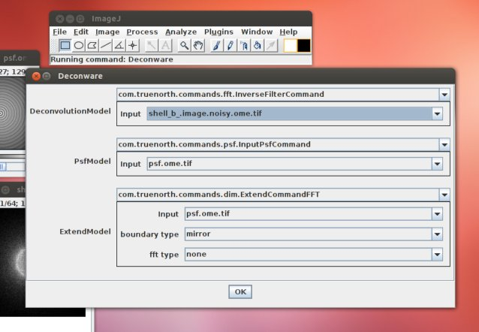
Command
Automatically Generated GUI

Slide 13
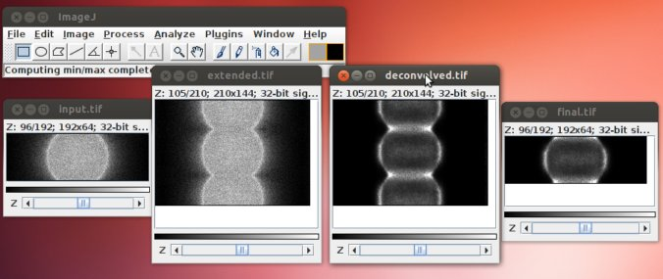
Commands
After running commands for reflection + deconvolution.

Slide 14
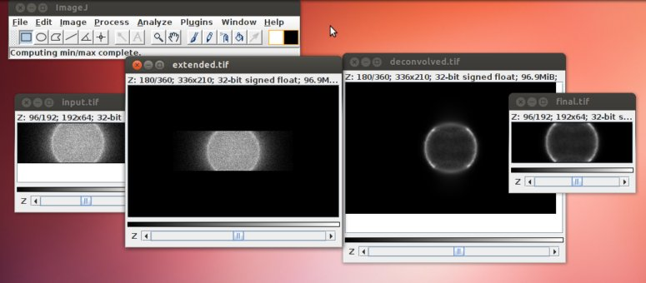
Commands
After running the commands for non-circulant deconvolution

Slide 15
ImgLib2
General Purpose ND image processing library
Java
Accessors
Templated
FFT – mines java toolkit
  90% as fast as fftw
  Could always wrap fftw with JNI if needed
Utilities to generate simulations

Slide 16
COSMOS
University of Memphis (Chysanthe Preza)
Computational Optical Sectioning Microscopy Open Source
C++ libraries for Deconvolution and PSF Generation.
PSFs used to generate simulations
Wrapped using JNI

Slide 17
IOCBIOS
Tallin University of Technology
Python Library
Used as template for Richardson Lucy Total Variation algorithm

Slide 18
ITK / Deconvolution Lab
Insight Toolkit
Deconvolution Lab
  EPFL
Used to double check and verify imglib2 implementations.

Slide 19
Octave
Open source version of Matlab
Needed to run various scripts and examples.

Slide 20
Alternatives to Imagej Ecosystem
Matlab?
Imaris Open?
ITK?

Slide 21
Components from Multiple Open Source Code Bases
ITK
Decon
Imglib2
ImageJ2
ITK
COSMOS
IOCBIOS
noncirculant
Octave

Slide 22
Results and Tests

Slide 23
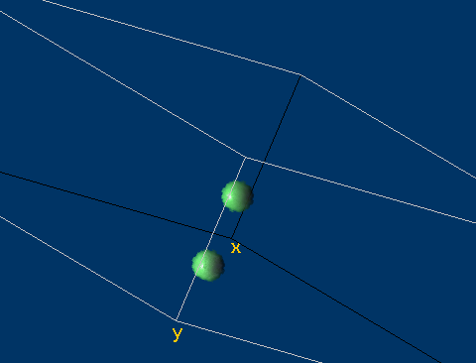
Test Object
2 Spheres 3D Space

Slide 24
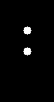
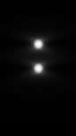

Convolution simulation

Slide 25
?
?

Slide 26
Restoration
Total Variation Richardson Lucy 200 iterations, 0.002 – 2 different boundary types
    Reflection
    Noncirculant
?
?

Slide 27
Result – mean gray level
 | Truth | Degraded | RL-Reflection | RL-Noncirculant
Center sphere | 100 | 4.25 | 84.4 | 87.8
Edge sphere | 100 | 4.25 | 73.5 | 89.9
Richardson Lucy noncirculant – bring us very close to the right answer.
Other factors that effect measurement
  Number of iterations
  Regularization

Slide 28
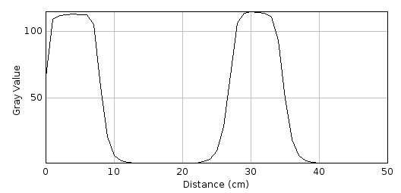
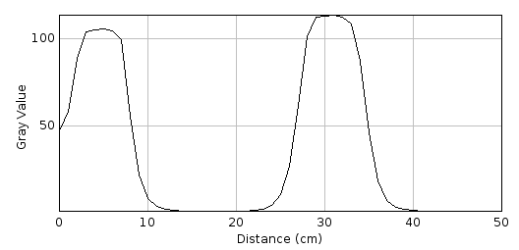
Z axis profile
RLTV non circulant boundaries
RLTV Reflection

Slide 29
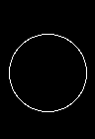
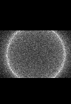
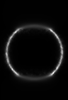
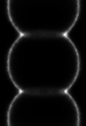
Non-circulant vs. reflection
Observation
Non-circulant
Deconvolution
Reflection and
Deconvolution

Slide 30
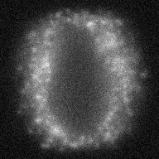
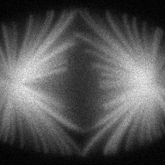
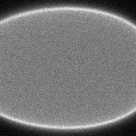
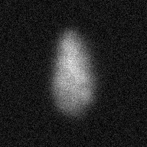
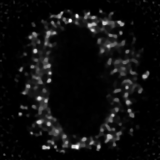
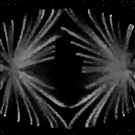
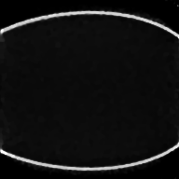
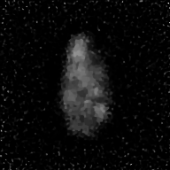
Final parameters for Challenge images
Rltv non-circulant algorithm
1000 iterations
λ = 0.0005

Slide 31
Future Work
IOCBIO
  Estimate regularization factor from images
Reconstruction error vs. PSF size experiments
  Fast FFT sizes
  Choose image size and PSF size to get power of 2?
Limitations of reconstruction outside of measurement window?

Slide 32
Future work
Iterations/Convergence
Aberrations
Noise and regularization
Variant blur models
Execution speed

Slide 33
Thank You
All code available on github.com/bnorthan/projects/

