Slide 1



Solidity Workshop (Part 1)
Mona Rassouli
Notes:
-Part one of a solidity workshop for teaching fundamentals of smart contract scripting for the ethereum network
-It will consist of a theoretical portion of about 25% and then 75% technical and hands on

Slide 2



Introduction
1) What is the purpose of this talk?
2) What will not be covered?
3) DYOR

Slide 3
Introduction
1)To Learn and understand Solidity programming language and by extension how to code smart contracts.
2) We will not cover investment advice or concepts that are covered in academia such as advanced cryptography or consensus mechanisms.
3) Do Your Own Research – Which of course applies to anything in DeFi (Decentralized finance) and Traditional finance
Notes:
For example: We will not go into a deep dive of blockchain details or argue benefits of proof of work vs proof of stake
Will not delve into elliptic curve signatures, although if interested I certainly can arrange for it in future workshops
I will post a link out for everyone to provide feedback, it’s totally anonymous and will just help me prepare for future workshops

Slide 4
Disclaimer
Nothing presented in this talks serves as an endorsement or investment advice towards any project or digital currency or technology.
Everything presented is exclusively for learning purposes.
Please trade or invest in cryptocurrency at your own risk and kindly bear the concept of DYOR in mind.
Notes:
-Later in the talk as an example I may mention specific projects
-To be clear this is not to endorse that project and I have no affiliation with any specific projects
-This is just an area I am passionate about and that I wanted to share with my peers on engineering day

Slide 5

Ethereum
Differences from Bitcoin -> why Ethereum?
The World Computer
Turing Complete
ERC-compliant tokens + projects
Backbone of modern Defi
Ethereum (ETH) is actually a Hard-Fork of Ethereum Cash (ETC)
Early in its history the network was hit with DDoS attacks necessitating the fork
Notes:
-The prerequisite to understanding solidity is to know, understand, and have familiarity with Ethereum
First came bitcoin, then came ethereum followed by an explosion of many different altcoins (alternative coins)
So Why Ethereum?
-Bitcoin is closer to a giant immutable database, with slow transaction wait time and smaller block sizes
-What Ethereum brings to the table is the ability to execute logic on chain, not just solely a means for txns storing
-It provides an infrastructure layer, and a means for interoperability between projects ->provided they follow ERC compatibility
This is why it’s vision statement was originally to be the world computer, it wants to be Web3.0 it wants and the base level on which other projects are built.
In essence it has achieved this vision statement and become the backbone of modern defi currently.
Security
-Turing complete means wide attack vector
-On Bitcoin it actually has become possible to code smart contracts and it’s actually more secure, however not quite so practical

Slide 6

Network Operations
High Level Overview:
1) User wishes to make a Txn of some form
2) In order to execute the txn, a gas fee is supplied to keep network honest
3) Txn is included in a block with many other transactions.
4) A miners picks up the block and adds it to the chain
The block does include other information (ex: txn hash of previous block, Merkle Patricia Tree, etc)
-> Won’t go deeper into this in this discussion
Notes:
Additional comments:
-blockchain -> saving to the chain and cannot rollback the txn because it is decentralized and immutable
-purpose of gas fee is to eliminate DDoS attacks. Becomes increasingly expensive for hackers to attempt to exploit or spam the network
-Linked some sources in the resource section, but also whenever I release the slides there are also good references in the footnotes of certain slides

Slide 7
Address Types
Smart Contracts
Users
0x4B20993Bc481177ec7E8f571ceCaE8A9e22C02db
0xAb8483F64d9C6d1EcF9b849Ae677dD3315835cb2
Notes:
-Two Address types in the network
-They can interact with other smart contracts and users
-Users-> “Externally owned accounts” -> which is from perspective of the network

Slide 8
Smart Contracts
Smart Contracts are pieces of executable logic on the blockchain.
Notes:
-They can interact with other smart contracts and users
-Similar to service + controller classes and just the idea of classes in general in java and spring boot framework to draw direct analogy to our day-to-day operations
-Once it is deployed the contract is immutable -> if want to modify logic must deploy a separate contract
-This is why testing the deployment and functionality on the test network is pivotal

Slide 9
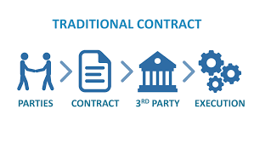
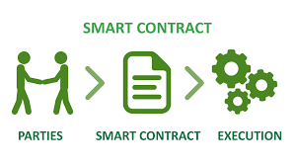
Smart Contracts
Notes:
-Decentralized network therefore NO middle man is necessary -> cross out the third party
-Make it possible to have a self sufficient network without the intervention of central institutions of governments
-This concludes the prerequisite fundamentals that we needed to discuss at a bare minimum

Slide 10
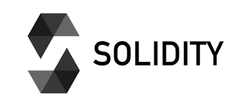

Smart Contract Languages
Solidity => JavaScript-like
Serpent => Python-like, no longer safe to use
Vyper => Python-like, with security features built in
Notes:
-IMO solidity is the best, but I don’t have much experience with vyper personally
-Solidity has a java, javascript, and C programming feel to it from my experience. I will demonstrate this as we proceed further, but memory management is incorporated to a certain extent

Slide 11
Solidity
Statically Typed language
Has similarities to Java:
Contracts are essentially classes
Inheritance between contracts
Encapsulation
Constructors
Global/local variables
But also, differences:
Syntax and some of the types
Modifiers
Events and exception handling
Notes:
-Just to share, events + exceptions are what truly allow for communication between the front and the back end.

Slide 12

Remix
Flow of what we will be doing is:
We will write the smart contract in solidity
Deploy to a test-network
Remix is a browser based solidity IDE
Plugin architecture, written in JS
Allows you to write solidity smart contracts straight from browser
Including testing, debugging, and deployment
It is essentially a sandboxed blockchain
Notes:
-When you go to refresh the page a new blockchain is actually created each time

Slide 13
Remix
Hello World Time
Navigate to:
https://remix.ethereum.org/
Notes:
-Going forward this demo will flow in the following way: I will show some remix code and then go back to the slides to explain fundamentals as needed
-The back and forth is to prevent boredom and to allow mental breaks

Slide 14
Questions?
Feel free to drop in chat as time goes on as well.
I can cover them at appropriate pauses.

Slide 15

Solidity Fundamentals
< Let’s do this pragmatically >

Slide 16
Argument Passing
Passing arguments in a solidity function:
1) Value: compiler creates a new copy of the param’s value and passes it to your function, while the original parameter’s value is the SAME
2) Reference: With reference to the original variable, original parameter is CHANGED

Slide 17
Argument Passing
Notes:
-reference fills both cups
-value fills just the copy

Slide 18
Argument Passing
Notes:
-Same slide just including for when I share the slides bc animation won’t work from previous slide in pdf format of course

Slide 19
Variable Types-[Value Types]
bool
uint-> usigned integer (positive values only)
uint8, uint16, … uint256
int
Int8, int16, … int256
Address
Refers to hash address
fixed
unfixed
Notes:
Uint and int are based on number of bits
-by using just uint or int declaration it defaults to 256 bits, which is what we will be using
-Uint = unsigned integer
-Solidity has uint which is for a variable that you only want to have positive values
-Now fixed and unfixed can be declared but solidity doesn’t really support them. I will also not cover them in this workshop, but I am including for sake of completion

Slide 20
Function Signature -> Java
public String helloWorld(type params) {
return stringValue;
}

Slide 21
Function Signature-> Solidity
function helloWorld() public pure returns (string memory) {
. . . .
}
Notes:
-We have to use PURE => Because we are not reading AND not modifying any data

Slide 22
Bank Account
< Let’s do this pragmatically >
Notes:
import "github.com/provable-things/ethereum-api/blob/master/oraclizeAPI_0.5.sol";
contract BankAccount is usingOraclize {

Slide 23
Variable Types-[Reference Types]
Arrays
Structs
Mappings
Strings
For these types must specify the location where it is stored:
1) memory -> temporary, erased outside of scope of method
2) storage ->permanently on blockchain (just like state variables)
3) calldata ->special data location
Notes:
I have grouped the reference types together on this slide.
We will not go over calldata in this presentation, but just know that it exists and usually house external function parameters
Comment on memory: cheaper and for more fixed size type variables, meanwhile storage is for dynamic types and is variable
Can create memory arrays for example, but it would be fixed size. This is why for reference types storage is default memory location

Slide 24
State Variables/Local
Equivalent of global variables in Java
Declared at the top of smart contract and are permanently stored to the blockchain
In other words, it is implied that they are stored in storage
Local variables are restricted to the method in which they are declared/passed in
By default, they are in memory …
…Unless they are of complex data type like arrays/structs which default to storage
Notes:
Another example of a local variable is of course a function parameter.
The variable type will supersede what it’s default memory location is

Slide 25
Encapsulation/Memory
Of course, Public and Private
Two modes for functions:
1) External -> public and only can be called from outside function
2) Internal -> same as private but also accessible to contracts that inherit it
For Java developers, Internal = Protected
Notes:
-I will cover External/Internal examples in future workshops, it wasn’t necessary for the contracts we are coding in this one.

Slide 26
View/Pure Functions
View
Only want to look at data and not change state or modify
Simply return data unchanged from function
Pure
Not even accessing data from the app
Think of a lambda function
No side effects
Ex: function just multiplies two inputs and returns every time it is called
Notes:
-since they do not cause any state changes there is no GAS FEE!

Slide 27
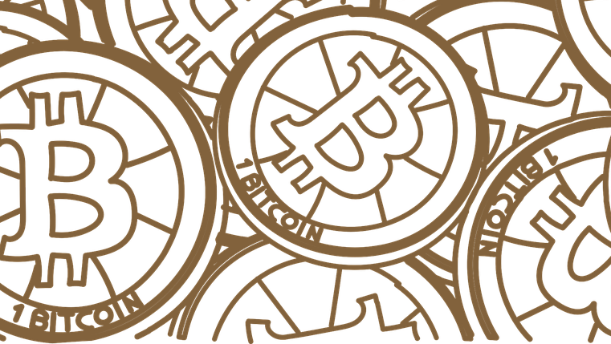
Staking
Simply put, providing tokens/collateral to smart contracts to earn rewards

Slide 28
Staking Walkthrough
Staking: DeFi concept where collateral is provided to a pool for a designated period of time while an APY is applied to it to generate a profit
Can be locked or unlocked
Formulas and percentages vary
Collateral and types of staking vary
All the code I wrote from scratch, and I tailored it for our learning purposes.
More secure practices will be covered in future workshops

Slide 29
Staking Walkthrough
Our staking contract will be a modification of that which the Ferrum Network uses currently. Please see article in the footnote.
Rules/Formula we are going to follow:
APY is 20%
Duration is 90 days
The value of our imaginary token is 0.035 per token at the moment
Assuming a 1:1 ratio of stake coin value to actual value
Conclusion: We will earn rewards every 90 days

Slide 30
Last Minute Questions?
Burning thoughts? Feedback for me? Was this a cool workshop?
Notes:
http://www.polljunkie.com/poll/qemidp/solidity-workshop

Slide 31
Feedback
Kindly respond to a feedback form I will be sending.
This will aid me in preparing and fine-tuning future workshops so that everyone may benefit as much as possible ☺
Notes:
http://www.polljunkie.com/poll/qemidp/solidity-workshop

Slide 32
Resources
https://www.quicknode.com/guides/solidity/what-is-an-abi
https://docs.soliditylang.org/en/v0.6.2/index.html
Latest version of solidity is v0.8.x but lower versions more stable
https://ethereum.org/en/
https://remix.ethereum.org/
https://remix-ide.readthedocs.io/en/latest/#

