Slide 1
IT Course Viewer
Mikael Ylivaara / Roni Hänninen / Jan Lindholm

Slide 2
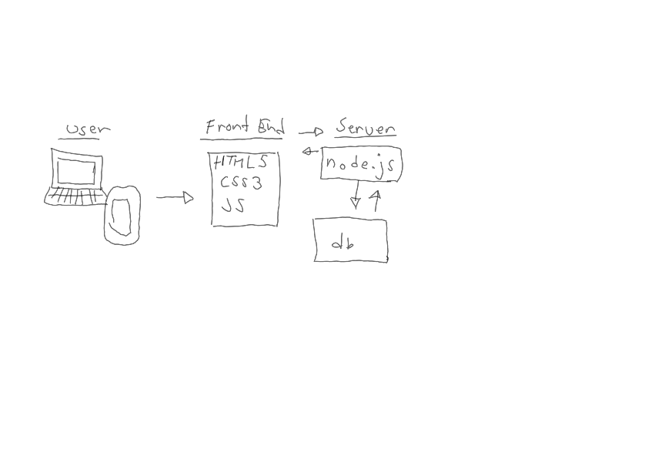

Slide 3
Crew
Mikael Ylivaara (Database, Back End -specialist)
Roni Hänninen (HTML5, CSS3 -specialist)
Jan Lindholm (HTML5, CSS3, JavaScript -specialist)

Slide 4
Techinques
HTML5, CSS3 and JavaScript
Node.js
Database

Slide 5
Front End - Challenges
Responsive tables
DOM is difficult
CSS3 collissions
REST-API

Slide 6
Back End - Challenges
Database
REST API

Slide 7
Loop through all .json -objects
var children = [ { "opinto_id": 1, "Period_name": "Älykkäät IoT-laitteet", "course_name": "Digitaalitekniikka" }, { "opinto_id": 1, "Period_name": "Älykkäät IoT-laitteet", "course_name": "Matematiikka" }, ]

Slide 8
`<section>
<div class="wrapper">
<div class="inner">
<input type="checkbox" id="toggle${i}">
<label for="toggle${i}">Click me for -
${child.course_name}</label>
<div class="content">
<h1>${child.course_name}</h1>
<p><img src="" width="200" height="200">${child.teacher_name}</p>
<p>${child.course_info}... Some information to be hidden along with this div.</p>
</div>
</section>`

Slide 9
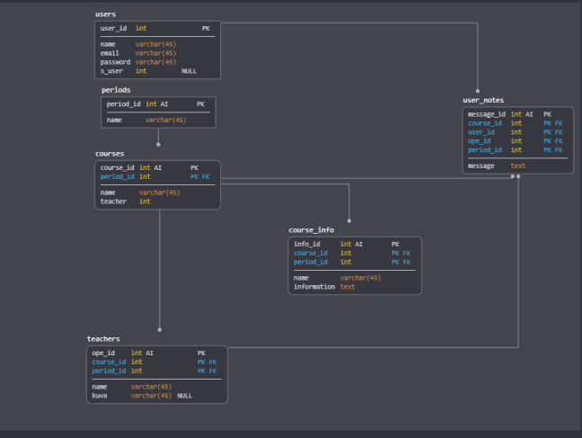

Slide 10
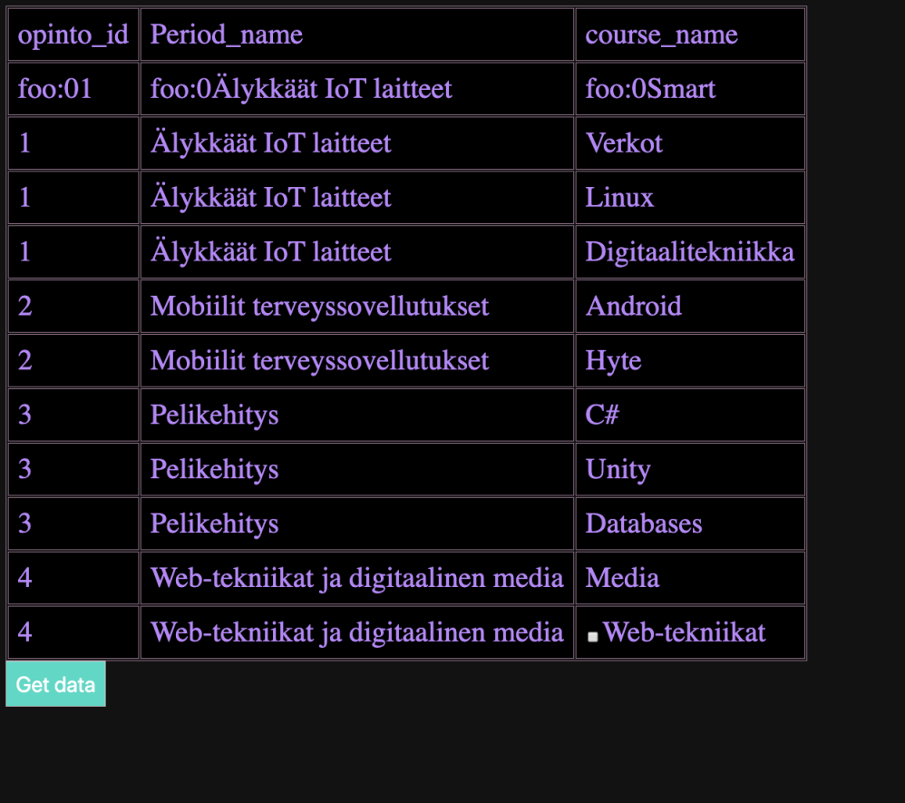

Slide 11
