Slide 1
Exploring Legal Change in Police Misconduct Cases
Presenter: Ryan Leung
hleung@uchicago.edu
March 7th, 2024

Slide 2
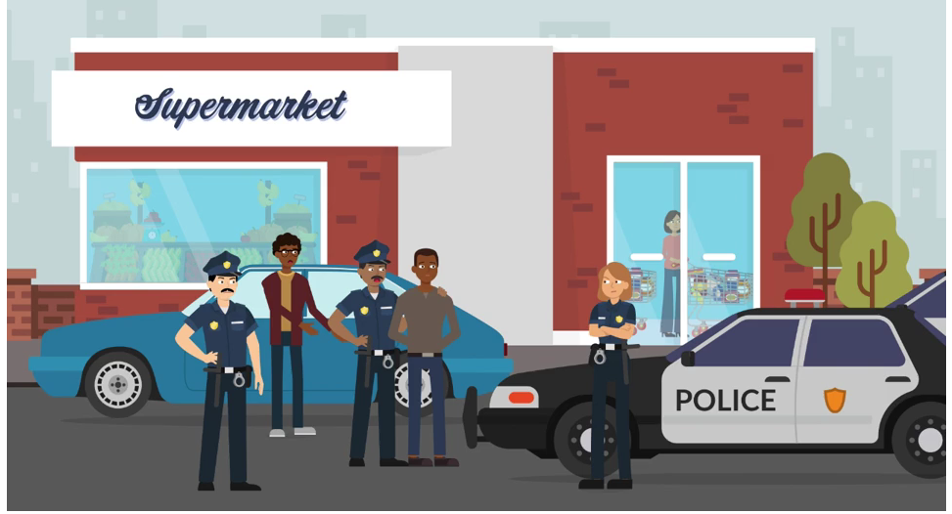
Research Background
Who watches the watchmen?
How do the administrative law curtailing law enforcement behavior evolve in the U.S. legal system?

Slide 3
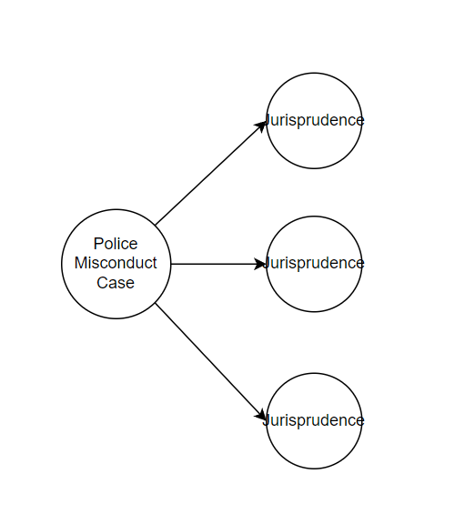
Research Background
Research Question:
What topics of law is invoked in the legal discussion? Can we extract patterns of legal change from actor sides?
Judge Side: Citations
Lawyer Side: Motions

Slide 4
Research Background
Research Question:
What topics of law is invoked in the legal discussion? Can we extract patterns of legal change from actor sides?
Judge Side: Citations
Lawyer Side: Motions

Slide 5
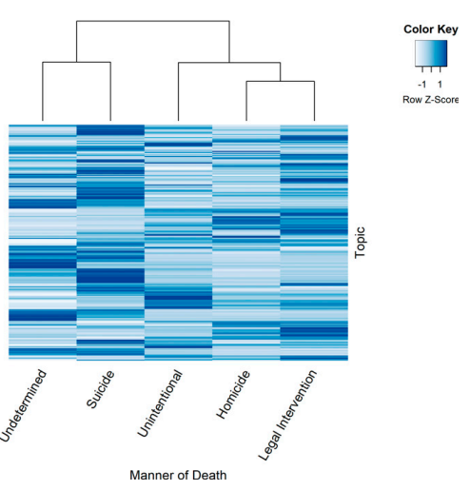
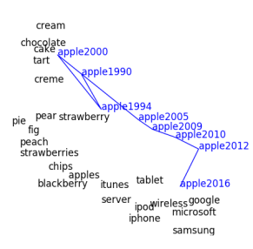
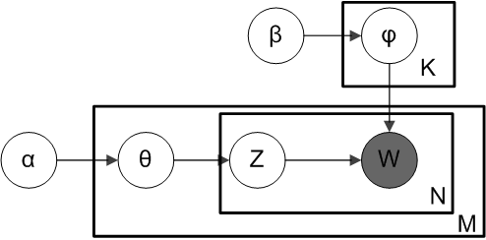
Methodology Roadmap
Topic Modeling
Discourse Atom
Dynamic Word2Vec

Slide 6
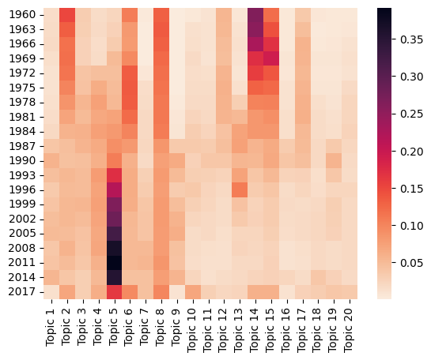
1. Topic Modeling of Cited Cases
Criminal Procedure
Topic 14: Arrest/Warrant
Topic 15: Criminal Cases
Topic 6: Search
Admin Law:
Topic 5: Admin Law / Civil Rights

Slide 7
1. Topic Modeling of Cited Cases
Criminal Procedure
Topic 14: Arrest/Warrant
Topic 15: Criminal Cases
Topic 6: Search
Admin Law:
Topic 5: Admin Law / Civil Rights

Slide 8
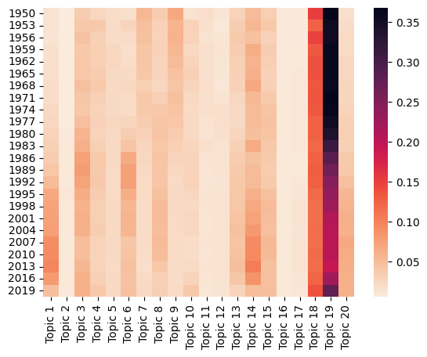
1. Topic Modeling of Cited Cases
Constitution
Topic 1: Con Rights
Topic 14: Interpretation
Criminal Law:
Topic 3: Jury Trial
Context of Case:
Topic 18, 19: Criminal Procedure

Slide 9
1. Topic Modeling of Cited Cases
Constitution
Topic 1: Con Rights
Topic 14: Interpretation
Criminal Law:
Topic 3: Jury Trial
Context of Case:
Topic 18, 19: Criminal Procedure

Slide 10
2. Discourse Atoms
Police/Custody
police
noncustodial
custody
warrant
arrest
Mens Rea
promptness
nature
truthfulness
motive
falsehood
14th Amend.
fourteenth
fourthteenth_amendment
section_1983
Section_1985
cause_of_action
Deadly Force
shoot
gun
flee
unarmed
deadly_force
fire
Unlawful
illegal
malicious
unlawful
conspire
civil_right

Slide 11
2. Discourse Atoms
Police/Custody
police
noncustodial
custody
warrant
arrest
Mens Rea
promptness
nature
truthfulness
motive
falsehood
14th Amend.
fourteenth
fourthteenth_amendment
section_1983
Section_1985
cause_of_action
Deadly Force
shoot
gun
flee
unarmed
deadly_force
fire
Unlawful
illegal
malicious
unlawful
conspire
civil_right

Slide 12
2. Discourse Atoms
Police/Custody
police
noncustodial
custody
warrant
arrest
Mens Rea
promptness
nature
truthfulness
motive
falsehood
14th Amend.
fourteenth
fourthteenth_amendment
section_1983
Section_1985
cause_of_action
Deadly Force
shoot
gun
flee
unarmed
deadly_force
fire
Unlawful
illegal
malicious
unlawful
conspire
civil_right

Slide 13
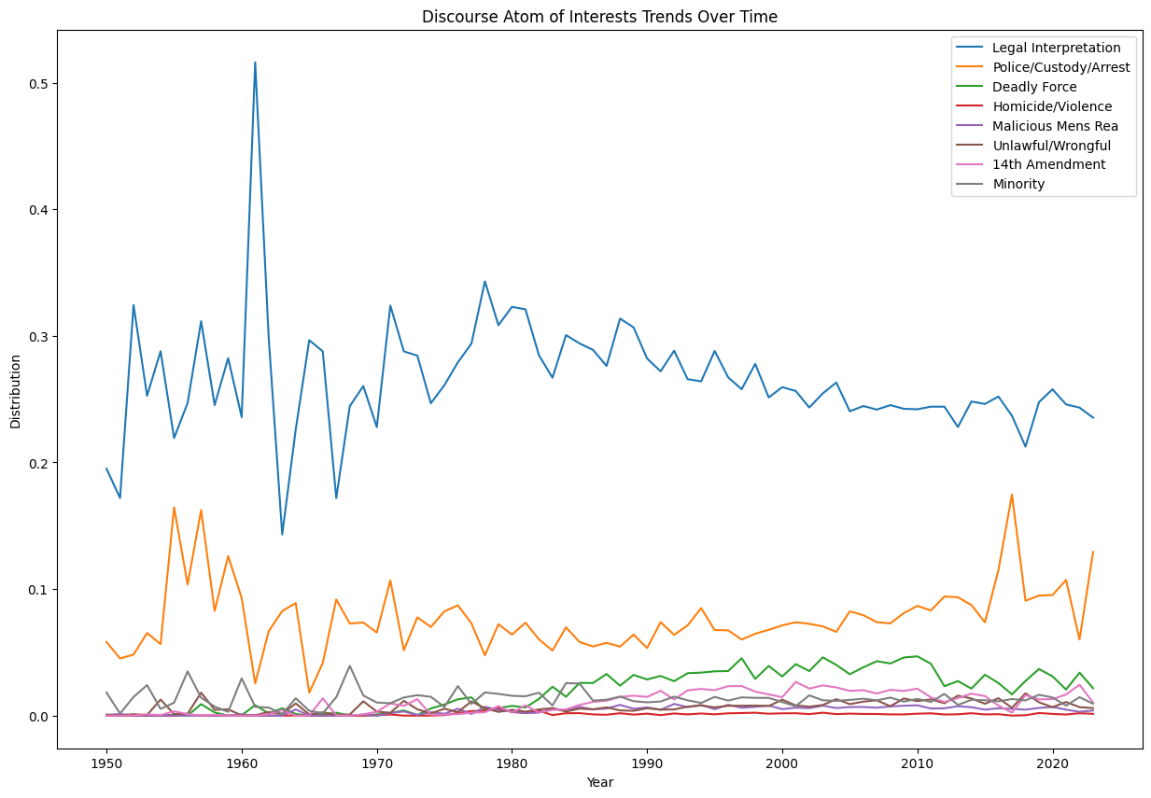
2. Discourse Atoms

Slide 14
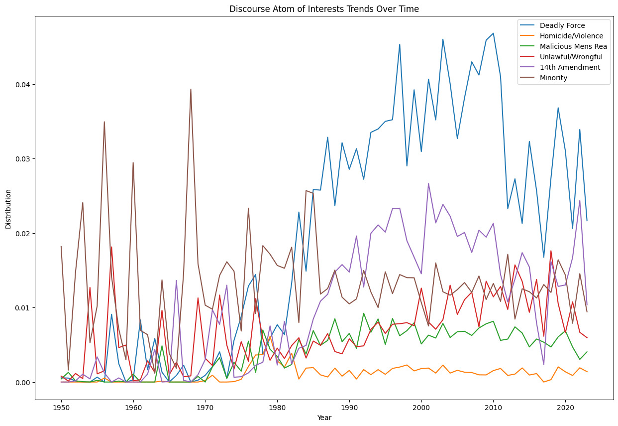
2. Discourse Atoms

Slide 15
2. Discourse Atoms

Slide 16
3. Dynamic Word2Vec
Using Skipgram after comparison on full data
Window size: 25 (Paragraph coverage)
Only use bigram preprocessing
Focal Words: ‘motion', ‘claim’,
Encore Words: 'due_process', 'excessive_force', '1983', 'fourth_amendment', 'fourteenth_amendment', 'fifth_amendment','arrest', 'civil_right'

Slide 17
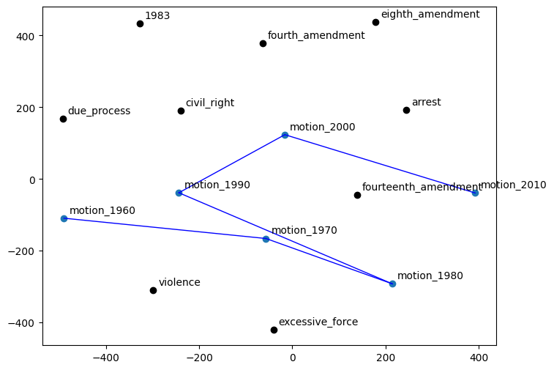
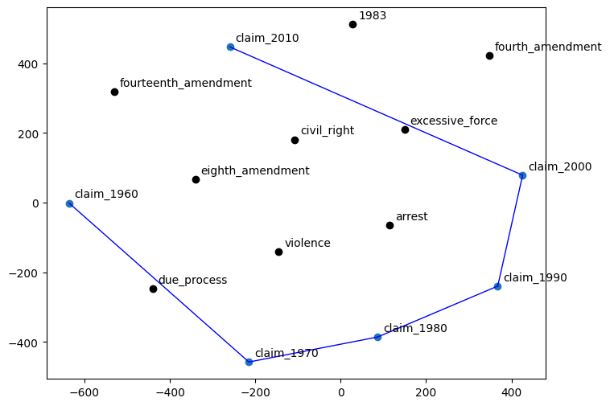
3. Dynamic Word2Vec

Slide 18
3. Dynamic Word2Vec

Slide 19
3. Dynamic Word2Vec

Slide 20
Summary
All three methods show similar pattern of change!
Police Misconduct cases gain their “case identity” with changes in social and legal background in the late 1980s
Understanding the legal context: should use word embeddings within certain stable procedural words
Tracing the change of context word around focal words as motion and claim

