Slide 1


AviateX
Internship Project Review
Dedeepya Yakkala
24CS0169
Computer Science Engineering
dedeepyayakkala.cse2024@citchennai.net

Slide 2
Introduction
Gaming systems today are rapidly evolving, offering more immersive and interactive experiences than ever before. With the integration of hardware sensors like accelerometers, games can respond to natural physical movements, enabling intuitive and engaging control mechanisms. This project explores such innovation by combining real-time accelerometer input from an external device with 3D graphics rendered using the Ursina game engine. The result is a dynamic, tilt-controlled airplane game where players navigate the skies through hand gestures, creating a realistic and enjoyable gameplay experience that bridges physical motion with digital action.

Slide 3
Problem Statement
Traditional computer games primarily rely on keyboard and mouse inputs, which can be restrictive and less engaging. While gesture-based games are popular on mobile platforms, they are rarely seen in PC environments, especially ones that involve integration with external hardware. Furthermore, existing setups that use motion control tend to be expensive or complex to implement. There is a growing need for an affordable and accessible system that uses real-world movements, such as tilting, to control gameplay in a way that is both fun and intuitive.

Slide 4
Existing / Current Solution
Currently, most games use standard digital input devices like keyboards, mice, or game controllers. While motion-based controls exist, they are generally limited to high-end consoles or mobile devices. Few open-source solutions allow the integration of external sensors like accelerometers into a PC game environment. Moreover, there is limited support for using microcontroller sensor data in PC games using Python, making it challenging for hobbyists or students to create immersive, sensor-controlled 3D games.

Slide 5
Proposed Solution
The proposed solution is to develop a PC-based 3D airplane game that utilizes real-time accelerometer data for control. Using Python and the Ursina game engine, the game reads tilt data from an external microcontroller via serial communication. This data controls the airplane’s movement and rotation in real-time, creating a seamless connection between the player's hand gestures and the in-game response. The game includes features such as obstacle spawning, collision detection, scoring, and a dynamic camera system, all driven by physical movement.

Slide 6
Proposed System Architecture / Block Diagram
The system is composed of an accelerometer sensor connected to a microcontroller, which reads tilt values along the x and y axes. These values are transmitted over a serial connection to the computer. A Python script with a background thread listens for incoming data, parses it, and updates global variables in real time. The Ursina game engine uses this data to control the airplane’s position and tilt within the 3D environment. The game also includes logic for generating obstacles (birds), tracking score, and displaying a game over screen when collisions occur.

Slide 7
Block Diagram Explanation
ACCELEROMETER SENSOR
(Microcontroller)
URISANA GAME ENGINE
(3D Rendering)
Score & Game
UI Display
PYTHON SCRIPT-READS
x,y data
Plane Control + Camera + Obstacle Logic

Slide 8
Tools and Technologies Use
The project was built using Python, a versatile and widely-used programming language.
For 3D rendering and game mechanics, the Ursina game engine was used due to its simplicity and
Python integration. Real-time sensor data was received using the pyserial library for serial communication.
The accelerometer used was MPU6050 or an equivalent, interfaced with a microcontroller such as RBoard
or ESP32. Python’s threading module enabled background reading of sensor
data without interrupting the game loop, ensuring smooth gameplay.

Slide 9
Implementation
Real-time accelerometer values are read via serial communication.
A background thread constantly updates accelerometer variables.
The airplane model in Ursina responds to tilt by moving and rotating smoothly.
Birds (obstacles) are randomly spawned and move toward the player.
If the plane collides with a bird, the game ends.
Score increases as birds are successfully passed.

Slide 10
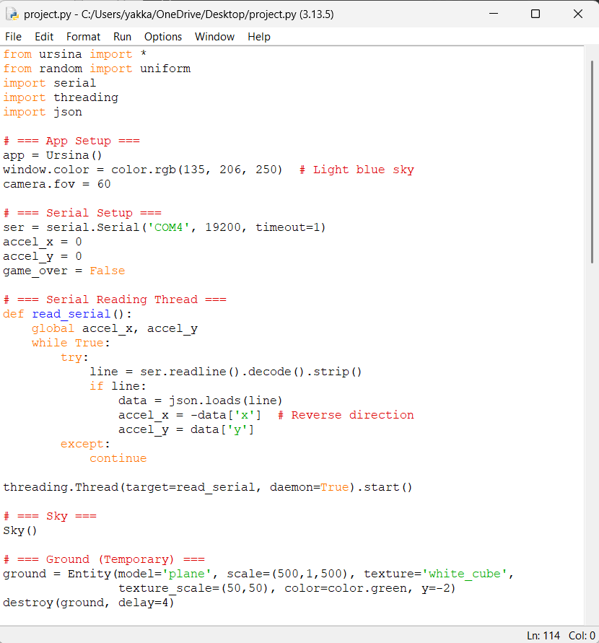
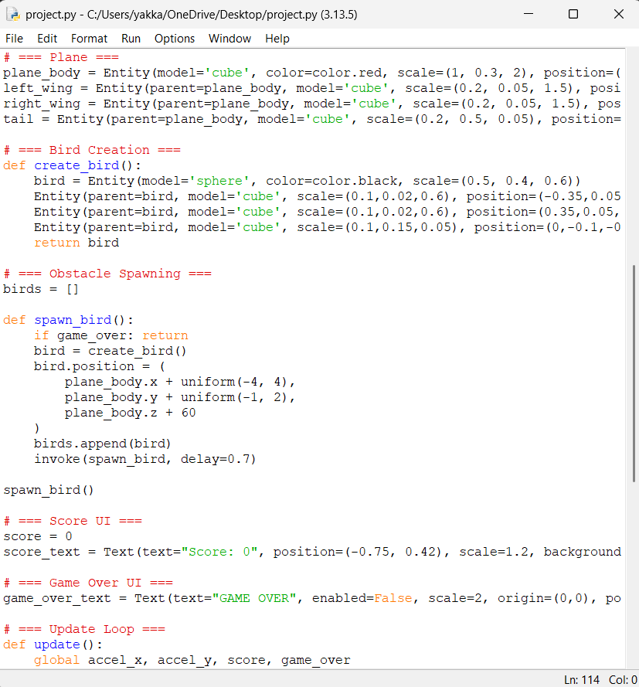
Implementation

Slide 11
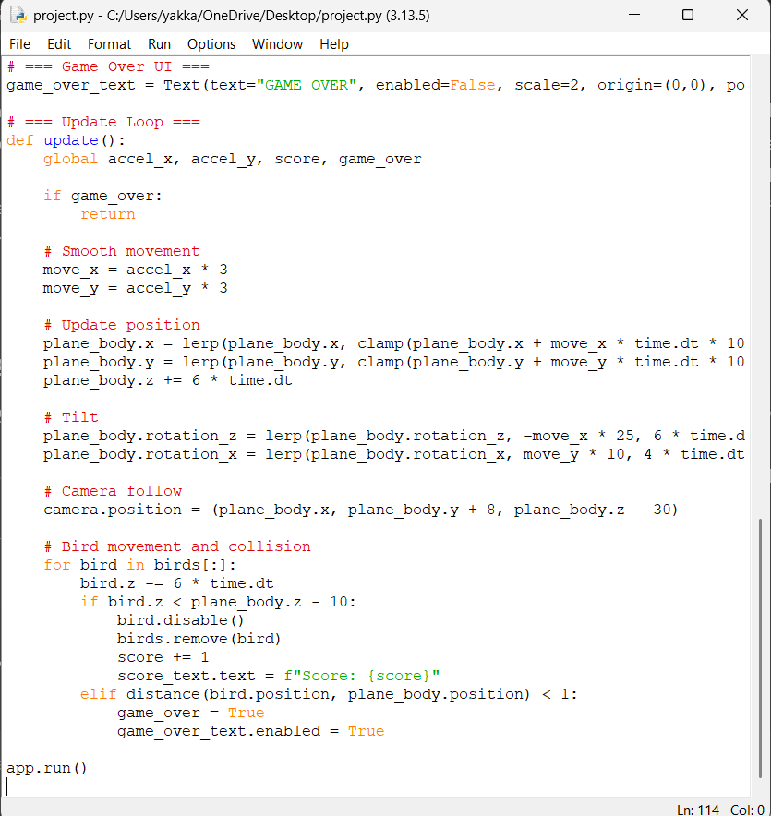
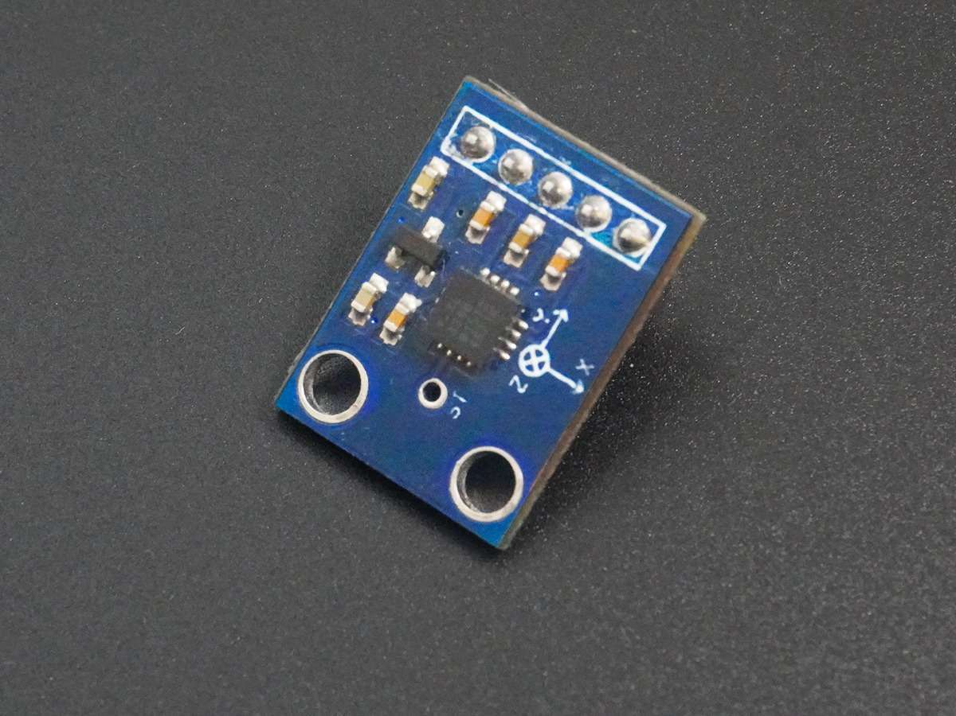
Implementation

Slide 12
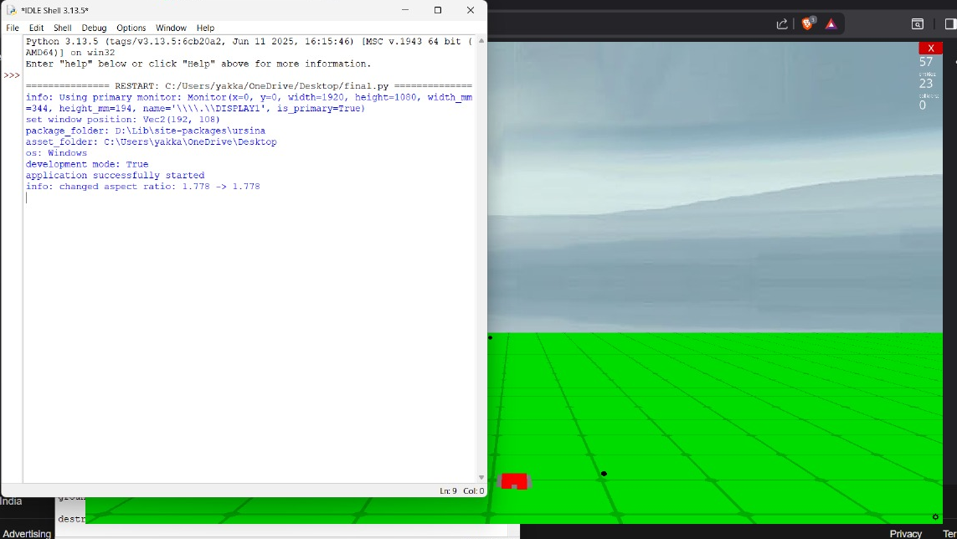
Results / Output

Slide 13
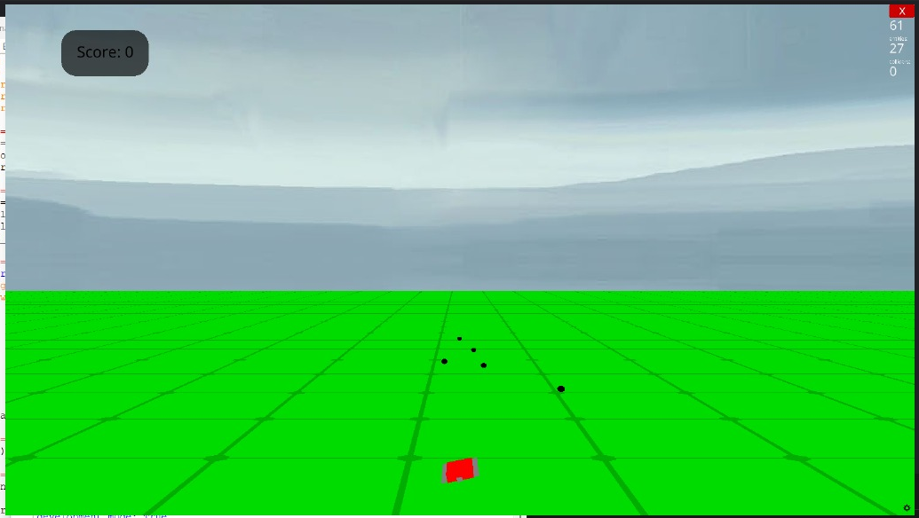
Results / Output

Slide 14
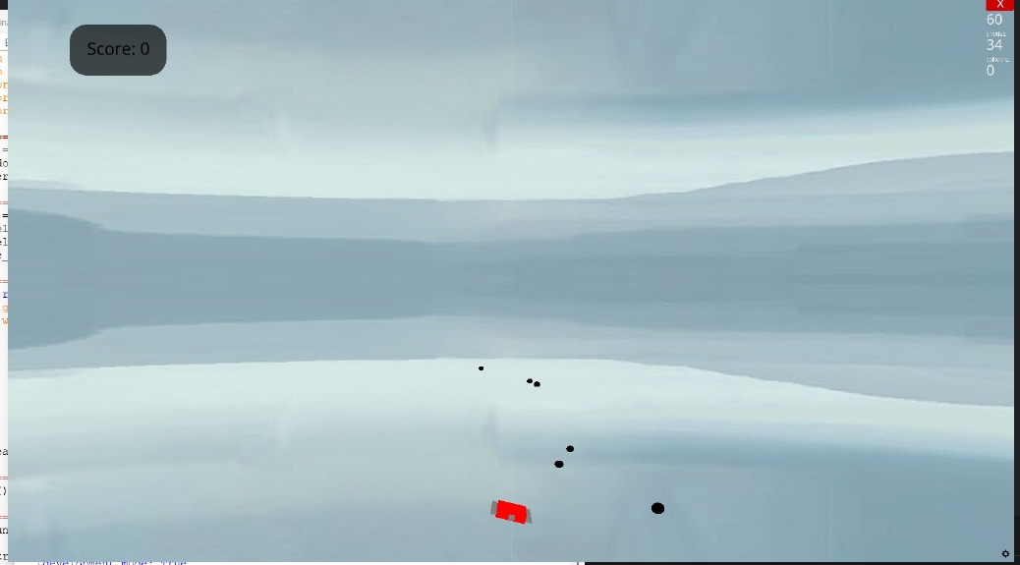
Results / Output

Slide 15
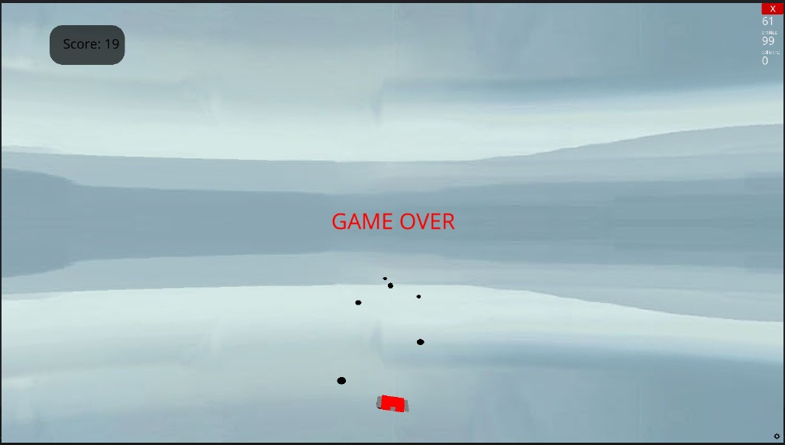
Results / Output

Slide 16
Learning Outcomes
Technical Skills:
Integrated MPU6050 accelerometer with Python via serial communication
Developed a complete game using Urisana
Real-time sensor data parsing & movement control
Hands-on experience with hardware-software interaction
Soft Skills:
Problem solving & creative thinking in game logic
Debugging real-world sensor input issues
Improved patience and persistence during development
Enhanced technical presentation and explanation skills

Slide 17
Future Scope / Improvements
Replace simple airplane model with a high-quality animated 3D model.
Add sound effects, background music, and particle effects.
Include levels, missions, and a scoring leaderboard.
Add weather effects like clouds, wind, or rain.
Support multiplayer or competitive mode with network integration.
Optimize for cross-platform deployment (Windows, Linux, macOS).

Slide 18
Conclusion
Built an engaging game using real-world motion data.
Demonstrated effective use of Python and Ursina for 3D game development.
Project bridges the gap between hardware and interactive 3D applications.

Slide 19
Thank You

