Slide 1
SHRI VISHNU ENGINEERING COLLEGE FOR WOMEN (AUTONOMOUS)
II B - Tech, II - Semester
MI NI PROJ ECT - Review 4
BATCH - C01
CourierMitra
- Web Application
PRESENTED BY :
P. DEDEEPYA
T. SAI ROSHINI
P. V. LAHARI
T. MAHA LAKSHMI
T. SAI VINEELA
- 19B01A05D0
19B01A05H6
19B01A05F6
19B01A05G5
20B05A0518
Guided by : Dr.V.V.R.Maheswara Rao

Slide 2


PROBLEM STATEMENT :
To design a website, for providing loss less courier service as well as class hours for the students.
To deal with the issues faced by students regarding couriers.

Slide 3


OBJECTIVES OF THE PROJECT :
Our Website is designed in such a way that the users can provide the entire details of their couriers in this website.
Firstly, the student should provide the complete details of his/ her courier in the CourierMitra Website.
The details of the couriers are maintained by the Admin, and checks the status of courier and updates to the user through provided mail.

Slide 4
REQUIREMENT ANALYSIS :
Hardware Requirements :
Processor : 1.9 GHz 64-Bit Dual Core Processor
RAM : 2 GB
Space on Hard Disk : 40 GB
Display : Resolution of 1024×768
Software Requirements :
Front-end
HTML
CSS
JAVA SCRIPT
Back-end
PHP
MySQL

Slide 5


PROJECT MODULES :
User Module
Admin Module

Slide 6


ADMIN MODULE :
Login to the site
View the List of Students
Update status of the product received
Maintain database of users
5. Logout from the site

Slide 7

USER MODULE :
Students are users in this system.
1. Create an Account
Login to the site
Provide Courier details
Logs out from the site
Frequently check whether the courier is arrived or not

Slide 8

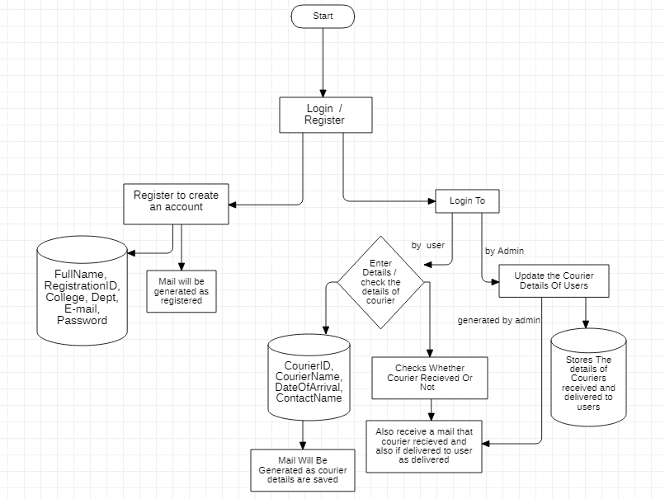

SYSTEM DESIGN:
System Architecture

Slide 9
Data Flow Diagrams :
There are various diagrams for designing a software.
Use Case Diagram
Class Diagram
Activity Diagram
Sequence Diagram
State chart Diagram

Slide 10
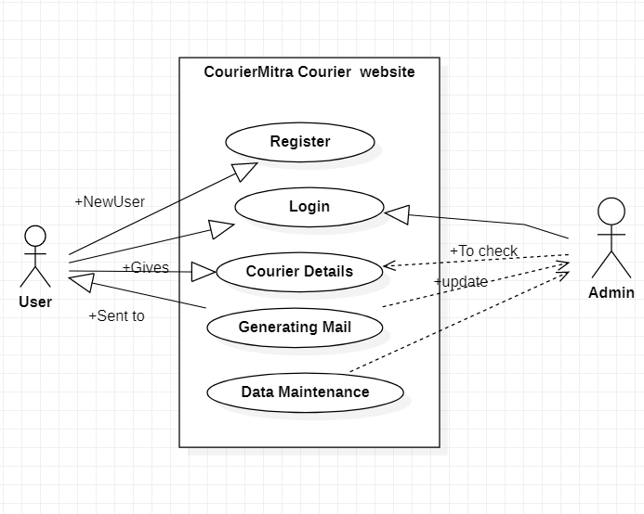
Use Case Diagram :

Slide 11
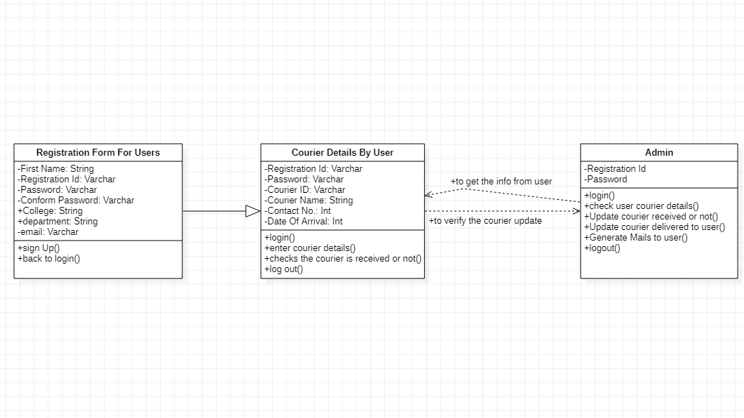
Class Diagram :

Slide 12
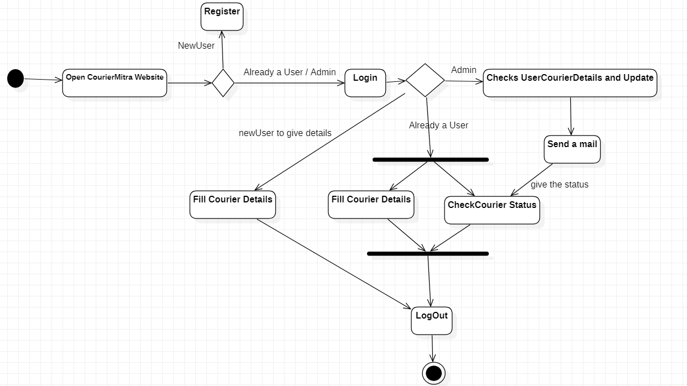
Activity Diagram :

Slide 13
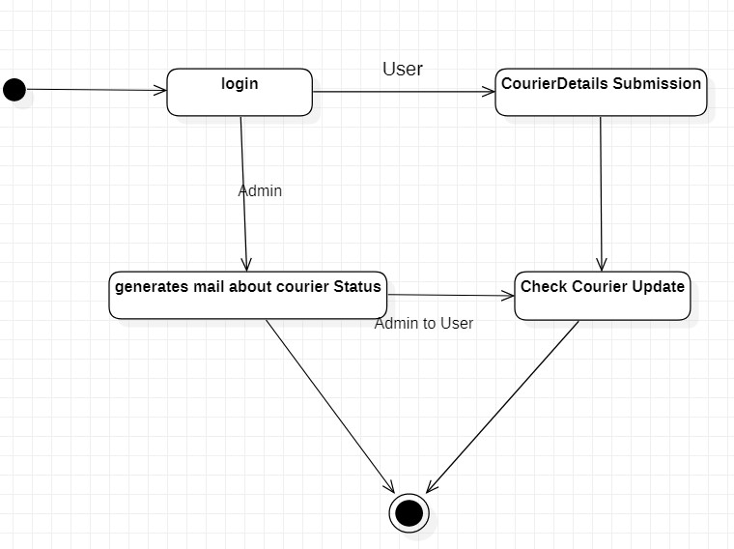
State Chart diagram :

Slide 14
System Implementation
Our website comprises of front end with login, registration of user to website ,admin page to view the courier details of users and backend with databases of registered user details , courier details.
Firstly, if the user is new to the CourierMitra website then user must register his details in the website with required details provided in the website.
Then the user can login to give his courier details and logout .
Also user will be provided with mail for every update.
Admin login and update the status of courier to user.

Slide 15
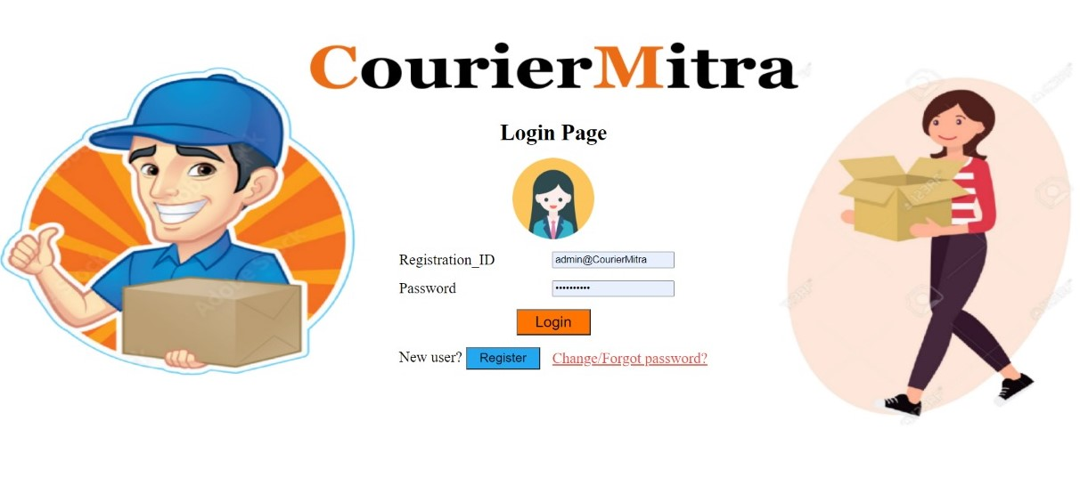
Screens

Slide 16
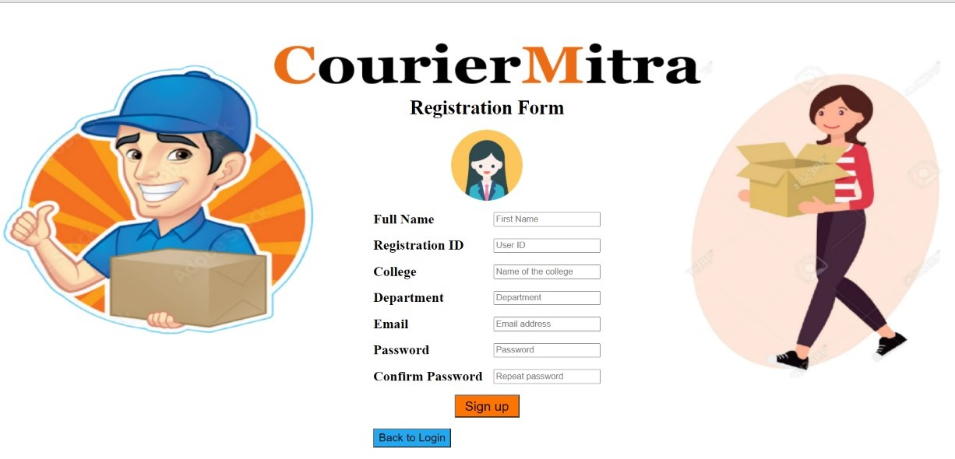

Slide 17
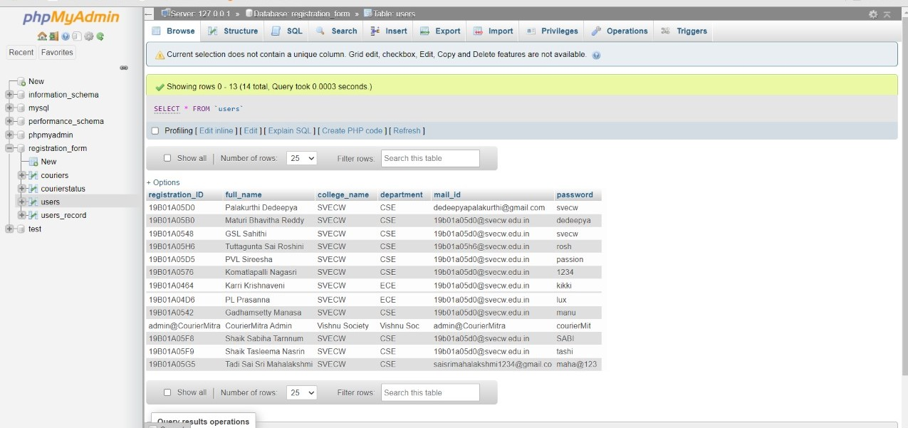

Slide 18
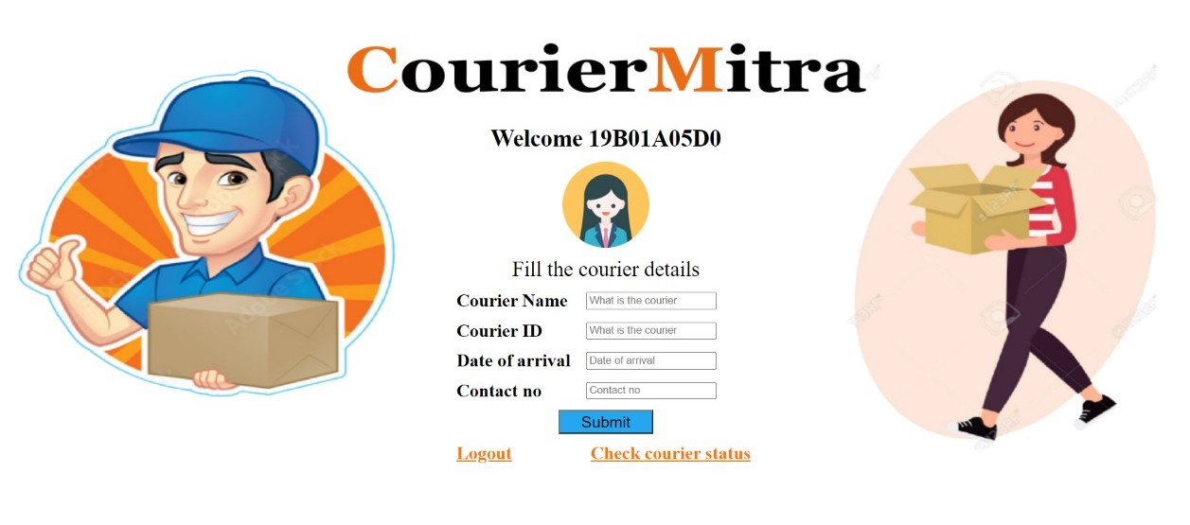

Slide 19
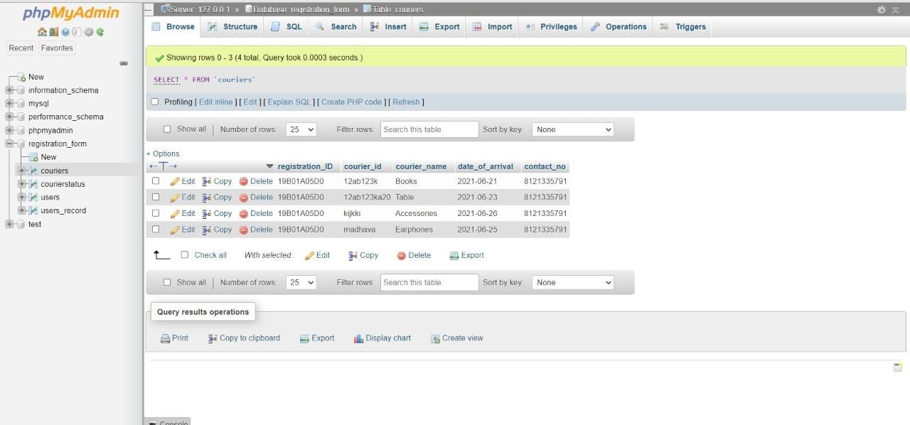

Slide 20
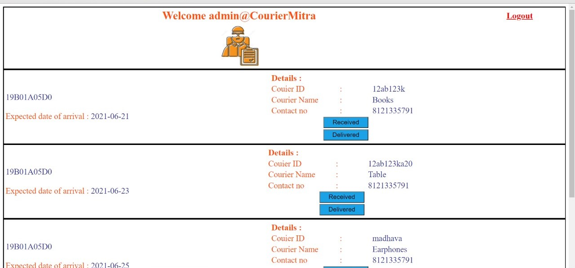

Slide 21
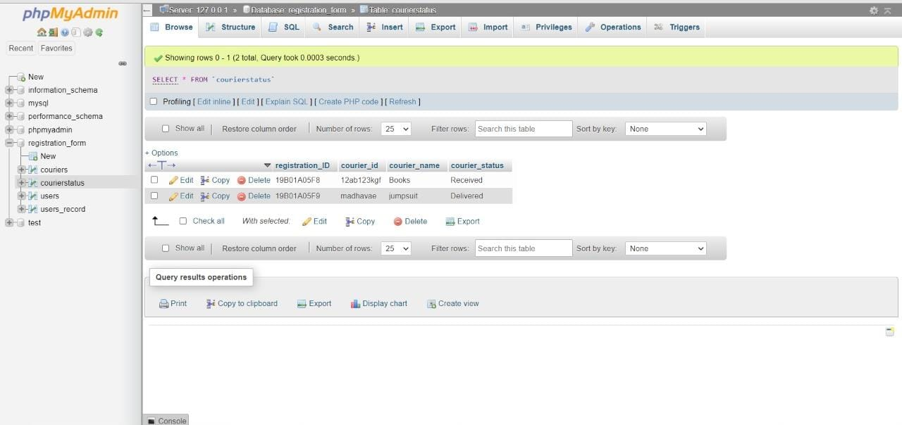

Slide 22
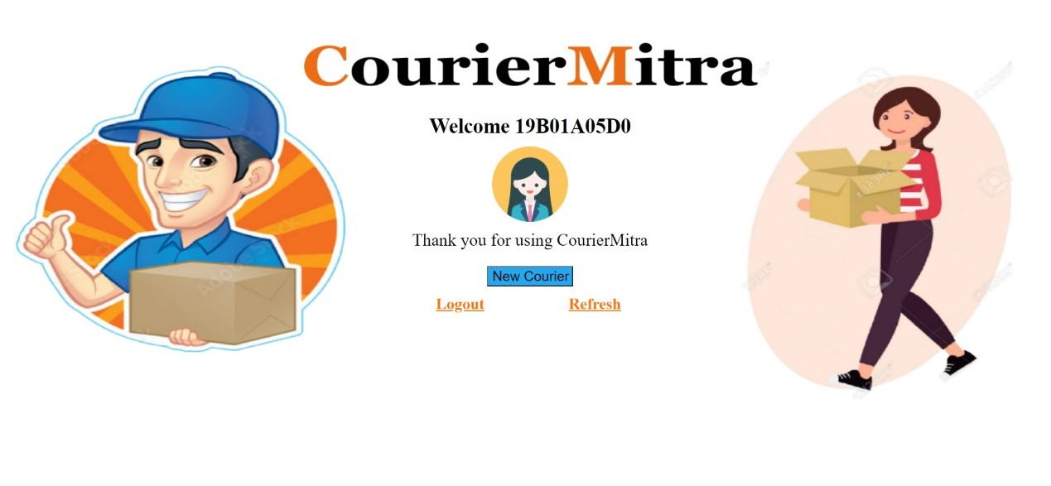

Slide 23
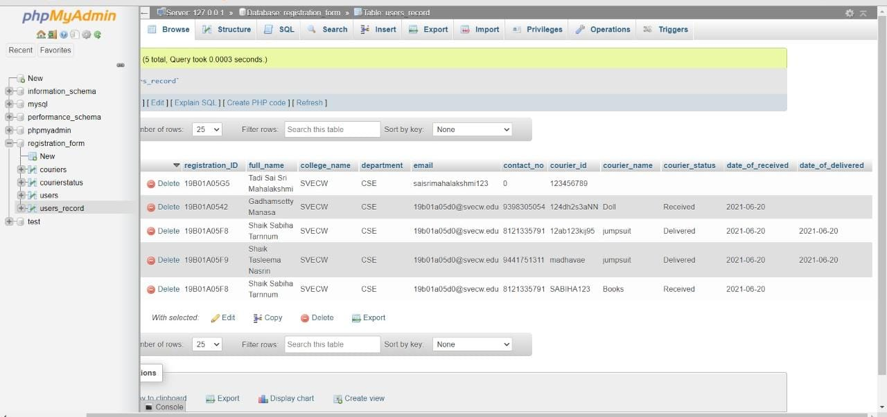

Slide 24
Future Enhancements
Various reports of the couriers which are received and delivered to the user will be
retrieved in a single page in admin portal.
To know the count and details of users courier of specific department of specific college.
Sending SMS to users mobile.

Slide 25
Thank You…

