Slide 1
Cryptocurrency Network Forensics using Ethereum Blockchain Transactions
Group – D5
Name Roll Number
Rangala Karthikeya CB.SC.U4AIE23333
Tanguturi Vinay Krishna Chetty CB.SC.U4AIE23341
Katikala Dedeepya CB.SC.U4AIE23349
Gutta Karthikeya CB.SC.U4AIE23358

Slide 2
Introduction
Ethereum is a widely used blockchain platform that supports decentralized applications and high-volume financial transactions.
Despite transparency and immutability, Ethereum networks experience fraudulent activities such as bots, wash trading, smurfing, and pump-and-dump schemes.
The large scale, high velocity, and complex structure of blockchain data make manual analysis and traditional fraud detection methods ineffective.
This project leverages Big Data analytics and unsupervised machine learning to analyze Ethereum blockchain data at scale.
Distributed processing, behavioral feature engineering, graph analysis, and time-series methods are used to detect both known and unknown anomalies.
The proposed approach provides a scalable and interpretable framework for Ethereum fraud and anomaly detection.

Slide 3
Problem Statement
Ethereum blockchain generates massive volumes of transaction data at high speed.
Fraudulent activities are hidden within legitimate transactions and are difficult to identify.
Most blockchain fraud patterns are unlabeled and continuously evolving.
Traditional rule-based and manual detection methods do not scale to large blockchain datasets.
There is a need for a scalable, intelligent system to detect anomalous and fraudulent behavior in Ethereum transactions.
Objectives
To analyze large-scale Ethereum blockchain data using Big Data technologies.
To preprocess and store blockchain data efficiently using distributed storage.
To extract transaction-level, wallet-level, and block-level behavioral features.
To identify known fraud patterns such as bots, smurfing, wash trading, and zero-value transactions.
To detect unknown anomalies using unsupervised machine learning models.
To perform graph-based and time-series analysis for understanding coordinated and temporal fraud patterns.

Slide 4
Dataset
Dataset Source
Name: Ethereum Blockchain Parquet Dataset
Platform: HuggingFace
Link: https://huggingface.co/datasets/vnegi10/Ethereum_blockchain_parquet
License: GPL-3.0 (Open & Free for research)
Dataset Size: 20.9 GB
The dataset consists of two core tables:
Blocks table
Transactions table
Join Key: block_number
Blockchain Time Range: 17-Nov-2016 to 25-Mar-2025

Slide 5
Literature Review
S.No | Paper Title & Year | Data Used | Techniques Used | Key Contributions | Limitations
1 | Behavior-aware Account De-anonymization on Ethereum Interaction Graph (2022) | Ethereum transaction graph | Graph Neural Networks (HGATE), Self-supervised learning | Proposes a graph-based framework to learn behavioral patterns of Ethereum accounts and identify entities like exchanges, miners, and malicious actors | Focuses on de-anonymization rather than explicit fraud or pump-and-dump detection
2 | Blockchain-based Fraud Detection: A Systematic Review of Ethereum Network Applications (2025) | Survey of Ethereum-based fraud studies | Machine Learning, Deep Learning (SVM, RF, LSTM) | Provides a comprehensive review of Ethereum-specific fraud detection methods and highlights research gaps | Does not implement a new model; mainly a review
3 | Aparecium: Detecting Scam Behaviors on Ethereum via Biased Random Walk (2023) | Ethereum transaction network | Biased Random Walk, Graph Analysis | Detects scam behaviors by modeling scam life-cycle patterns using transaction graphs | Requires sufficient scam interaction data; computationally expensive
4 | Detection of Fraudulent Transactions in Ethereum Blockchain Smart Contracts Using Deep Learning (2025) | Ethereum smart contract transactions | Feature optimization + Deep Neural Networks | Achieves high fraud detection accuracy by combining feature selection and deep learning | Limited to smart contract transactions; less focus on network-level analytics
5 | Intelligent Fraud Detection in Ethereum Transactions Using Machine Learning (2025) | Ethereum transaction dataset | Random Forest, XGBoost, SVM | Demonstrates effectiveness of classical ML models for Ethereum fraud detection | Relies on labeled data, which is difficult to obtain in real blockchain systems

Slide 6
Big Data Tools
Category | Tools / Technologies
Big Data Engine | Apache Spark
Storage Layer | Hadoop (HDFS compatible)
File Format | Parquet
Data Ingestion | Hugging Face Datasets
Programming Interface | PySpark
Query Engine | Spark SQL
Graph Analytics | NetworkX
ML / Anomaly Detection | Scikit-learn, PyTorch
Environment | Google Colab

Slide 7
Data Ingestion:
Tool / Method | Purpose
Hugging Face Datasets | - Directly load Ethereum blockchain Parquet files hosted online. - Support partial loading (e.g., only first 1 million transactions) to avoid memory issues. - Convert datasets to Arrow format internally for efficient handling.
Python / PySpark | - Load the datasets from local Parquet storage into Spark DataFrames. - Spark allows distributed ingestion of large datasets without exceeding memory limits.
Streaming & Lazy Loading | - Hugging Face Datasets supports on-the-fly data streaming, so we don’t have to load full blockchain into RAM at once. - Spark also evaluates transformations lazily, saving memory.

Slide 8
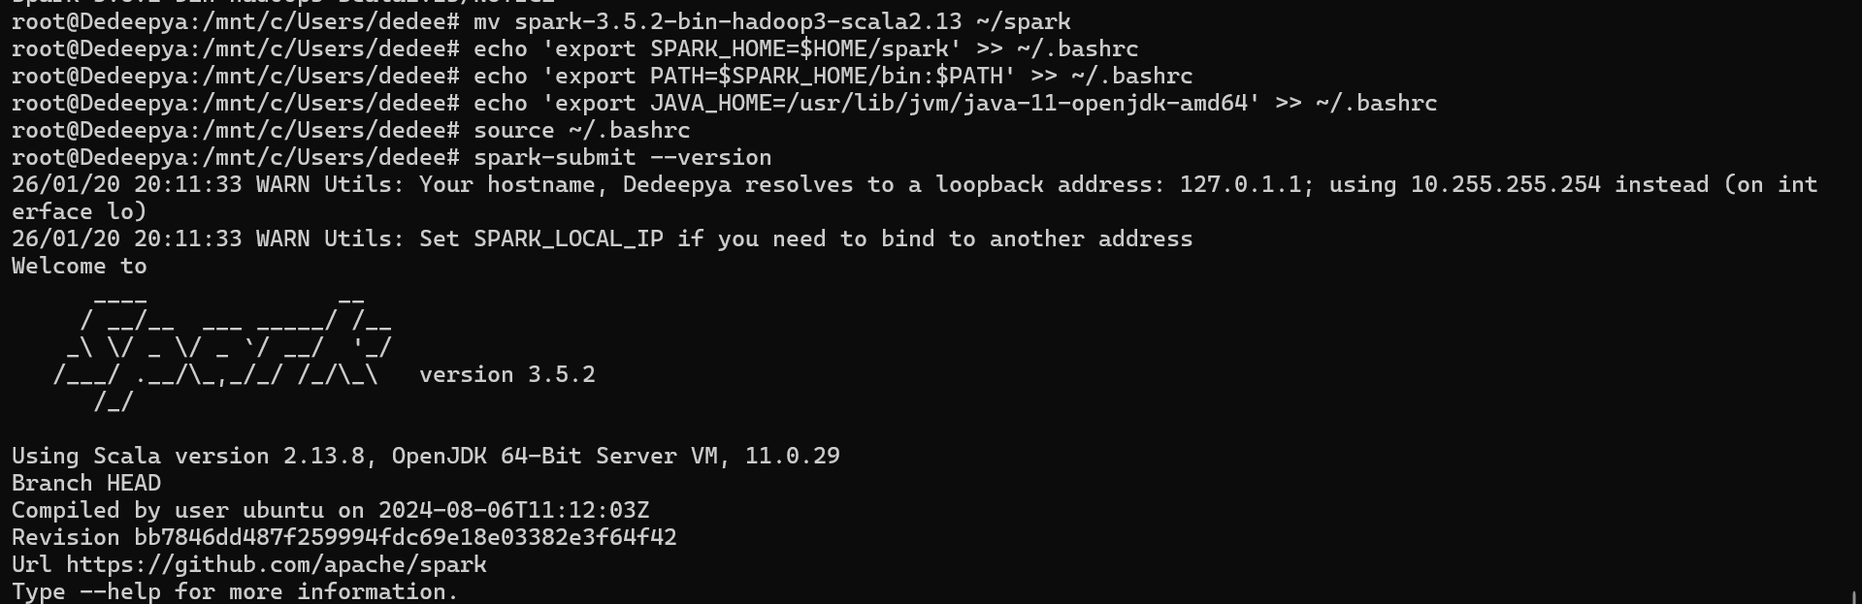
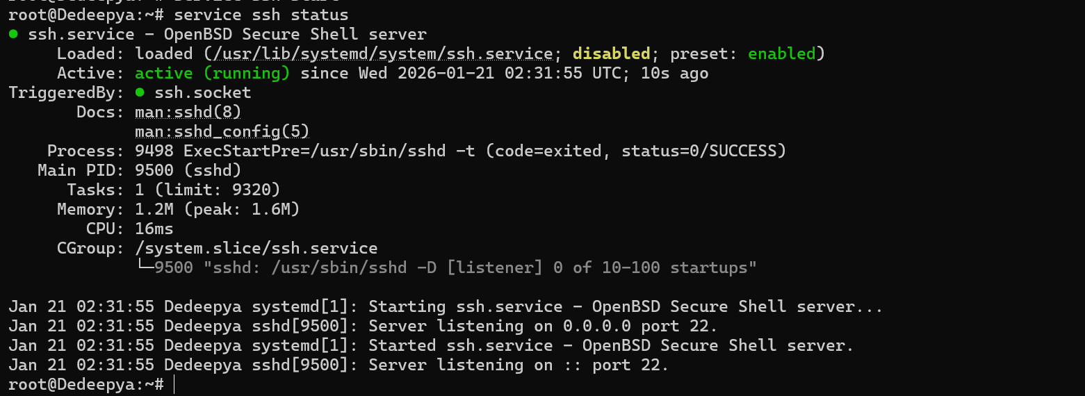
Spark Shell Startup

Slide 9
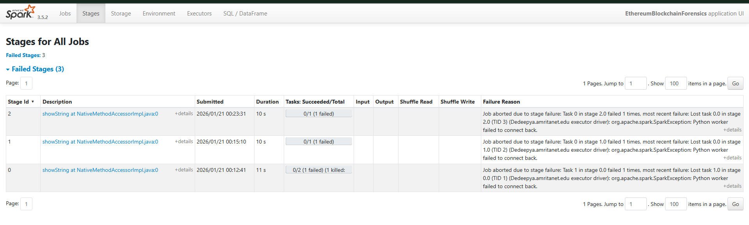
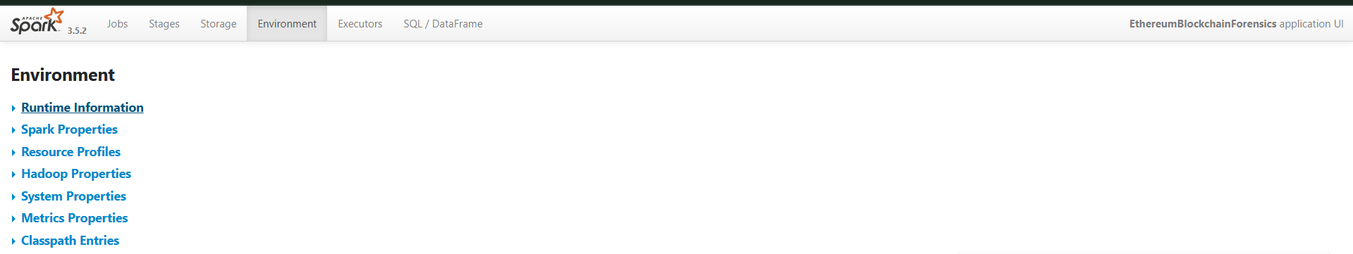
Spark UI – Stages
Shows real-time status of individual tasks within a running stage.
Environment / Executors Tab

Slide 10
SPARK COMMANDS
Start Spark:
cd $HOME/spark
./sbin/start-master.sh
./sbin/start-worker.sh spark://localhost:7077
Launch Spark Shell :
spark-shell
pyspark
Create / Set Environment Variables :
export JAVA_HOME=/usr/lib/jvm/java-11-openjdk-amd64
export HADOOP_HOME=$HOME/hadoop
export PATH=$PATH:$HADOOP_HOME/bin:$HADOOP_HOME/sbin:$JAVA_HOME/bin
export SPARK_HOME=$HOME/spark
export PATH=$PATH:$SPARK_HOME/bin:$SPARK_HOME/sbin
source ~/.bashrc
Spark Submit / Run Scripts:
spark-submit --master local[*] ethereum_forensics.py
spark-submit --class MainApp --master local[*] ethereum_blocks.jar
Monitoring Spark Jobs:
Spark UI: http://localhost:4040

Slide 11
Methodology
Step 1. Data Collection & Ingestion
Public Ethereum blockchain block and transaction data collected in Parquet format.
Dataset includes block details, transaction values, gas information, timestamps, and wallet addresses.
Data ingested using Apache Spark (PySpark) for distributed and scalable processing.
Step 2. Data Storage & Preprocessing
Data stored in Hadoop-style distributed storage using Parquet.
Removal of incomplete, corrupted, and invalid transaction records.
Cleaning of critical fields such as transaction value, gas usage, gas limit, and wallet addresses.
Step 3. Feature Engineering
Transaction-level features: ETH value, gas used, gas limit, transaction fee, success/failure.
Wallet-level features: Transaction count, average value, failure rate, gas usage variance.
Block-level features: Average gas used, gas utilization, base fee per gas, transactions per block.
Enables behavioral profiling instead of raw data analysis.

Slide 12
Step 4. Exploratory Data Analysis (EDA)
Statistical analysis of transaction values and gas usage.
Visualization of gas limit vs gas used and transaction distributions.
Identification of skewed behavior, spikes, and abnormal trends.
Step 5. Rule-Based Anomaly Detection
Bot detection using high transaction frequency with low ETH value.
Smurfing detection through many small-value transactions.
Zero-value transaction identification for spam activity.
Wash trading detection using repeated sender–receiver wallet pairs.
Step 6. Machine Learning-Based Anomaly Detection
Isolation Forest: Detects anomalous wallets and blocks without labeled data.
Autoencoder: Identifies deviations by measuring reconstruction error.
Helps discover unknown and evolving fraud patterns.

Slide 13
Step 7. Graph-Based Network Analysis
Ethereum transactions modeled as a directed graph.
Nodes represent wallets; edges represent ETH transfers.
Detection of circular transactions, repeated interactions, and coordinated behavior.
Step 8. Time-Series & Temporal Analysis
Transactions grouped into fixed time windows.
Rolling averages computed for transaction count and ETH volume.
Detection of sudden spikes and drops indicating pump-and-dump activity.
Step 9. Visualization & Interpretation
Use of histograms, bar charts, scatter plots, time-series plots, and transaction graphs.
Visual validation and interpretation of detected anomalies.
Supports explainable and transparent fraud detection.

Slide 14
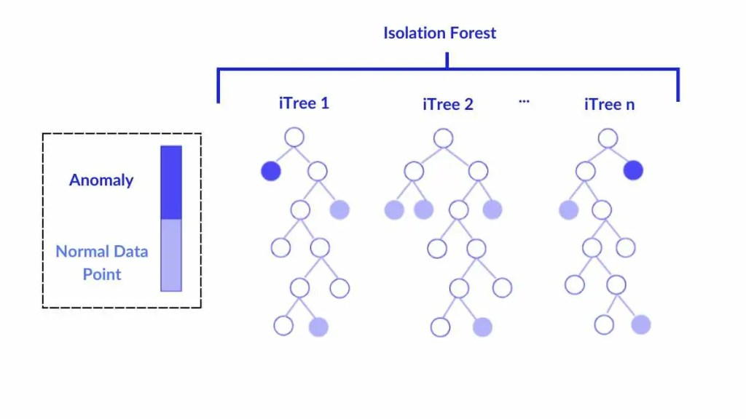
Isolation Forest
Isolation Forest is an unsupervised machine learning algorithm designed specifically for anomaly detection.
It is based on the idea that anomalies are easier to isolate than normal data points.
Instead of profiling normal behavior, it directly isolates unusual observations.
Normal data points require many random splits to be isolated.
Anomalies require fewer splits because they are rare and different.
Points with shorter path lengths in trees are considered anomalous.
Isolation Forest Working:
Randomly selects a feature and a split value.
Builds multiple isolation trees (iTrees).
Each data point is passed through all trees.
The average path length is computed:
Short path → anomaly
Long path → normal

Slide 15
Advantages
High scalability
Low computational cost
Effective for blockchain-scale data
Easy to integrate with Spark workflows
Limitations
Less effective for extremely complex temporal patterns alone.
Best results achieved when combined with:
Autoencoders
Graph-based analysis
Time-series analysis

Slide 16
Autoencoder
Unsupervised deep learning model
Learns to reconstruct its input
Used for anomaly detection when labeled data is unavailable
Anomalies have high reconstruction error
Autoencoder Architecture
Neural network with three main parts:
Encoder
Compresses input features into low-dimensional representation
Removes noise and redundancy
Captures essential behavioral patterns
Uses dense layers with activation functions
Latent Space (Bottleneck)
Smallest layer in the network
Stores compressed representation of normal behavior
Forces model to learn meaningful patterns
Anomalies fail to be represented well here
Decoder
Reconstructs original input from latent representation
Tries to match input as closely as possible
Outputs reconstructed transaction or wallet features

Slide 17
Training Process
Trained only on normal or majority data
Input = Output (self-supervised learning)
Loss function:
Mean Squared Error (MSE)
Optimization using gradient descent
Reconstruction Error
Difference between original input and reconstructed output
Normal data → low reconstruction error
Anomalous data → high reconstruction error
Used as anomaly score
Anomaly Detection Process
Pass transaction/wallet data through trained autoencoder
Compute reconstruction error
Compare error with predefined threshold
Classify as:
Normal
Anomalous

Slide 18
Pump and Dump
A pump and dump is a fraudulent market manipulation strategy in which attackers:
Artificially increase activity and price (Pump) by creating high transaction volume and ETH inflow.
Rapidly sell or withdraw funds (Dump), causing a sudden drop in activity and value.
Working Process:
Transaction timestamps are converted to readable time format and grouped into 10-minute windows
Key metrics computed per window:
Transaction count
Total ETH transferred
Rolling averages (1-hour baseline) are calculated using the previous 6 windows

Slide 19

Relative spike detection is performed using:
A pump is detected when:
Transaction spike > 1.5
ETH volume spike > 1.5
A dump is confirmed when the next window shows a sharp decline:
Future transaction change < −0.5
Time windows satisfying both conditions are flagged as Pump-and-Dump events
Detected events are validated through time-series visualizations

Slide 20
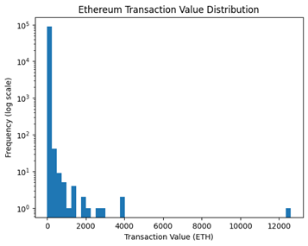
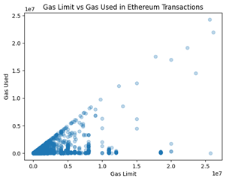
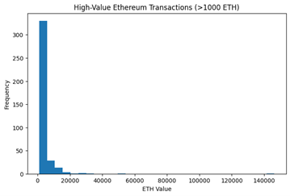
Results
Exploratory Data Analysis (EDA) Results

Slide 21
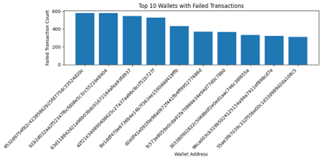
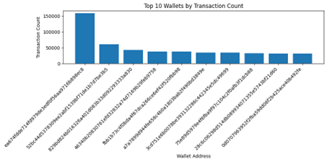
Transaction-Level Anomalies
Failed Transaction Analysis (Wallet-Level Anomaly)
Address-Level Behavioral Analysis

Slide 22
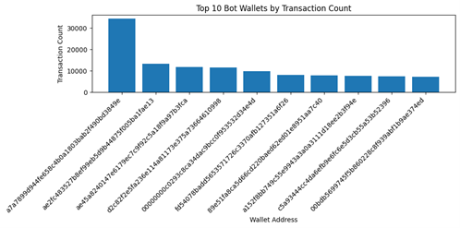
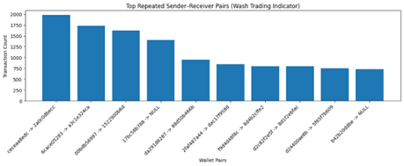
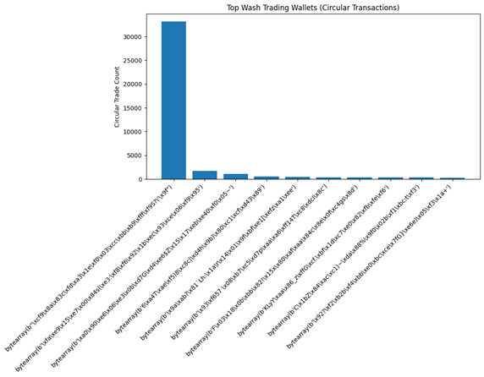
Wash Trading Indicator (Repeated Sender–Receiver Pairs)
Bot Wallet Detection
Wash Trading Wallet Detection (Circular Transactions)

Slide 23
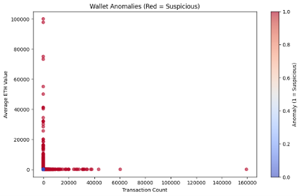
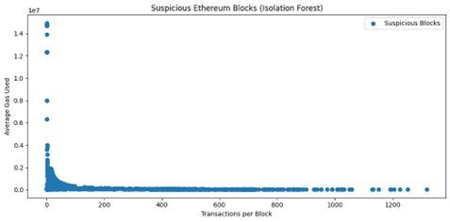
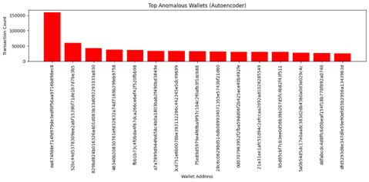
Isolation Forest-Based Anomaly Detection
Autoencoder-Based Anomaly Detection

Slide 24
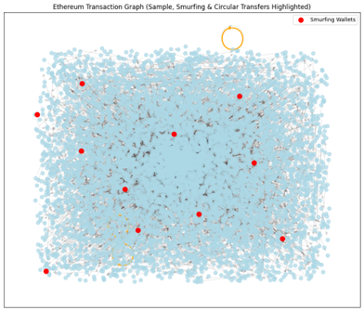
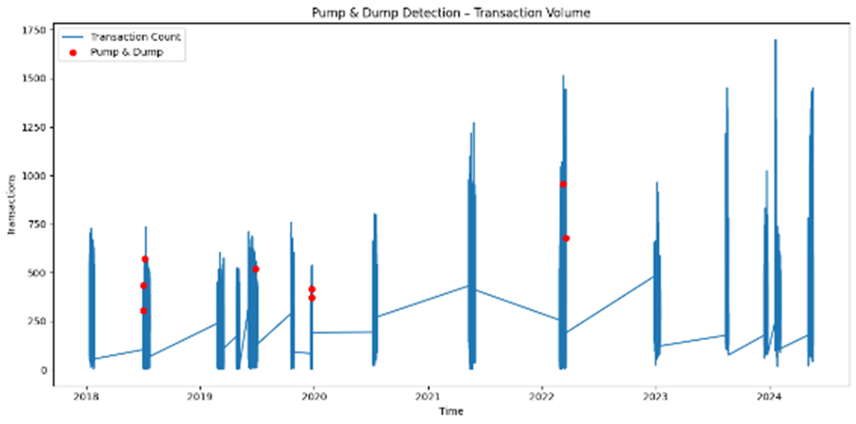
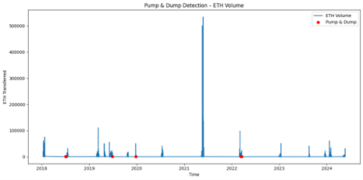
Money Laundering Patterns
Pump-and-Dump Detection

Slide 25
Results Comparision
Paper | Method Used | Detection Type | Limitations | Our Project Contribution
Zhou et al., 2022 Behavior-aware Account De-anonymization | Graph Neural Networks (Ethident) | Account identity classification | Focuses only on de-anonymization, not anomaly detection | Our system detects behavioral anomalies, bots, and suspicious transactions using feature-based analytics
Ghnemat & Mosa, 2025 Blockchain Fraud Detection Survey | Literature review of ML methods | Overview of fraud detection techniques | Does not implement practical detection system | Our project implements a complete big-data pipeline for anomaly detection on Ethereum transactions
Shen et al., 2023 Aparecium | Biased Random Walk + Random Forest | Scam wallet detection | Requires labeled data and focuses mainly on scam accounts | Our system performs unsupervised anomaly detection without labeled data using Isolation Forest
Sethy & Ray, 2025 Deep Learning Fraud Detection | Deep Neural Network | Fraudulent transaction classification | Works mainly on smart contract fraud datasets | Our approach analyzes transaction, wallet, and block behavior simultaneously
Satish & Ganesh, 2025 ML-based Fraud Detection | Supervised ML models | Transaction fraud classification | Requires labeled datasets and focuses on specific fraud types | Our system detects multiple anomaly patterns including bots, wash trading, smurfing, and pump-and-dump events

Slide 26
Contributions
Vinay: Data Engineering Lead: Designed the big-data pipeline and implemented large-scale Ethereum data ingestion and preprocessing using Apache Spark and PySpark.
Gutta Karthikeya : Data Analytics & Feature Engineering: Performed exploratory data analysis and engineered transaction-level, wallet-level, and block-level features for behavioral analysis
Katikala Dedeepya: Machine Learning & Anomaly Detection: Developed the machine learning framework for identifying suspicious blockchain behavior using Isolation Forest and Autoencoder models.
Rangala Karthikeya : Network & Temporal Behavior Analysis: Modeled blockchain interactions and temporal patterns for fraud detection. Conducted graph-based and time-series analysis to detect suspicious patterns such as wash trading, circular transactions, and pump-and-dump events.

Slide 27
References
[1] J. Zhou, C. Hu, J. Chi, J. Wu, M. Shen, and Q. Xuan, “Behavior-aware account de-anonymization on Ethereum interaction graph,” arXiv preprint arXiv:2203.09360, 2022.
Link: https://arxiv.org/abs/2203.09360
[2] R. Ghnemat and H. Mosa, “Blockchain-based fraud detection: A systematic review of Ethereum network applications,” Cluster Computing, Springer, 2025.
Link (publisher): https://link.springer.com/article/10.1007/s10586-025-05797-w
[3] M. Shen et al., “Aparecium: Understanding and detecting scam behaviors on Ethereum via biased random walk,” Cybersecurity, Springer, vol. XX, no. XX, pp. XX–XX, 2023.
Link: https://link.springer.com/article/10.1186/s42400-023-00180-x
[4] A. Sethy and A. Ray, “Detection of fraudulent transactions in Ethereum blockchain smart contracts using deep learning,” International Journal of Information Technology, Springer, 2025.
Link: https://link.springer.com/article/10.1007/s41870-025-02900-7
[5] V. Satish and S. Ganesh, “Intelligent fraud detection in Ethereum transactions using machine learning,” International Journal for Research in Applied Science & Engineering Technology (IJRASET), vol. XX, no. XX, 2025.
Link : https://arxiv.org/abs/2509.03939

