Slide 1

Critical/Analytical Thinking
Ms. Philomina O. Mintah
Central University

Slide 2
Welcome Students
Hello everyone, welcome to the first lesson of Critical Thinking and Analysis.
I hope you will take everything you will be taught seriously and apply it to your daily lives.
You will begin with the introduction and definition of key terms, after which you will be taught the characteristics of a critical thinker.
I hope you will enjoy every bit of the lesson.

Slide 3
What is critical thinking?
Critical thinking is the ability to think clearly and rationally about what to do or what to believe.
It includes the ability to engage in reflective and independent thinking.
It is the careful application of reason in the determination of whether a claim is true.

Slide 4

Importance of critical thinking cont.
One big difference between humans and animals is the capacity of humans to think, reason and evaluate their actions.

Slide 5
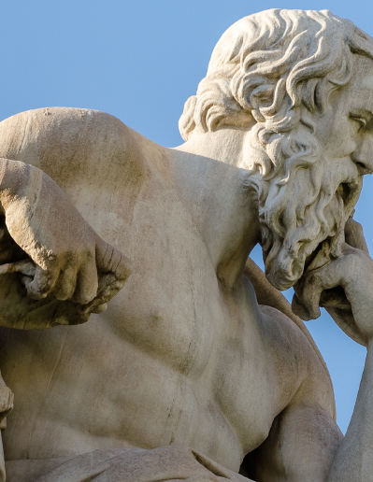
Socrates, a famous Greek Philosopher, once said: “the unexamined life is not worth living”.
How do you understand this statement?

Slide 6

A CRITICAL THINKER
A critical thinker is able to
understand the logical connections between ideas
Formulate ideas succinctly and precisely
identify, construct and evaluate arguments
detect inconsistencies and common mistakes in reasoning
solve problems systematically
identify the relevance and importance of ideas
reflect on the justification of one's own beliefs and values

Slide 7
A critical thinker cont.
Deduce
Deduce consequences from what you know, and how to make use of information to solve problems.
Evaluate
Evaluate the pros and cons of a decision and the evidence for and against a hypothesis.
Reflect
Reflect on one’s thinking skills.

Slide 8
Importance of critical thinking
In education
In any career
creativity
self-reflection - our values, beliefs and decisions.

Slide 9
Importance of critical thinking cont.
Critical thinking enhances language and presentation skills.
Good critical thinking is the foundation of science and democracy.

Slide 10
Some misconceptions about CT
CT thought to be too confrontation
CT thought to be about criticizing people all the time
CT makes people doubt the existence of God
CT waste time in an emergency situations
CT is opposed to emotions, feelings and sympathy
CT destroys good relationship

Slide 11
How to improve CT skills?
There are three ways to improve our CT skills:
Learning the theory
Deliberate practice
Adopting the right attitudes
(ref. Lau p.4-8)

Slide 12
Summary
In this lesson we have learnt the following:
CT is to think critically and rationally about our beliefs, actions and judgements.
The qualities of a CT
The importance of CT
How to improve our CT
Some misconceptions about CT

Slide 13
Exercise
Do
Do the exercise on pp. 8 &9
Group
Group 1. exercise 1.1
Group
Group 2. exercise 1.2

