Slide 1
DIGITAL LITERACY
Presented by
Joel Appiah / K. Kissi Mireku / Bright Anibrika

Slide 2
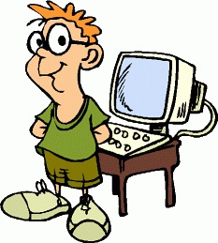
PRESENTATIONAL OUTLINE
Defining Digital Literacy
Digital Literacy in Real World
Why call it "Digital Literacy"?
Transforming Learning
Identify CU Digital Platform
Digital Literacy Competencies
Digital Literacy Examples

Slide 3
DEFINING DIGITAL LITERACY
What is Literacy?
Literacy traditionally means being able to read and write.
Literacy is the ability to read and use written information and to write appropriately in a range of contexts…”
Australian language and literacy policy (2001)
What is Digital?
Digital describes systems that generate and process binary data.
involving or relating to the use of computer technology.
Computers are fundamentally digital machines because they process information that has been encoded as binary values either one that’s positive (represented as 1) or one that’s non-positive (represented as 0).
Examples of digita items: camera, clock, radio etc...
Notes:
Whereas analog clocks are capable of indicating every possible time of day, a digital clock is capable of representing only a finite number of times (every tenth of a second, for example)

Slide 4
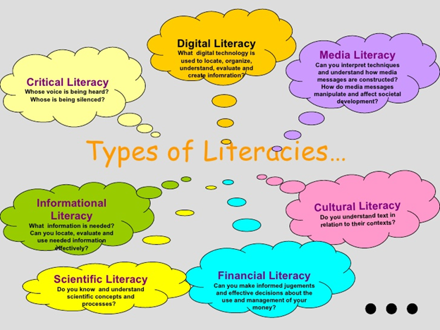
TYPES OF LITERACY

Slide 5
DEFINING DIGITAL LITERACY
WHAT IS DIGITAL LITERACY?
Is the reading and writing of digital texts.
for example being able to ‘read’ a website by navigating through hyperlinks and ‘writing’ by uploading digital photos to a social networking site.
In this sense, digital literacy means the functional skills required to operate and communicate with technology and media.
the ability to understand and use information in multiple formats from a wide range of sources when it is presented via computers in an ethical and responsible manner.
Paul Gilster , Digital Literacy (1997)
Digital literacy refers to an individual's ability to find, evaluate, and clearly communicate information through typing and other media on various digital platforms. Wikipedia (2022)
The ability to critically understand digital media content and applications; and the knowledge and capacity to create with digital technology.
Notes:
researchers have delved into the process of understanding how this technology will enhance student’s lives within the school curriculum.

Slide 6
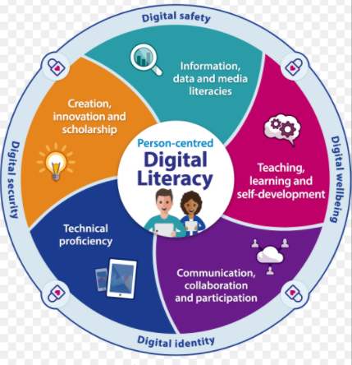
Why call it "Digital Literacy"?
Many organizations use different terms such as ICT (information and communication technology), educational technology, computer literacy, and others.
Notes:
We view these terms as synonymous with digital literacy

Slide 7
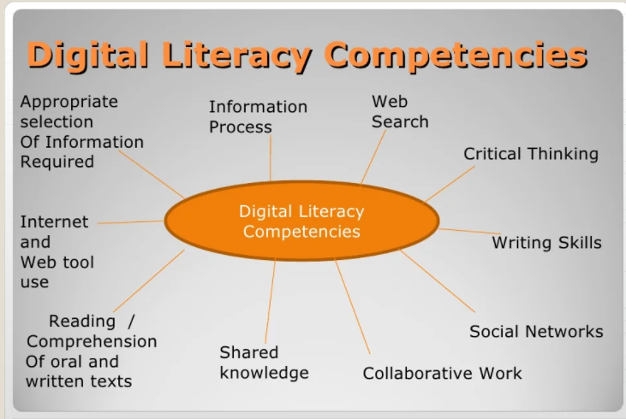
DIGITAL LITERACY COMPETENCIES

Slide 8
EXAMPLES OF DIGITAL LITERACY
Understanding how to use web browsers, search engines, email, text, wiki, blogs, Photoshop, Powerpoint, video creation/editing software , etc. to showcase learning.
Evaluating online resources for accuracy / trustworthiness of information.
Using online classes to enhance learning in the classroom.
Choosing appropriate media to showcase learning -
understand what platforms will best illustrate your message and learning to peers and educators.
Using an interactive whiteboard in the classroom for lessons and allowing students to use the interactive whiteboard on a daily basis.
Notes:
They are used in industries, schools, government offices, and shops. You can use computers to communicate with your family and friends, create a household budget, book travel and movie tickets, or manage your business.

Slide 9
EXAMPLES OF DIGITAL LITERACY
Encouraging students to use technology to showcase their learning.
Using the web ( web sites video, music) to enhance the learning of your students.
Students and teachers creating online content to be utilized both in and out of the classroom.
Notes:
They are used in industries, schools, government offices, and shops. You can use computers to communicate with your family and friends, create a household budget, book travel and movie tickets, or manage your business.

Slide 10
DIGITAL LITERACY EMBEDDED IN THE CLASSROOM THROUGH TECHNOLOGY
“Motivates students in their learning due to their enjoyment and ease of use with various technological mediums.
Reaches students of various learning styles. Technology use applies to and compliments Howard Gardner's Multiple Intelligences.
Allows students to create and design their own unique products reflective of their personalities and learning needs/styles.
Encourages students to manipulate media to construct their own meaning.
Enables students to easy share their learning with teachers, families and peers.
Gives students the chance to explore technological mediums which in inevitable increase job skills that employers look for in the workforce.”

Slide 11
THE REAL-WORLD IMPORTANCE OF DIGITAL LITERACY
“Digital literacy is one component of being a digital citizen - a person who is responsible for how they utilize technology to interact with the world around them.
Digital technology allows people to interact and communicate with family and friends on a regular basis due to the "busy constraints" of today's world.
Not only do white-collar jobs require digital literacy in the use of media to present, record and analyze data, but so do blue-collar jobs who are looking for way to increase productivity and analyze market trends, along with increase job safety.”

Slide 12
TRANSFORMING THE WAY WE LEARN
A theory that breaks digital literacy down into four different categories:
■ Language – print and texting, as well as visual, multimedia, and coding literacies.
■ Information – search, tagging, and critical thinking / filtering literacies fall into this category
■ Connections –social skills and networking, collaboration, digital safety and intercultural awareness.
■ (Re)design – remix literacy, encompassing all of the above literacies, but also including an awareness of copyright, fair use and the legal issues surrounding remixes and mashups.

Slide 13
CENTRAL UNIVERSITY DIGITAL PLATFORM
What are some of the Digital Platform CU uses:
■ Zoom Video Communication.
■ VCampus
■ OSIS
■ Microsoft Team
Discuss....

Slide 14
THANK YOU.

