Slide 1
ITEC 101 Fundamentals of Information Technology
DANIEL OBUOBI, DCSIT, CU
SECURITY

Slide 2
Computer Ethics
The standards determines whether an action is good or bad.
Areas of computer ethics include:
use of computer ethics and network.
software theft (piracy).
information accuracy.
intellectual property rights.
codes of conduct.
and information privacy.

Slide 3
Ethical and Social Issues in Information Systems
Computer Ethics definition?
Computer ethics is concerned with standards of conduct pertaining to computers.
Or the set of moral principles that regulate the use of computers.
Or moral guidelines that govern the use of computers and information systems.

Slide 4
Information Privacy
Inaccurate input can result in erroneous information and incorrect decisions based on that information.
Also refered to as GIGO (Garbage In, Garbage Out).
Computer users need to be mindful of what is inputted into the computer.
Computer users need to check for accuracy of the data.

Slide 5
Information Privacy
Never be certain that any information on the web is accurate.
The question that arises is who is responsible for the accuracy of this information?
The ability of computers to alter reality also imposes certain ethical obligations.
Is it ethical for news organizations to use digitally altered photographs?

Slide 6
Intellectual Property Rights
Intellectual property refers to unique and original works such as ideas, inventions, writings, art, processes, company and product names and logos.
Intellectual property rights are the rights to which creators are entitled for their work.
The owner of intellectual property controls its use and is entitled to any benefits arising from such use.

Slide 7
Copyright
A copyright gives authors and artists exclusive rights to duplicate, publish, and sell their materials.
A copyright protects any tangible form of expression.
These rights are of limited duration.
The symbol for copyright is ©, and in some jurisdictions may alternatively be written as either (c) or ©.
Plagiarism is taking someone else’s work or idea and passing it off as your own.

Slide 8
Copyright
Public domain
Not everything is protected by copyright law.
Some works can be copied because the copyright has expired or the works were placed in the public domain.
The following are categories of works that can be copied:
Words and short phrases such as names, titles, and slogans.
(some titles and words might be protected under trademark law).
Familiar symbols or designs.

Slide 9
Copyright on Software
There are several types of software and users need to know the category which they fall.
Freeware are free software, but may have restrictions on use. They are however copyrighted.
Open-source software is a variation of freeware. The source code is provided so that programmers can modify it and understand it

Slide 10
Copyright on Software
Shareware are free software but for a short time.
Small fee are usually paid after the trial period. It is however copyrighted
Public-domain software is uncopyrighted software that may be used or altered without restriction.

Slide 11
Information Rights and Obligations
What information rights do individuals and organizations possess with respect to information about themselves?
What can they protect?
What obligations do individuals and organizations have concerning this information?

Slide 12
Information Rights and Obligations
Intellectual freedom requires a sufficient degree of autonomy for individuals with respect to information flows to, by, and about them.
The individual should be given the option of preventing their personal data from being released to third parties.
Also, the individual should be given the chance to review their personal data from time to time to check for accuracy.

Slide 13
Property Rights and Accountability
How will traditional intellectual property rights be protected in a digital society in which tracing and accounting for ownership is difficult, and ignoring such property rights is so easy?
Who can and will be held accountable and liable for the harm done to individual and collective information and property rights?

Slide 14
System Quality
What standards of data and system quality should we demand to protect individual rights and the safety of society?
Information quality (IQ) is a term to describe the quality of the content of information systems.
But how do you measure the quality of an information system?

Slide 15
System Quality
Measures of System Quality typically focus on performance characteristics of the system under study.
System Quality may be measured by analysing:
Resource utilization and investment utilization.
Hardware utilization efficiency.
Reliability.
Response time, ease of terminal use.
Human factors
System accuracy etc.

Slide 16
System Quality
Hamilton and Chervany's list of system quality measures is probably the most well known:
Data currency.
Response time.
Turnaround time.
Data accuracy.
Reliability.
Completeness.
System flexibility and ease of use.

Slide 17
System Quality
In recent times, system quality is concerned with:
"bugs" in the system (system reliability),
User interface consistency
Ease of use
Documentation quality
Quality and maintainability of the program code.

Slide 18
INFORMATION SYSTEMS SECURITY AND CONTROL

Slide 19
Information Systems Security
The protection of information systems against unauthorized access to or modification of information, whether in storage, processing or transit, and against the denial of service to authorized users, including those measures necessary to detect, document, and counter such threats.

Slide 20
Information Systems Security
The terms information security, computer security and information assurance are frequently used interchangeably

Slide 21
Basic principles of Information Security
Confidentiality
Integrity
Availability

Slide 22
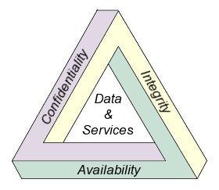
CIA Triad

Slide 23
Access control
Access to protected information must be restricted to people who are authorized to access the information
The foundation on which access control mechanisms are built start with identification and authentication

Slide 24
Identification
It is an assertion of who someone is or what something is
Eg. User name

Slide 25
Authentication
It is the act of verifying a claim of identity
There are three different types of information that can be used for authentication
Something you know
Something you have
Something you are

Slide 26
Something you know
Examples of something you know include such things as a PIN number, a password, or your mother’s maiden name.

Slide 27
Something you have
Examples of something you have include a driver’s license or a magnetic swipe card

Slide 28
Something you are
Examples of biometrics include palm prints, finger prints, voice prints and retina (eye) scans
Strong authentication requires providing information from two of the three different types of authentication information
One-factor, Two-factor and Three-factor Authentication

Slide 29
Authorization
After a person, program or computer has successfully been identified and authenticated then it must be determined what informational resources they are permitted to access and what actions they will be allowed to perform (run, view, create, delete, or change). This is called authorization.

Slide 30
Three types of controls
Administrative Control
Logical Control
Physical Control

Slide 31
Administrative Control
These are comprised of approved written policies, procedures, standards and guidelines. Administrative controls form the framework for running the business and managing people

Slide 32
Logical Control
These controls (also called technical controls) use software and data to monitor and control access to information and computing systems. For example: passwords, biometric authentication, possessed objects, network and host based firewalls, network intrusion detection systems, access control lists, and data encryption is logical controls.

Slide 33
Password
It is a form of secret authentication data that is used to control access to a resource

Slide 34
Good passwords
must not be too short (otherwise brute-force guessing will soon open them)
should not be words found in a dictionary (hacking programs can use dictionaries to try each real word in turn until they get access)
should be a mixture of uppercase, lowercase, letters and digits
should not be easily guessable by people who know you (first names, birthdates, children's names, pets' names etc)
should not be so hard to remember that you have to write them down
are not be written down - and are especially not written down and stuck to the monitor!

Slide 35
Biometric authentication
This refers to technologies that measure and analyzes human physical and behavioral characteristics for authentication purposes. Examples of physical (or physiological or biometric) characteristics include fingerprints, eye retinas and irises, facial patterns and hand measurements

Slide 36
Possessed Objects
A possessed object is any item you must carry to gain access to a computer system or an information system. Examples of possessed objects are badges, cards, smart cards and keys. The card you use in an automated teller machine(ATM) is a possessed object to access a bank account.

Slide 37
Network Firewall
A firewall is an information technology (IT) security device which is configured to permit or deny access to a network based on the organization's security policy
Principle of Least Privilege

Slide 38
Cryptography
Information security uses cryptography to transform usable information into a form that renders it unusable by anyone other than an authorized user
Encryption
Decryption
Cryptographic Key

Slide 39
Physical Control
These monitor and control the environment of the work place and computing facilities. They also monitor and control access to and from such facilities. For example: doors, locks, heating and air conditioning, smoke and fire alarms, fire suppression systems, cameras, barricades, fencing, security guards, cable locks, etc

Slide 40
Information Privacy
Spyware
Spyware is computer software that collects personal information about users without their informed consent
Anti-spyware programs
Spam
Spam is an unsolicited e-mail message or newsgroup posting sent to many recipients or newsgroup at once.
Anti-spam techniques

Slide 41
Virus
A virus is a parasitic program that infects another program (the host). Most viruses fall into the following categories:
Boot sector viruses Self-encrypting viruses
Cluster viruses Self-changing viruses
File-infecting viruses Stealth viruses
Worms Macro viruses
Bombs Joke programs
Trojan Horses Bimodal viruses
Polymorphic viruses Bipartite viruses

Slide 42
Software Piracy
It is the illegal copying of software program. It is the biggest problem facing the software industry.

Slide 43
Types of Software Piracy
End-User piracy: When users copy software without appropriate licensing for each copy.
Pre-installed Software: When a computer manufacturer takes one copy of software and illegally installs it on more than one computer
Internet Piracy: When unauthorized copies are downloaded over the Internet

Slide 44
Counterfeiting
When illegal copies of software are made and distributed in packaging that reproduces the manufacturer's packaging.

Slide 45
INFORMATION PRIVACY

Slide 46
Introduction
In the electronic age, raw data has become a valuable commodity—and the protection of personal information has become increasingly important to our sense of privacy.
This section explains how new principles that have created challenges for the protection of personal information, and provides an overview of basic facts that affects privacy

Slide 47
Information Systems Security
The terms information security, computer security and information assurance are frequently used interchangeably

Slide 48
The following are information privacy principles
Principle 1 - Manner and purpose of collection of personal information
.Personal information shall not be collected by a collector for inclusion in a record or in a generally available publication unless:
(a) the information is collected for a purpose that is a lawful purpose directly related to a function or activity of the collector; and
(b) the collection of the information is necessary for or directly related to that purpose.
2. Personal information shall not be collected by a collector by unlawful or unfair means.

Slide 49
Principle 2 - Solicitation of personal information from individual concerned
Where:
a collector collects personal information for inclusion in a record or in a generally available publication; and
(b) the information is solicited by the collector from the individual concerned;
(c) the purpose for which the information is being collected;
(d) if the collection of the information is authorized or required by or under law - the fact that the collection of the information is so authorized or required; and
(e) any person to whom, or any body or agency to which, it is the collector's usual practice to disclose personal information of the kind so collected, and (if known by the collector) any person to whom, or any body or agency to which, it is the usual practice of that first mentioned person, body or agency to pass on that information.

Slide 50
Principle 3 - Solicitation of personal information generally
Where:
(a) a collector collects personal information for inclusion in a record or in a generally available publication; and
(b) the information is solicited by the collector:
(c) the collector shall take such steps (if any) as are, in the circumstances, reasonable to ensure that, having regard to the purpose for which the information is collected:
(d) the information collected is relevant to that purpose and is up to date and complete; and
(e) the collection of the information does not intrude to an unreasonable extent upon the personal affairs of the individual concerned.

Slide 51
Principle 4 - Storage and security of personal information
A record-keeper who has possession or control of a record that contains personal information shall ensure:
that the record is protected, by such security safeguards as it is reasonable in the circumstances to take, against loss, against unauthorized access, use, modification or disclosure, and against other misuse; and
(b) that if it is necessary for the record to be given to a person in connection with the provision of a service to the record-keeper, everything reasonably within the power of the record-keeper is done to prevent unauthorized use or disclosure of information contained in the record.

Slide 52
Principle 5 - Information relating to records kept by record-keeper
1. A record-keeper who has possession or control of records that contain personal information shall, subject to clause 2 of this Principle, take such steps as are, in the circumstances, reasonable to enable any person to ascertain:
(a) whether the record-keeper has possession or control of any records that contain personal information; and
(b) if the record-keeper has possession or control of a record that contains such information:
(i) the nature of that information;
(ii) the main purposes for which that information is used; and
(iii) the steps that the person should take if the person wishes to obtain access to the record.
2. A record-keeper is not required under clause 1 of this Principle to give a person information if the record-keeper is required or authorised to refuse to give that information to the person under the applicable provisions of any law of the Commonwealth that provides for access by persons to documents.

Slide 53
Principle 6 - Access to records containing personal information
Where a record-keeper has possession or control of a record that contains personal information, the individual concerned shall be entitled to have access to that record, except to the extent that the record-keeper is required or authorised to refuse to provide the individual with access to that record under the applicable provisions of any law of the Commonwealth that provides for access by persons to documents.

Slide 54
Principle 7 - Alteration of records containing personal information
1. A record-keeper who has possession or control of a record that contains personal information shall take such steps (if any), by way of making appropriate corrections, deletions and additions as are, in the circumstances, reasonable to ensure that the record:
(a) is accurate; and
(b) is, having regard to the purpose for which the information was collected or is to be used and to any purpose that is directly related to that purpose, relevant, up to date, complete and not misleading.
2. The obligation imposed on a record-keeper by clause 1 is subject to any applicable limitation in a law of the Commonwealth that provides a right to require the correction or amendment of documents.

Slide 55
Principle 8 - Record-keeper to check accuracy etc of personal information before use
A record-keeper who has possession or control of a record that contains personal information shall not use that information without taking such steps (if any) as are, in the circumstances, reasonable to ensure that, having regard to the purpose for which the information is proposed to be used, the information is accurate, up to date and complete.

Slide 56
Principle 9 - Personal information to be used only for relevant purposes
A record-keeper who has possession or control of a record that contains personal information shall not use the information except for a purpose to which the information is relevant.

Slide 57
Principle 10 - Limits on use of personal information
1. A record-keeper who has possession or control of a record that contains personal information that was obtained for a particular purpose shall not use the information for any other purpose unless:
(a) the individual concerned has consented to use of the information for that other purpose;
(b) the record-keeper believes on reasonable grounds that use of the information for that other purpose is necessary to prevent or lessen a serious and imminent threat to the life or health of the individual concerned or another person;
(c) use of the information for that other purpose is required or authorised by or under law;
(d) use of the information for that other purpose is reasonably necessary for enforcement of the criminal law or of a law imposing a pecuniary penalty, or for the protection of the public revenue; or
(e) the purpose for which the information is used is directly related to the purpose for which the information was obtained.

Slide 58
HEALTH CONCERNS OF COMPUTER USE
Ergonomics is the study of the physical relationship between people and their tools – such as computers

Slide 59
ERGONOMICS
A chair with a seat pan that adjusts both vertically and an adjustable height backrest, and adjustable tilting tension
An adjustable height work surface or separate keyboard/mouse tray (note that many keyboard trays are too narrow to accommodate a mouse pad, leaving the mouse at an awkward height or reach on the desktop)
A height adjustment for the video display (a good use for those manuals you'll never read!)
An adjustable document holder to minimize head movement and eyestrain
Adjustable foot rests, arms rests, and/or wrist rests.

Slide 60
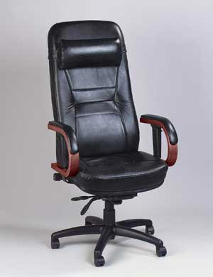
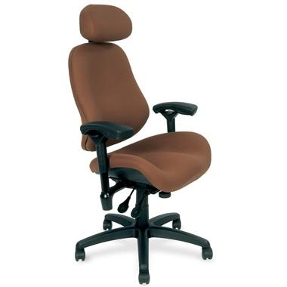
ERGONOMICS

Slide 61
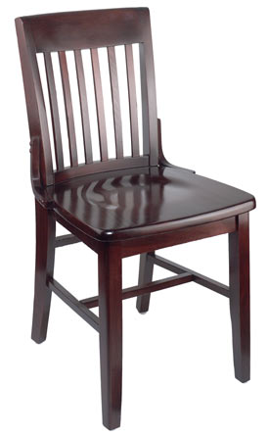
ERGONOMICS

Slide 62
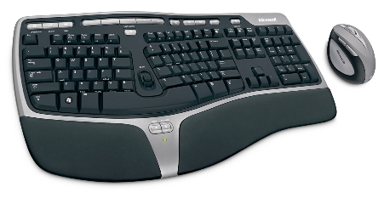
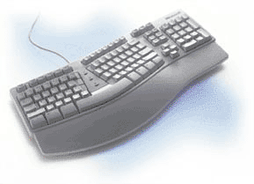
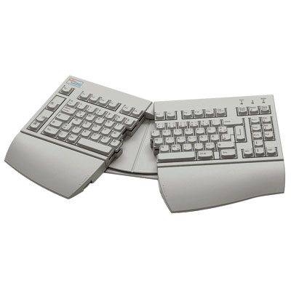
ERGONOMICS KEYBOARDS

Slide 63
Light and glare
Eyestrain, headaches, and impaired vision are often a product of improper illumination resulting in glare, which is light within the field of vision that is brighter than other objects to which the eyes are adapted.

Slide 64
Light and glare
Many offices are too bright for computer use, which may be a carryover from the days when paperwork required such brightness or the result of many office workers' preferences for sunlight and open windows

Slide 65
Light and glare
Some users have found filters placed in front of the screen to be effective in reducing reflections; however some dimming or blurring of the display may result.

Slide 66
Light and glare
28 inches or more from the video screen
48 inches or more from the sides and backs of any VDTs

Slide 67
Breaks and exercises
Working in the same position for too long causes tension build-up and is thought to increase the risk of repetitive motion injuries, such as carpal tunnel syndrome.

Slide 68
Radiation hazards
Earlier fears about ionizing radiation, such as X rays, have been laid to rest, since these rays are blocked by modern glass screens.

Slide 69
Radiation hazards
More recent controversy surrounds very low frequency (VLF) and extremely low frequency (ELF) electromagnetic radiation produced by video displays' horizontal and vertical deflection circuits, respectively.

Slide 70
Radiation hazards
Several epidemiological studies have found a correlation between VDT use and adverse pregnancy outcomes, whereas other studies found no effect.

Slide 71
Radiation hazards
A 1990 Macworld article by noted industry critic, Paul Brodeur, proposed that users maintain the following distances to minimize VLF and ELF exposure:
28 inches or more from the video screen
48 inches or more from the sides and backs of any VDTs.

Slide 72
NOW

