Slide 1
ITEC 101 Fundamentals of IT
DANIEL OBUOBI, DCSIT,CU
STORAGE

Slide 2
STORAGE
Secondary storage includes:
the hard disk drives,
floppy disks,
optical disk and
magnetic tape storage.
The kind of storage is dictated by the size of the computer and how it's used.
Cost is dropping significantly while the technology is improving all the time.

Slide 3
MAGNETIC TAPE & DISK
The most common form is the magnetic disk.
Magnetic tape is still used on larger computers for data that don't require fast access, such as historical records maintained
For fast, direct access to data, magnetic disks is used
Every personal computer has a hard disk
Store data, application & system software

Slide 4
OPTICAL DISK
Same as compact disk (CD-ROM) that holds music.
Common because of the large amount of data it can hold. DVD stores much more.
Many software programs are on compact disks (CD).
Data are stored on the disk by literally burning pits into its surface
Modern PCs allow users to record CDs using CD-RW.

Slide 5
FLOPPY DISK
Floppy disks (diskettes or disks) are flat, circular pieces of mylar plastics that rotate within a jacket.
Data and programs stored as electromagnetic charges on a metal oxide film coating the mylar plastics.
Data and programs represented by the presence or absence of these charges, using ASCII or EBCDIC data representation code.
Most of these disks can only hold 1.44 MB of data. Zip disks capacity is from 250 MB
As the disk rotates, electronic heads can read data (copies data) and write data.
Data is retrieved from tracks (closed concentric circles) .

Slide 6
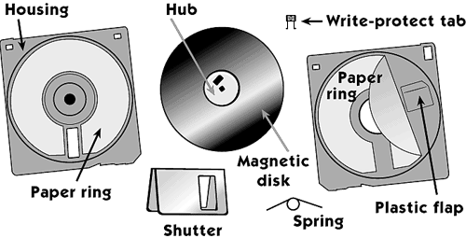
PARTS OF FLOPPY DISK

Slide 7
TYPICAL FLOPPY DISK
Each track is divided into invisible wedge-shaped sections known as sectors.
Tracks and sectors are put on the disk using a process called formatting.
The number of tracks and sectors is known as the disk format.
The sector size can either be fixed permanently or can be altered by software.
When it is fixed permanently, it is called a hard sectored disk and when altered by software it is called soft sectored disk

Slide 8
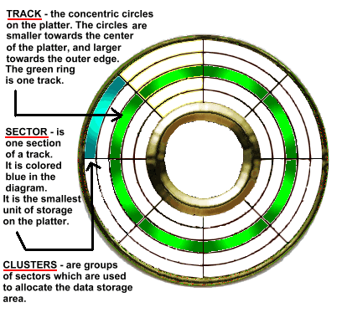
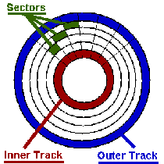
TRACKS & SECTORS

Slide 9
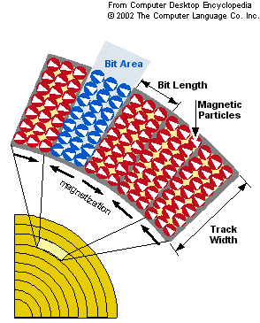

Slide 10
HARD & SOFT SECTORED DISK
HARD SECTORING
Has a hole in front of each sector; normally near the centre and this provide timing information to the device.
When data is stored / retrieved, one full sector is written/read at a time
The exact storage of each disk can be determine as
No. of sector X no. of bytes/sector
e.g. If a 16 sectored disk with 512 bytes/sector
= 16 x 512 x 40 x 2 = 8192 bytes x 80
= 655,360 bytes
SOFT SECTORING
Have a single hole, which indicate the beginning of the track.
A control program (format.com) defines the number of sector per track and the number of characters that can be stored in each sector.

Slide 11
HOW DATA ARE STORE ON FLOPPY
The sector method is used
The disk is divided into 8 sectors ( the number depends on the system used).
Each sector has the same storage capacity since data is recorded most densely on the inner tracks.
Data located using a unique address consisting of the sector number and individual data record number or by using the surface number, track number and the sector number.
Data is then stored at that unique address
Disk Access time
The following factors affect the access time:
Access motion time- time to position the r-w head over the proper track
Latency – time for the sector containing the data to rotate under the head
Settling time – time for the head to be placed in contact with the disk
Data transfer rate – time required to transfer the data from disk to RAM

Slide 12
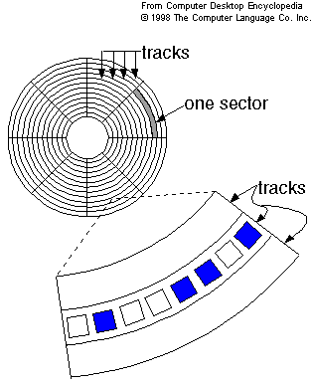
DATA STORAGE ON FLOPPY

Slide 13
HARD DISK
Three types – the internal HD, Hard disk cartridge and hard disk pack.
Hard disk consist of metallic rather than plastics platters.
Tightly sealed to prevent any foreign matter from getting inside.
The contamination-free environment allows very high speeds of rotation, typically 3600 revolutions per minutes.
Hard disks are extremely sensitive devices.
The read-write head rides over a cushion of air about 0.000001 inch thick. (so thin that smoke particle, fingerprint, dust or human hair could cause a head crash)
A head crash happens when the surface of the read-write head or particle on its surface contact the magnetic dist surface.
A head crash is a disaster for the hard disk and it means some or all the data on the disk is destroyed.

Slide 14
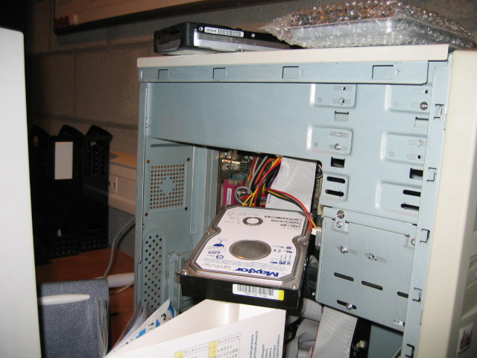
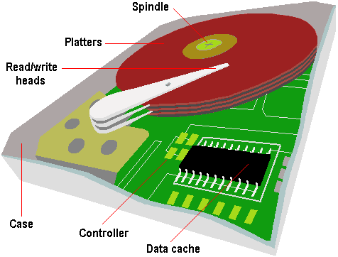
HARD DISK PACK

Slide 15
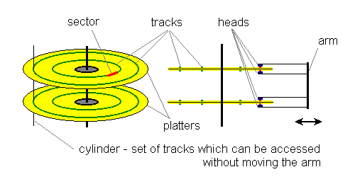
HARD DISK PARTS

Slide 16
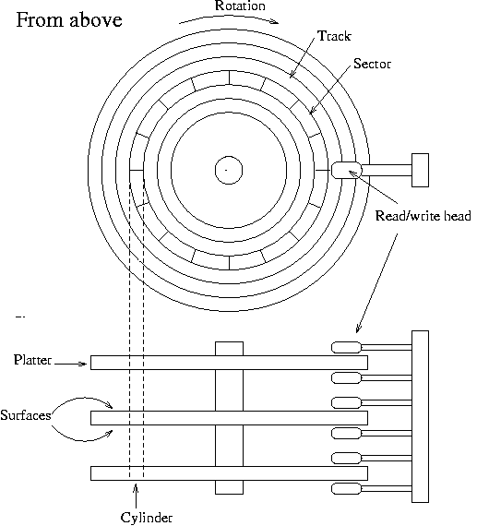
HARD DISK - CYLINDER

Slide 17
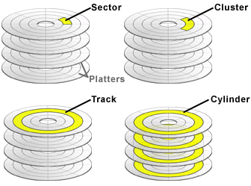
CLUSTER, CYLINDER etc

Slide 18
HARD DISK ACCESS TIME
Access time is the interval between the moment the command is given to transfer a data block (sector) from the disk to the main memory and the moment the transfer is complete.
Depends on 3 factors - Seek time, Rotational delay, Data transfer rate
Seek time – time to move to the required cylinder. E.g. read-write head is on cylinder 5 and data is on cylinder 24.
Rotational delay – rotational delay while the disk rotates into the proper position. On the average the time taken is half a revolution of the disk pack. The average time is known as the latency.
Data Transfer Rate – time taken to read the block of data into memory.

Slide 19
REDUCING ACCESS TIME
Strategies used to reduce access time.
Store related records in the same cylinder, so that the head movement is minimised. This strategy is adopted for sequential file. Even with random files it is possible (sometimes) to group related records in the same cylinder.
Using fixed hard disk, which provide each track with its own read-write head and involve no seek time. No longer used because of high cost.
Other techniques - for speeding disk performance.

Slide 20
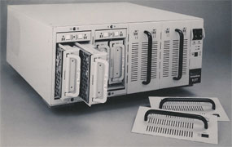

RAID DISK SYSTEM

Slide 21
HD PERFORMANCE ENHANCEMENT
4 ways to improve performance of disk
Disk Caching – improves HD performance by anticipating data needs. It require a combination of hardware and software
De-fragmentation software re-organise the disk space, such that each file occupies contiguous clusters.
RAID – improve performance by expanding external storage. Out perform single disks of comparable capacities.
Data Compression - increase storage capacity by reducing the amount of space required to store data and programs. May slow down things

Slide 22
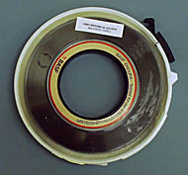
MAGNETIC TAPE
Provide a way of recovering from Head crash
A sequential access media therefore slow
Very effective for making backup
two form of tape storage
magnetic tape streamers for use with PCs
magnetic tape reel for minicomputers
Magnetic tape streamers
capacity of tape cartridge is 120MB – several GB.
Magnetic tape reel
0.5 inch wide and 0.5 mile (2400ft) long
stores 1600 to 6400 characters to the inch

Slide 23
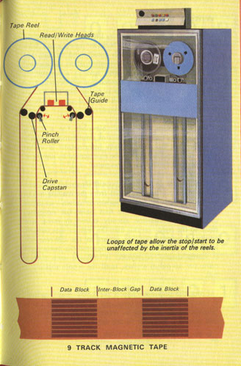
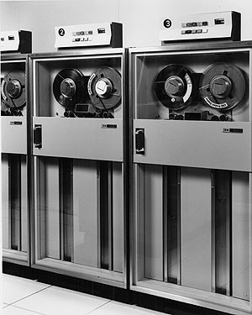
MAGNRTIC TAPE

Slide 24
STORAGE ON TAPE
Records are stored in serial or sequential order.
Each byte of data utilizes one column on the tape and each column consists of 8 bits + a parity (using the EBCDIC coding system)
Vertical columns are called frames and the horizontal rows are called tracks or channel.
Each character is represented by a group of 8 binary digits plus a parity bit ( for checking transmission errors) across the width of the tape.
The method of recording 0 and 1 bit depends on the recording system in use.

Slide 25
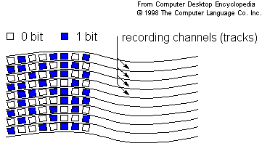
DATA STORAGE OF TAPE

Slide 26
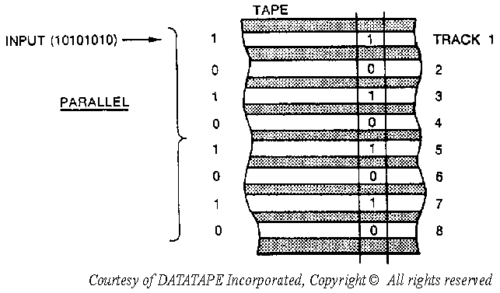
LAYOUT OF TAPE

Slide 27
PHYSICAL & LOGICAL RECORD
Data records on tape are subdivided into fields.
Data record (called logical record) are separated by inter record gap (IRG).
Logical records may be group together into blocks of multiply record (called physical record).
The number of logical record in a block is called blocking factor.

Slide 28
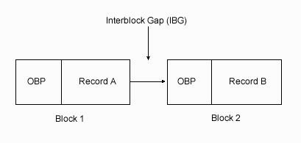
INTERBLOCK GAP

Slide 29
NOW

