Slide 2
Electronic Information Retrieval
Information can also be accessed from the Internet through the use of tools such as:
Search Engines
The Web
Databases
Social Media

Slide 3
The Internet
The Internet is a high-speed electronic network that connects personal computers and organizational computer facilities around the world.
This network is connected by fiber optics such as telephone lines, cables, and communication satellites.
The Internet is available to anyone with a computer, connection, and the internet service provider, example Vodafone.

Slide 4
The Uniform Resource Locator (URL)
Every Web page has its own address called a Uniform Resource Locator (URL). Much like the address on an envelope with a name, street address, city, state, and zip code, each part of a URL provides information about the Web page.
https://www.central.edu.gh

Slide 5
The domain name tells you the type of organization sponsoring a page. It is a three-letter code that is part of the URL and preceded by a "dot(.)" Here are the most common domains:
Domain Names
Domain | Description
.edu / .ac | educational institution Even though a page comes from an educational institution, it does not mean the institution endorses the views published by students or faculty members
.com | commercial entity Companies advertise, sell products, and publish annual reports and other company information on the Web. Many online newspapers or journals also have .com names.
.gov | government Federal and state government agencies use the Web to publish legislation, census information, weather data, tax forms and many other documents.
.org | non-profit organization Nonprofit organizations use the Web to promote their causes. These pages are good sources to use when comparing different sides of an issue.
.net | internet service providers
.mil | U.S. military

Slide 6
Search Engines
These are computer programs that search documents for specified keywords and returns a list of documents where the keywords were found.
On the World Wide Web, the search engine utilizes automated robots to gather information and automatically index sites.

Slide 7
Examples of Search Engines
Google Yahoo
Bing Yandex
Alta Vista Ask.com
Dogpile Hotbot
DuckDuckGo

Slide 8
Databases
Databases are collections of digitized information organized for simplified, fast searching and retrieval.
Databases may be full text or bibliographic.
Databases contain scholarly journals, books, reports etc.
They may be general or subject specific.
Databases are updated regularly.

Slide 9
Examples of some Databases
Britannica Online Academic Edition http://www.search.eb.com
EBSCO http://search.epnet.com
Emerald Press http://www.emeraldinsight.com
JSTOR (archive) http://www.jstor.org/logon
Taylor and Francis Online https://www.tandfonline.com

Slide 10
Information Search Strategies
Search strategies are ways of using search terms in finding required information from search tools, such as search engines (Google), the online library catalogue (WINNOPAC) and online databases

Slide 11
Planning a Search Strategy
Plan the next five steps before proceeding with the search.
Identify search terms
Limit the search
Apply Truncation, Wildcards And Phrases
Combine terms using Boolean logic
Combine terms using other connectors

Slide 12
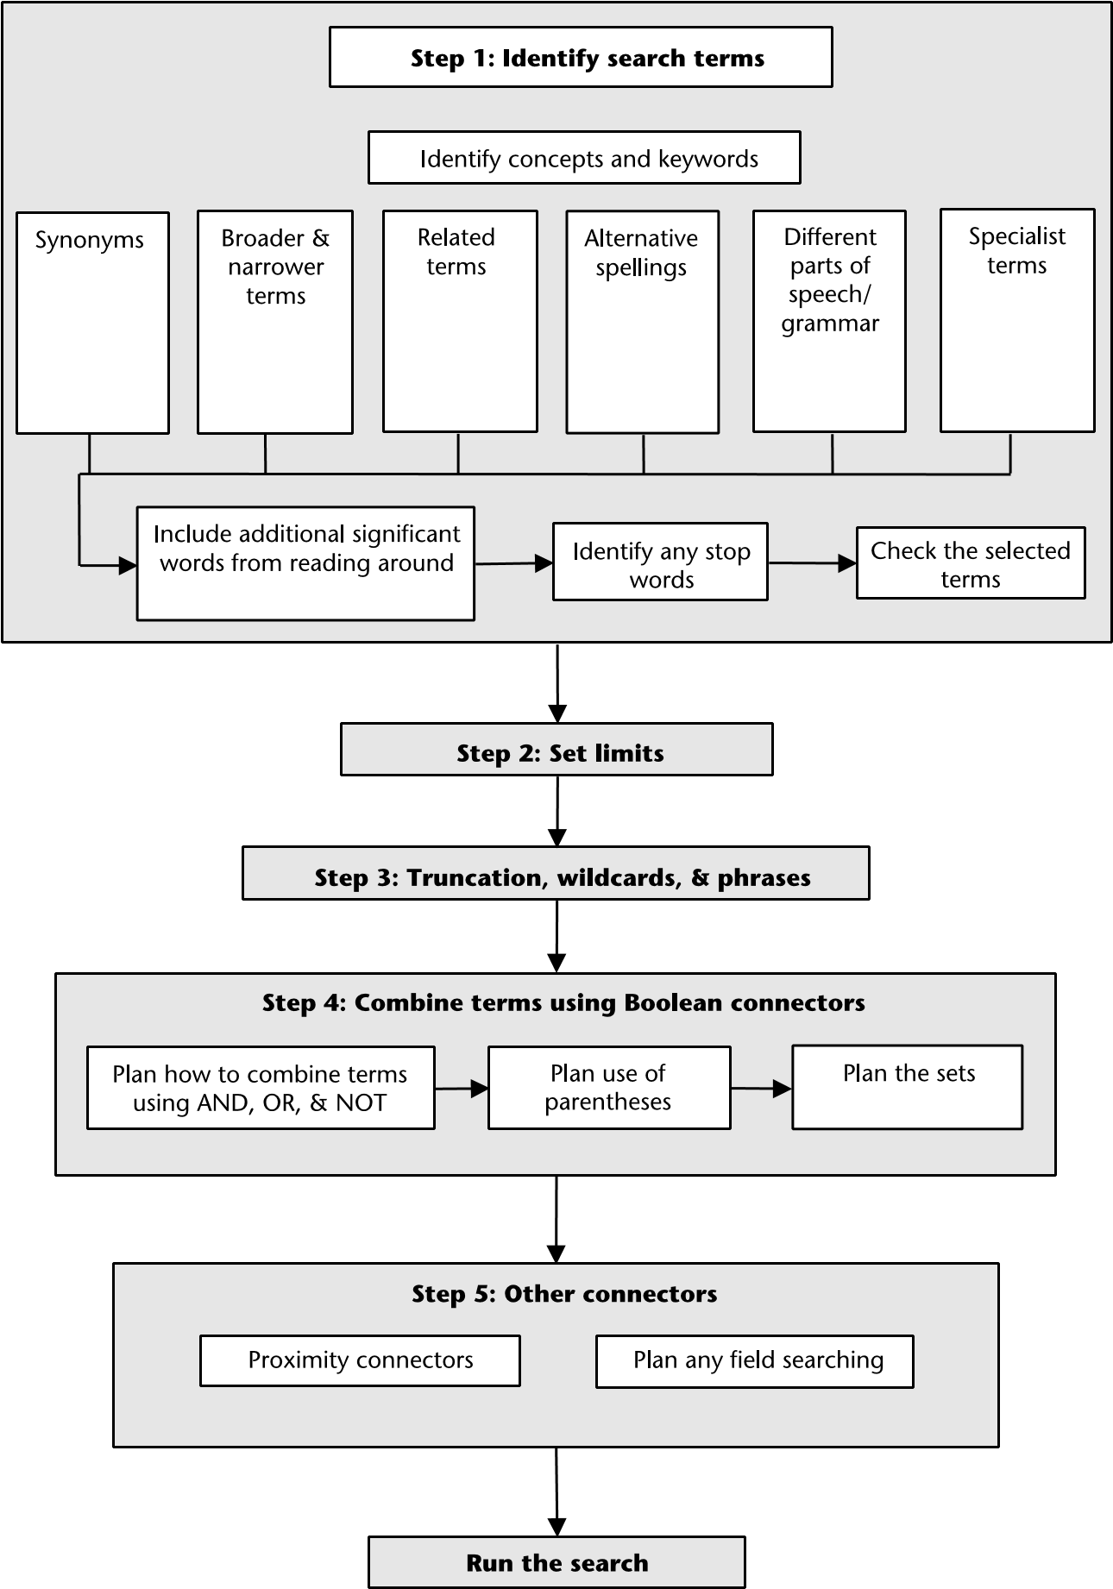
Source: The Five Search Steps (Rumsey, S., 2008)

Slide 13
Strategies for Conducting Academic Searches: Analysis & Synthesis
What is the problem? The problem is the research problem; the reason why you need the information.
Create a research topic out of your research problem. Your assignment topic or project topic may be your research topic.
Re-write your research topic as a research question.
Break main research question into smaller research questions. Try to re-write the questions back into smaller thesis statements.
Finally, create thesis statements out of each research question.
Notes:
Student Activity: In Groups
1. Students brainstorm and give examples of a research problem and break them down into research questions.
2. Conversely, students brainstorm and give examples of a research question and re-write them as thesis statements.

Slide 14
Strategies for Conducting Academic Searches: Create Concept Charts
Keywords are major concept terms.
They are used to match words that are used in already publicly available published/unpublished works.
Garbage in; Garbage out!
Identify your keywords from thesis statement
Develop concept charts out of keywords to identify PREFERRED TERMS (synonyms) and un/related terms
Leave out adwords: articles, prepositions, conjunctions, etc.
Notes:
Student Activities
Students write their thesis statements on board and select keywords.

Slide 15
Strategies for Conducting Academic Searches: Create Search String
Using Boolean operators, create a search string by combining your keywords.
Boolean Operators are AND (+), OR (*), NOT (-)
Do not combine more than three keywords in a single search, such as:
“Climate change” AND food OR crop AND Africa
Keywords can be compound words, hyphenated words, or very short phrases.
The fewer keywords combined, the more relevant your results, the more your results too!
Notes:
Student Activity
Students practice combining their keywords

Slide 16
Boolean Search Strategy
Boolean search is a type of search that allows you to use keywords with operators such as:
AND, OR, NOT
The Boolean operators combine keywords to broaden or narrow search results
They can be used with most search engines, databases, and OPACs

Slide 17
AND
In this search we retrieve records in which both search terms are present.
Use AND to narrow your search and retrieve fewer records.
For example, Exercise AND Health retrieves records containing both keywords.
Exercise 52,600,000
Health 182,000,000
Exercise AND Health 8,490,000
You get fewer results the more terms you combine.

Slide 18
OR
OR Logic is most commonly used to search for synonymous terms or concepts. It collates the results to retrieve all unique records containing either or both of them.
Use OR to broaden your search.
For example, Salary OR Income.
Salary 368,000,000
Income 196,000,000
Salary OR Income 570,000,000
Notes:
memory loss or amnesia or Alzheimer's
aging or aged or elderly, seniors

Slide 19
NOT
In this search we retrieve records with only one of the terms present, the one we have selected with our search.
For example, Eating Disorders NOT Bulimia. Note that this search shows fewer results for eating disorders NOT bulimia than each term on its own.
Eating disorders 232,000,000
Bulimia 241,000,000
Eating disorders NOT Bulimia 26,600,000

Slide 20
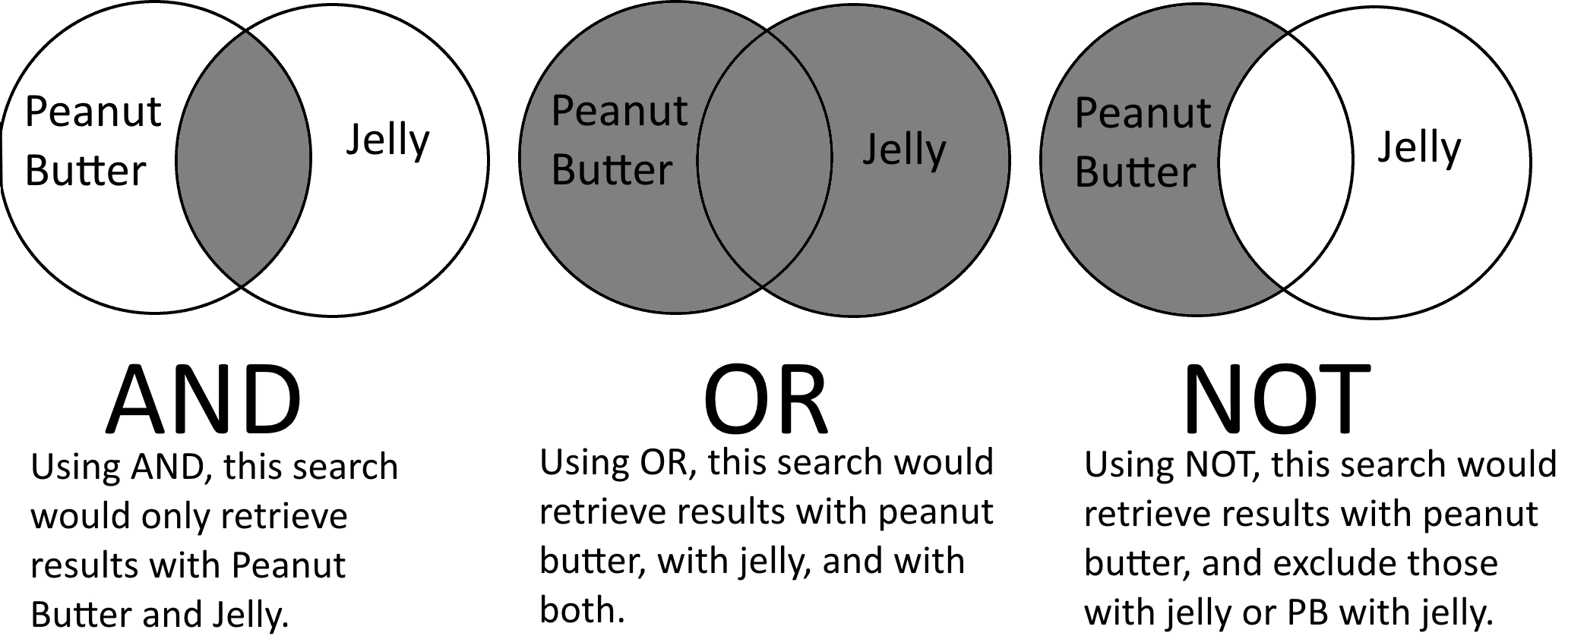
BOOLEAN LOGIC/OPERATORS
Notes:
Boolean operators work like a Venn diagram with words

Slide 21
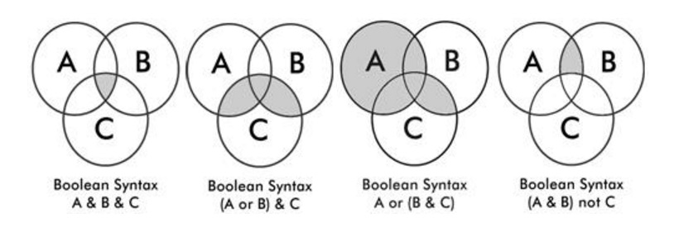
Combining three (3) terms for more complex searches
Notes:
A = “Climate Change”
B= “Food Production”
C= Africa

Slide 22
e-Resources of the Library
Online Academic Databases:
Are a web based filing system designed to store academic information. The database can be accessed by Web scripts and are purchased by subscription.
Accessible from a local network or the Internet.
Provides access to online journals
Scholarly or peer-reviewed articles written by experts in academic or professional fields.

Slide 23
e-Resources of the Library
Online Academic Databases:
They are excellent sources for finding out what has been studied or researched on a topic.
To find bibliographies that point to other relevant sources of information.
Example:
EBSCO, Science Direct, Ajol, Emerald, etc.

Slide 24
e-Resources of the Library
Accessing CU e-Resources
You can access e-resources in two ways:
1. On- Campus access (without password):
Simply ...
Connect to CU network
Go to http://central.edu.gh
Click on Library
Click on e-Resources Link

Slide 25
e-Resources of the Library
2. Off- Campus access (with password)
Connect to the internet
Go to http://offcampus.central.edu.gh
Click on the Off-Campus Access Link
Login with the credential sent to your email
For example:
Username: mobile number or email
Password: password

Slide 26
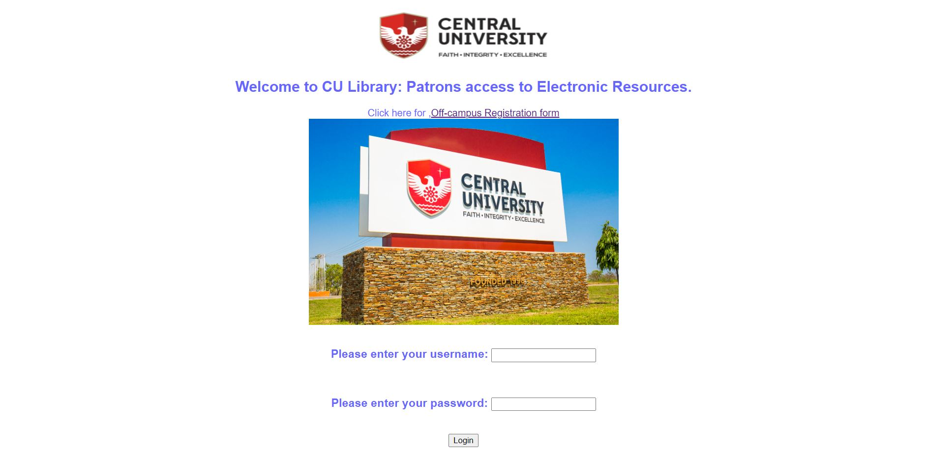
e-Resources of the Library

Slide 27
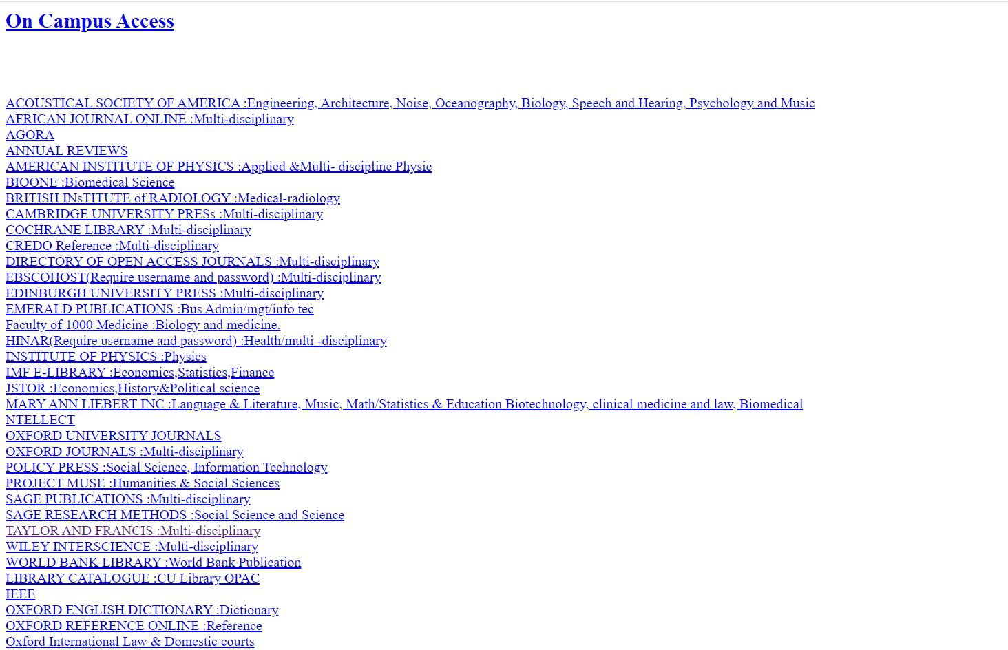
e-Resources of the Library

