Slide 1

LOGIC & LANGUAGE USAGE
Philomina O. Mintah
Central University
Faculty of Arts and Social Sciences
Department of Vision & Life

Slide 2
Learning Objectives
By the end of this lesson students should be able to identify
the benefits of language
types of meaning derived from language usage
Emotive meaning
Cognitive meaning
Making value claims from emotive language
Vagueness & ambiguity
Types of definition

Slide 3

What is logic

Slide 4
Logic entails the following
It’s a science of how to evaluate arguments and reasoning
It’s part of critical thinking
It involves deductive and inductive reasoning
The word logic is derived from the Greek word logos which means word or reason.
To argue logically is to use reason and not emotion.

Slide 5
language
Language is a structured system of communication
It can be conveyed through speech, sign or writing.

Slide 6


Logic & Language
Thoughts are expressed in language
We analyze our thoughts logically
Logic is a way to use language
To communicate well, we must use language effectively, Literally and explicitly to avoid misunderstanding.
Compare these two statements:
We shall try and pass by your house if we get the chance.
We will pass by your house when we get the chance.

Slide 7

Sentence
A sentence is a group of words that expresses a complete thought.
There are four functions of a sentence:
Declarative
Imperative
Interrogative
Exclamative

Slide 8
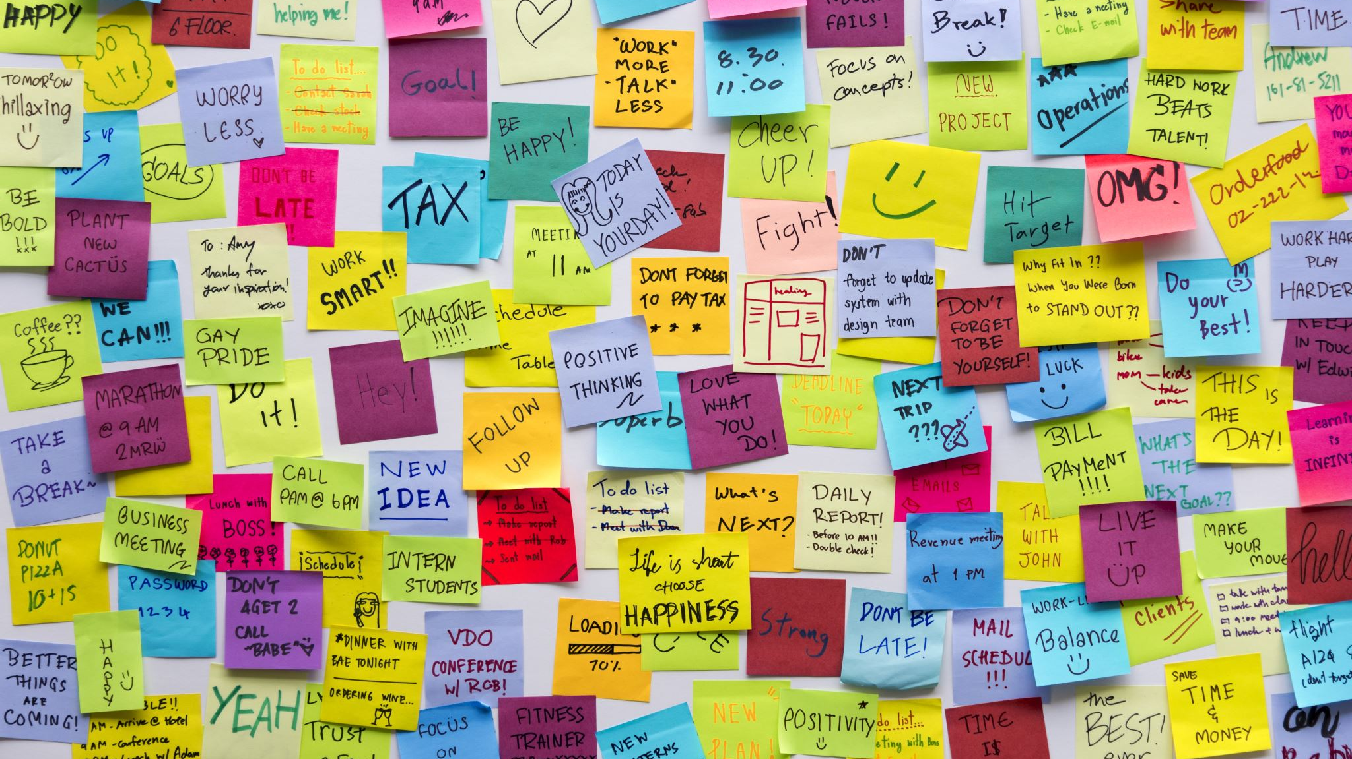
Declarative sentence
Declarative sentence is used to convey information in the form of statements.
They can be true or false.
They end with a full stop/ period (.) punctuation mark.
In Analytical thinking, declarative sentences are called prepositions.
There are three kinds of declarative statements:
Statements of facts
Value judgement
Definitions

Slide 9
Statements of facts
A statement of fact is an expression that conveys information about the state of affairs in the external world.
Examples:
Kwasi brushed his teeth this morning.
Ghana had her independence in 1957.
Russia attacked Ukraine in February 2022.
Ama is married to Kofi.
The sun shines in Accra.

Slide 10
Value judgement
Value judgement is a claim about someone’s/something’s moral, practical, and aesthetic suitability.
VJ prescribes attitudes, behaviour, qualities, and utilities towards the world.
VJ prescribes how the world ought to be rather than describing how the world is (factual statement).
Examples :
This is good life.
You must stop smoking.

Slide 11
Types of value judgement
There are two types of VJ: moral and non-moral value judgment.
Moral VJ are claims about someone’s/something’s moral suitability or otherwise.
Examples:
Homosexualism is evil.
Abortion is wrong.
Do not steal.
Do not commit adultery

Slide 12

Non-moral value judgement
These are claims about someone’s/something’s aesthetic suitability.
Examples:
Ama is a beautiful girl.
The painting in your room is nice.
That dress you wore to the party was ugly, don’t wear it again.

Slide 13
Definitions
Definitions are sentences spoken to convey information about the meaning of a word (s).
Examples:
Literature is an imaginative or creative piece of work.
Computer is an electronic device for storing and processing data.

Slide 14
Imperative sentences
Imperative sentences are used to require someone to undertake an action.
They include commands, directives, requests and pleas.
The punctuation mark for imperative sentence is the full stop/period (.) or exclamation mark (!).
Examples:
Stop talking when you are eating.
Please give me your pen.
Enough of your ranting!

Slide 15
Covert imperatives
Covert imperative is sometimes called ambiguous interrogative. They are imperatives framed as questions.
Examples:
Could you please shut the door?
Will you stop shouting?
May I take your car to school today?
Sentences of this nature play a dual role

Slide 16

Interrogative sentences
Interrogative sentences are used to ask questions.
The punctuation mark for Int. Sent. is the question mark (?).
Interrogative sentences solicit information from someone.
They cannot be true or false.
Examples:
How many credit hours do you have in a week?
Who is responsible for this mess?
What is your name?

Slide 17
Rhetorical questions
These are interrogative sentences that do not require answers.
They are for literary effects and not considered proper questions.
Examples:
Don’t you know that God is good?
Do you feel that love in the atmosphere?

Slide 18

Exclamative sentences
Exclamative sentences are also called emotive expressions. These are sentences that express strong emotions.
They can be single word, phrase or sentence.
They end with the exclamative mark (!)
Examples:
Wow!
Just imagine!
You are a champion!

Slide 19
Sentence Fragments
Sentence Fragments are incomplete sentences, lacking either a subject or a verb or both.
SF can also be a dependent or subordinate clause containing a subject or a verb but not expressing a complete thought.
Examples
Although we got to the hospital early
Calling John
Unless you pay the merchant cash

Slide 20

Activity
The act of reasoning to arrive at meaning can be called Logic.
True or false
Language can be conveyed through modes of a._______b.______c______
To avoid being misunderstood, we must use language that is _______ and ____________
Which of the four functions of a sentence can mostly be illogical ________

Slide 21

Activity
Identify the kind of statements below:
Dressing should be to cover oneself and not to attract attention.
You look beautiful this evening dear.
Pollination is the transfer of pollen to a stigma, ovule, flower or plant to allow fertilization.
Change the following sentences to declaratives:
Stop playing in the sand at once.
Is your name Mary?
Can you give me a ride?

Slide 22
End of part 1 of Logic and Language usage.
All the best

