Slide 1
ITEC 102 INTRODUCTION TO INFORMATION SYSTEMS
DANIEL OBUOBI, DCSIT, CU
INFORMATION SYSTEMS

Slide 2
Diagram and Rich Pictures
Dia- means “across” or “through”
so diameter literally means “a measurement through (or across)”
sometimes also means “composed of”
it has something to do with “two” so dialogue means “words across”, i.e., spoken with someone else
-gram – something written or drawn

Slide 3
Diagrams
A useful method for
expressing our understanding
communicating our understanding (with self as well as others)
In information systems work, we construct diagrammatical models that are used in
analysing a situation
design and specification of the future system

Slide 4
Modelling techniques
Models - used to understand and design:
Human Activity System:
rich picture
organisational structure and processes
process design: activity diagrams
Interface between Human and Information Systems:
use cases, storyboards and scenarios
Information System:
entity–relationship model
system architecture

Slide 5
System Architecture
Models:
Rich Picture
Org Struct & process
Activity Daigram
Storyboard
Scenario
Usecase
Entity-relationship
Systems Architecture
Architectural Layers:
Business
Interaction
(incl program)
Information
Technology
management
users
customers
Generic
IT tools
Organisation
Metabolism
tasks
Bookings
application
web presence
databases
infobase
I T I N F R A S T R U C T U R E

Slide 6
Diagrams: IS design
over the next few weeks we will look at design diagrams for information systems, including:
systems architecture
process and task diagrams (activity diagrams)
conceptual data models (class diagrams, E-R diagrams)
interaction diagrams (use-cases)
scenarios, story boards, etc..
Today: “rich pictures”

Slide 7
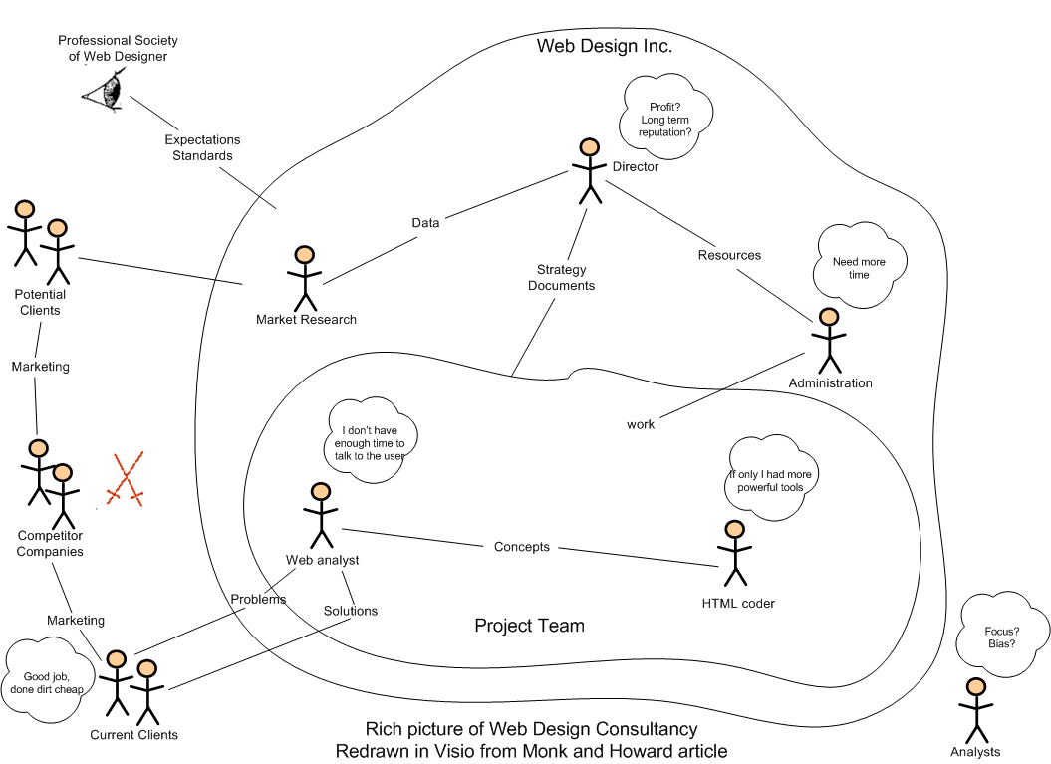
An example

Slide 8
Rich pictures
Peter Checkland and others
using rich pictures is a method of brainstorming ideas about the situation
either in a group
while communicating with users/clients
just to find out what you understand or do not understand about a situation or system
it is a way of identifying critical issues of context, rather than a tool for any formal analysis, and is a way of providing “inspiration” about a situation

Slide 9
Rich pictures
Rich pictures are primarily about:
the people in a situation
their concerns
their interactions
and the environment they operate in

Slide 10
Rich pictures
rich pictures are about human activity systems
they are a way of starting with what people are doing, rather than what sort of IT system they need to help them do it
so they are about the environment in which such systems might find themselves embedded
Checkland noted that human affairs reveal a “rich moving pageant of relationships”, and pictures are better means for recording relationships than is linear prose

Slide 11
rich pictures should stimulate ideas on all areas of the human activity situation under investigation:
work goals
work processes and activities
work-related problems
the relationship between groups of people - various workers, other stakeholders, and other organisations
the interactions between workers and various internal and external computer systems
the context and constraints of the work environment
anything else that seems relevant to you ...
it is important that they should reflect multiple points of view - introduce as many stakeholder viewpoints as is reasonable

Slide 12
What is a rich picture about?
rich pictures are about human activity systems
rich pictures are not primarily about computerised information systems, they are about the environment in which such systems might find themselves embedded

Slide 13
Elements of a rich picture
This may include such things as:
interfaces and boundaries (of whatever type)
resources, involved personnel and roles
ideas, thoughts, concerns, reactions and responses
organisational units, goals and issues
areas of conflict
needs and constraints, and so on

Slide 14
key aspects include
stakeholders !!!!
structure - include only enough structure to allow you to record the process and concerns
processes - do not attempt to record all the intricacies of process; a broad brush approach is usually all that is needed if at all
concerns - caricature the concerns of the people in thought bubbles
use the language of the people depicted in it

Slide 15
Rich picture semantics
use any pictorial or textual device that suits your purpose – there is no one correct way of drawing a rich picture
rule of thumb - should occupy a single A4 page
if it does not take up most of the page there is probably not enough detail in it, since the situation to which it refers is likely to be reasonably complex
limiting it to a single page forces you to analyse and focus on the most important issues and things to represent
process of developing a rich picture forces the participants to discuss, argue, negotiate until an agreed representation is reached - important role as a communication tool

Slide 16
Drawing rich pictures
there is no formal technique or classic form for rich pictures, and skill in drawing is by no means essential
some possible symbols as used in rich pictures might include:
roles or groups of people represented by the most appropriate icon, often some form of stick figure
artefacts and objects can be represented by rectangular boxes, or a symbol that captures the essence of the object
activities (and tasks and interactions) are represented by clouds
a role or group’s concerns and actions can be represented by a thought cloud

Slide 17
Drawing rich pictures
try to introduce as many stakeholders’ points of view into the picture as you can - imagine that you are in various roles:
the manager of the organisation, department or system
various different staff who work for that manager
the managers and staff of other organisations/departments who interact with the area of concern
clients of things (services as well as products) produced by the area of concern
other stakeholders
organisational systems rarely have a single purpose, goal or rationale - try to capture some of the multiple perspectives on these if possible

Slide 18
Drawing rich pictures
show the environment within which the area of concern works and how it interacts with this environment
other organisations and departments, agencies, external stakeholders, etc.
consider superimposing alternative boundaries on the rich picture
who is included and who is excluded
what work is done inside and outside of your boundary and how these activities interrelate
who is in charge of the work inside your boundary (who could sponsor or preclude your suggestions for improvement)
what people are trying to achieve inside this boundary and if it is coherent
what impact using this boundary would have

Slide 19
Straight lines vs “fried-egg” shapes and curved arrows
straight arrows and rectangular boxes convey an apparent certainty
this is typical of work in science and engineering
the style conveys the implication: “this is the case” - not necessarily what you want to achieve with rich pictures
the more organic style of hand-drawn models indicates that the status of the models and their artefacts is that they are working models, currently relevant now in this study, not claiming any permanency of status
they are meant to look more human and more natural than the ruled lines and right angles
temporary constructs are important for IS work

Slide 20
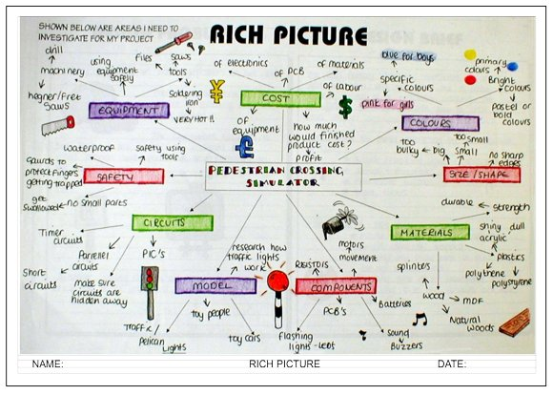
Example – teaching kids
http://www.technologystudent.com/designpro/richpic1.htm

Slide 21
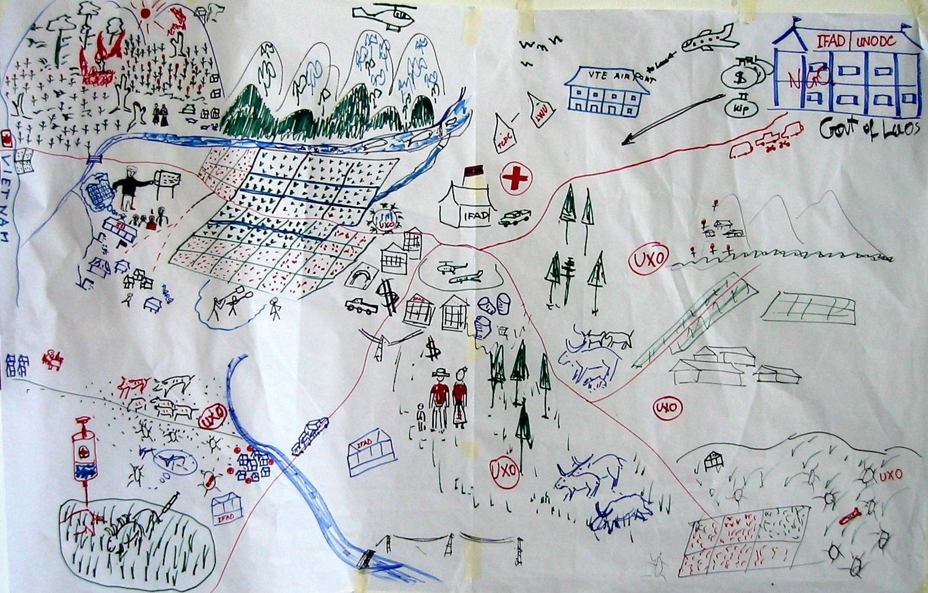
Example – rural development
http://www.iac.wur.nl/ppme/content.php?ID=353&IDsub=425

Slide 22
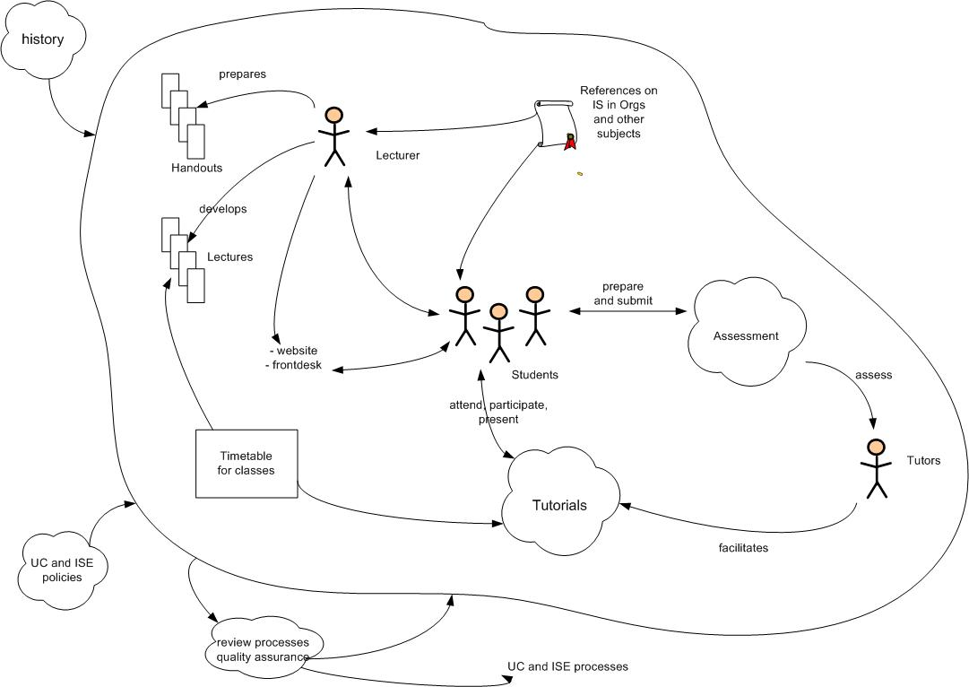
Rich picture of Programme

Slide 23
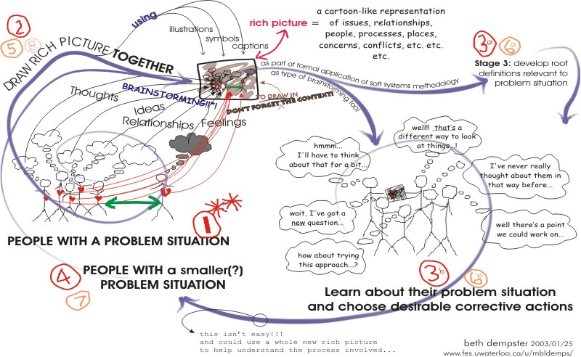
Rich picture of a rich picture

Slide 24
DIAGRAMMING WORK & PROCESSES
Organisational processes
organisations are made up of
structure, for management and control
collections of organisational processes
the collection of organisational processes will be different for different organisations
each organisational process is part of the overall Human Activity System of an organisation

Slide 25
A Process
a process is made up of a number of interrelated tasks
process design specifies how the tasks interact to produce the desired results.
Process: Doing Assignment 1
Assignment
requirements
assignment

Slide 26
Process with Tasks
a process is made up of a number of interrelated tasks
process design specifies how the tasks interact to produce the desired results
Review
Lectures/labs
Test
Draft paper
Sketch
approach
Submit
research
Assignment
requirements
Process: Doing Assignment 1
assignment

Slide 27
IS support for Tasks
tasks can be supported by information technology, generic information systems, and specific systems
www
Research
End Note
Library
system
Ms Word
Visio

Slide 28
IS Support for Processes
IS supports the tasks in a number of interrelated organisational processes
Process:
Library Acquisitions
(buying books)
Process:
Library Circulation

Slide 29
IS Support for Processes
IS supports the tasks in a number of interrelated organisational processes
Library
Information
System
Process:
Library Acquisitions
(buying books)
Process:
Library Circulation

Slide 30
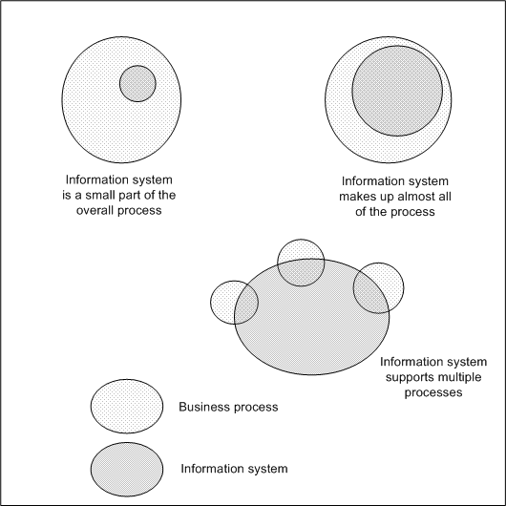
IS support for processes
Alter, 2002, Fig 2.4, p51

Slide 31
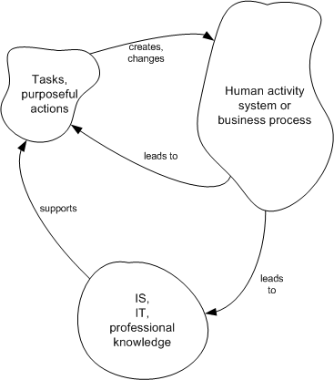
Another Viewpoint
Checkland, 1998, fig 4.6, p110

Slide 32
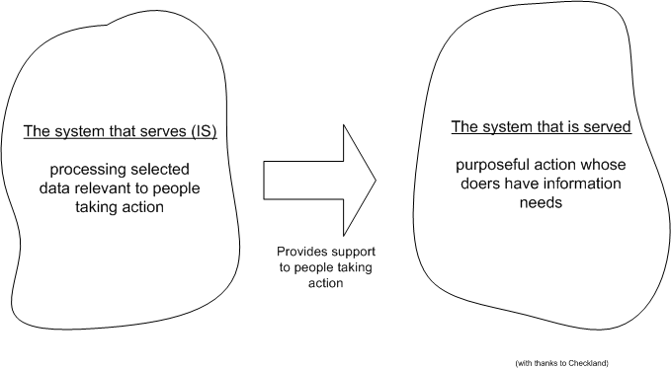
Checkland, 1998, fig 4.7, p111

Slide 33
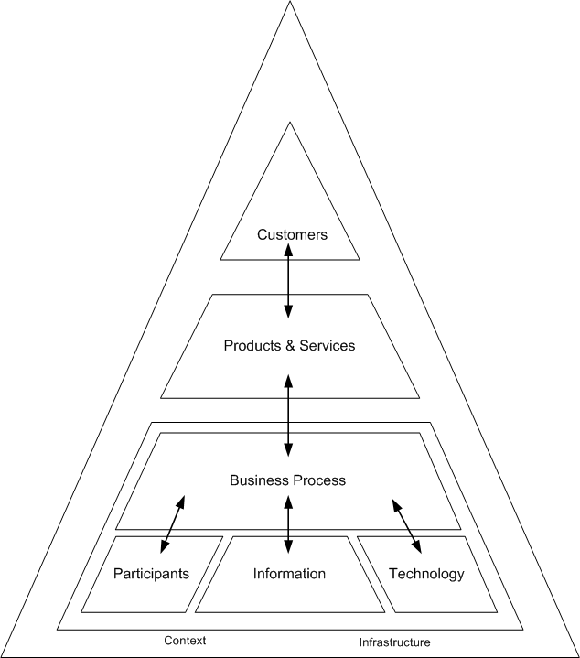
Alter’s work system framework
Redrawn from Alter, 2002, fig 1.1, p8

Slide 34
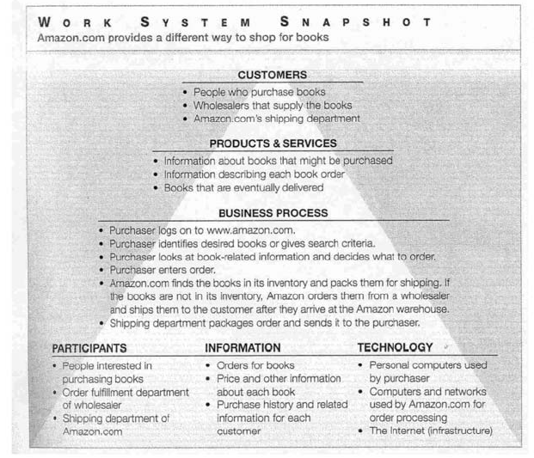
Amazon.com
Alter, 2002, p43

Slide 35
Key elements in Processes
the customers are the people who use and receive direct benefit from the products and services
the products and services are essentially the outputs of the processes produced for the customers
the organisational process is the set of tasks or activities performed within the system
the participants are the people who perform the work steps in the process

Slide 36
Key elements
the information is that used by the participants to perform their work
the context is the organisational, competitive, technical and regulatory realm within which the work system operates (the environment in systems terms)
the technology is the IT and other tools and equipment used by the participants while doing their work
the infrastructure is the shared human and technical resources that the system relies on, even though these resources exist and are managed outside of the system.

Slide 37
Example: Paying employees
customers - are the staff of the organisation who are to be paid
products and services - are the payments to staff, payslips, group certificates, reports to organisational managers about staff payments, and other personnel functions (eg leave)
organisational process - involves:
commencing staff on the payroll
tracking staff movements and salary levels
receiving details of time worked/absent/on leave
producing payroll
sending transaction details to bank for payments
sending out payslips, group certificates etc
producing various reports for organisational man

Slide 38
Example: Paying employees
participants - are payroll/personnel staff, organisational managers, employees
information - might include timesheets, organisation structure/establishment, relationship of employees to positions, salary scales or rates, leave records, payments made, etc.
technology - would include the payroll system (computer and associated software), and any distributed technology for inputting timesheets and leave applications, and producing reports.

Slide 39
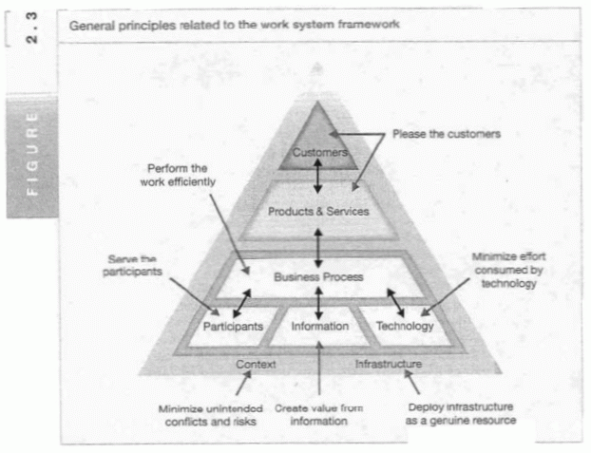
Work System Principles
Alter, 2002, Fig 2.3, p 48

Slide 40
Various viewpoints
focus on the organisational results - main consideration would be customers and the various products and services
focus on the people and organisation - main consideration: the participants and how they fit into, or are impacted by, the organisational process, and how they might be supported by information provision
focus on the technology and information, and the interaction of these with the organisational process
all of these viewpoints are valid, but it is important that they are not considered in isolation of the others

Slide 41
Performance variables
for customers: satisfaction levels
for products and services: cost, quality, responsiveness, reliability, conformance to standards and regulations
for the organisational process: productivity and efficiency measures, reduce conflict
for participants: skills, involvement, job satisfaction etc
for information: quality, accessibility, presentation, security, integrity, etc
for technology: capabilities, ease of use, cost of ownership, compatibility, maintainability

Slide 42
Modelling
we have been looking at modelling:
Human Activity Systems
Organisational processes & tasks.
we are trying to understand complexity – this is the analyst role
now we’ll look at modelling approaches aimed at the design of Information Systems
over the next few classes we’ll use these techniques to look at examples of information systems

Slide 43
Purposes of Modelling
requires the analyst to think clearly about the topic of interest
test understanding between the analyst, organisation and technical people
be a specification for intervention
form a permanent record of the analyst's thoughts on the subject at the time, useful for future reference
many different modelling techniques, even for doing the same or similar work

Slide 44
Elements of modelling
All good modelling has these elements:
Constructs - the component elements or symbols of the modelling approach
Notation - the form of representation employed for the constructs within the modelling approach
Principles of Construction - the formal and informal rules for correctly constructing models
Methods of Quality Assurance – how do we know the model is any good?

Slide 45
Process of modelling
to help us understand phenomena, we abstract - the process of recognising similarities between phenomena and ignoring differences
IS modelling is a process of abstraction – the area of concern is simplified – only elements of interest are represented
IS models need to be negotiated between the various stakeholder groups - potential for unresolved conflicting views
IS models need to be tested for efficacy

Slide 46
Modelling techniques
Models - used to understand & design:
Human Activity System:
Rich picture
Organisational Structure & Processes
Process Design: Activity diagrams
Interface between Human and Information Systems:
Use cases, storyboards and Scenarios
Information System:
Entity – Relationship Model
System Architecture

Slide 47
Example - Travel Planning
We’ll use this example to illustrate the various modelling tools and how they relate to each other:
Consider a person who wishes to plan an extended holiday, visiting a variety of different places, and seeing many of the local attractions. Bob contacts a travel agency …

Slide 48
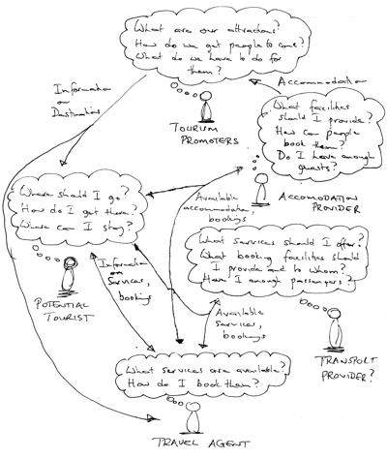
Rich Picture

Slide 49
Organisational Structure and Functions
Travel Agency Organisational Structure
Travel Agency
Cust. service
transport
accommodation
Book trip
Advertising
Accounting
Purchasing
Staff
etc
ACT
NSW
Organisational Processes (aka Function or Workflow)

Slide 50
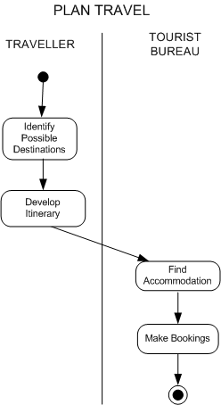
Activity diagram

Slide 51
Where are we up to ? ! !
Human Activity System:
Rich picture
Organisational Structure & Processes
Process Design: Activity diagrams
Interface between Human and Information Systems:
Use cases, storyboards and Scenarios
Information System:
Entity – Relationship Model
System Architecture

Slide 52
Activity diagram with interfaces
Information System
Human – computer interfaces
(use cases)

Slide 53
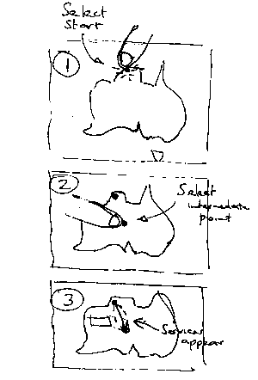
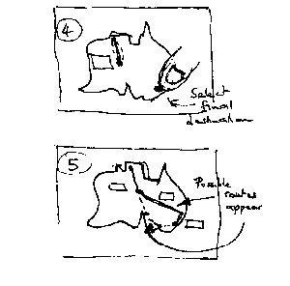
Interface Storyboards
Use: interface design specification

Slide 54
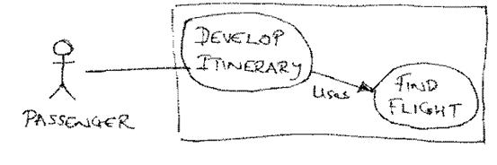
Interaction spec

Slide 55
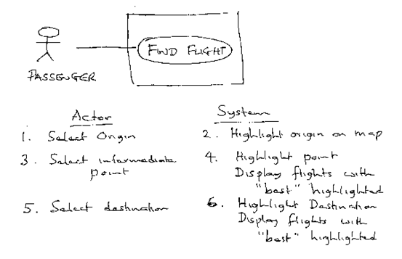
Interaction spec – a use case
Use: program specification

Slide 56
Scenarios
Scenarios are used to explore requirements by creating concrete examples which can be worked through with potential users
Bob wishes to spend a month in Australia. He has not been to Australia before. He has friends that he wants to visit in Melbourne. He is interested in seeing some “outback” scenery, but does not enjoy walking or climbing. He wants to find out what sort of things he can see, then plan his trip. His budget is not unlimited . . . . .

Slide 57
Where are we up to ? ! !
Human Activity System:
Rich picture
Organisational Structure & Processes
Process Design: Activity diagrams
Interface between Human and Information Systems:
Use cases, storyboards and Scenarios
Information System:
Entity – Relationship Model
System Architecture

Slide 58
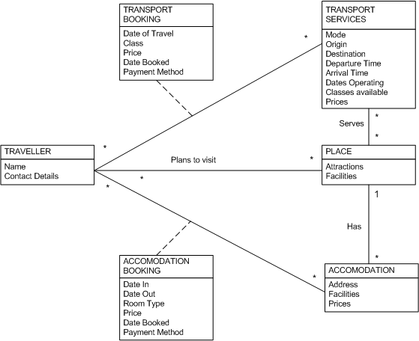
Domain Level Class Diagram
Use: database specification

Slide 59
System Architecture
ArchitecturalLayers:
Business
Interaction
(incl program)
Information
Technology
management
users
customers
Generic
IT tools
Organisation
Metabolism
tasks
Bookings
application
web presence
databases
infobase
I T I N F R A S T R U C T U R E

Slide 60
System Architecture
Models:
Rich Picture
Org Struct & process
Activity Daigram
Storyboard
Scenario
Usecase
Entity-relationship
Systems Architecture
Architectural Layers:
Business
Interaction
(incl program)
Information
Technology
management
users
customers
Generic
IT tools
Organisation
Metabolism
tasks
Bookings
application
web presence
databases
infobase
I T I N F R A S T R U C T U R E

Slide 61
Summary - Modelling techniques
Models - used to understand & design:
Human Activity System:
Rich picture
Organisational Structure & Processes
Process Design: Activity diagrams
Interface between Human and Information Systems:
Use cases, storyboards and Scenarios
Information System:
Entity – Relationship Model
System Architecture

Slide 62
Take home exercise
Think of the Tutorial registration system
Use it as a scenario and try to imagine the actual data, information and processes that played a part in your tutorial enrolment
See how models can represent the system that allowed you to enrol in tutorials

Slide 63
NOW

Slide 64
Exercise
Draw a Rich Picture

